Slide 1
SHIELD Updates
December 5, 2023
Riki Merrick, Lead Specialist, Terminologist

Slide 2




SHIELD Background
Agenda
LIDR WG Work
Crowdsourcing Disease LIVD Content
Questions & Answers

Slide 3
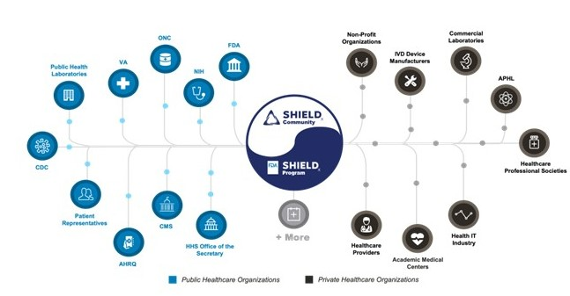

Systemic Harmonization and Interoperability Enhancement for Laboratory Data
Mission:
“Describe the SAME test the SAME way ANYWHERE in the Healthcare ecosystem”.
The Need for SHIELD is Identified
The SHIELD Committees Form
The Pandemic Hits
SHIELD Workgroups Form
2015
2017
2020
2023
2016
2019
2021
SHIELD is Founded by Mike Waters
SHIELD Begins Pilot Site Evaluation
Strat. Planning & Assessment Begins
Roadmap published
Notes:
While clinical laboratory data like orders, results and their interpretation are among the most important types of data for clinical care, public health, and the development of drugs and medical devices may be easy to transmit, but as we have already discussed the non-standardized coding practices across our national landscape makes laboratory data incredibly difficult to curate and analyze.
This problem is not new and in 2015 Mike Waters’ used his gift of bringing federal agencies, laboratorians, in-Vitro Diagnostics and Health Information System vendors, clinicians and professional organizations together to form the SHIELD community back in 2016 with the mission to “Describe the SAME test the SAME way ANYWHERE in the Healthcare ecosystem” and we are honoring his legacy by continuing the work.
Goal is two-pronged: e.g.) Then data collection workgroup that is focused on using curated standardized data for secondary uses. Think about the different implications for information; the method of testing might not matter for the health department if they are only interested in the case count, but could be very important to track for the lab.
If laboratory is the holder of the data, they should be the ones dictating/authoring the codes. Ideally, the lab would send the same LOINC code to all partners, BUT each entity has their own requirements/needs. It’s the receiver dictating the requirements. And labs themselves are not harmonized.

Slide 4
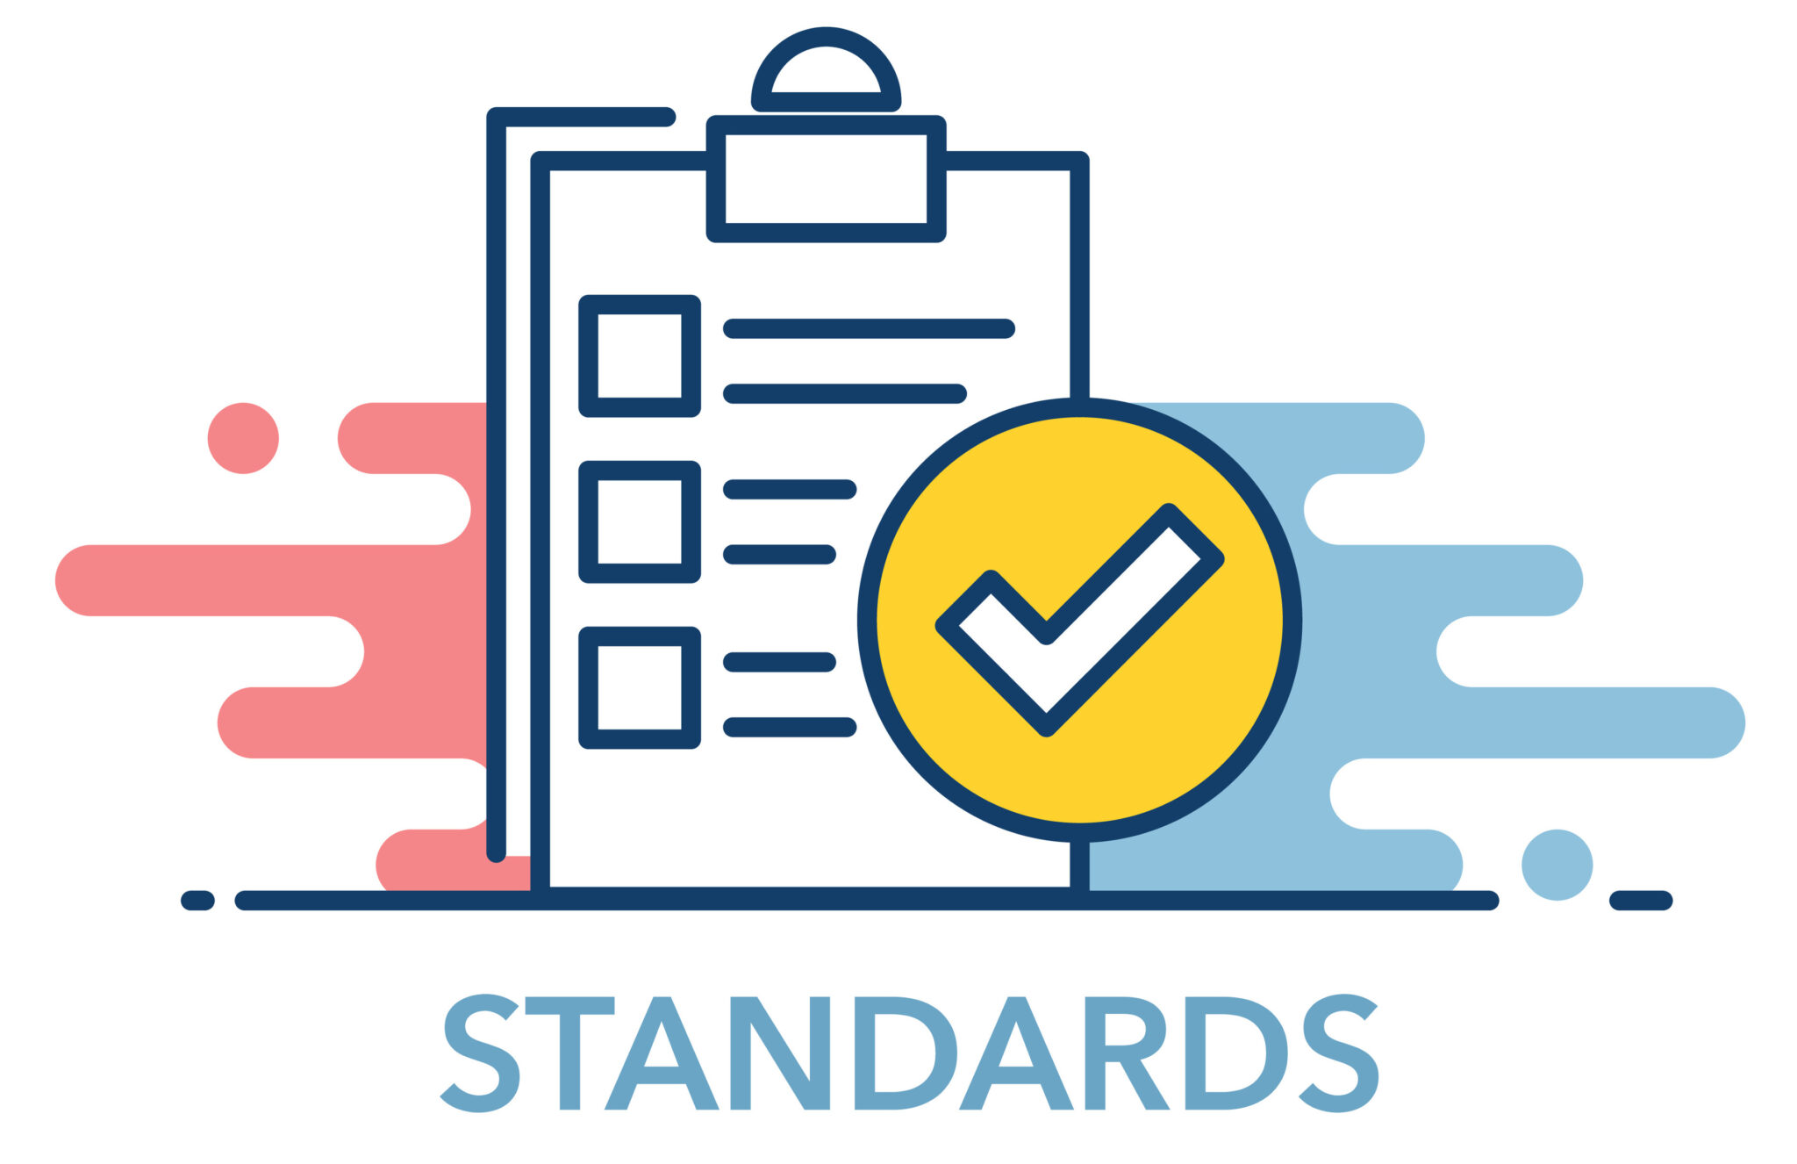


Implementation Strategies in the SHIELD Roadmap
Knowledge Management
Promoting an integrated approach to identifying, capturing, evaluating, retrieving, and sharing laboratory data and ensuring that data is understandable, reproducible, and useful
Action: standards alignment of data representation / development of laboratory data repository
Laboratory Interoperability Data Registry WG
Requirements
Fields across Testing Areas
Structure Definition
Standards / Vocab Updates WG
Identify gaps in content for lab data
Preferred standards use for lab data scenarios
Implementation challenges
Systems Thinking
Reengineering the laboratory data transfer process in a manner that prioritizes safety, integrity, and graceful evolution over time above all else
Action: production and expansion of “data reliability” metrics and Standards updates
Enhanced Analytic Data Storage
Developing an authoritative source for laboratory data representation that supports existing data models and is accessible by all entities that create or use laboratory data
Action: creation of an IVD Data Store / Hub
Ecosystem Engagement
Communications and Branding WG
Website
Presentations
Publications
Real World Evidence WG
Content
Structure
Design
Collaborating and sharing perspective across industry, agency, and discipline, as well as educating stakeholders about laboratory data interoperability
Action: Implementation of SHIELD identified standards, collaboration with Health IT stakeholders for feedback and validation (e.g., HL7, LOINC, SNOMED CT)
Notes:
Addressing the four focus areas for SHIELD identified in the community roadmap will allow us to build a long-lasting and comprehensive future solution:
Knowledge Management is the critical backbone to making laboratory data understandable and useful across the ecosystem by providing an integrated approach to handling data
<CLICK>
The Laboratory Interoperability Data Registry (LIDR) Working Group is looking at categorically defining data elements of a specific test to the level of equipment and reagents identified by Universal Device Identifier (UDI) to build a library of information about different kinds of tests. It is also identifying which of those need to be exchanged for each patient result using ETOR and curating in the registry additional information about the test that entities would need for purposes beyond clinical care like public health, research or and post-market surveillance.
<CLICK>
Systems Thinking involves having all systems in the entire ecosystem participate in the process of improving lab data. Being able to support data capture in a consistent manner, create data quality metrics and measure change over time.<CLICK>
The Standards and Vocabulary Updates Working Group is tasked with finding data gaps in current systems and standards by identifying implementation challenges, deciding on preferred standards for different use cases and ensuring future versions of the standards are supporting all SHIELD needs.
<CLICK>
Enhanced Analytical Data Storage addresses having clinical sample level data accessible for secondary use, be it for post-market research by IVD vendors, for other regulatory purposes, clinical research or public health<CLICK>
The Real World Evidence Working group is identifying the data content, structure and design needed to support appropriate access to quality patient level data inside the IVD data store.
<CLICK>
Ecosystem Engagement has been the cornerstone of SHIELD for a long time, but we need to retain, keep enthusiasm going and expand participation to more partners to educate about SHIELD’s work and to promote implementation and use of SHIELD identified standards and resources.<CLICK>
The Communication and Branding Working group is in charge of raising SHIELD’s visibility

Slide 5
Laboratory Interoperability Data Registry WG
Goal is to build library of data about tests (Reference for Lab set up and users of lab results)
Authoritative source for coding by labs
Ideally make this data about tests (NOT patient level results) available to systems to support auto
mapping
Deliverable | Expected Date | Description
White Paper | Q1 2024 | Describe LIDR requirements for MVP and roadmap using prioritized use cases Needs to be published as input for tooling work
Journal articles | Q2 2024 | Write a few articles to raise awareness about LIDR
LIDR Content | Q1 2024 | Potassium Analyzers as example to work through data elements needed IN ADDITION to LIVD specification

Slide 6
Crowdsourcing Disease LIVD Content
Current state:
  Limited disease specific LIVD files available here: https://www.cdc.gov/csels/dls/livd-codes.html
    SARS-CoV-2
    HIV
    Lyme
    Biomerieux
  Other vendors for customers only: Abbott, Roche, Siemens
Using googlesheet to collect data from PHAs while they are validating manufacturer specific tests
Work out additional columns to add for this effort - what would be helpful?
  Column for related reportable disease
How to socialize information about it / get participation?
Do we want a deadline?

