Slide 1
Overdose Alerting Practices
Developing and maintaining alerting mechanisms to identify overdose trends
Rita Seith, MPH
Michigan Department of Health and Human Services
Notes:
Hi, my name is Rita Seith and I work for the Michigan Department of Health and Human Services as an emergent response epidemiologist in the drug overdose surveillance unit. I want to start by emphasizing that these practices are things that have worked for us, reflect the way MDHHS is structured and the resources available to us. I will be sharing a mix of tips and tricks that I wish I had known or things I would want to tell others who are just beginning this work. Of course, your state or county is structured differently, the populations are different, so please consider that context. I will give you an overview of Michigan's framework for responding to abnormal drug overdose events and then run through 7 key practices or questions.

Slide 2
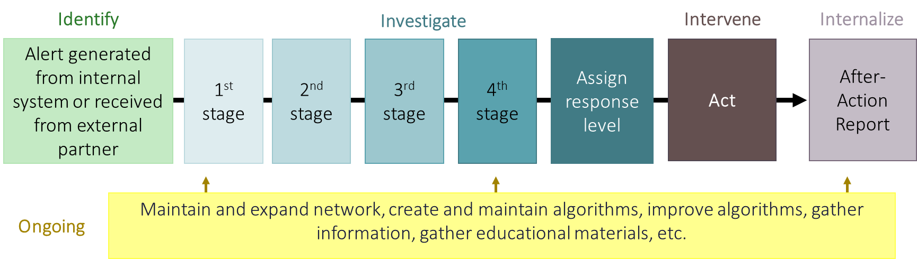
Michigan’s framework
Notes:
To first explain our response framework, I have constructed a color-coded flow chart that explains our workflow. Phase one is identifying an alert, this could be generated from an internal system or received from an external partner. Every single alert is investigated, but each alert may go through various stages of evaluation. The goal of each evaluation stage is gathering enough information to confidently assign a response level. After each response, we internalize, We write an after-action report , save it in a shared folder and if needed, gather as a team to assess how we could have improved our response. Of course, on an ongoing basis we are looking to expand our network of stakeholders and partners, we are maintaining and improving algorithms, and gathering information that could help us in the future.

Slide 3
Green – No action
Orange – Targeted investigation
Red – HAN
Purple – Multi-state
Yellow – Informative email
Setting trigger levels
and determining appropriate response type: a complex problem.
We considered:
Severity
Geographic scope
Time frame
Potential ramifications of inaction
Notes:
Michigan has five response levels, they are color coded, green, yellow, orange, red, purple. Green means that after evaluation, we determined the alert does not require any action. Yellow means that after evaluation, we have determined an informative email to partners is necessary. Orange is a step up from yellow, the difference being that some back and forth between partners is needed, we need to follow up on the event before we can close it out. Red means that we have determined a health alert is required, and purple would be a large multistate outbreak.

Slide 4

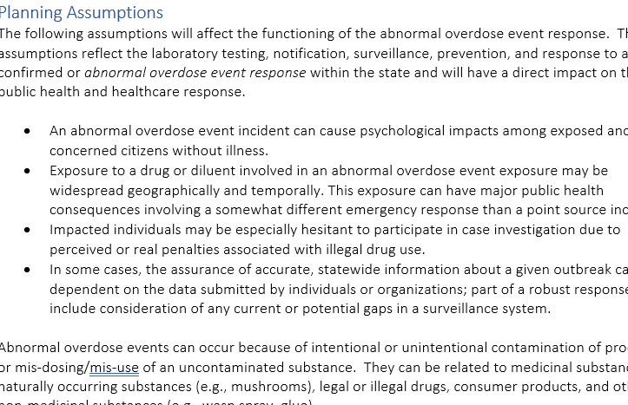
Before you begin….
Scrap the massive word document
Identify and investigate
Intervene
Internalize
Notes:
Like many states I began drafting a response plan on a word document, I was using our toxic substance response plan as a guide, which was a 40 or 50 page document. I ended up with 55 pages, a complete response plan with appendices and reference tables, descriptions of thresholds and alerting methodology. However, I wasn't using any of it. I was working out of folders where I would store my past emails, my response tracker, my after-action response summaries, etc. I was starting to realize that all those documents were actually way more helpful then my giant document. Further, if I wanted to explain to somebody else what my response plan was, I used a PowerPoint and then I showed them my folders. If I ever left MDHHS, I would direct them to all of the files that I was saving in my response folders. My format was all wrong, not only that but with such a giant document, the second I hit save and started actually working, it would become out of date. So I deleted it. All of the materials of course have been saved, but I decided to lean into the structure that I was actually using, so I now have folders that are labeled in a clear way, if somebody who has never read my response plan came in because they we're now in charge of responding to something, it would be clear to them which folder to open, what they could find there, and when they would need to use it. Instead of appendices with educational materials, for example, I just have a folder labeled educational materials with all of my PDFs. Instead of sifting through a large document to find an example email, I just have the folder where I save all of my emails. Since those are the folders that I use every single day, it is always up to date. Certainly, I don't mean to suggest that my new format is the best way to organize your thoughts, but I would consider asking yourself where you save your materials as you are responding to an outbreak and consider if that giant 50 page Word document is going to be useful.

Slide 5

Reach out to your EVALI epi
Notes:
I know everyone here also understands that when public health thinks about an outbreak we think communicable disease, and this is very different from that. There is not an incubation period or a treatment that we can recommend everyone receive. It was challenging to look at response plans for toxic substance exposure, for communicable disease, and realize that I was going to need to create a plan that was very distinct from both of those. There is little guidance out there that can be used for an overdose outbreak response plan. I was lucky enough to be Michigan's lead epidemiologist in the EVALI outbreak. (DEFINE) I say this because I learned so much valuable information during that outbreak that could be directly applied to our response plan. If you are tasked with writing a response plan for overdose outbreaks, I would highly recommend reaching out to your vaping epi. For example, I could reuse our interview forms that we used, make them more generic and reuse them for a potential multistate outbreak. Many of the things that I needed to consider when it came to tracking vaping cases and responding are applicable here. The populations for both are quite similar, the considerations with stigma, the questions you might ask about various products, etc.

Slide 6
Getting started with alert thresholds
And know that you will have to rely on others.
When mapping things out….
Consider multiple types of events:
Spikes
Clusters
Novel threats with potential
Notes:
There are multiple types of events that need to be detected, spikes, clusters, and novel threats. A spike is a large increase in counts. A cluster is a series of related cases, an example might be one of your counties had 4 cases in which those individuals came into a hospital back-to-back, and all took the same drug, so a bad batch situation. A novel threat might be a neighboring state has identified a new synthetic opioid that might be coming your way, or you’ve identified a new drug in your state that is especially lethal – like purple heroin.
Setting thresholds looks very different for each type of event. A traditional surveillance system, like syndromic, tells us information about the population at large and will do a great job identifying spikes. Clusters, or a series of related cases, and novel threats with potential to do harm will be challenging to identify and evaluate with a traditional surveillance system alone. Without information from folks on the ground, it will be very challenging if not impossible to differentiate between clusters of small counts and outliers. Similarly, a novel threat with potential to do harm but has not caused harm yet cannot be identified in a traditional surveillance system.
For example, if there is a new synthetic opioid that is being seen in other nearby states but is not seen in your state yet, you will need to leverage other, non-traditional means of detection since they will be more effective at identifying clusters and novel threats. For clusters and novel threats, partners at poison control , syringe service programs, law enforcement and first responders, etc. will be critical.

Slide 7
Setting limits & response levels
Capturing 100% of important alerts
Alert fatigue, overburdened staff
Notes:
Setting thresholds is a balancing act, you want to make sure you don’t miss anything, while also avoiding alert fatigue and overburdening staff. Running through tabletop exercises can be helpful here. A tabletop exercise is a discussion with your core team regarding different example situations and how you might respond to or categorize different alerts.
As you run through different examples to set limits for different response levels, a key question to ask is how many alerts will be generated at a given level.
It’s common to begin with very low thresholds, thinking that you won’t miss anything important. Calculating how many alerts would have been generated in the past year with a given threshold will give you a surprising amount of information about the appropriateness of a threshold.
Something else to ask, is can I automate this? Some things that we have done in Michigan are building our alert checks into code that we already run every single week, so it doesn't require any additional staff time. For other systems, we have the system sending us emails when a threshold is broken, which should be the gold standard. Checking for alerts and maintaining up to date thresholds can very quickly become time intensive and I think there is always room for a more efficient workflow and that those solutions are very much worthwhile.
A final, key benefit to a tabletop is figuring out what action would be appropriate if a threshold is broken. I know I really needed to go through and look at different potential situations, and then figure out if this happened tomorrow what would my decision be? From there it was easy to see there were common types of responses, common rules, and questions that I would ask about the hypothetical situation that guided my response that were helpful in developing my methodology.

Slide 8
Thank you!
SeithR@Michigan.gov
Notes:
I know that I just ran through a lot, and I could talk for another hour about our response plan and some of the other efforts and developments that we're working on in Michigan, I would love to hear from anyone else who is doing this work, looking to collaborate or has questions period please reach out tomorrow or in a month if you have questions or want to chat. I think that we have 10 minutes for questions so I will end there.

Slide 9
Questions
How far along are you in response planning?
What aspect of developing or conducting a response plan is most challenging?
How do you envision sharing information with other states?
What methods of non-traditional surveillance do you use?
How many alerts do you respond to each year or month?
How do you get information out to persons with substance use disorder?
Where do you get educational materials?

