Slide 1
COVID19 non- HC outbreak reporting workgroup
9/26 call – Proposed agenda
Update on data collection ( basecamp, fixing the table, using NGA report?)
Purpose of public reporting of outbreak data – thinking about data users
Approach to generating recommended standard list of workplace settings
Brainstorm outstanding questions to be addressed (time allowing)
Action items and Set regular meeting time every other week for next 6 weeks.

Slide 2
State | Responsible person | Public reporting | Note | Sheet 2
CA | Tish | Yes | 60 setting list including HC - and CIC categories | x
Chicago | Fran | Yes
CO | Karla | Yes |  | x
CT | Marija | Yes | Limited to small number of settings, e.g daycare, schools. | x
GA | Karla | Yes
HI | Tish | Yes | 11 broad settings defined - some specific cluster reports w/o corporate identifiers
Il | Fran | Yes | 16 broad groups, inclu HC, 70 detailed | x
LA CTY | Tish | Yes | Employer name | x
MA | Tish | Yes | Comprehensive range of categories
NH | Karla | Yes
NJ | Marija | Yes |  | x
OR | Cher | Yes
WA | Cher | No
Wisconsin | Colin | No | 13 non hc settings | x
FL | Colin | No
ID | Cher | No
LA | Colin | No
NE | Karla | No | Tish spoke with Derry Stover - no outbreak reporting
NY | Fran | No
NYC | Fran | No |  | x
TX | Marjia | Waiting
ELC states no response | Karla
IA
Kansas
Michigan
NC
Minnesota
PA
Philadelphia
RI |  | See paper
Utah

Slide 3
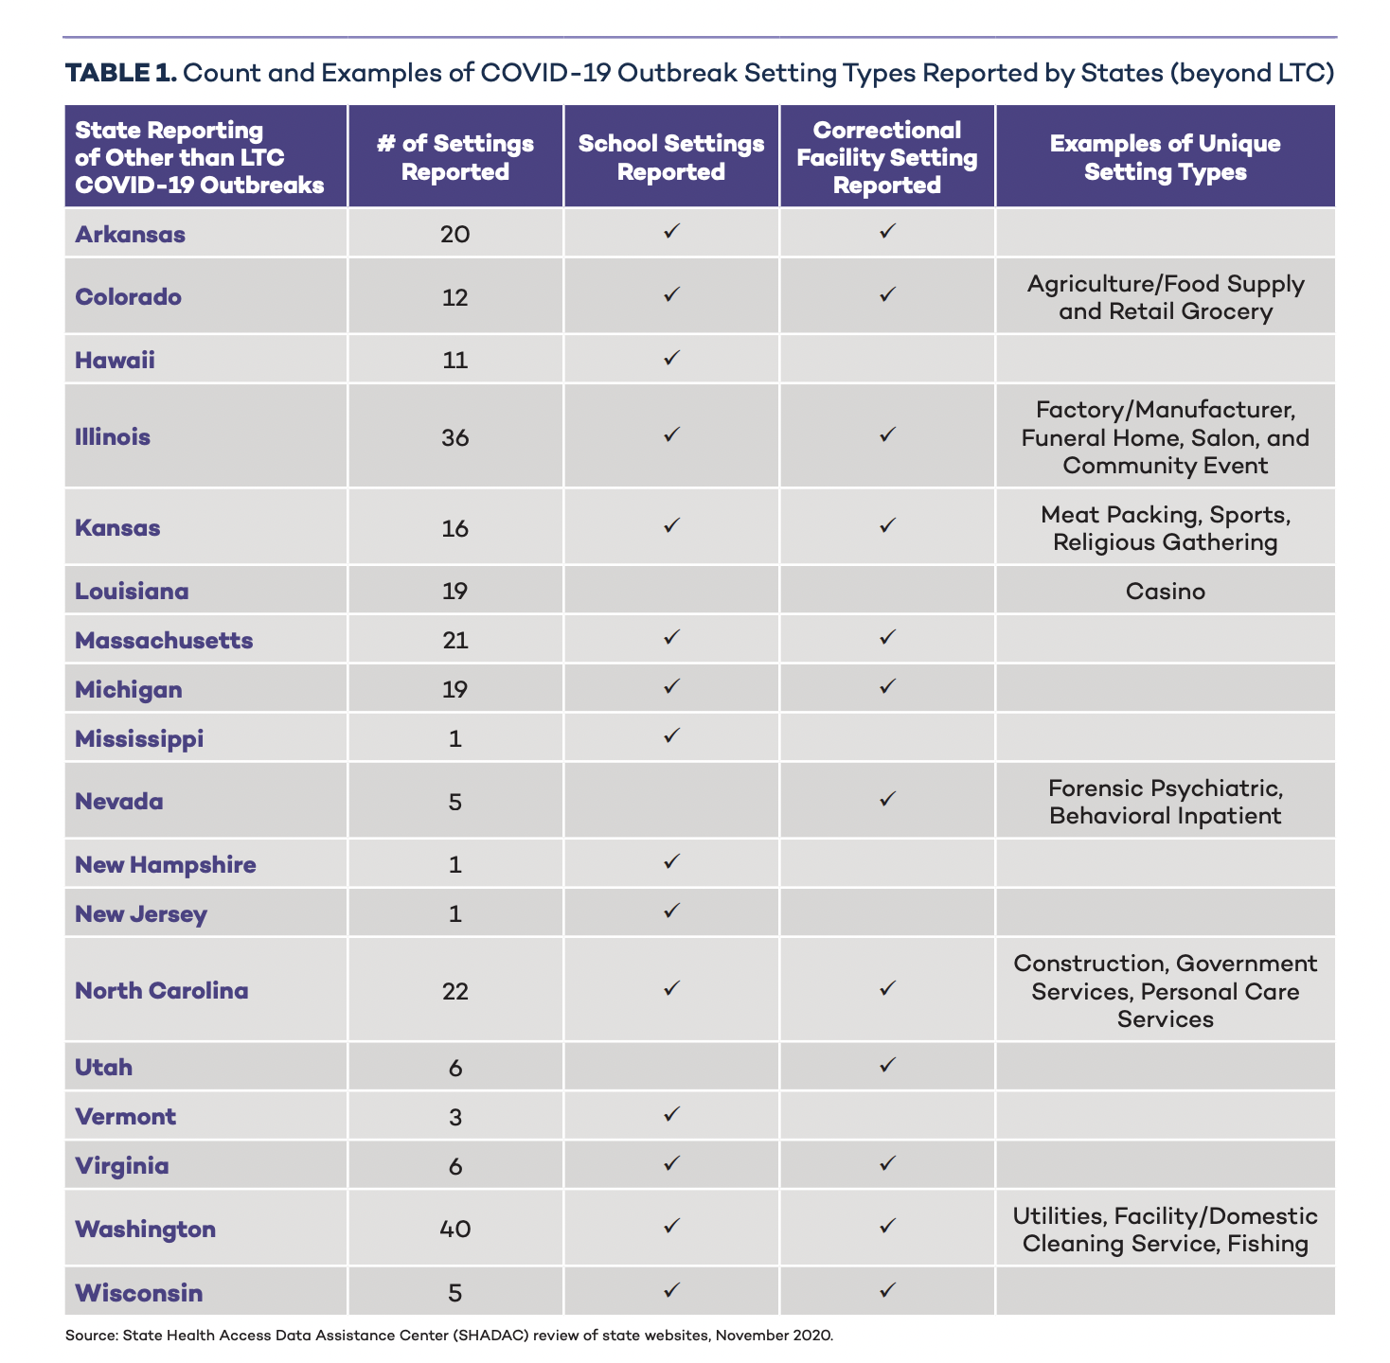

Slide 4
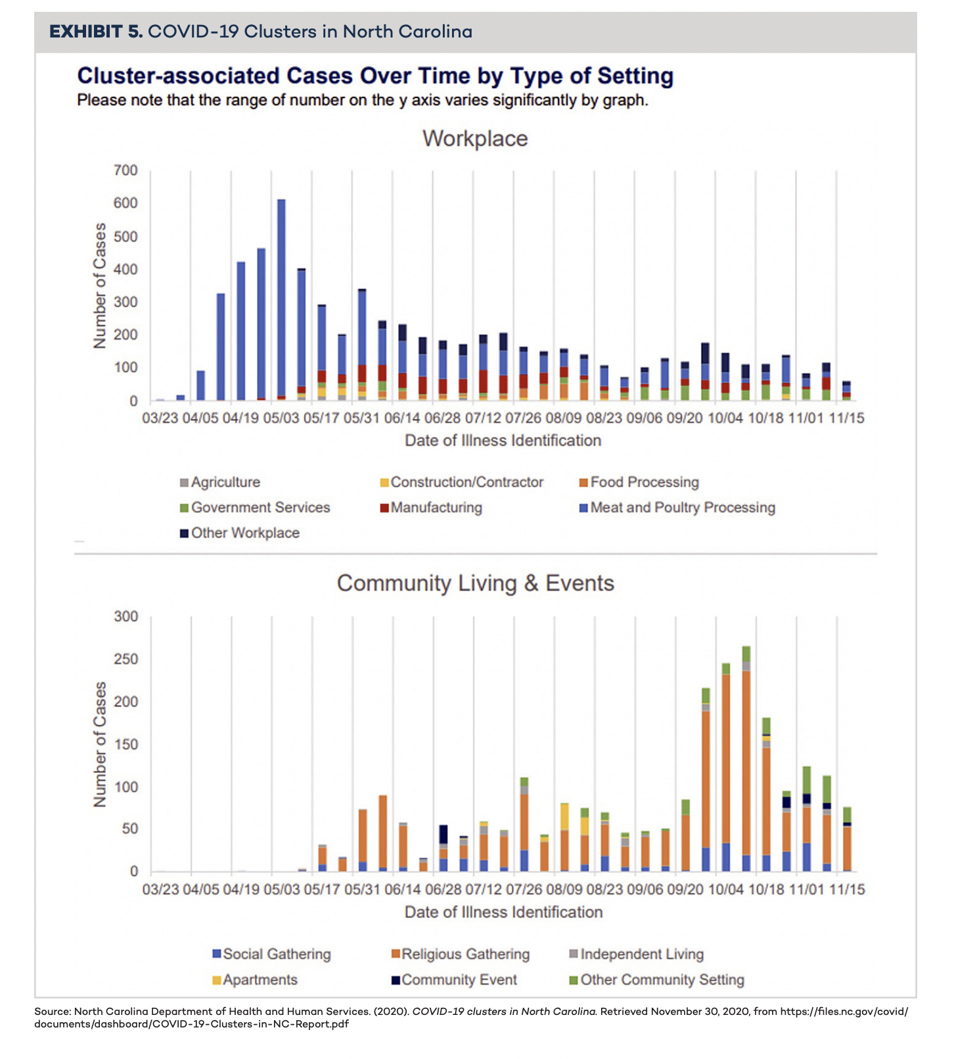

Slide 5
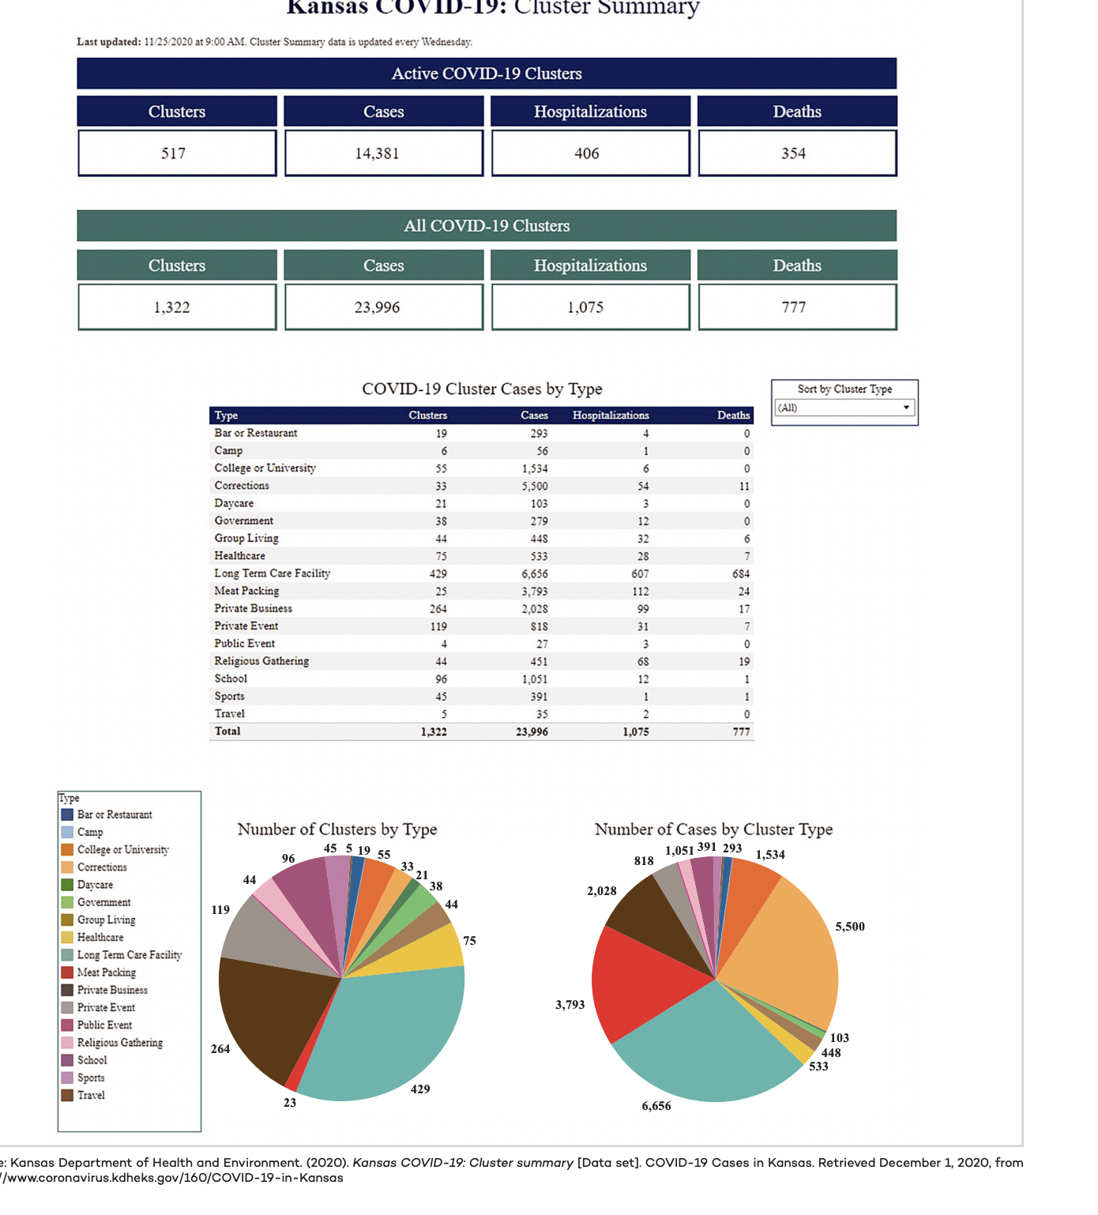

Slide 6
Purpose of public reporting of/summarizing outbreak data Who are the data users?
To provide information about potential risk of transmission in different settings to inform policy, practice and personal risk assessment?
Data users:
  State, local public health- prioritizing investigains
  Government agencies with regulatory responsibilities for settings
    Dept Agriculture - FFIS, migrant labor camps
    OSHA - dept of transportation ...
    Food safety
    Dept of Education – Early Childhood development
  Employers, unions in positions to implement controls
  Workers – personal risk assessment
  Researchers
  Media
Governor’s office, legislators
  Openings, closings...
  To demonstrate level of PH activity/action

Slide 7
Current Approach to developing proposed list
Work within NAICS/CIC – framework – Broad industrial sectors
Organize detailed lists from the states into broad categories
Identify /address groupings that cross sectors
Allow for data collection at different level of detail (
Consider indicator for other dimensions (food related, youth, congregate)
Question: are there key detailed settings that should be included for public consideration, e.g day care, grocery stores...

Slide 8
Some outstanding questions
  Do we agree that for all (workplace) outbreaks, staff and others(customers, students, clients, prisioners) – should be differentiated. Note that for many settings (e.g retail, state’s don’t have capcity to track down cases among customers...
  What do we think of CA model where all workplace outbreaks are assigned NAICS/CIC codes and reported by CIC?. Could/should this be done possibly using narrative text and NIOCCs?
    How does this compare with settings?
  How to categorize outbreaks in workplace settings that involve customers/clients AND workers but don’t meet numeric criteria for workplace outbreaks (e.g. 3 or more cases in 14 days with epi link.) In CA non-hc non congregate anyoutbreak with one or more workers gets included on the industry list...Do we need to deal with this?
  How to categorize events(settings) that also take place in workplaces and involve workers – e.g wedding at a hotel?
  How to categorizes relevant settings within a broader setting, e.g food service areas within a grocery store? Who has control over the setting

