Slide 1
Supporting State Health Agencies in Addressing PFAS Issues
Nicholas Porter
Senior Analyst, Environmental Health
8/22/2019

Slide 2
Supporting State Health Agencies in Addressing PFAS Issues
EPA/ECOS/ASTHO Memorandum of Agreement
  Signed by ASTHO’s President, the Environmental Council of the States’ (ECOS) President, and EPA Administrator on April 11, 2016
  PFAS Risk Communication Case Studies and Risk Communication Clearinghouse
CDC/ATSDR Cooperative Agreement
  PFAS Exposure Assessment Technical Tools Pilot Projects and Expansion
Notes:
First MOA projects included revisions to collaborative “Wildfire Smoke – A Guide for Public Health Officials” document.

Slide 3
Background for PFAS Risk Communication Case Studies
2016 EPA Drinking Water Health Advisories for PFOA and PFOS
States were interested in additional guidance around risk communication, including information on how other states approached PFAS risk communication challenges.
EPA’s Office of Research and Development (ORD) worked with ASTHO and ECOS to conceptualize a risk communication case study project.

Slide 4
Risk Communication of Waterborne Contaminants
Background and Health
Advisories
Contaminants of Interest:
  Harmful Algal Blooms (HABs)
  PFAS
Conducted interviews with state health and environmental agencies.
Produced 13 case studies on risk communication strategies and lessons learned in 2018.
Presented findings on two webinars in June 2018.
Rollout of Advisories
Next Steps for ASTHO

Slide 5
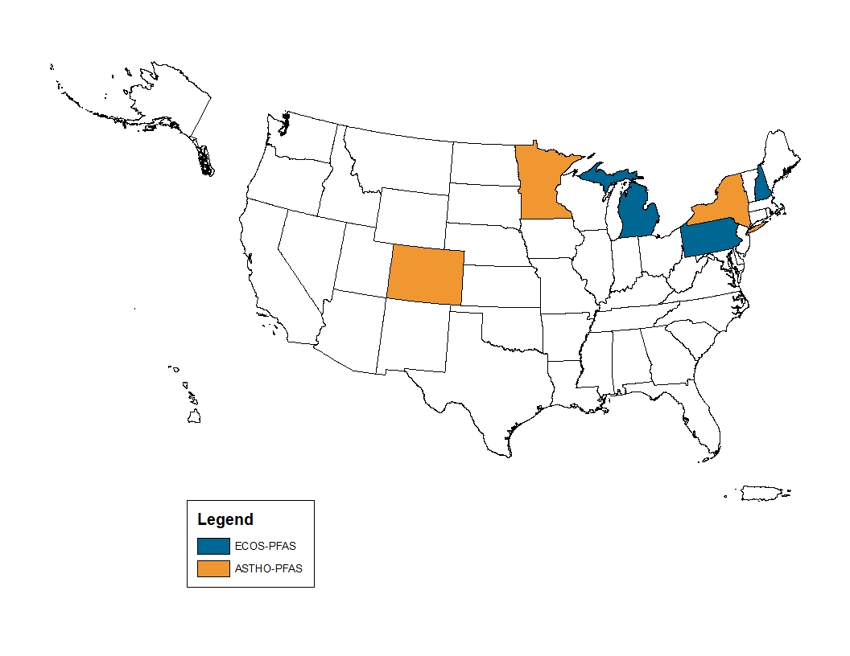

Slide 6
Common Risk Communication Themes Across PFAS Case Studies
State Health and Environmental Officials need clear, regular, honest language that builds a level of trust between state officials and affected communities.
Public education is needed regarding the different quantitative values meant to convey acceptable levels of exposure to PFAS.
Multi-agency coordination is important.
Be consistent and comprehensive when communicating with the public.
Notes:
One on one meetings worked well when discussing PFAS contamination with affected communities.
A lack of public education on the various health based guidance values/health advisory values/action levels/state MCLs make this issue difficult to communicate about. Confusing array of values that differ between states/federal gov.
Federal drinking water standard could help alleviate some confusion.

Slide 7
Risk Communication Clearinghouse
Using lessons learned from states’ experiences with chemicals of emerging concern, ASTHO and ECOS compiled a set of helpful tools, materials, and strategies for risk communication.
Goals for the Clearinghouse:
  Increase collaboration between state environmental health and emergency management.
  Increase accessibility of risk communication models for states and communities.
  Improve public health through awareness of potential risks of contaminants of emerging concern.
The clearinghouse will be housed on the ASTHO and ECOS websites.
Notes:
Clearinghouse will have a launch webinar.

Slide 8
Risk Communication Clearinghouse
FAQs for communicating with different audiences
  Public, media, clinicians, and legislators
Guidance materials for risk communication
  Toolkits, fact sheets, templates, etc.
Collection of state-level resources
  Case studies and state PFAS websites
Notes:
Main contents of the Clearinghouse:
FAQs that members can share w/ their audiences
Risk Communication materials from federal, state, and NGOs
Hyperlinks to states’ web-based resources

Slide 9
PFAS Exposure Assessment Technical Tools: State Implementation and Feedback Pilot Grants
Purpose: To provide state health agencies with the opportunity to implement and evaluate CDC/ATSDR’s PFAS Exposure Assessment Technical Tools (PEATT).
Funding Amount: $175,000 for two state health agencies.
Chosen Grantees: Pennsylvania Department of Health and New York State Department of Health.
Notes:
It should be noted that funding was transferred from PA to NY to allow NYS Wadsworth center to analyze the PA samples.
Evaluation plan consisted of regular check-ins, online surveys, and one comprehensive interview at the end of the project with key project staff.

Slide 10
CDC/ATSDR’s PFAS Exposure Assessment Technical Tools (PEATT)
The PEATT provides a step by step protocol to conduct a statistically based biomonitoring investigation for community exposures to PFAS.
Assumed that main exposure source is contaminated drinking water.
In addition to the 8 step protocol outlined in the PEATT, the document contains sampling protocols, lab analysis protocols, communication materials, question banks, etc.
Interested parties can request a copy of the PEATT at PFAS@cdc.gov.
Notes:
Discuss 8 Steps here.
PA- no exposures above EPA LTHA since June 2016.
NY- Exposures have also been mitigated from drinking water sources.
1. Evaluate existing data on PFAS in drinking water and assess potential current or past community exposure. Consider whether additional exposure pathway data are important (e.g., consumer products, dietary sources including fish from PFAS-contaminated water bodies, crops grown in fields amended with contaminated biosolids, and occupational exposure). ATSDR’s Public Health Assessment Guidance Manual provides helpful information for evaluating existing data.
2. If PFAS was or is expected to be elevated in drinking water compared to EPA’s Lifetime Health Advisory (HA) or state-specific threshold levels, identify variables expected to be associated with increased exposure within the population. Examples of variables can include people in a particular geographic area where elevated PFAS water concentrations existed in the past or currently exist, or people who have been drinking contaminated water over a long period of time, etc. Develop a protocol that describes how these factors will be assessed, and include provision of the variables in steps number 3 through 7 below.
3. Develop and implement a communications plan.
4. Develop a questionnaire that includes demographics, geographic information, and factors influencing exposure to PFAS in water and other potential sources of PFAS. The CDC/ATSDR PFAS Environmental Assessment Technical Tools (PEATT) provide a questionnaire example with core questions.
5. Identify laboratories (with appropriate quality control assurance) capable of performing water PFAS measurements using EPA Method 537. Likewise, identify a quality laboratory to perform serum PFAS measurements. The PEATT provides serum sample collection, storage, and analysis information.
6. Develop a statistically based, community sampling design that will provide information about the range of PFAS exposures in an affected community. Ensure that higher exposure groups and other subgroups of interest are adequately sampled.
People likely to have higher exposure to PFAS.
Relevant demographic groups (e.g., children and adults; males and females; race/ethnic groups)
7. Administer the questionnaire, collect blood samples, and, if exposures are ongoing, collect home tap water or other appropriate environmental samples.
8. Analyze data from step 6 to do the following:
Determine PFAS blood level estimates and the uncertainty for those estimates for the community as a whole and for subgroups such as:
Groups considered at risk for higher exposures
Children and adults
Males and females
Race/ethnic groups (if relevant)
Persons in different economic strata
Different neighborhoods
Different drinking water sources
Other
Using questionnaire data, water PFAS information, and serum PFAS levels from the targeted community exposure assessment, develop the best predictive multivariate model of serum PFAS levels. This model can assist in predicting serum PFAS levels for persons who have water PFAS measurements but have not had their blood tested.

Slide 11
PEATT Pilot Projects – Challenges and Opportunities
Challenges:
  Random sampling in affected communities – not everyone will be sampled.
  Timing of the studies – summer often difficult.
  PFAS in the national news.
  Additional health outcome guidance.
Opportunities:
  Educating the affected communities on PFAS exposures.
  Declining serum concentrations.
  Results from these pilots can be incorporated into larger national exposure assessment activities.
Notes:
Reports of White House blocking tox profiles from releasing caused program staff to need to answer questions for which they did not have good answers.
Also, there was some confusion as to how these studies tied into the larger nationwide exposure assessment/multi-site health studies.

Slide 12
Next Steps
ASTHOConnects Webinar on PEATT Pilot Projects
  Webinar recording on ASTHO’s website today (8/22)
Risk Communication Clearinghouse
ASTHO Member PFAS Summit

Slide 13
Thank You!
Nick Porter
Senior Analyst, Environmental Health
571-318-5491
nporter@astho.org

