Slide 1
Oct 18 2018
Prescription Drug Cost Drivers in WA State, 2014-2017
WA APCD Use Case Scenario

Slide 2
Purpose: Prescription Drug Transparency
Prescription drug costs represent a large and growing component of total health care costs.
  Nationally, prescription drugs comprised 12% of personal health care costs in 2016.
Lack of transparency in drug pricing complicates efforts to reduce health care costs.
This study aims to increase transparency by:
  Identifying the 25 costliest prescription drugs in Washington State in 2017,
  Identifying the 25 prescription drugs with the largest increase in cost from 2016 to 2017
  Quantify the impact of these high cost drugs on total WA state health care spending.

Slide 3
Washington All-Payer Claims Database
Washington All-Payer Claims Database (WA-APCD) was enacted by Washington State Legislature in 2014
WA-APCD includes data from:
  Publicly funded: Medicaid, Medicare Advantage, Medicare Part D, PEBB, and Labor and Industries
  Commercial plans including group and individual markets.
  All pharmacy claims
WA-APCD does not currently include
  Medicare fee-for-Service (will be added in 2019)
  Self-funded plans
  Veterans Administration
WA-APCD contains comprehensive prescription drug claims data from 2014 - 2017.

Slide 4
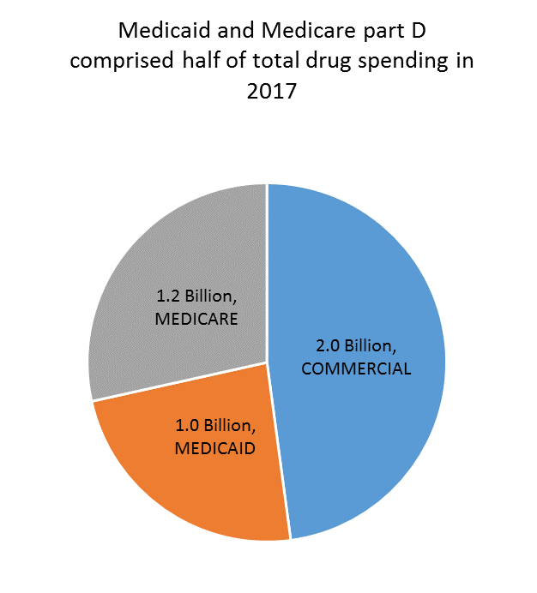

Slide 5
House Bill 1541 – Prescription Drug Transparency
Sec. 4. (1) … issuer must submit … prescription drug cost and utilization data for the previous calendar year:
(a) The twenty-five prescription drugs most frequently prescribed by health care providers participating in the issuer's network;
(b) The twenty-five costliest prescription drugs by total health plan spending, and the issuer's total spend for each of these prescription drugs;
(c) The twenty-five drugs with the highest year-over-year increase in prescription drug spending, and the percentages of the increases for each of these prescription drugs; and
(d) A summary analysis of the impact of prescription drug costs on health plan premiums or on spending per medical assistance enrollee under chapter 74.09 RCW, as applicable, disaggregated by the state Medicaid program, public employees' benefits board programs, and the individual, small group, and large group markets.

Slide 6
Approach
Prescription drug claims filled in 2017 are grouped by NDC product codes.
Calculate summary statistics by product
  Number of member-prescriptions
  total insurer paid amount for each product
Sort by summary statistic, and select the top 25 products
Combine data for 2016 and 2017
By product, calculate change
  Total paid amount 2017 – Total paid amount 2016.
  Percent change
Sort and select top 25 products with largest increase in total paid amount

Slide 7
Challenges
Define terms
  “Most prescribed” – Most prescriptions written? Most members with prescriptions?
  “Prescription drug” –
    NDC (National Drug Code) – 11 characters, uniquely identifies drug ingredients, manufacturers, delivery method, package form, strength, and dosages.
    Need a meaningful way to group NDC codes
Year to year changes
  New drugs introduced, old drugs discontinued.
  NDC codes discontinued or recycled.

Slide 8
NDC code structure
Up to 11 characters, separated by dashes.
  Full form: 5-4-2 e.g. 01234-0567-08
  Format varies. Can be 5-3-2, 4-4-2, 5-4-1, etc.
  May need to add leading zeroes for consistency.
First segment: labeler code
  identifies any firm that manufactures, repacks, or distributes the product
Second segment: product code
  Identifies a specific formulation, strength, and dosage combination
Third segment: package code
  Identifies package form and sizes

Slide 9
Identifying drugs by name
Excel workbooks of drug names that can be linked to NDC product codes can be obtained from FDA
  https://www.fda.gov/Drugs/InformationOnDrugs/ucm142438.htm
For higher level grouping, VA drug class is useful, though not quite comprehensive (only VA covered drugs are included)
  https://www.va.gov/opal/nac/fss/pharmPrices.asp
  Also useful: this data includes price.
Other groupers are available – e.g. Rxcui / RxNorm
Whatever source you use, be sure it is updated to match your data source, as NDC codes change.

Slide 10
Pharmacy Claim structure
Beneficiary information
  Unique identifier – linkable to medical claims
  Age and sex (no race)
  Geography (WA-APCD)
Prescription information
  NDC code
  Quantity
  Days supply
  Fill date
  Pharmacy ID
  Prescriber ID
  Generic drug name (Medicare part D)
Financial information
  Charge, paid, deductible, copay, coinsurance
Plan information

Slide 11
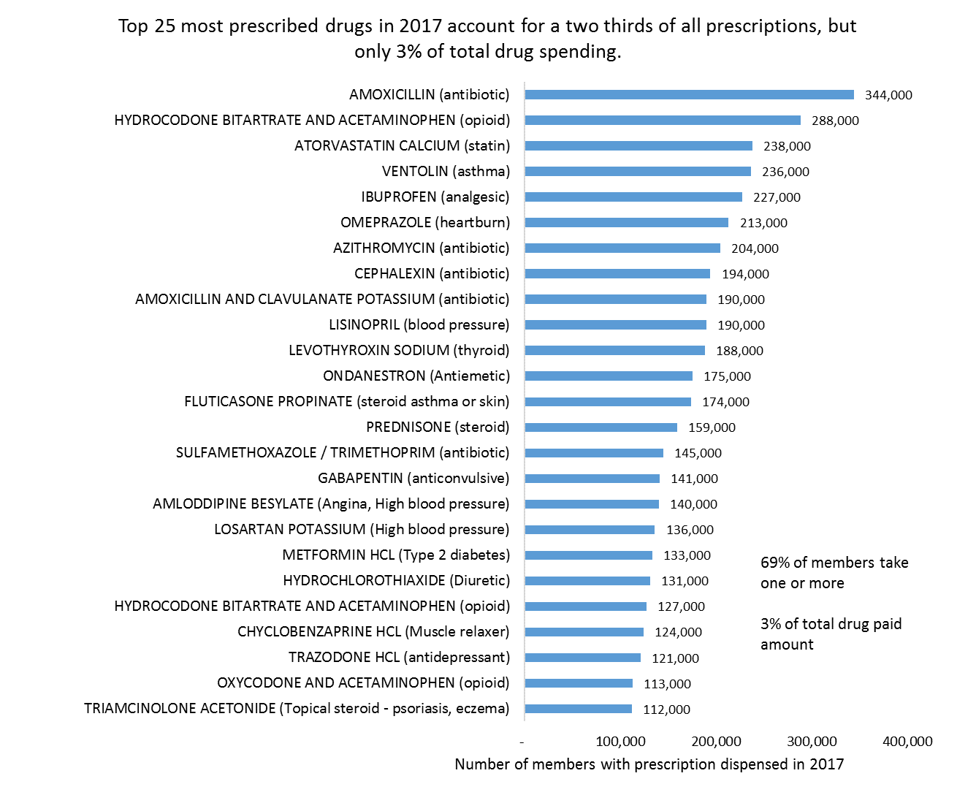
Notes:
We chose to group drugs by NDC product code, and display by proprietary name
We chose to summarize “most prescribed” by number of distinct members with one or more filled prescriptions in a calendar year.
Once the top 25 were identified, product indications were found by Google search.

Slide 12
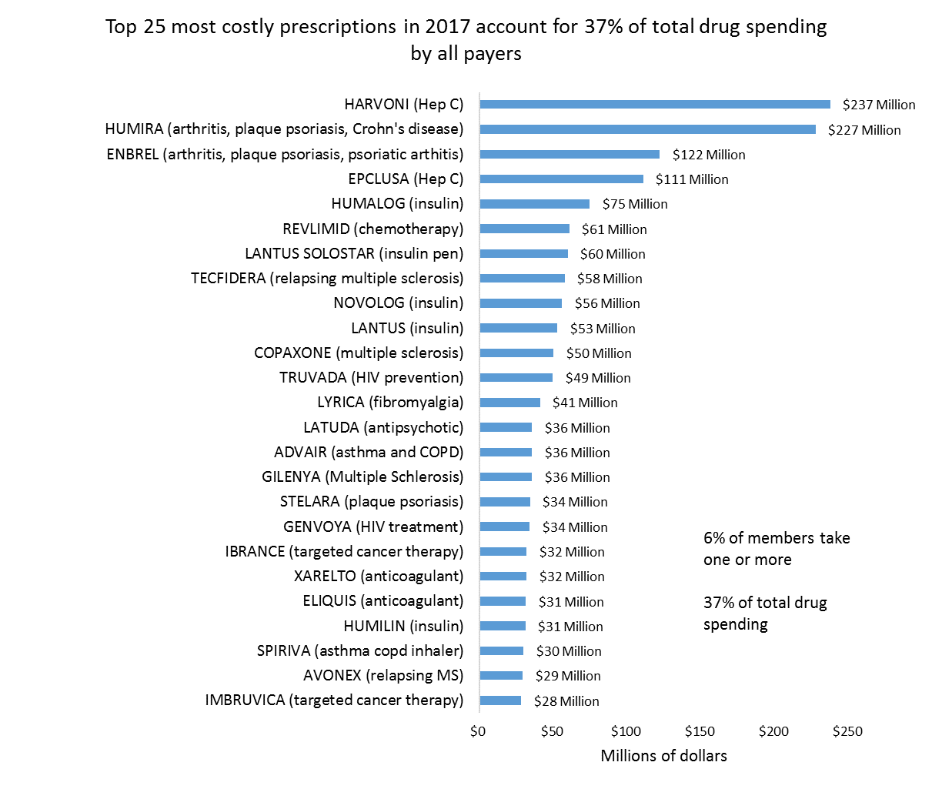
Notes:
We chose to group drugs by NDC product code, and display by proprietary name.
A different grouping (e.g. VA class) would have yielded very different results.

Slide 13
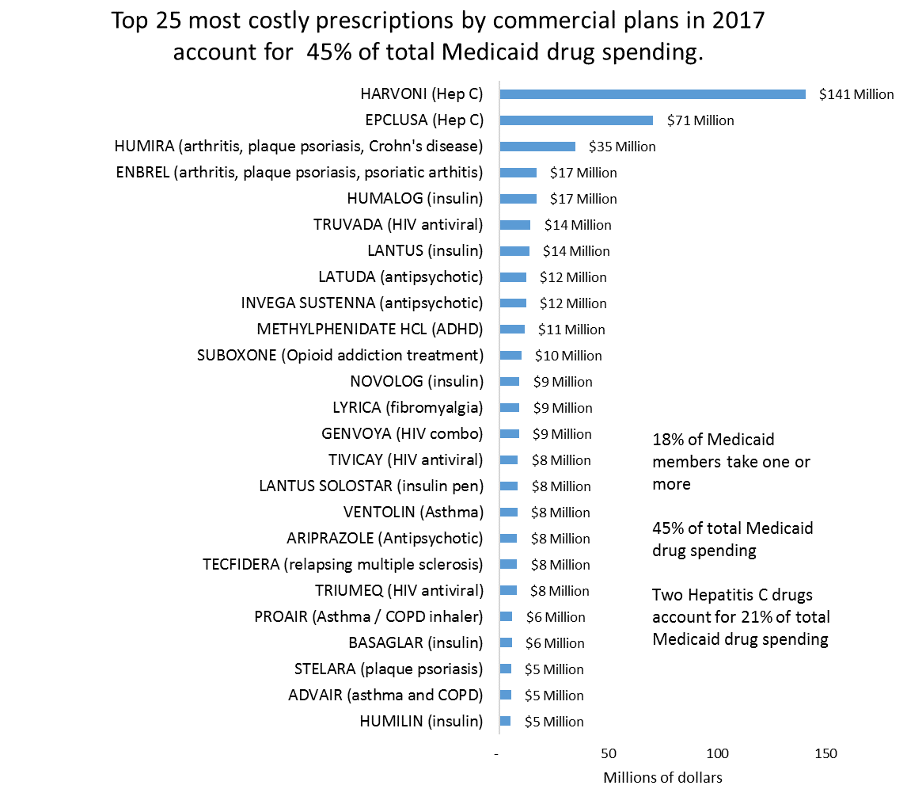
Notes:
Claim data does not contain SES measures for members, but payer type can provide an imperfect proxy.
Medicaid population low income, predominantly children.
We could further stratify - separating Medicaid children from Medicaid adults.

Slide 14
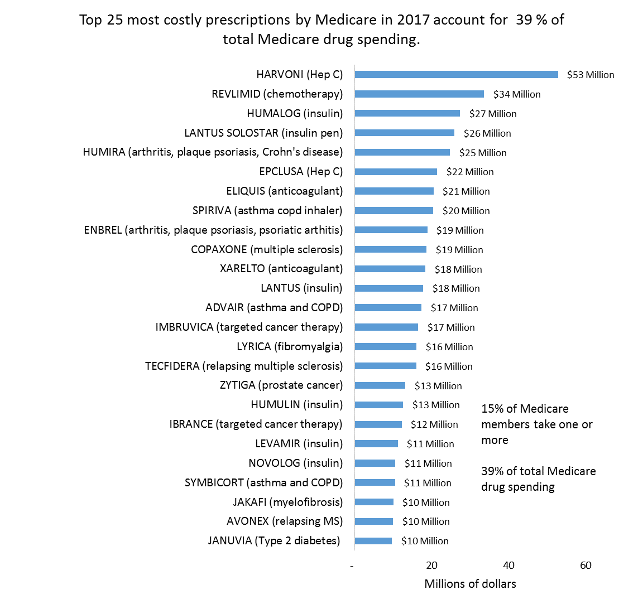
Notes:
Population is predominantly, but not exclusively older. Senior population may be more precisely described by stratifying on age.

Slide 15
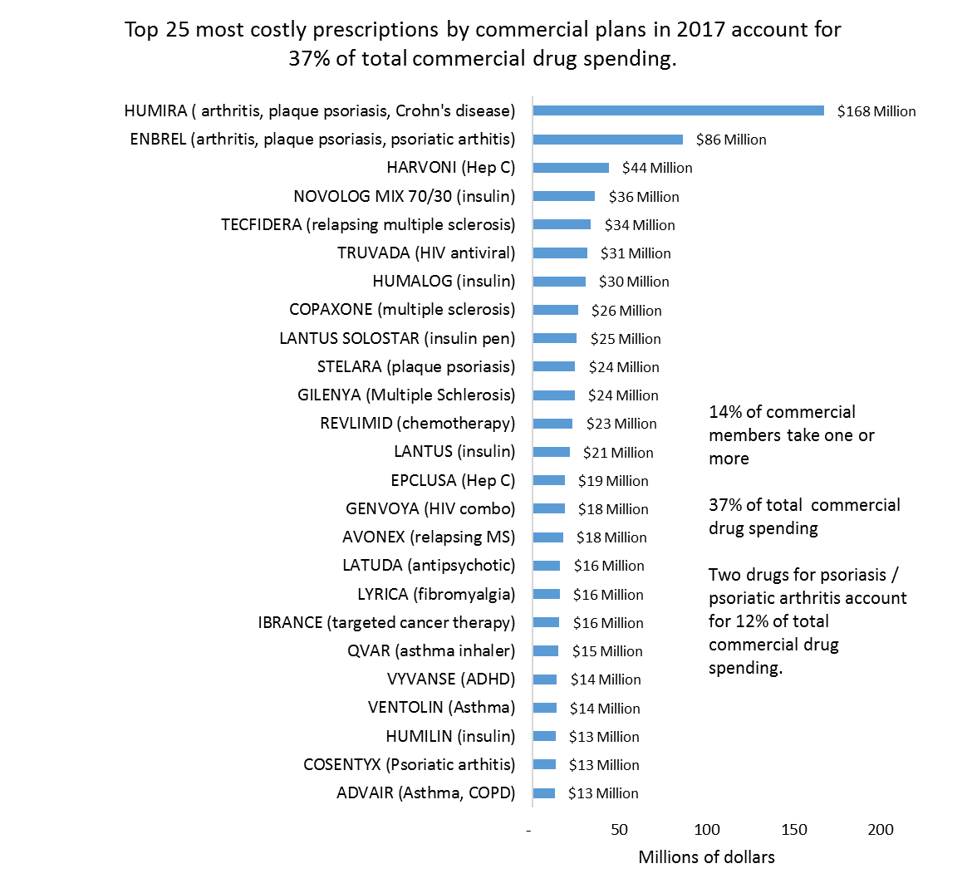
Notes:
Commercial population mostly working, younger, healthier.

Slide 16
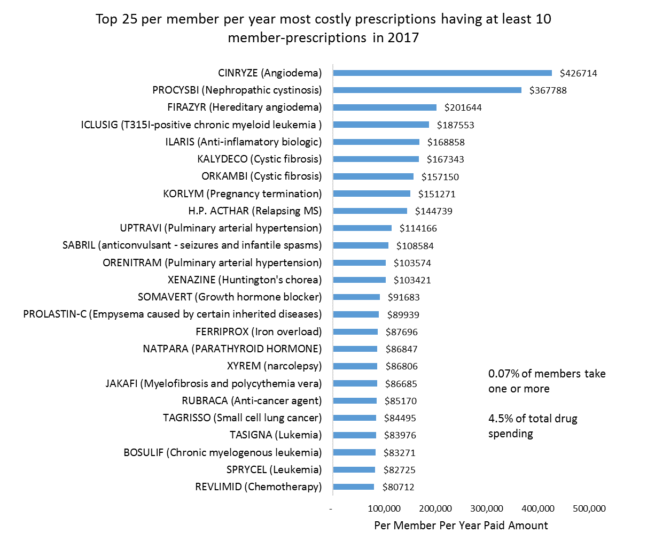
Notes:
Sorting by Per-Member-Per-Year cost
Top 25 list yields some rare but extremely expensive prescriptions.
Many expensive drugs had < 10 members.

Slide 17
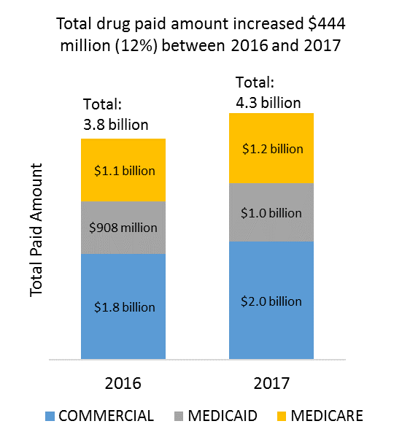
Notes:
Total year over year change was easy.
Year over year change for particular drugs presents some new challenges.

Slide 18
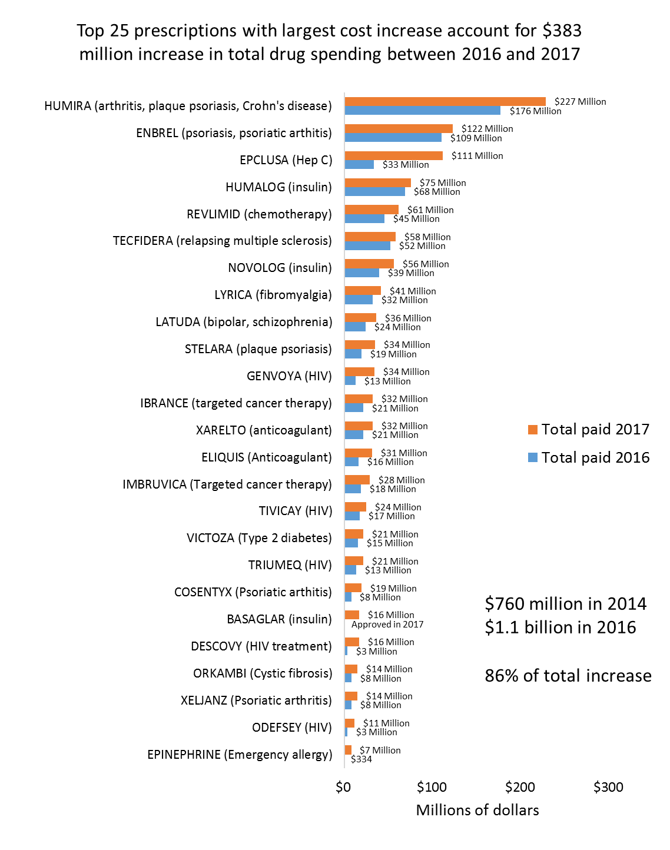
Notes:
Absolute change more straightforward than relative percent change
Big question remains: How much of this represents actual cost increase, and how much is substitution of one Rx for another?

Slide 19
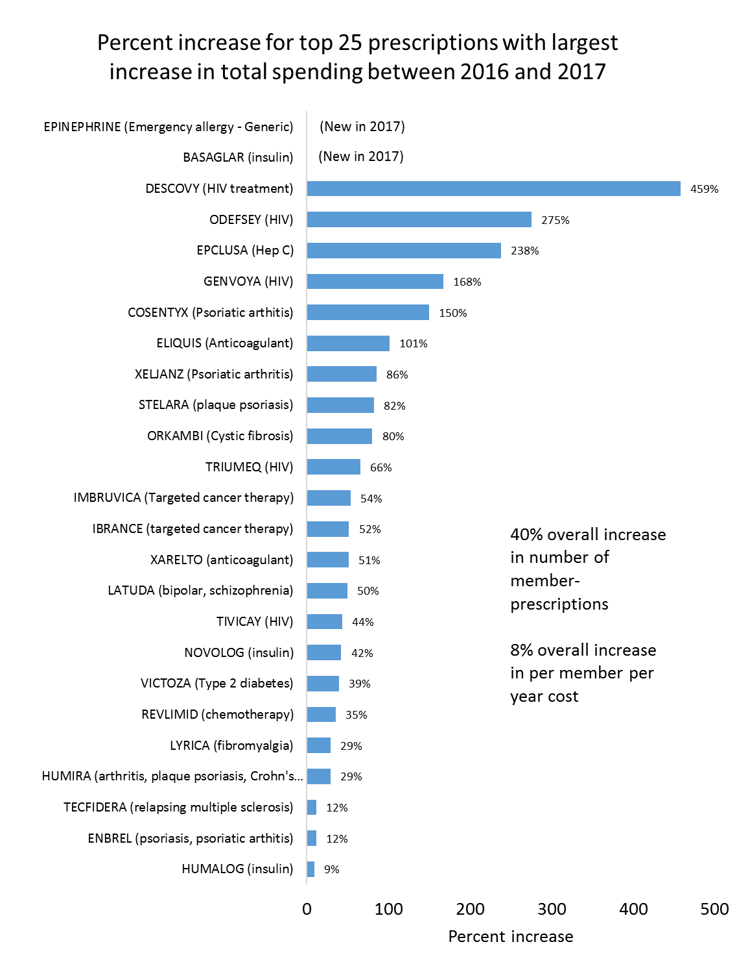
Notes:
Note: two of the top 25 were new in 2017.
Epinephrine: New generic epi-pen, released late 2016 by the same manufacturer, (and still expensive). Does this increase in spending represent overall new cost, or cost saving as users switch to generic?
Basaglar: New formulation of insulin. Presumably most new Basaglar users had previously been using a different form of insulin. Which ones? What is net cost difference?

Slide 20
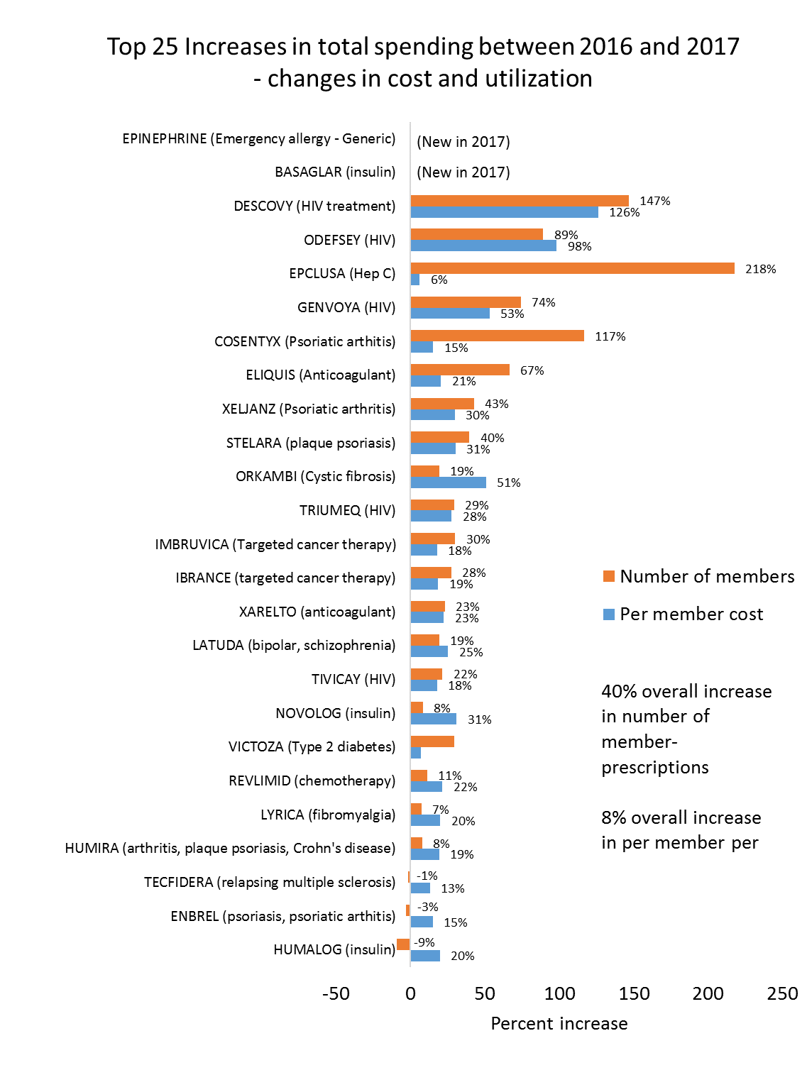
Notes:
An attempt to separate cost and utilization as drivers.

Slide 21
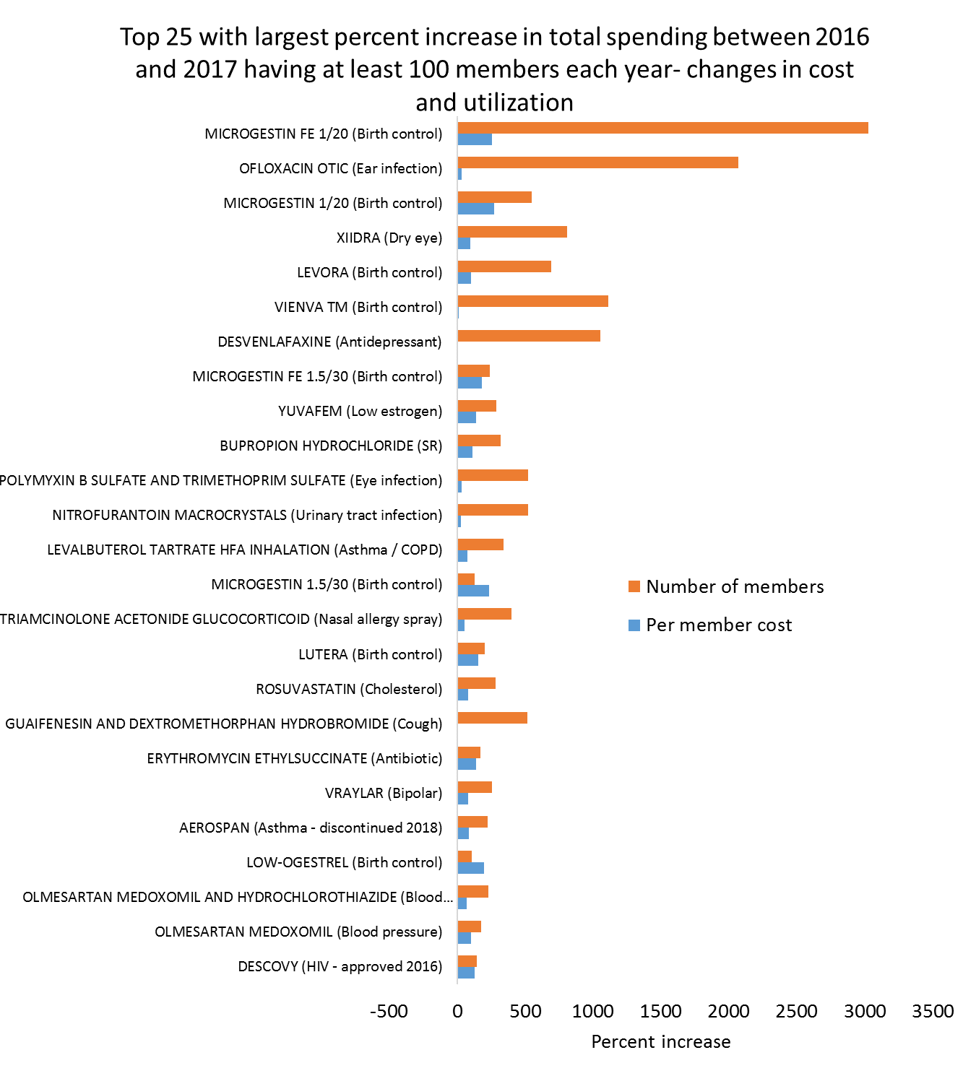
Notes:
Sorting by percent change yields less than useful results.
Many drugs were new in 2017 – no percent change can be computed.
The rest of the top 25 list consisted of rarely prescribed drugs that went from 1 user to 10 for example – not reportable due to small numbers.
Restricting to drugs with at least 100 Rx each year was an arbitrary choice. Why not 1000?

Slide 22
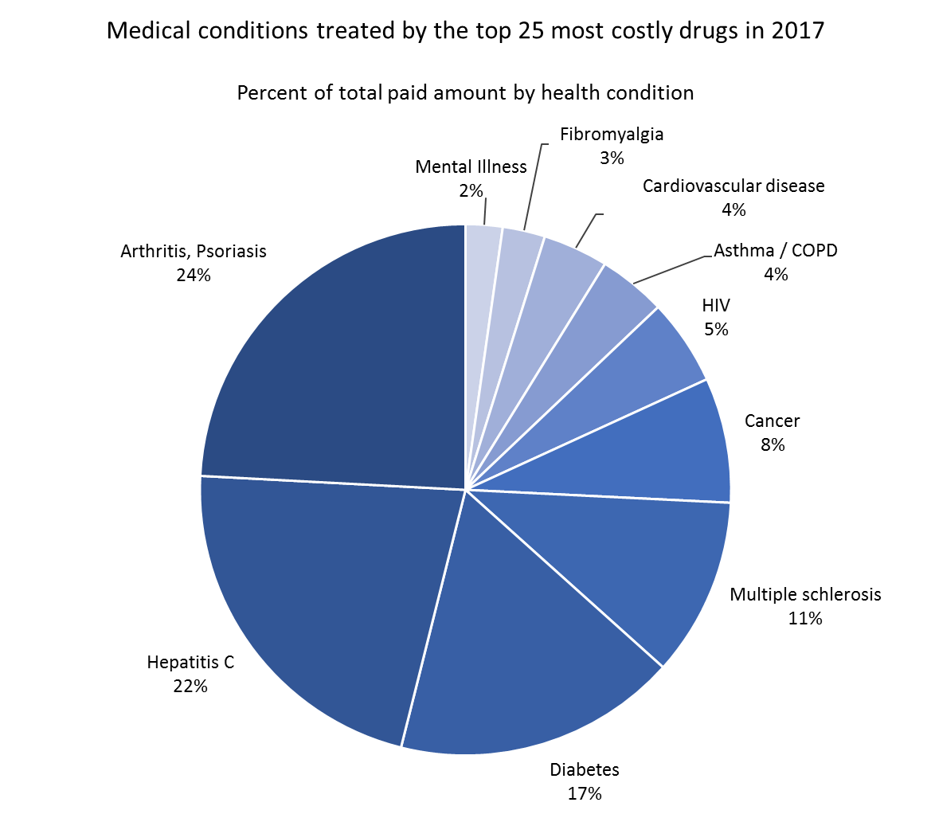
Notes:
This chart is based on health conditions the drug is intended to treat (Google). It would also be possible, though tricky, to join pharmacy claims to medical claims to identify comorbid conditions.
It’s on my to-do list.

Slide 23
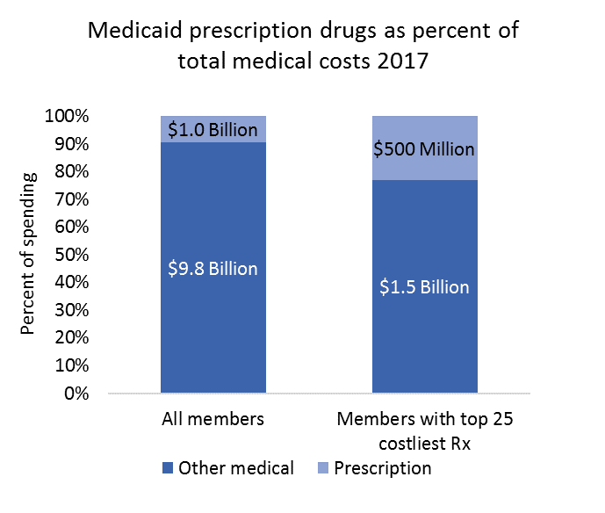
Members taking the top 25 high cost drugs account for 18% of total Medicaid spending.
Note: WA AMCD includes all pharmacy claims, but currently does not include Medicare fee-for-service, or commercial self-insured plans.
Notes:
WA APCD currently only has complete representation of Medicaid claims.
Medicare coming soon, but not all Medicare beneficiaries have part D.
For commercial plans, we could get relative costs by restricting to members with both medical and prescription coverage

Slide 24
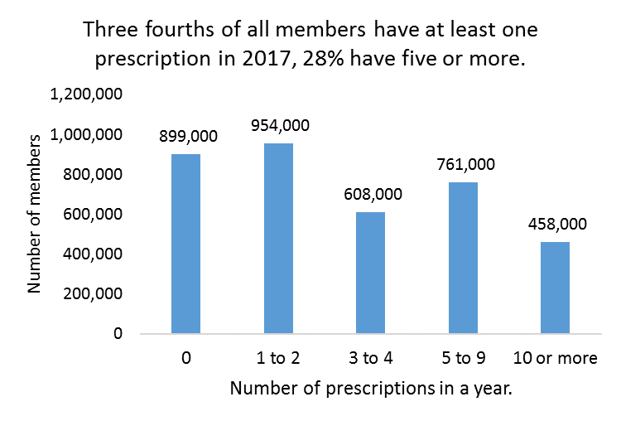
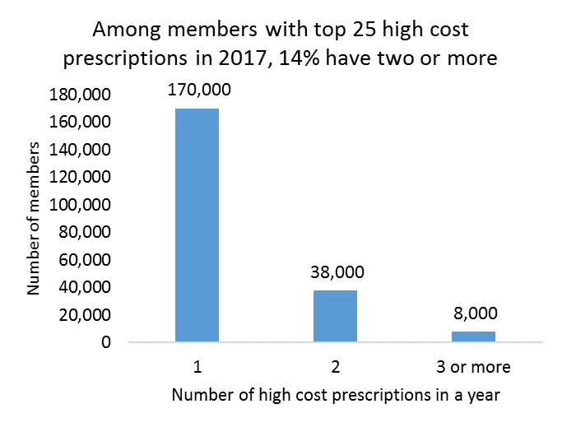
Notes:
Note: this is polypharmacy among members with pharmacy coverage. It may not be representative of the population.

Slide 25
Key Findings Summary
Top 25 most costly prescriptions in 2017 account for 37% of total drug spending by all payers
  45% for Medicaid, 39% for Medicare
Two Hepatitis C drugs account for 21% of total Medicaid drug spending
Total drug paid amount increased $444 million (12%) between 2016 and 2017
  Top 25 drugs with largest cost increase account for 86% (383 million) of total cost increase
  Question remains: does this represent new costs, or substitution?
Total cost increase of top 25 drugs was driven by increased utilization of emerging drugs.
  40% increase in number of members with prescriptions
Increases in price also contribute to total cost
  8% increase in per-member-per-year cost for top 25 drugs

Slide 26
Recap - Strengths
Data on cost and utilization (but not price)
Unique ID linking medical, pharmacy and provider.
  Able to follow a cohort
  Can assess comorbidity, polypharmacy of individual members
  Can assess cost and utilization by provider or geography
  Can assess quality of care by provider or geography

Slide 27
Recap - Limitations
Claims, not medical records.
  Procedures not specifically paid for are not listed on claim – e.g. hospital administered medication.
Database missing some key components (Medicaid FFS, self-insures, VA)
Physician administered drugs not included
Claim cost data does not account for rebates
Member ID linkage not perfect.
Coding changes make year-to-year comparisons difficult.

Slide 28

Any Questions?

