Slide 1





Prevention and Population Health Framework
The 3 Buckets of Prevention
1
2
3
TRADITIONAL CLINICAL PREVENTION
INNOVATIVE CLINICAL PREVENTION
COMMUNITY-WIDE PREVENTION
Increase the use of clinical preventive services delivered to individuals
Provide services delivered to individuals that extend care outside the clinical setting
Implement interventions that reach whole populations
Health Care
Public Health
Auerbach J. The 3 Buckets of Prevention. J Public Health Management Practice. J Public Health Manag Pract. 2016; 22(3):215-18.

Slide 2
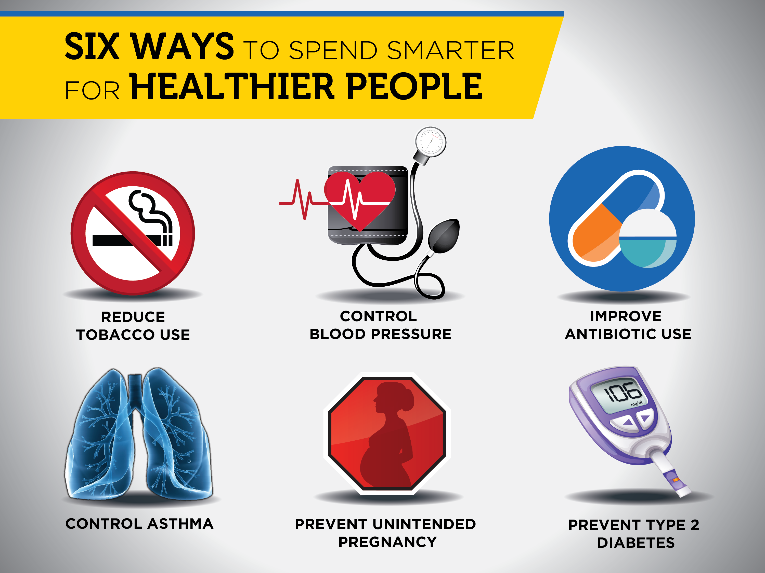

Slide 3






Evidence-based Interventions
REDUCE TOBACCO USE
Improve Antibiotic Use
PREVENT UNINTENDED PREGNANCY
Increase access to tobacco cessation treatments, including individual, group, and telephone counseling, and Food and Drug Administration-approved cessation medications (in accordance with the 2008 Public Health Service Clinical Practice Guidelines and the 2015 U.S. Preventive Services Task Force recommendations).
Remove barriers that impede access to covered cessation treatments, such as cost-sharing and prior authorization.
Promote increased use of covered treatment benefits by tobacco users.
Require antibiotic stewardship programs in all hospitals and skilled nursing facilities, in alignment with CDC’s Core Elements of Hospital Antibiotic Stewardship Programs and The Core Elements of Antibiotic Stewardship for Nursing Homes.
Improve outpatient antibiotic prescribing by incentivizing providers to follow CDC’s Core Elements of Outpatient Antibiotic Stewardship.
Reimburse providers for the full range of contraceptive services (e.g., screening for pregnancy intention; counseling; insertion, removal, replacement, or reinsertion of long-acting reversible contraceptives, and follow-up) for women of childbearing age.
Reimburse providers for the actual cost of FDA-approved contraceptive methods.
Unbundle payment for long-acting reversible contraceptives from other postpartum services.
Remove administrative barriers to receipt of contraceptive services (e.g., pre-approval step therapy restriction, barriers to high acquisition and stocking costs).
CONTROL ASTHMA
Use the 2007 National Asthma Education and Prevention Program as clinical practice guidelines.
Promote strategies that improve access and adherence to asthma medications and devices.
Expand access to intensive self-management education by licensed professionals or qualified lay health workers for patients whose asthma is not well-controlled with medical management.
Expand access to home visits by licensed professionals or qualified lay health workers to provide intensive self-management education and reduce home asthma triggers for patients whose asthma is not well-controlled with medical management and self-management education.
CONTROL HIGH BLOOD PRESSSURE
Implement strategies that improve adherence to anti-hypertensive and lipid-lowering prescription medications via expanded access to:
  low cost medication copayments, fixed dose medication combinations, and extended medication fills;
  innovative pharmacy packaging;
  improved care coordination using standardized protocols, primary care teams, medication therapy management programs, and self-monitoring of blood pressure with clinical support.
Provide home blood pressure monitors to patients with high blood pressure and reimburse for the clinical support services required for self-measured blood pressure monitoring.
PREVENT TYPE 2 DIABETES
Expand access to the National Diabetes Prevention Program, a lifestyle change program to prevent or delay onset of type 2 diabetes

Slide 4
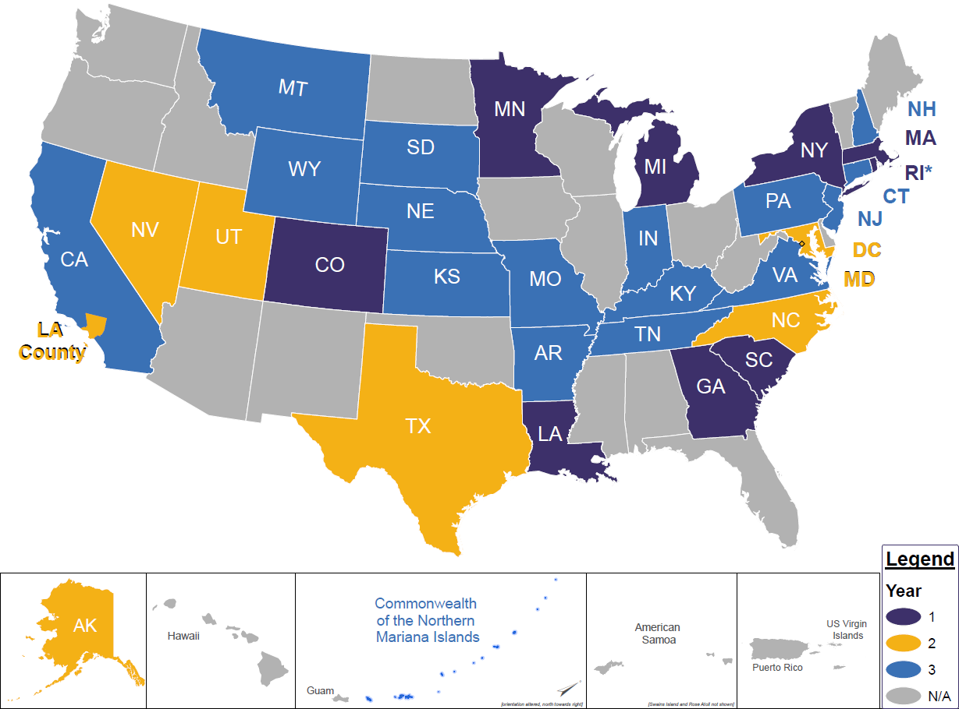
States & Territories Participating in CDC’s 6|18 Initiative

Slide 5
Public Health & Health System Complementary Roles
PUBLIC HEALTH
Contributed condition-
specific subject expertise
Translated epidemiologic evidence into benefits for coverage
Developed awareness campaigns targeting providers and patients
Promoted linkages with community services
MEDICAID AGENCY
Developed a business case for chosen interventions
Utilized available policy levers to improve coverage and promote increased uptake of services
Engaged with Medicaid managed care plans to enhance benefits
Engaged providers and members
Excerpted from: Seeff LC, McGinnis T, Heishman H. CDC's 6|18 Initiative: A Cross-Sector Approach to Translating Evidence Into Practice
Journal of Public Health Management and Practice: February 22, 2018 - Volume Publish Ahead of Print - Issue - p
doi: 10.1097/PHH.0000000000000782. Practice Full Report: PDF Only

Slide 6

SOUTH CAROLINA – Reducing Tobacco Use
As of July 1, 2017, SC Medicaid has removed barriers to access to cessation treatment (eg, no co-pays and no prior authorizations)
SC now provides consistent medication and cessation counseling coverage across all Medicaid Managed Care Organizations
The SC 6|18 team is educating providers and consumers about cessation services
SC received a 50% CMS administrative match for quitline services
Quitline and claims data are being aligned to monitor impact of above efforts
  “Mid-Century Map Postcard – South Carolina” by Yesterdays- Paper is licensed under CC BY 3.0
SOURCE: Tobacco Cessation Coverage. July 1, 2017: South Carolina Department of Health and Human Services.
https://www.scdhhs.gov/press-release/tobacco-cessation-coverage.

Slide 7
Improving health where it begins.
LIVE
LEARN
WORK
PLAY
Healthy communities are a good value for all

Slide 8
The 3 Buckets of Prevention
Prevention and Population Health Framework
1
2
3
TRADITIONAL CLINICAL PREVENTION
INNOVATIVE CLINICAL PREVENTION
COMMUNITY-WIDE PREVENTION
Increase the use of clinical preventive services delivered to individuals
Provide services delivered to individuals that extend care outside the clinical setting
Implement interventions that reach whole populations
Health Care
Public Health
Auerbach J. The 3 Buckets of Prevention. J Public Health Management Practice. J Public Health Manag Pract. 2016; 22(3):215-18.

Slide 10
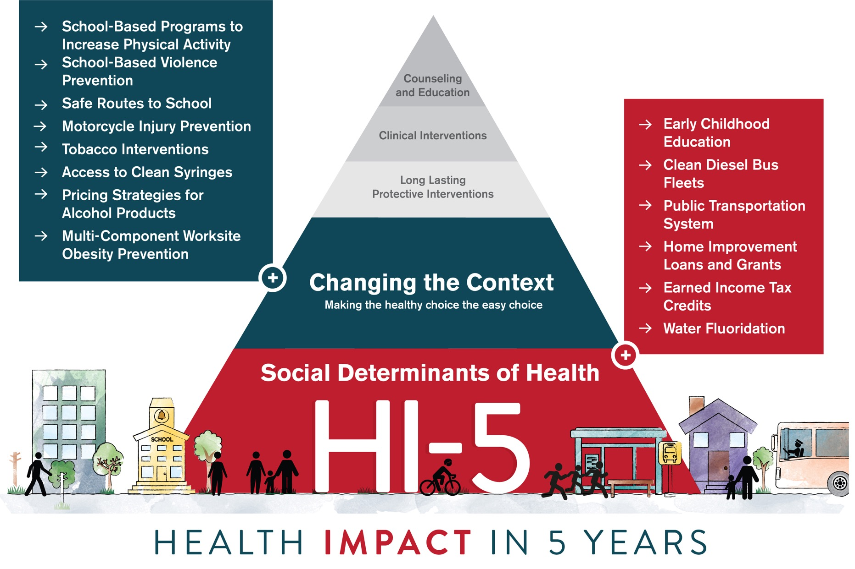

Slide 11

14 Evidence-based, Community-Wide Interventions
Evidence Brief for each at www.cdc.gov/hi5
Change the Context: Making the Healthy Choice the Easy Choice
School-based Programs to Increase Physical Activity
School-based Violence Prevention
Safe Routes to School (SRTS)
Motorcycle Injury Prevention
Tobacco Control Interventions
Access to Clean Syringes
Pricing Strategies for Alcohol Products
Multi-Component Worksite Obesity Prevention
Address the Social Determinants of Health
Early Childhood Education*
Clean Diesel Bus Fleets
Public Transportation System* Introduction or Expansion
Home Improvement Loans and Grants*
Earned Income Tax Credits*
Water Fluoridation

Slide 12

Public Transportation System Introduction or Expansion
Description
  Includes a variety of transit options such as buses, light rail, and subways
  Increases both access to and use of public transit and reduces traffic
Health Impact
  Reductions in health risk factors such as motor vehicle crashes, air pollution, and physical inactivity
  Increases from 8 to 33 minutes of walking per day
Economic Impact
  Typical American public transit service improved to high quality urban rail or bus rapid transit service would result in per capita annual health benefits of $354.86

Slide 13
Transportation Stories from
Public Health Innovators
Minnesota: Active Transit
San Francisco:
Access to
Healthcare
Massachusetts: McGrath Bridge
North Carolina:
Safe Routes to School
Columbia, MO: Health Impact Assessment (HIA)
Maricopa county
AZ: Health Impact
Assessment & Light Rail
Stapleton, CO:
Health Equity
Biloxi MS:
Post Hurricane
Florida: Millennials to Seniors
Acknowledgement: E. Moore, ASTHO

Slide 14

Transportation as a Vehicle
to Health Improvement
Gulf Coast Mississippi
Coastal Transit Authority - Bus and trolley system
“Wave finder” links residents and tourists to the beach and shopping destinations
Increased physical activity and jobs for local economy through tourism

