Slide 1

Inspiring Data to Action: Using Online GIS Tools to Mobilize Public Health Response
Presenter: Brian Hendricks¹
Contributors: Tim Dotson ², Jing Wu^{3,} Jhonatan Garridolecca³
Affiliations: ¹ West Virginia University, ² West Virginia Board of Pharmacy, and
³ ESRI Health and Human Services

Slide 2

Presenter Background
Current Employment
Research Assistant Professor – West Virginia University
Research Published in 2019
Pesarsick J.*, Gwilliam M., Adeniran O., Rudisill TM., Smith GS., Hendricks B. Identifying high-risk areas for nonfatal opioid overdose: a spatial case-control study using EMS run data. Annals of Epidemiology (2019) 36 pgs. 20-25 https://doi.org/10.1016/j.annepidem.2019.07.001.
Minc SD., Hendricks B., Ren Y., Marone L., Smith GS. Geographic variation in amputation rates among patients with diabetes and/or peripheral arterial disease in the rural state of West Virginia identifies areas for improved care. Journal of Vascular Surgery (2019) https://doi.org/10.1016/j.vs.2019.06.215.
Rudisill T.M., Menon S., Hendricks B., Zhu M., Smith G.S. “Differences between occupational and non-occupational-related motor vehicle collisions in West Virginia: a cross-sectional and spatial analysis”. PlosOne (2019) 14(12): e0227388. doi: 10.1371/journal.pone.0227388.

Slide 3
“A new wave of technological innovation is allowing us to capture, store, process, and display an unprecedented amount of information about our planet and a wide variety of environmental and cultural phenomena. Much of this information will be “geo-referenced” that is, it will refer to some specific place on Earth’s surface. The hard part of taking advantage of this flood of geospatial information will be making sense of it, turning raw data into understandable information.”
- Former Vice President Al Gore
Source: Gore A. “The Digital Earth: Understanding our Planet in the 21rst Century. Speech given at the California Science Center: 31 January, 1998; Los Angeles, CA. http://www.digitalearth.gov/VP1998019.html

Slide 4
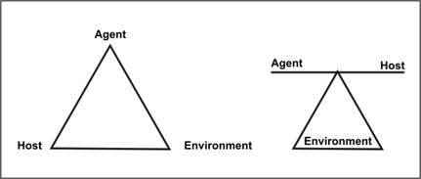
Epidemiologic Triad - CDC
Model 1: Agent, Host, and Environment equal influence
Model 2: Agent and host variables are dependent on each other and the environment
Source: https://www.cdc.gov/csels/dsepd/ss1978/Lesson1/Section8.html#ALT116

Slide 5
Learning Objectives
Summarize importance of ESRI’s Operation Dashboard and related tools to build dynamic interfaces for public health decision making.
Execute the steps to organize a theoretical operations dashboard for a public health response.
** Today we will use a more general example to provide basic framework

Slide 6
Importance of GIS for Public Health Decision Making
Brissette et al. 2019 Application of GIS to Address Chronic Disease Priorities: Experiences in State and Local Health.
Please provide a brief description of how your health department currently uses GIS to address chronic disease priorities.
Please describe the benefits and challenges of using GIS to address the chronic disease priorities in your health department.
Please discuss how the use of GIS has enhanced your health department’s ability to perform one or more of the Public Health Foundation’s Core Competencies for Public Health Professionals (4) or the CDC/Council of State and Territorial Epidemiologists Applied Epidemiology Competencies (5).
Brissette I, Casper M, Huston SL, Jordan M, Karns B, Kippes C, et al. Application of Geographic Information Systems to Address Chronic Disease Priorities: Experiences in State and Local Health Departments. [Erratum appears in Prev Chronic Dis 2019;16. http://www.cdc.gov/pcd/issues/2019/18_0674e.htm.] Prev Chronic Dis 2019;16:180674. DOI: http://dx.doi.org/10.5888/pcd16.180674

Slide 7
Importance of GIS for Public Health Decision Making
New York Department of Health Reported (Brissette et al. 2019)
GIS analysis has aided in identifying specific communities in need of focused public health action.
The resulting maps enabled us to communicate effectively with decision makers and engage communities.
Using GIS to analyze and display these data enables stakeholders to understand the schools, worksites, childcare centers, hospitals, etc. affected by these interventions.
In program evaluation, maps are used to assess whether policy, system, and environmental changes established by grantees occur in high-need communities and have the potential to affect a sizable population.

Slide 8
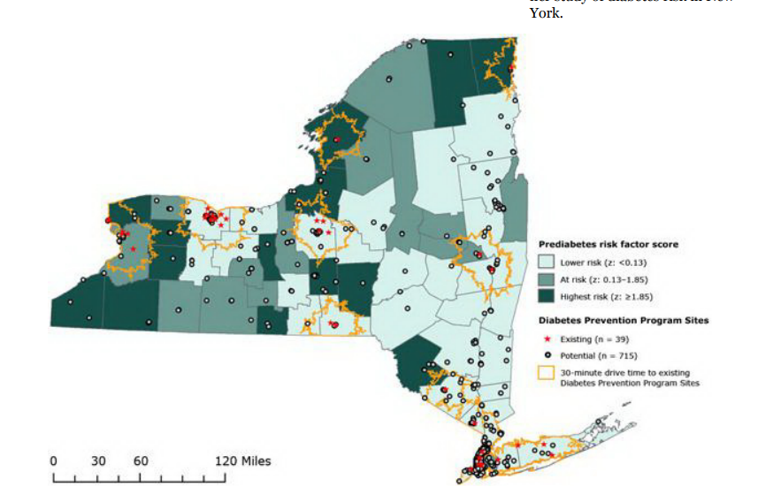
Importance of GIS for Public Health Decision Making
NY Dep of Health Access to Diabetes Programs
Ruberto RA, Brissette IF. Geographic Access to Diabetes Prevention Program Sites: New York State Department of Health. Prev Chronic Dis 2014;11:130400. DOI: http://dx.doi.org/10.5888/pcd11.130400

Slide 9
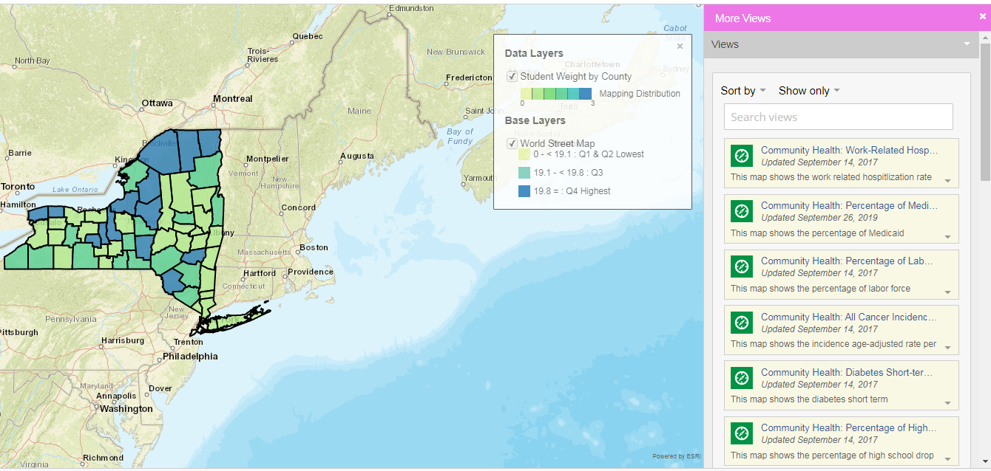
Importance of GIS for Public Health Decision Making
NY Dep of Health: Student Weight County Level Mapping Tool
Health Data NY. Creating healthy places child focused interventions an student weight state county map. https://health.data.ny.gov/Health/Creating-Healthy-Places-Child-Focused-Intervention/qshu-47dt.

Slide 10
Operations Dashboard
If the previous two mapped displays are meeting our agency’s needs why use Operations Dashboard?
Answer
Dashboards are designed to display multiple visualizations that work together on a single screen.
They offer a comprehensive and engaging view of your data to provide key insight for at-a-glance decision making.
Source: https://doc.arcgis.com/en/operations-dashboard/help/what-is-a-dashboard.htm

Slide 11
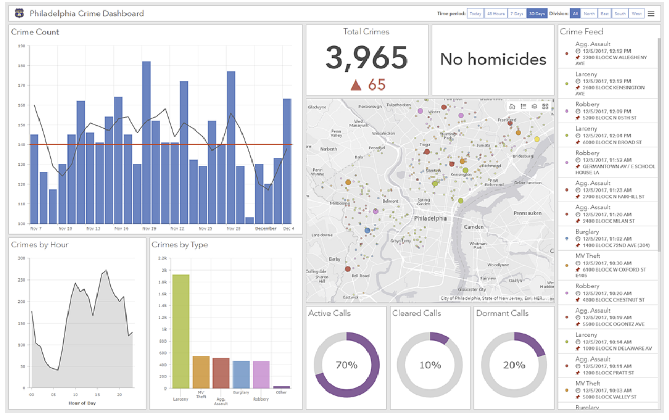
Operations Dashboard
Example: Crime Dashboard Philadelphia, PA
Source: https://doc.arcgis.com/en/operations-dashboard/help/what-is-a-dashboard.htm

Slide 12
Operations Dashboard
When to create an operations dashboard?
See –in one view – all the data you need you need for decision making
Monitor the most important information about your day-to-day operations.
Ensure all your colleagues are focused on the same goal through viewing and using the same information.
Monitor the health of a business, product, organizational team, or campaign.
Create a personalized view of a larger set of data to show all the metrics that matter to you.
Source: https://doc.arcgis.com/en/operations-dashboard/help/what-is-a-dashboard.htm

Slide 13
Operations Dashboard
West Virginia Board of Pharmacy Dashboard
Data: Controlled Substance Monitoring Program
Credit: Tim Dotson and Nathan Wood
**Screen Share

Slide 14
Operations Dashboard
Other potential products to build dashboard include Microsoft BI.
WV Office of Drug Control Policy
Data: EMS Responses
Credit: ODCP
** Screen Share
https://dhhr.wv.gov/office-of-drug-control-policy/datadashboard/Pages/Emergency-Medical-Services-Dashboard-Related-to-Suspected-Overdoses.aspx

Slide 15

Operations Dashboard
With all of the other options why is ESRI’s Dashboard technology the one we are discussing?

Slide 16
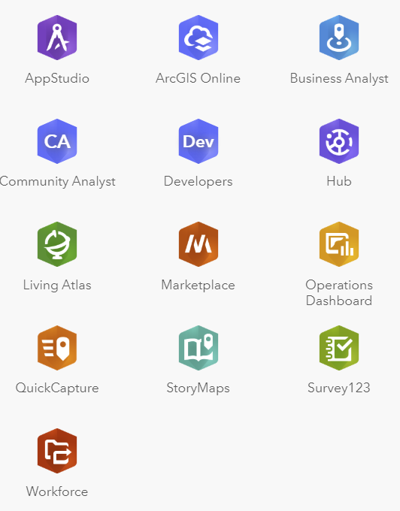
Operations Dashboard
With all of the other options why is ESRI’s Dashboard technology the one we are discussing?
Web/Mobile

Slide 17
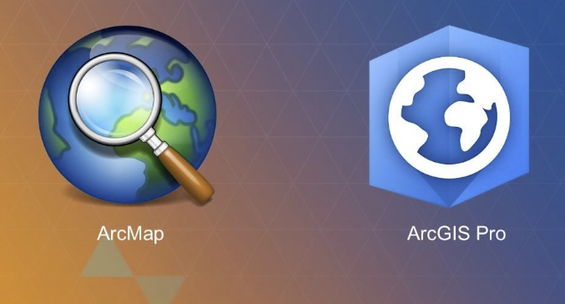
Operations Dashboard
With all of the other options why is ESRI’s Dashboard technology the one we are discussing?
Web/Mobile
Desktop

Slide 18

Operations Dashboard
Take the survey
ESRI Survey 1-2-3
Data: Primary Data Collection
Credit: Hendricks Example
** Screen Share
https://arcg.is/1Gui1j

Slide 19
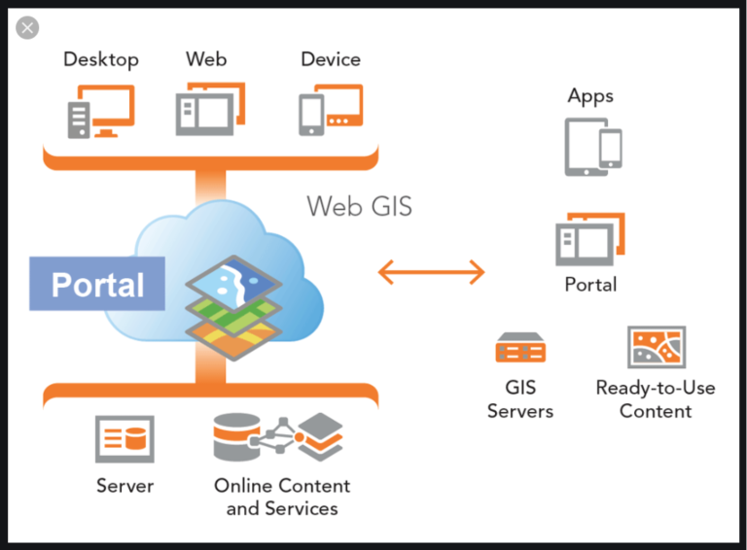
Operations Dashboard
For most situations ESRI’s online tools are enough to create dynamic eye catching displays to inform decision making.
However, the online
tool set is not HIPAA
compliant. ArcGIS
Enterprise provides
the same toolset as
ArcGIS Online, but
can be placed behind
institutional firewalls.

Slide 20
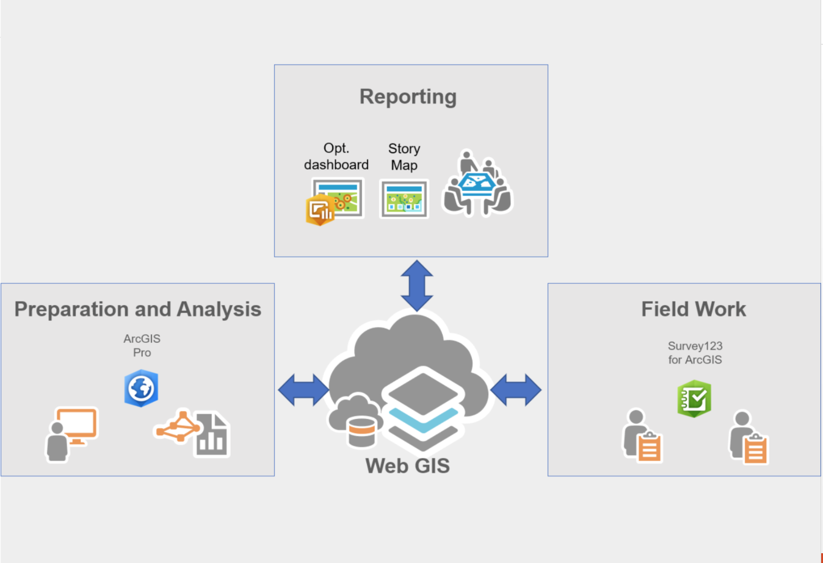
Operations Dashboard
The Goal!

Slide 21
Steps to organize a theoretical operations dashboard
https://www.esri.com/arcgis-blog/products/ops-dashboard/decision-support/configure-your-first-dashboard/

Slide 22
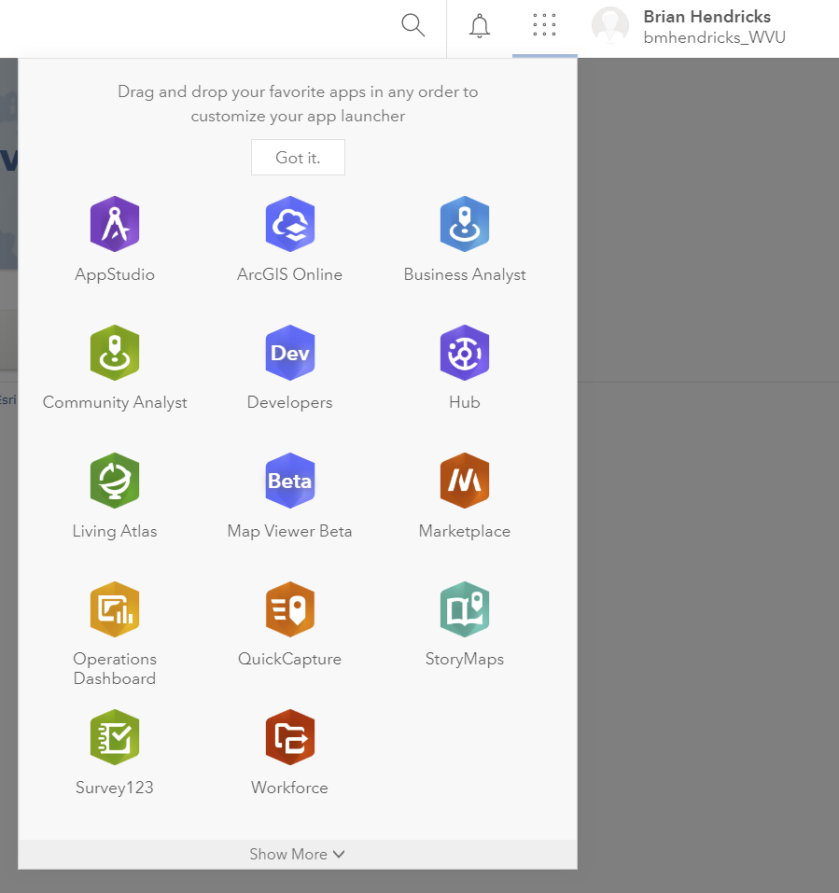
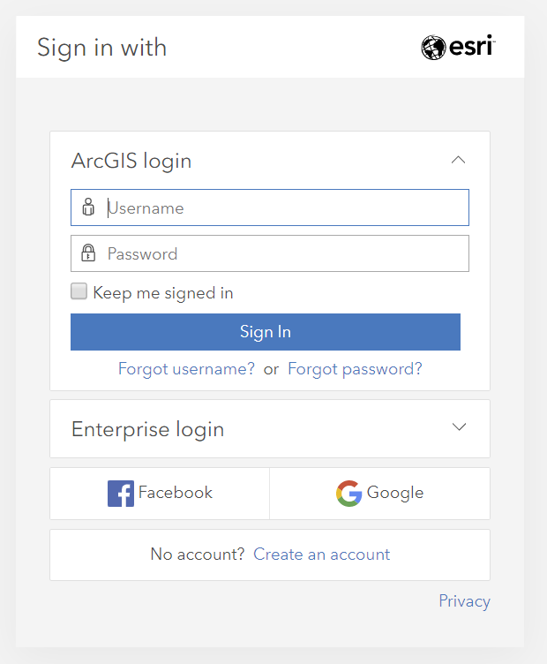
Step #1: Create a Dashboard
Log into ArcGIS Online (must have access)
Use app switcher to go to Operations Dashboard
Click Create, then give it a name and tags
Next

Slide 23
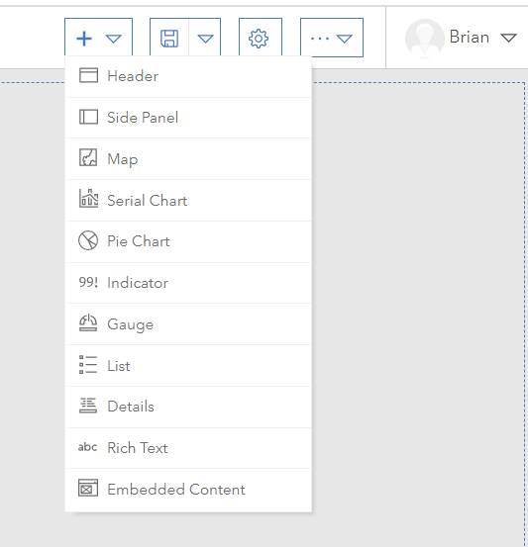
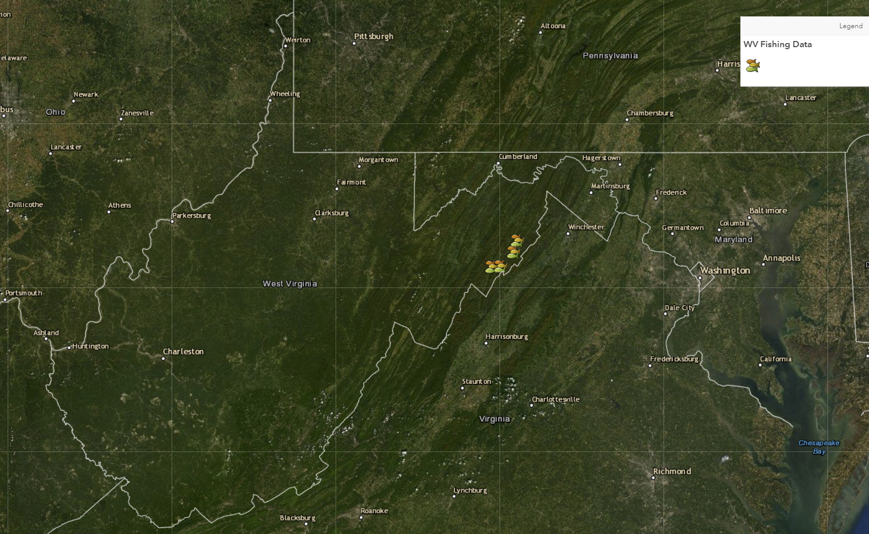
Step #2: Add Elements
Add your visuals
Configure: add scale, base map options, label, choose variables displayed.
Next
Featured Map: “WV Fishing Map”
Credit: WGIS_jaearle

Slide 24
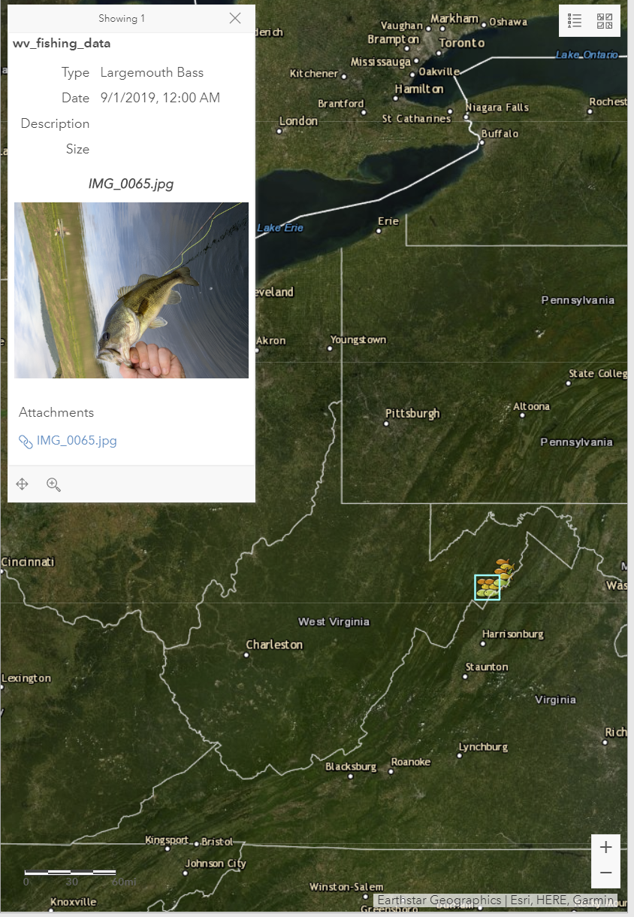
Step #2: Add Elements
For each element you can choose what information is displayed. Consider the information displayed for each fishing site in our example.
Type
Date caught
Image

Slide 25
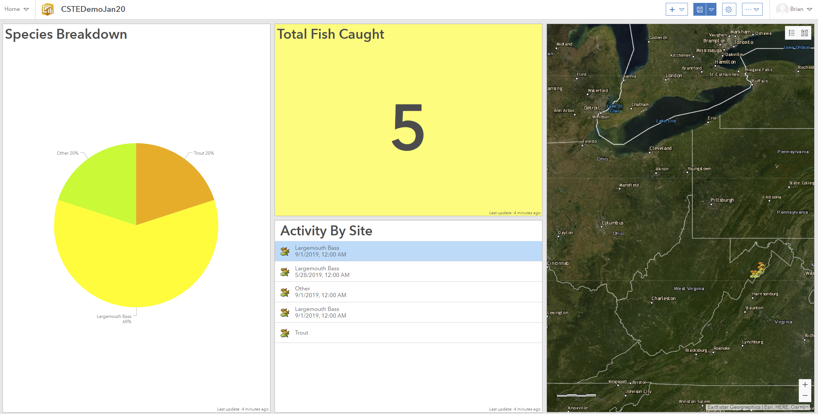
Step #3 Build the layout

Slide 26
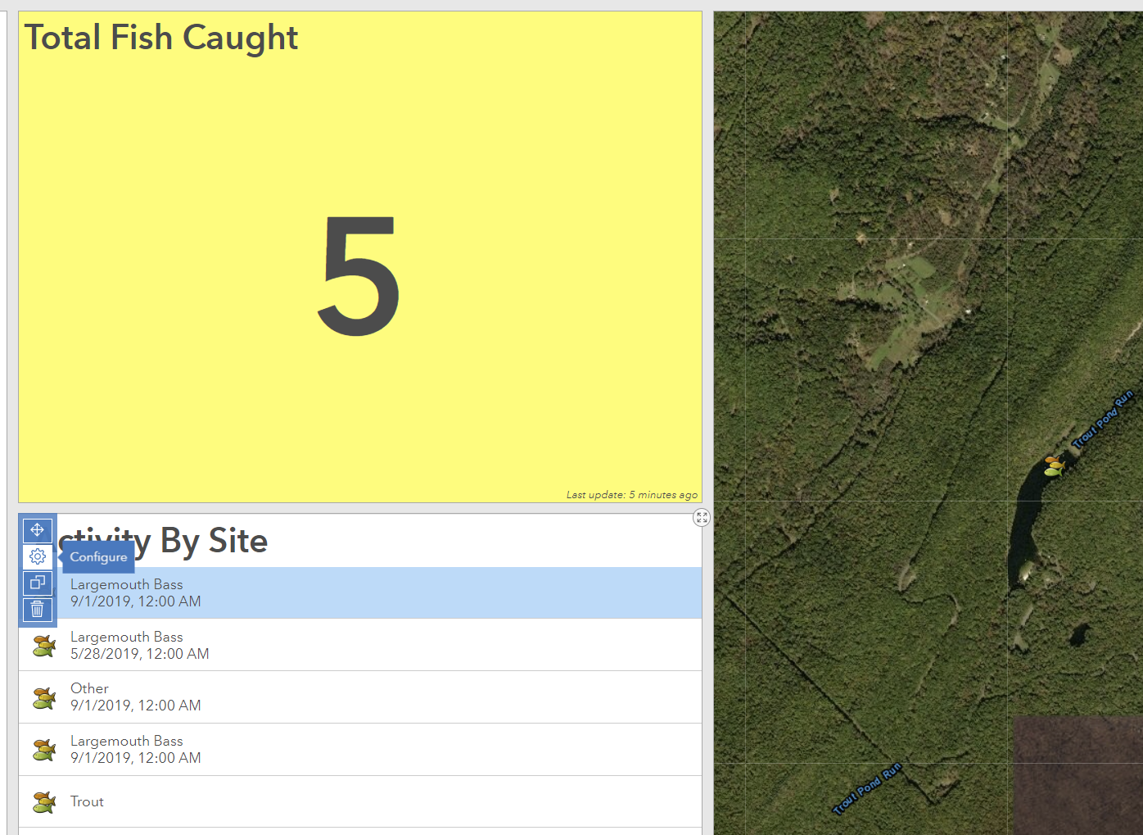
Step #4 Develop Interactivity
Hover over the top left corner of any tile and select the configure option.

Slide 27
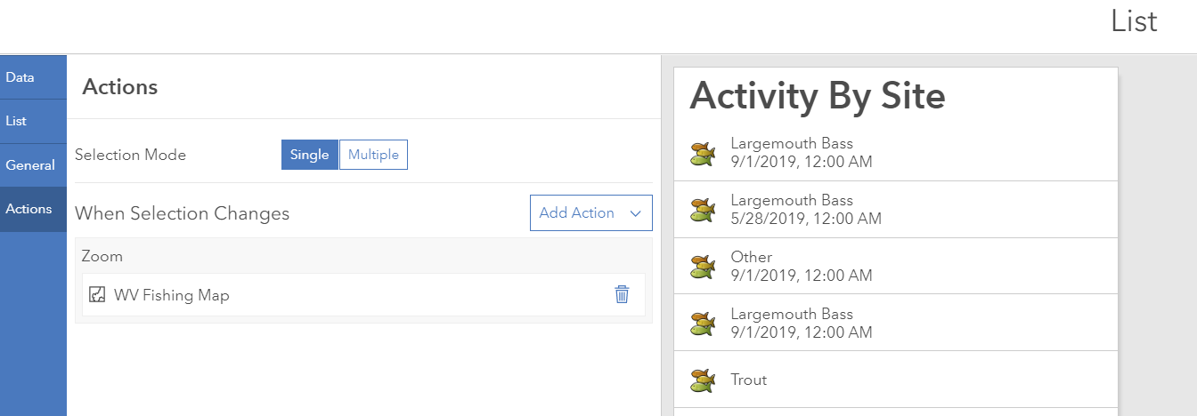
Step #4 Develop Interactivity
Select “Action” from the tasks on the left hand side
Click on “Add Action” drop down
Select action and choose the feature you want to interact with
Select Done
** Repeat for each of the elements.

Slide 28
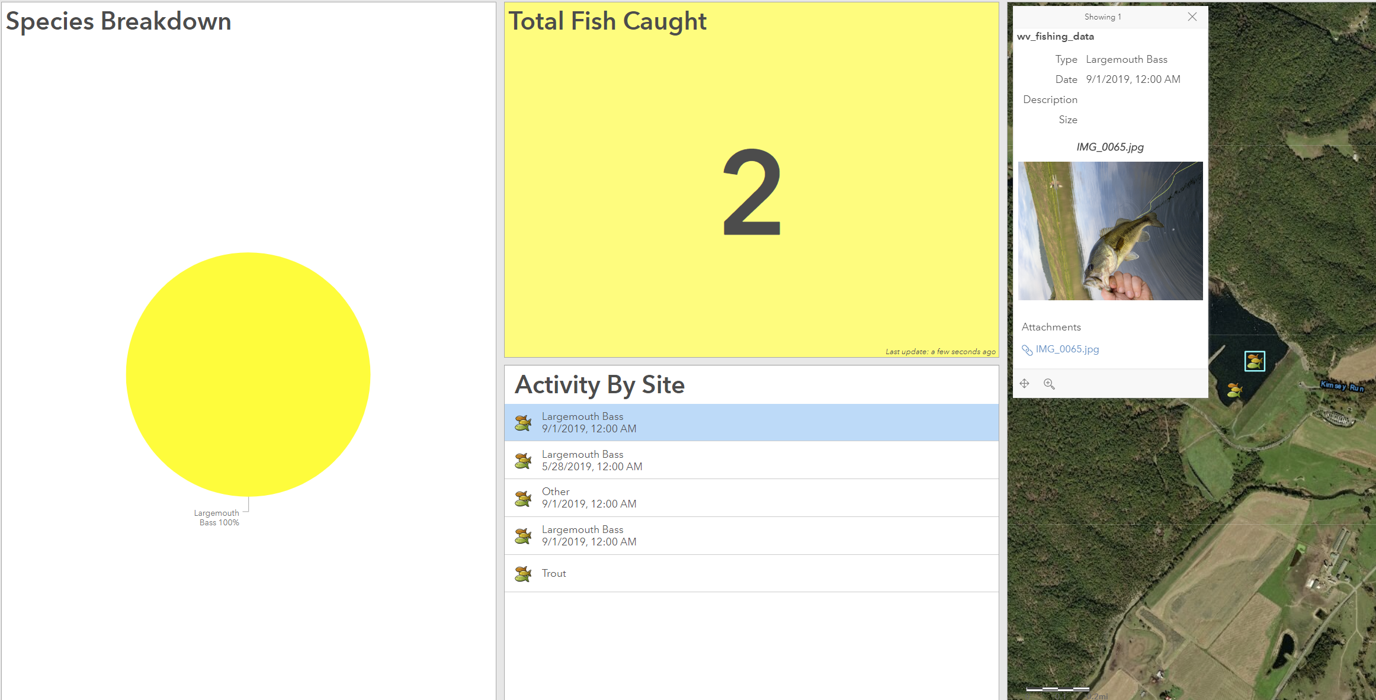
Step #4 Develop Interactivity
Now when we select a site all of the displays change to match that site’s specific attributes.

Slide 29
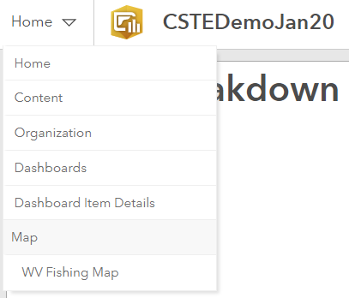
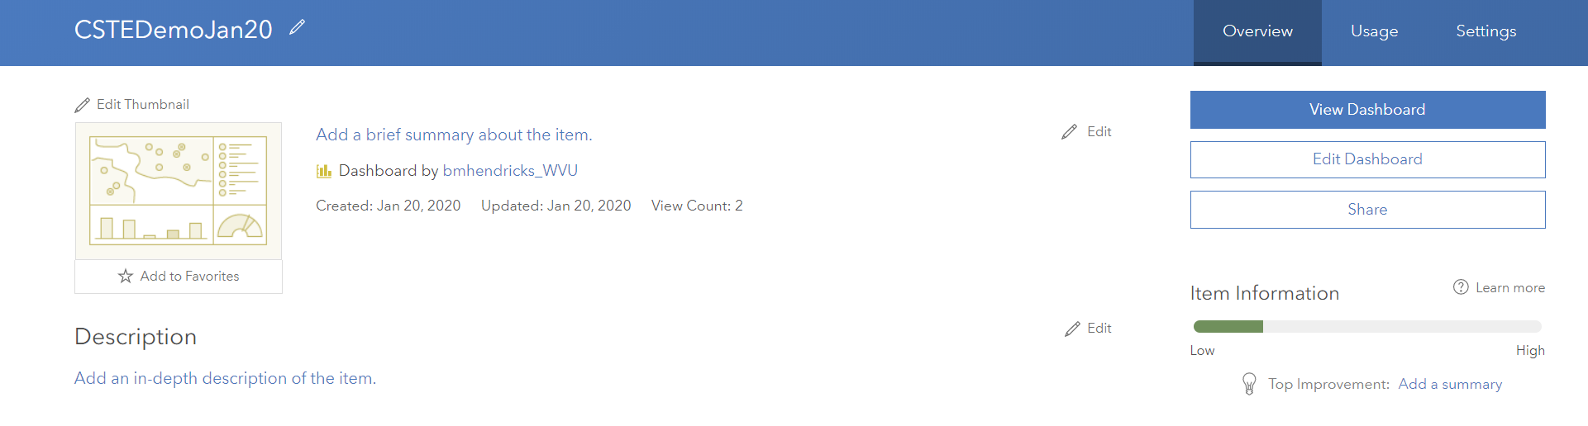
Step #5 Save, Test, Share
Top right corner click home
Select “Dashboard Item Details”
Click “Share” and Check “Everyone”
Now you can share link with all colleagues within your agency without them have to log onto ArcGIS Online
Next
http://www.arcgis.com/apps/opsdashboard/index.html#/1b1a8d3125d64aa5bf84004cb5a15ef4
Link to Publicly Viewable Dashboard We Just Created.

Slide 30
Thank You For Your Attention!
Contact information
Brian Hendricks, PhD
West Virginia University, School of Public Health
Department of Epidemiology
G103C Health Sciences Center North
304 –293-5256
bmhendricks@hsc.wvu.edu

