Slide 1
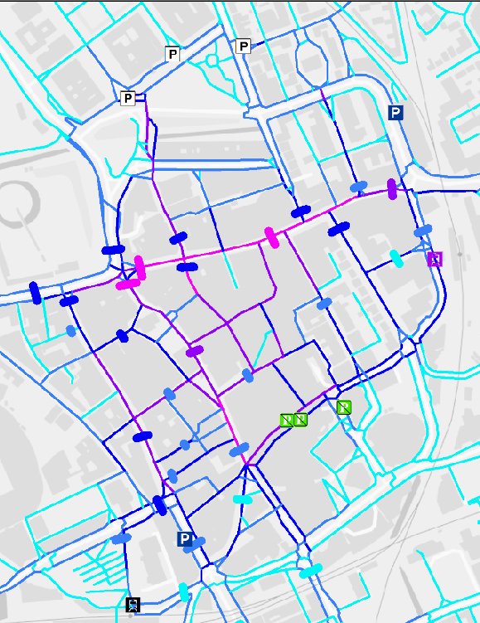
Spatial Network Analysis
Rany octaria

Slide 2




Antimicrobial Resistance
One of the biggest public health challenges in the US and worldwide
In the United States:
  ~2.8 million infections/ year
  ~35,900 deaths/year
https://www.cdc.gov/drugresistance/biggest_threats.html
Notes:
Let’s start with diving first into the concept of antibiotic resistance.
Antibiotic resistance is one of the biggest public health challenges in the US and , to a greater extent in developing countries. It’s a world wide problem.
Every year in the United States, about 2 million people acquired a serious infection from bacterias with resistance to more than one antibiotics, and it causes about 23,000 deaths.

Slide 3

CRE colonized 38% of patients for 1 year since discharged from hospitals
Patient sharing is a likely means of MDRO transmission
Centers for Disease Control and Prevention. Antimicrobial Resistance Threats. https://www.cdc.gov/drugresistance/pdf/threats-report/2019-ar-threats-report-508.pdf
Notes:
Among these MDROs, Carbapenem Resistant Enterobacteriaceae or CRE is one of the biggest threats in the world and United States. CDC in 2013 set CRE as an urgent level threat. This condition is reportable to public health in Tennessee. CRE is are bacterias that have become resistant to all or nearly all commonly available antibiotics. These infections causes 600 deaths a year in 2013, but this number is expected to have risen since. When you invasive CRE infections, mortality rate is higher than 40%.

Slide 4
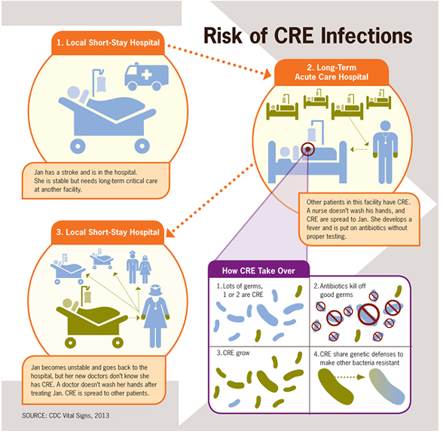
How Antimicrobial Resistance Spreads
Notes:
To illustrate the spread of CRE across healthcare facilities,
We are going to start off with an example case to illustrate how antimicrobial resistance spreads. Patient Jane Doe here in blue had a stroke and was admitted to a hospital.
Since her condition was serious, she was referred to a larger hospital with a stroke unit. In this large hospital, other patients in her unit were colonized with antimicrobial-resistant organisms. Her healthcare provider had bad hand hygiene and spreads these resistant bacteria to Jane. Jane is colonized with these resistant organisms. She becomes a carrier, but not yet sick.
After Jane’s condition improves, she was transferred to an inpatient rehab facility. There, her healthcare providers may spread Jane’s resistant bacteria to other patients if they have bad hand hygiene.
This illustrates how interfacility patient transfers are a common way for antimicrobial resistant organisms to spread.
Breach of infection control occurs either thru healthcare workers or environmental precautions.

Slide 5
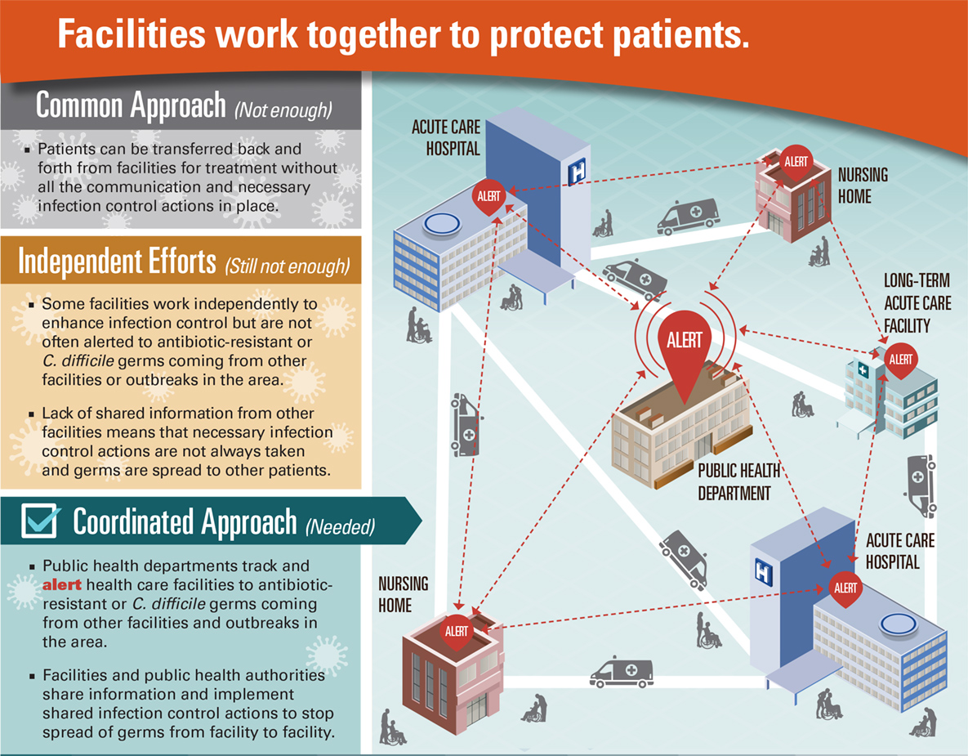
Significance of the Project
Coordinated CRE prevention is predicted to reduce CRE acquisitions by 74% in 5 years in a 102 facility network model
Slayton RB, Toth D, Lee BY, et al. Vital Signs: Estimated Effects of a Coordinated Approach for Action to Reduce Antibiotic-Resistant Infections in Health Care Facilities — United States. Morb Mortal Wkly Rep. 2015;64(30):826-831.
Notes:
Because interfacility patient transfers are important in the spread of CRE, it is important to expand the infection control strategies outside the barriers of the wall of each facilities. CDC has estimated using a mathematical model that a coordinated approach of CRE prevention could reduct CRE acquisitions by 74% In this coordinated approach, facilities not only improve the infection control strategies of their personel in the hospital, but public health departments track and alert Healthcare facilities to antibiotic resistant organisms that are coming from other facilities, and notify the facilities about outbreaks in the area.

Slide 6
BACKGROUND
Since 2016, the Tennessee (TN) Department of Health has been working to visualize the patient sharing network among hospitals to improve outbreak containment and identify collaborations
The geographical pattern of TN patient sharing network has not been analyzed, although network graph suggested geographical clustering and focal points in Nashville

Slide 7
Tennessee Patient Sharing Network

Slide 8
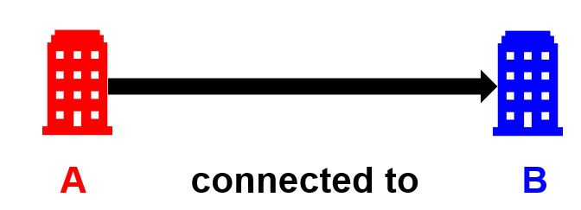

Patient Sharing Network
Mapping movement of patients across healthcare facilities (hospitals, nursing homes) through patient transfers, including direct and indirect transfers
Borgatti et al, 2003
Notes:
This is why as a public health entity, we started the effort to understand the patient movement across healthcare facilities in Tennessee using network analysis. In our network, we map patient movements across healthcare facilities, like nursing homes and hospital using historical patient transfers data.
Hospitals and nursing homes do not necessary know where their patients are admitted to during the 365 range.
Most hospitals have an idea of their “DIRECT TRANSFERS”

Slide 9

Direct Patient Transfer
A patient is discharged from one facility and then is admitted to another facility within 1 day
Notes:
And we define patient transfer a bit differently than the regular common definition.
A patient transfer occurs when
In this example, patient Jane Doe was admitted to hospital A on January 1, 2014, and discharged on February 1st. On June 1st, 4 months later, she was then admitted to hospital B.
Because of this transfer, hospital A is connected to hospital B.
This is an indirect transfer. The patient has had an intervening stay in the community before being admitted to the next facility.

Slide 10
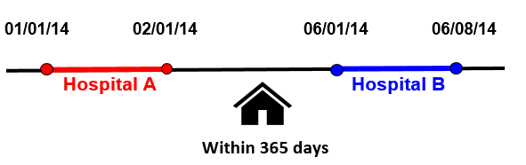
Indirect Patient Transfer
A patient is discharged from one hospital and then is admitted to another hospital within up to 365 days
Only consecutive admissions produces an edge
Notes:
A patient transfer occurs when
In this example, patient Jane Doe was admitted to hospital A on January 1, 2014, and discharged on February 1st. On June 1st, 4 months later, she was then admitted to hospital B.
Because of this transfer, hospital A is connected to hospital B.
This is an indirect transfer. The patient has had an intervening stay in the community before being admitted to the next facility.

Slide 11
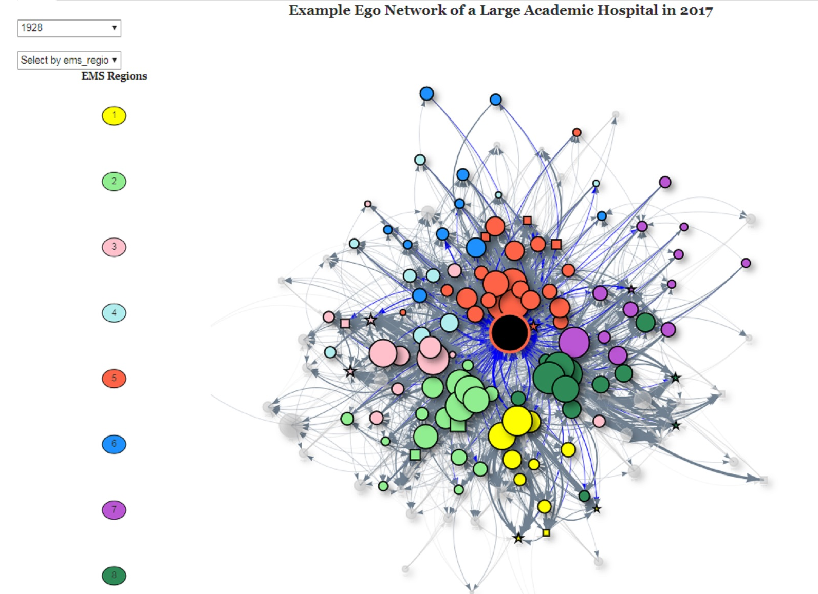
Current Visualization of TN Patient Sharing Network

Slide 12
Spatial Network Analysis
In urban environments & transportation systems, Euclidean distances are of limited use for understanding spatial relationships
“Least Cost Paths” are also of limited utility
People move through physical networks
Spatial network analysis provides tools for measuring and modeling movement, distance, time, & impedances through a network

Slide 13
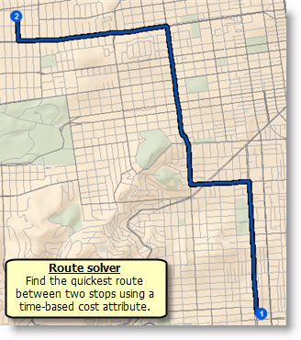
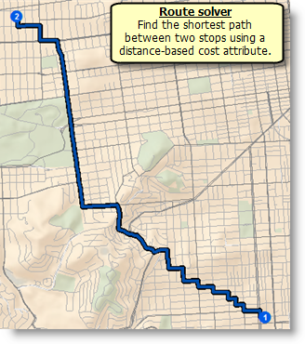
Least cost network path
(AKA least cost route modeling)
What’s the best route between two locations?
  By time
  By distance
From ANTH 8201, Wernke S. Vanderbilt University

Slide 14
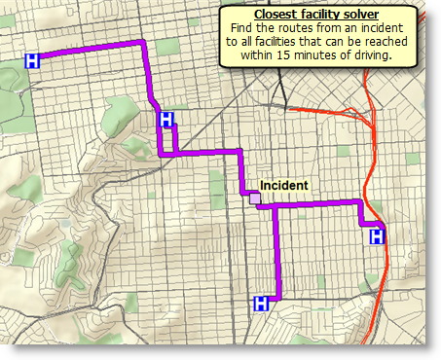
Closest facility
Find the closest “facility” (however you define it) through the network
Again, by distance or time
From ANTH 8201, Wernke S. Vanderbilt University

Slide 15
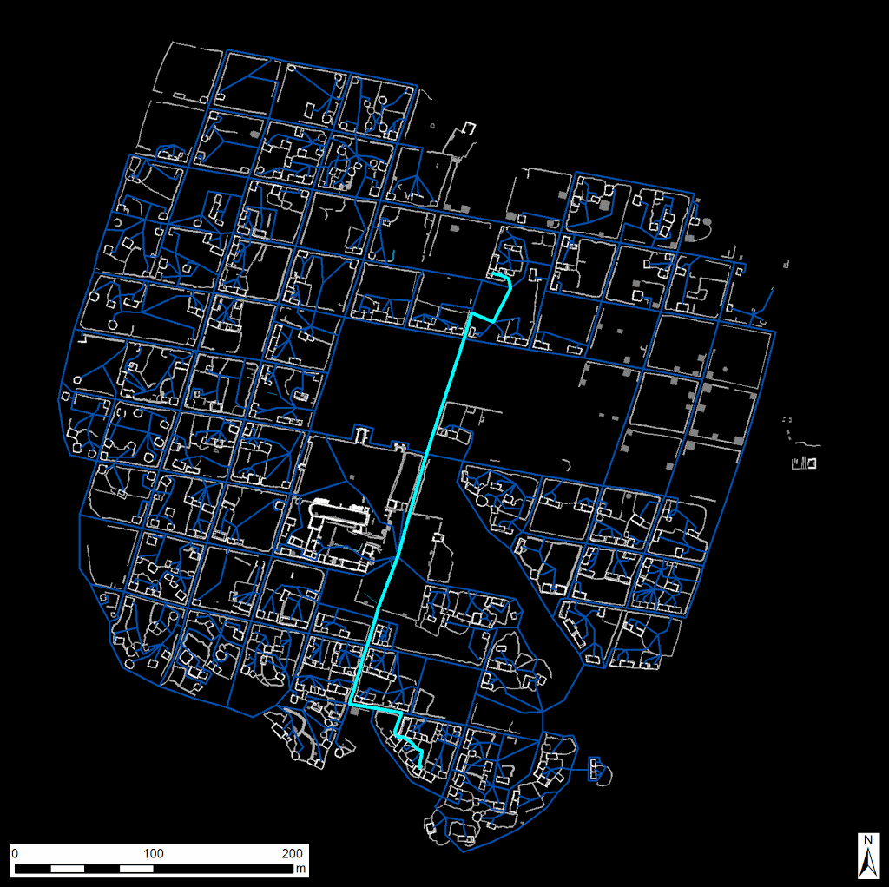
Least Cost Network Paths
(here as an everywhere to everywhere route matrix)
Example: an archeological site in Inka.
Aim: Looking to see possible central “hub” of civilization in the site and major roads.
473 x 507 origin|destination matrix = 239,338 routes
Network traffic: proportional to roofed area of houses of origin
Geoprocessing: spatial join of overlapping route segments, summed by population
From ANTH 8201, Wernke S. Vanderbilt University

Slide 16
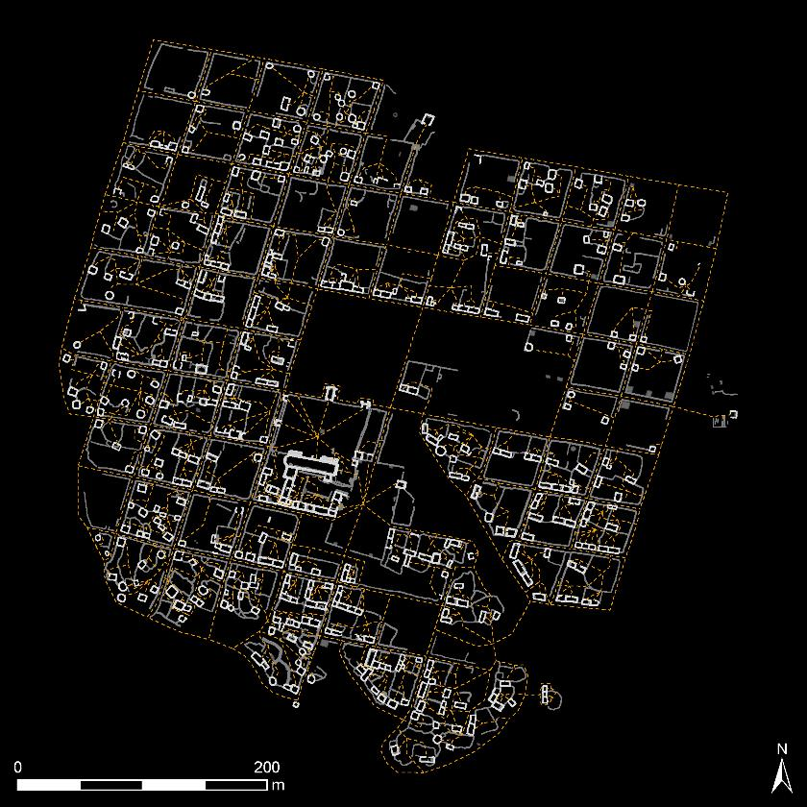
Everywhere-to-everywhere traffic density
Plazas are central! Especially the Plaza Real (Inka-era plaza)
Major thoroughfares include both major roads
Probable original entry to site
From ANTH 8201, Wernke S. Vanderbilt University

Slide 17
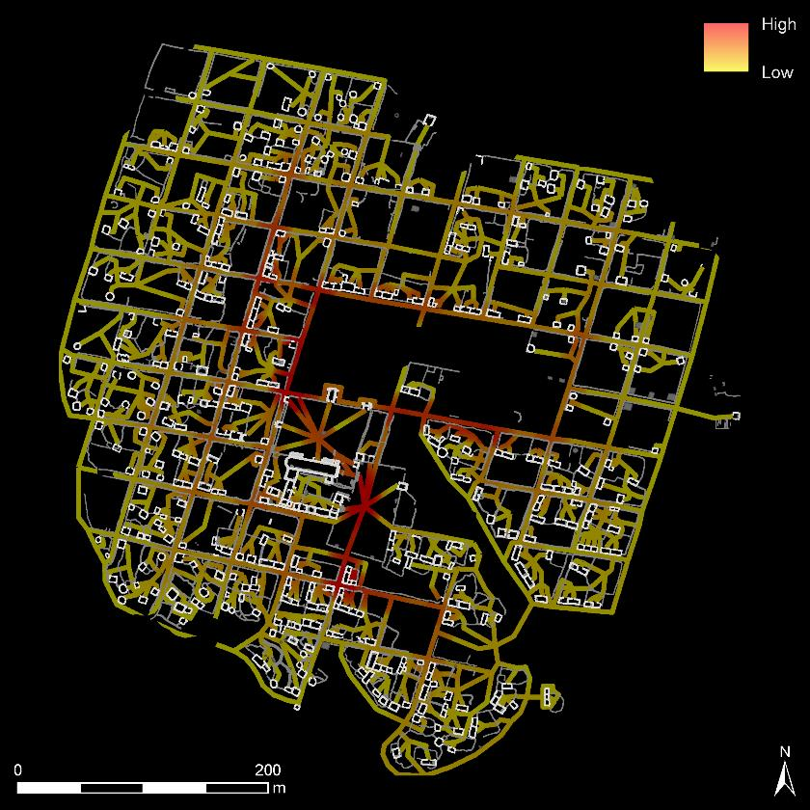
Everywhere-to-everywhere traffic density
Plazas are central! Especially the Plaza Real (Inka-era plaza)
Major thoroughfares include both “Calles Reales”
Probable original entry to site/Inka plaza
From ANTH 8201, Wernke S. Vanderbilt University

Slide 18
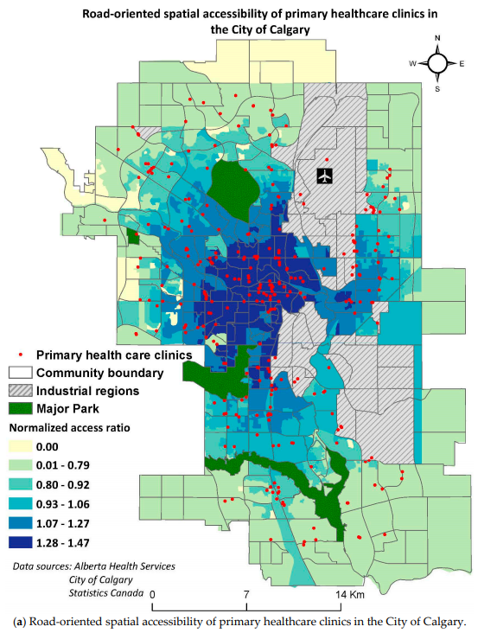

Slide 19
RESEARCH QUESTION
Where are the areas and hospitals with high patient sharing density in TN?
Does proximity play a larger role than Emergency Medical Services (EMS) region in patient sharing patterns?

Slide 20
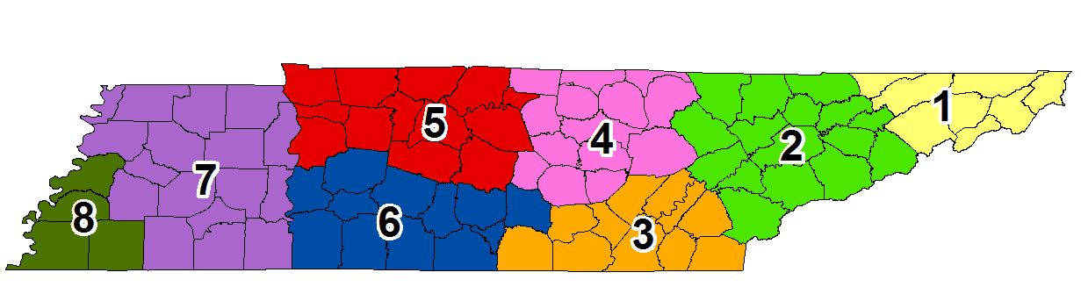
Understand whether geographical factors plays a role in patient sharing patterns. Hypothesis :
  Proximity plays a larger role in patient sharing patterns.
  Patient sharing occurs across the borders of Emergency Medical Services Region
Nashville
Knoxville
Memphis
Chattanooga
Notes:
Our objectives are to
To do this, we are going to use social network analysis (SNA)
The 154 TN facilities include ACH, LTACHs and Inpatient Rehab Facilities (IRFs), and psychiatric facilities.

Slide 21
Data Source
Patient Sharing Data from the TN Hospital Discharge Data in 2017
  Include 886,277 admissions to 157 TN hospitals
  Each hospital pairs considered to share patients based on indirect transfers → when a patient is discharged from a hospital and spend up to 365 days in the community before being admitted to another hospitals.
Street Shapefiles from OpenStreetMaps.org

Slide 22
Patient Sharing Edgelist
Sender Hospital ID | Receiver Hospital ID | COUNT
120 | 120 | 0
120 | 221 | 2
120 | 322 | 0
120 | 421 | 0
120 | 520 | 18
120 | 540 | 61
120 | 622 | 16
120 | 623 | 1
120 | 724 | 45
120 | 725 | 11
120 | 821 | 0

Slide 23
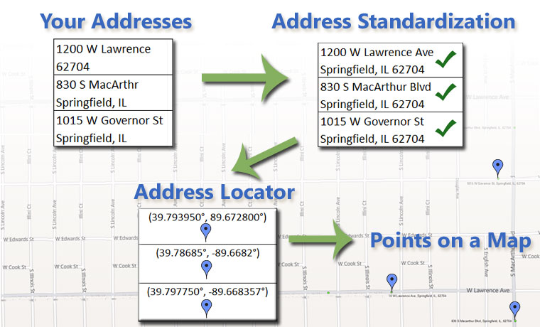
STEP 1
GEOCODING HOSPITAL ADDRESSES

Slide 24
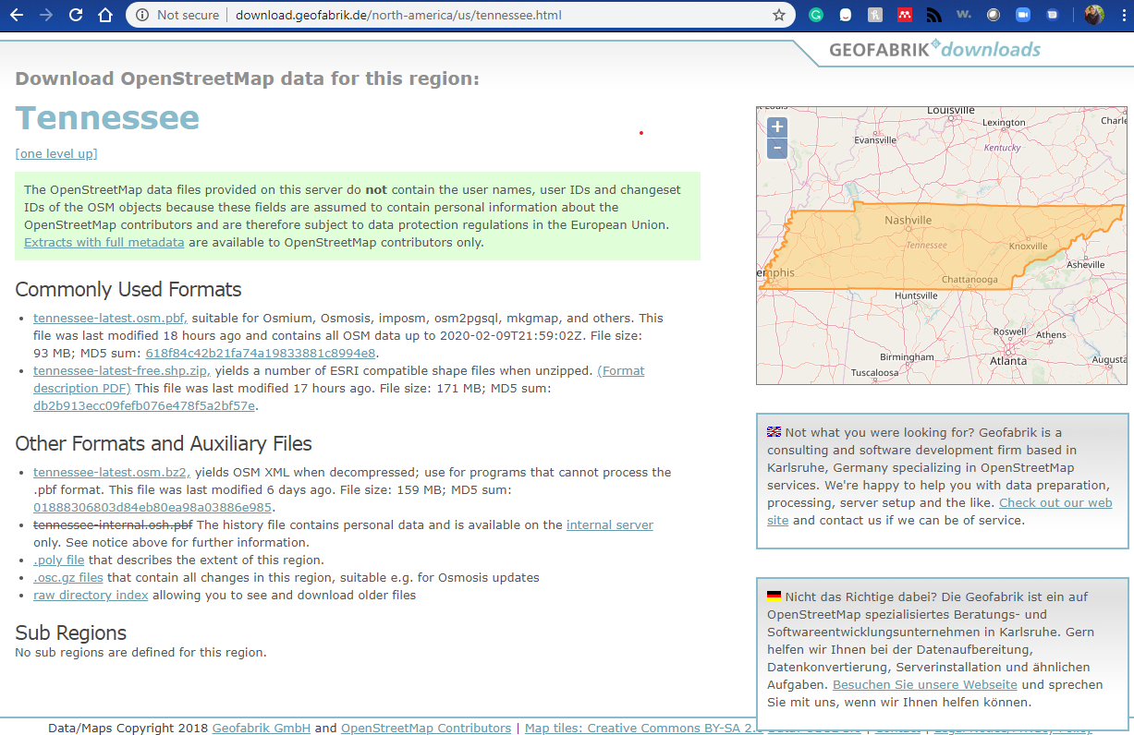
Download Street Data
Other sources: https://www.census.gov/geographies/mapping-files/time-series/geo/tiger-line-file.html

Slide 25
METHODS
Generate and dissolve street network dataset
Create a “from everywhere to everywhere” routes between all hospitals using closest facilities
Join routes with patient sharing statistics table
Line Density (Kernel Density method) of Network Routes using number of patients traveled in routes
Extract expected transfer raster values to hospitals and routes (zonal statistics)

Slide 26
RESULTS

Slide 27
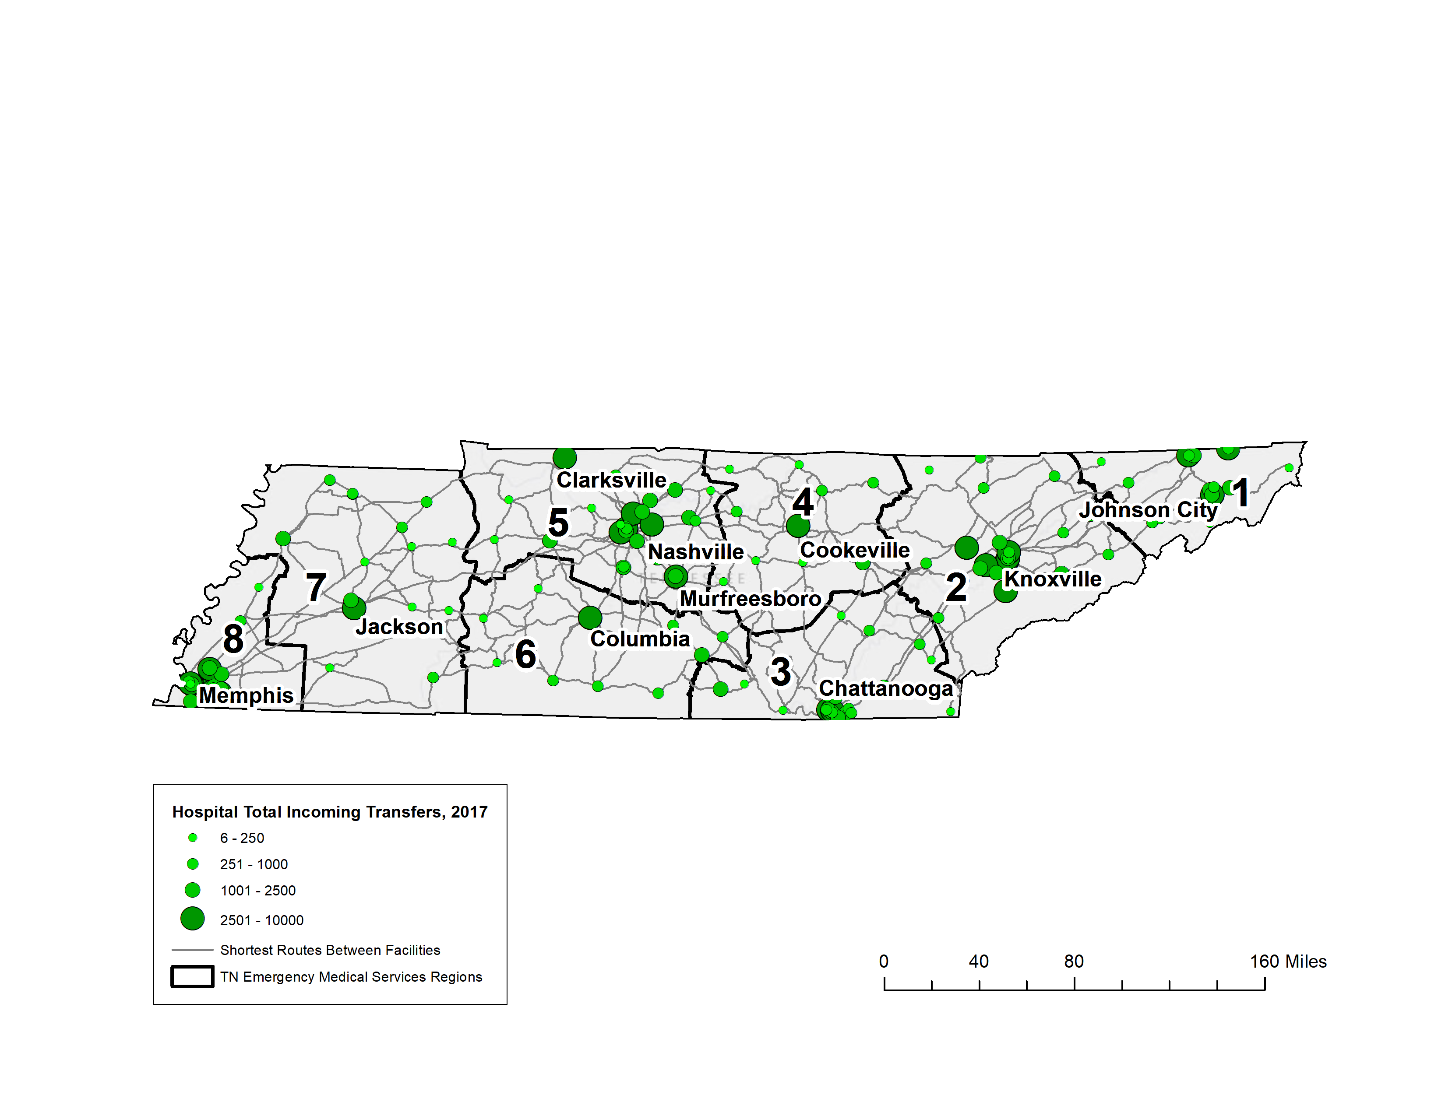
Total Incoming Indirect transfers within 365 days of each TN Hospitals in 2017

Slide 28
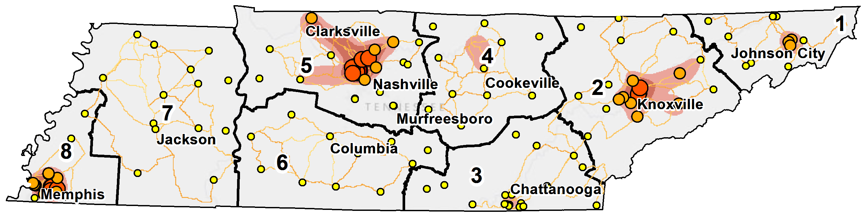
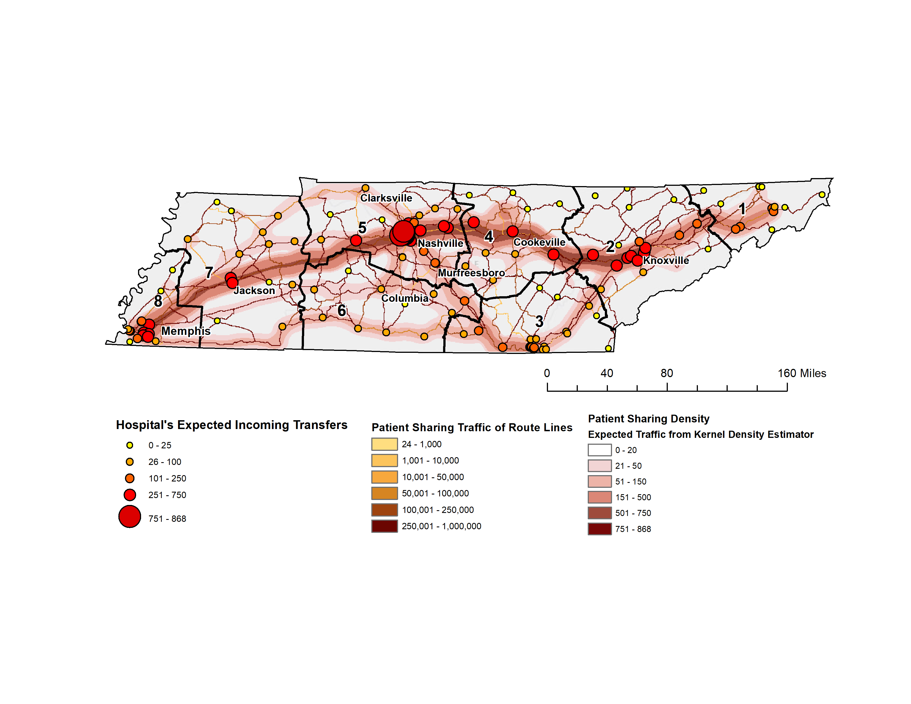
Spatial network of patient Sharing among TN Hospitals within the same EMS Region

Slide 29
Spatial network of patient Sharing among TN Hospitals with a Hospital in a Different EMS Region

Slide 30
RESULTS
High density Intra- and Interregional Transfers only in EMS Region 5, 2 and 8
Some EMS region only has high interregional transfers, despite having a large facility
Nashville and Knoxville shows high interregional transfer traffic, followed by Nashville, Memphis, and Jackson

Slide 31
DISCUSSION
Cities connected through the I-40 more connected to each other than those connected through I-24.
  Highest connectivity: Nashville and Knoxville
  Role of Nashville in TN patient sharing network
Some smaller hospitals in region 4, 6 and 7 more connected to larger hospitals in a different EMS region than to a larger facility its own EMS region
Patients discharged from hospitals near the border (Chattanooga and Memphis) may be re-admitted to out-of-state hospitals

Slide 32
ACKNOWLEDGEMENTS
Dr. Steve Wernke and James Zimmer-Dauphinee for their guidance and assistance throughout the semester; Dr. Marion Kainer for her mentorship; Karen Bury and the rest of TDH HAI Team

Slide 33
Centers for Disease Control and Prevention. Antibiotic Resistance Threats in the United States. 2013. Available at: https://www.cdc.gov/drugresistance/threat-report-2013/pdf/ar-threats-2013-508.pdf. Fernández-Gracia J, Onnela J-P, Barnett ML, Eguíluz VM, Christakis NA. Spread of Pathogens in the Patient Transfer Network of US Hospitals. Springer, Cham, 2017: 271–280. Available at: http://link.springer.com/10.1007/978-3-319-60240-0_33. Accessed 27 February 2019.
ESRI. Route Analysis. Available at: http://desktop.arcgis.com/en/arcmap/latest/extensions/network-analyst/route.htm. Accessed 26 February 2019.
Haverkate MR, Weiner S, Lolans K, et al. Duration of Colonization With Klebsiella pneumoniae Carbapenemase-Producing Bacteria at Long-Term Acute Care Hospitals in Chicago , Illinois. Open Forum Infect Dis 2016; :1–4.
Simmering JE, Polgreen LA, Campbell DR, Cavanaugh JE, Polgreen PM. Hospital Transfer Network Structure as a Risk Factor for Clostridium difficile Infection. Infect Control Hosp Epidemiol 2015; 36:1031–1037
Chatterjee, S. Calculating density on a network: a comparison of Network KDE and Planar KDE. https://www.esri.com/arcgis-blog/products/analytics/analytics/calculating-density-on-a-network-a-comparison-of-network-kde-and-planar-kde/.

