Slide 1

Health and Health Determinants Metrics for Cities: A Comparison of County versus City-level Data
Department of Population Health
Ben R Spoer, MPH, PhD
Manager of Metrics and Analytics, City Health Dashboard
Department of Population Health
NYU School of Medicine
November 17th, 2020
Council of State and Territorial Epidemiologists Spatial Analysis Workgroup Meeting

Slide 2


Our goal is to help cities across the U.S. leverage the power of data to improve the health and well-being of everyone in their community.
Notes:
Our goal is to help cities across the U.S. leverage the power of data to improve the health and well-being of everyone in their community.
From Carol: We are here with the ultimate purpose of helping Mayors, city leaders and others to improve the health of their citizens.
Our goal is to help cities across the U.S. leverage the power of data to improve the health and well-being of everyone in their community.

Slide 3

What
Gets Measured
Gets Done
Notes:
This is an old adage but is true. There are changes that are made from emotion but hard data is what helps move the needle. Seeing is believing.

Slide 4
The Challenge

Slide 5

US cities are responsible for many strong influences on health
Safe and affordable housing
Smoking policies
Access to healthy food
Walkability
Notes:
We heard from city leaders that there was a lack of data at the city and neighborhood level clearly showing which factors have the greatest influence on their community’s health and well-being……

Slide 6

Gary, IN
What does health look like in your city?
Graphic modified from Map of Indiana with Counties - Single Color by FreeVectorMaps.com

Slide 7

Lake
County
Gary, IN
INDIANA
Many cities
do not know.
Most health-related data exists only
at the county or
state level.
Graphic modified from Map of Indiana with Counties - Single Color by FreeVectorMaps.com

Slide 8


Without data cities are making decisions in the dark
Notes:
Deleted: the quote Cities Can’t Manage What Can’t be Measured
This is an old adage but is true. There are changes that are made from emotion but hard data is what helps move the needle. Seeing is believing.

Slide 9
City Health Dashboard
Empowering Cities to Create Thriving Communities
Notes:
The result: a resource to improve health and create thriving communiites…

Slide 10

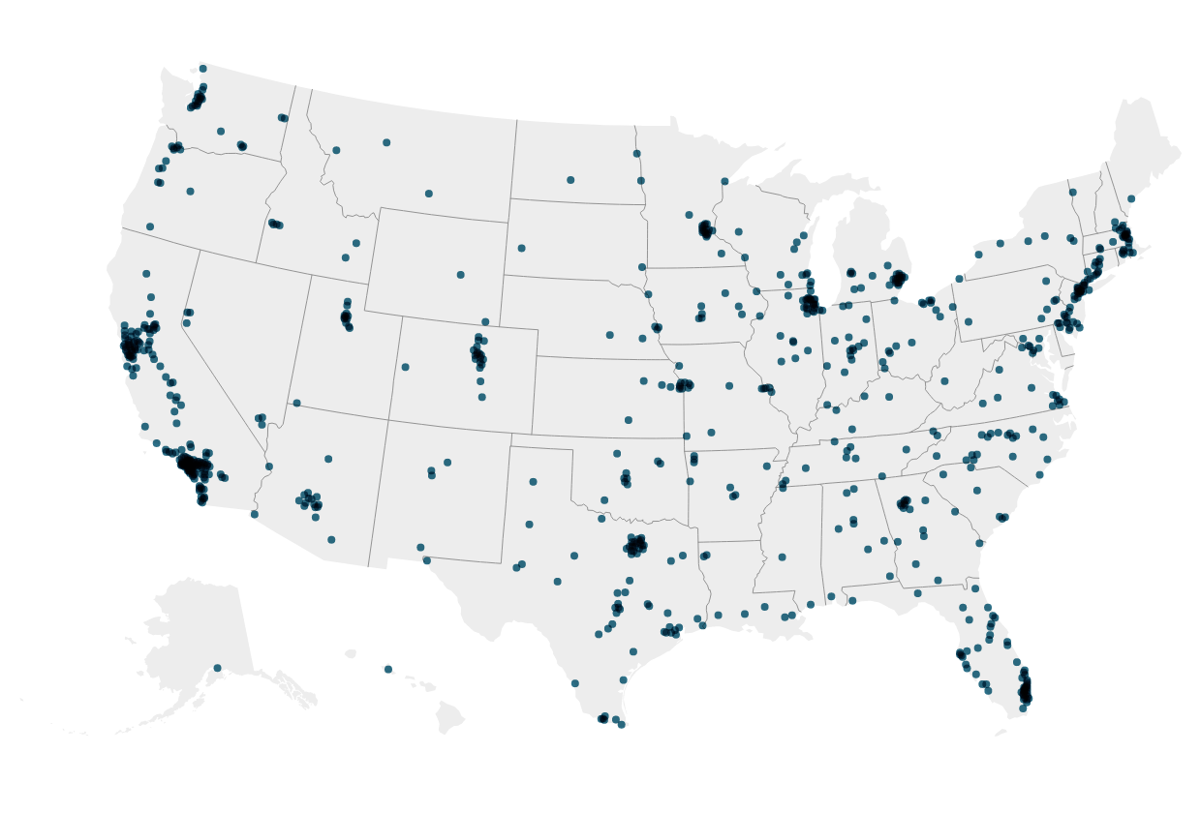
Over 35 measures of health, the factors that shape health, and the drivers of health equity to guide local solutions for 750+ U.S. cities.
Notes:
The Dashboard launched in May of 2018. It was developed by our team at NYU School of Medicine Dept. of Population Health in close collaboration with NYU Wagner School, NRN, NLC, and ICMA. We also worked closely with our city partners, to create an easy to use, one stop resource to help create healthier and more equitable communities.

Slide 11
Power of the Dashboard
Pinpoint social and economic influencers
of healthy and thriving communities
Spark collaboration
and create cross-sector partnerships
Take action
so everyone has the same opportunity
to live a long and healthy life
Notes:
Developing proposals, applications, reports
Prioritizing resource allocation
Making the case for health
Democratizing data access across communities
Partnering with other tools for action
Advancing collective impact
Bringing place into projects
Building real cross-sectoral networks
Promoting systems thinking

Slide 12
Measure
Selection Criteria
National datasets
Rigorous methods underlying original data collection
Reflect public health priorities
Amenable to city-level intervention
Updated regularly
Balanced across 5 over-arching domains

Slide 13
Measures by Category
Clinical
Care
Health
Behaviors
Physical
Environment
Health
Outcomes
Social and Economic Factors
Notes:
Notes: Give example of how city has uncovered/used a specific measure

Slide 14
Clinical Care
Prenatal care | NVSS
Primary care physicians | AMA
Preventive services | 500 Cities (BRFSS)
Dental care | 500 Cities (BRFSS)
Uninsured | ACS
Notes:
Notes: Give example of how city has uncovered/used a specific measure

Slide 15
Health Behaviors
Teen Births | NVSS
Smoking | 500 Cities (BRFSS)
Binge Drinking | 500 Cities (BRFSS)
Physical Inactivity | 500 Cities (BRFSS)

Slide 16
Measures by Category
Clinical Care
Health Behaviors
Health Outcomes
Dental care
Prenatal care
Preventive services
Primary care physicians
Uninsured
Binge Drinking
Physical Inactivity
Smoking
Teen Births
Breast cancer deaths
Cardiovascular disease deaths
Colorectal cancer deaths
COVID Local Risk Index
Diabetes
Frequent physical distress
Frequent mental distress
High blood pressure
Life expectancy
Low birthweight
Obesity
Opioid overdose deaths
Premature deaths (all causes)
Social and Economic Factors
Physical Environment
Absenteeism
Children in poverty
High School Graduation
Housing cost, excessive
Income inequality
Neighborhood racial/ethnic segregation
Racial/ethnic diversity
Third-grade reading proficiency
Unemployment
Violent Crime
Air pollution – particulate matter
Housing with potential lead risk
Lead exposure risk index
Limited access to healthy foods
Park access
Walkability
City level
Neighborhood level

Slide 17
A Comparison of County versus City-level Data
Department of Population Health

Slide 18
The need for city-specific data
Many local health departments develop city-level public health policies but lack city-level health data
Local health departments may rely on county-level data in this situation

Slide 19
Research question
Does the use of county-level data to understand public health needs in cities yield biased profiles of city health?

Slide 20
Spatial Methods
Population: US cities with 2010 population of at least 66,000
  To ensure all states were represented, three smaller cities (Burlington, Vermont; Cheyenne, Wyoming; and, Charleston, West Virginia) were included
Sample: The 447 Dashboard cities that are nested within their surrounding counties.
  Nested means that a minimum of 90% of the city population resides within the surrounding county, omitting the 53 cities that overlapped, or shared, county boundaries

Slide 21
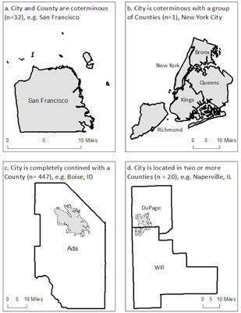

Slide 22
Metric Selection
We compared four metrics across city-county pairs
Two demographic measures associated with population health outcomes
  Percent non-Hispanic Black population
  Percent of children living in poverty
Two core public health outcome measures
  Life expectancy at birth
  Cardiovascular disease death rate per 100,000 population

Slide 23
Analytic Methods
Percent non-Hispanic Black and percent of children living in poverty data were provided by US Census American Community Survey, 2018 5-year estimates
CVD Death rate data were provided by CDC. City data were obtained via a data use agreement with NCHS and county data were provided by WONDER
  We defined CVD deaths using a standard group of ICD-10 (International Classification of Disease, Revision 10) codes, with certain codes removed because their etiology differs substantially from that of more typical CVD mortality: I00–02 (acute rheumatic fever), I00–09 (chronic rheumatic heart diseases), I26–28 (pulmonary heart disease), and I30-I51 (other forms of heart disease)
Life expectancy was provided by the US Small-area Life Expectancy Estimates Project at the tract-level. City and county values were calculated used tract population-weighted means in consultation with USA LEEP

Slide 24
Results description
Analysis included 73.9% of the Dashboard population and 23.3% of the US population
Estimates for CVD mortality, the percent of non-Hispanic Black population, and the percent of children living in poverty were, on average, higher in cities than in counties
Most city–county pairs had meaningful absolute and relative differences for these 3 metrics
  Consistent with previous literature, absolute differences over 5% and relative differences over 15% were considered meaningful
Life expectancy was longer, on average, in cities, but for most city—county pairs differences were not considered meaningful

Slide 25
Table. Average Difference Between City and County Estimates for 4 Public Health Metrics in Large US Cities Completely Contained in their Counties (N = 447)
Metric | Overall Metric Values |  | City–county Pair Comparisons
 | City, Mean (SD) | County, Mean (SD) | Mean Difference (SD) | Range | City–County Pairs with Meaningful Absolute Difference (> 5%) | City–County Pairs with Meaningful Relative Difference (> 15%)
Cardiovascular disease deaths (per 100,000) | 210.42 (58.79) | 180.27 (34.47) | 30.15 (46.68) | −39.10 to 268.80 | 380 (85.0%) | 250 (55.9%)
Children in poverty, no. (%) | 23.49 (11.34) | 20.84 (7.08) | 2.65 (9.65) | −31.27 to 31.03 | 416 (93.0%) | 342 (76.5%)
Non-Hispanic Black, no. (%) | 13.88 (15.51) | 11.43 (10.96) | 2.45 (10.43) | −35.17 to 56.30 | 422 (94.4%) | 366 (81.9%)
Life expectancy | 78.95 (2.28) | 78.77 (2.00) | 0.18 (1.23) | −4.20 to 5.60 | 13 (2.9%) | 7 (1.6%)
Analysis of city-level data cardiovascular disease death rates required restricted data, which were accessed through the National Vital Statistics System’s Research Data Center. The findings and conclusions in this paper are those of the authors and do not necessarily represent the views of the Research Data Center, the National Center for Health Statistics, or the Centers for Disease Control and Prevention

Slide 26
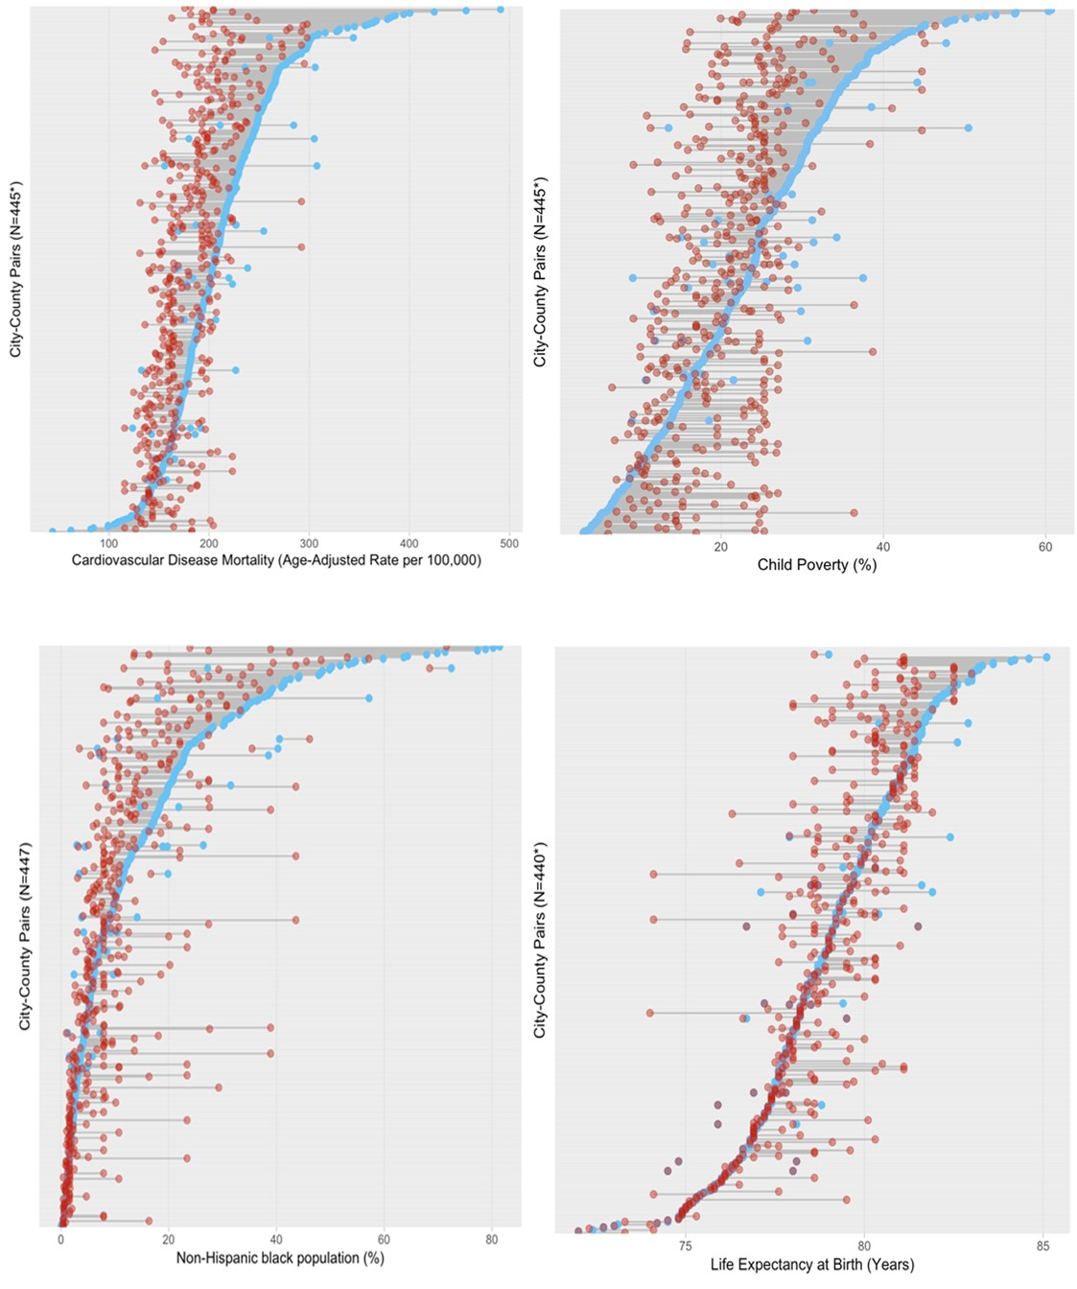
Notes:
CITIES are BLUE!

Slide 27
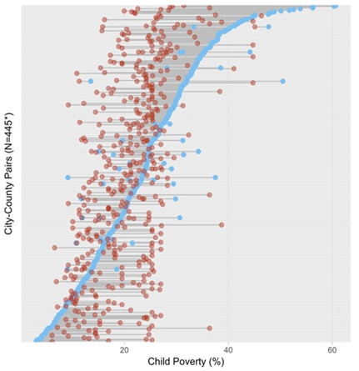
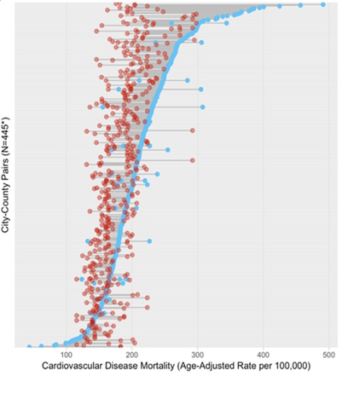

Slide 28
Discussion
Although the general tendency was toward underrepresentation of poorer health outcomes when county-level metrics were compared with city-level metrics, there was substantial variation in observed differences.
As key public health actors, cities’ reliance on county-level estimates could in some cases attenuate the apparent need for action and resources.

Slide 29
Conclusion
Geographically granular data is increasingly available for cities from numerous sources, including the City Health Dashboard (www.cityhealthdashboard.com)
Cities should use such data whenever possible
The use of granular data should result in more accurately targeted interventions and programs, which can contribute to better overall health outcomes

Slide 30








Stay in touch
  @CityHealthData
  @CityHealthData
  info@cityhealthdashboard.com
  www.cityhealthdashboard.com

