Slide 1
Using ArcGIS Story Maps to display health assessment data
Kathleen Lovgren, MPH
Epidemiologist
Clark County Public Health
Vancouver, WA
11.17.2020 CSTE Spatial Analysis Workgroup Meeting

Slide 2
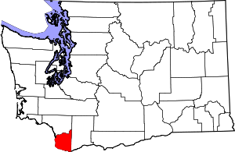

Clark County, Washington
Population: 488,500
Portland, OR metropolitan area

Slide 3
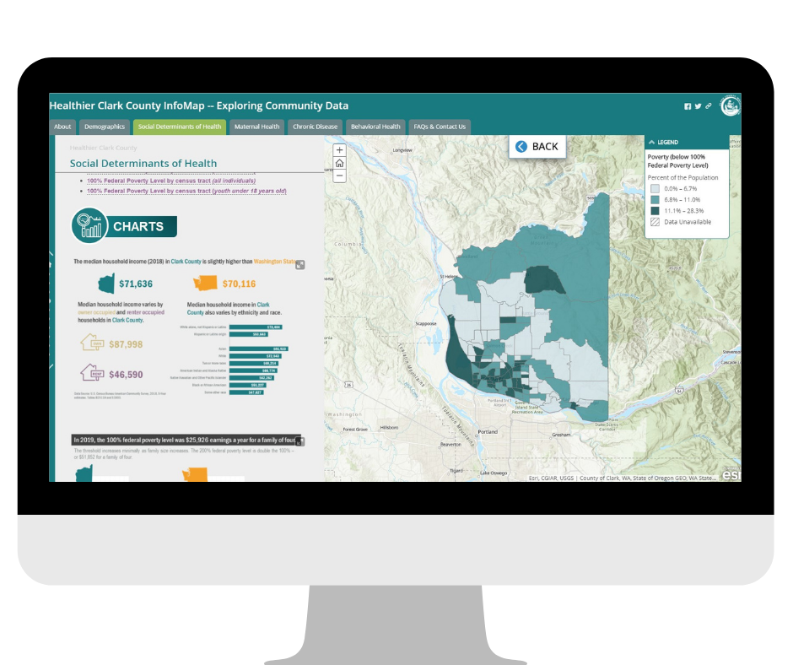
Healthier Clark County InfoMap
Product of Clark County Public Health’s Health Assessment & Evaluation team
Visual and interactive way to explore health assessment data
ESRI’s Story Maps
https://clark.wa.gov/InfoMap

Slide 4




Healthier Clark County InfoMap
Useful for:
Public
Community partners
Non-profits
Policy makers
Our own county staff
Understand factors that influence the health of communities in Clark County.
Inform decision making and strategic planning.
Use data to support work and incorporate into grant applications.
Implement change that will benefit the health of the community.

Slide 5
Thank you!
Kathleen.Lovgren@clark.wa.gov
Healthier Clark County InfoMap: https://clark.wa.gov/InfoMap
Demo video: https://clark.wa.gov/public-health/healthier-clark-county-infomap

