Slide 1
Census Tract Mapping Methods: Visually Balanced Cartograms and the Urban Census Tract Invisibility Problem in Washington State
Notes:
This presentation covers a data visualization method as opposed to a presentation on a research study.

Slide 2

Visually Balanced Cartograms
Christopher Ahmed, MPH
Spatial Epidemiologist
WA State Department of Health
christopher.ahmed@doh.wa.gov

Slide 3
Visually Balanced Cartograms: The Problem

Slide 4
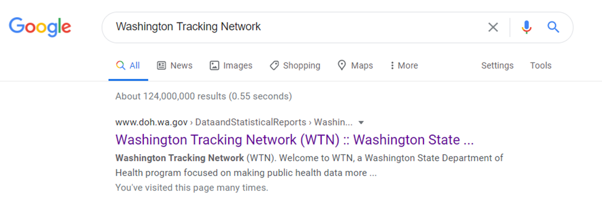
Visually Balanced Cartograms: The Problem

Slide 5
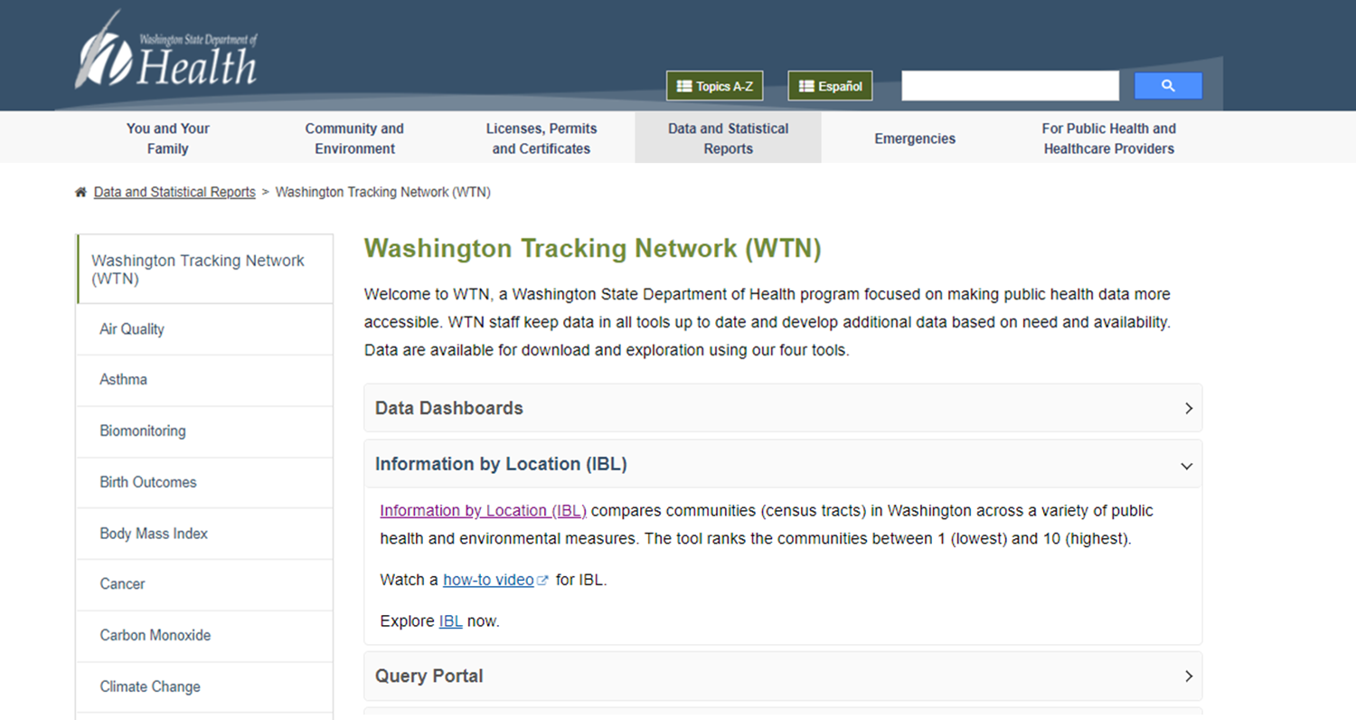
Visually Balanced Cartograms: The Problem

Slide 6
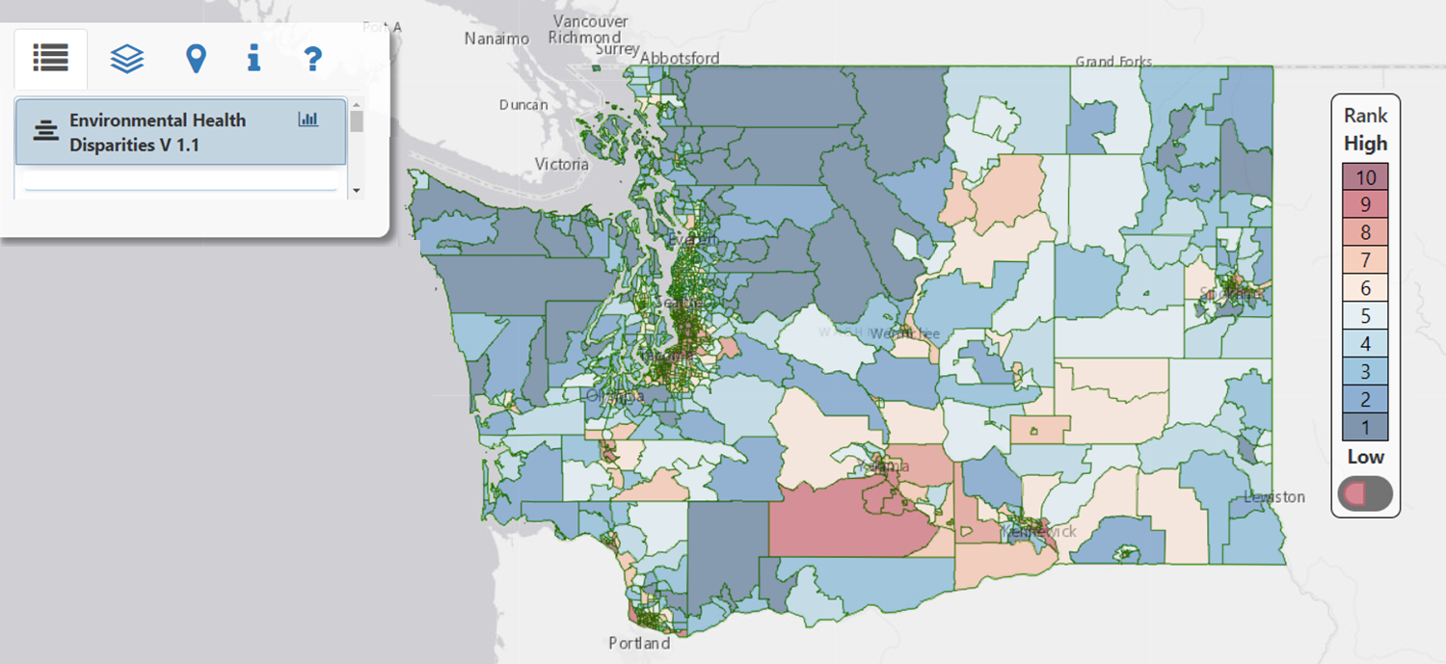
Visually Balanced Cartograms: The Problem

Slide 7
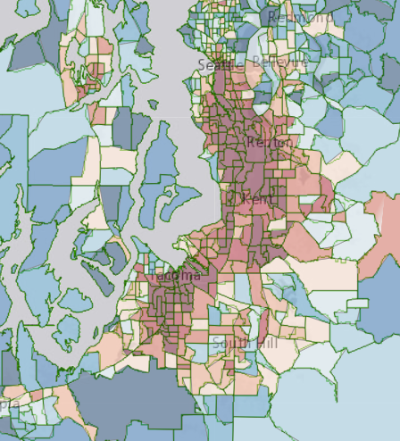
Visually Balanced Cartograms: The Problem

Slide 8
Visually Balanced Cartograms: The Problem

Slide 9
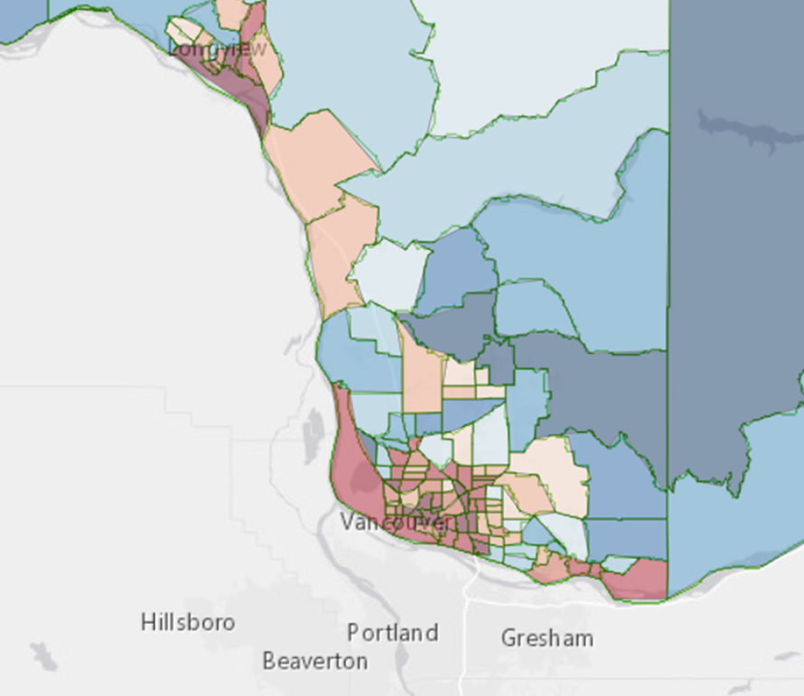
Visually Balanced Cartograms: The Problem

Slide 10
Visually Balanced Cartograms: The Problem

Slide 11
Visually Balanced Cartograms: Methods

Slide 12
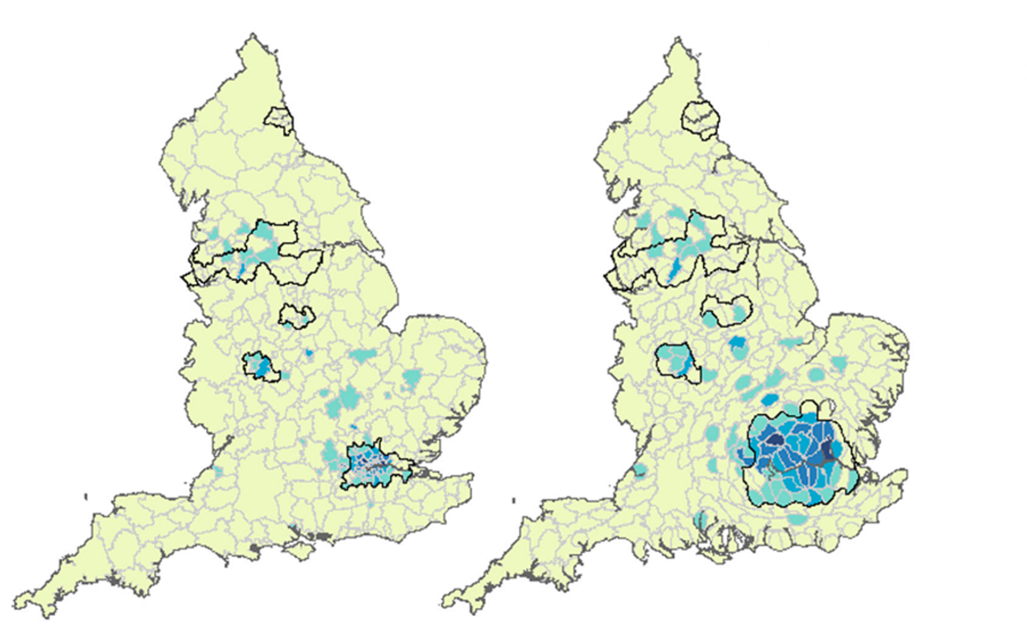
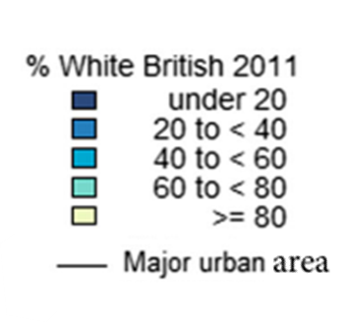
Visually Balanced Cartograms: Methods
(Left) United Kingdom English local authority geographies
(Right) A Visually Balanced Cartogram of the same geographies
Harris, R., Charlton, M., BrunBrunsdon, C. (2018). Mapping the changing residential geography of White British secondary school children in England using visually balanced cartograms and hexograms, Journal of Maps, 14:1, 65-72.

Slide 13
Visually Balanced Cartograms: Methods
For Washington State
Calculate area of each census tract

Slide 14
Visually Balanced Cartograms: Methods
For Washington State
Calculate area of each census tract
Remove census tracts if not land-locked and zero population
  12 tracts removed 1,446 remaining

Slide 15
Visually Balanced Cartograms: Methods
For Washington State
Calculate area of each census tract
Remove census tracts if not land-locked and zero population
  12 tracts removed 1,446 remaining
Determine minimum area needed for visibility
  3-square miles: 864 (59.8%) of tracks < 3-square miles

Slide 16
Visually Balanced Cartograms: Methods
For Washington State
Calculate area of each census tract
Remove census tracts if not land-locked and zero population
  12 tracts removed 1,446 remaining
Determine minimum area needed for visibility
  3-square miles: 864 (59.8%) of tracks < 3-square miles
Integrate and Generalize polygon segments to smooth
  ArcPro tools

Slide 17
Visually Balanced Cartograms: Methods
For Washington State
Calculate area of each census tract
Remove census tracts if not land-locked and zero population
  12 tracts removed 1,446 remaining
Determine minimum area needed for visibility
  3-square miles: 864 (59.8%) of tracks < 3-square miles
Integrate and Generalize polygon segments to smooth
  ArcPro tools
Iteratively create visually balanced cartogram
  cartogram package in R

Slide 18
Visually Balanced Cartograms: Results

Slide 19
Visually Balanced Cartograms: Results

Slide 20
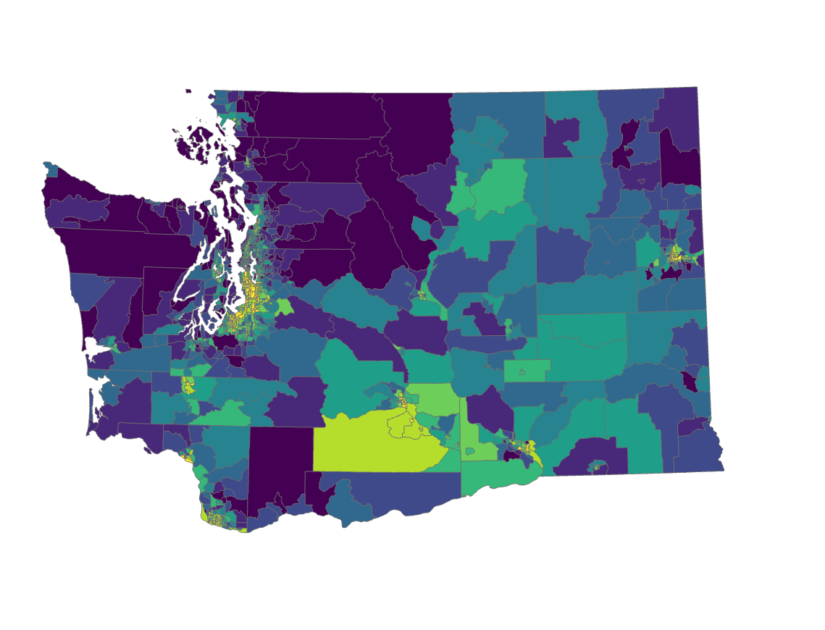
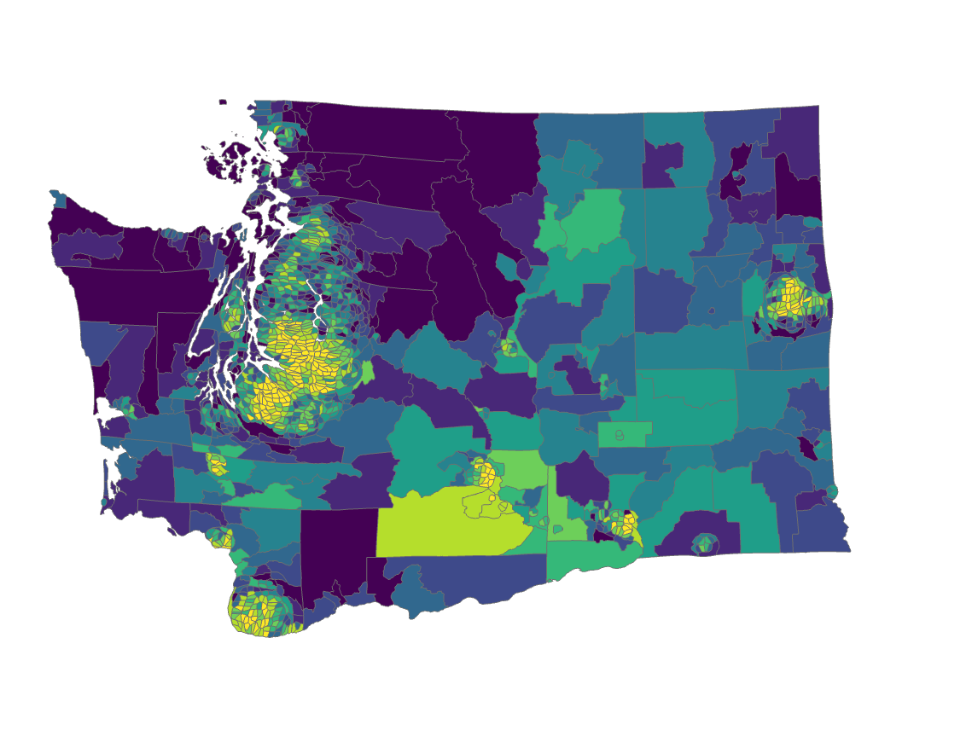
Visually Balanced Cartograms: Results
WTN Environmental Health Disparities Map (Deciles)
(Left) WA State census tract geographies
(Right) A Visually Balanced Cartogram of the same geographies

Slide 21
Visually Balanced Cartograms: Results
Urban Census Tract Invisibility problem
864 invisible census tracts (59.8% of all WA tracts)
After the visibly balanced cartogram method only 16 remained invisible (1.1% of all WA tracts)
Race/Ethnicity Urban Invisibility problem
The demographics of invisible census tracts is 36% people of color (not non-Hispanic White) compared with 22% in visible tracts

Slide 22
Visually Balanced Cartograms: Results
WTN Environmental Health Disparities Invisibility Problem
Census tracts ranked 9th and 10th for worst health disparities based on WTN data were 7.8 times more likely to be an invisible tract (264 tracts compared with 34)

