Slide 1

From Web Maps to Story Map:
Showcase Your Work in A Compelling Way
Diana Lavery, Content Product Engineer
dlavery@esri.com

Slide 2

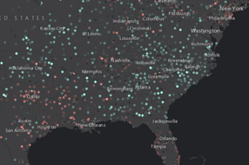
Web Maps using CMS’ Hospital Compare data
Overall Quality Rating
Medicare Hospital Spending per Patient, 2016

Slide 3
Why These Web Maps Are Effective
Symbology is appropriate
  Points with N/A values have been filtered out
  Sequential color ramp used for star ratings
  “Above and below” ramp used for a ratio
Pop-ups are informative

Slide 4

Create a story map live!
Diana Lavery

Slide 5
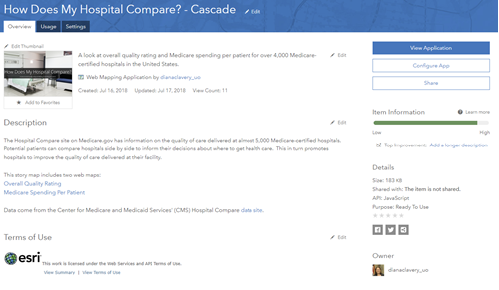
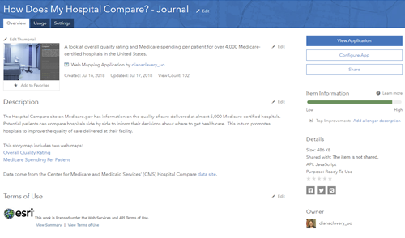
Now Fill Out the Item Details Page!
Good practice to include documentation
Helps others know what this item is
Required if nominating to ArcGIS Living Atlas
Makes your item “social-media-ready” for sharing

Slide 6
More Resources for Authoring and Sharing Story Maps
Storymaps.arcgis.com/en/resources (Official Help Page)
10 Essential Steps for Story Map Success (Blog Post)
13 Ways to Make Your Story Map Sing (Cascade Story Map)
Story Map Booklet (PDF Document)
Twelve Things You Didn’t Know You Could Do With Story Maps (Blog Post)
Esri Story Map Gallery (High-quality examples of story maps)
Creating Story Maps with ArcGIS (Esri Training Course)
How to Cascade: Map Legends
How to Cascade: Sections
How to Cascade: Transitions
How to Cascade: Multi-View Map
How to Cascade: Media

Slide 7
Blog Posts with Examples for Configuring Pop-ups in Web Maps
Using Color in Web Map Pop-ups
Suppress Low Counts and Still Create Informative Web Maps with Pop-ups
Crafting Custom Attribute Displays in Pop-ups
Combining Arcade and HTML for a Real-Life Pop-up Display
Better Breaks Define Your Map’s Purpose
How to Make Smart Color Choices in Your Maps
How to Make a Relationship Map in ArcGIS Online
Map Multiple Attributes at Once Using Predominance
Clustering in ArcGIS Online Enables Data Exploration
Heat Mapping in Two Simple Steps
Blog Posts with Examples for Symbolizing Features in Web Maps

