Slide 1
Relating the Social Vulnerability Index to Emergency Department Visits for Asthma in Saint Louis County, Missouri 2010-2014
Jennifer Kret, MPH
Saint Louis County Department of Public Health
CSTE Spatial Analysis Subcommittee
August 21, 2018
Notes:
Previously presented: 2017 CSTE Annual Conference June 5, 2017
Chronic disease epidemiologist at St. Louis County DPH
Thank you for the opportunity to present to you work that I did using the SVI in relation to Asthma ED visits
I’ll give you a brief overview of St. Louis County, Associations of SES and Asthma, refresh your memories of the SVI, and discuss my study results

Slide 2
Asthma Emergency Department (ED) Visits
32,387 in St. Louis County during 2010–2014
  Over half children under 17 years
Total charges ~$9.5 million annually, average $1,500 per visit (StL CO)
Severe asthma attacks potentially life-threatening
Preventable through proper medication use and avoid triggers
Disparities likely due to lack of high‐quality health care and education on asthma control
Socioeconomic factors can be a barrier to preventative care
Notes:
2010-2014 >32,000 ED visits for Asthma in StLCO
Severe asthma attacks can require emergency care or even be life threatening
Preventable
Medication management: inhaled corticosteroids and other prescribed daily long-term control medicine
Avoid Triggers: cigarette smoke; air pollution; chemicals or dust in the workplace; allergens from dust, animal fur, cockroaches, mold, and pollen; viral respiratory infections (a cold or the flu); fragrances; and physical activity.
Asthma has a high cost to the health care system
Socioeconomic factors: About 2 in 5 (40%) uninsured people with asthma could not afford their prescription medicines and about 1 in 9 (11%) insured people with asthma could not afford their prescription medicines. (CDC)
Medicaid is the dominant payer (62%) of asthma-related pediatric (age 0 to 17) hospital visits. The highest poverty (5th quintile) zip codes in Missouri accounted for 43% of pediatric asthma ED visits (Oct 2013-Sept 2014). (Reidhead, 2015)

Slide 3
Social and Environmental Factors Related to Asthma
Low socioeconomic status (SES) zip codes have significantly higher rates of ED visits for asthma (Largent 2012)
  SES: 200% poverty level, median household income, associate degree
Social disadvantage increases asthma morbidity, decreased control (Kopel 2014)
  Social disadvantage: SES (i.e., household income, employment, education, living conditions, living in predominantly poor geographic locations), psychosocial stress and violence, minority, environmental allergens and pollution, poverty in rural setting
Neighborhood concentrated disadvantage increases odds of asthma diagnosis (Brewer 2017)
  Concentrated disadvantage: poverty, use of public assistance, female-headed households, unemployment, and density of children
Current study: social vulnerability index (SVI) and asthma ED visits
Notes:
Previous studies have shown links between social and environmental factors and various asthma outcomes
Most study children and asthma
- Blue text highlights the definition of the SES indicator used for each study
Indicators included:
Low SES/ED Visits
- Largent et al (2012) purpose to examine trends and identify vulnerable populations; children 0-14 years Orange County, CA
Social disadvantage/Asthma control
Neighborhood Concentrated disadvantage/asthma diagnosis
SVI combines several similar social and environmental factors, capturing synergistic effects of factors

Slide 4
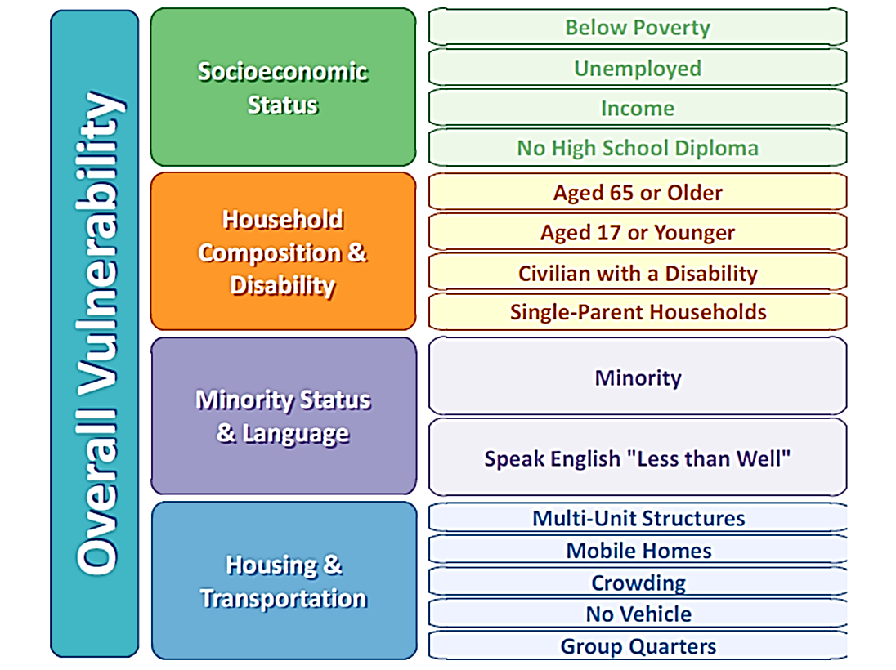
Social Vulnerability Index (SVI)
Agency for Toxic Substances and Disease Registry (ATSDR) Geospatial Research, Analysis & Services Program (GRASP)
Identify and map communities socially vulnerable communities for emergency preparedness and disaster relief
Census tracts – American Community Survey (ACS) data
Rank on 15 social factors, 4 themes, and overall
Percentiles (0 to 1), higher values have greater vulnerability
Notes:
SVI was a tool designed to help Emergency Preparedness/Public Health Officials identify and map communities likely to need more assistance in emergency or disaster
Free, Publicly available dataset
Ranking for census tracts within States or all U.S. census tracts
State-specific database ranks only against other tracts/counties in specified state
Relative vulnerability based on percentiles (0 to 1), higher values greater vulnerability
Themes - summed percentiles for each variable, then ordered summed percentiles for each theme for theme-specific rankings
Why use SVI to study Asthma?
SES theme – access to care/medication/lack of adequate insurance; education important for understanding asthma/control
Minority status theme - Asthma severity found to be higher in African American children (closely tied to SES)
Hispanic/Black households higher level of allergens-cockroaches; crowding/multi-unit structures relate cockroaches/building degradation

Slide 5
Saint Louis County, Missouri
Population: 1,001,327 (2011-2015 ACS)
69.6% White, 23.4% Black/African American, 2.7% Hispanic/Latino
8.2% without high school degree
10.9% below poverty level
8.6% uninsured
7.4% unemployment (e.g., 5.1% White, 15% Black/African American)
High segmentation and neighborhood segregation
  Seceded from St. Louis City in 1876
  90 municipalities, 24 independent public school districts, 60 police departments
Notes:
Located on the eastern side of Missouri and is the most populous county in the state (~1 million)
- Mostly White, highly educated, but high black-white disparities
St. Louis continues to be one of the most racially and economically segregated regions in the country
This residential segregation and income inequality has created school districts with a large majority of either White or Black students, as well as drastic disparities in resources.

Slide 6
Methods
Cross-sectional study
Emergency Department (ED) visits, with principal diagnosis of ICD-9 code 493, during 2010-2014
  MO Department of Health and Senior Services
  Data included Census tract and patient age
ACS 2009-2013 (5-year estimates) used for ED visit rate calculation
SVI 2014 Tract Shapefile for Missouri accessed online (CDC, ATSDR)
Maps created using ESRI ArcMap version 10.3
Statistical analysis performed in SAS version 9.3
Notes:
Cross Sectional Study
Emergency Department data obtained from Missouri DHSS
Downloaded SVI 2014 Tract Shapefile for Missouri from the CDC – ATSDR – SVI website
Mapped themes and overall SVI
Performed statistical analysis in SAS

Slide 7
Analytic Methods
Negative Binomial Regression
SVI percentile rank variables converted to percentage units
  Multiplied by 100
Offset variable: log of population estimates per census tract
Notes:
SVI percentiles have 0 to 1 values – for analyses multiplied by 100 to use percentages (units)
Estimates account/adjust for the total population in census tracts
The next few slides will show the theme maps and distribution among census tracts using quartiles

Slide 8
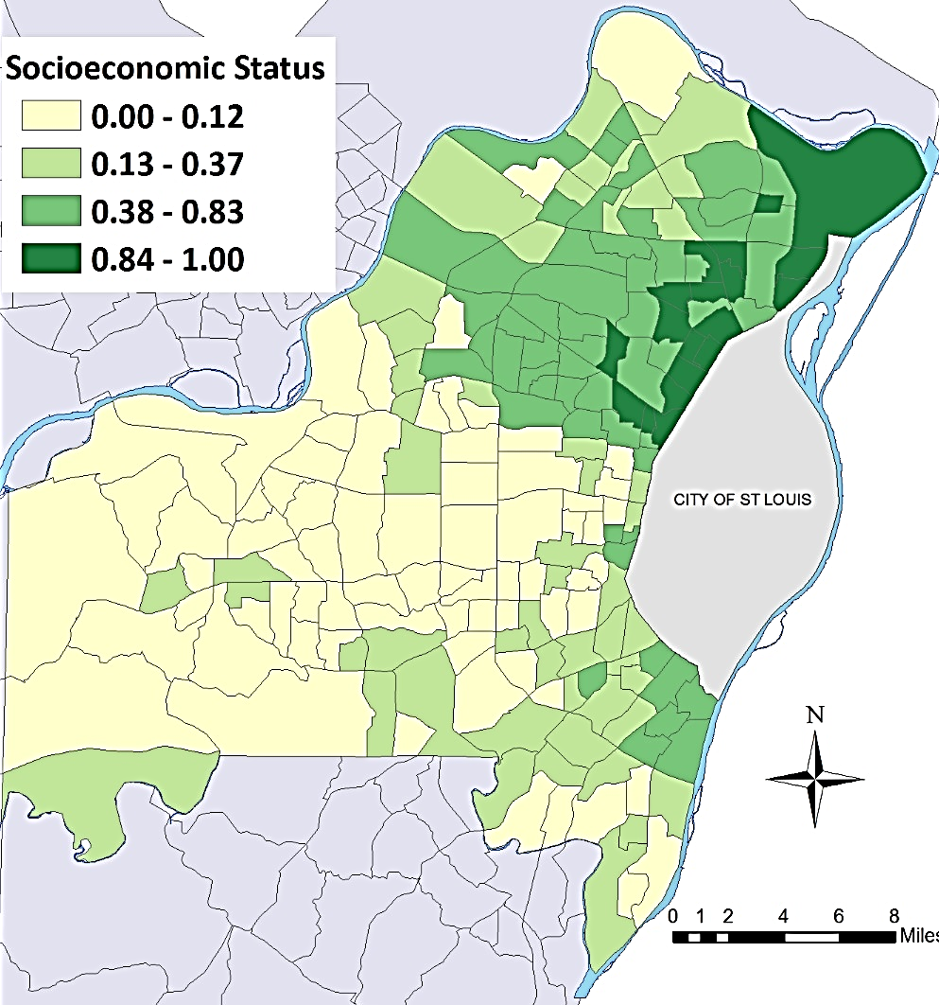
Socioeconomic Status Theme Quartiles by Census Tract
Average: 0.32
SD: 0.30
Highest vulnerability clustered in north, near city border
Notes:
Map shows the range of vulnerability in St. Louis County for the Socioeconomic Status theme, which consists of income, poverty, employment, and education variables.
The highest vulnerability was in areas bordering St. Louis City—especially in North and South County.
These communities are less likely to have adequate income or employee benefits plans to support proper preventative care for asthma.

Slide 9
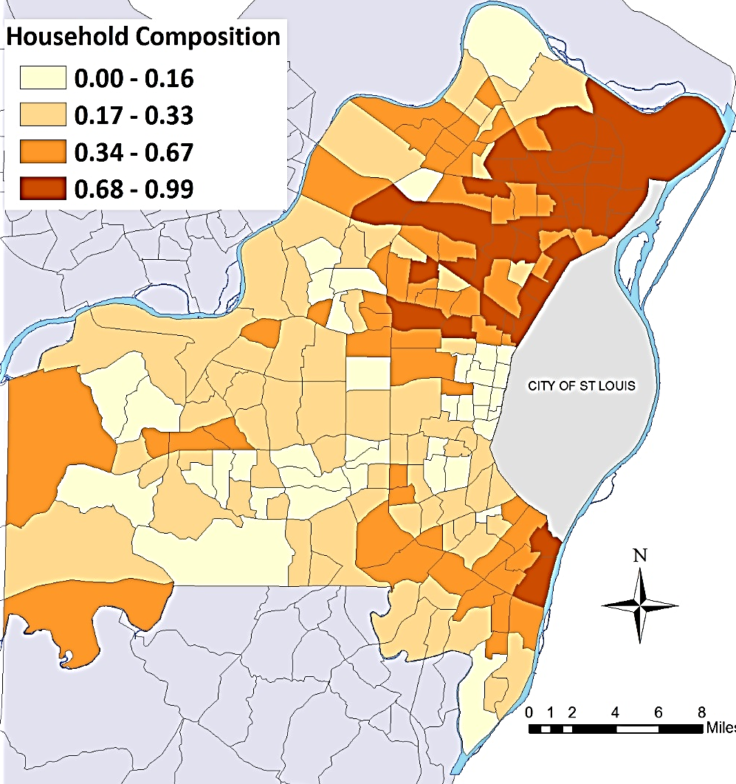
Household Composition Theme Quartiles by Census Tract
Average: 0.39
SD: 0.26
Highest vulnerability in north and near city border
Notes:
Map shows the range of vulnerability in St. Louis County for the Household Composition/Disability theme, including age (i.e., less than 17 years; 65 years and older), single parent households, and civilians with a disability variables.
Again, similar to SES Theme, the highest vulnerability areas bordered St. Louis City but were also spread more throughout the county.
Single-parent households have higher responsibility as caretakers, and children have less control of exposures to asthma triggers.

Slide 10
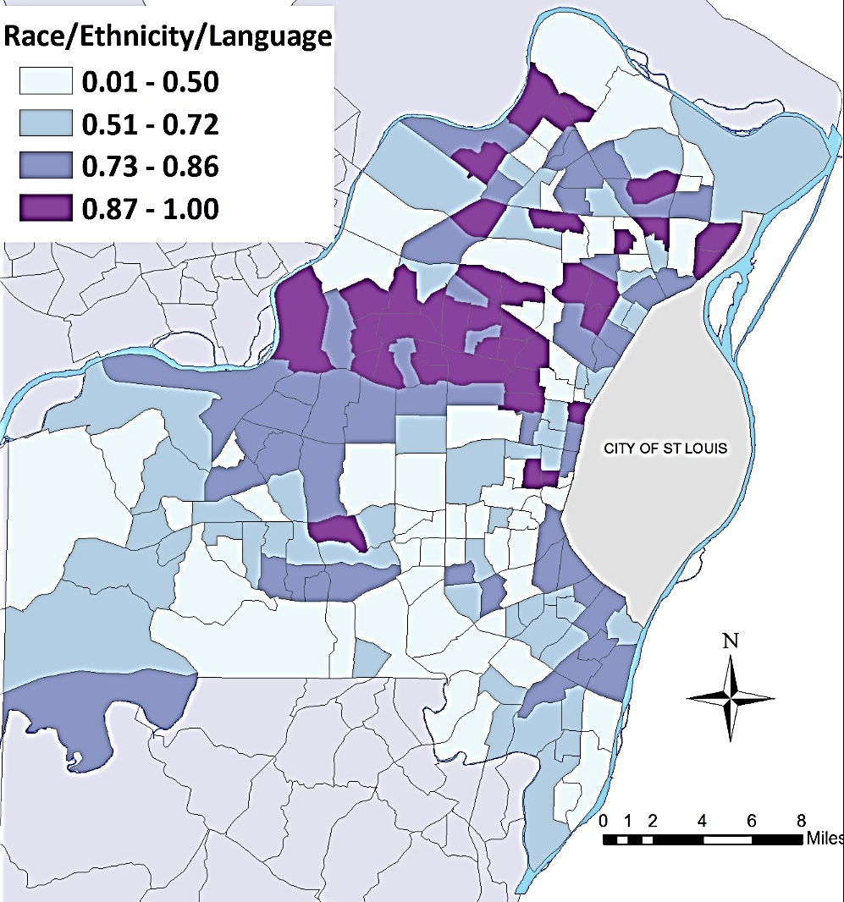
Race/Ethnicity/ Language Theme Quartiles by Census Tract
Average: 0.64
SD: 0.23
Highest vulnerability more dispersed
Notes:
Map shows the range of vulnerability in St. Louis County for the Race/Ethnicity/Language theme, comprising race, ethnicity and English-language proficiency (people who Speak English "Less than Well“) variables.
The highest vulnerability areas bordered St. Louis City, some in the North and West.
These communities have disproportionately burdened, non-white race groups. Also, immigrant populations with limited literacy rates, could have lower access to care for asthma.
In St. Louis race and SES are usually strongly linked – unexpected to see this geographic pattern; expected to look more like the SES theme map. Will discuss this later.

Slide 11
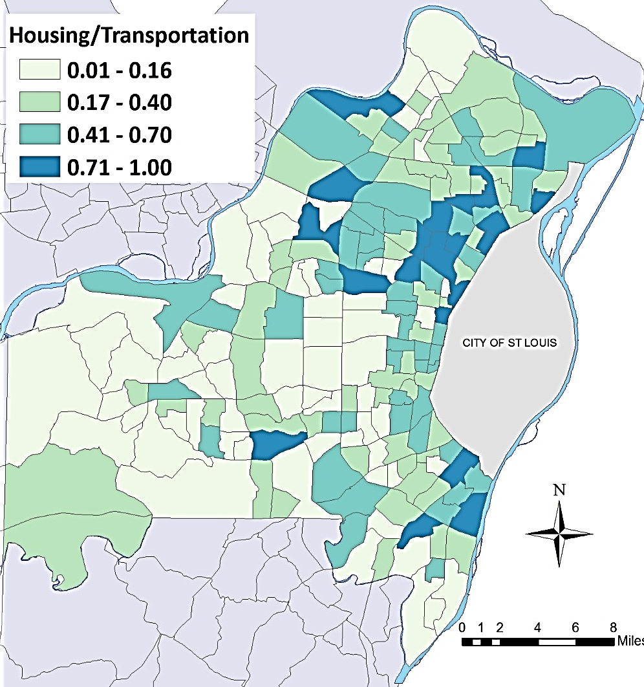
Housing/ Transportation Theme Quartiles by Census Tract
Average: 0.35
SD: 0.26
Highest vulnerability in north, south – near city
Notes:
Map shows the range of vulnerability in St. Louis County for the Housing/Transportation theme, which consists of housing structure, crowding, and vehicle access variables.
The highest vulnerability areas bordered St. Louis City, with some in West County – similar to SES Theme map
Housing quality is an important factor for asthma triggers (e.g., indoor air quality, allergens, and mold) and asthma attacks.

Slide 12
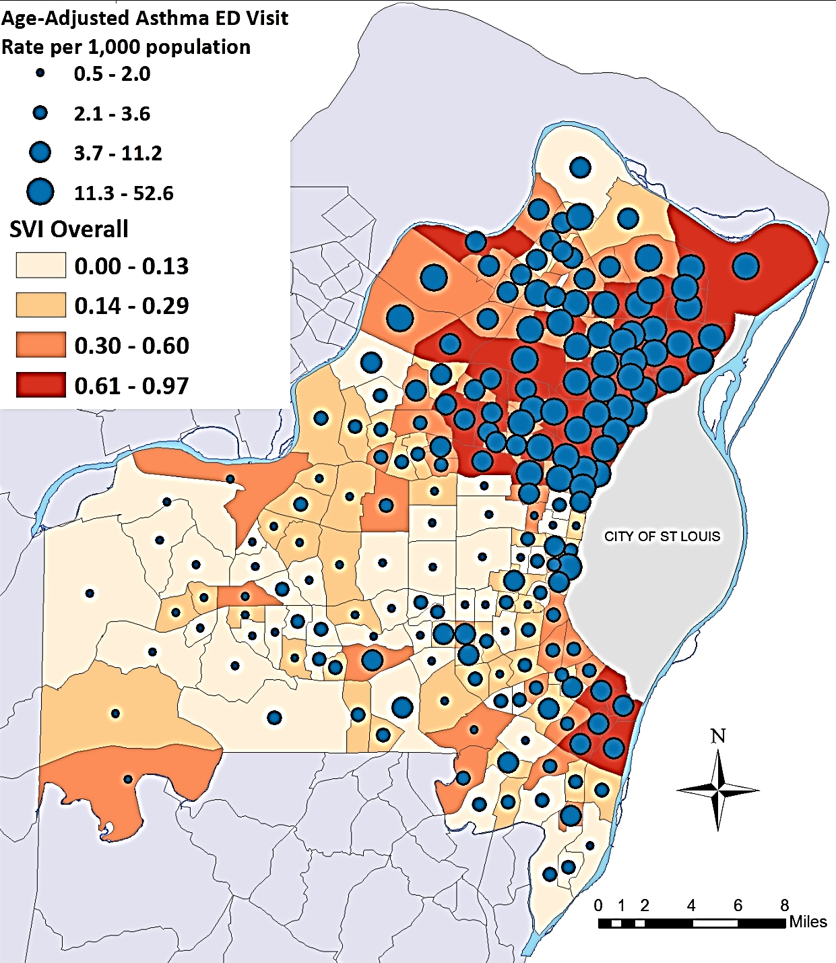
SVI and Asthma ED Visit Rate per 1,000 population in St. Louis County, 2010-2014
Average ED Visits: 167.7
Average Rate: 7.8 per 1,000
Average SVI: 0.37
SD SVI: 0.29
Notes:
SVI (all Themes together) mapped as quartiles; overlayed with ED visit rates – for visual inspection of the relationship between SVI and Asthma ED visits
Highest Vulnerability ranking correspond with highest Asthma ED visit rates

Slide 13
Association Between Overall SVI and Asthma ED Visits per Census Tract in 2010-2014
Predictor | Estimate | SE | 95% CI | Rate Ratio | 95% CI
Overall SVI | 0.030** | 0.002 | 0.027 to 0.034 | 1.031 | (1.027-1.034)
SE, standard error
CI, confidence interval
** P < 0.0001
For a 1% increase in SVI, expect 3% increase in ED visit rate
Notes:
Here's the results from the regression analysis – confirming what we saw in the map
Factors included in the SVI significantly associated with Asthma ED visits
For a 1% increase in SVI (percentile rank) expect a 3% increase in ED visit rate

Slide 14
Association Between SVI Quartiles and Asthma ED visits by Census in 2010-2014
SVI Quartile | Rate Ratio | 95% CI | Estimated ED visits per 1,000 population
1st quartile | Reference |  | 8.61
2nd quartile | 1.68* | (1.29-2.19) | 14.47
3rd quartile | 4.02** | (3.08-5.24) | 34.62
4th quartile | 9.51** | (7.30-12.39) | 81.89
First quartile corresponds with lowest vulnerability.
* P = 0.001
** P < 0.0001
Notes:
Also looked at Quartiles of SVI and estimated absolute rates at each quartile
With increasing quartile of SVI increasing ED visit rates
4 times higher ED rates comparing the 3rd to the 1st quartile
ED visit rates for asthma in the highest quartile of social vulnerability was 9.5 times higher compared to the lowest quartile.

Slide 15
SVI Themes Associated with Asthma ED Visits per Census Tract in 2010-2014
SVI Theme | Unadjusted Rate Ratio | 95% CI | Adjusted Rate Ratio | 95% CI
Socioeconomic Status | 1.032** | (1.029-1.035) | 1.029** | (1.025-1.033)
Housing Composition | 1.028** | (1.023-1.032) | 1.004* | (1.000-1.008)
Race/Ethnicity/Language | 1.005 | (0.998-1.012) | 0.999 | (0.996-1.003)
Housing/Transportation | 1.018** | (1.013-1.024) | 1.000 | (0.997-1.004)
One unit increment is 1 percent.
* P < 0.05
** P < 0.0001
Notes:
Also looked at regression models for each themes to determine statistical associations in maps
Unadjusted models only Race/Ethnicity/Language NOT Significant
Again, this was a surprising result
In adjusted models, only SES and Housing Composition Themes remained significant
1 percent increase SES, 3% increase in ED visit rates
Less strong association for Housing: 1 percent increase, <1% increase in ED visit rates

Slide 16
SVI Themes Associated with Asthma ED Visits per Census Tract in 2010-2014
SVI Theme | Unadjusted Rate Ratio | 95% CI | Adjusted Rate Ratio | 95% CI
Socioeconomic Status | 1.37** | (1.33-1.41) | 1.33** | (1.28-1.39)
Housing Composition | 1.31** | (1.26-1.37) | 1.04* | (1.00-1.09)
Race/Ethnicity/Language | 1.05 | (0.98-1.12) | 0.99 | (0.96-1.03)
Housing/Transportation | 1.20** | (1.13-1.27) | 1.00 | (0.97-1.04)
Rate Ratio estimates are for a 10 percent increment in SVI theme.
* P < 0.05
** P < 0.0001

Slide 17
Discussion
Overall SVI may capture synergistic effects not easily disentangled
Low SES areas, high single-parent households likely lack adequate resources to control asthma, prevent ED visits
Unexpected results for Race/Ethnicity/Language and Housing/ Transportation themes
  Examine Race/Ethnicity and Language associations separately
  Explore SVI overall analyses stratified by race
Limitations
  ED visit data captures encounters, not individuals
  Interpretation of SVI is complex
Notes:
SVI includes multiple factors that may be inextricably linked – poverty, employment, education, race, and housing
Factors related to barriers in access to care – income or increase in environmental exposure (Crowding, multi-unit housing – increase smoke exposure)
Unexpected results for Race/Language theme; outlined next steps
Several studies have found racial disparities in asthma prevalence/ED visits
Brewer et al. 2017, after adjusting for neighborhood disadvantage, particulate matter, ozone concentration, and race/ethnic composition, black children had higher odds of asthma diagnosis vs white

Slide 18
Characteristics of ED Visits for Asthma in St. Louis County, 2010-2014
Characteristic | Number | Percent | Rate per 1,000 population | 95% Confidence Interval
St. Louis County | 32,387 | 100.0 | 7.2 | 7.1 to 7.3
< 18 years | 17,796 | 54.9 | 15.6 | 15.4 to 15.8
18 – 24 years | 3,898 | 12.0 | 8.9 | 8.6 to 9.2
25 – 44 years | 6,906 | 21.3 | 5.6 | 5.5 to 5.8
45 – 64 years | 3,086 | 9.5 | 2.2 | 2.1 to 2.3
65 years and over | 701 | 2.2 | 0.9 | 0.8 to 1.0
Male | 16,402 | 50.6 | 7.4 | 7.3 to 7.5
Female | 15,985 | 49.4 | 6.9 | 6.8 to 7.0
Asian | 109 | 0.3 | 0.7 | 0.5 to 0.8
Black/African American | 24,286 | 75.0 | 20.2 | 19.9 to 20.4
Hispanic or Latino | 421 | 1.3 | 2.8 | 2.5 to 3.0
Multiple | 246 | 0.8 | 1.1 | 1.0 to 1.3
White | 7,000 | 21.6 | 2.4 | 2.3 to 2.5
Notes:
In St. Louis County, Blacks/African Americans have the highest rates of ED visits for asthma – almost 10x rate for whites and Hispanic/latinos
Rate per 1,000

Slide 19
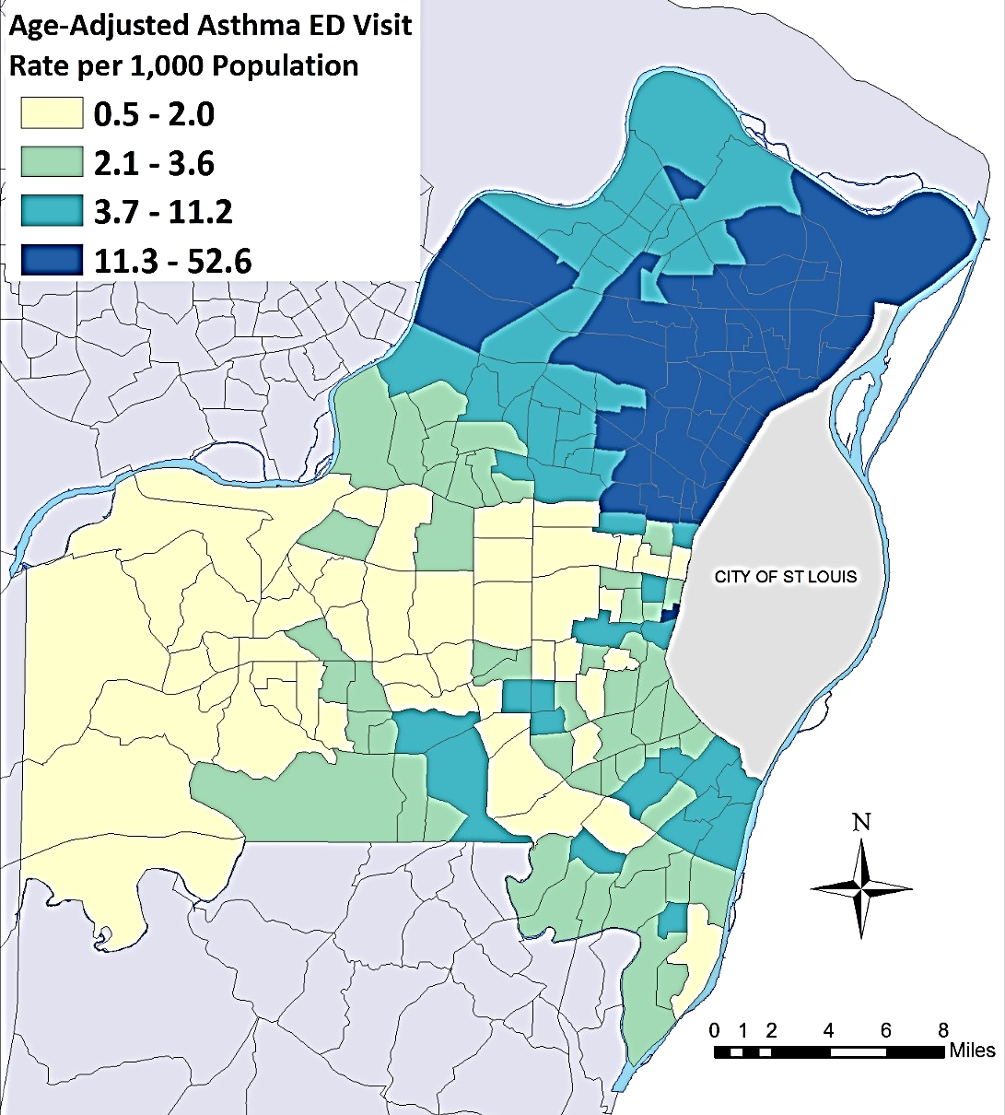
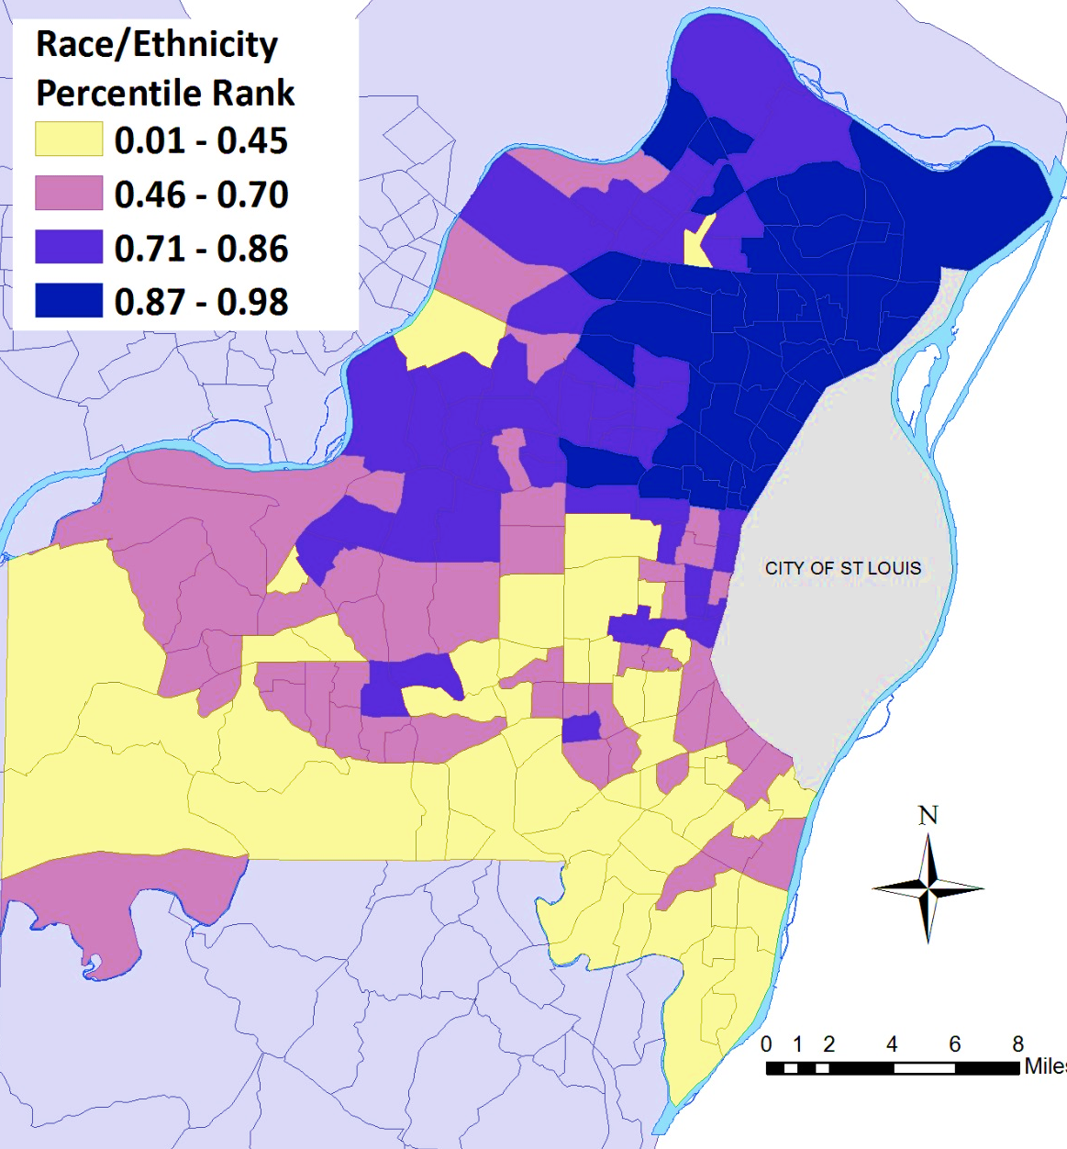
Comparison of Asthma ED Visit Rates and Proportion Non-White Race/Ethnicity by Census Tract , St. Louis County, 2010‐2014
Notes:
Here side by side comparisons of the Asthma ED Visit rates and SVI data for Race/Ethnicity factor alone (Proportion of non-white Race/ethnicity
This correlation is more what we expected for the relationship
During 2010 to 2014 ED visit rates for asthma ranged from 0.5 to 52.6 per 1,000 population. The highest burden of ED visits for asthma were among residents living in census tracts in North

Slide 20
Asthma ED Visits, SVI Overall Rank, SVI Theme Ranks, and 15 SVI Factors by Census Tract (N=199)
Variable | Mean | SD | Minimum | Maximum | Pearson Correlation (Rho) for Asthma ED Rate
Asthma ED Visits, n | 162.7 | 180.6 | 8 | 905 | 1.00
Overall SVI | 0.4 | 0.3 | 0.0022 | 0.9704 | 0.68932
Theme 1 - SES | 0.3 | 0.3 | 0 | 0.9877 | 0.7779
Percentage below Poverty | 11.4 | 9.7 | 0.2 | 59.8 | 0.70534
Percentage unemployed (age 16+) | 8.6 | 6.2 | 0.4 | 34 | 0.78253
Per capita income (2010-2014 ACS) | $34,995 | $16,195 | $7,218 | $102,205 | -0.6033
Percentage no HS diploma (age 25+) | 7.8 | 5.9 | 0 | 27.9 | 0.63567
Theme 2 – Household Composition | 0.4 | 0.3 | 0.0086 | 0.9741 | 0.64083
Percentage aged 65 and older | 15.6 | 5.6 | 4.2 | 34.5 | -0.25169
Percentage aged 17 and younger | 22.8 | 5.2 | 4.6 | 45.5 | 0.19887
Percentage with disability | 11.6 | 4.3 | 3.3 | 28.6 | 0.56526
Percentage of single parent households | 10.0 | 7.6 | 0.8 | 35.8 | 0.68997
Theme 3 – Race/Ethnicity and Language | 0.6 | 0.2 | 0.0086 | 0.982 | 0.06447
Percentage minority (non-white) | 33.1 | 29.8 | 0.9 | 98.9 | 0.79776
Percentage who speak English “less than well” (age 5+) | 1.3 | 1.8 | 0 | 8.6 | -0.21903
Theme 4 – Housing and Transportation | 0.3 | 0.3 | 0.005 | 0.9871 | 0.36671
Percentage housing structures 10+ units | 10.1 | 11.1 | 0 | 60.8 | -0.04967
Percentage mobile homes | 0.4 | 3.3 | 0 | 45.1 | 0.38754
Percentage occupied housing units >1 pp room | 1.0 | 1.5 | 0 | 10.3 | 0.34634
Percentage households with no vehicle | 7.5 | 7.3 | 0 | 35.8 | 0.61416
Percentage of institutionalized group quarters | 1.7 | 4.8 | 0 | 57.1 | -0.10241
Notes:
Here's a table looking at Pearson correlation coefficients for SVI overall, Themes, and individual factors
Notably the correlation between Minority/non-white and Asthma ED is strong and positively associated, in contrast to the correlation with the language factor which is negatively associated with ED visit rates
Other factors have opposing directions of correlation that are summed into themes of the SVI – this is something to be aware of.
- Perhaps, the factors should be transformed so that the associations are in the same direction before being summed

Slide 21
Conclusions
Significantly higher rates of ED visits for asthma associated with social vulnerability overall, SES and household composition themes
Implications for monitoring health equity in chronic disease epidemiology
SVI is a useful tool to visually identify vulnerable populations
Public health prevention and intervention programs should target socially vulnerable populations to improve asthma control
  Education for patients and caregivers
  Comprehensive interventions addressing home remediation, tailored to environmental exposures
Notes:
Communities less resilient in emergencies or disasters may also lack resources to prevent emergency department visits for asthma

Slide 22
References
U.S. Department of Health and Human Services (HHS). Expert panel report 3: Guidelines for the diagnosis and management of asthma. Bethesda, MD: HHS, National Heart Lung, and Blood Institute, National Institutes of Health. Publication No. 07‐4051. 2007.
Centers for Disease Control and Prevention/ Agency for Toxic Substances and Disease Registry/ Geospatial Research, Analysis, and Services Program. Social Vulnerability Index 2014 Database Missouri. http://svi.cdc.gov/SVIDataToolsDownload.html. Accessed on November 11, 2016.
Largent J, Nickerson B, Cooper D, Delfino RJ. Paediatric asthma hospital utilization varies by demographic factors and area socio-economic status. Public Health. 2012; 126:928-936.
Kopel LS, Phipatanakul W, Gaffin JM. Social Disadvantage and Asthma Control in Children. Paediatr Respir Rev. 2014 September; 15(3): 256-263. doi:10.1016/j.prrv.2014.04.017.
Brewer M, Kimbro, RT, Denney JT, Osiecki KM, Moffett B, Lopez K. Does neighborhood social and environmental context impact race/ethnic disparities in childhood asthma? Health & Place. 2017; 44:86-93.
Notes:
Reidhead, M. Hospital utilization for pediatric asthma in Missouri. HIDI HealthStats. Missouri Hospital Association. Hospital Industry Data Institute. 2015 June. Available at http://web.mhanet.com/hidi
Gay JL, Robb SW, Benson KM, White A. Can the social vulnerability index be used for more than emergency preparedness? An examination using youth physical fitness data. Journal of Physical Activity and Health. 2016; 13:121-130. PMID: 27029324

Slide 23
Questions?
Jennifer Kret, MPH
Saint Louis County Department of Public Health
Jkret@stlouisco.com

Slide 24
Other GIS Projects in St. Louis County
Collaboration and Data Sharing to Promote Active Transport, Reduce Pedestrian and Bicycle Injuries in St. Louis County, Missouri
  2018 CSTE Paper 10199
  Check out our Story Map: http://arcg.is/T485v

