Slide 1

Spatial Epidemiology of
Invasive Pneumococcal Disease
Steven Hinojosa, PhD, MPH, CPH
Lead Epidemiologist
Hidalgo County Health and Human Services

Slide 2
Outline
Introduction and Study Purpose
Methods and Results
Discussion and Conclusion

Slide 3
Introduction

Slide 4
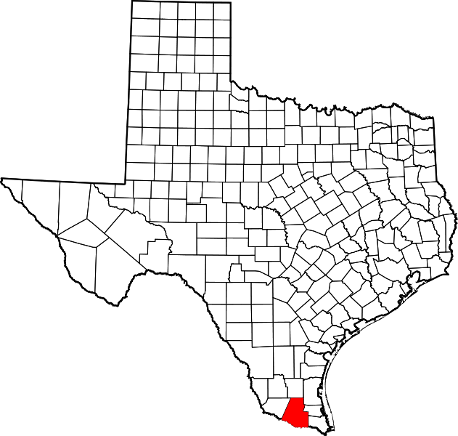
Hidalgo County Population
https://www.lib.utexas.edu/
Located along the U.S. – Mexico Border
McAllen-Edinburg-Mission MSA
Largest Populated Texas-Mexico Border County
  860,661 Population
22 Cities
27 Zip Codes
113 Census Tracts
Median Age: 28.8 years
91.8% Hispanic/Latino
Median Household Size: 3.70
Median Household Income: $36,094
Per Capita: $14,689
34.2% below Poverty Line
32.0% without Health Insurance
Introduction and Study Purpose Methods and Results Discussion and Conclusion

Slide 5
Significance of the Problem
Disease Morbidity and Mortality
  700,000 adults die due to pneumococcal pneumonia, sepsis, and meningitis each year (Muley et al., 2017)
Vaccination Coverage
  Eligibility vs. Ineligibility
Antibiotic Resistance
  Limited Treatment
Economic Impact
  $3.5 billion in 2004 for direct medical costs in the United States (Song et al., 2013)
  Median cost for direct medical care was $7,452 (Song et al., 2013)
Economic Impact
Antibiotic Resistance
Vaccination Coverage
Morbidity and Mortality
Introduction and Study Purpose Methods and Results Discussion and Conclusion

Slide 6
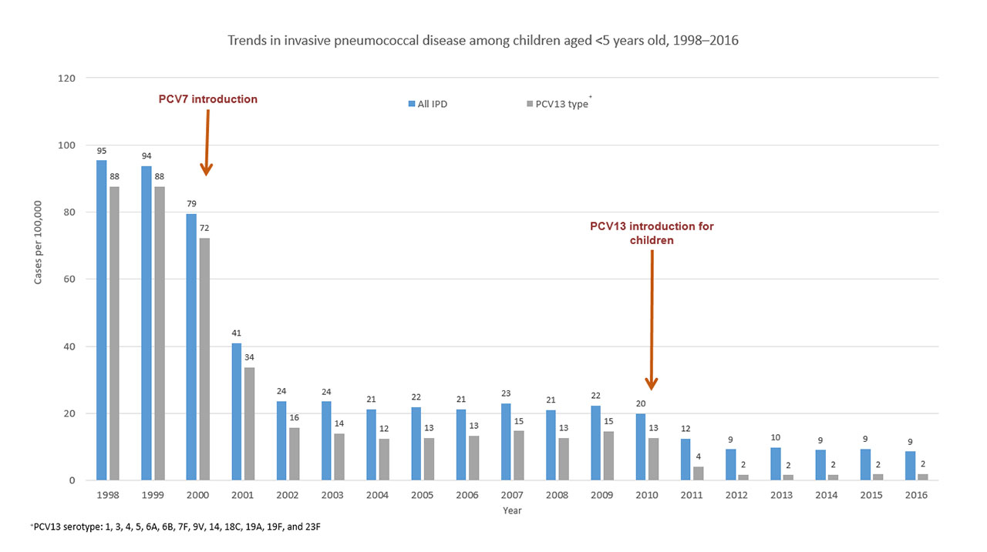
Significance of the Problem
Decreased Case Trends United States
  Post-Vaccine Introduction
  Pediatric, Adult, and Geriatric Groups
Hidalgo County median age (28.8 years) is nearly nine years younger than U.S. (37.7 years) (U.S. Census Bureau, 2017)
  Larger demographic without vaccine indication
https://www.cdc.gov/pneumococcal/surveillance.html
Introduction and Study Purpose Methods and Results Discussion and Conclusion

Slide 7
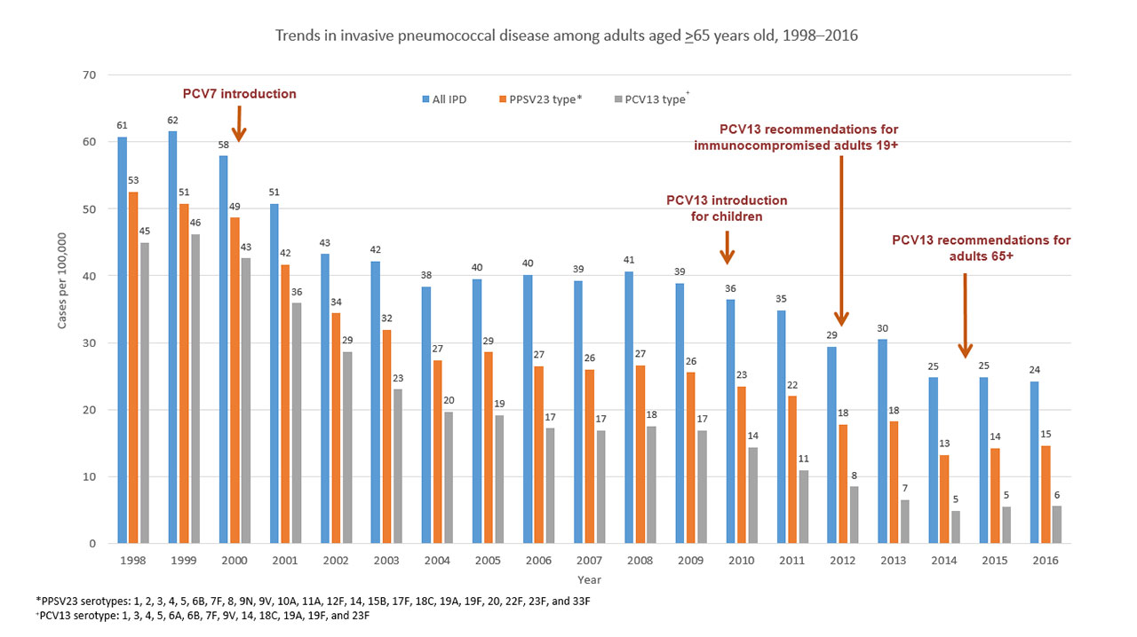
Significance of the Problem
Decreased Case Trends United States
  Post-Vaccine Introduction
  Pediatric, Adult, and Geriatric Groups
Hidalgo County median age (28.8 years) is nearly nine years younger than U.S. (37.7 years) (U.S. Census Bureau, 2017)
  Larger demographic without vaccine indication
https://www.cdc.gov/pneumococcal/surveillance.html
Introduction and Study Purpose Methods and Results Discussion and Conclusion

Slide 8
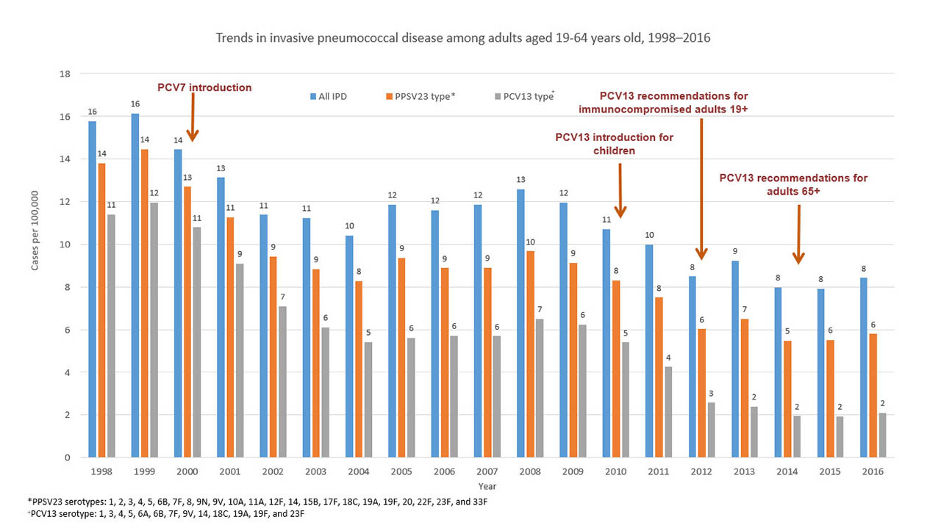
Significance of the Problem
Decreased Case Trends United States
  Post-Vaccine Introduction
  Pediatric, Adult, and Geriatric Groups
Hidalgo County median age (28.8 years) is nearly nine years younger than U.S. (37.7 years) (U.S. Census Bureau, 2017)
  Larger demographic without vaccine indication
https://www.cdc.gov/pneumococcal/surveillance.html
Introduction and Study Purpose Methods and Results Discussion and Conclusion

Slide 9
Research Topic
Epidemiology of invasive pneumococcal disease (IPD) in a south Texas metropolitan area
Conduct statistical and spatial analyses to identify which populations are at most risk for infection
Determine what further research is needed for disease prevention and to protect the broader population
Introduction and Study Purpose Methods and Results Discussion and Conclusion

Slide 10
Hypothesis
H₀: Within the population of study, lower income populations have no increased risk in the rate of infection for invasive pneumococcal disease (H₀: Β₁ = 0)
H₁: Within the population of study, lower income populations have an increase risk in the rate of infection for invasive pneumococcal disease (H₁: B₁ ≠ 0)
Introduction and Study Purpose Methods and Results Discussion and Conclusion

Slide 11
Methods

Slide 12

Software
Excel
ArcGIS
Epi Info
Tableau
Previously Used: QGIS and Google Earth
Introduction and Study Purpose Methods and Results Discussion and Conclusion

Slide 13
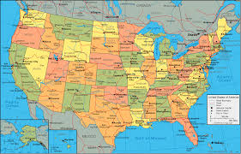


HIPAA and Data Security
Only Desktop Licenses and Applications
  No Online Services or Functions
De-identifying Data
  Utilizing Census Tracts, Cities, and Zip Codes
  Randomizing Dot Density Points
Being Aware of Parameters
  Geography Population Sizes
  Disease Sensitivity
Introduction and Study Purpose Methods and Results Discussion and Conclusion

Slide 14
Data Variables
Demographic Data
Clinical Data
Age | Sex | Zip Code
Census Tract | City | Ethnicity
Race | Population Density | Household Size
Household Income | Educational Attainment | Foreign-Born
Facility Location | Hospitalization | Hospitalization Duration
Infection Type | Deceased Indicator | Vaccine History
Comorbidities | Symptom Onset | Risk Group
Introduction and Study Purpose Methods and Results Discussion and Conclusion

Slide 15
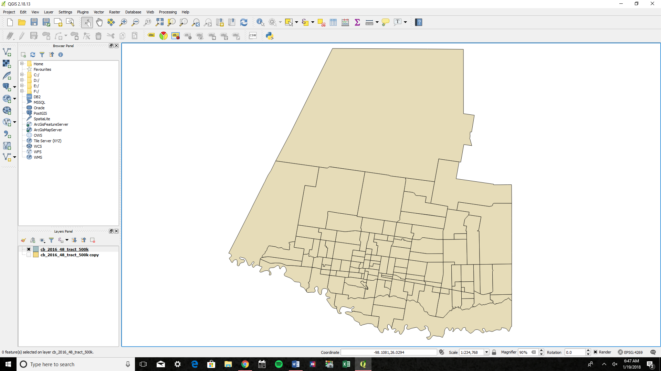
Hypothesis Analyses
Population level Descriptive Statistics
Case Incidence by Cities and Census Tracts
Spatial Autocorrelation (Moran’s Index) to determine clustering
Choropleths of Census Data and Case Data
Hot and Cold Spot Analysis on incidence,
with Median and Mean Center
Ordinary Least Squares (Getis-Ord Gi*) and Geographically Weighted Regression (GWR)
Linear Regression of Socio-Economic Factors (H₀: Β₁ = 0)
Introduction and Study Purpose Methods and Results Discussion and Conclusion

Slide 16
Overview of the Data

Slide 17
Data Collection and Clean-up
Collection
Clean-up
329 of 333 Case Records
MMWR 2010 to 2016
Resides in Hidalgo County
A positive culture of Streptococcus pneumoniae
Variable Categorization
Variable Conversion
Introduction and Study Purpose Methods and Results Discussion and Conclusion

Slide 18
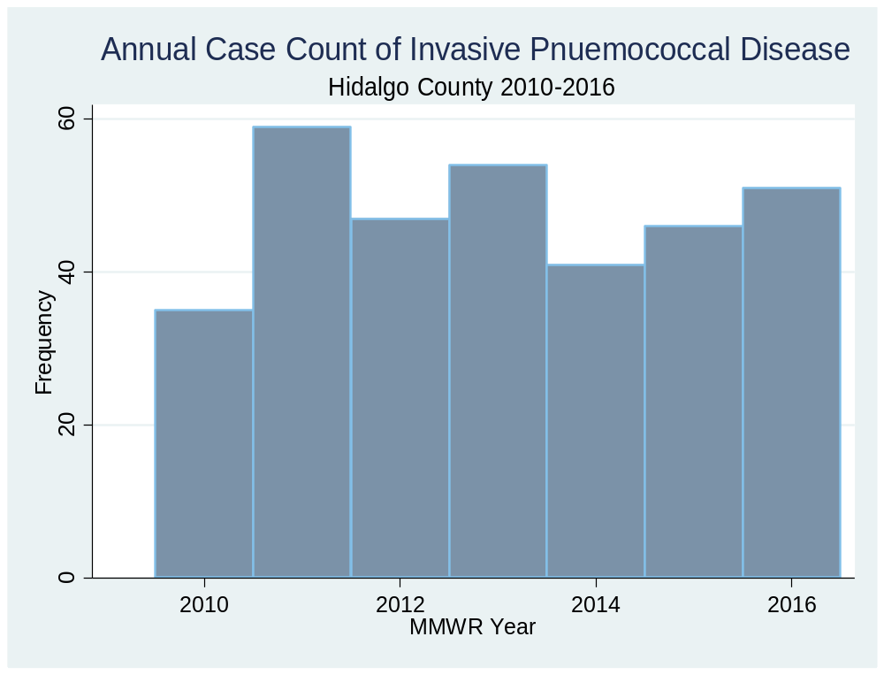
Annual Case Counts
 | 2010 | 2011 | 2012 | 2013 | 2014 | 2015 | 2016
Cases | 35 | 59 | 47 | 54 | 41 | 46 | 51
Sex (n) Male Female | 20 15 | 28 31 | 24 23 | 27 27 | 22 19 | 23 23 | 29 22
Median Age | 52.0 | 50.0 | 61.0 | 58.0 | 60.0 | 57.5 | 59.0
Hispanic/Latino Ethnicity | 31 88.57% | 50 84.74% | 39 82.98% | 40 74.07% | 38 92.68% | 37 80.43% | 43 84.31%
Underlying Conditions Present | 7 20.00% | 38 64.41% | 32 68.09% | 39 72.22% | 33 80.49% | 33 71.74% | 28 54.90%
Avg. Hospitalization duration (Days) | 1.667 | 4.810 | 4.625 | 5.963 | 12.294 | 10.441 | 6.324
Deceased (n / %) | 3 8.57% | 6 10.17% | 2 4.65% | 3 5.56% | 2 4.88% | 3 6.52% | 3 5.88%
Infection Type (n) Bacteremia Meningitis Other | 33 2 0 | 52 1 6 | 42 1 0 | 53 1 0 | 40 1 0 | 45 1 0 | 51 0 0
Introduction and Study Purpose Methods and Results Discussion and Conclusion

Slide 19
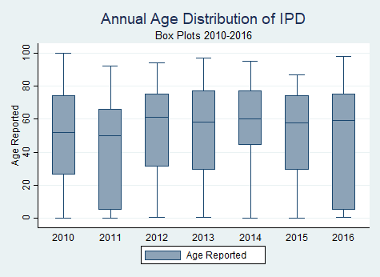
Annual Overview of Data
Introduction and Study Purpose Methods and Results Discussion and Conclusion

Slide 20
Case Representation
Parameter (Age Category) | 0-17 Pediatric | 18-64 Adult | 65+ Geriatric
Sex Male Female | 45 / 58.4% 32 / 41.6% | 64 / 48.9% 67/ 51.1% | 63 / 52.1% 58 / 47.9%
Ethnicity Hispanic Non-Hispanic | 74 / 96.1% 3 / 3.9% | 120 / 91.6% 11 / 8.4% | 103 / 85.1% 18 / 14.9%
Infection Type Bacteremia Meningitis Other | 75 / 97.4% 1 / 1.3% 1 / 2.3% | 124 / 94.7% 5 / 3.8% 2 / 1.5% | 117 / 96.7% 1 / 0.8% 3 / 2.5%
Over the seven year timespan:
Adult age group most common with 131 cases, followed by geriatric (n=121), and pediatric (n=77)
Non-Hispanic highest in Geriatric Population
Bacteremia most common type of infection
Introduction and Study Purpose Methods and Results Discussion and Conclusion

Slide 21
Spatial Analysis

Slide 22
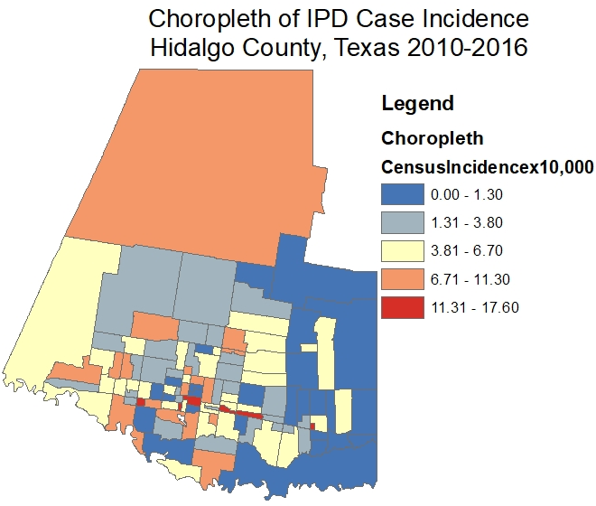
Population Data
Smallest census tract population- 243.02 (1,002 people)
Largest census tract population- 240.00 (17,165 people)
Average median household income was $36,182
  Lowest was $18,274 in tract 241.12
  Highest was $76,971 in tract 235.10
Average private health insurance coverage was 33.65%
  Lowest was 10.40% in tract 241.12
  Highest was 75.4% in tract 209.01
Average household size was 3.59 per household
  Lowest was 2.29 in tract 241.11
  Highest was 5.03 in tract 205.1
Introduction and Study Purpose Methods and Results Discussion and Conclusion

Slide 23
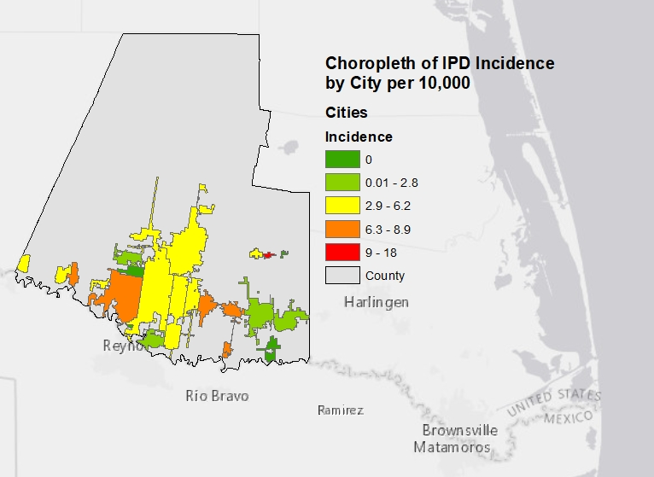
City Data
City | Case Count | 2016 Population | Incidence per 10,000
Edcouch | 6 | 3,365 | 17.83060920
Mission | 75 | 84,424 | 8.88372975
Penitas | 4 | 4,886 | 8.18665575
Donna | 13 | 16,638 | 7.81343912
Alamo | 14 | 19,679 | 7.11418263
San Juan | 23 | 36,981 | 6.21940997
Edinburg | 55 | 90,280 | 6.09215773
Palmview | 3 | 5,792 | 5.17955801
Pharr | 40 | 79,487 | 5.03226943
Sullivan City | 2 | 4,153 | 4.81579581
La Joya | 2 | 4,286 | 4.66635558
McAllen | 65 | 142,696 | 4.55513820
Elsa | 3 | 7,134 | 4.20521447
Hidalgo | 4 | 13,931 | 2.87129424
Weslaco | 11 | 40,358 | 2.72560583
Mercedes | 3 | 16,734 | 1.79275726
Alton | 3 | 17,278 | 1.73631207
Granjeno | 0 | 301 | 0
La Villa | 0 | 2,740 | 0
Palmhurst | 0 | 2,738 | 0
Progreso | 0 | 5,938 | 0
Progreso Lakes | 0 | 248 | 0
Introduction and Study Purpose Methods and Results Discussion and Conclusion

Slide 24
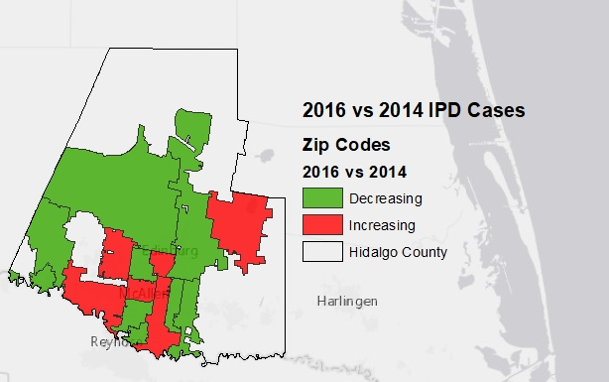
Annual Case Comparison
2016 vs 2014
Decreasing and Increasing Trends
Introduction and Study Purpose Methods and Results Discussion and Conclusion

Slide 25
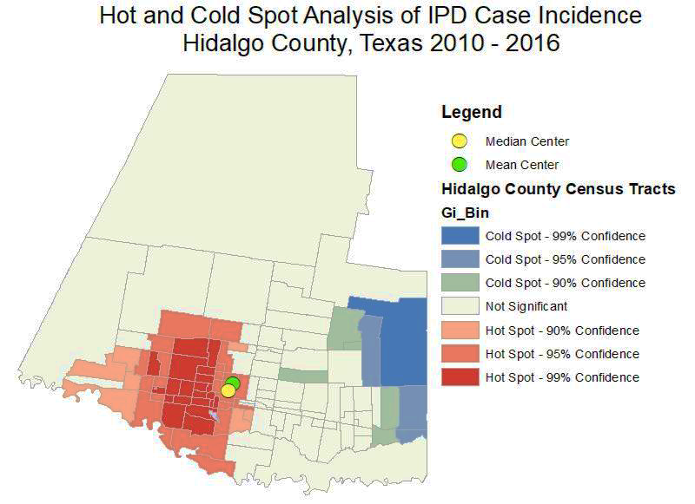
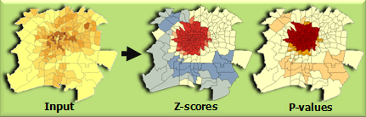
Hot and Cold Spot Analysis (Getis-Ord Gi*)
This tool identifies statistically significant spatial clusters of high values (hot spots) and low values (cold spots)
The z-scores and p-values they indicate whether the observed spatial clustering of high or low values is more pronounced than one would expect in a random distribution of those same values
A high z-score and small p-value for a feature indicates a spatial clustering of high values
A low negative z-score and small p-value indicates a spatial clustering of low values
A z-score near zero indicates no apparent spatial clustering
http://desktop.arcgis.com/en/arcmap/10.3/tools/spatial-statistics-toolbox/hot-spot-analysis.htm
Introduction and Study Purpose Methods and Results Discussion and Conclusion

Slide 26
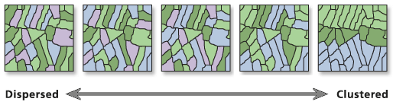
Spatial Autocorrelation (Global Moran's I)
Spatial autocorrelation in GIS helps understand the degree to which one object is similar to other nearby objects
This tool evaluates whether the pattern expressed is clustered, dispersed, or random
Moran’s I (Index) measures tendency towards clustering
Spatial autocorrelation (Moran’s Index)
Variable | Moran’s Index | Z-score | P-Value
MedianHHI | 0.087268 | 6.594138 | 0.000000
AvgHHSize | 0.055591 | 4.396873 | 0.000011
PrivateHInsurance | 0.099732 | 7.414162 | 0.000000
PopDensity | 0.260318 | 18.367830 | 0.000000
HighSchoolorHigher(%) | 0.141476 | 10.237786 | 0.000000
BachorHigher(%) | 0.169649 | 12.222716 | 0.000000
Hispanic(%) | 0.078939 | 6.006147 | 0.000000
Foreign-Born(%) | 0.128167 | 9.330242 | 0.000000
CensusIncidencex10,000 | 0.017161 | 1.794334 | 0.072760
http://pro.arcgis.com/en/pro-app/tool-reference/spatial-statistics/spatial-autocorrelation.htm
Introduction and Study Purpose Methods and Results Discussion and Conclusion

Slide 27
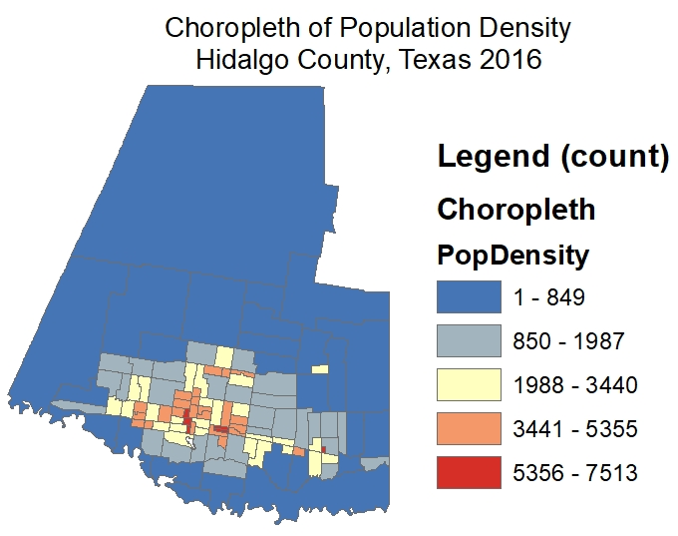
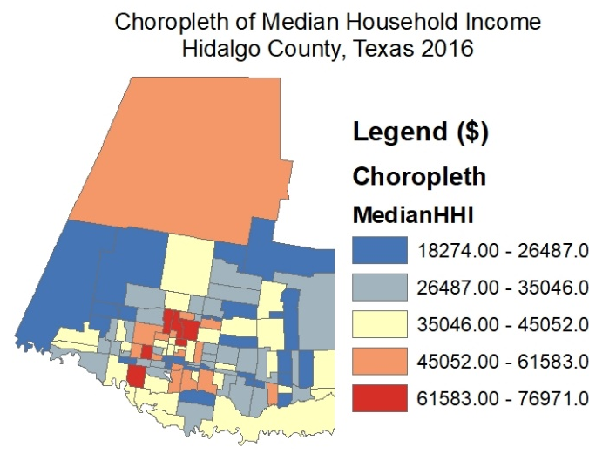
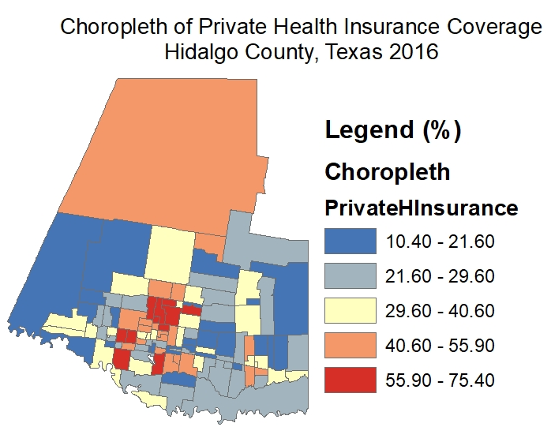
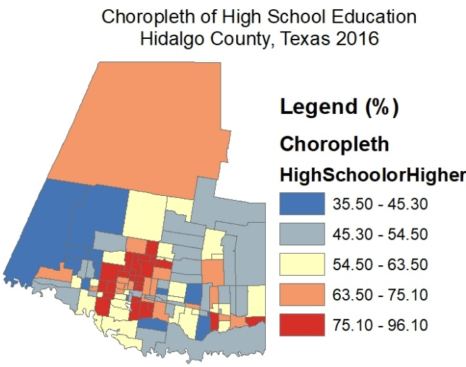
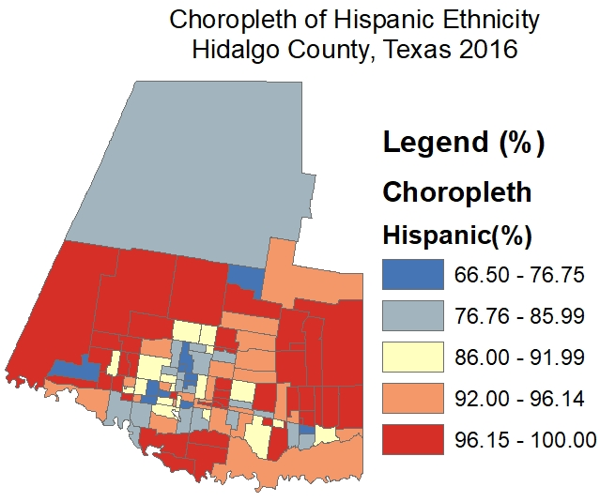
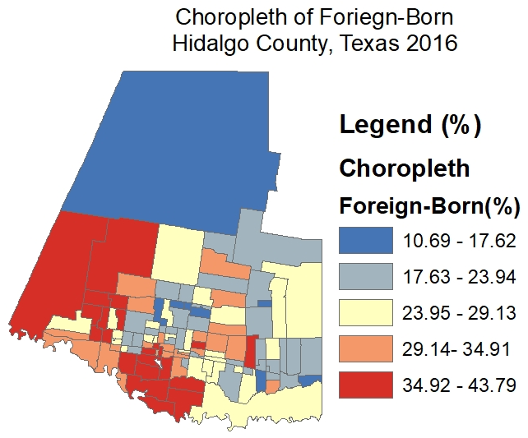
Introduction and Study Purpose Methods and Results Discussion and Conclusion

Slide 28
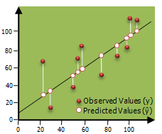
Ordinary Least Squares (OLS)
Performs global Ordinary Least Squares (OLS) linear regression to generate predictions or to model a dependent variable in terms of its relationships to a set of explanatory variables
Diagnostics include:
Corrected Akaike Information Criterion (AICc)
Coefficient of Determination
Joint F statistic
Wald statistic
Koenker's Breusch-Pagan statistic
Jarque-Bera statistic
Results from OLS regression are only trustworthy if your data and regression model satisfy all of the assumptions inherently required by this method
Nonlinear Relationships
Spatial Autocorrelation Residuals
Multicollinearity
Outliers
Non-normal Data
http://pro.arcgis.com/en/pro-app/tool-reference/spatial-statistics/ordinary-least-squares.htm
Introduction and Study Purpose Methods and Results Discussion and Conclusion

Slide 29
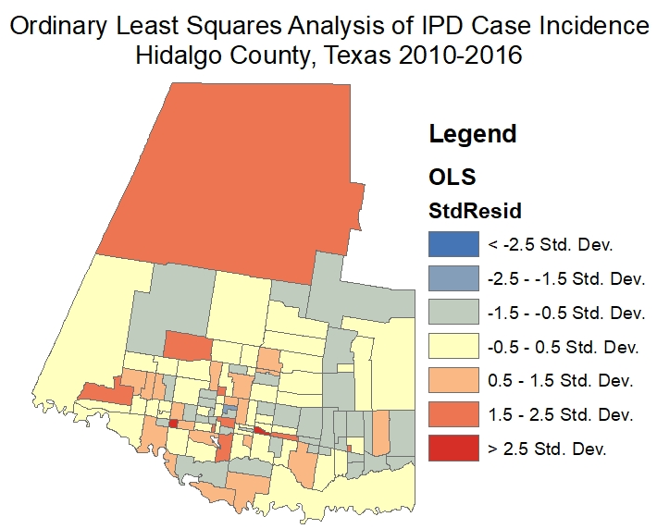
Ordinary Least Squares
Variable | Coef. | Std. Error | t-Statistic | Prob. | Robust_SE | Robust_t | Robust_Pr | VIF
Intercept | 8.337238 | 8.793977 | 0.948062 | 0.345309 | 9.451485 | 0.882109 | 0.379764 | --------
Median HHI | -0.00011 | 0.000057 | -1.98024 | 0.050343 | 0.000054 | -2.08222 | 0.039796* | 4.66852
AvgHH Size | 0.49916 | 0.620409 | 0.804566 | 0.422917 | 0.620357 | 0.804634 | 0.422878 | 1.147504
PrivateH Insurance | 0.059551 | 0.07021 | 0.84818 | 0.398297 | 0.07064 | 0.843015 | 0.401166 | 8.843104
Pop Density | 0.000626 | 0.00021 | 2.976133 | 0.003641* | 0.000247 | 2.529814 | 0.012921* | 1.168593
Census Incidence x10,000 | -0.09301 | 0.073864 | -1.25926 | 0.210785 | 0.073215 | -1.27042 | 0.206799 | 9.509675
High Schoolor Higher(%) | 0.086623 | 0.079946 | 1.083529 | 0.281099 | 0.08433 | 1.027192 | 0.30673 | 7.658657
Bachor Higher(%) | -0.00753 | 0.064367 | -0.11696 | 0.907114 | 0.072657 | -0.10362 | 0.91767 | 2.372627
Hispanic (%) | -0.00504 | 0.063621 | -0.07918 | 0.937033 | 0.069769 | -0.07221 | 0.942571 | 1.867692
Introduction and Study Purpose Methods and Results Discussion and Conclusion

Slide 30
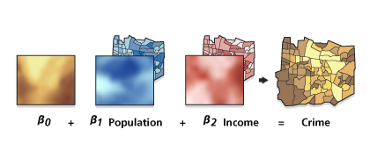
Geographically Weighted Regression (GWR)
A local form of linear regression used to model spatially varying relationships
GWR should be applied to datasets with several hundred features for best results
It is not an appropriate method for small datasets
Local R2: These values range between 0.0 and 1.0 and indicate how well the local regression model fits observed y values
AICc: This is a measure of model performance and is helpful for comparing different regression models
  The model with the lower AICc value provides a better fit to the observed data
http://desktop.arcgis.com/en/arcmap/10.3/tools/spatial-statistics-toolbox/geographically-weighted-regression.htm
Introduction and Study Purpose Methods and Results Discussion and Conclusion

Slide 31
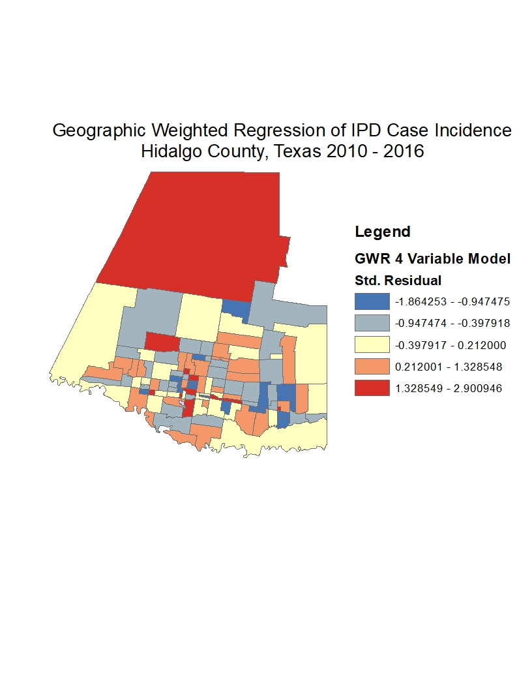
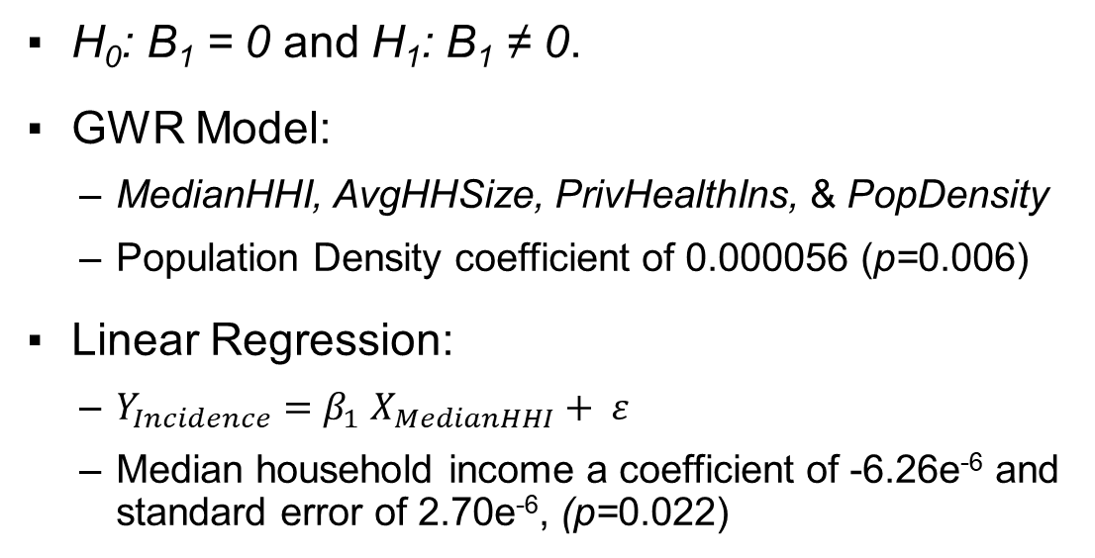
GWR and Linear Regression
H₀: Β₁ = 0 and H₁: B₁ ≠ 0.
GWR Model:
  MedianHHI, AvgHHSize, PrivHealthIns, & PopDensity
  Population Density coefficient of 0.000056 (p=0.006)
Linear Regression:
  $Y_{Incidence}=β_{1} X_{MedianHHI}+ ε$
  Median household income a coefficient of -6.26e⁻⁶ and standard error of 2.70e⁻⁶, (p=0.022)
Model | Coef. | Std. Err. | t | P>|t| | [95% Conf. Interval]
MedianHHI | -0.0000626 | 0.000027 | -2.32 | 0.022 | [-.000116, -9.16e-06]
_cons | 6.633215 | 1.037496 | 6.39 | 0.000 | [4.577142, 8.689288]
Introduction and Study Purpose Methods and Results Discussion and Conclusion

Slide 32
Other Software Platforms

Slide 33
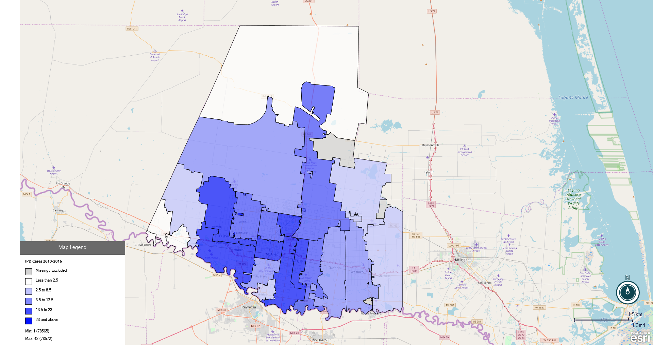
Epi Info
Introduction and Study Purpose Methods and Results Discussion and Conclusion

Slide 34
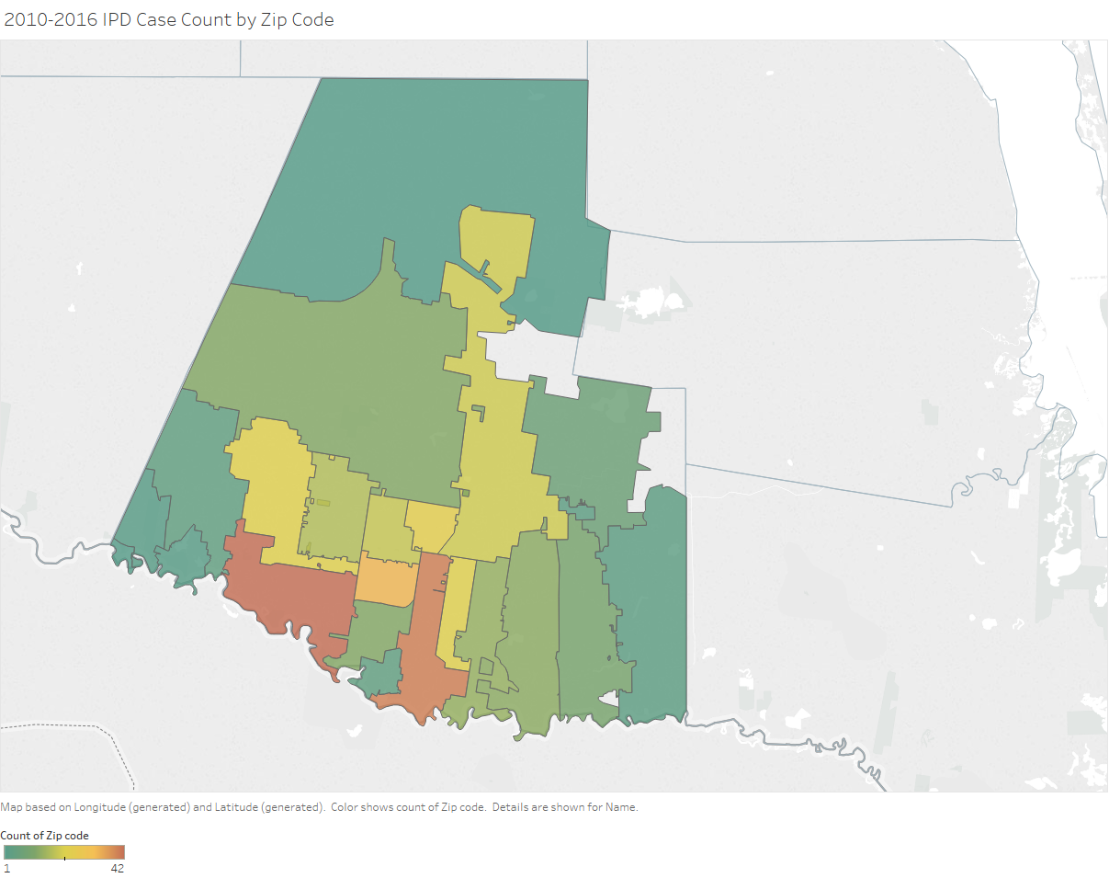
Utilizing Tableau in Spatial Epidemiology:
IPD Cases by Zip Code

Slide 35
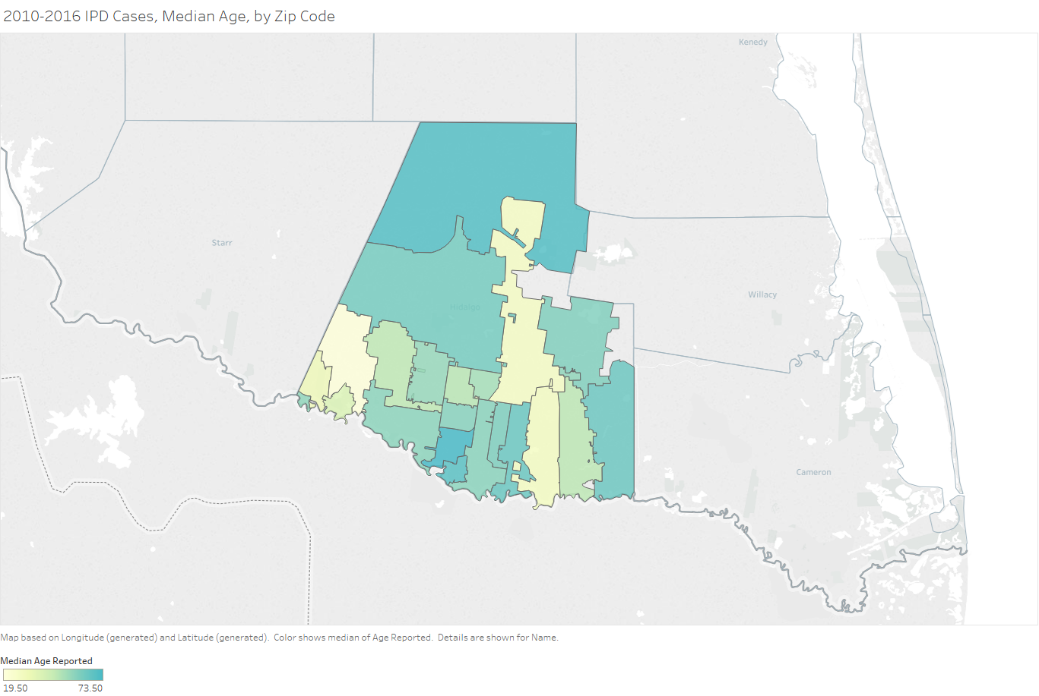
Introduction and Study Purpose Methods and Results Discussion and Conclusion

Slide 36
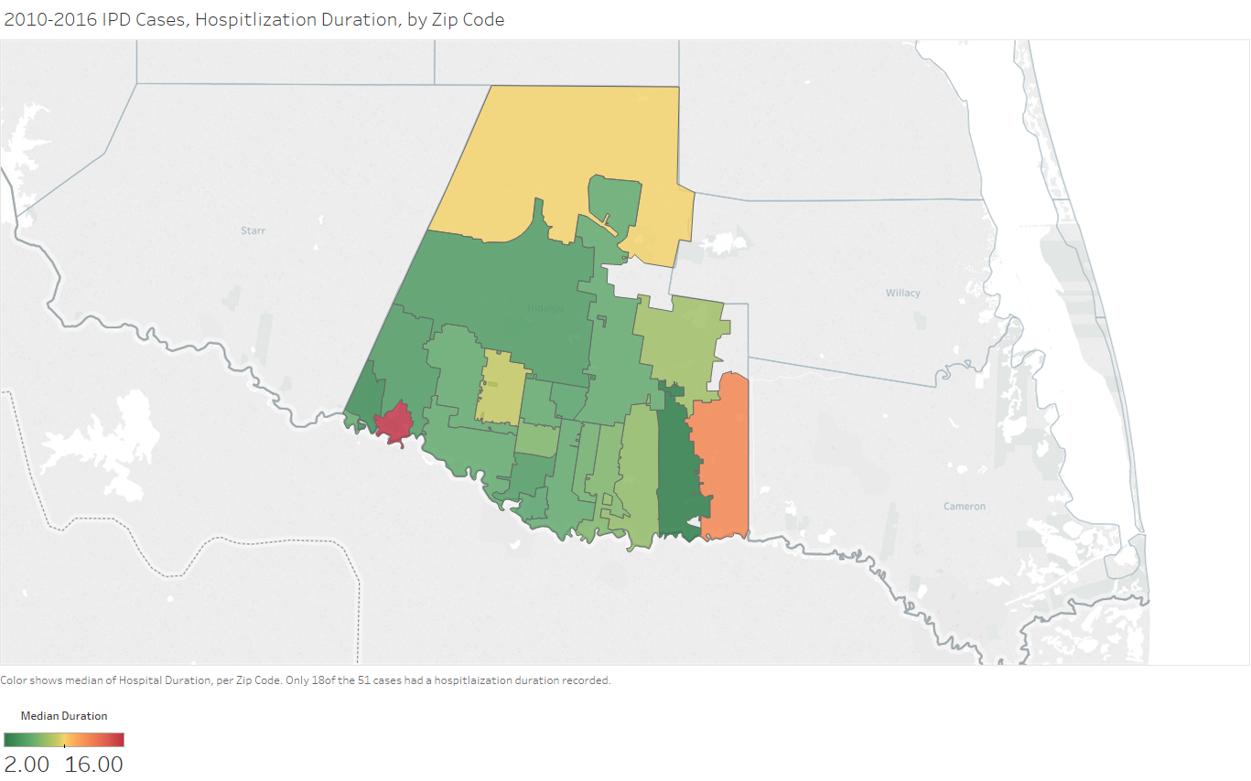
Introduction and Study Purpose Methods and Results Discussion and Conclusion

Slide 37
Summary and Conclusion

Slide 38
Findings and Interpretations
Central Patient: Male, mid to late fifties
2011-2016 case counts consistently in the forties to fifties
Three most recent years have shown an increasing trend line
  Rhode Island study decreasing case trend line from 2011 (94 cases) to 2015 (62 cases) (Gosciminski et al., 2017)
  Taiwan university hospital study’s incidence of IPD was 3.8 per 10,000 in 2010, decreased to 3.1 in 2011, and then to 2.1 in 2012 (Chih-Cheng et al., 2014)
  Guatemalan hospital study presented with a stable, non-decreasing trend line, with case count from 32 cases in 2009, to 27 cases in 2010, to 32 cases in 2011, to 22 cases in 2012 (Contreras et al., 2015)
Introduction and Study Purpose Methods and Results Discussion and Conclusion

Slide 39
Discussion:
Spatial Analysis of IPD Incidence
Within the Ordinary Least Squares analysis, population density
(p = 0.0129) presented significant association with IPD case incidence
Median household income (p=0.022) with negative relationship
Data Non-Normal, Residuals, Goodness of fit
H₀: Β₁ = 0 rejected
Edcouch, Texas had highest city incidence
Private Health Insurance, Education, Ethnicity, and Foreign-Born had no significance
Introduction and Study Purpose Methods and Results Discussion and Conclusion

Slide 40

Summary and Conclusion
Explore Software Options
Be Aware of Data Security
There is a lot of Online Resources Available
Spatial Epidemiology has expanded our Public Health Toolkit
Introduction and Study Purpose Methods and Results Discussion and Conclusion

Slide 41

Thank
You
Any Questions?

