Slide 1
GIS and Spatial Analysis:
Project Work Related to the Opioid Epidemic
Erin E. Jacque, GISP, MPS
Research Assistant
Dept. of Public Health & Community Medicine;
Tufts University School of Medicine
March 19, 2019

Slide 2
About me
Graduate Student at Northeastern - interest in the opioid epidemic
Several class research papers subject matter focus on the epidemic
I introduced myself to my current supervisor (Dr. Thomas Stopka, Associate Professor at Tufts School of Medicine, Dept. of Public Health & Community Medicine) and expressed interest in the subject
Hired as a Research Assistant at Tufts in October of 2017
I was an unconventional student. Prior to working at Tufts I had 14 years of GIS experience in a range of disciplines
In 2018 I was awarded a scholarship from the Northeast Geographic Information Society for my continued work at Tufts

Slide 3
Introduction
Datasets
Collaboration
Maps and data analysis
Projects – A brief overview of three projects I have contributed to

Slide 4
Datasets: Related to Access to Services
Drug treatment facilities: point data
Medications for Opioid Use Disorder (MOUD) Facilities: point data
Public Transportation: line data
Syringe Service Providers (SSPs): point data for brick & mortar locations, polygons for mobile service areas
Pharmacies: point data

Slide 5
Datasets: Related to Opioid Burden
Opioid overdose: point or polygon data
Opioid Use Disorder (OUD): polygon data
Co-morbidities (HIV, HCV, Depression, Anxiety): polygon data, likely point data aggregated to polygon
Emergency Response data (ER records, Ambulatory services): point or polygon data
Syringe discard data: point data

Slide 6
Other Datasets
Socio-Economic data: polygon data
  Poverty
  Income
  *Employment
  Occupation
  Race/Ethnicity
Highway Exists, transportation networks: line data
Fast food establishments: point data
Public Restrooms: point data

Slide 7

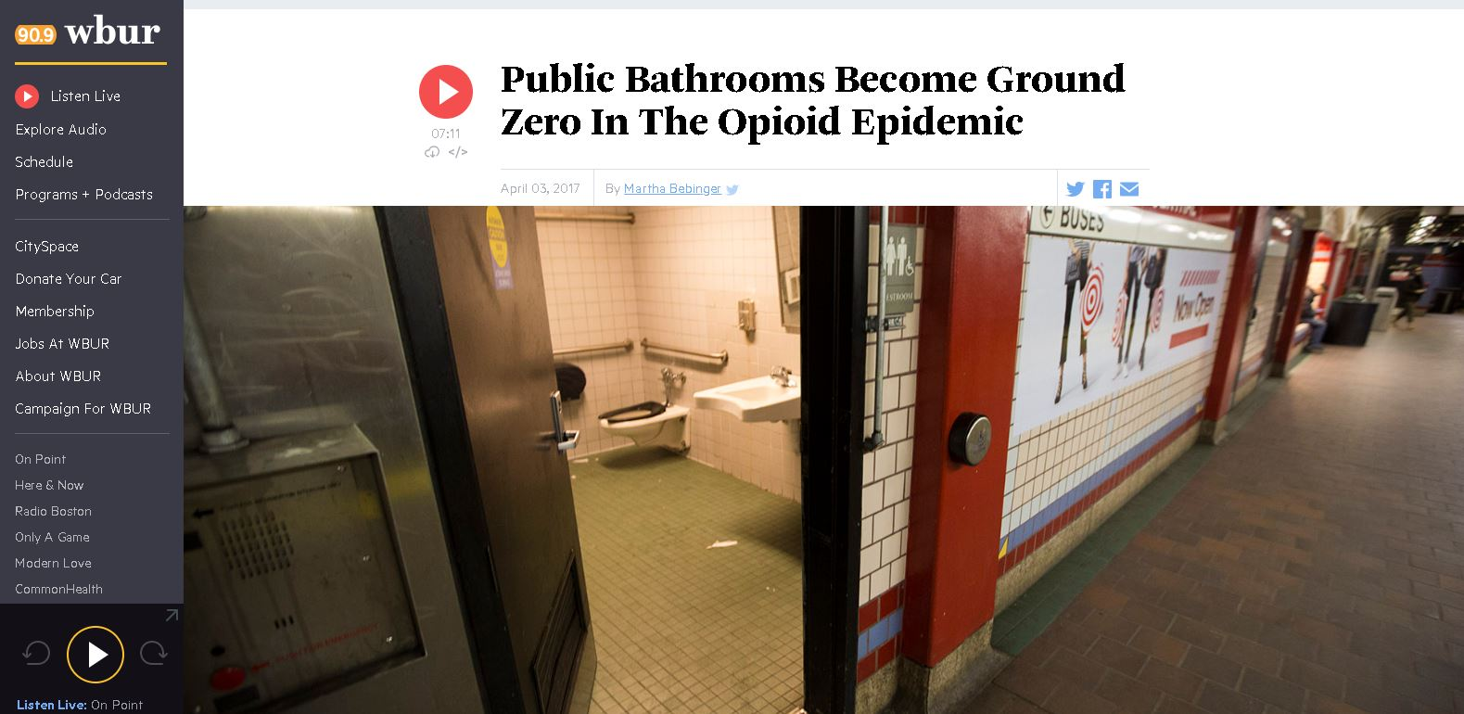
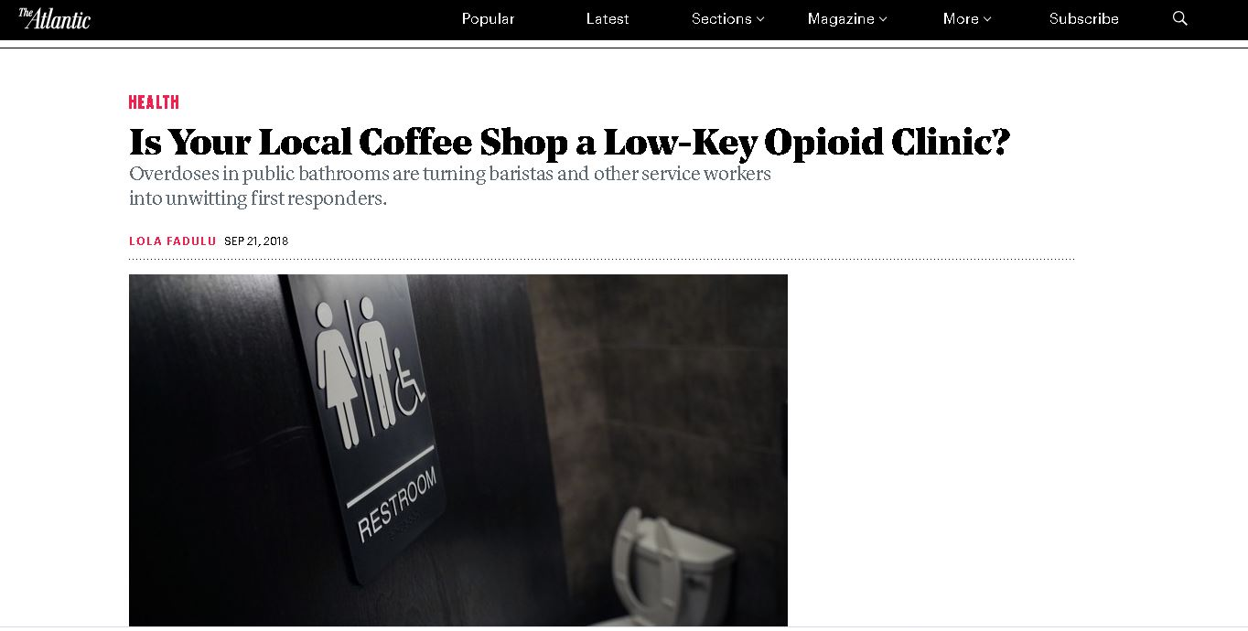

Unexpected Relationships

Slide 8
Collaboration
Subject
Matter Experts:
  Epidemiology
  Addiction Specialists
  Statisticians
  Geographic Information Systems Specialists
  Directors/staff of SSPs, community centers,
  etc.
Experts from :
  Academic institutions
  Medical institutions
  State departments of public health
  Public safety (Police, Fire, EMTs)
  Community groups
  Civic/community leaders

Slide 9

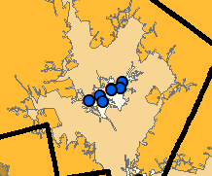
Examples: Types of Analysis
Analysis tools I have used on Tufts projects:
  Hotspot analysis: optimized hotspot analysis; 5-step process (Stopka et al.) to identify statistically significant hotspot and coldspot clusters
  Kernel density estimates (KDEs; “heat maps”)
  Distance buffers (consecutive distance rings)
  Service areas (distance using road networks)
  Weighted Overlay
Other types of analysis
  Nearest neighbor hierarchal clustering
  Spatial distributions
  Drive time analysis

Slide 10
Project Examples
DISCERNNE (MA, NH, VT)
Massachusetts Department of Public Health, Opioid Hotspot Project (MA)
Capstone Project (Northeastern University)/Lowell Vulnerability Analysis (PEERs) (Lowell, MA)

Slide 11
DISCERNNE
The Drug Injection Surveillance and Care Enhancement for Rural Northern New England (DISCERNNE) study (PI: Friedmann, UMass Med. School-Baystate; Co-I: Stopka)
One of eight national studies funded by the National Institute of Health (NIH)/Centers for Disease Control (CDC)/Substance Abuse and Mental Health Administration (SAMHSA) in 2017 to assess and understand the opioid epidemic in high risk rural locations across the U.S.

Slide 12
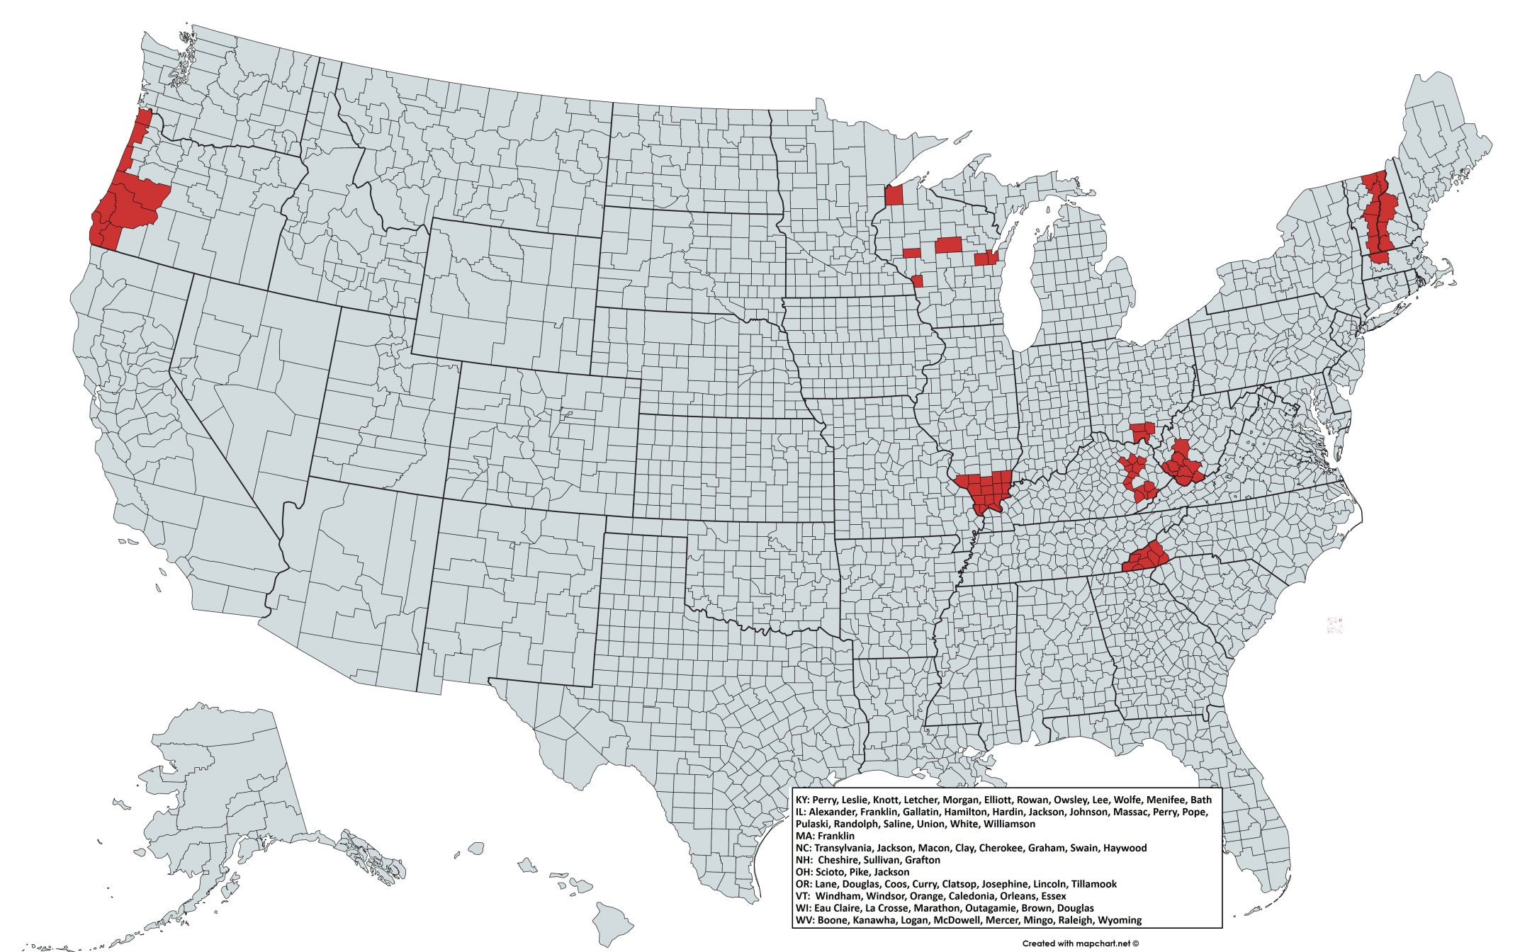

DISCERNNE Study Areas

Slide 13
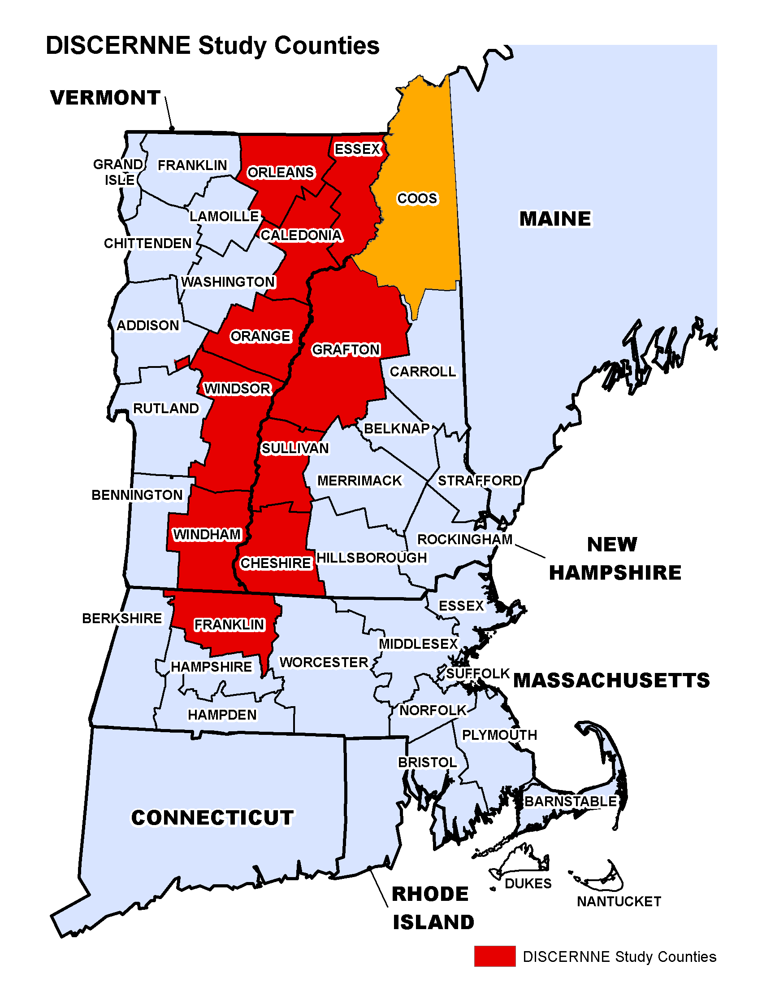
New England Study Area
Massachusetts: Franklin County
New Hampshire: Cheshire, Sullivan, Grafton, Essex, and Coos Counties
Vermont: Caledonia, Orleans, Orange, Windham and Windsor Counties

Slide 14
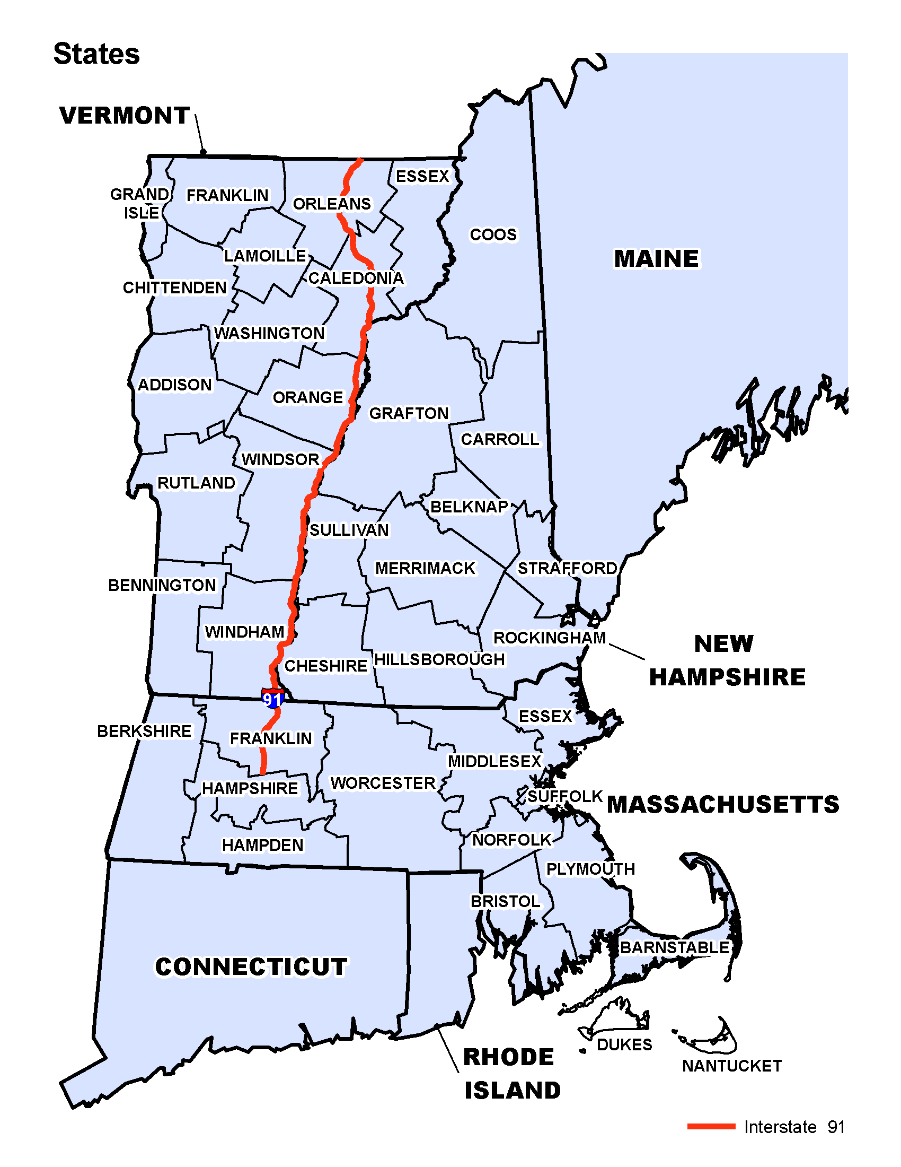
Background/Objectives
Characterize the risk environment and epidemiology in 11 rural counties in MA, VT and NH that abut I-91. Within those counties:
  Assess the demographics and underlying trends (income, race, unemployment).
  Assess the opioid syndemic including HIV, Hepatitis C Virus, and STIs (syphilis), fatal and non-fatal opioid overdose burden.
  Assess available services (SSPs, drug treatment) to determine if the needs related to the syndemic are being met, or whether additional services or approaches may be beneficial.
Interstate 91

Slide 15
Methods
State epidemiologists, academic researchers, public health staff, and community partners convened to perform epidemiologic policy and legal scans in the 11 rural counties:
Accessed the geospatial distribution of SES (socioeconomic status?) variables;
Assessed rates of overdose and infectious complications;
Examined access to Medication Assisted Therapy (MAT), harm reduction, pharmacy, healthcare, and disease prevention and treatment resources;
Generated geographic information system (GIS) maps, causal diagrams, and policy summaries.

Slide 16

Process
Consensus building and definition development:
Workgroup met biweekly via video conference to:
develop and refine definitions for key opioid epidemic measures
developed data dictionaries and data tables shells that collaborators filled. When data were available for all 11 counties across our three states, we merged data into one dataset for GIS mapping
GIS Mapping and Spatial Analysis:
Maps to assess the geospatial landscape for opioid epidemic outcomes at the county, municipality, and census tract level to assess burden
Maps at the state, county, and sub-county level to assess access
Assessed access to public transportation in our study catchment area

Slide 17
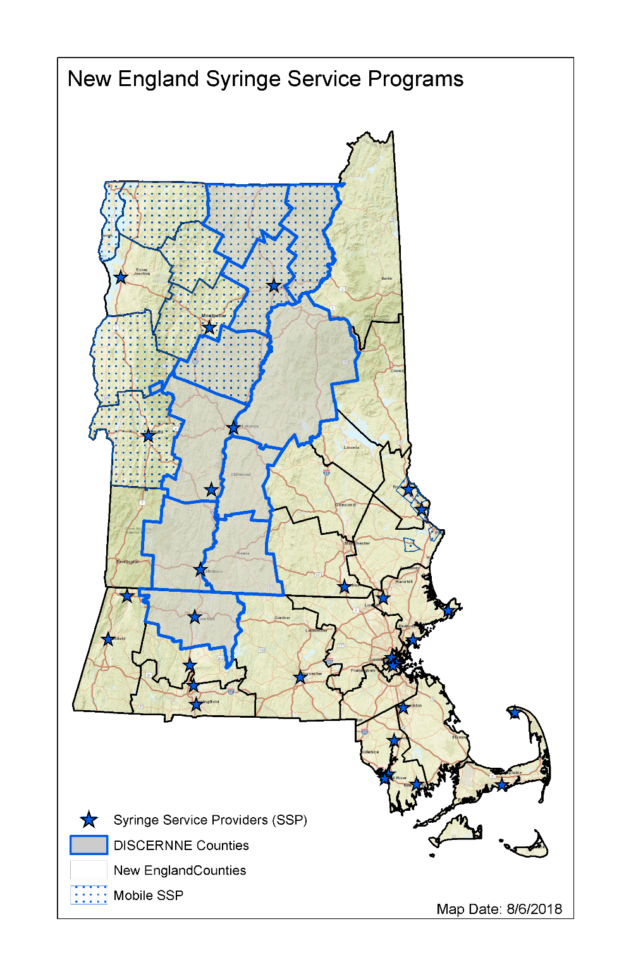
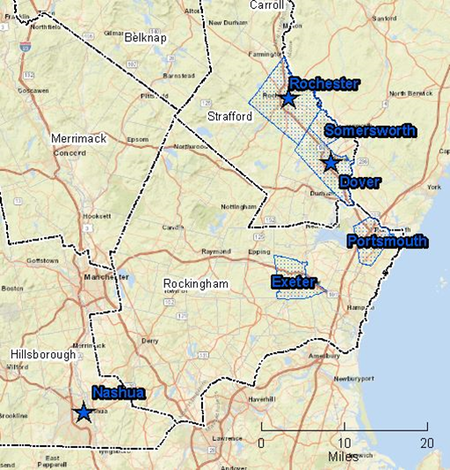
A few map examples: Access
Syringe Service Programs

Slide 18
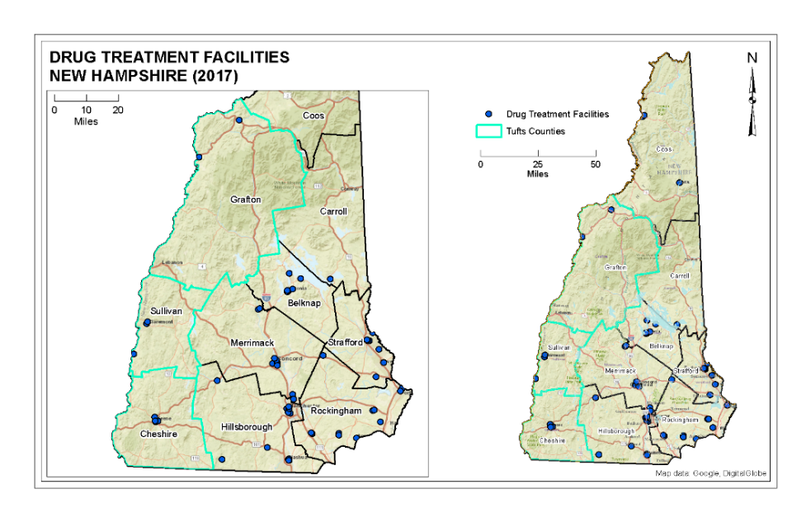
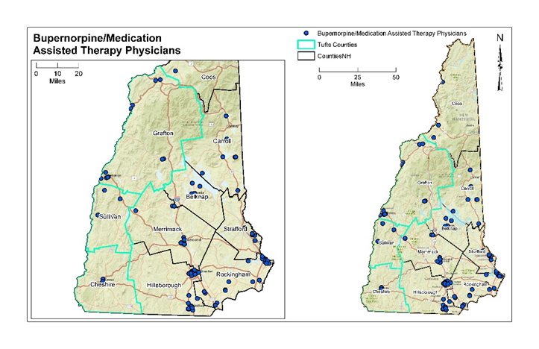
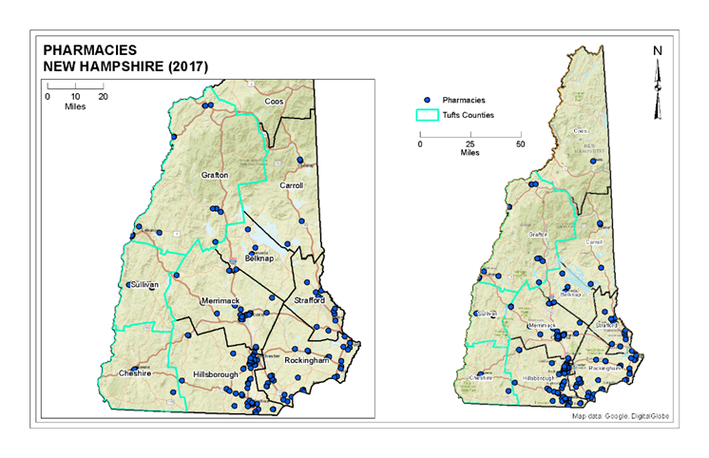
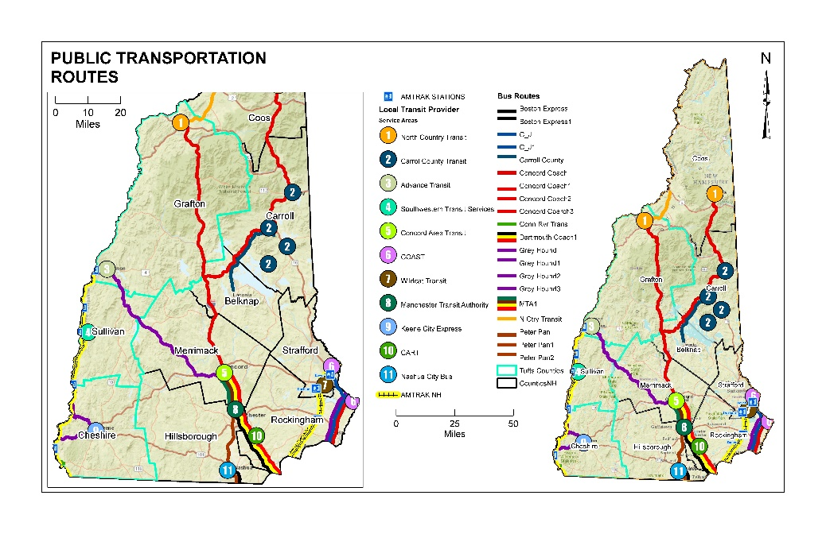
Services and Transportation: The New Hampshire Experience

Slide 19
Opioid Hotspot Project Team
Tufts School of Medicine
Mass. Department of Public Health
UMass Med. School-Baystate

Slide 20
Background/Objectives
Examine variables (access, burden) that are suspected to be closely associated with the opioid syndemic for geospatial patterns.
Use Hotspot Analysis (5-Step Process) on variables to identify geographic areas of high statistical significance.
Conduct Geographically Weighted Regression to as a means to predict the relationship between variables.

Slide 21
Methods
Academic researchers, and public health staff convened to identify relevant variables.
Data were compiled, suppressed values were imputed, and data was imported into ArcMap.
Descriptive Count and Rate Maps were Developed for all relevant variables.
Hotspot Analysis was conducted on a subset of variables.
Geographically Weighted Regression was conducted on a subset of variables.

Slide 22
GIS Team Tasks & Document Development
Standard Operating Procedures Document
Project Map Templates (reviewed and approved by project team)
Count, Rate, Hotspot Analysis Map Development
Revise /Update, and Consolidate 5-Step Recipe Book
Project Index/Inventory
Project Matrix

Slide 23
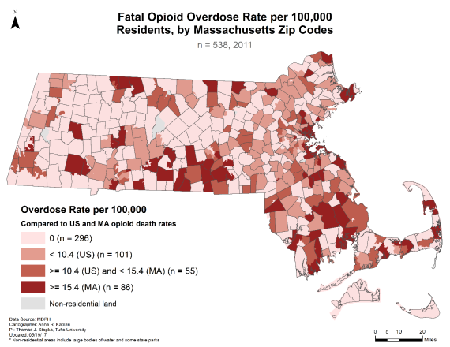
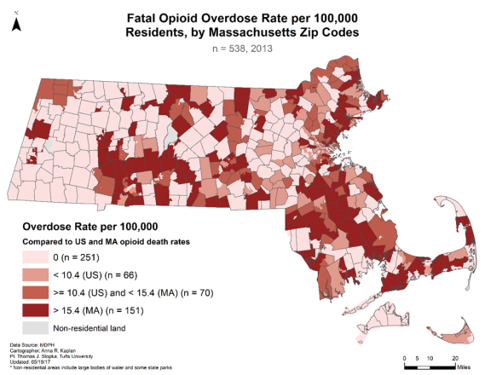
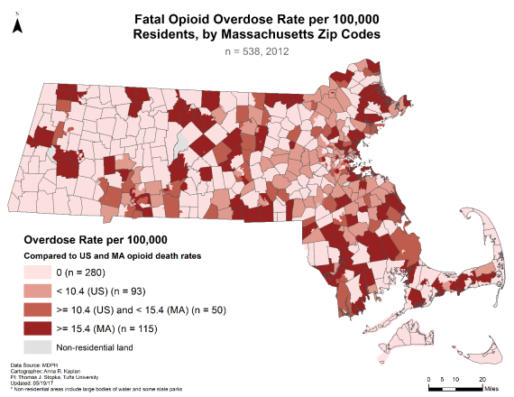
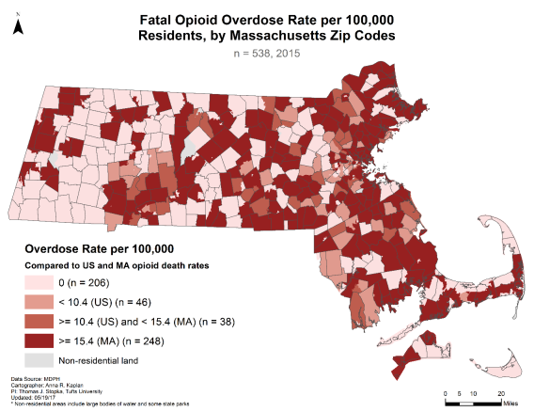
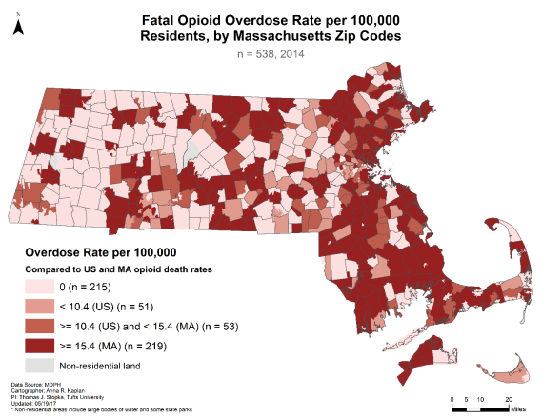
Fatal Overdose:
Massachusetts, 2011-2015

Slide 24
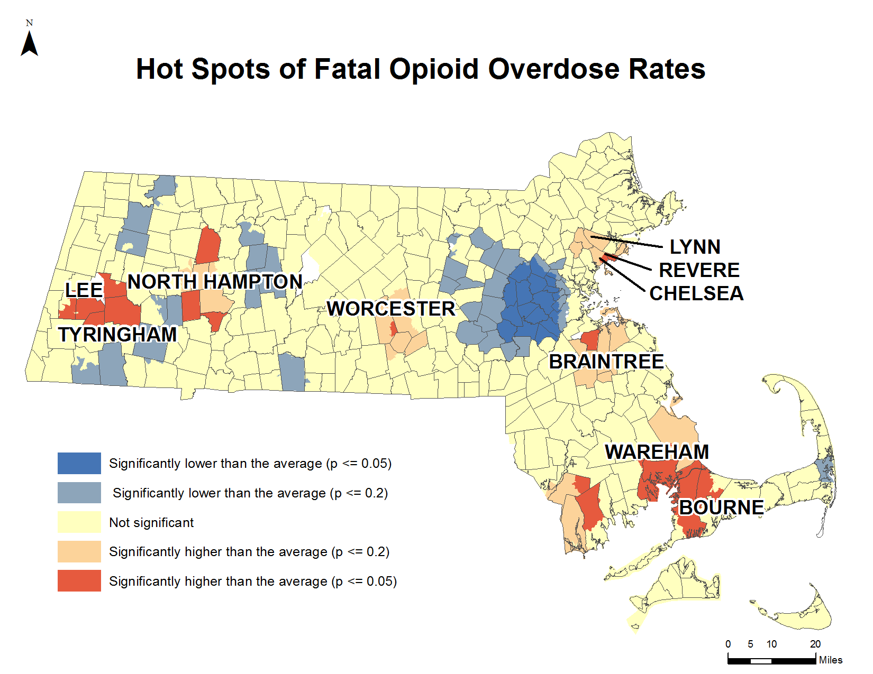
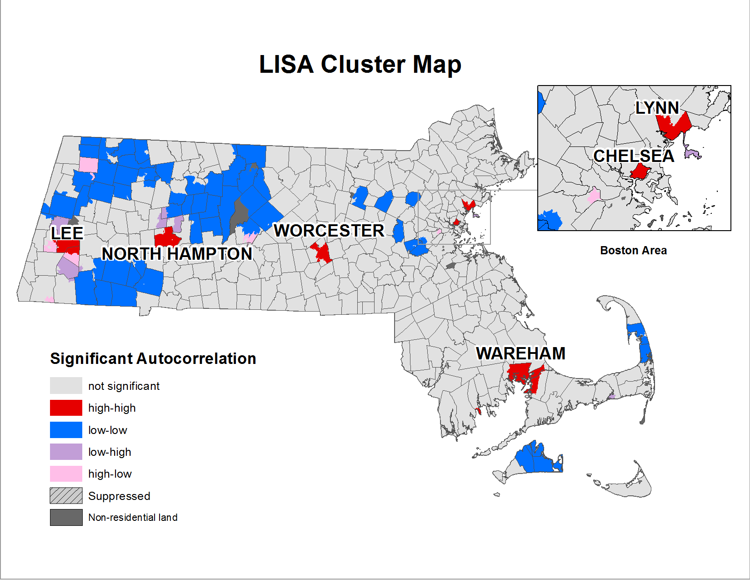
Fatal Overdose Hotspot Clusters:
Massachusetts, 2011-2015
Hotspot Clusters (Getis-Ord Gi*)
Hotspot Clusters (LISA)

Slide 25
Capstone Project/Lowell Vulnerability Analysis
Death Records – Address Point locations 2015-2016. KDE used to identify high density fatality areas density per square mile.
HCV Data 2001-2013 –Aggregated data. KDE estimates to establish a density per square mile based on aggregated data.
Syringe Discard Data – Point data (Trinity EMS Emergency Services) that documented syringe discard calls. Not all reports resulted in a syringe being found. Some reports resulted in multiple syringes being recovered. KDEs established a density per square mile.

Slide 26
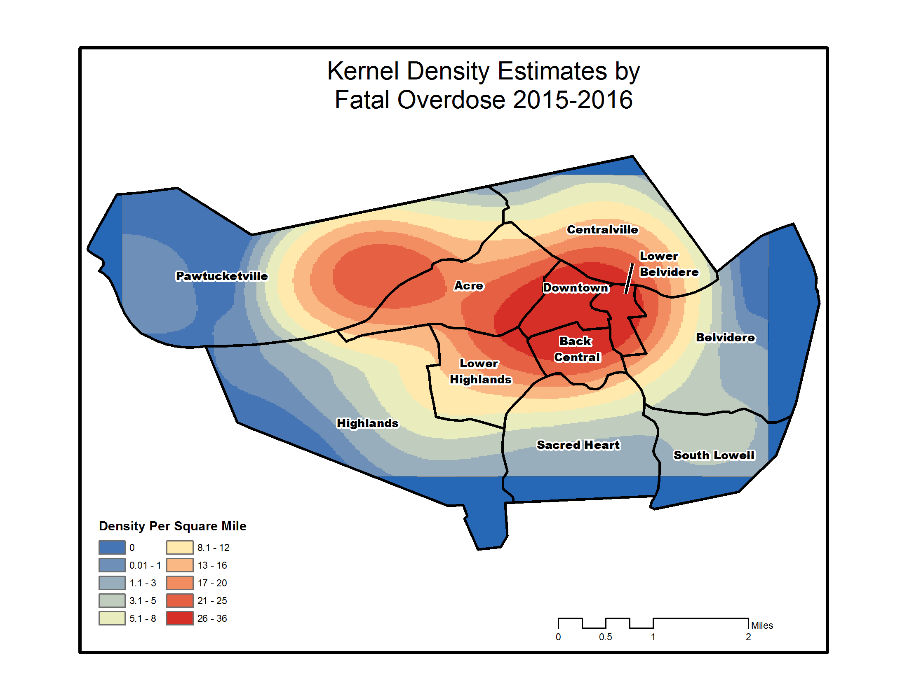
Kernel Density Estimate

Slide 27
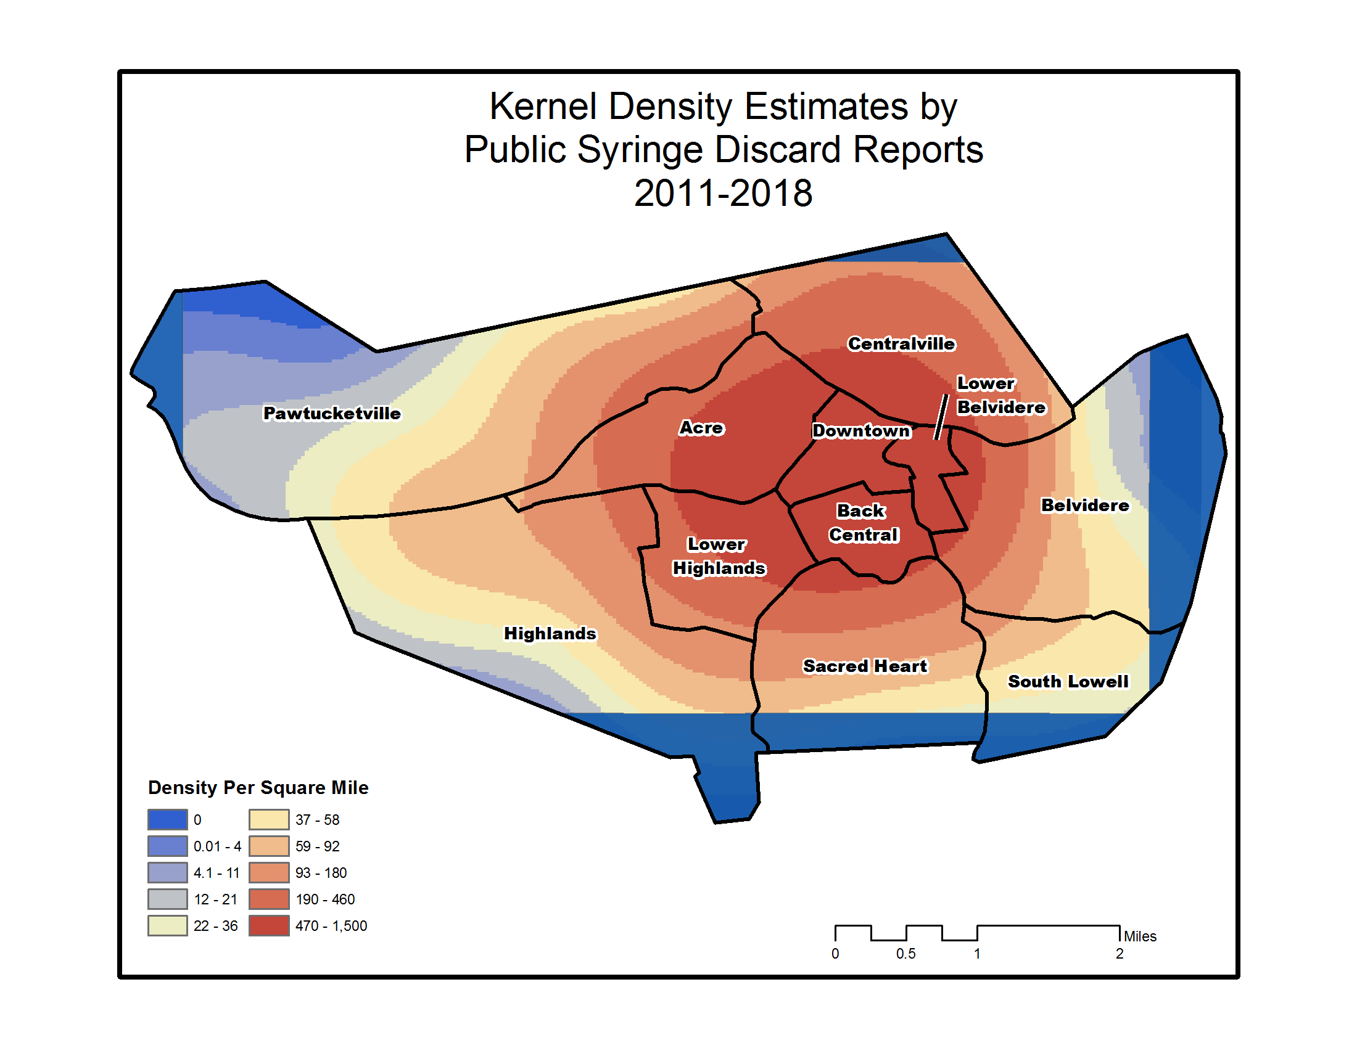
Kernel Density Estimate

Slide 28
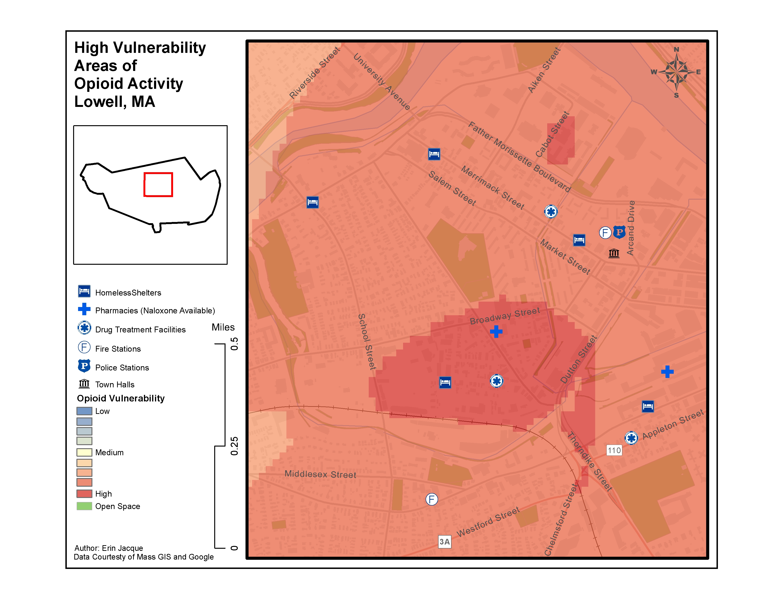
1st Weighted Overlay prepared for Capstone Project

Slide 29
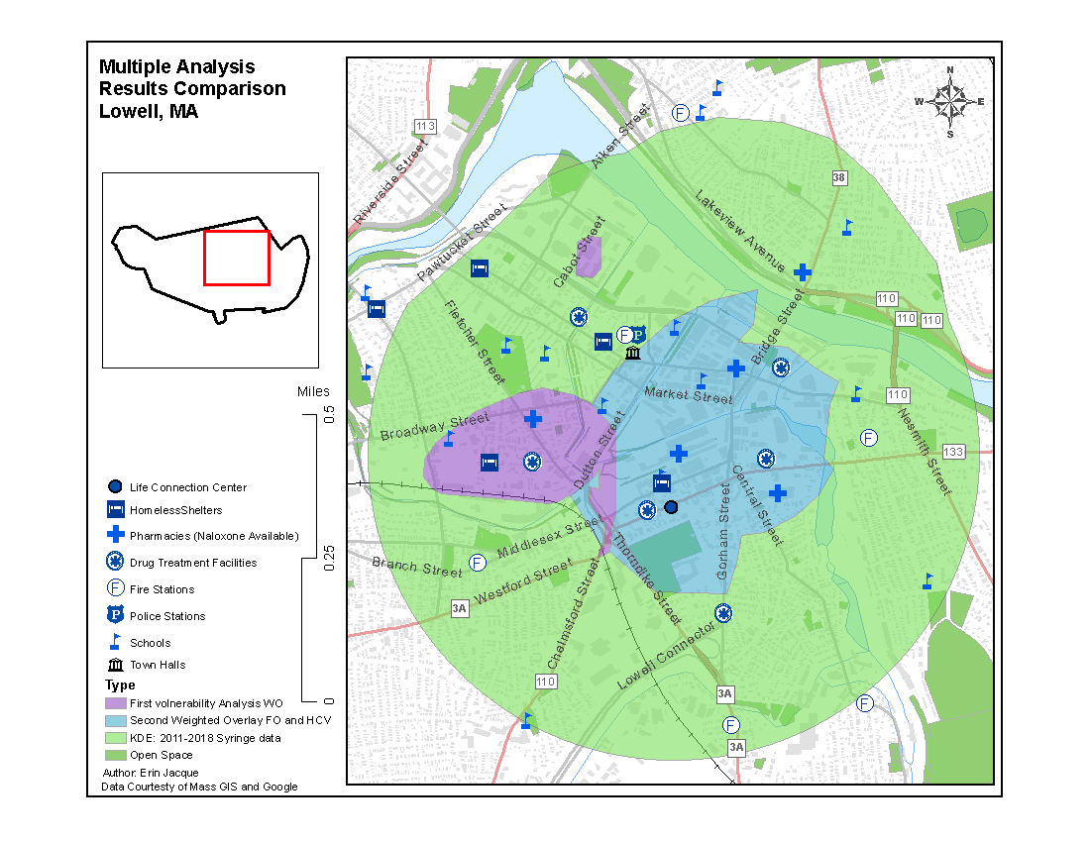
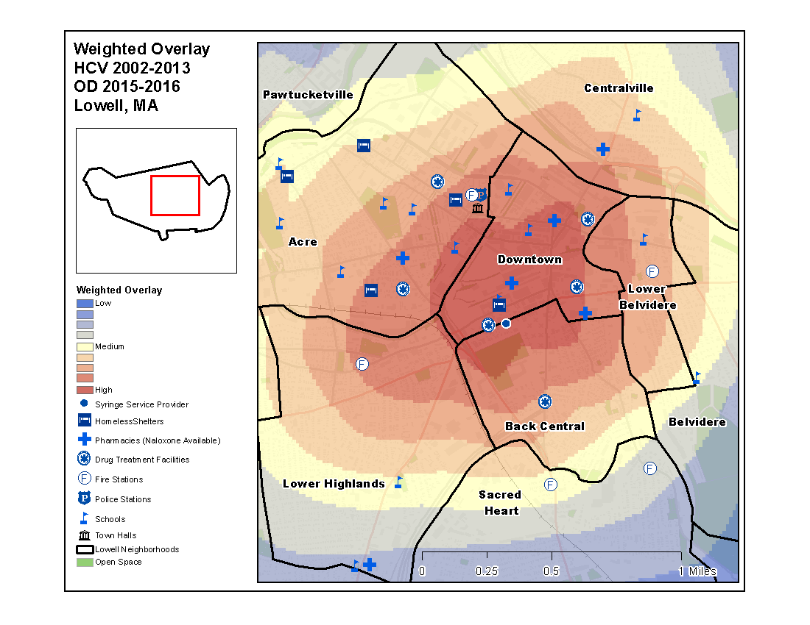
Comparing Iterations of Weighted Overlay
Second Iteration
First Iteration
Third Iteration

Slide 30
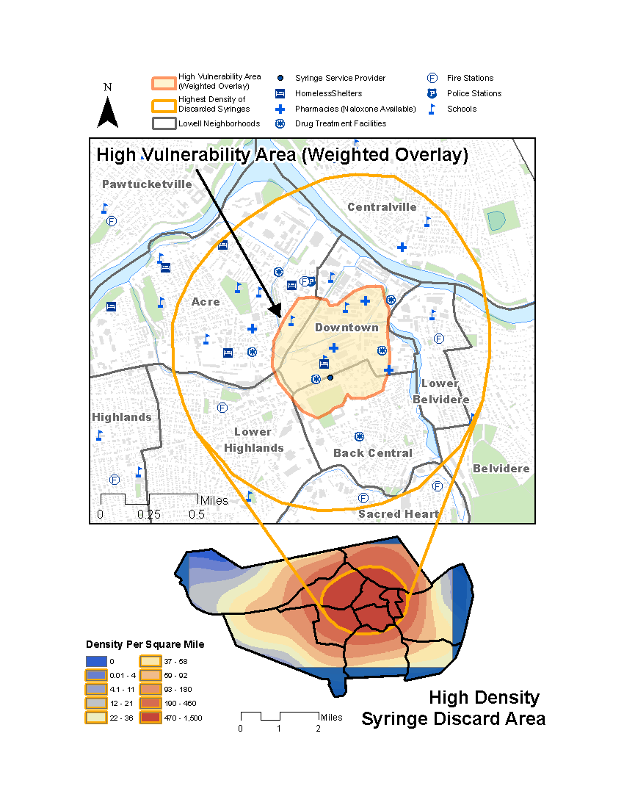
3rd Iteration of Weighted Overlay

Slide 31
Thank you!
Questions?
Erin E. Jacque
Erin.jacque@tufts.edu

