Slide 1
Ensuring Confidentiality of Geographically Sensitive Data
Brooke Reams

Slide 2
Displaying data on a map allows us to see:
Spatial patterns
Correlations
Associations

Slide 3
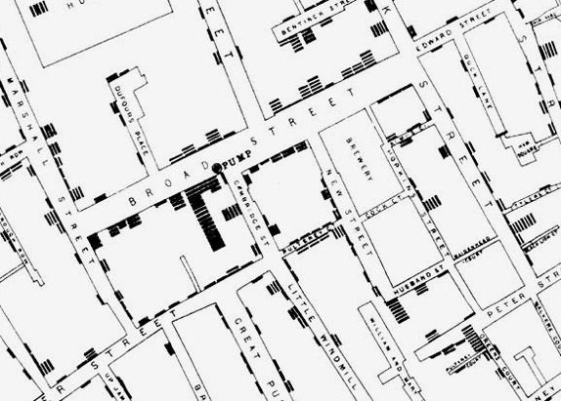
John Snow and the 1854 Cholera Outbreak in London
Cholera thought to be caused by Miasma – contaminated air
Snow mapped deaths associated with the disease
Source of the outbreak: Broad Street water pump
Outbreak caused by sewage dumped into cesspools near the Broad Street water pump

Slide 4
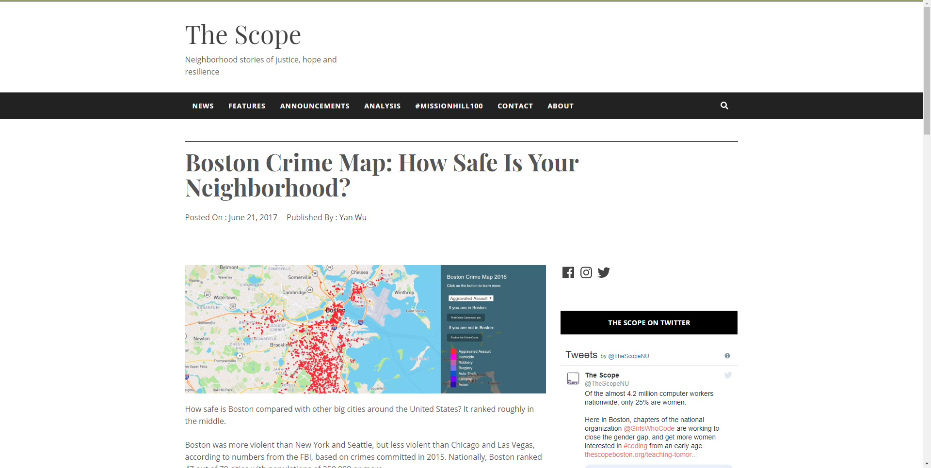

Slide 5
Geocode
ge·o·code
/ˈjēəˌkōd/
verb
gerund or present participle: geocoding
provide geographical coordinates corresponding to (a location).
"participants' residential addresses were geocoded, enabling individual survey data to be linked with data on land use“
Source: Dictionary.com

Slide 6
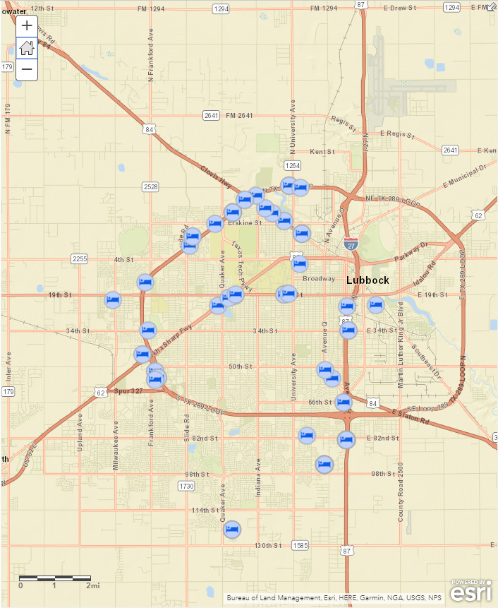
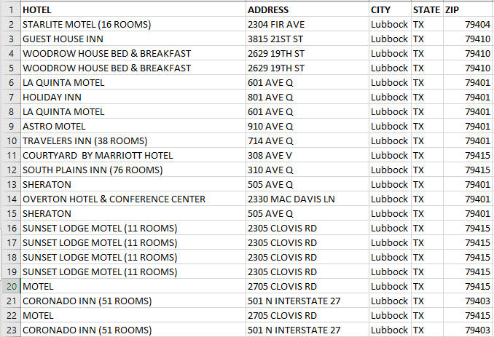

Slide 7
Problem solved… right??
Geocode data by address to display on a map
Mask the Address number from the Text

Slide 8

Not exactly…

Slide 9
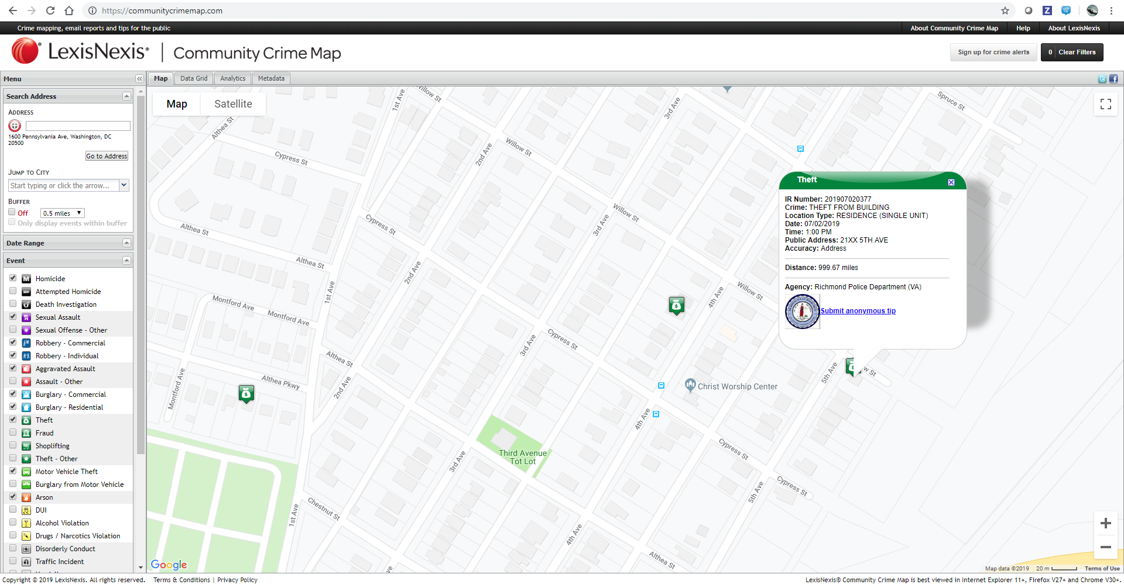

Slide 10
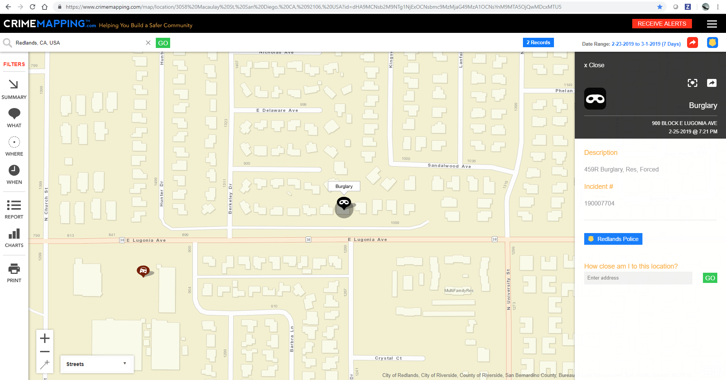

Slide 11
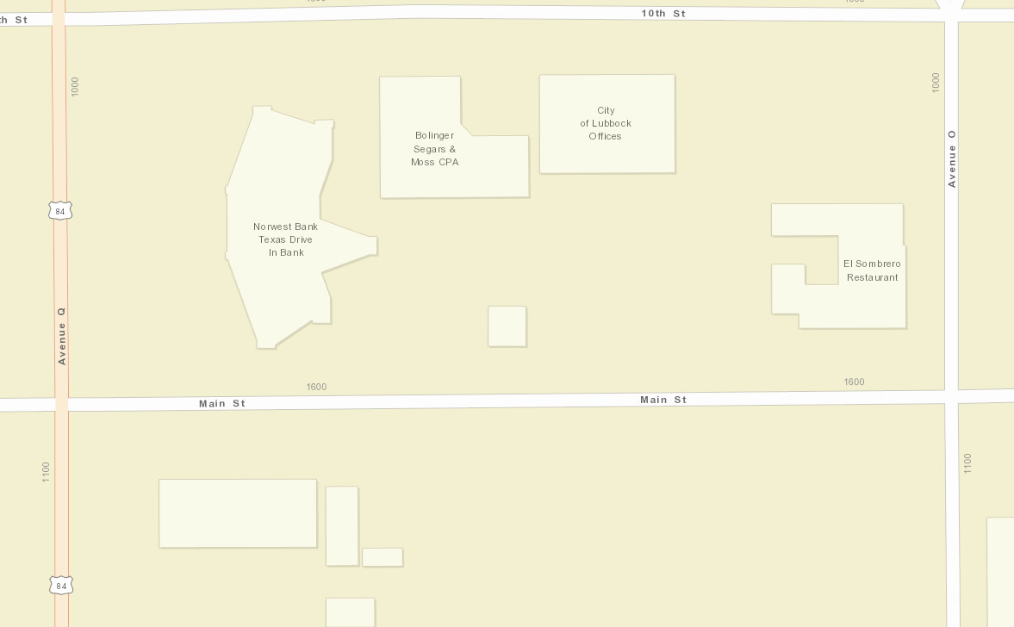


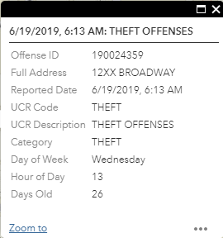
Solution
Find address at center of street segment
Geocode on street segment center address
Mask address number
1698
1686
1650
1600
16XX MAIN ST

Slide 12
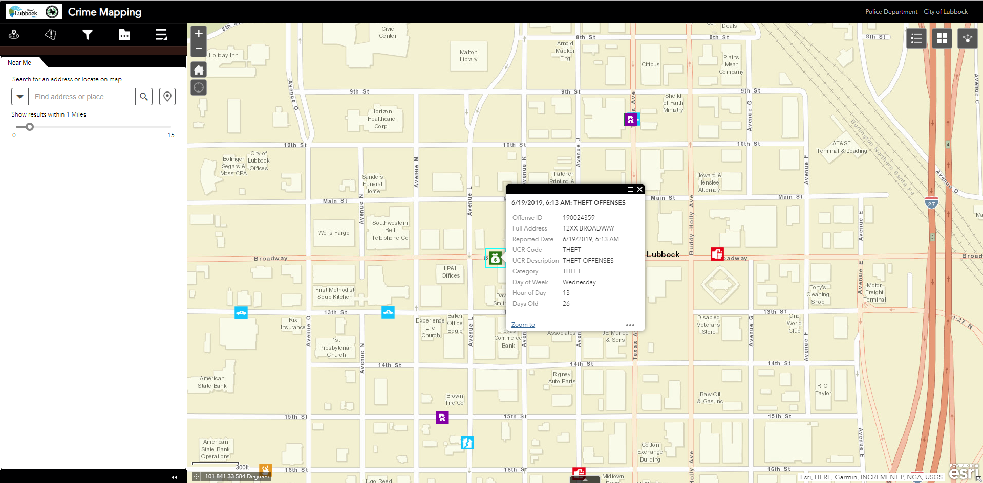

Slide 13
The Process
Access the Esri World Geocode Server (or a custom geocode server built w/ Esri technology)
Use the findAddressCandidates operation to retrieve street segment info

Slide 14
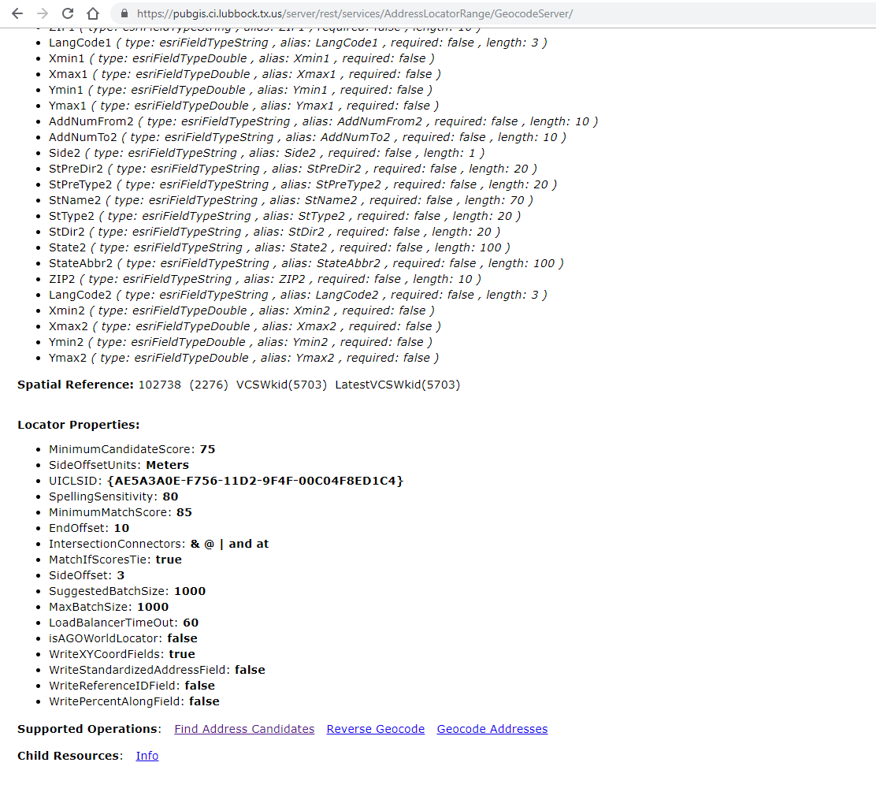

Slide 15
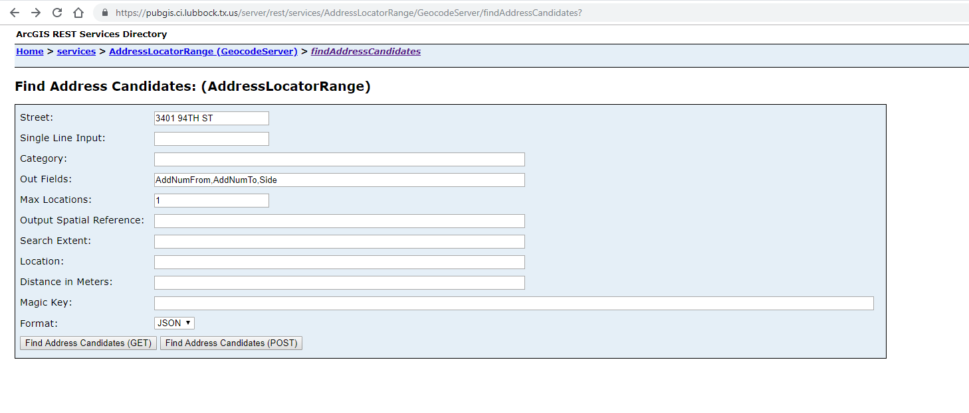

Slide 16
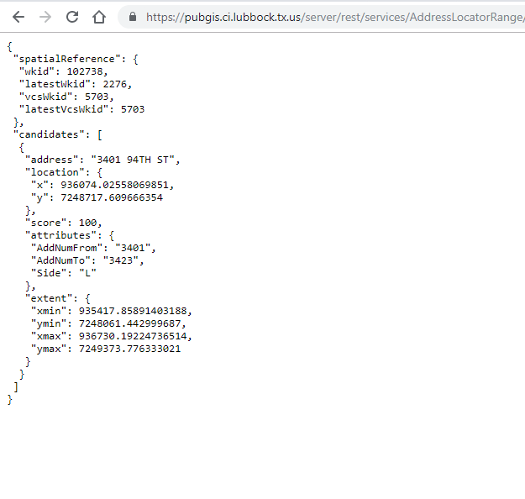

Slide 17
The Process
Access the Esri World Geocode Server (or a custom geocode server built w/ Esri technology)
Use the findAddressCandidates operation to retrieve street segment info
Calculate the address at the street segment center

Slide 18
Formula
(AddNumFrom + AddNumTo) / 2
(3401 + 3423) / 2 = 3412

Slide 19
The Process
Access the Esri World Geocode Server (or a custom geocode server built w/ Esri technology)
Use the findAddressCandidates operation to retrieve street segment info
Calculate the address at the street segment center
Store street segment center address in new table

Slide 20
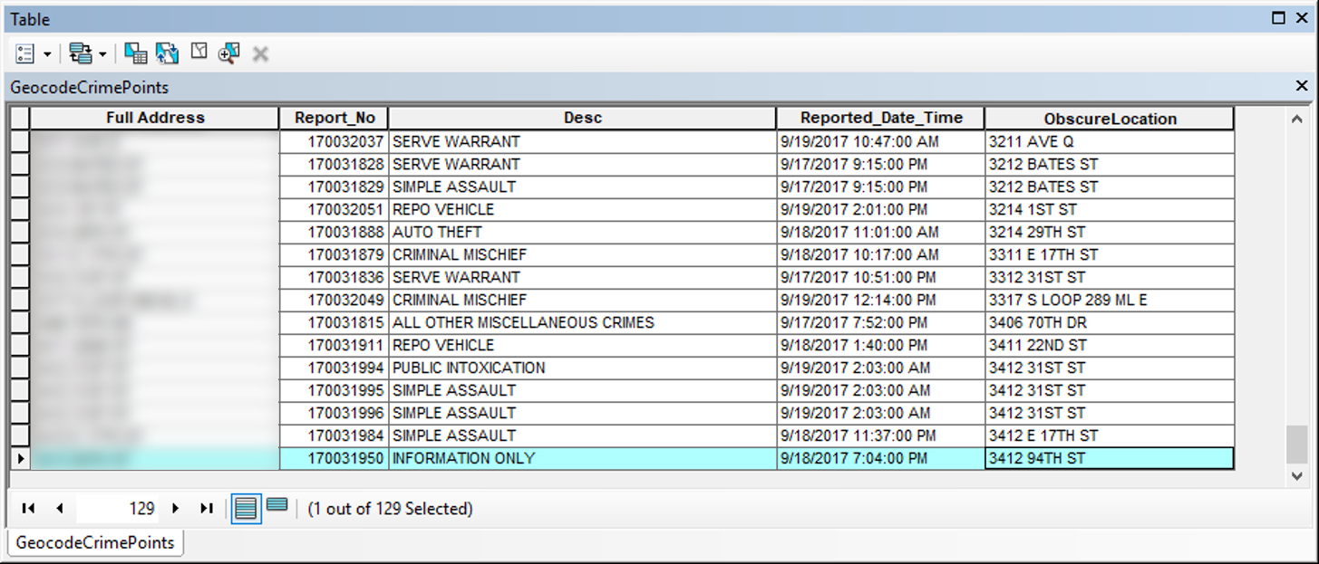

Slide 21
The Process
Access the Esri World Geocode Server (or a custom geocode server built w/ Esri technology)
Use the findAddressCandidates operation to retrieve street segment info
Calculate the address at the street segment center
Store street segment center address in new table
Batch geocode records on street segment centers

Slide 22
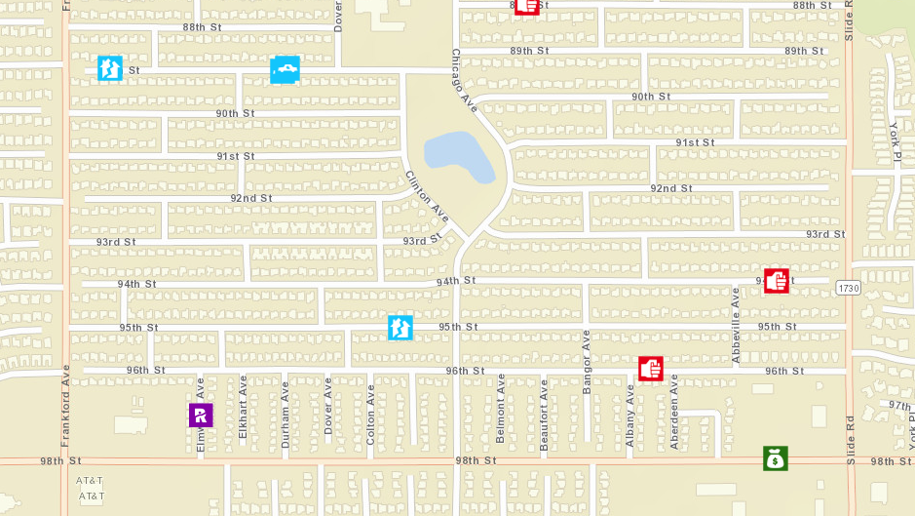

Slide 23
The Process
Access the Esri World Geocode Server (or a custom geocode server built w/ Esri technology)
Use the findAddressCandidates operation to retrieve street segment info
Calculate the address at the street segment center
Store street segment center address in new table
Batch geocode records on street segment centers
Mask the last two digits in the address number

Slide 24
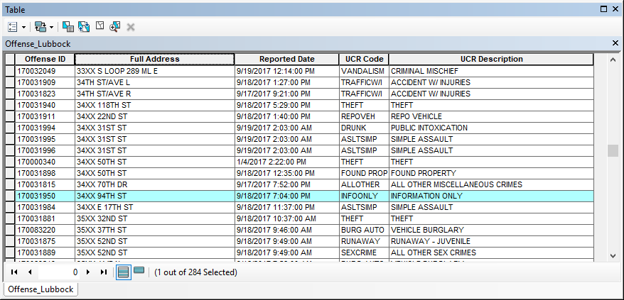

Slide 25

What if there are dozens, hundreds, or THOUSANDS of records??

Slide 26


Slide 27
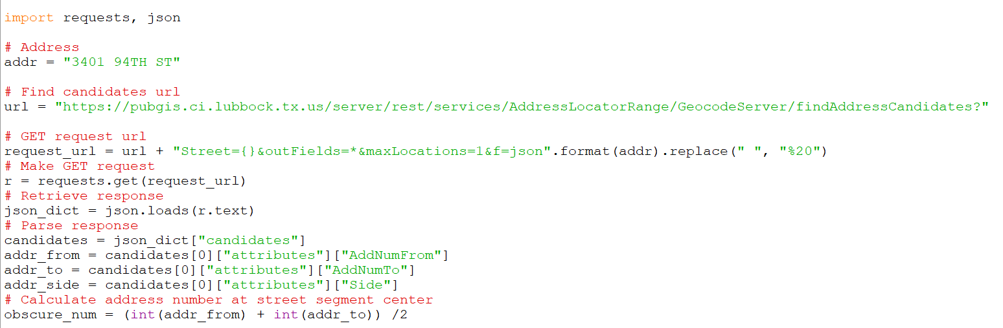
The Process with PYTHON
Use the requests and json modules to make an http request on the findAddressCandidates operation via REST

Slide 28
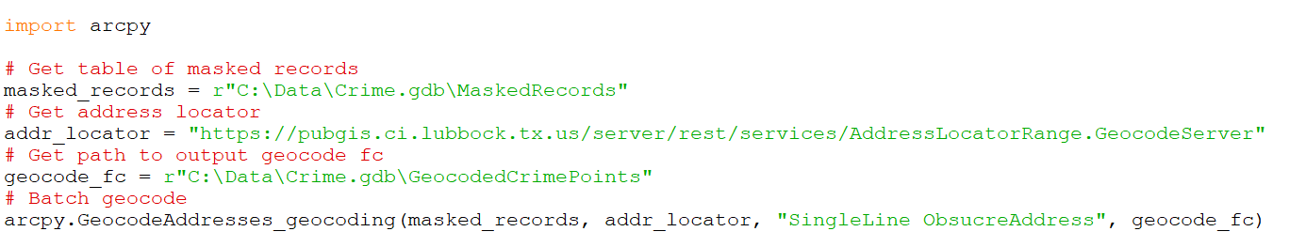
The Process with PYTHON
Use the requests and json modules to make an http request on the findAddressCandidates operation
Batch geocode the table of masked addresses

Slide 29
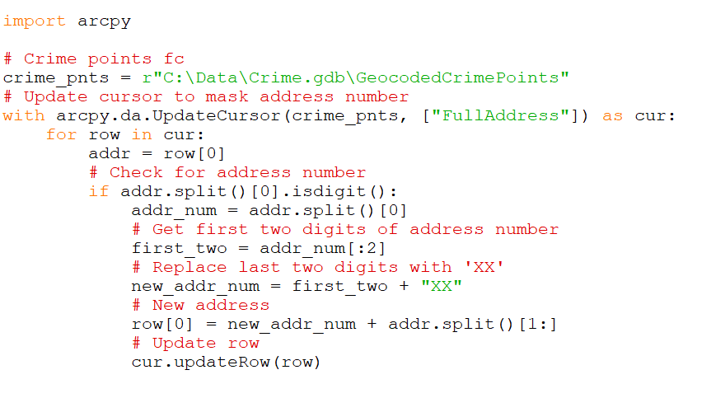
The Process with PYTHON
Use the requests and json modules to make an http request on the findAddressCandidates operation
Batch geocode the table of masked addresses
Mask address number

Slide 30
Is this solution 100% fool proof?

Slide 31
Not exactly…

Slide 32
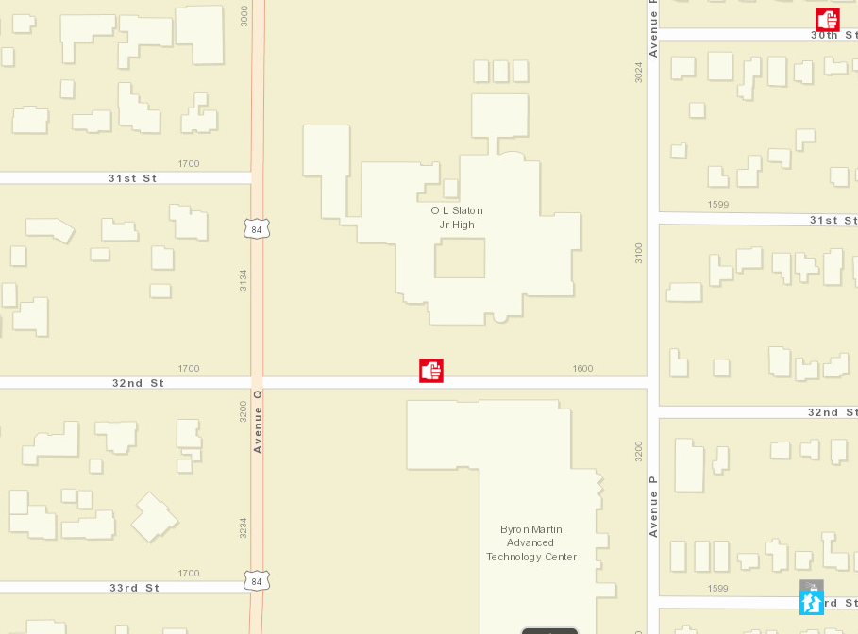
Street Segment Center Anomalies
Remote or rural areas where there’s only one address on the entire street segment
Businesses that consume an entire street segment

Slide 33
Pre-determine street segments that only have one building and then…
Geocode the point to the center of the closest street segment That HAS multiple buildings
Don’t show the point at all
Something else…

Slide 34
Thank you.
Questions?

