Slide 1
Spontaneous Pneumothorax and Vaping
Summary of literature & Questions for consideration

Slide 2
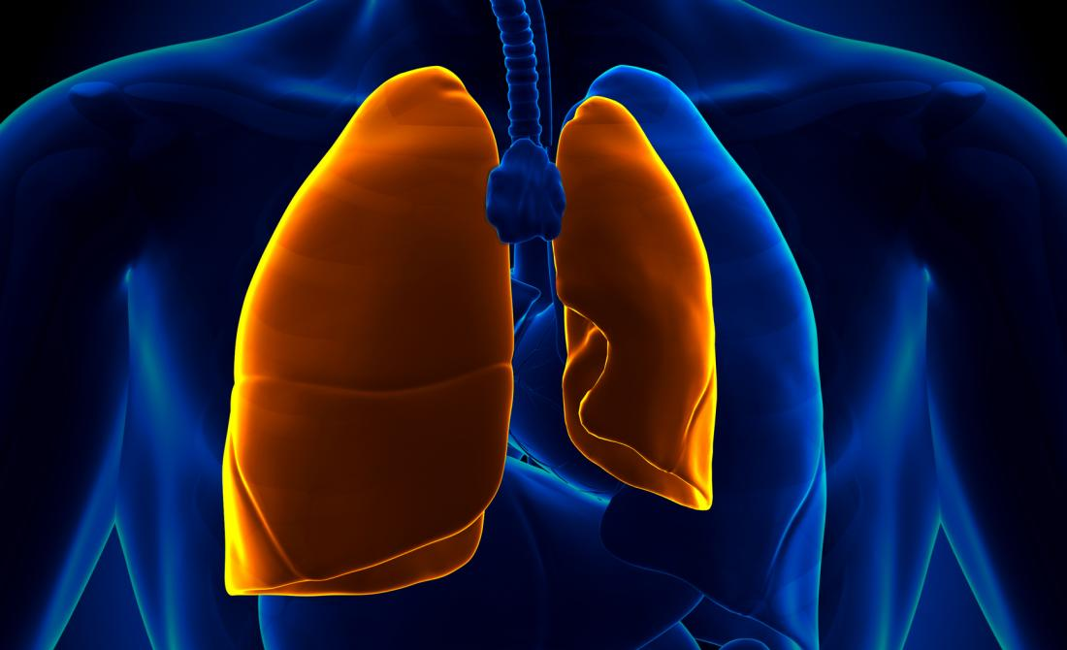
Notes:
Spontaneous Pneumothorax occurs when air gets into the pleural space between the lungs and the chest wall (AKA pleural space). This air can partially or fully collapse the lung. If left untreated, pneumothorax can
Pneumothoraces can occur spontaneously or as a result of trauma.
Broadly, Pneumothoraces can be classified into 3 groups:
Primary SP – When no underlying lung disease is present
Secondary SP – Occurs in the presence of underlying lung disease (emphysema, COPD, sarcoidosis, lung cancer)
Traumatic Pneumothorax – as a result of lung damage from direct impact or other trauma or injury (car accidents, stabbings, sports injuries, SCUBA diving accidents, medical procedure complications)
Any of these can lead to a Tension Pneumothorax, where the air escaping from the lung flows out into the pleural space but can’t get back in.
Treatment is decompression of the lung by needle or chest tube; some cases may require surgical intervention to close the leak.
Once someone develops a pneumothorax they are more likely to develop a second.

Slide 3
There is a known association between smoking tobacco and spontaneous pneumothorax.
In 1987, Bense et al found:
9
Increased relative risk for PSP in female smokers:
Increased relative risk for PSP in male smokers:
22
Notes:
Swedish study with
Smoking and the increased risk of contracting spontaneous pneumothorax
Bense L, Eklund G, Odont D, Wiman L. Chest. 1987 vol: 92 (6) pp: 1009-1012
“The study showed that smoking increased the relative risk of contracting a first spontaneous pneumothorax approximately ninefold among women and 22-fold among men.”

Slide 4
There is a dose-response relationship for smoking tobacco and spontaneous pneumothorax.
“[…]there is a striking, statistically significant
(p < 0.001) dose-response relationship between smoking and the occurrence of SP.”
Notes:
Smoking and the increased risk of contracting spontaneous pneumothorax
Bense L, Eklund G, Odont D, Wiman L. Chest. 1987 vol: 92 (6) pp: 1009-1012

Slide 5
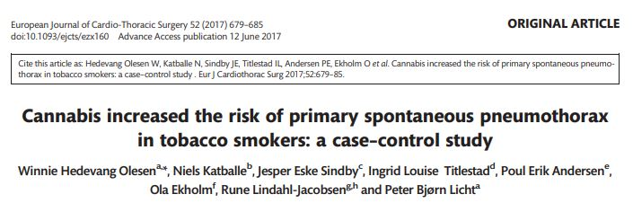
There is a possible relationship between smoking tobacco and cannabis and spontaneous pneumothorax.
“We detected a significantly higher occurrence of cannabis smoking within the last month in individuals with primary spontaneous pneumothorax: OR = 8.22 (95% CI: 6.37–10.57, Table 3). However, the observed increased occurrence was only significant in men (P < 0.001), and we observed no isolated effect of cannabis: OR = 0.85 (95% CI: 0.17–2.61, P = 0.789)”
Notes:
Cannabis increased the risk of primary spontaneous pneumothorax in tobacco smokers: A case-control study. Winnie Hedevang Olesen, Niels Katballe, et al. European Journal of Cardio-thoracic Surgery, 52, 4, 10 2017
Danish case-control study involving 416 patients from 2009-2016
Concluded that “Combined smoking of tobacco and cannabis significantly aggravates the risk of having a primary spontaneous pneumothorax in young men compared to both never smokers and daily smokers.”

Slide 6
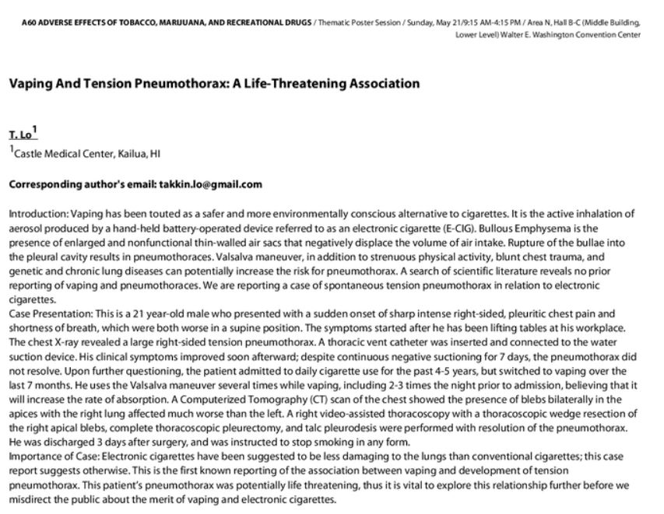
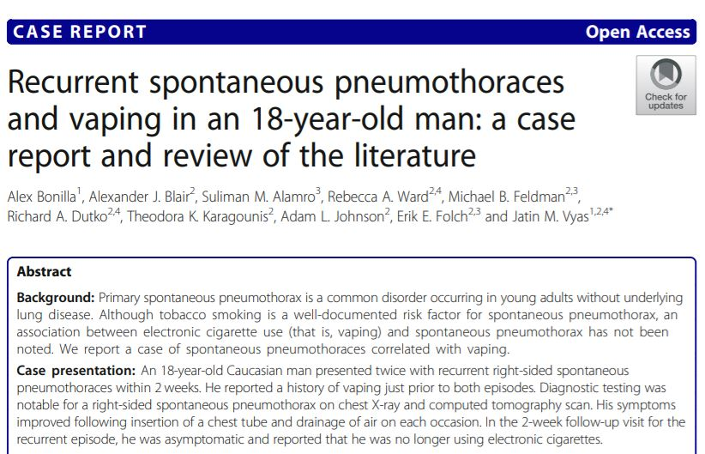
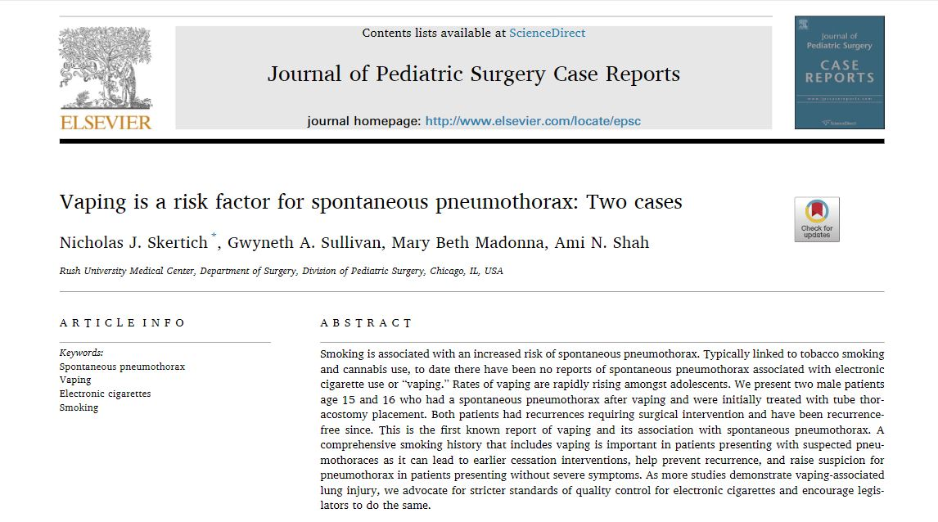
Since 2017, there have been case reports describing vaping as a risk for spontaneous pneumothorax.
Notes:
2016 systematic review of vaping-associated health problems: 27 cases of health effects - SP not noted.
Potential health effects of electronic cigarettes: A systematic review of case reports. Hua M,
Talbot P. Preventive Medicine Reports, 2016, vol: 4 pp: 169-178
Click 1: Then in 2017. poster session at the American Thoracic Society with a single case of vaping-associated tension pneumothorax.
Vaping and Tension Pneumothorax: A Life-Threatening Association
Takkin Lo. American Journal of Respiratory and Critical Care Medicine 2017;195:A2052
Click 2: 2019: Two more cases reported
Vaping is a risk factor for spontaneous pneumothorax: Two cases. Skertich N, Sullivan G, Madonna M, Shah A
Journal of Pediatric Surgery Case Reports. 2019 vol: 50 pp: 101305
Click 3 Soon to be published: RECURRENT spontaneous pneumothroaces
Recurrent spontaneous pneumothoraces and vaping in an 18-year-old man: a case report and review of the literature. Alex Bonilla, Alexander J. Blair, et al. Journal of Medical Case Reports, 13, 1, 12 2019

Slide 7
What is not known:
Is the incidence of spontaneous pneumothorax increasing?
Is there an increased risk of spontaneous pneumothorax with vaping compared to combustible substances?
Is there a more severe course of illness with vaping-associated spontaneous pneumothorax?
What are other jurisdictions seeing?

