Slide 1
Stimulants

Slide 2
Public Health Purpose
According to the 2017 National Survey on Drug Use and Health (NSDUH), approximately 1.6 million people (0.6 percent of the population) reported using methamphetamine in the past year, and 774,000 (0.3 percent) reported using it in the past month.Meth is an pulic healt issue which indicates an increasing trends. Meth is used with other drugs.

Slide 3
Stimulant classifier
Change classifier?
  Do not change the classifier for Stimulant.
Caveats for the syndrome
  Utilize the CCQV
  Definition for stimulant
  Evaluation
    Evaluate the CC for min, max, and average
    Consider using parse or original cc

Slide 4
Scope of syndromic surveillance
This would be shared for data sharing
Encompasses geographic regions that take part in syndromic surveillance

Slide 5
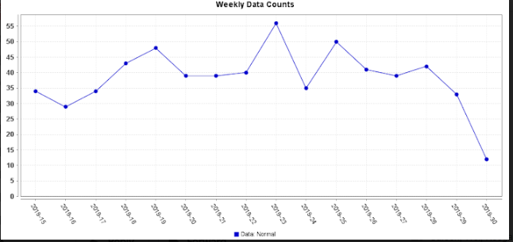
Query applied to CCQV

Slide 6
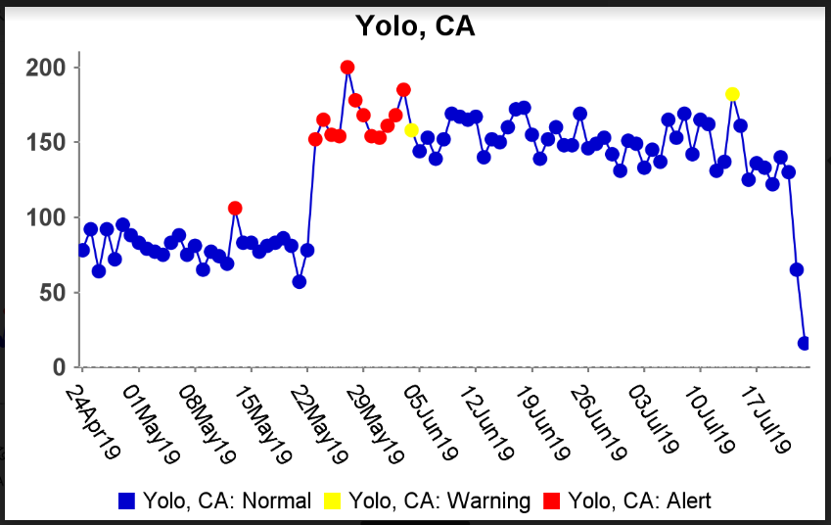
Query applied to CCQV

Slide 7
Actions
Communicate, communicate, communicate
  Other states
  Law enforcement (?)
  Stakeholder
  Source of supplies

