Slide 1
R Packages
Not knowing all the answers, but knowing where to find all those answers
Patric V. Prado, MPH
Data Science Epidemiologist

Slide 2
Table
of Contents
04. ArcPy and Python
Using ArcGIS and Python scripts within R and R studio
01. Google is your friend
Examples for asking for passwords, waiting for manual intervention, errors with using packages and functions
05. DBI
Creating temporary databases to deal with loading large datasets
02. Fastlink vignette
Applying knowledge from experts (Josh), augmenting with documentation. Applying to linkages for vaccination and positives.
06. Presentation for results
Table1 package.
03. Wide to Long Formats
Using Reshape2 and Dplyr (pivotlonger and pivotwider) to transform data for data warehousing, pivot tables, and dashboarding
07. Next steps
Communication is key.
p / 2

Slide 3
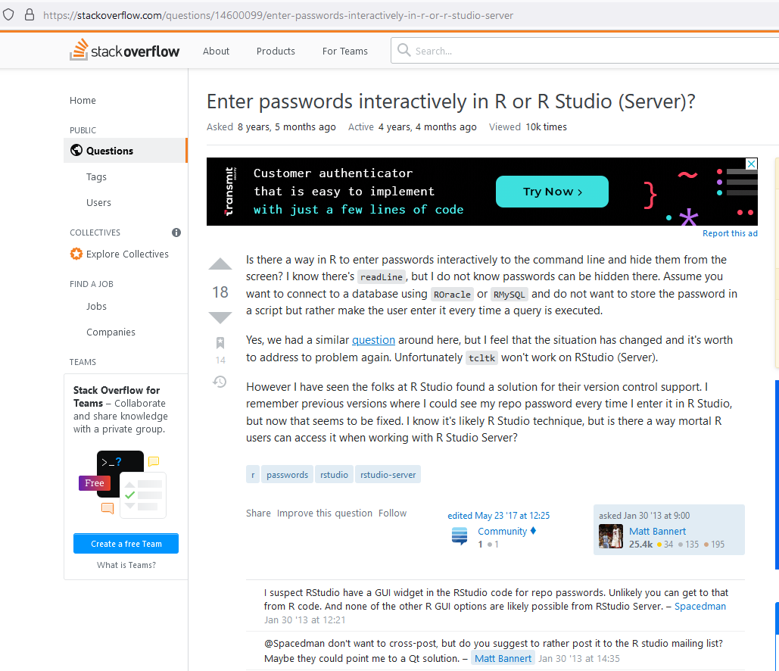
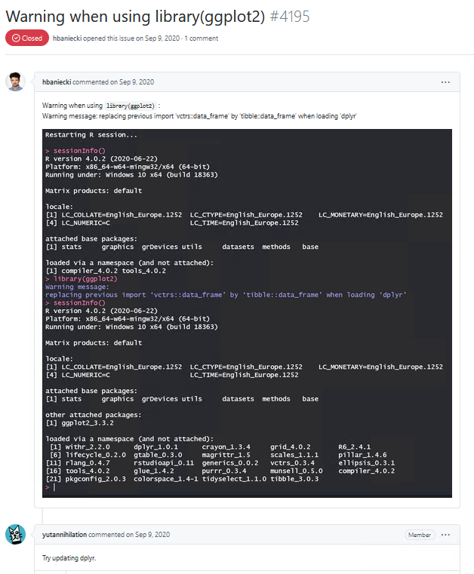
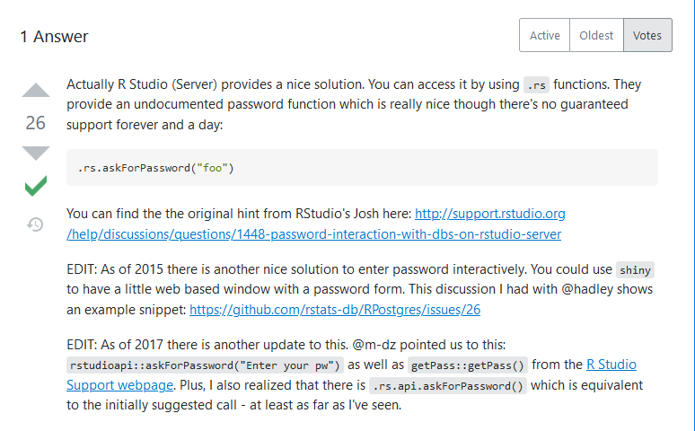
Ask questions
From experts; From google
Functions:
Asking for password –
askForPassword(“Enter your password”)
Waiting for user input –
readline(prompt="After manually geocoding cases (case_geocode.shp), Press [enter] to continue")
ERRORs –
Sometimes as simple as an update
p / 3

Slide 4
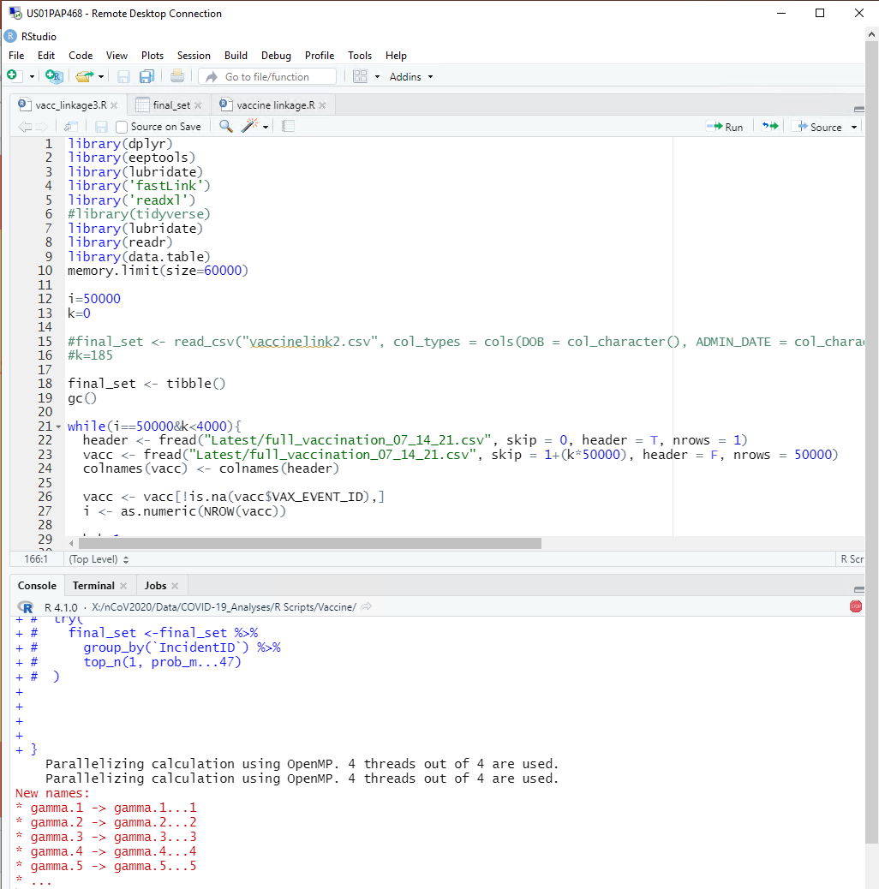
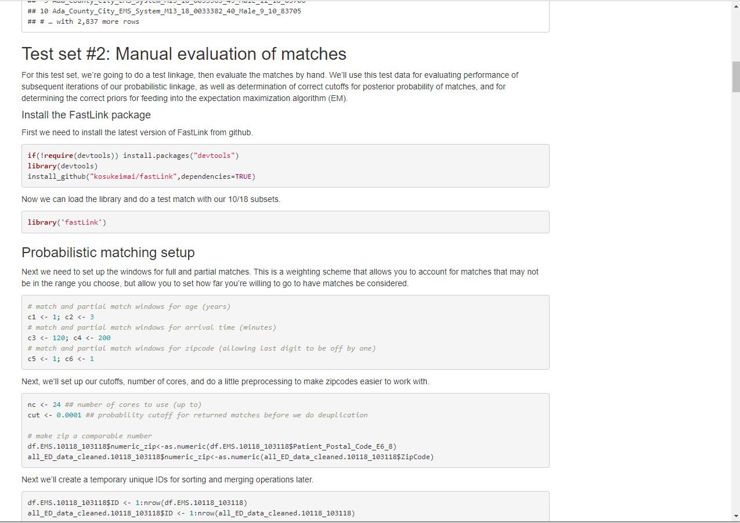
p / 4
Using your resources:
Lessons from coaches
(Fastlink)
Apply lessons learned from class and office hours (right away)
Copy, paste, and change snippets of code
Ask questions from experts (and google!)

Slide 5
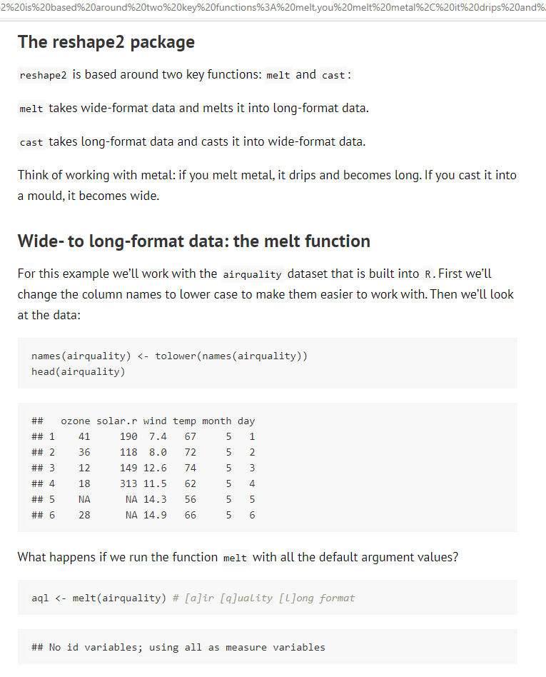
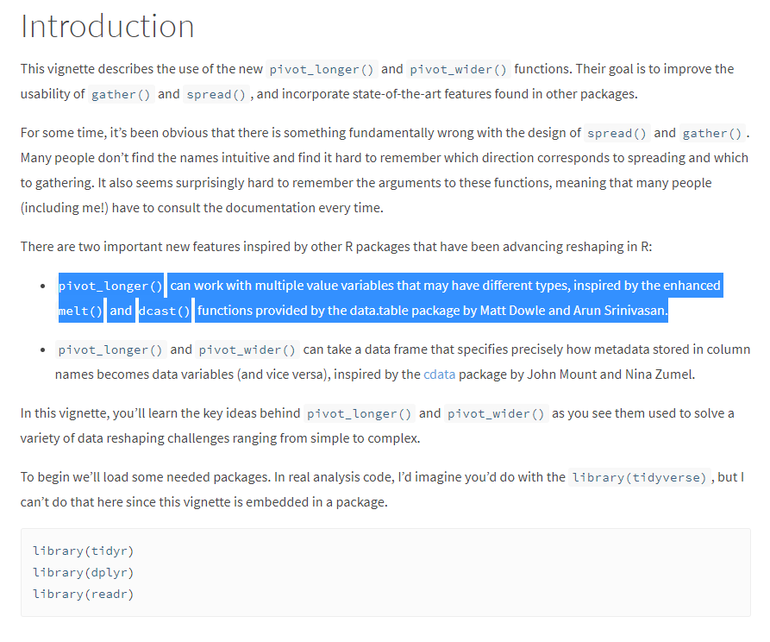
Using your resources:
Wide to Long Format
Data Warehousing
Excel Pivot Tables
Powerbi and Tableau Dashboards
Always look for improvements in code and functions
-> Dplyr and pivot_longer / pivot_wider
p / 5

Slide 6
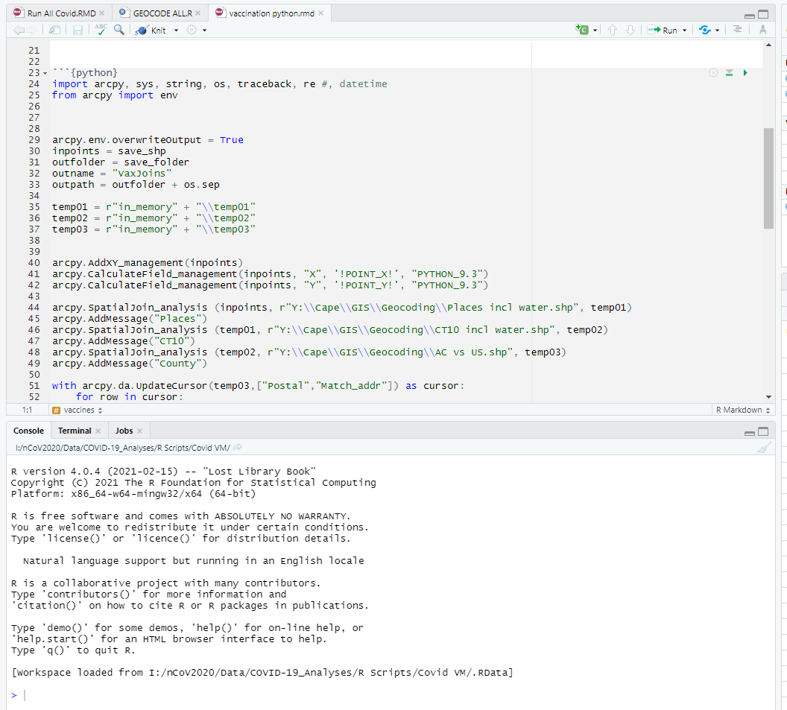
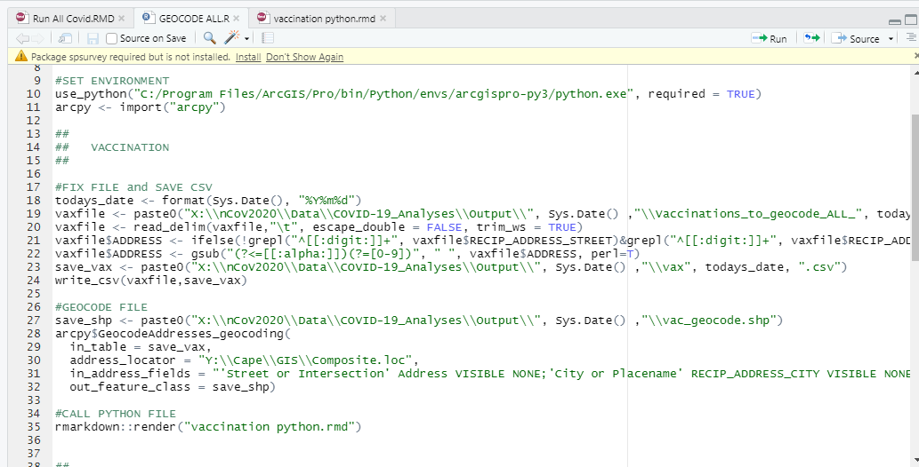
p / 6
R and Python:
Integrations
You don’t need to decide between using R and Python!
You can use Python within R Markdown Files
Applications:
ARGIS -> ARCPY -> Reticulate -> RMD -> R

Slide 7
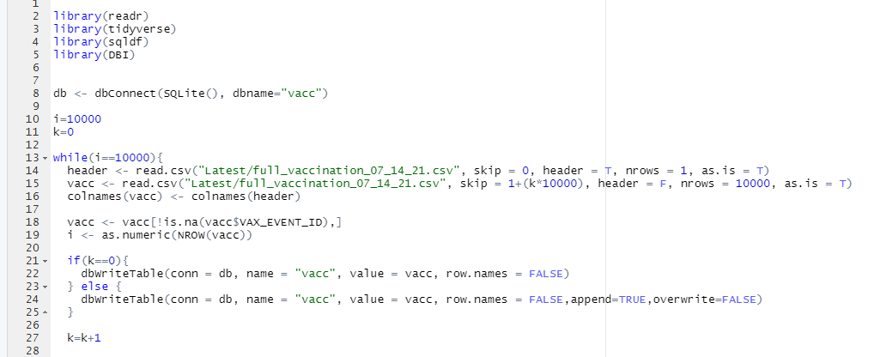
Dataset too big?:
DBI and on-the-fly DBs
Datasets in R are loaded into RAM (Memory)
If the dataset is too big, you have a few options:
Loop through dataset and only keeping what you need (variables and values)
Creating a temporary database for dataset
Getting an environment with more RAM
p / 7

Slide 8
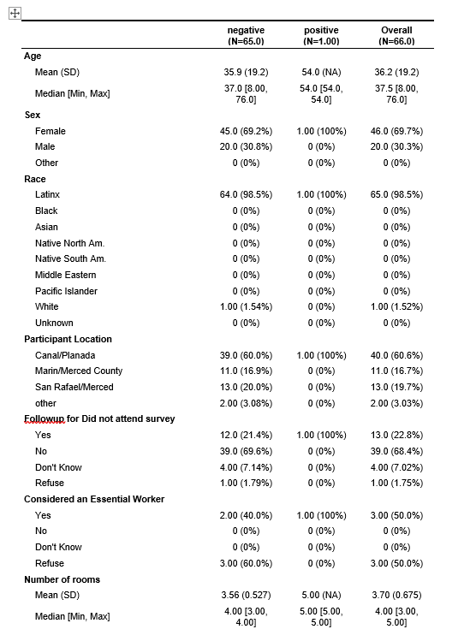
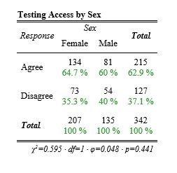
p / 8
Presentation of results:
For Publications and Scientific Audiences
Formatting and Reformatting scientific tables are the bane of my existence. Enter packages:
Table1 – HTML formatted / Presentation-ready tables
sjPlot::tab_xtab – HTML formatted tables with P-values

Slide 9

Thank You
Questions?

