Slide 1
Good afternoon!
The workshop will be starting soon.
Please mute your microphones.

Slide 2
Reproducible Research & Code Documentation
CSTE DSTT Monthly Workshop
April 20, 2022

Slide 3
CSTE Announcements

Slide 4
Agenda
Reminders
Learning Objectives
Topic Presentations
  Git, Github and Gitlab
  Irreproducible Research and Filename Conventions
DSTT Team Experience and Points of Contact
  Cook County Health and Hospitals System
  Arkansas Department of Health
Group Discussion
Report Out and Wrap-up

Slide 5
Reminders
Main Room
  Please mute your microphone
  Use the chat to share questions or comments
Breakout Rooms
  Please unmute your microphone
  Discuss discussion prompts
Remember that the workshop is being recorded
Enjoy the workshop!

Slide 6
Learning Objectives
Describe methods of documenting, sharing and backing up code with software tools, such as Git.
Describe the challenges of maintaining critical code or documentation for major technical projects.
Describe common practices that support reproducible research and other methods for version control (coding templates, workflows, filename conventions, etc.).
Describe the consequences of not having formal processes for maintaining critical code or documentation.

Slide 7
Git, Github and Gitlab

Slide 8
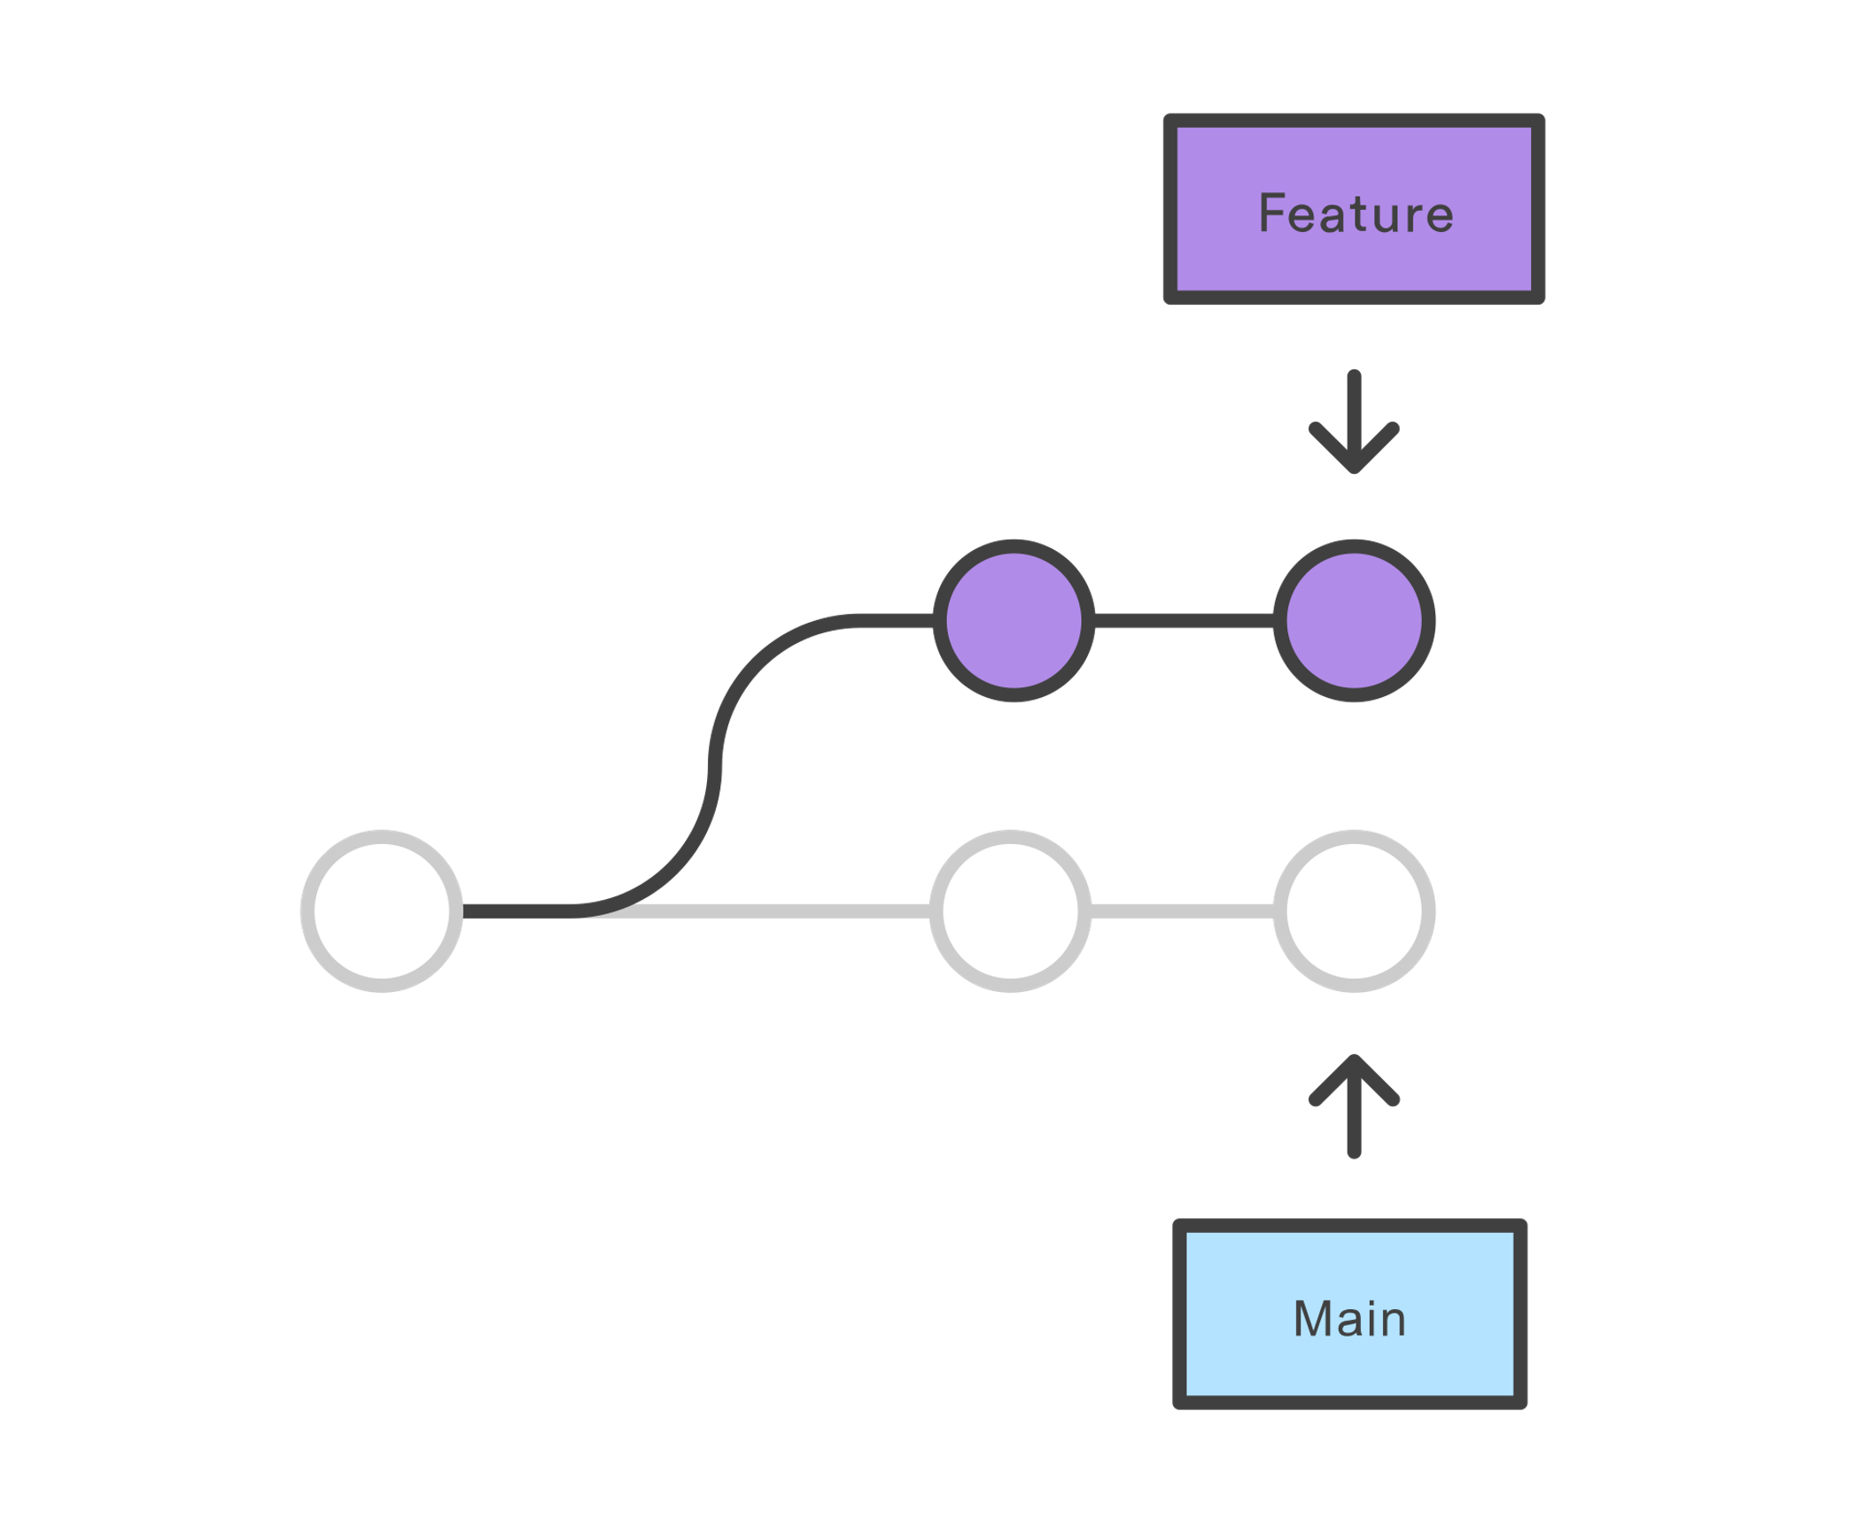
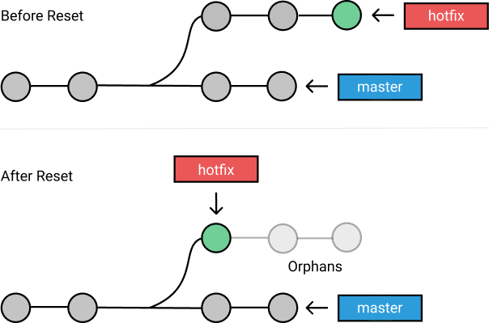
Git is a source control system
Add new features without disturbing the code base
Roll back to previous versions if there are problems

Slide 9
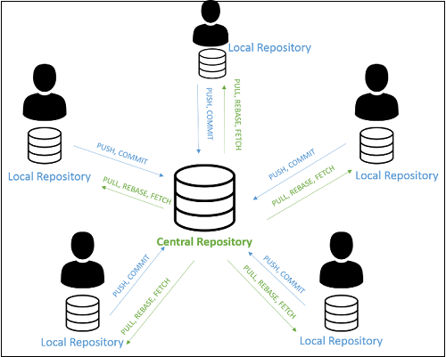
Git enables distributed development
You work with a full and complete local copy of your code repository

Slide 10
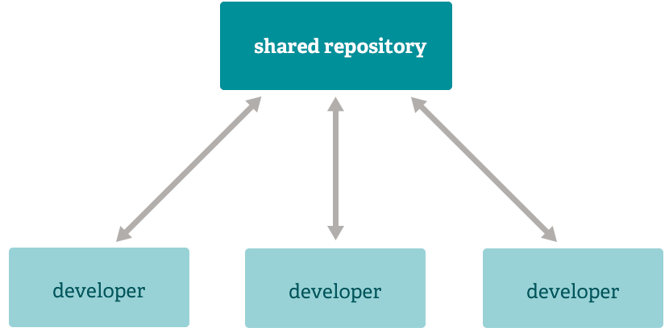
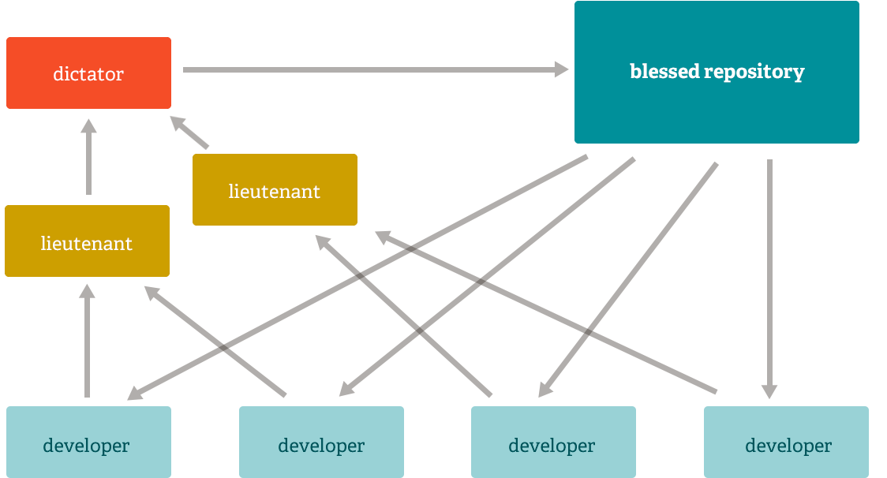
Git has different ways you can manage changes to the code base
You can allow anybody to push
Or you assign a code manager to maintain standards and quality

Slide 11
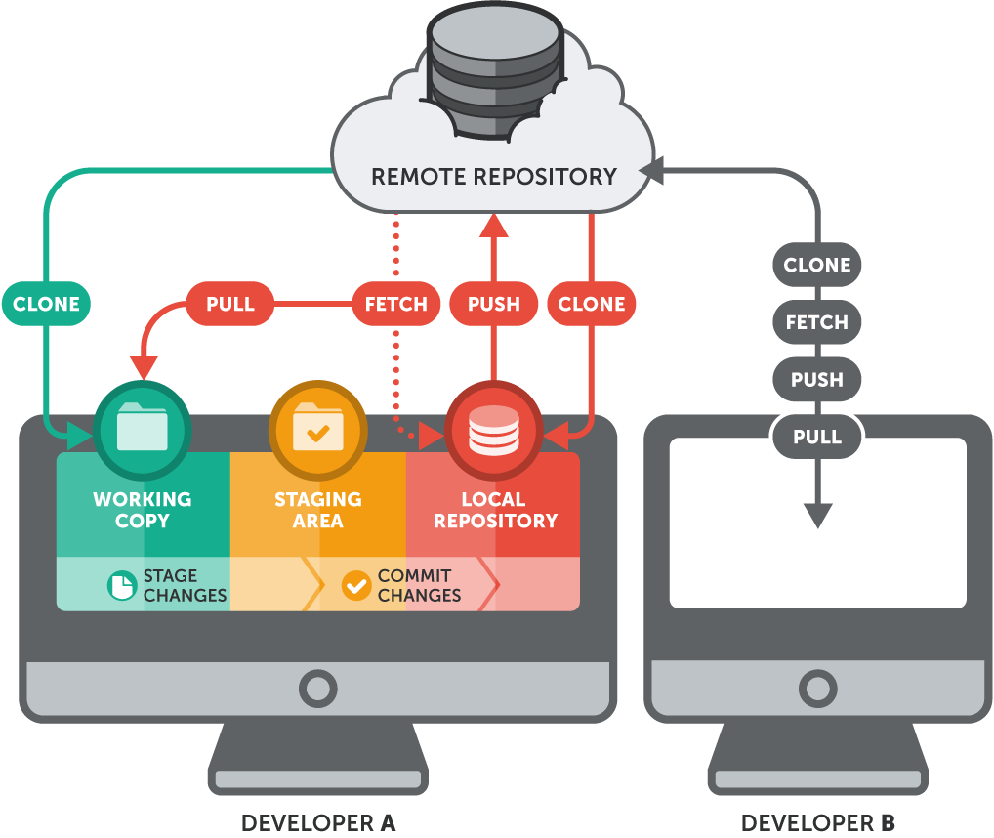

Slide 12



Options for a remote repository
Hosting services
Host your own
  https://git-scm.com/book/en/v2/Git-on-the-Server-Setting-Up-the-Server

Slide 13
Gitlab vs. Github similarities
Both use git
Includes a wiki
Preview code changes
Track issues
Code review by code manager
Project management boards
Team discussions
Public repositories available for free

Slide 14
Differences
Github
Gitlab
Pull request for branch merge
CI/CD auto builds require other tools
Differences in UI
Basic philosophy of using your chosen 3rd party tools
Merge request for branch merge
CI/CD auto builds easy to do and set up
Differences in UI
Basic philosophy of providing complete ecosystem

Slide 15
Irreproducible Research
& Alternatives for Version Control

Slide 16
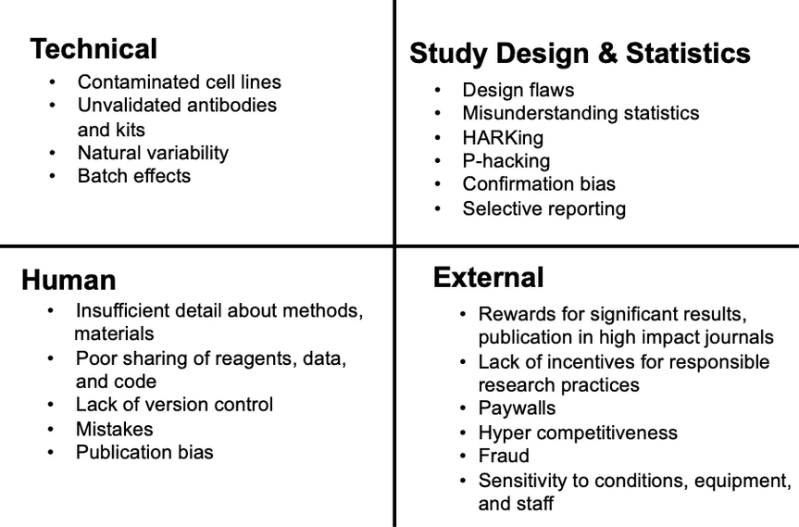
Irreproducible Research
Notes:
Image credit to https://elifesciences.org/articles/64719#box1

Slide 17
Alternatives for Version Control
Other methods for version control
  Coding templates
  Workflows
  Filename conventions
    Machine and human readable
    Easy to compute on
  The classical “token”/”cookie” system

Slide 18
Filename Conventions: Machine Readable
Regular expression and globbing friendly
  Avoid spaces, punctuation, accented characters, case sensitivity
  Globbing is the process of using wildcard characters to request or evaluate sets of files with the same partial names or sets of characters
Easy to compute on
  Deliberate use of delimiters
Notes:
Credit to Jenny Bryan’s “naming things” presentation for Reproducible Science Workshop

Slide 19
Filename Conventions:
Machine and Human Readable
Easy to search for files later
Easy to narrow file lists based on names
Easy to extract info from file names
Regular expressions and globbing
  Avoid spaces in file names
  Avoid punctuation
  Avoid accented characters
  Avoid case-sensitive filenames (Mew versus mew)
Include content in the file name
Notes:
Credit to Jenny Bryan’s “naming things” presentation for Reproducible Science Workshop

Slide 20
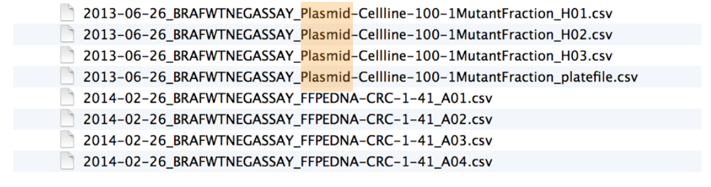
Filename Conventions: Good Example
Notes:
Image credit to Jenny Bryan’s “naming things” presentation for Reproducible Science Workshop

Slide 21
Filename Conventions: Easy to Compute On
Use a numeric value to start your file name
Employ the ISO 8601 standard for dates (YYYY-MM-DD)
Include zeros in front of other numbers in file name
Notes:
Credit to Jenny Bryan’s “naming things” presentation for Reproducible Science Workshop

Slide 22
The Classical “Token”/”Cookie” System
Using an informal token system
  Use all other options first!
To edit Section 1 of a paper, even just to fix a single typo, you follow these steps:
Email all with the text "I am claiming the token for section 1."
Edit section 1
Email all with your edited version of Section 1 and the text "I am releasing the token for Section 1."
Notes:
Read the entire post at https://academia.stackexchange.com/questions/149100/file-naming-conventions-when-sending-file-back-and-forth-via-email

Slide 23
DSTT Team Experience
& Points of Contact

Slide 24
DSTT Team Experience & Points of Contact
DSTT Team Experience
  Cook County Health and Hospitals System
DSTT Points of Contact
  Donald McCormick, MSHI
  Public Health Informatics Supervisor
  Arkansas Department of Health
  4815 West Markham
  Little Rock, AR 72205
  Office: 501-614-5501
  Cell: 501-249-4284
  Email: Donald.McCormick@arkansas.gov
  *** Include “Code Doc – DSTT 2022” and your site name in subject line of email ***

Slide 25
Group Discussion

Slide 26
Group Discussion
Often, multiple data sources need to be used when creating a data science product, like a dashboard, script for cluster detection, or publication ready research data set. As a first step, we suggest completing an up to date data audit of these data. Documentation of the dimensions that impact your data flows and processes should also be compiled. For example, data may be owned or processed from within or outside your department, these data may be updated daily or yearly, you may have data dictionaries that need to be updated and you may need to document the various levels of complexity for data processing before the data gets used.
  Is your group starting with a data audit before you move forward with your project? What dimensions are you considering when doing so?
  Are there any issues you currently have with your data audits and what type of support do you need?

Slide 27
Report Out and Wrap-up

Slide 28
Wrap-up
Thanks for joining!
May workshop topic: Data Dashboards

