Slide 1
RCKMS Community of Practice
Town Hall meeting on March 24, 2021

Slide 2
Today’s Agenda
  1. Welcome and Announcement
  2. Questions from the RCKMS Community
  a. RCKMS SMEs Responses
  i. Test Cases: Overview of Test Cases in Test Case Manager
  ii. Reviewing Criteria/ Logic sets: S/N/O Logic
  3. Community “OPEN MIC” Discussion:
  Peer to Peer Engagement: Sharing Ideas, Experiences and Lessons Learned
  4. Reminders
  5. Adjourn

Slide 3
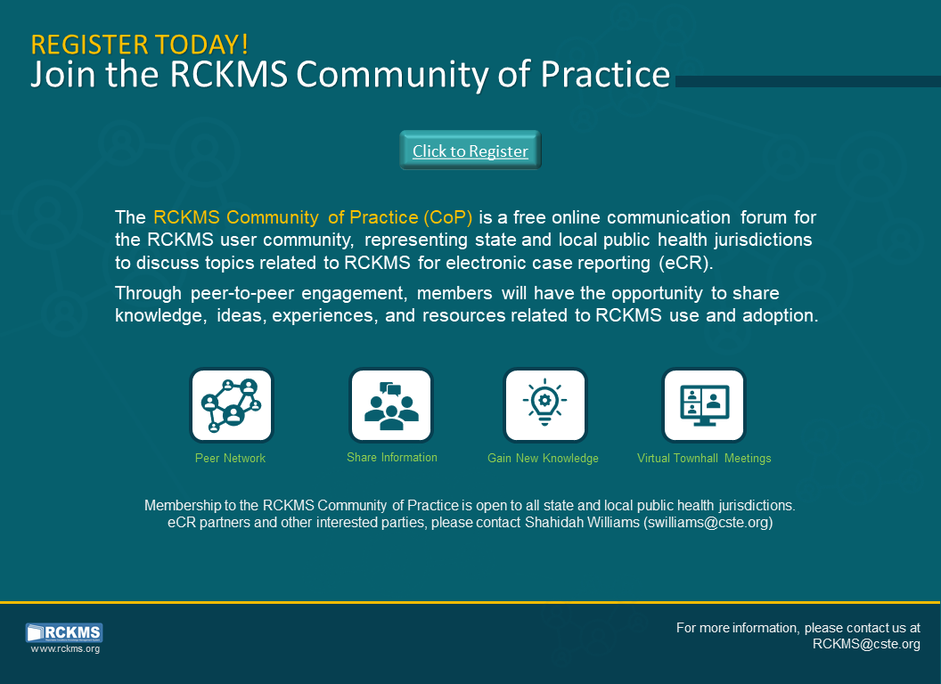

Slide 4
Questions from the Community

Slide 5
Questions for RCKMS SMEs
Test Cases in Test Case Manager
  What’s the best way to test?
  Are there any new test cases, and can we share them?
  Can other users see test cases that I create?
  How can test cases be saved to reporting spec, to re-use at next release?
    A peer’s suggestion: Name your test cases with your two-letter state abbreviation, then underscore (ex: WI_) so they are easy to find.

Slide 6
Questions for RCKMS SMEs
Reviewing criteria/ logic sets:
  Can we get clarification on how S/N/O logic works within the same column?
    (It may work differently than epi’s are used to in Position Statements)
  Is this an accurate statement: “N” may be present without any “O” specification, but an “O” may not be present without “N” being specified to meet the requirement for reporting?
  Tips for jurisdictions to use when helping their SME’s complete the logic?

Slide 7
Open ‘MIC’ Discussion
Peer to Peer Engagement about RCKMS:
        Sharing your Ideas
        Experiences
        Lessons Learned
Topics and suggestions for further Town Hall discussions

Slide 8
Reminders and Notes
Next Town Hall: Wednesday, April 28, 2021
Register for the RCKMS CoP Basecamp
Upcoming RCKMS Office Hours
    Session 2: Thursday, April 1, 2021
    Session 3: Thursday, April 15, 2021
Visit www.rckms.org
  Submit a ticket
  RCKMS Content Release updates

Slide 10


CSTE National Office
2635 Century Parkway NE, Suite 700
Atlanta, Georgia 30345
770.458.3811
770.458.8516
swilliams@cste.org

