Slide 1

RCKMS Community of Practice
Town Hall meeting
August 25, 2021

Slide 2
Today’s Agenda
1. Welcome
2. CSTE Announcements
a. NSSP Community of Practice/ 2021 Syndromic Surveillance Symposium: Hayleigh McCall
3. Breakout Rooms: Thinking through Reporting Specifications (RS) in the RCKMS Tool
4. Community “Open Mic” Discussion
5. Reminders
6. Adjourn
b. COVID-19 Condition Code Update: Charisse LaVell

Slide 3
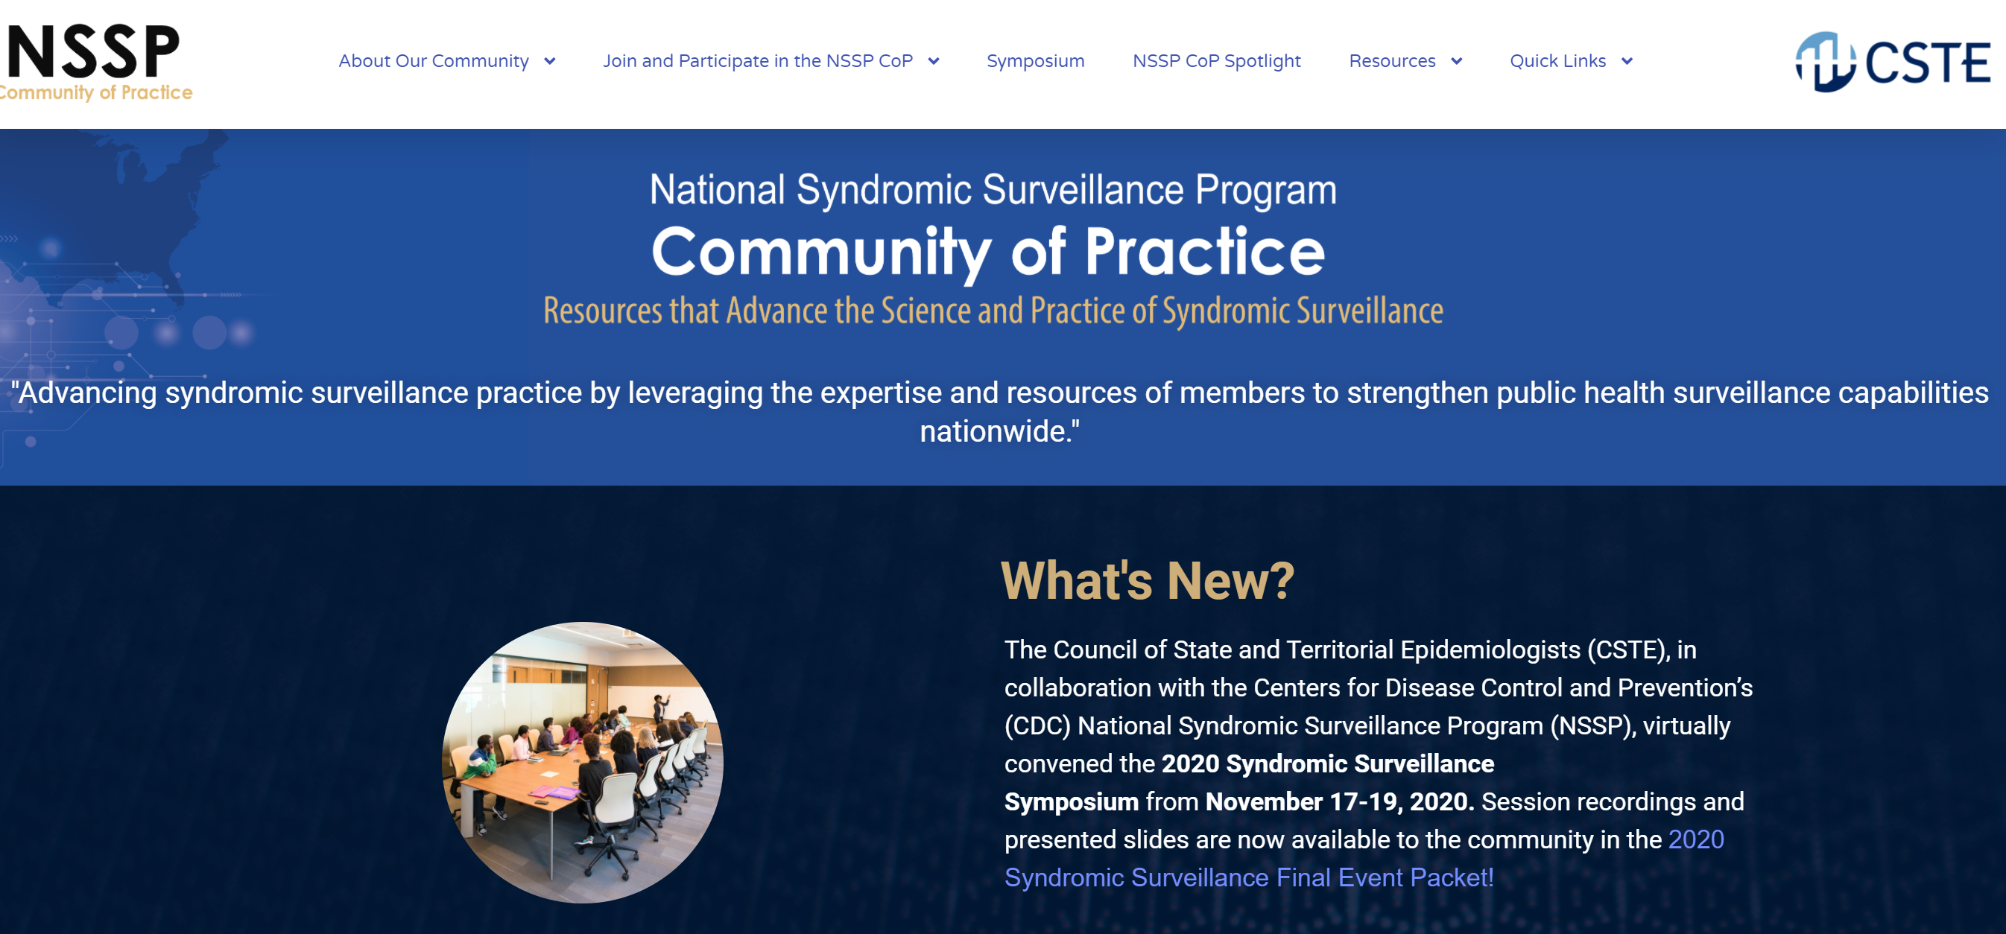
Get Involved with the NSSP
Community of Practice!
Visit the home of the NSSP CoP at nsspcommunityofpractice.org
Find information about the NSSP CoP, join or update member information, request to join the Slack Workspace, check out monthly call schedules, and much more!
Notes:
NSSP CoP membership is voluntary, free of charge, independent of CSTE membership, and open at any person or organization interested in advancing SyS
Monthly community-wide calls are held on the 3rd Tuesday of the month from 3:00-4:30 ET

Slide 4

2021 Syndromic Surveillance Symposium
CALL FOR ABSTRACTS OPEN THROUGH FRIDAY, SEPTEMBER 3RD
(Deadline Extended)
Review abstract requirements and the planning process, submit abstracts, and learn more about the event at nsspcommunityofpractice.org!
Notes:
Review abstract requirements and the planning process, submit abstracts, and learn more about the event at nsspcommunityofpractice.org!

Slide 5

Contact Us!
Have questions about the syndromic community and/or the 2021 Syndromic Surveillance Symposium?
Reach us at syndromic@cste.org!

Slide 6
COVID-19 Condition Code Update
Charisse LaVell

Slide 7
Breakout
Rooms
Thinking through Reporting Specifications (RS) in the RCKMS Tool
  What challenges are you facing?
    Community suggestions or recommendations
    Lessons learned
  Any suggestions or requests for the RCKMS Team?

Slide 8
RCKMS Community
“Open Mic” Discussion

Slide 9
Reminders:
RCKMS CoP Basecamp
Continue actively engaging with peers
Submit topic suggestions for future Town Hall meetings
Registration for the RCKMS Community of Practice remains open

Slide 10


CSTE National Office
2635 Century Parkway NE, Suite 700
Atlanta, Georgia 30345
770.458.3811
770.458.8516
rckms@cste.org

