Slide 1
Welcome to the July
RCKMS Community of Practice
Town Hall Meeting - July 27, 2022

Slide 2
Today’s Agenda
Welcome and CSTE Announcement - (Allison Seidel, RCKMS ASA and Shahidah Williams, CSTE)
COVID-19 Update - (Amanda Payne, RCKMS Content Team)
  Proposed COVID-19 Reporting Specification updates based on CSTE Position Statement 22-ID-01
RCKMS Tool Updates - (Janet Hui, HLN/RCKMS Admin Team)
  Recent RCKMS Deployments – June and July Tool Releases
  Known issues and bugs
  Feature requests
Open Discussion:
  Removal of specific codes from RCKMS value sets for Diagnosis & Active Problems
Other Topics/Open Mic (as time allows)
Reminders and Adjourn

Slide 3

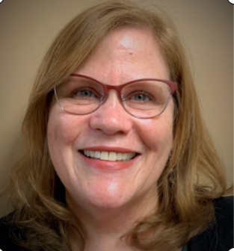


RCKMS Authoring Support (ASA) Team
Allison Seidel
Lead RCKMS Authoring Support Associates (ASA)
Oversees the RCKMS Authoring Support team and Co-Facilitates the RCKMS Community of Practice. In addition to supporting RCKMS Office Hours and jurisdiction authoring needs across all public health agencies.
Direct Support for the following Territories
Region 1 Region 2
Connecticut New York
Maine New Jersey
Massachusetts Puerto Rico
New Hampshire US Virgin Island
Rhode Island
Vermont
Ann Whitney
RCKMS Authoring Support Associates (ASA)
Supports and engages with public health agencies on all jurisdiction authoring support needs, to include authoring reportable conditions, RCKMS user training, help desk and Office Hours support.
Direct Support for the following Territories
Region 3 Region 4
Delaware Alabama South Carolina
District of Columbia Florida Tennessee
Maryland Georgia
Pennsylvania Kentucky
Virginia Mississippi
West Virginia North Carolina
Melissa Ivey
RCKMS Authoring Support Associates (ASA)
Supports and engages with public health agencies on all jurisdiction authoring support needs, to include authoring reportable conditions, RCKMS user training, help desk and Office Hours support.
Direct Support for the following Territories
Region 5 Region 6 Region 7
Illinois Arkansas Iowa
Indiana Louisiana Kansas
Michigan New Mexico Missouri
Ohio Oklahoma Nebraska
Wisconsin Texas
Minnesota
Kayla McKiski
RCKMS Authoring Support Associates (ASA)
Supports and engages with public health agencies on all jurisdiction authoring support needs, to include authoring reportable conditions, RCKMS user training, help desk and Office Hours support.
Direct Support for the following Territories
Region 8 Region 9 Region 10
Colorado Arizona Alaska
Montana California Idaho North Dakota Hawaii Oregon South Dakota Nevada Washington
Utah Guam
Wyoming

Slide 4

CSTE Announcements
Thanks to our attendees, speakers, moderators, sponsors, exhibitors, and everyone who contributed to the 2022 CSTE Annual Conference!
2022 Approved Position Statements: https://www.cste.org/page/PositionStatements
Continuing Education (CE) – Deadline was Tuesday, July 26th
  CSTE has partnered with CDC to provide up to 20 hours of free CE for doctors (CME), nurses (CNE), veterinarians (RACE), health educators (CHES), and those Certified in Public Health (CPH)
  Eligible sessions include the NASPHV Business Meeting, all Sunday workshops, and the plenaries
  For questions email WFResources@cste.org

Slide 5
Announcements
Reportable Conditions Knowledge Management System (RCKMS) Content Release - July 2022
  41 New conditions available for authoring in RCKMS
    173 total conditions
RCKMS Office Hours Schedule: Summer 2022 Series
    Session 1: Tues. August 9, 2022 @3PM
    Session 2: Thurs. August 25, 2022 @3PM
    Session 3: Thurs. September 8, 2022 @3PM
    Session 4: Tues. September 27, 2022 @3PM
Visit https://www.rckms.org/
Email: rckms@cste.org

Slide 6
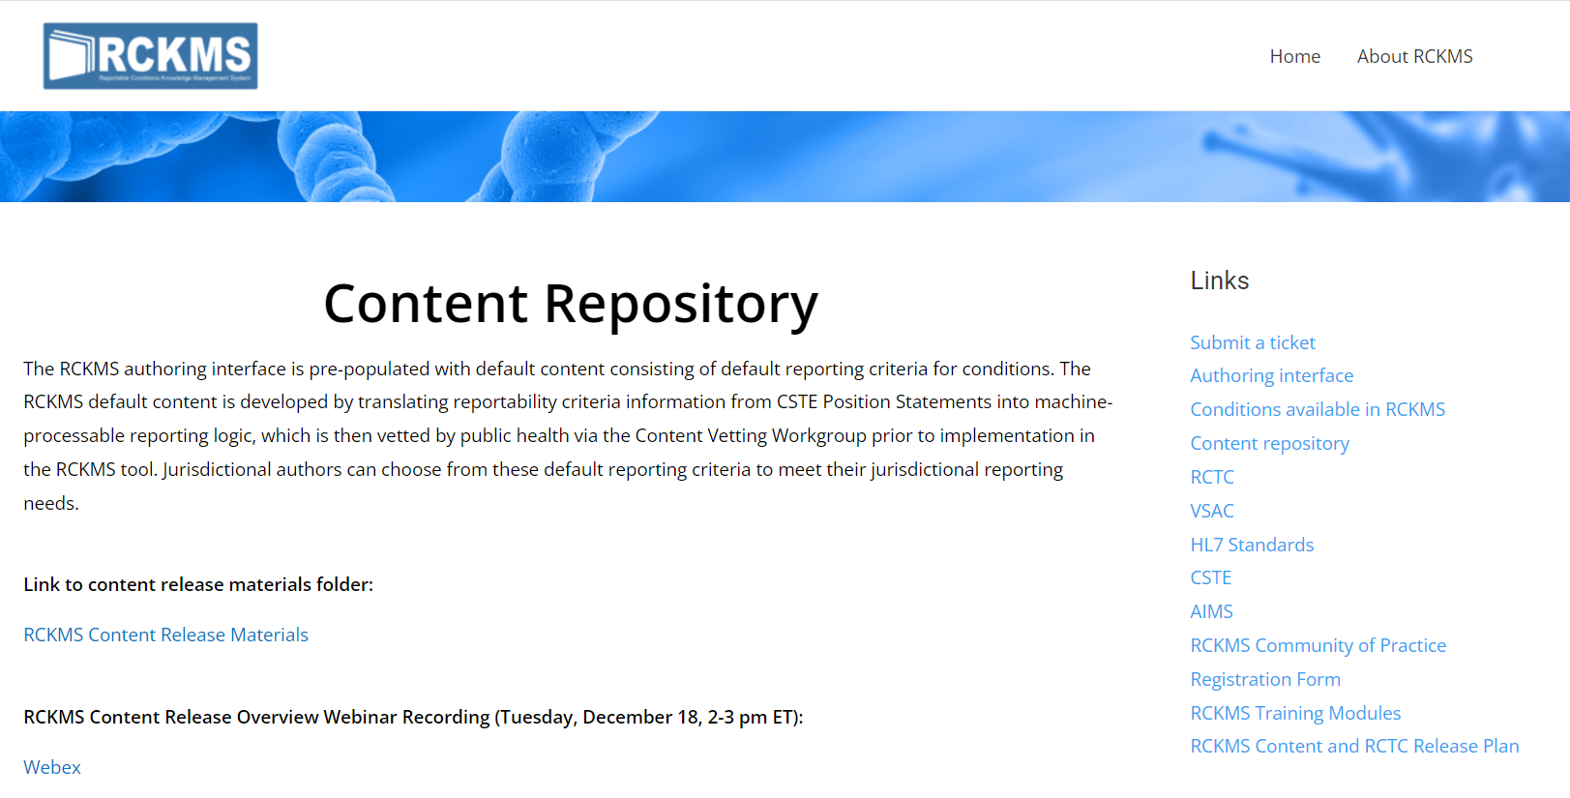
RCKMS Content Repository
RCKMS Reporting Specifications and supporting documents are available in the Content Repository on www.RCKMS.org

Slide 7
Proposed COVID-19 Reporting Specification Updates Based on CSTE Position Statement 22-ID-01

Slide 8
Introductions
RCKMS Content Team Lead: Shaily Krishan (CSTE)
RCKMS Content Team Contractors (J Michael Consulting)
  Surveillance Epidemiology SMEs
    Grace Mallard
    Gib Parrish
    Amanda Payne
    Natalie Raketich

Slide 9
Agenda
Summary of case ascertainment updates in 22-ID-01
Potential impacts to COVID-19 RS
Questions and feedback

Slide 10
Summary of Updates

Slide 11
Updates to COVID-19
Topic | Previous | New
Timeframe for notification | Immediately notifiable, urgent (within 24 hours) | Routinely notifiable
Case ascertainment criteria (Section VI and Table VI)
Clinical criteria | 22 clinical criteria | No clinical criteria
Epidemiologic linkage criteria | 2 epi linkage criteria | No epi linkage criteria
Laboratory criteria | 4 laboratory criteria | 3 laboratory criteria (removed antibody results)
CSTE Position Statement 22-ID-01, “Update to the standardized surveillance case definition and national notification for SARS-CoV-2 infection (the virus that causes COVID-19)” can be found here: https://cdn.ymaws.com/www.cste.org/resource/resmgr/ps/ps2022/22-ID-01_COVID19.pdf
Notes:
This shows the major changes to the case definition for COVID-19 from the 2021 CSTE PS to 2022.
Biggest changes, and those that have the most impact on RCKMS, can be seen in the case ascertainment criteria found in Section VI and Table VI of the PS

Slide 12
Potential Impacts to COVID-19 RS

Slide 13
Creating content for each condition
Position Statement available?
Yes
Review Case Ascertainment criteria
No
Review other resources, as needed
Suggested RCKMS criteria and logic sets
Content Team review
RCKMS Reporting Specification
Notes:
- As a reminder, this slide describes the process for creating and updating content for each condition in RCKMS
- When available, the RCKMS Content Team always starts with the CSTE Position Statement for the condition. The team reviews the background, justification, and case ascertainment sections of the position statement to understand what should be reported as a potential case for the condition and the reasons for those criteria.
- The team also reviews other sources of information about the condition, including the CDC website, textbooks or manuals, and recently published articles addressing the condition.
- After researching the condition, a member of the Content Team develops suggested reporting criteria and logic sets for that condition
- Those suggestions are reviewed with the larger content team, and after that review, the RCKMS Reporting Specification is created

Slide 14
Current COVID-19 RS
Default
3 logic sets (LAB, DX, CLIN+EPI)
2 diagnosis criteria (COVID-19, suspected COVID-19)
All the clinical criteria listed in the 2021 CSTE PS
6 laboratory criteria
2 epidemiologic criteria
1 vital records criterion
Optional
4 logic sets (LAB, DX, DX+HOSP, LAB+HOSP)
1 diagnosis criterion (post-acute or chronic COVID-19)
1 encounter criterion
29 laboratory criteria (positive results, all results, lab orders)
Notes:
In the current COVID-19 RS, we have many default and optional criteria and logic sets.
All these criteria are associated with value sets, including ones in the RCTC

Slide 15
Questions & Feedback

Slide 16
RCKMS Questions & Feedback
Implementation of updated case ascertainment criteria in RCKMS:
For any current default criteria and logic sets that are excluded from the 2022 CSTE position statement, should those be removed from the RS entirely, or moved to optional logic sets?
For any current optional criteria and logic sets, should those remain as optional in the updated RS?
Should we keep the optional criteria for reporting all test results?
Notes:
Updating the COVID-19 RS to match the updated position statement will have major impacts on the current RS and trigger codes. So before making any updates, we want to hear from you!

Slide 17
RCKMS Questions & Feedback
Timing of RS updates:
Would you want to see one last emergent COVID-19 RS release to address these updates? Or wait until the next scheduled content release in January 2023?
Notes:
Updating the COVID-19 RS to match the updated position statement will have major impacts on the current RS and trigger codes. So before making any updates, we want to hear from you!

Slide 18
RCKMS Questions & Feedback
If you have any questions or feedback about the RCKMS content, or if you would like to request changes or additions to RCKMS reporting criteria, RCKMS value sets, or RCTC to meet your jurisdiction’s reporting needs, please submit your request here: RCKMS Ticket
RCKMS Ticket Tips
  Include justification (e.g., point to jurisdiction reporting requirements)
  Double-check that request is related to case ascertainment and not case classification
  If you have questions about authoring in RCKMS, please contact your jurisdiction’s authoring support agent (ASA).
Notes:
Reminder to submit a ticket with any requests for updated content.
Reminder to reach out to ASAs with questions about authoring.

Slide 19


CSTE National Office
2635 Century Parkway NE, Suite 700
Atlanta, Georgia 30345
770.458.3811
770.458.8516
skrishan@cste.org

Slide 20
RCKMS Tool Updates – RCKMS Admin

Slide 21
RCKMS Tool Updates
Updates on recent RCKMS Deployments
  June RCKMS Deployment
  July RCKMS Deployment
Known Issues and Bugs
Feature Requests

Slide 22
Background: RCKMS Tool Updates
After we switched to the new architecture, RCKMS moved to monthly tool deployments
  No downtime to RCKMS Tool
  No stopping of eICR processing (queuing of messages)
RCKMS team works with APHL, CSTE and other stakeholders to prioritize features for development
RCKMS Development Team develops features and works with AIMS Platform Team to deploy to AIMS Platform

Slide 23
Background: RCKMS Tool Updates
Priority Areas (May – October 2022)
Scaling the “processing” side of RCKMS to accommodate increased volume
  Performance optimizations
  Improvements to resilience
  Routine security updates
  Adjustments to RCKMS processing logic based on feedback from eCR Team
Begin improving the user experience in the Authoring Tool
  Bug fixes
  Begin planning and implementing feature requests

Slide 24
June Tool Release: Release Notes
Optimizations to Rules Publishing Process: We’ve made improvements to make rules publishing faster and less resource intensive.
Improved Processing of Facility Address: We’ve updated RCKMS to align with the HL7 specification regarding where to find facility addresses and to better support multiple facility addresses
Removal of the flashing read-only banner: We’ve stopped the “read-only” banner from the authoring freeze from flashing across the screen.
Expanded support for Encompassing Encounter data: RCKMS now supports data about encounter type if it is sent as a “translation” code in the Encompassing Encounter Section.
Backend UI Fixes: We’ve made a few bug fixes and improvements to Admin modules in the RCKMS Authoring interface.
Rules Template Fix: This doesn’t impact any current rules, but we’ve made a bug fix to one of our rules templates.

Slide 25
July Tool Release: Release Notes
Continued Modernization of RCKMS infrastructure: As use of eCR grows, we’ve been modernizing RCKMS to improve its performance. Changes made in this deployment include:
  Updates to make the RCKMS start up processes more reliable
  Updates to how the decision support is notified of rules changes, so the process is more reliable and faster
  Other optimizations to backend services to make them faster and reduce security vulnerabilities
Authoring Tool Bug Fix: Several users reported being able to access the user list when clicking on the “Jurisdiction” module. This has been fixed now, thanks for reporting this!
Backend UI Fixes: We’ve made a few bug fixes and improvements to Admin modules in the RCKMS Authoring interface

Slide 26
Item | Status
Ability to see other users when accessing Jurisdictions module | Fixed in July 2022 Release
Test Cases in test case manager failing | - Fix scheduled for August 2022 Release - For interim, ASAs helping PHAs test using eICR Test Cases and the Shared Service Test Tool; also looking into temporary workaround fix
Copy over of Monkeypox and Orthopox rules to ”Onboard” environment | Updated 7/21 *Training environment was not updated
Issues with new user credentials (e.g., logging in for first time) | If you’re seeing issues, please contact rckms@cste.org

Slide 27
Item | Status
RCKMS Rule Testing: Requests for eICR/Criteria Test Cases | In Progress – related to broader eCR efforts related to testing
Reporting Specifications Module: Updates to “Last Updated” / addition of “Last Published” fields | Under consideration / planning
Reporting Specifications Module: Ability to indicate conditions that are not reportable to your jurisdiction
Reporting Specifications Module: General improvements to Reporting Specifications module to handle increased number and versions of RS

Slide 28
Open Discussion/Open Mic

Slide 29
Open Discussion
Removal of specific codes from RCKMS value sets for Diagnosis and Active Problems
    Response by RCKMS Content Team (Shaily Krishan)
Other Topics/Open Mic

Slide 30
Reminders
Upcoming RCKMS Office Hours Schedule – Summer 2022 Series
    Session 1: Tues. August 9, 2022 @ 3PM ET.
    Session 2: Thurs. August 25, 2022 @ 3PM ET.
    Session 3: Thurs. September 8, 2022 @ 3PM ET.
    Session 4: Tues. September 27, 2022 @ 3PM ET.
RCKMS CoP Basecamp
    New forum – “Ask an Authoring SME”
    Discussion Forum - continue engaging with peers
    Resource Exchange – See call notes and recordings
Continue engaging with the RCKMS Authoring Support (ASA) Team
Visit the RCKMS website rckms.org for more information

Slide 31
RCKMS Authoring Support (ASA) Team
Allison Seidel
Lead RCKMS Authoring Support Associates (ASA)
Oversees the RCKMS Authoring Support team and Co-Facilitates the RCKMS Community of Practice. In addition to supporting RCKMS Office Hours and jurisdiction authoring needs across all public health agencies.
Direct Support for the following Territories
Region 1 Region 2
Connecticut New York
Maine New Jersey
Massachusetts Puerto Rico
New Hampshire US Virgin Island
Rhode Island
Vermont
Ann Whitney
RCKMS Authoring Support Associates (ASA)
Supports and engages with public health agencies on all jurisdiction authoring support needs, to include authoring reportable conditions, RCKMS user training, help desk and Office Hours support.
Direct Support for the following Territories
Region 3 Region 4
Delaware Alabama South Carolina
District of Columbia Florida Tennessee
Maryland Georgia
Pennsylvania Kentucky
Virginia Mississippi
West Virginia North Carolina
Melissa Ivey
RCKMS Authoring Support Associates (ASA)
Supports and engages with public health agencies on all jurisdiction authoring support needs, to include authoring reportable conditions, RCKMS user training, help desk and Office Hours support.
Direct Support for the following Territories
Region 5 Region 6 Region 7
Illinois Arkansas Iowa
Indiana Louisiana Kansas
Michigan New Mexico Missouri
Ohio Oklahoma Nebraska
Wisconsin Texas
Minnesota
Kayla McKiski
RCKMS Authoring Support Associates (ASA)
Supports and engages with public health agencies on all jurisdiction authoring support needs, to include authoring reportable conditions, RCKMS user training, help desk and Office Hours support.
Direct Support for the following Territories
Region 8 Region 9 Region 10
Colorado Arizona Alaska
Montana California Idaho North Dakota Hawaii Oregon South Dakota Nevada Washington
Utah Guam
Wyoming

Slide 32
CSTE National Office
2635 Century Parkway NE, Suite 700
Atlanta, Georgia 30345
770.458.3811
770.458.8516
swilliams@cste.org

