Slide 1



American College of Medical Toxicology
&
American Academy of Pediatrics

Slide 2
Acknowledgements and Disclaimers
The findings and conclusions in this presentation have not been formally disseminated by the Agency for Toxic Substances and Disease Registry and should not be construed to represent an agency determination or policy.
Acknowledgement: The U.S. Environmental Protection Agency (EPA) supports the PEHSU by providing partial funding to ATSDR under Inter-Agency Agreement number DW-75-95877701. Neither EPA nor ATSDR endorse the purchase of any commercial products or services mentioned in PEHSU publications.

Slide 3
Program Overview

Slide 4
About the PEHSUs
A national network of academically based medical experts in reproductive and children’s environmental health
Each PEHSU works with federal, state, and local agencies to address reproductive and children’s environmental health issues in homes, schools, and communities
Provide pediatric environmental health education to physicians, nurses, and other health professionals
Offer medical consultation to healthcare providers, public health and environmental agencies, community groups
Refer to specialized medical resources when necessary

Slide 5
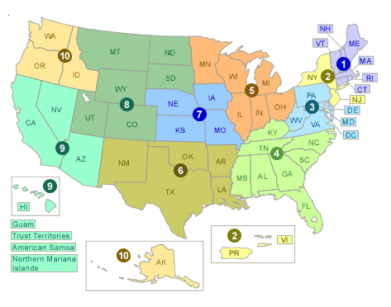
Source: http://www2.epa.gov/fec/forms/contact-us

Slide 6
What We Do
The basic services of the PEHSU network are:
Community Education and Outreach
Training Health Professionals
Consultation and Referral
Notes:
They also work with Federal, State, and local agencies to address children’s environmental health issues in homes, schools, and communities.

Slide 7


Partnership (AAP/ACMT)
Collaboration on:
Steering Committee
Education
Database
Evaluation
Performance Measures
Capacity Building
Expanding Resources

Slide 8
Program Mission & Vision
Mission:
Improve the environmental health of children by:
Enhancing educational and consultative services to clinicians, health professionals and the community.
Providing evidence-based information from a network of experts in environmental health.
Vision:
The PEHSU network is the globally recognized go to resource for Pediatric Environmental Health expertise for clinicians, health professionals and communities.

Slide 9
Program Purpose
Increase awareness of Clinical Preventive Environmental Health Services through development of clinician outreach education capabilities regionally for the purpose of reducing environmental health threats to children
Expand national and regional relationships, and approach that enhances continuity in pediatric and reproductive environmental medicine.

Slide 10
Key Partnerships
Federal agencies e.g. CDC, NCEH/ATSDR, EPA, NIEHS
State & local health departments
NGOs: AAP, APHA, ACMT, ACOG
Regional collaborations with Poison Control Centers

Slide 11
PEHSU Performance Tracking System-REDCap

Slide 12
Development of the Tracking System
REDCap: robust, web-based, HIPAA-compliant platform
Needs assessment (WebEx) R1-10, ATSDR
Consult Activity Form and Education/Outreach Form developed
IRB determination acquired (non-research activity)
Support materials developed (handbook, quick-start)
Regional pilot and revision of Forms
Soft launch R1-10, hybrid participation for Q2 and Q3
Revisions and improvements

Slide 13
Enhancements of the PM Tracking System
Greater breadth, depth of information re: consultations, and ability to filter all records on any of a large number of criteria, including:
  Activity: Consultation Type, Primary Reason for Encounter
  Caller: Location (State), Demographics, Referral Source, Resources Contacted prior to PEHSU
  Client: Age, Gender, Pregnancy Status, Week of Pregnancy, Demographics
  Exposure: Agent/Health Concern, Setting, Media
  Treatment: Discrete Recommendations
Flagging of unique cases
Follow-up
Internal Resource Utilization: Personnel, Time

Slide 14
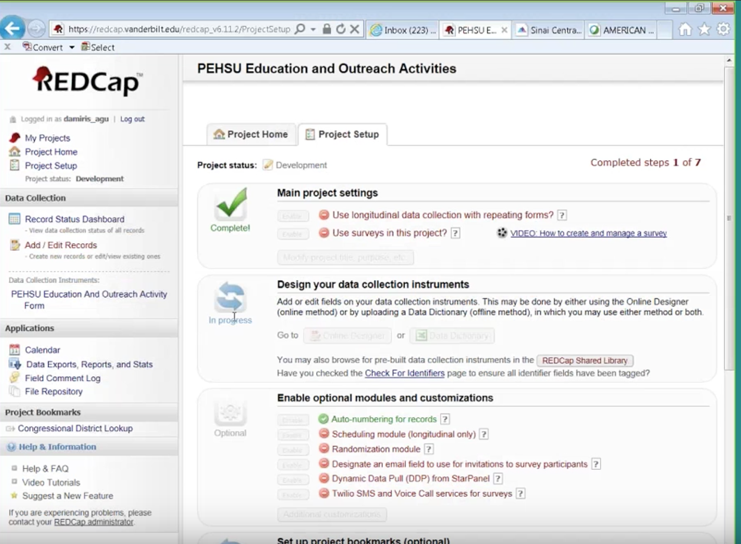

Slide 15
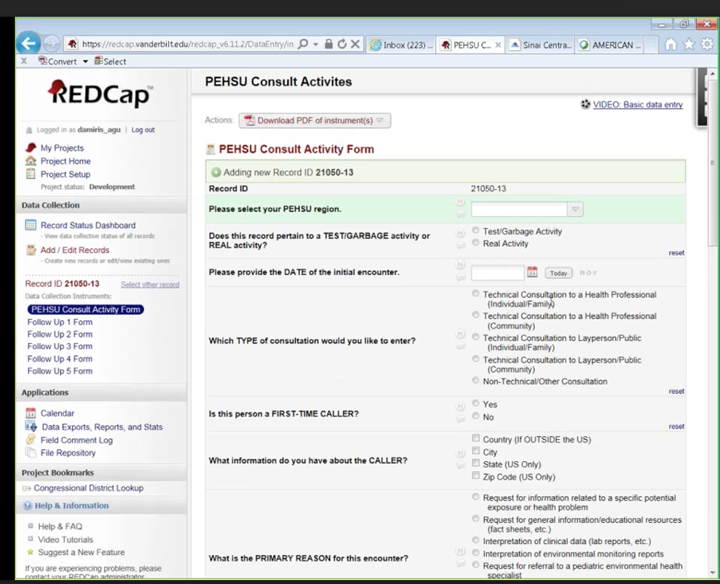

Slide 16
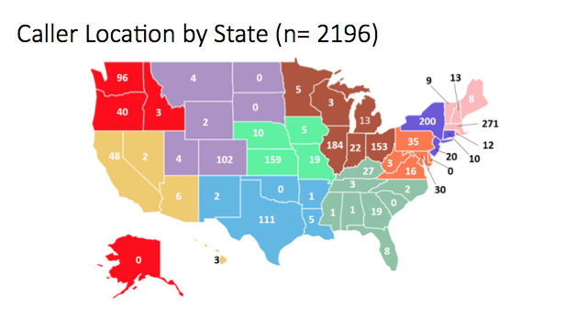

Slide 17
TOP 10 EXPOSURE CONCERNS
2016-2017
Substance of Concern
1. Lead
2. Fungus/Mold
3. Drugs
4. Carbon Monoxide
5. Pesticides
Substance of Concern
6. Cleaning/disinfectant products
7. Arsenic
8. Gases/Fumes
9. Mercury
10. Asbestos

Slide 18
TOP 5 HEALTH CONCERNS
2016-2017
Health Concern
Asthma (88 counted)
Socio-Environmental Factor (11)
Autism (8)
Cancer (4)
Anemia(2)/Pregnancy(2)/Multiple Chemical Sensitivity (2)

Slide 19
Consultations & Outreach:
2015-2017
 | Totals
Presentations Delivered | 433
Book Articles/Chapters | 72
Consultations to Health Professionals | 1026
Consultations to Lay Professionals | 795

Slide 20
What was the exposure setting? (controlling for settings of interest) 2015-2017
 | Totals
Childcare/Daycare | 19
Schools | 35
Total | 54

Slide 21
PEHSU National Classroom

Slide 22




www.pehsu.net/nationalclassroom.html
Webinars
Online Courses
Resource Catalog
Series of scientific webinars that provide a forum for discourse on scientific issues.
Evidence-based online courses on a variety of children's environmental health topics.
Fact sheets, journal publications, reports, and other resources for parents, community members, patients and healthcare professionals
Live and On-Demand
Interactive and Self-Paced
Case Conferences
Journal Clubs
Grand Rounds
Topics included:
Air Quality, Pesticides, Natural Disasters, BPA, Mold, Lead, Mercury
CE Available
CE Available

Slide 23


Slide 24
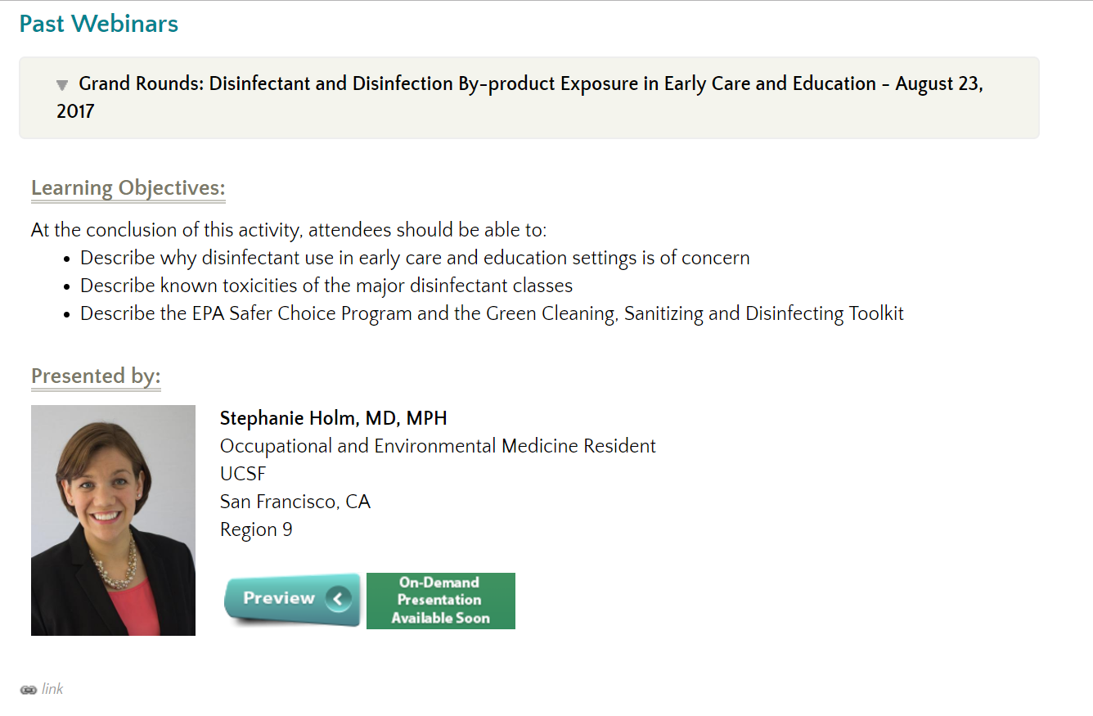

Slide 25
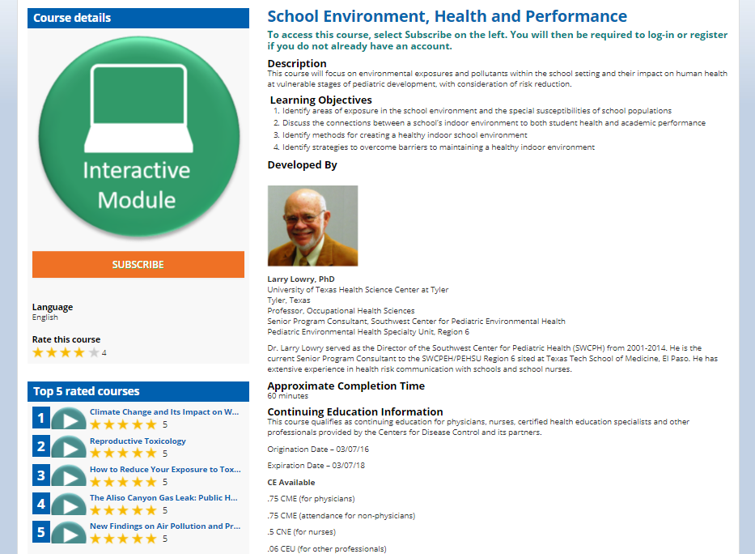

Slide 26
Questions?

