Slide 1

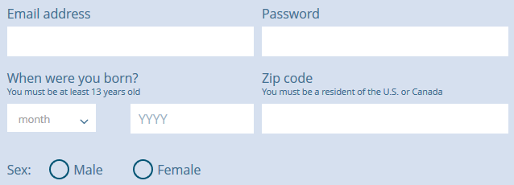
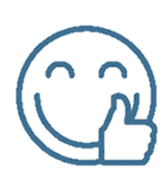
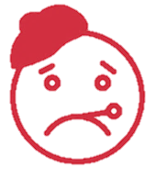
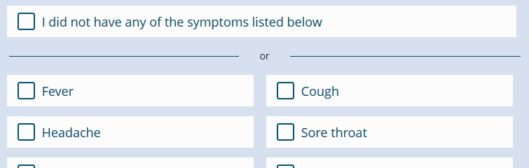
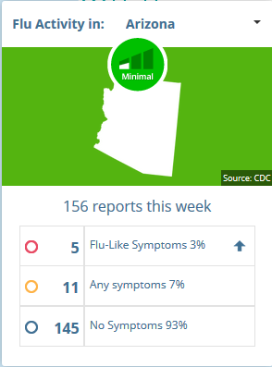
How can YOU
track the FLU?
1. Register at www.FluNearYou.org
Join the 60,000+ Flu Trackers reporting their symptoms
2. Each Monday, we’ll ask how you’ve been feeling
Reminders sent by e-mail or push notification
3. Report your symptoms
Takes less than one minute
4. Track flu activity in the region, state, and nation
Interactive maps help you explore flu data near you
Benefits:
Become a citizen scientist
Protect yourself, your family, and your community
Learn about epidemiology, statistics, and public health technology

