Slide 1
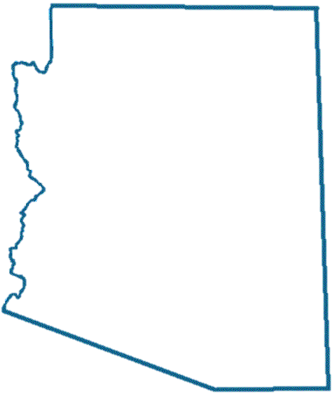

FLU
FLU
FluNearYou.org
FluNearYou.org
R
R
NEA
NEA
Your participation is important for One Health
Your participation is important for One Health
YOU
YOU
FLU
FLU
FluNearYou.org
FluNearYou.org
R
R
NEA
NEA
Your participation is important for One Health
Your participation is important for One Health
YOU
YOU

Slide 2


Be a scientist in your community!
Analyze flu data in Arizona with Flu Near You, a real-time participatory tool that tracks and visualizes influenza-like illness.
Make your data inFLUential!
With Flu Near You, you can access and contribute to a data stream about influenza-like illness in your community. Report symptoms, learn when to take action, and help build a resource for data-driven wellness.
Be a scientist in your community!
Analyze flu data in Arizona with Flu Near You, a real-time participatory tool that tracks and visualizes influenza-like illness.
Make your data inFLUential!
With Flu Near You, you can access and contribute to a data stream about influenza-like illness in your community. Report symptoms, learn when to take action, and help build a resource for data-driven wellness.
Register at FluNearYou.org
Register at FluNearYou.org
Be a scientist in your community!
Analyze flu data in Arizona with Flu Near You, a real-time participatory tool that tracks and visualizes influenza-like illness.
Make your data inFLUential!
With Flu Near You, you can access and contribute to a data stream about influenza-like illness in your community. Report symptoms, learn when to take action, and help build a resource for data-driven wellness.
Be a scientist in your community!
Analyze flu data in Arizona with Flu Near You, a real-time participatory tool that tracks and visualizes influenza-like illness.
Make your data inFLUential!
With Flu Near You, you can access and contribute to a data stream about influenza-like illness in your community. Report symptoms, learn when to take action, and help build a resource for data-driven wellness.
Register at FluNearYou.org
Register at FluNearYou.org

