Slide 1

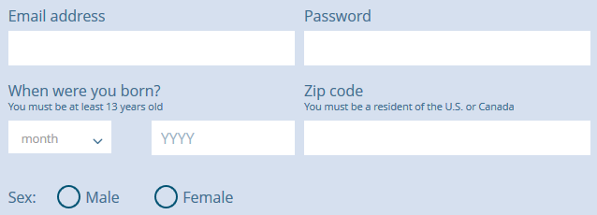


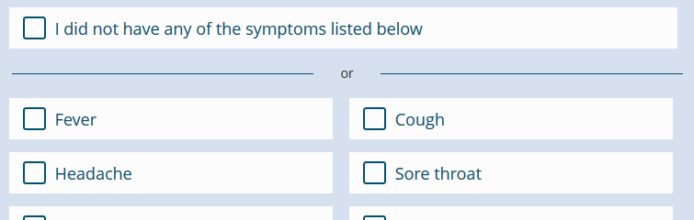
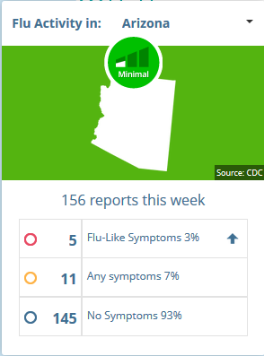
How can YOU
track the FLU?
1. Register at www.FluNearYou.org
Join the 60,000+ Flu Trackers reporting their symptoms
2. Each Monday, we’ll ask how you’ve been feeling
Reminders sent by e-mail or push notification
3. Report your symptoms
Takes less than one minute
4. Track flu activity in the region, state, and nation
Interactive maps help you explore flu data near you
Benefits for providers:
Monitor community-level flu-like symptoms in near real-time
View flu activity among community members who may not seek care
Contribute to public health efforts in Maricopa County and Arizona

