Slide 1

A One Health Approach Towards Agricultural Fairs and Shows
David A. Crum, DVM, MPH
Prevention and Health Promotion Administration
Center for Zoonotic and Vector-borne Diseases
July 16, 2019

Slide 2
MISSION AND VISION
Prevention and Health Promotion Administration
MISSION
The mission of the Prevention and Health Promotion Administration is to protect, promote and improve
the health and well-being of all Marylanders and their families through provision of public health
leadership and through community-based public health efforts in partnership with local health
departments, providers, community based organizations, and public and private sector agencies, giving
special attention to at-risk and vulnerable populations.
VISION
The Prevention and Health Promotion Administration envisions a future in which all Marylanders and
their families enjoy optimal health and well-being.

Slide 3

Overview
Potential Health Risks From Animals
One Health Partners
Public Health Messaging

Slide 4
Potential Health Risks From Animals

Slide 5
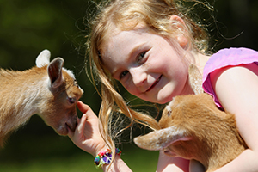
Why Interact With Animals?
Potential Health Risks From Animals
Human - animal bond
Public can learn about:
  Living on a farm
  Where food comes from
  Animal behavior
Opportunity for entertainment and education
Image: CDC

Slide 6
How We Can Get Into Trouble
Potential Health Risks From Animals
Inadequate understanding of the potential risks to health and safety
Unaware that apparently healthy animals can transmit pathogens
Not practicing personal protective behaviors
  Handwashing/Sanitation
  Contamination prevention

Slide 7
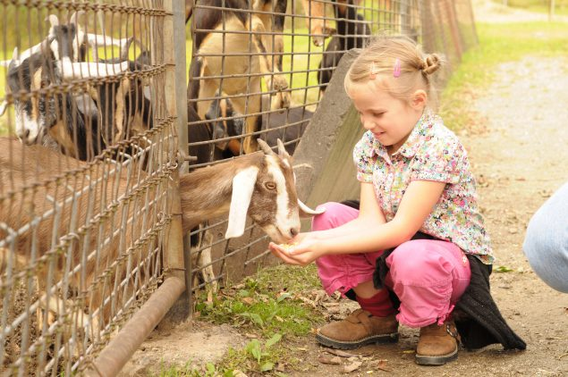
Injury Risk
Potential Health Risks From Animals
Animals can be unpredictable
Injuries can include:
  Crush injury
  Pushed / Kicked
  Scratched / Bitten
Source: CDC

Slide 8
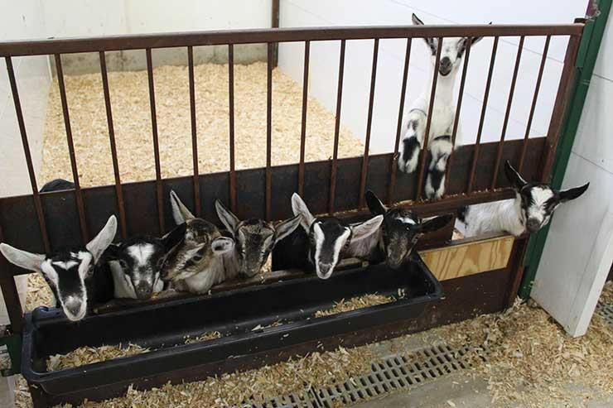
Disease Risk
Potential Health Risks From Animals
Apparently healthy animals can carry pathogens
Source: AVMA

Slide 9
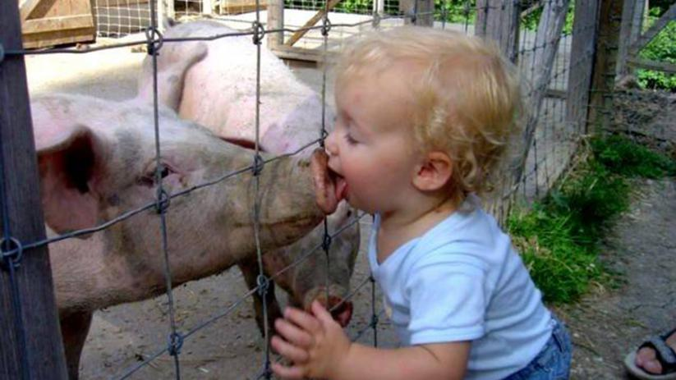
Disease Risk
Potential Health Risks From Animals
Direct Contact
Image: Larry Jacobsen/Flickr CC BY

Slide 10
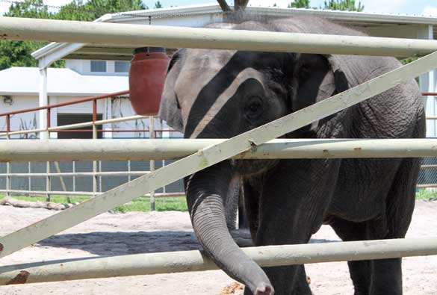
Disease Risk
Potential Health Risks From Animals
Indirect Contact
  Animal enclosures
  Contamination of objects
Image: AVMA

Slide 11
Why Worry About Animal Contact?
Potential Health Risks From Animals
What is common sense to you is not common sense to most visitors
  Limited understanding of disease transmission
  Don’t know the importance of handwashing

Slide 12
Why Worry About Animal Contact?
Potential Health Risks From Animals
What is common sense to you is not common sense to most visitors
  Limited understanding of disease transmission
  Don’t know the importance of handwashing
It is our responsibility to help educate the public.

Slide 13
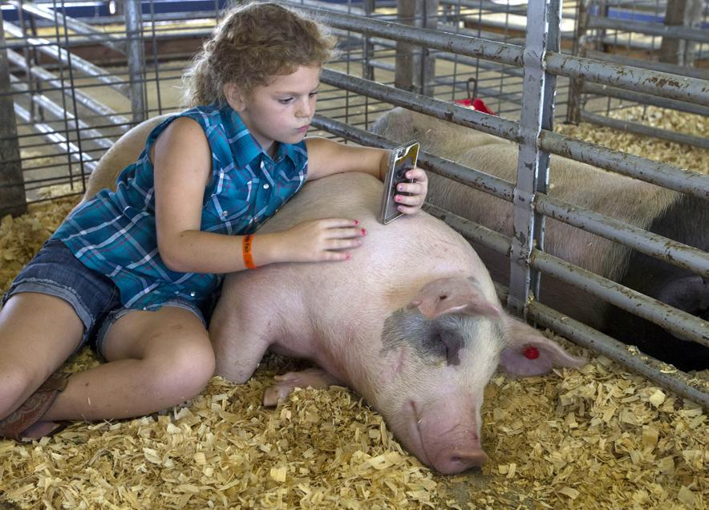
Perception of Risk
Potential Health Risks From Animals
Visitors may be misled by the close contact they observe between exhibitors and their animals
Important to emphasize that both visitors and exhibitors can get sick

Slide 14
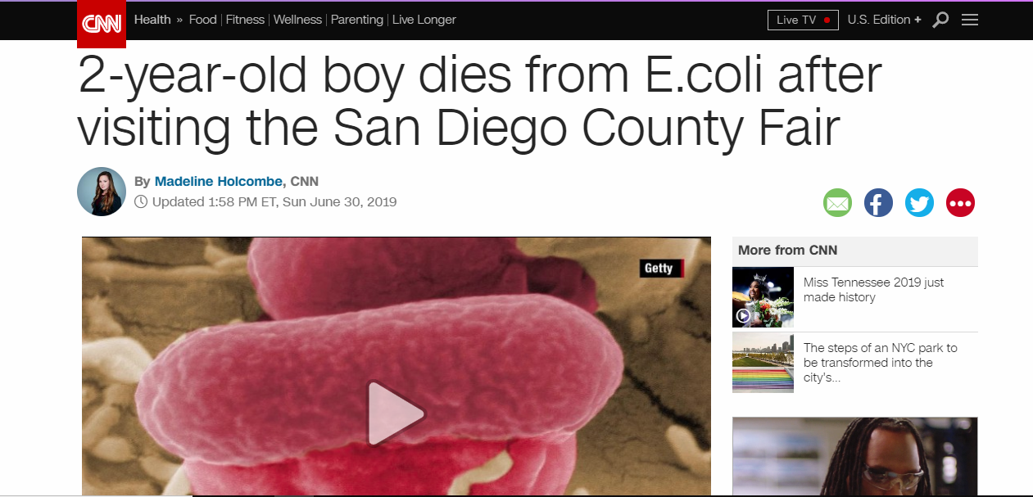
A Cautionary Tale…
Potential Health Risks From Animals

Slide 15
Next Steps
Potential Health Risks From Animals
Completely eliminating risks from animal contact is not possible
Educate exhibitors and visitors on the prevention of zoonotic diseases
  Understand the risks of illness and injury from animals
  Prevention strategies for illness associated with animal contact

Slide 16
Who Are Your Partners?

Slide 17
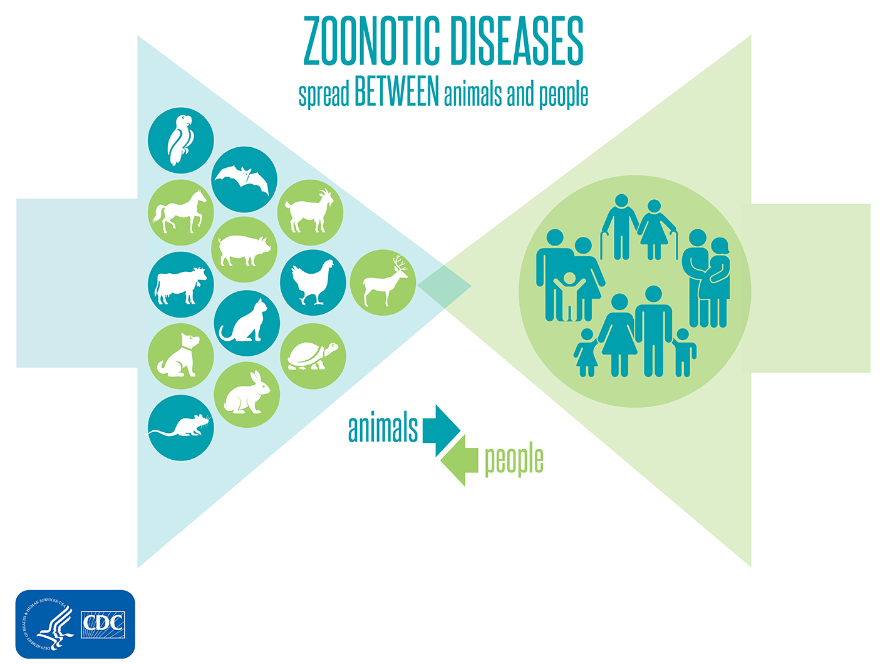
One Health In Action
Who Are Your Partners?
MDA: Animal health issues, veterinary and sponsor education
4-H/Fair Organizers: Exhibitor education
MDH: Human health issues, fair visitor education

Slide 18

Maryland and West Virginia 4-H
Who Are Your Partners?
Healthy Animals | Healthy YOUth Program
Information regarding influenza and other zoonotic diseases:
  Animal Health and Quality Assurance (AH&QA) program
  Club/Chapter lesson plans
  Signage to be used at fairs

Slide 19
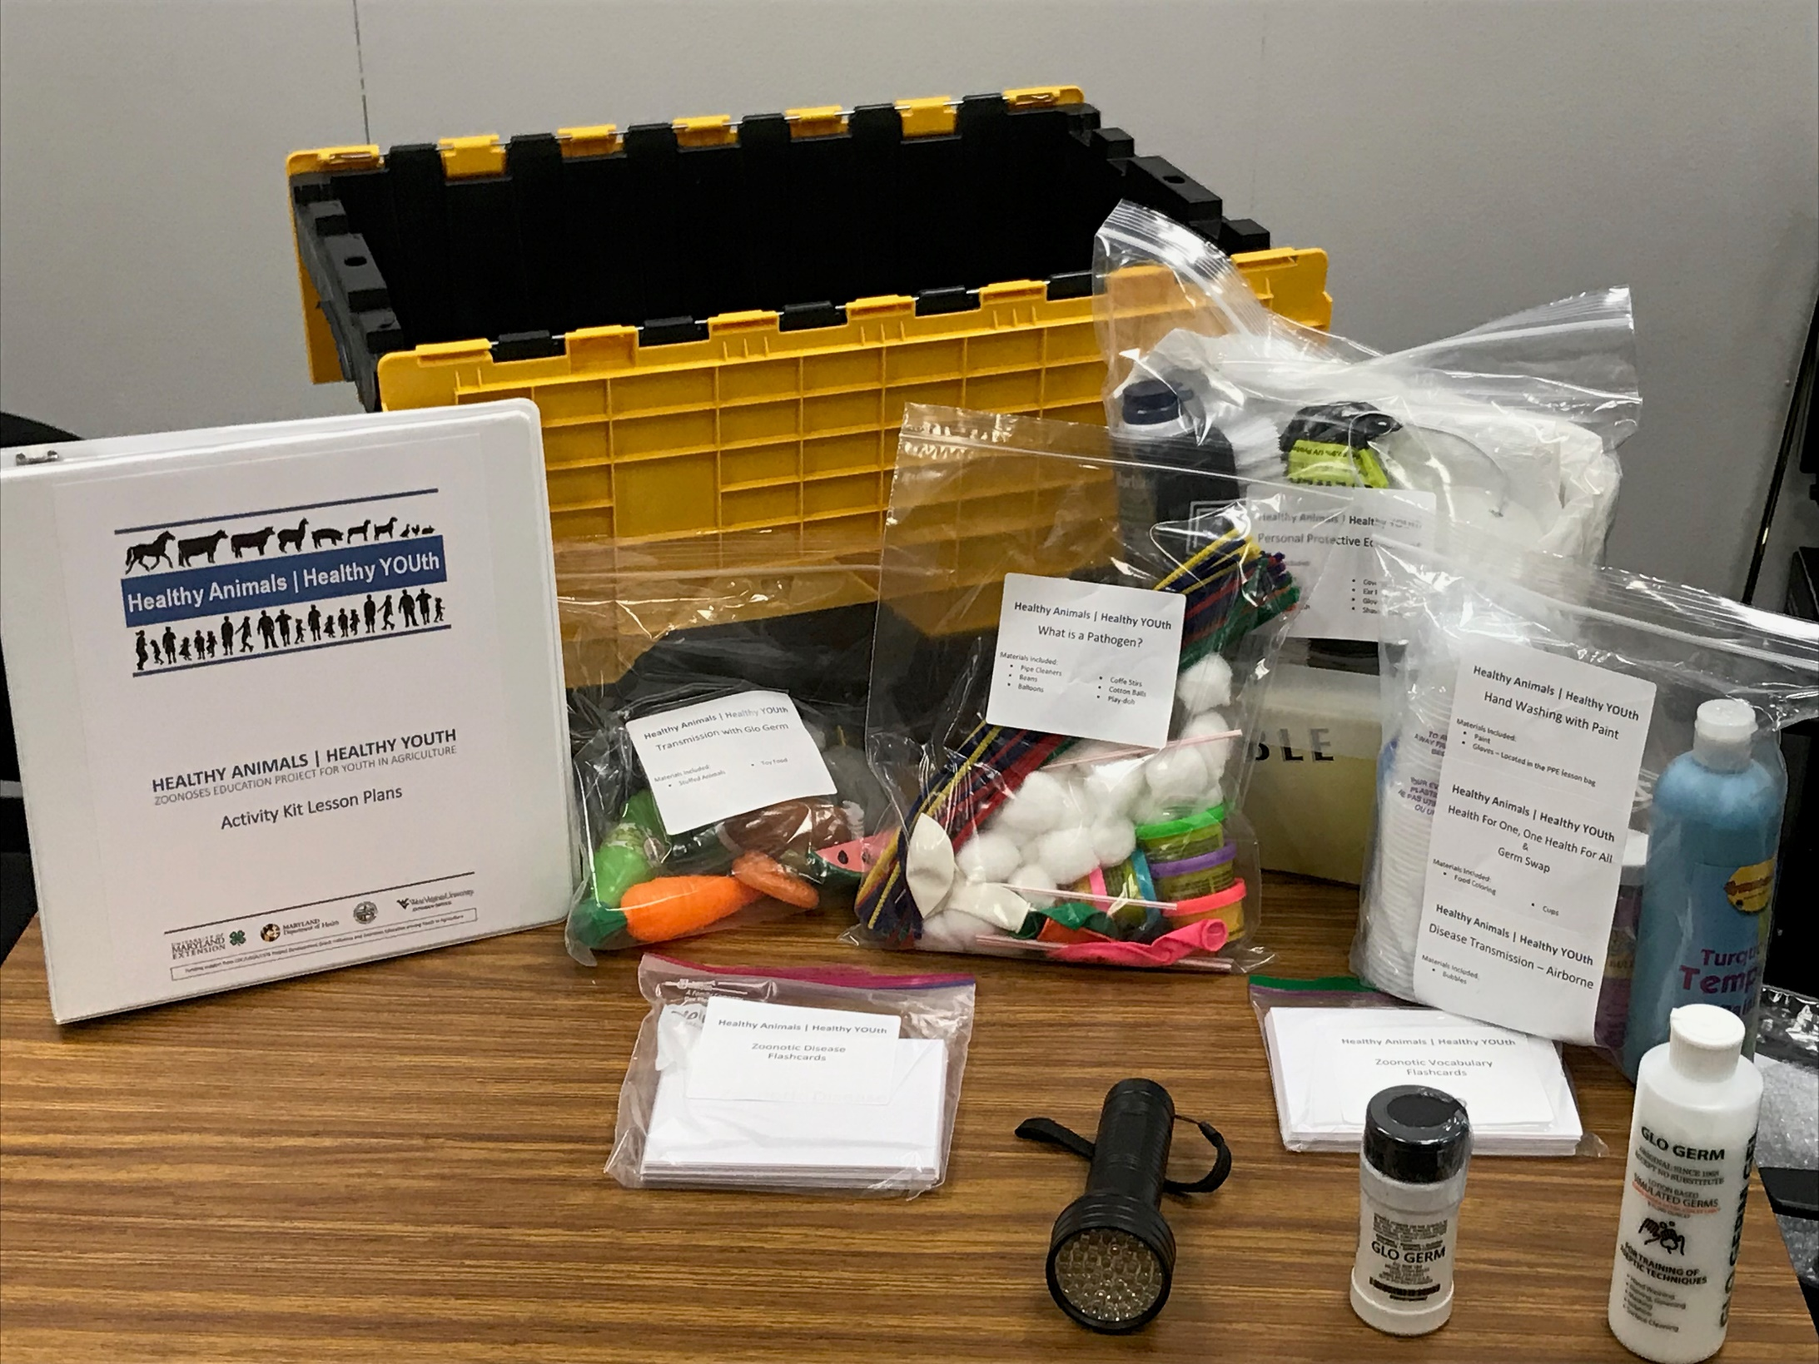
Zoonosis Activity Kits
Who Are Your Partners?

Slide 20
Public Health Messaging

Slide 21
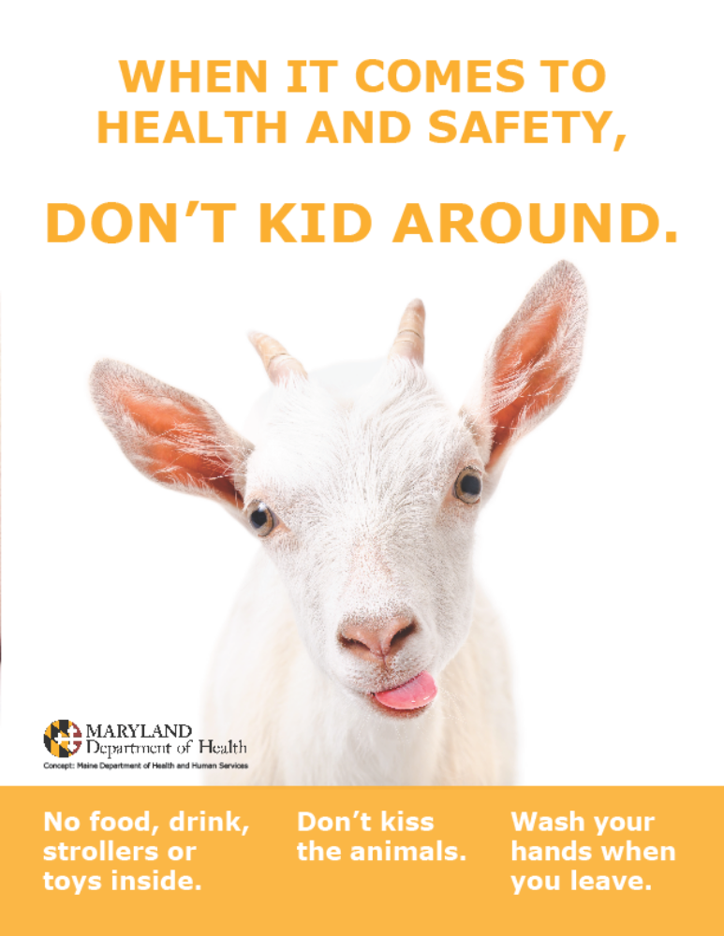
Fair Visitor Education
Public Health Messaging
Simple and easy to understand messaging
  No food or drink in animal areas
  No strollers or toys in animal areas
  No kissing the animals
  Wash your hands

Slide 22
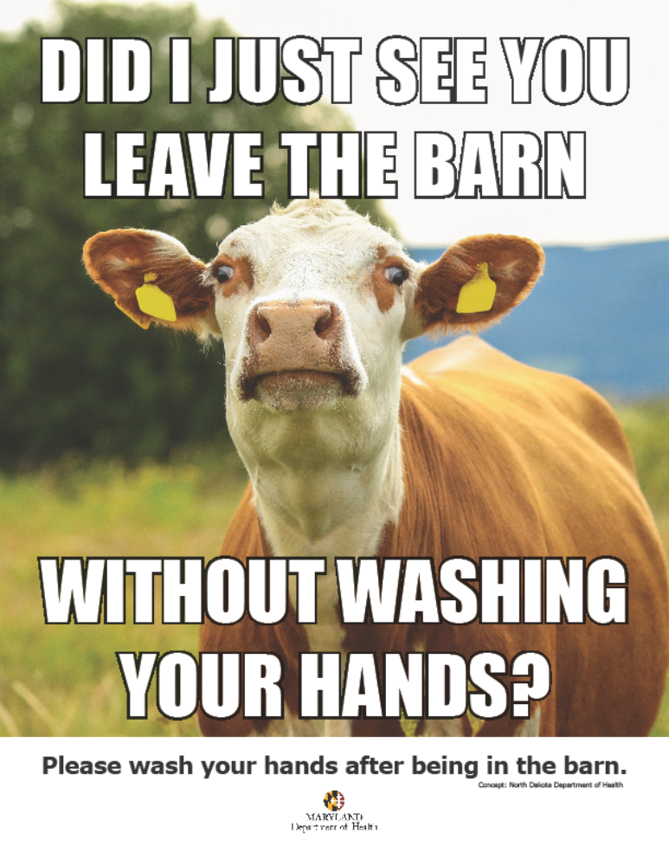
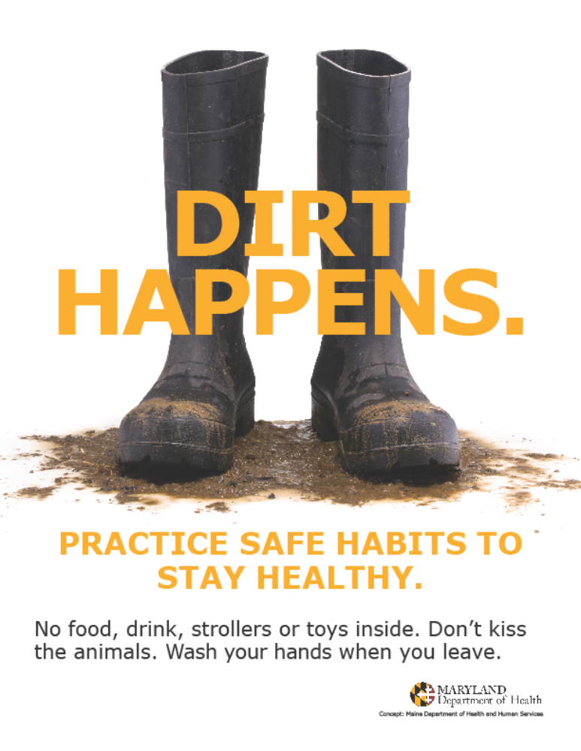
Fair Signage Examples
Public Health Messaging

Slide 23
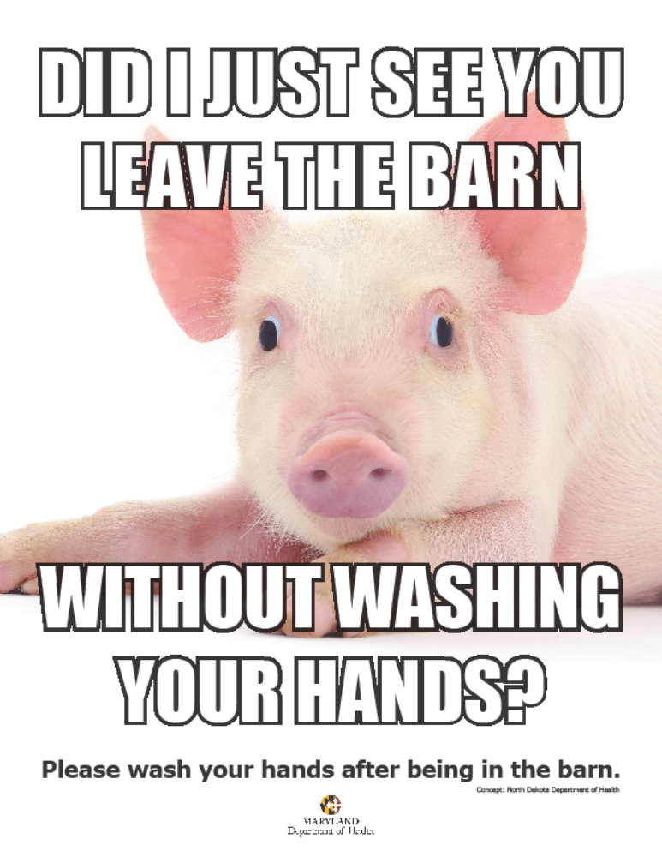
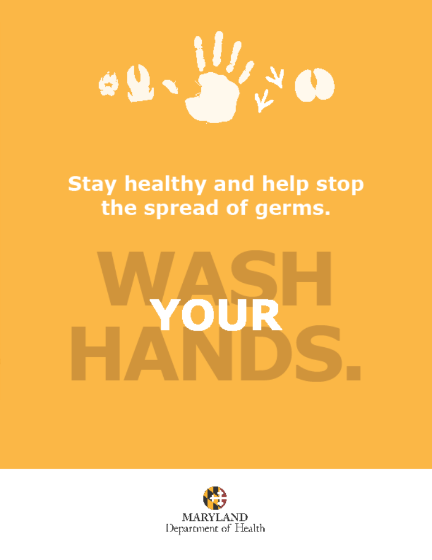
Fair Signage Examples
Public Health Messaging

Slide 24
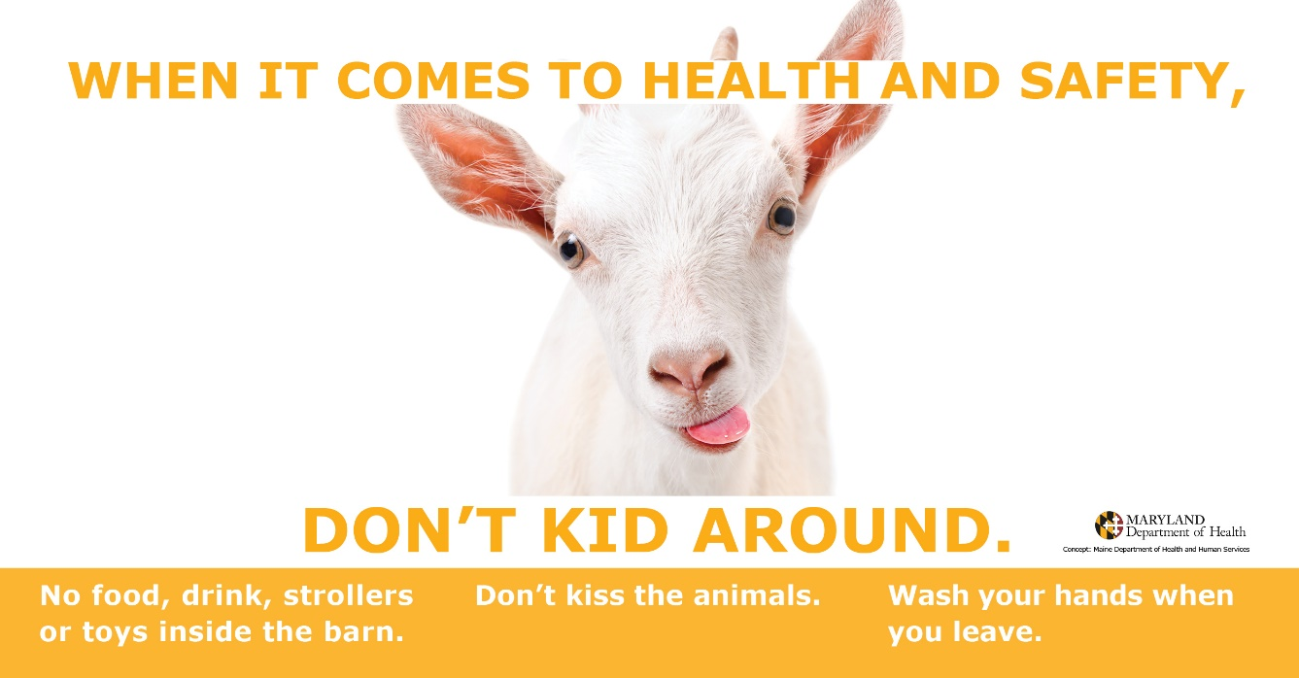
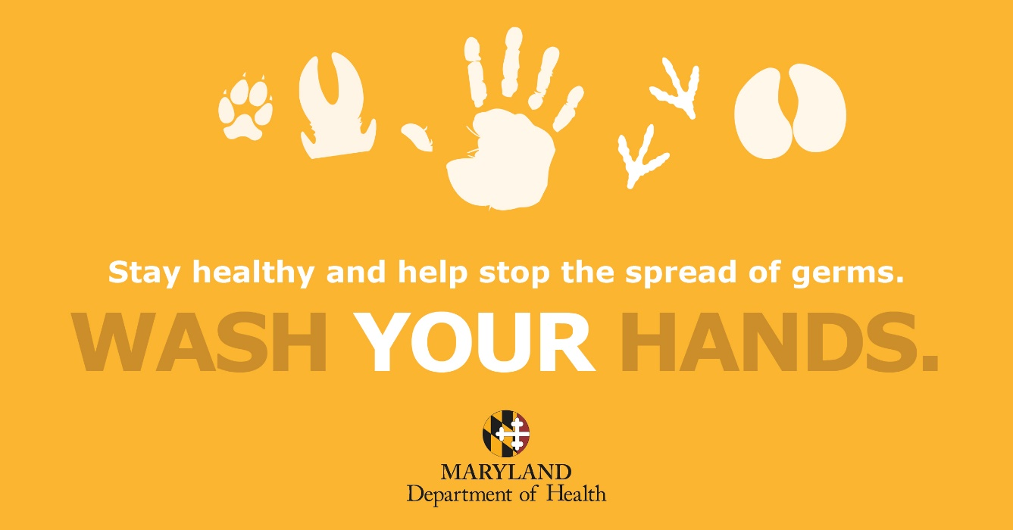
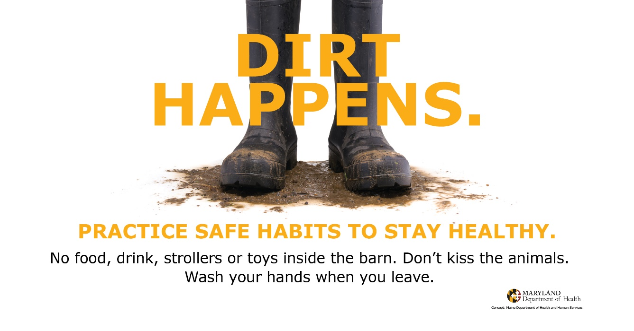
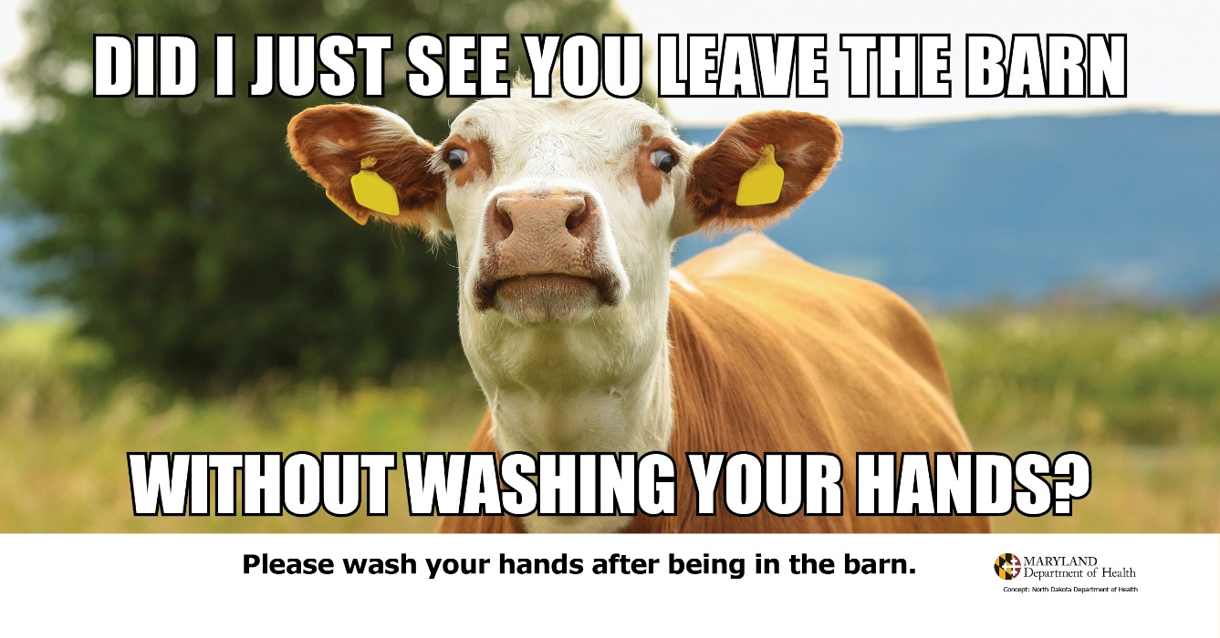
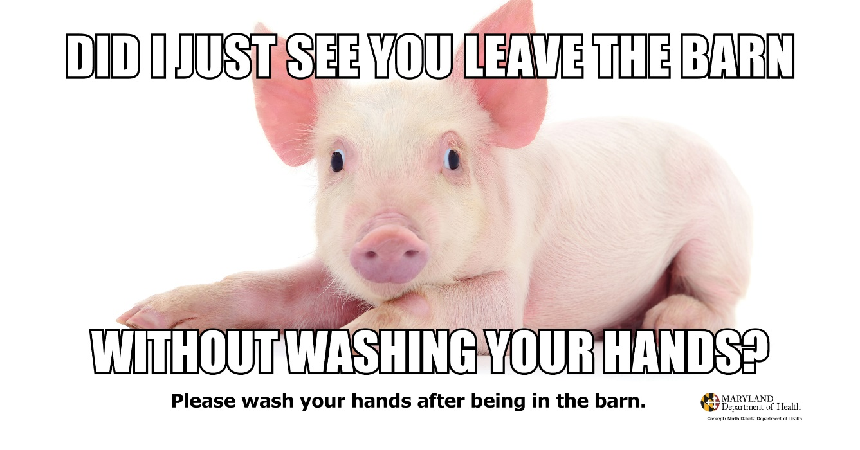
Social Media
Public Health Messaging

Slide 25
Social Media
Public Health Messaging
Stay healthy when visiting the fair this summer. Wash your hands after touching the animals and keep food, drinks, toys and strollers outside their environment. Learn more: https://bit.ly/2XmxVZC
Have fun and stay healthy at the fair this summer. Keep food, drinks, toys and strollers outside any animal exhibits and remember to wash your hands after touching the animals. Learn more: https://bit.ly/2XmxVZC
Share the fun — not the germs — at the fair this summer. Wash your hands after touching the animals and make sure you leave food, drinks, toys and strollers outside any animal areas. Learn more: https://bit.ly/2XmxVZC

Slide 26
Resources

Slide 27
Tools and Resources
Resources
NASPHV Compendium of Measures to Prevent Disease Associated with Animals in Public Settings, 2017 AND Animals in Public Settings Toolkit
http://nasphv.org/documentsCompendiumAnimals.html
Influenza and Zoonoses Education Among Youth in Agriculture Program Resource Repository http://resources.cste.org/yia?deliveryName=USCDC_1164-DM2681
CDC Stay Healthy at Animal Exhibits https://www.cdc.gov/features/animalexhibits/

Slide 28
Tools and Resources
Resources
CDC Health Pets, Healthy People https://www.cdc.gov/healthypets/pets/
CDC Information on Swine Influenza/Varian Influenza Virus
https://www.cdc.gov/flu/swineflu/
The Junior Disease Detectives: Operation Outbreak (CDC, USDA, 4-H)
https://itunes.apple.com/us/book/the-junior-disease-detectives-operation-outbreak/id1405644904?mt=11

Slide 29

Contact Lists
Resources
List primary contacts for:
  Fair/Show Organizers
  Local Health Department
  Maryland Department of Agriculture
  Maryland Department of Health
Facilitate effective and timely communication
mdh.czvbd@maryland.gov
Image: CDC

Slide 30
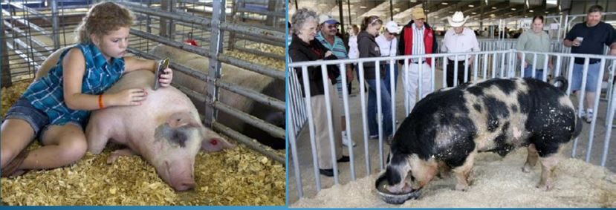
PREVENTING SWINE INFLUENZA & other diseases at Fairs & Shows
Presented July 16, 2019
N. Jo Chapman, DVM MPH
MDA Acting State Veterinarian
Njo.chapman@maryland.gov
Notes:
This presentation is to be used by Educators or volunteers as part of a quality assurance program to teach youth about basic animal health awareness. This slide show is designed to be shown to the youth and the notes are teaching points for the presenters.

Slide 31
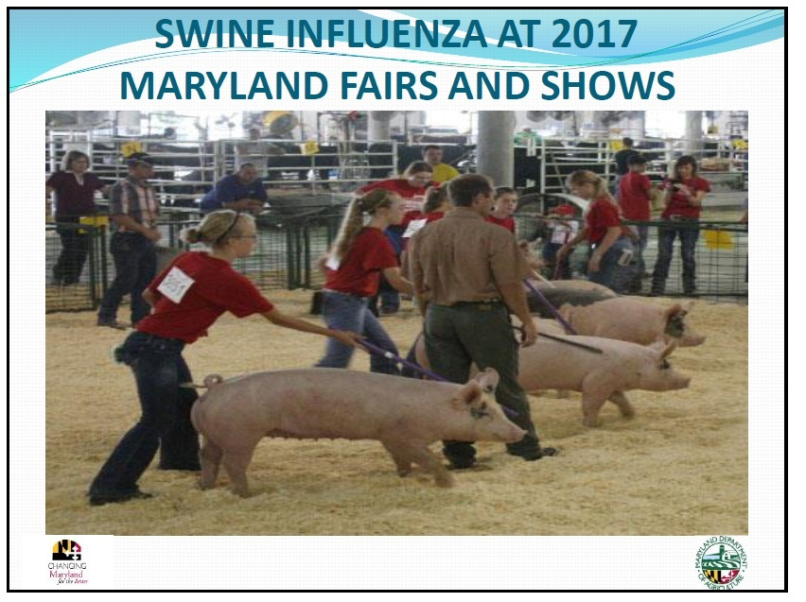
SWINE INFLUENZA happens…
2012 – H3N2v at Queen Anne’s County Fair
  13 swine cases
  6 human cases
2017 – H3N2 at Frederick & Charles County Fairs
  23 swine cases
  40 human cases

Slide 32
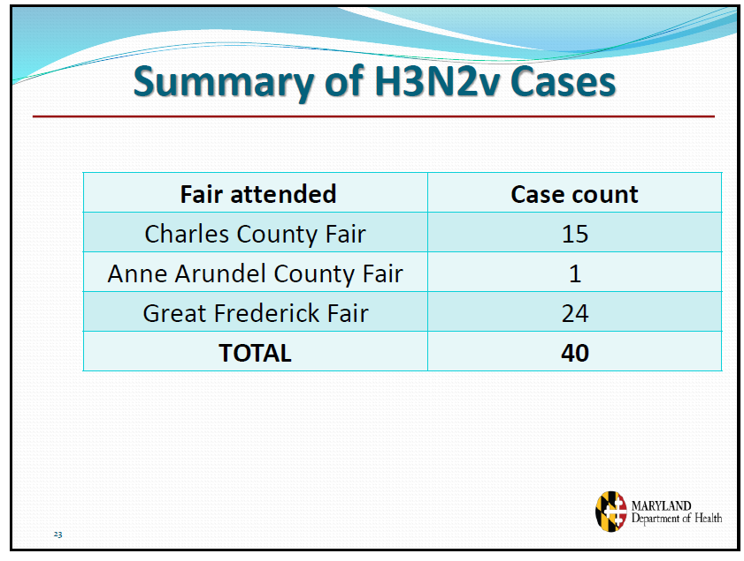
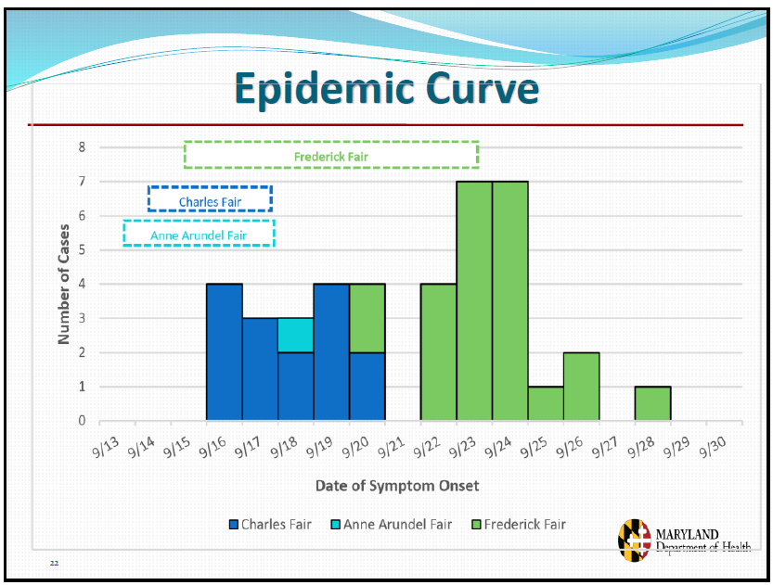
Human H3N2 SIV Cases Md 2017

Slide 33
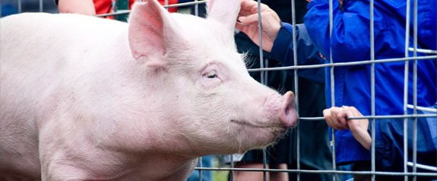
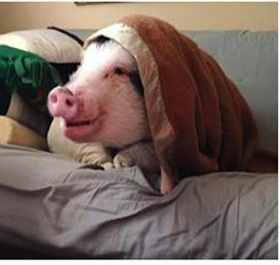
Swine Influenza
(Swine flu, Pig flu)
Orthomyxovirus – Influenza A
Classic Subtypes: H1N1, H3N2, H1N2, H3N2v
Signs:
Dry, hacking, "goose-honk" cough that worsens with activity
Sudden onset of symptoms
Discharge from eyes and nose
Fever, weakness, weight loss, unwillingness to move
Pigs piling up, chilled with fever
Difficulty breathing, open mouth breathing
Most of herd affected
Should recover in 5 - 7 days unless secondary infection involved

Slide 34
Swine Influenza
(Swine flu, Pig flu)
Orthomyxovirus – Influenza A
Classic Subtypes: H1N1, H3N2, H1N2, H3N2v
Transmission:
Pig to Pig, Pig to Human, Human to Pig
Nasal Secretions, Short Distance Aerosols, Fecal-Oral Ingestion
Commercial Pigs are both clinical and sub-clinical cyclic carriers
Prevention:
Avoid stress (overcrowding, moving, mixing); age grouping; good ventilation, sanitation, minimize dust
Vaccinate – against 1 or all subtypes (check yearly)
Sick Animals: Isolate, Antibiotics to prevent secondary infections, consult your veterinarian

Slide 35
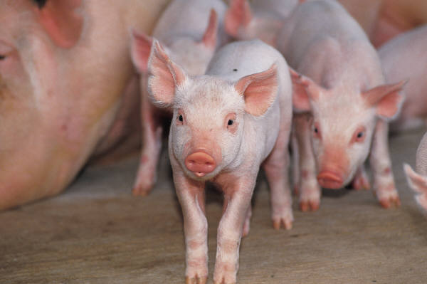
EXHIBITOR & VETERINARIAN’S ROLE
TO PREVENT DISEASE
Follow Best Management Practices at Home and Fair
Observe animals for signs of illness & isolate if sick –don’t bring to fair
Self-Certification within 24 hrs of Loading for Fair
Report any animals with
signs of illness at Fair
to Superintendant
immediately –
isolate animal

Slide 36
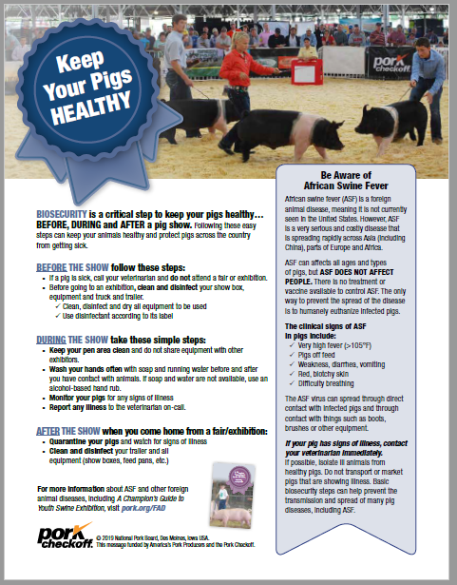

Slide 37
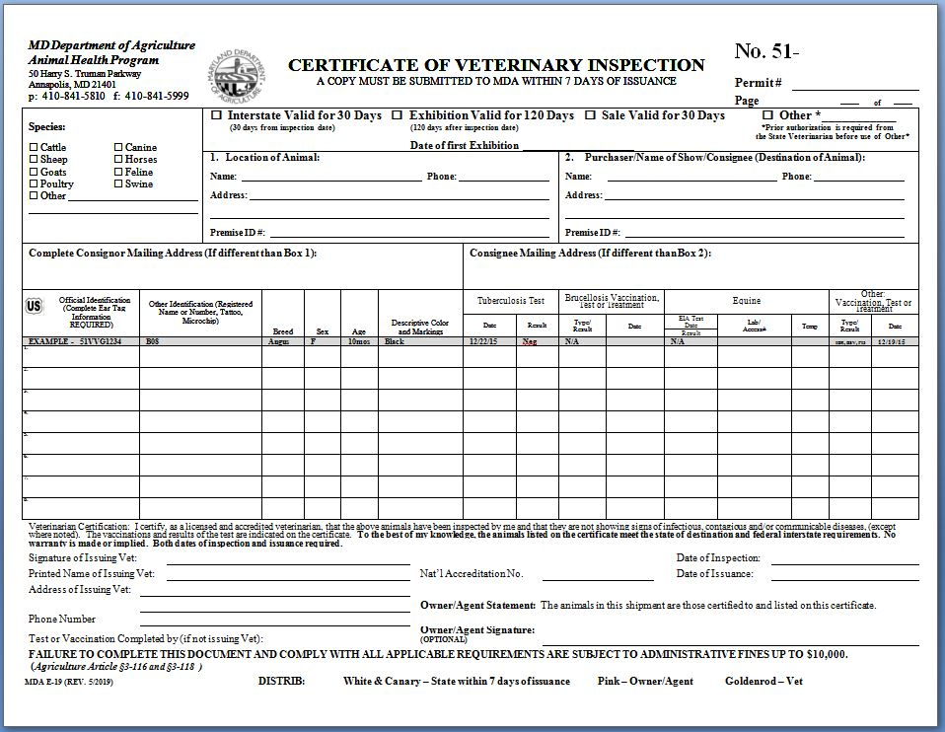
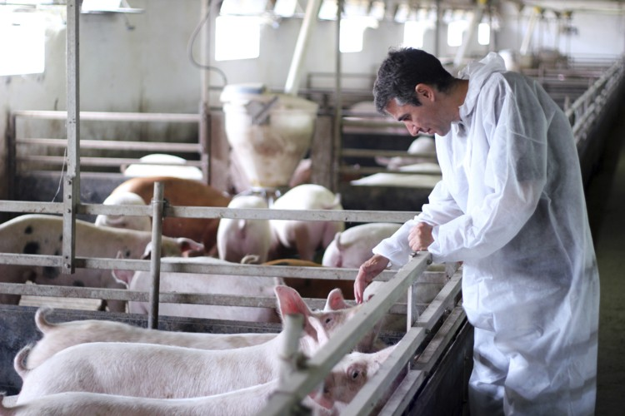
CERTIFICATE OF VETERINARY INSPECTION (CVI)
Must have CVI done within 120 DAYS
(Show Season) to enter exhibitions
Vaccination & Identification may be done at time of inspection

Slide 38
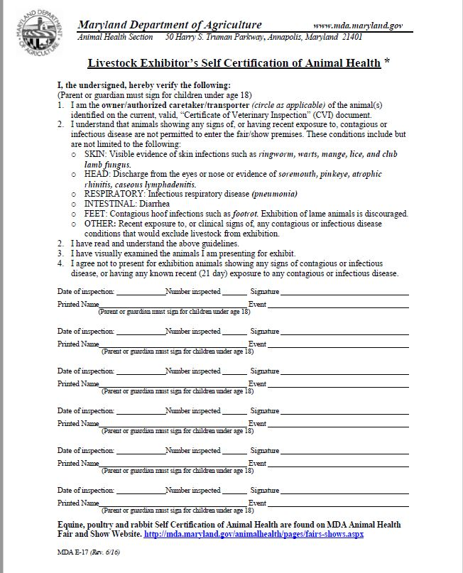
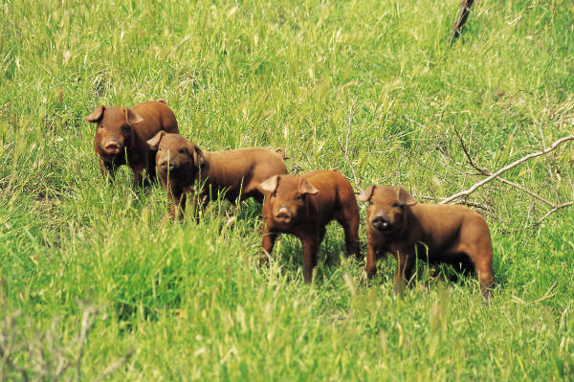

Slide 39
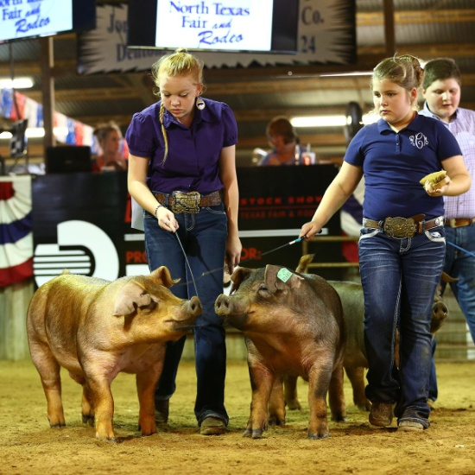
FAIR SPONSOR’S ROLE
TO PREVENT DISEASE
Inspection at Entry: Animal, CVI, Self-Cert
Post signs & enforce sanitation and
biosecurity measures in Show Barns
72 hour limit on swine exhibits rec’d
Designing the intake process for animals when they arrive at the fairgrounds so that they aren’t all touching the same surfaces with their snouts….
Consider requiring vaccinations for flu
Isolate any ill animals, request veterinary evaluation from on-call veterinarian
Notify MDA inspector of any ill animals

Slide 40
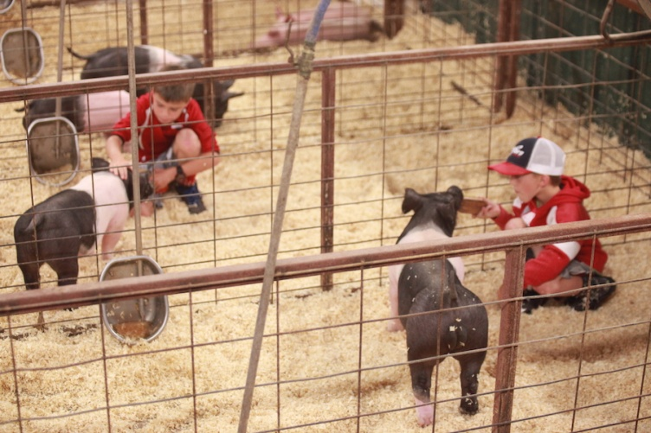
STATE’S ROLE – MDA, MDH, UMD TO PREVENT DISEASE
Inform, Educate Swine Producers & Fair/Show Sponsors on disease prevention –
  MDA Outreach to Vets, Farmers, Fair Sponsors in Spring
  UMD Extension Outreach and 4H Training
Apply and enforce sanitation and biosecurity measures
  MDA Permit/Quarantine rules
  Inspection at or near Entry (Check animal, CVI, Self-Certification)
  Inspection during fair - daily when feasible
  IF DISEASE DETECTED: Quarantine on farms, markets, fair, or show

Slide 41
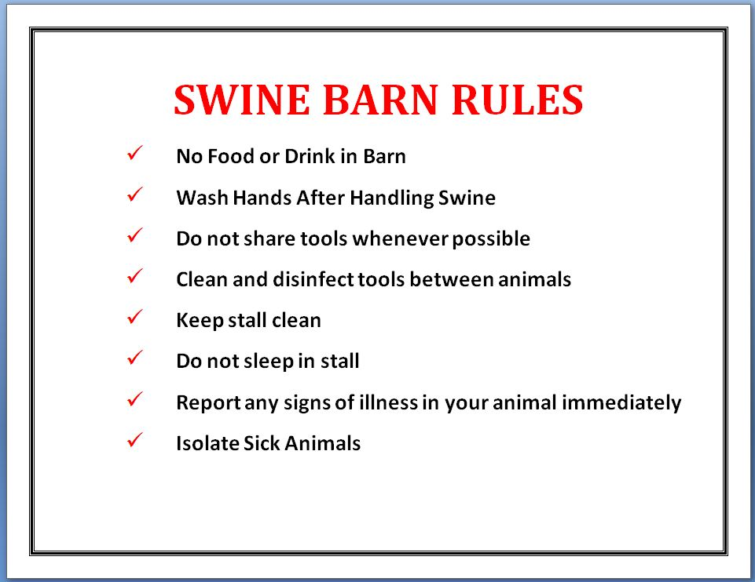
STATE’S ROLE – MDA Animal Health
TO PREVENT DISEASE

Slide 42
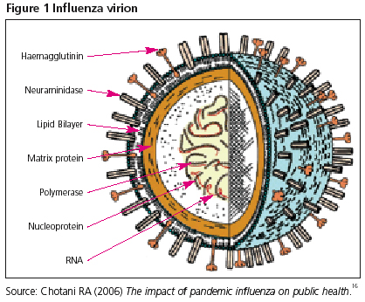
Swine Influenza Events –
Roles and Responsibilities
MDA
Quarantine Swine at Fair or at Farm
Test out Swine, Response & Control
Joint Planning, Joint Press Release with MDH
Manage public inquiries on swine disease
MDH
Identify human cases, follow-up on cases
Provide health education for fair visitors
Manage public inquiries on human disease

Slide 43
Questions?

Slide 44
Maryland Department of Health
Prevention and Health Promotion Administration
44

