Slide 1

Maryland/West Virginia
Online 4-H Animal Husbandry and Quality Assurance Program
Chris Anderson
4-H Youth Development Specialist, Animal Science
April Barczewski
4-H Youth Development Educator
Sheryl Bennett
4-H Youth Development Educator
Ashley Travis
4-H Youth Development Educator

Slide 2
Situation: Maryland 4-H Animal Science Programs
Approximately 5,500 youth from 23 counties and Baltimore City enrolled in nearly 7,000 animal projects.
4-H Livestock exhibitors required to complete quality assurance training to be eligible to exhibit animals at county and state 4-H shows.
Prior to 2010, educators conducted face-to-face training programs for exhibitors in the counties.
1,000’s of Maryland youth needed to be trained each year, and 100’s of hours were spent preparing for and teaching local training classes.
No statewide standard for content.
Range of comfort levels in teaching the face-to-face sessions.

Slide 3
Program Objectives
Livestock quality assurance programs emphasize the need for youth livestock exhibitors to provide a wholesome, quality livestock product for the consumer. Training programs help youth:
Understand best management practices for the responsible production of livestock,
Understand their responsibilities to provide a safe, wholesome food product to consumers,
Understand how to follow labels carefully for feed additives, medicines, or products used in their livestock production systems, and
Learn the importance of practicing honest, ethical behavior in the production of livestock.

Slide 4

Benefits of an Online Training
Standardized quality assurance training program
Professionally narrated
Reduction in time investment of faculty and staff
Convenience (training can be completed from home, school or local library, Extension Office, etc.)
Training doesn’t have to be completed at one time
Completion certificate generated for youth
Database tracking system
Notes:
Conducting the quality assurance training online offers several benefits, which include:
Youth across the state receive the same standardized quality assurance training. Program is professionally narrated.
Reduces county/city 4-H educator time required to schedule, prepare and conduct face-to-face quality assurance training sessions to help members meet minimum requirements.
Youth fulfill the quality assurance training requirement via internet from their home, school or local library at a time of convenience and area able to leave the training if needed and return later at the point they left off.
A statewide database of all youth completing the program is generated by the program. The system tracks each youth’s progress and/or level of completion of the program and automatically generates completion certificates for the youth member’s records.

Slide 5
Initial Program Development
Step 3: To save time and cost, Maryland purchased web programming code from the University of Illinois and modified it for our purposes.
Step 2: Team created a content outline and explored web applications available to “power” the program online.
Step 1: Team explored web-based quality assurance training programs offered across the nation by 4-H, FFA and animal industry organizations.

Slide 6
Program Implementation
Spring/Summer 2011
Implemented Statewide in MD
Summer 2010
Pilot Test: 4 counties, n=790
2009-2010
Program Development
Spring 2010
Committee Tested Program
Winter 2010
MD 4-H Faculty Trained
2009 2010 2011

Slide 7
Program Evolution
2013
Junior Track for youth ages 8-10 years added.
2011
Camelid, Horse, and Dairy modules added.
2010
Initial Program: 7 narrated modules created: Across Species, Beef, Dairy, Goats, Horse/Pony, Sheep, Swine
2015
Developed new delivery platform. Complete review and adaptation of all content of the MD AH&QA training program. Program adopted by West Virginia 4-H/FFA
2010 2011 2012 2013 2014 2015

Slide 8
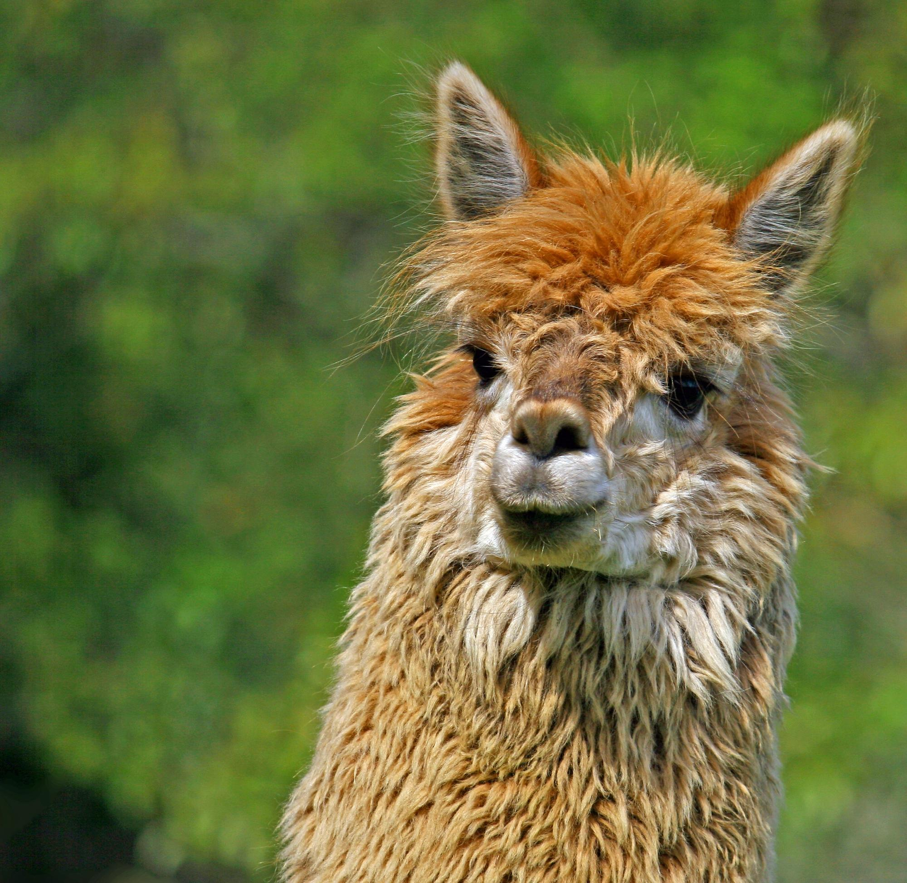
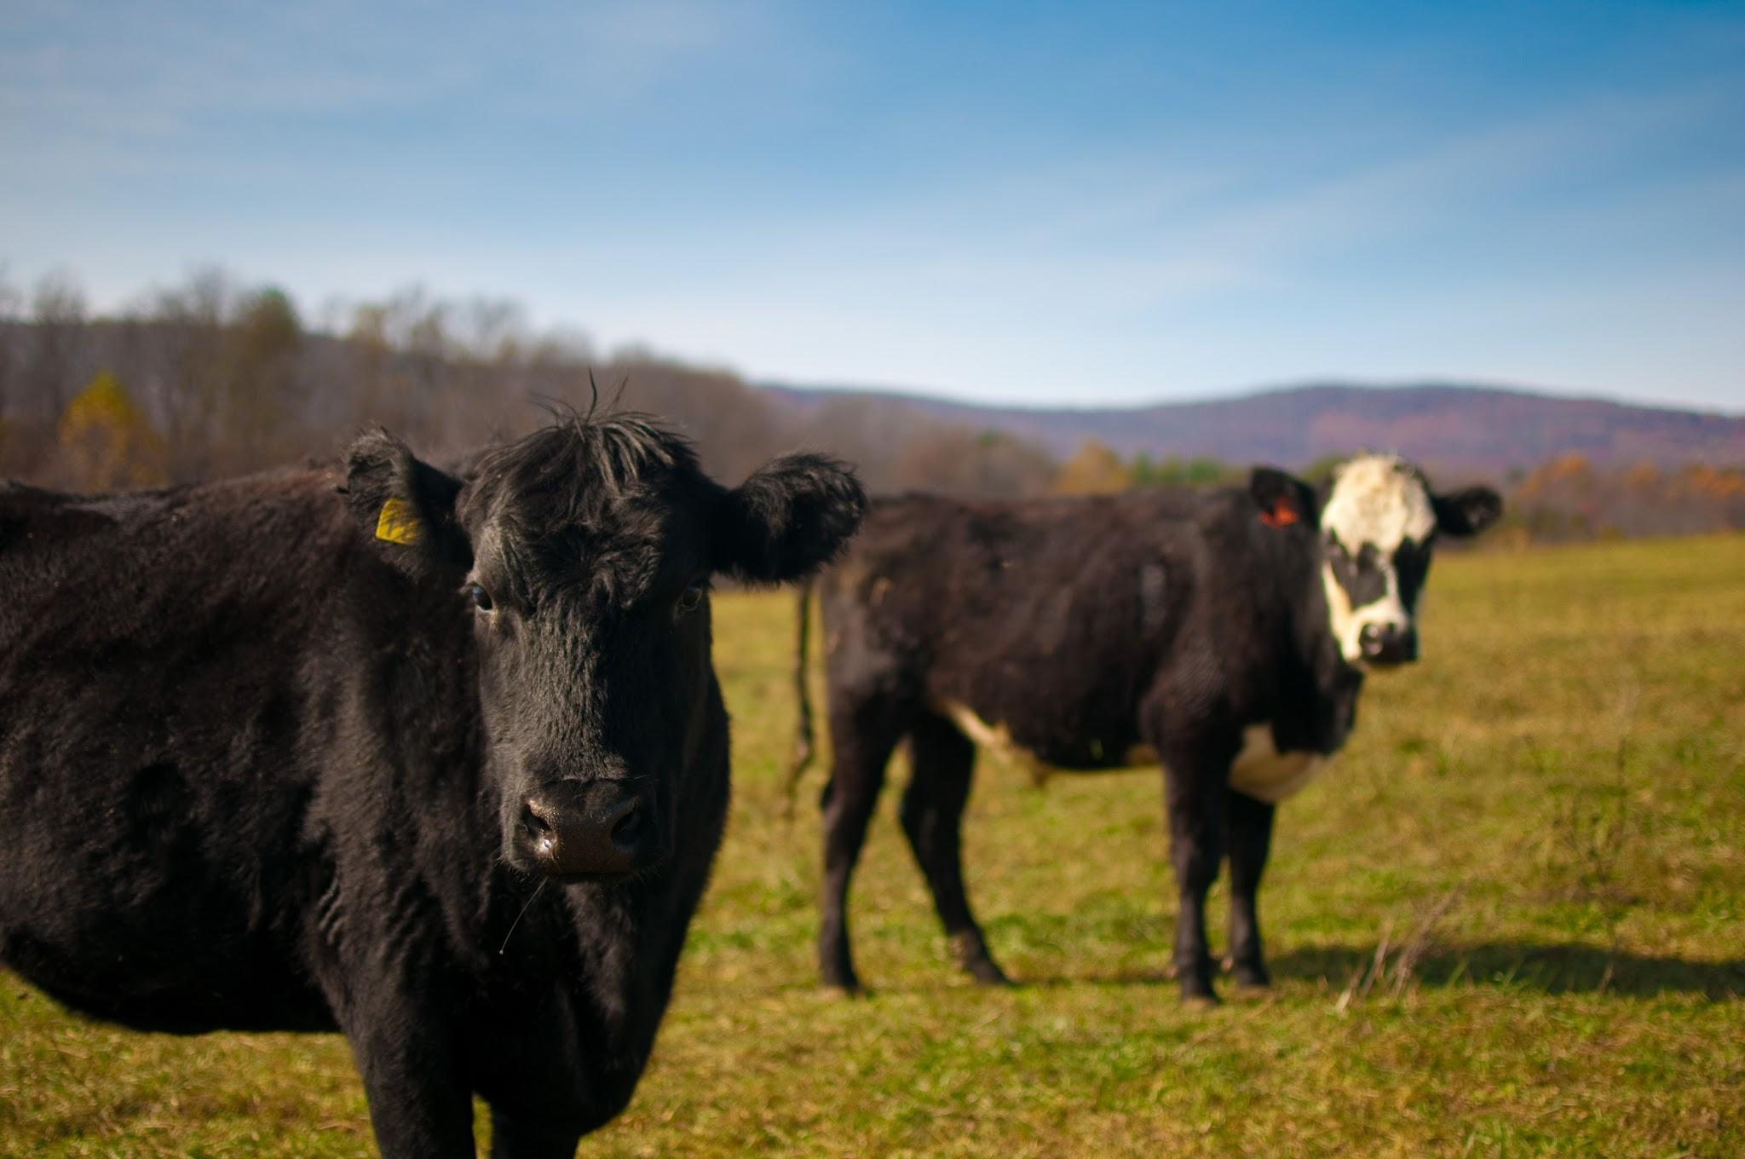
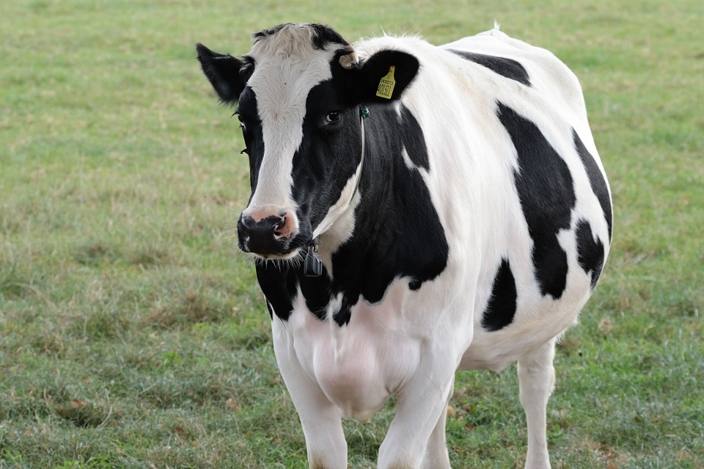
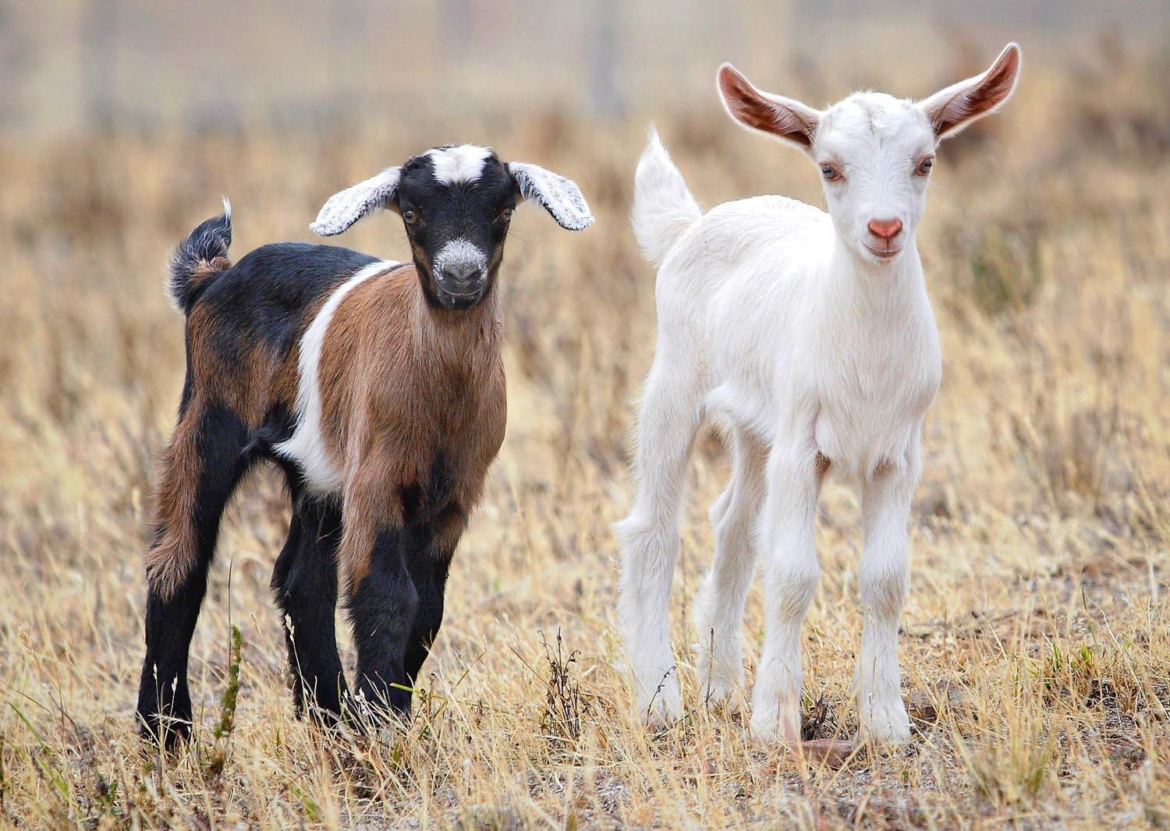
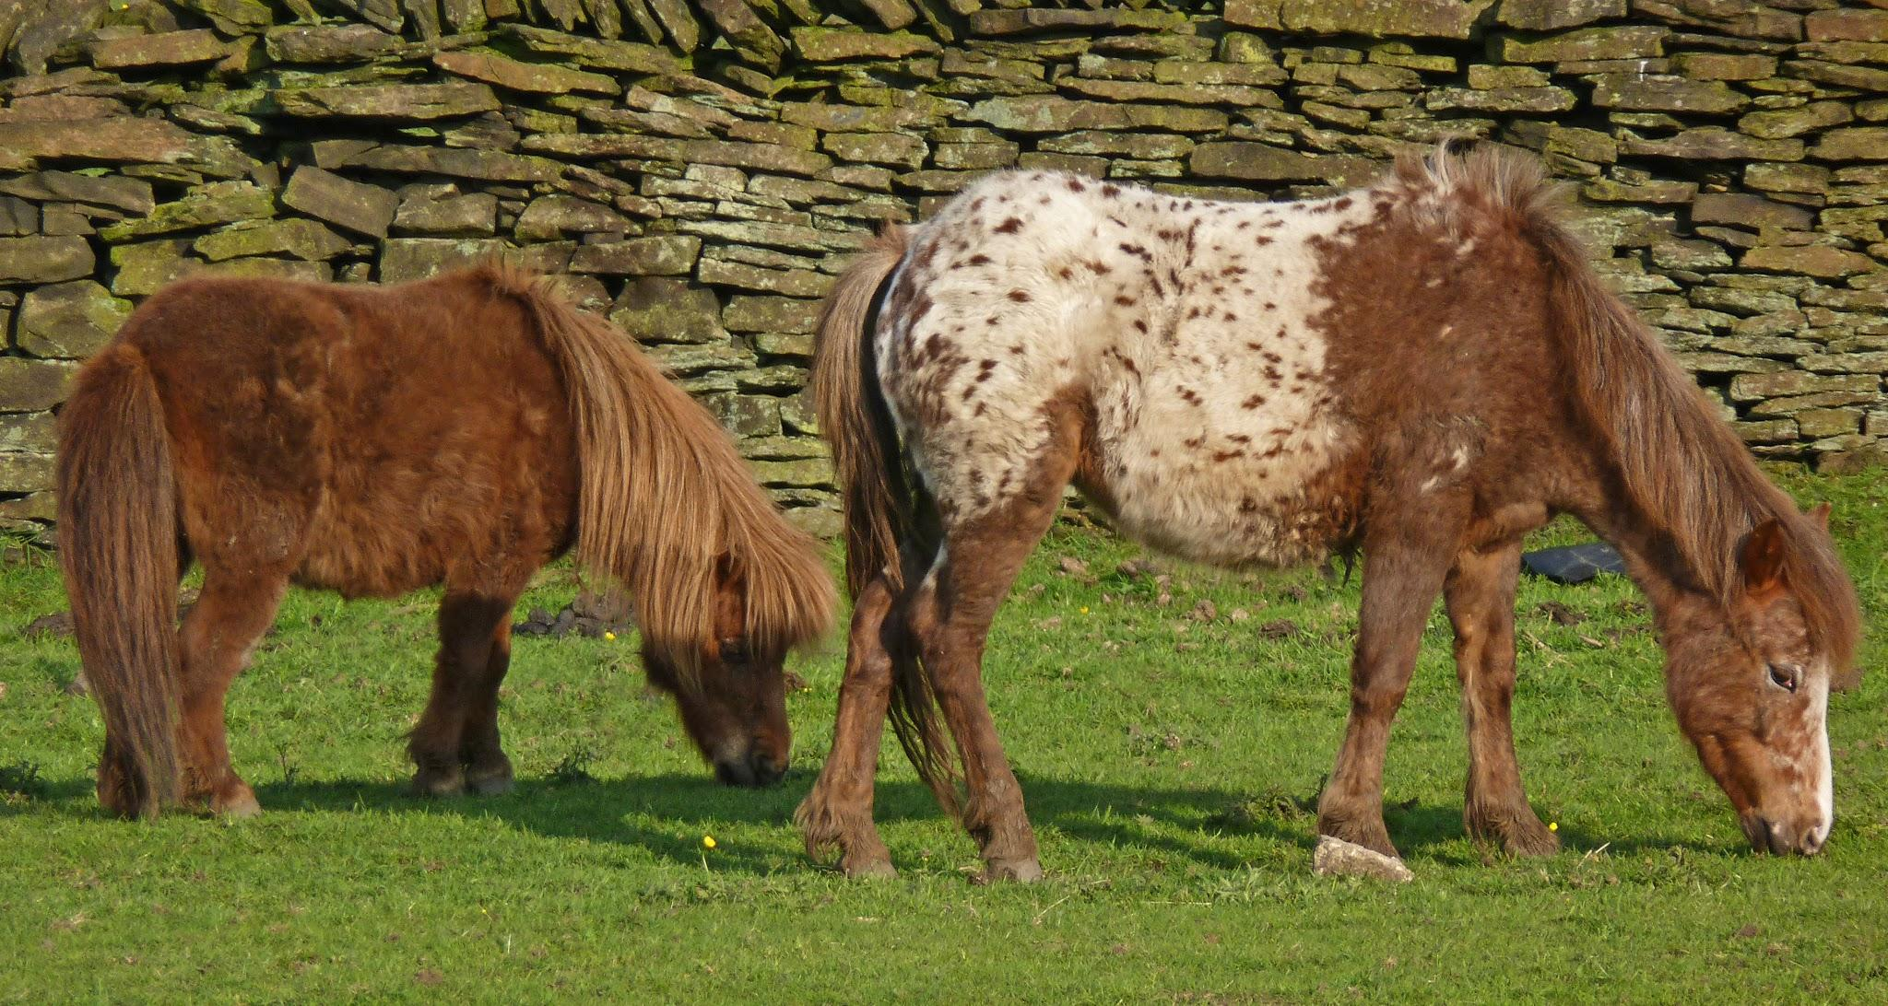
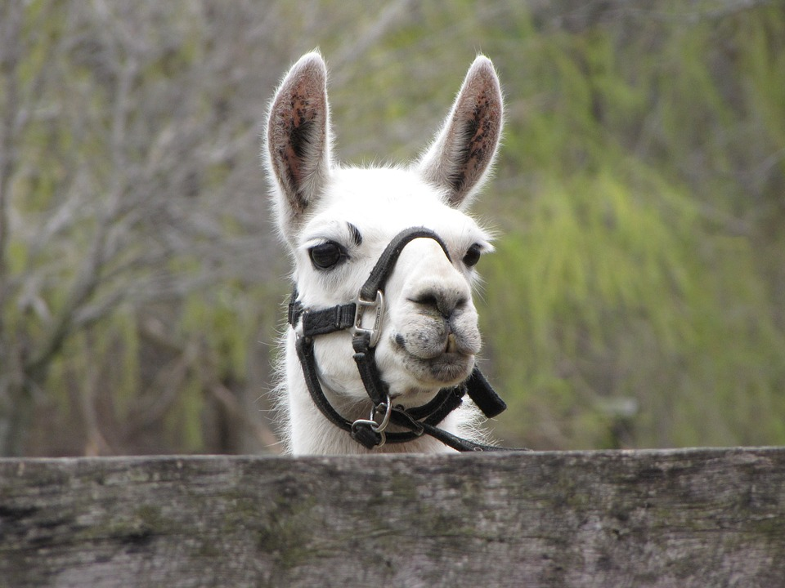
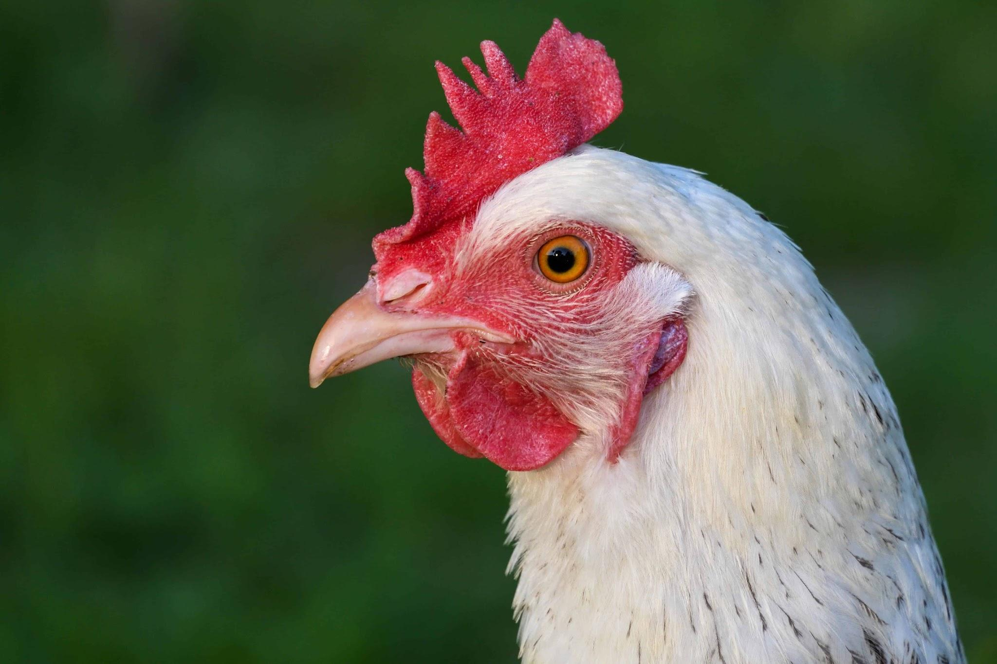
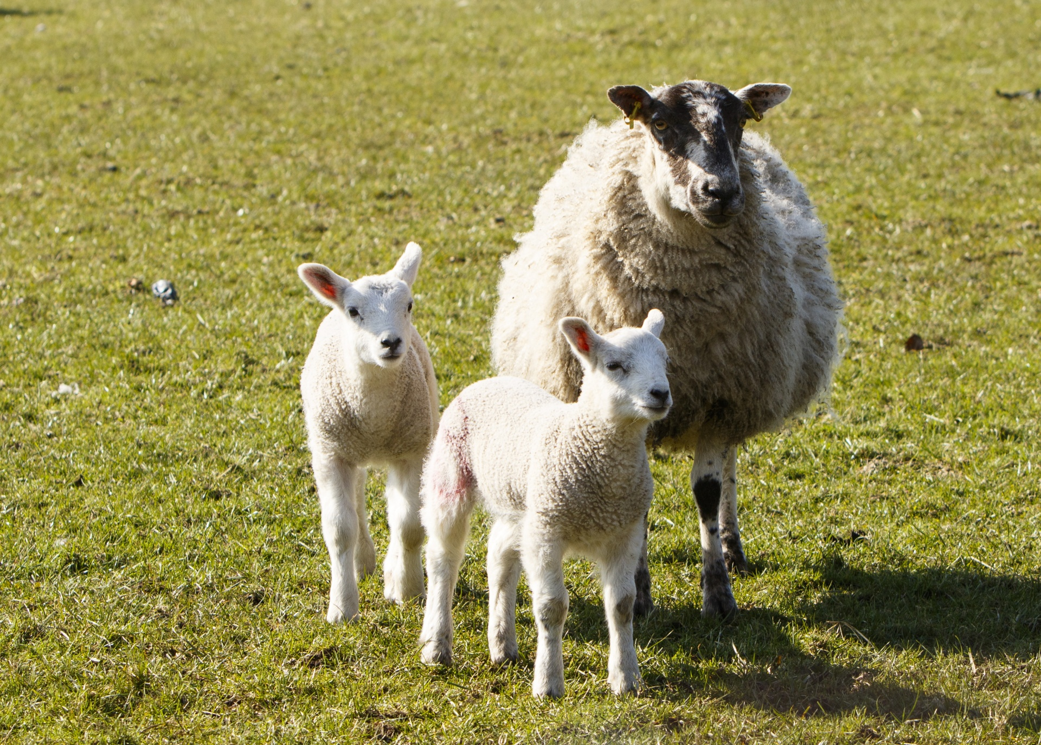
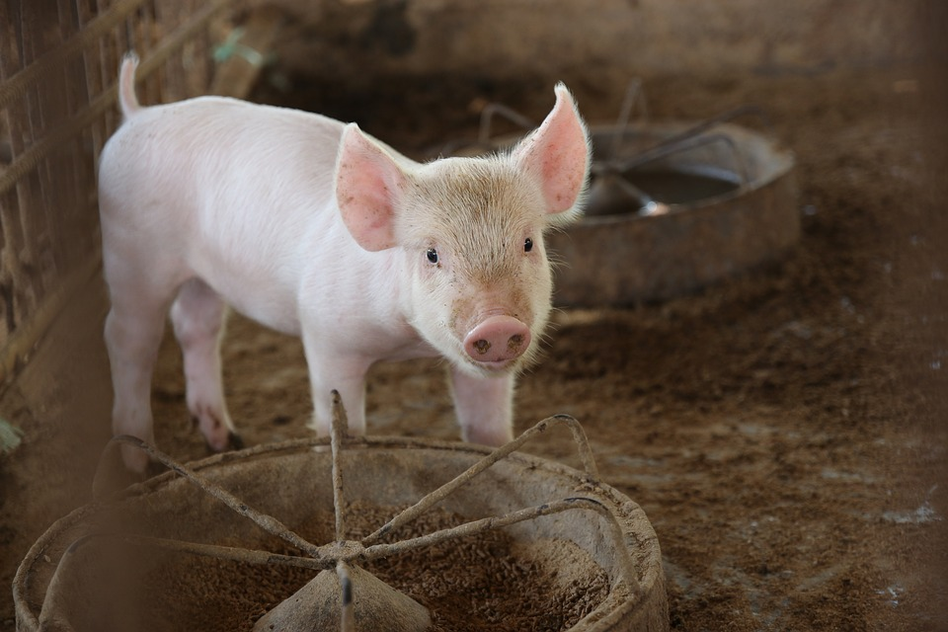
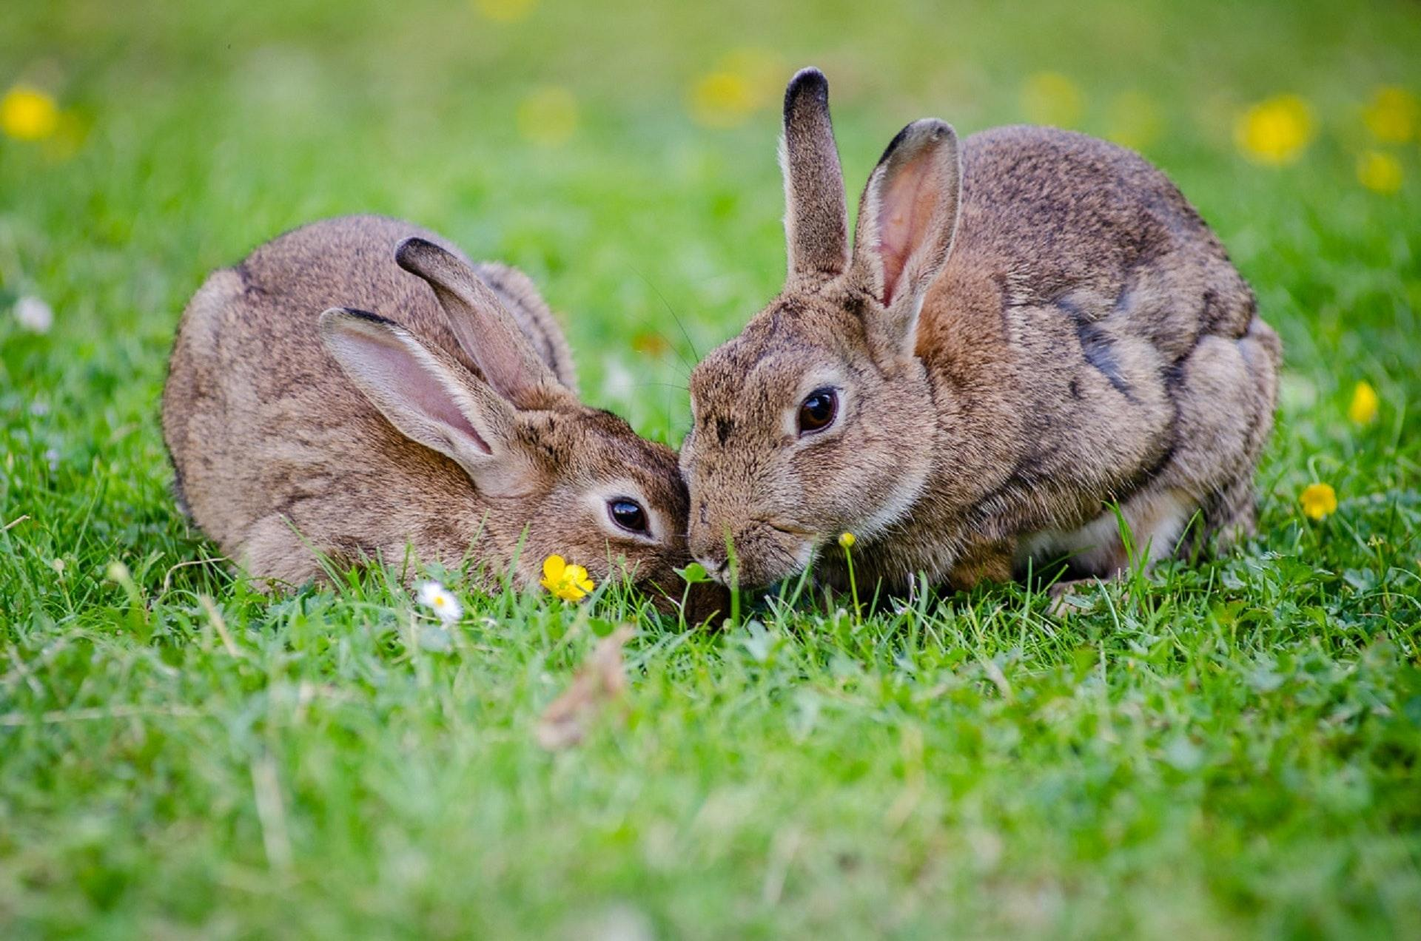
Program Requirements for Members
4-Hers enrolled in the following projects are required to complete in order to be eligible to exhibit project animals in Maryland 4-H County and State Shows.
alpacas
beef
dairy
goats
horse and pony
llamas
poultry
sheep
swine
rabbits

Slide 9
Additional Program Requirements for Members
Complete between March 15 and August 10.
4-Hers are required to complete the online training program when they reach each 4-H age division:
  Junior (ages 8-10)
  Intermediate (ages 11-13)
  Senior (ages 14-18)
OR
  when as an Intermediate or Senior, they add a new animal science project from the list on the previous slide

Slide 10
Program Structure
There are two different levels to the program. Members are automatically taken to the appropriate level according to their birthdate:
Junior AH&QA Level | Intermediate/Senior AH&QA Level
There is one part. There is no species specific information sections as with the Intermediate /Senior Level of the program. | There are two parts: Part 1 is completed by all intermediate and senior members. Part 2 contains specific information for each animal species members complete Part 2 for each specie/project they are enrolled in and wish to exhibit.

Slide 11
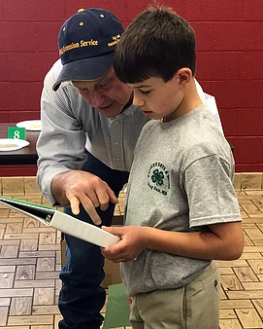
Program Content: Juniors and Intermediates/Seniors: Part 1
Welcome, Instructions, Registration
Roles of Youth Animal Owners
Purpose of Quality Assurance
Benefits of Animal Projects
Keeping Animals, Products, and Handlers Safe
  Animal Handling
  Animal Identification
Animal Health
  Medicine Use
  Labels
  Record Keeping
  Biosecurity
Humane Care
Ethics in Animal Projects
Review the MD 4-H Code of Animal Science Ethics
Basic Fair Requirements

Slide 12
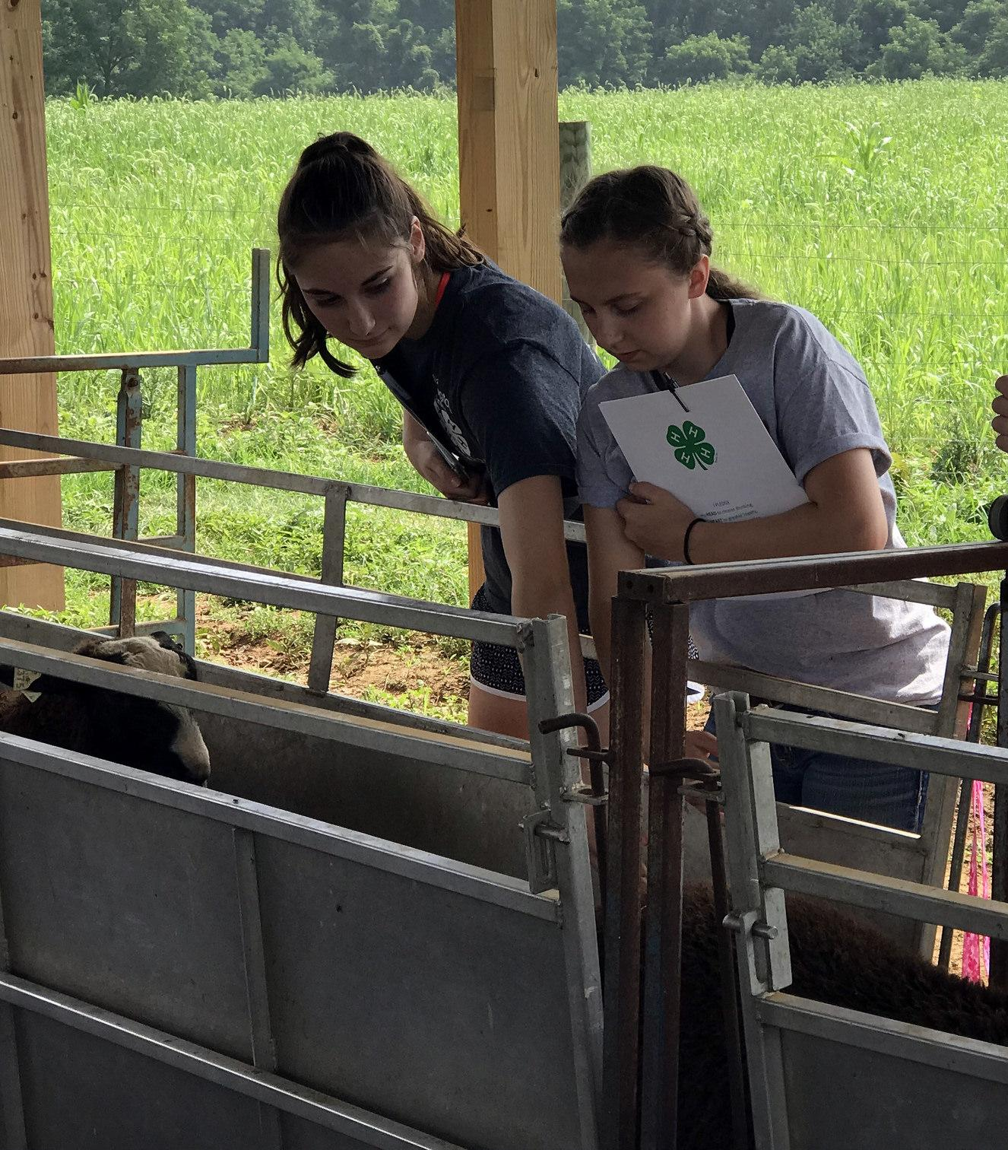
Program Content: Intermediates/Seniors: Part 2
Species specific sections:
Basic Nutrition Needs
Common Diseases
Proper Injection Techniques
Pre-Fair Health Inspection/Post-Fair Quarantine
Basic Housing
Animal Behavior and Handling
Transporting Animals
Additional Resources

Slide 13
Program Testing
Pre-test/post-test questions
  Pre-test: “Test Your Knowledge” – Junior and Intermediate/Senior: Part 1
  Post-test: “What I Learned” - Junior and Intermediate/Senior: Part 1
  Species Test – Intermediate/Senior: Part 2
Testing system utilized external survey applications to seamlessly interface with the online training program.
  Instant Survey. 2010-2012
  Qualtrics. 2013-2018
No passing score required to complete the program.

Slide 14
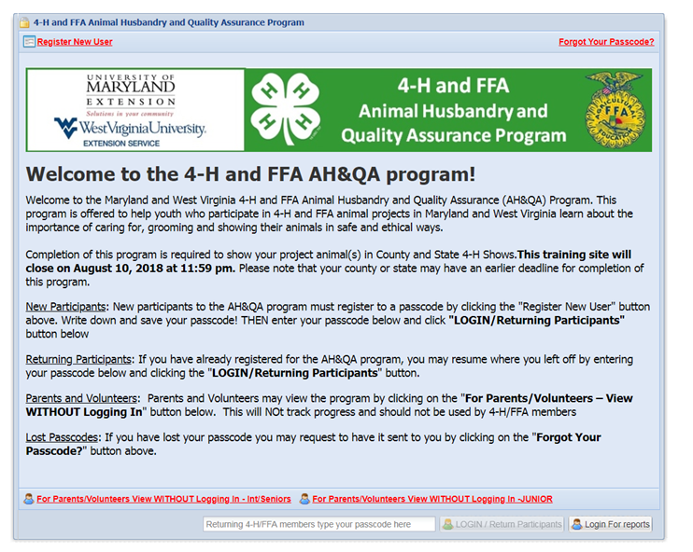
Program Welcome Page
Members register and then are assigned a unique passcode.
If a password is forgotten, it can be retrieved.
Parents and volunteers may view the program as a guest.
On following visits, they use the unique assigned passcode to log in.
Notes:
A member must be LOGGED IN for the system to track their progress and record their completion of the program.
There is a message at the top right-hand corner of the screen indicating the member’s status. When logged in, the message will read “Logged in: [Member’s Name]”. (If the member is not logged in correctly, the message will not identify them by name; it will identify them as a “Guest Account“. Progress will NOT be recorded using a “Guest Account”.)
Time required to complete the Online AH&QA program:
Juniors - approximately 45 minutes
Intermediates/Seniors - approximately 60 to 75 minutes (depending on number of species)
A member may LOG OUT of the program at any point and return to the program at a later time to the place at which they logged out. Their passcode is required to return.

Slide 15
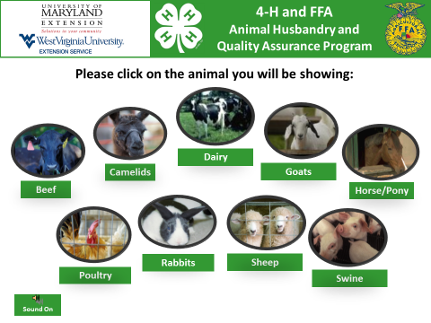

Slide 16
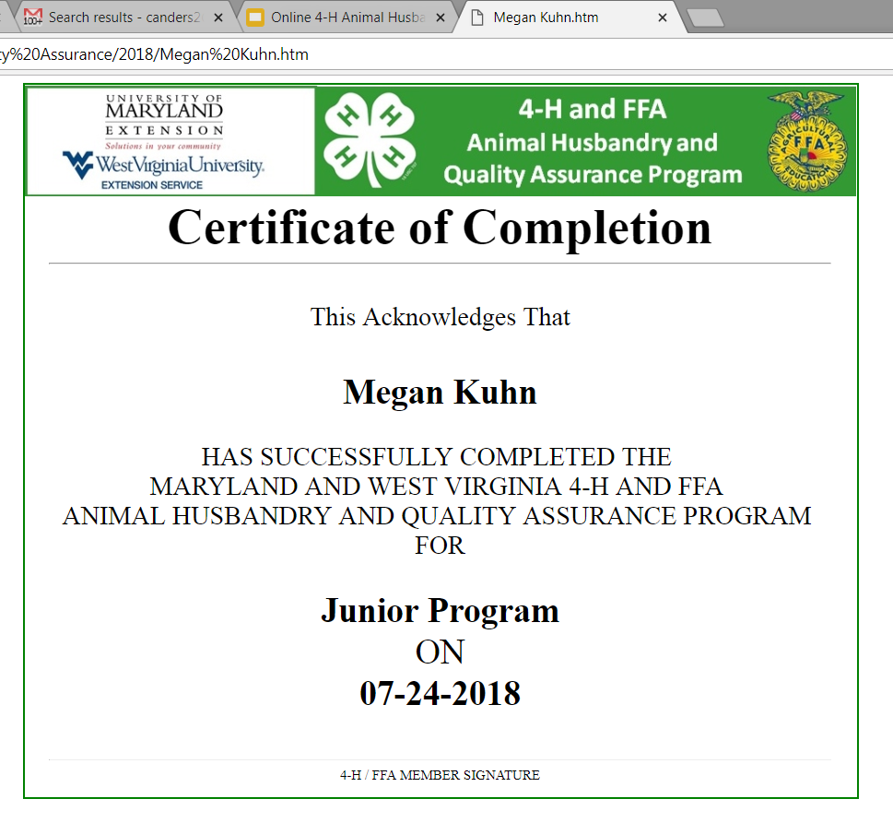
Completing the Program
Upon completion of the program, a certificate that automatically fills in the member’s name, species (if applicable) and completion date is created.
Members can print the certificate for their records.
Notes:
It is suggested that members keep the Certificate of Completion with their animal health papers, registration papers and other important animal records.

Slide 17
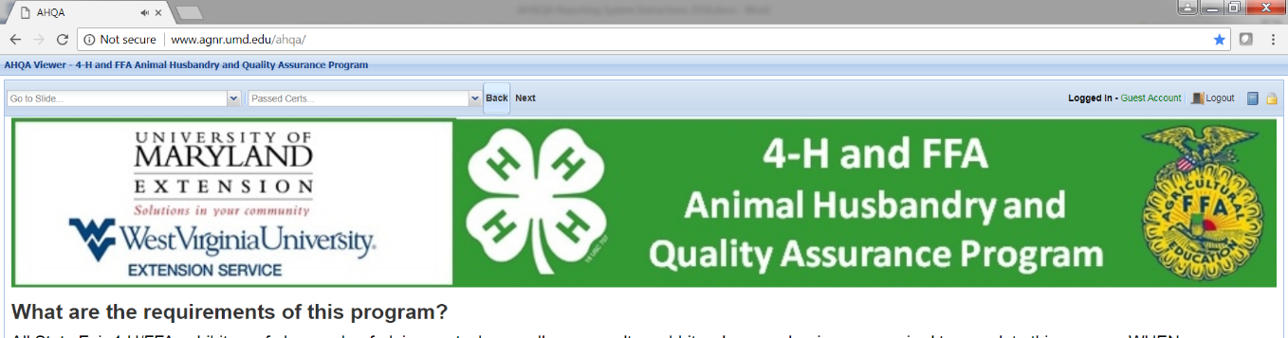
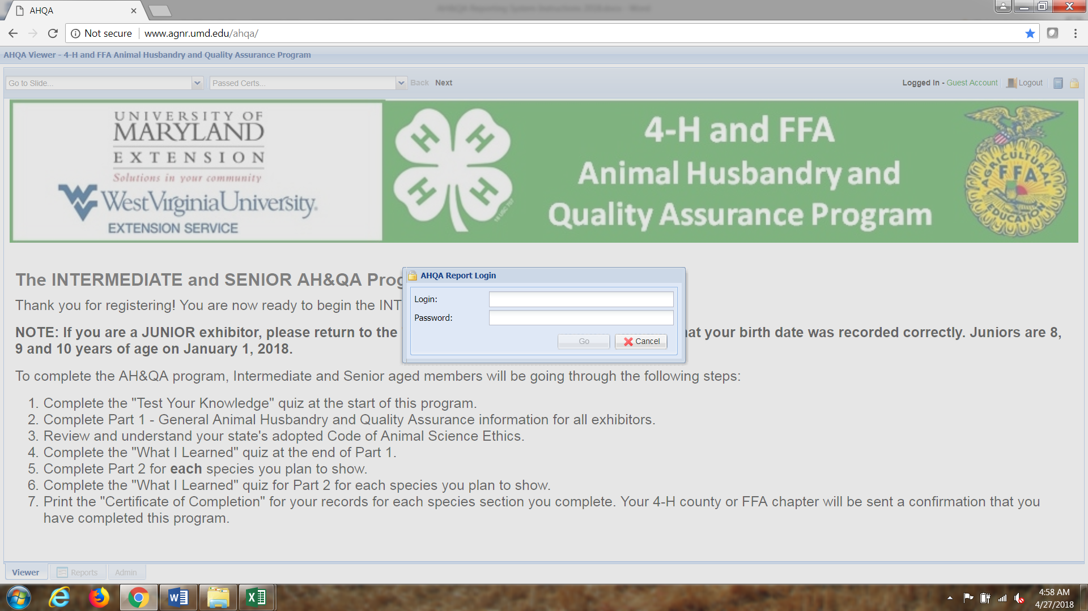
Accessing County Completion Reports
County offices see blue report completion reports
County offices are provided a unique login name and password.

Slide 18

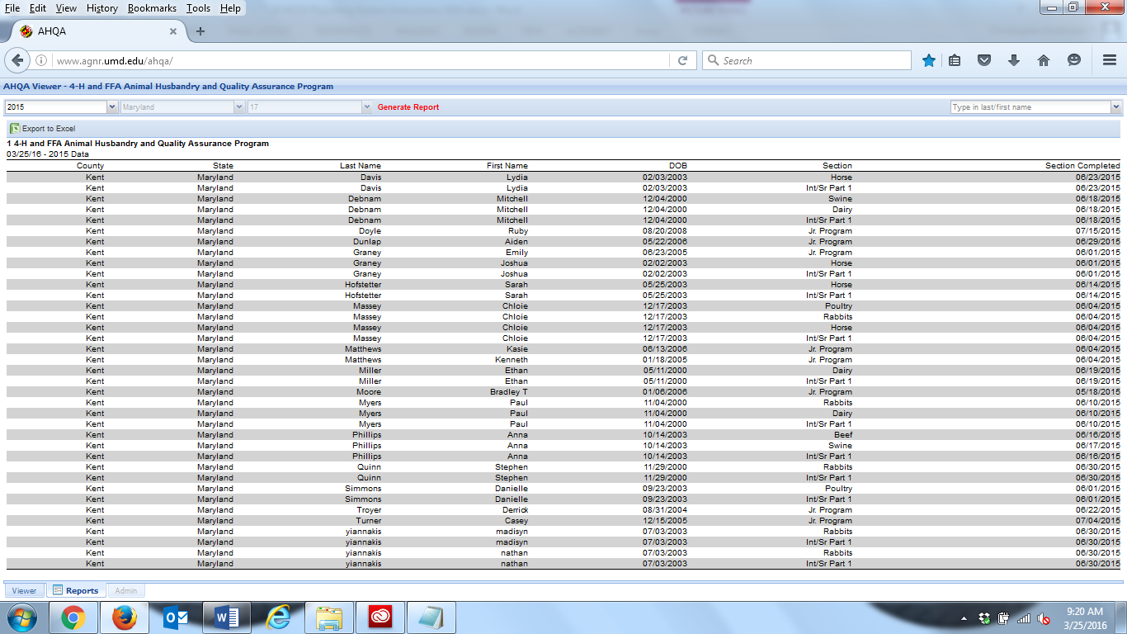
Accessing County Completion Reports
Historical reports are accessible at all times for county offices.
Reports are “real time”. They may be exported Excel.

Slide 19
Maryland/West Virginia 4-H AH&QA Program Participation
SPECIES | 2010 MD | 2011 MD | 2012 MD | 2013 MD | 2014 MD | 2015 MD/WV | 2016 MD/WV | 2017 MD/WV | 2018 MD/WV | TOTALS
Juniors | -- | -- | -- | 372 | 393 | 1196 | 1123 | 995 | 1134 | 5213
Int/Sr General Overview | 791 | 2185 | 1581 | 1446 | 956 | 3761 | 2632 | 2341 | 2622 | 18315
Beef | 228 | 582 | 272 | 204 | 200 | 1004 | 625 | 576 | 681 | 4372
Camelids | 35 | 78 | 33 | 18 | 18 | 40 | 31 | 20 | 22 | 295
Dairy | 135 | 319 | 147 | 110 | 118 | 207 | 174 | 112 | 162 | 1484
Goats | 167 | 529 | 311 | 204 | 192 | 782 | 547 | 519 | 641 | 3892
Horses/Ponies | 84 | 483 | 288 | 191 | 158 | 421 | 314 | 280 | 322 | 2541
Poultry | 101 | 409 | 289 | 179 | 149 | 314 | 235 | 237 | 308 | 2221
Rabbits | 87 | 377 | 279 | 156 | 160 | 367 | 294 | 254 | 365 | 2339
Sheep | 155 | 487 | 267 | 187 | 152 | 765 | 535 | 473 | 604 | 3625
Swine | 307 | 859 | 484 | 367 | 310 | 1591 | 998 | 931 | 1010 | 6857
Total Int/Sr Species Sections | 1299 | 4123 | 2370 | 1616 | 1457 | 5491 | 3753 | 3402 | 4115 | 27626
Number Species/Member (Int./Sr.) | 1.64 | 1.89 | 1.50 | 1.12 | 1.52 | 1.57 | 1.51 | 1.60 | 1.57 | 1.51
TOTAL YOUTH | 791 | 2185 | 1581 | 1818 | 1349 | 4957 | 3755 | 3336 | 3756 | 23528

Slide 20
Program Effectiveness
A formal study conducted (2013) to assess the effectiveness of the online training program as a delivery method for animal husbandry and quality assurance information to 4-H members.
The study included three participant groups:
  UME 4-H faculty and staff,
  4-H volunteers,
  4-H members.
Results from surveys completed by UME 4-H faculty and staff indicate:
  Prior to online AH&QA, county 4-H educators conducted an average of 5.1 sessions annually to teach quality assurance and after AH&QA, they conduct an average of 0.9 sessions annually.
  Online AH&QA implementation saves an average of 13.2 hrs. per educator per year (16.5 hrs. to 3.3 hrs. spent per year before and after online); Online AH&QA saves educator time and labor costs (13.2hrs/yr. for 23 county educators at estimated $40/hr.) equal to a projected cost savings of $12,160/yr.

Slide 21
Knowledge Level Change on Subject Areas
Measure Knowledge Level on 5 point Likert Scale (Scale = None, Low, Medium, High, Very High) | 2011 (n = 3,960) |  | 2012 (n = 1,581)
 | Before AH&QA (% High or Very High) | After AH&QA (% High or Very High) | Before AH&QA (% High or Very High) | After AH&QA (% High or Very High)
Important role youth have in animal agriculture | 57.3 | 88.4 | 54.7 | 85.8
Public concerns about animal welfare and animal product safety | 50.6 | 86.8 | 54.0 | 86.2
Proper handling of animals | 73.6 | 92.9 | 71.2 | 92.2
Proper use of animal medications | 53.7 | 85.2 | 50.7 | 84.3
Importance of ethical behavior in animal projects | 67.4 | 89.3 | 66.9 | 89.8
Animal care | 70.1 | 92.0 | 60.3 | 88.0
Common animal diseases | 45.9 | 81.0 | 31.7 | 73.7
Animal health | 59.7 | 88.4 | 55.5 | 86.1
Animal nutrition | 60.5 | 87.1 | 49.4 | 82.8
Overall | 59.9 | 87.9 | 54.9 | 85.4

Slide 22
Pre-post Tests Item Analysis
Conducted an item analysis on the questions of the pre-post tests at the end of 2017. Questions were modified for 2018 based on:
  Item Difficulty - Popular consensus suggests that the best approach is to aim for a mix of difficulties. That is, a few very difficult, some difficult, some moderately difficult, and a few easy.
  Item Discrimination - The maximum item discrimination difference is 100 percent. This would occur if all those in the upper group answered correctly and all those in the lower group answered incorrectly. Zero discrimination occurs when equal numbers in both groups answer correctly. Negative discrimination, a highly undesirable condition, occurs when more students in the lower group then the upper group answer correctly.

Slide 23
Next Steps ??
Interface completion records with 4-H Online.
Software generated narration – easier to update.
Continue building a library of supplemental activities for club and county/city workshops.
Incorporation of video demonstrations into the program.

Slide 24
Research Related to Animal Quality Assurance Programming
Nold & Hanson (2001)evaluated effectiveness of Quality Assurance training for youth and found:
Quality assurance training had a positive impact on youths' opinions about quality assurance and consumers.
Quality assurance training had a positive impact and on youth's knowledge of quality assurance practices.
Emphasis on character development and decision-making skills translated into positive responses about the responsibilities of a livestock producer, both to the animals and to consumers.
While most youth understood at least some of their responsibilities prior to completing the training, the quality assurance training served to reinforce the understanding of those youth and also to help all youth recognize the breadth of the responsibilities that they have as livestock producers.”

Slide 25
Research Related to Animal Quality Assurance Programming
Ivey, O’Rourke, Grenawalt, & Hobson (2015)studied youth outcomes of the Wisconsin Meat Animal Quality Assurance Program and found:
Quality assurance training helped youth increase knowledge of eight outcome areas:
  Animal Health, Animal Management, Animal Handling, Understanding Agricultural Issues, Communicating with Consumers, Knowledge of Agricultural Careers, Sportsmanship, and Mentoring and Leadership.
Quality assurance training has an impact on youth's knowledge of quality assurance practices.
While most youth reported some knowledge about these quality assurance practices before completing the MAQA program, the quality assurance training served to increase their practices in quality assurance.
Youth are better prepared to raise public awareness about the importance of proper animal handling, care and welfare.

Slide 26
Research Related to Online Learning for Youth
Schwab and Freeman (2011) conducted a pilot evaluation of an Internet Educational Module for Agricultural Safety and found that Internet learning environment increased participants' ability to recognize universal symbols faster and more accurately supporting use of the Web for effective youth Extension programming.
Young, Manton, Worker, & Martin (2014) evaluated the effectiveness and efficiency of online Training in Cooperative Extension and found online delivery is an effective and efficient delivery for staff and volunteer development.
Ouellette, Lesmeister, Lobley, & Gross (2014) found that volunteers from seven states perceived that online modules made learning more convenient and flexible.

Slide 27
For More Information
Chris Anderson
4-H Youth Development Specialist, Animal Science
Email: canders2@umd.edu
April Barczewski
4-H Youth Development Educator
Email: adhall@umd.edu
Sheryl Bennett
4-H Youth Development Educator
Email: sherylb@umd.edu
Ashley Travis
4-H Youth Development Educator
Email: ashley90@umd.edu
MD AH&QA Program was recognized by NAE4HA in 2012:
National Communicator Award - Media Presentation Team
Regional Animal Science Program Award
Regional Technology Team Award

Slide 28
References
Nold, R., & Hanson, D. (2001). Effectiveness of quality assurance training for youth. Journal of Extension [On-line], 39(2). Retrieved from: http://joe.org/joe/2001april/a4.html
Nold, R., Fassett, J., Rockwell, S. (2005). Assuring Youth Raising Livestock for Food Produce a Quality Product. Journal of Extension [On-line], 43(1). Retrieved from: http://www.joe.org/joe/2005february/rb7.php
Chin Young, J., Manton, L. M., Worker, S. M., & Martin, A. C. (2014). Effective, Efficient Online Training in Cooperative Extension, Journal of Youth Development, 9(3). Retrieved from: https://jyd.pitt.edu/ojs/jyd/article/view/51/37

Slide 29
Program credits
(2010) - Maryland 4-H Online Animal Husbandry and Quality Assurance Training.
  Anderson, C., Ashby, L., Axline, D., Barczewski, A., Bennett, S. & Shute, M.
(2011) - Camelid, Horse, and Dairy Modules for Maryland 4-H Online Animal Husbandry and Quality Assurance Training.
  Anderson, C., Ashby, L., Axline, D., Barczewski, A., Bennett, S., Finucane, K., Shute, M.
(2013) - Junior Member Module for Maryland 4-H Online Animal Husbandry and Quality Assurance Training.
  Anderson, C., Ashby, L., Axline, D., Barczewski, A., Bennett, S. & LaVigna, A.
(2015) - Maryland and West Virginia 4-H/FFA Online Animal Husbandry and Quality Assurance Training.
  Anderson, C., Shaffer, K., Ashby, L., Barczewski, A., Bennett, S., Boyden, B., Buster, C., Friend, D., Helmondollar, R., and Loyd, B.

