Slide 1
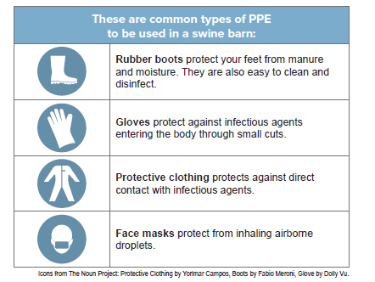
What is biosecurity?
Biosecurity is the protection of agricultural animals from any type of infectious agent—viral, bacterial, fungal, or parasitic.
Examples of biosecurity measures:
• Do not have contact with your pigs if you have been in contact with other pigs in the past 24 hours.
• Limit visitors to your barn. Be sure visitors are wearing clean boots and have not had swine exposure in the past 24 hours.
• Limit the access of rodents and other wildlife in your barn.
• Do not enter the barn if you are ill. Stay out of the barn until your clinical signs have subsided and you are fever free for at least 24 hours.
• Quarantine animals arriving at the farm for 7 days. Feed and care for existing animals before new or returning animals.
• Do not share animal care or manure hauling equipment.
• Clean and disinfect all equipment between uses, including feeders, waterers, hurdles, and show supplies.
What is PPE?
Personal protective equipment, or PPE, is items used to protect you from contact with agents that cause disease. You should consider wearing PPE when caring for pigs, especially when they are ill.

