Slide 1
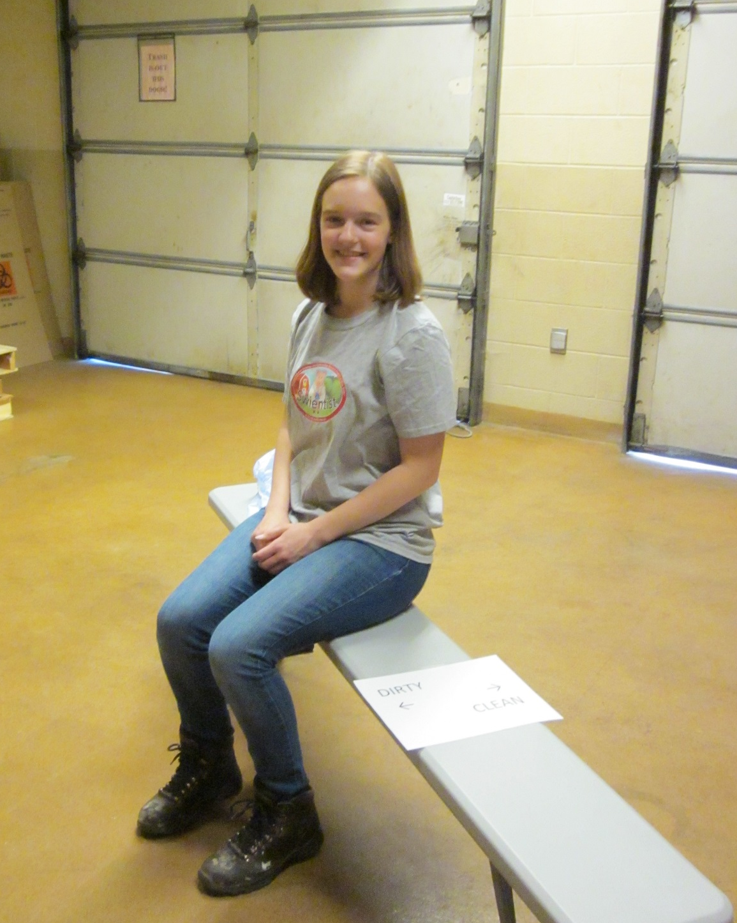
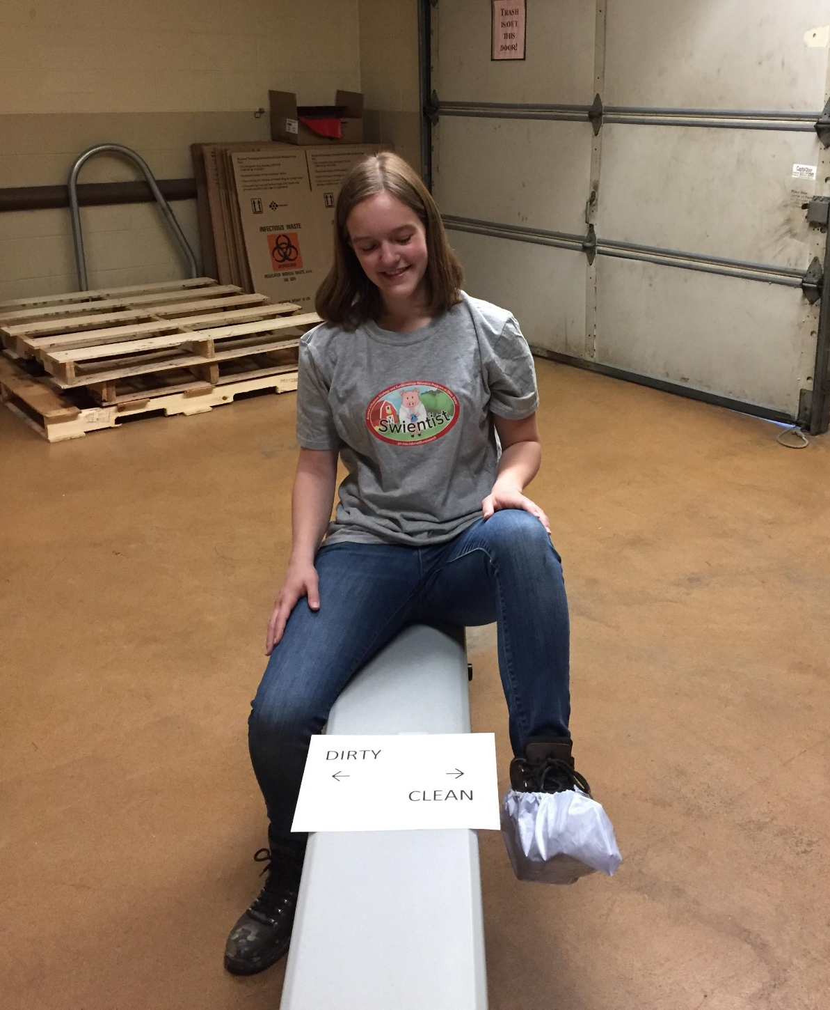
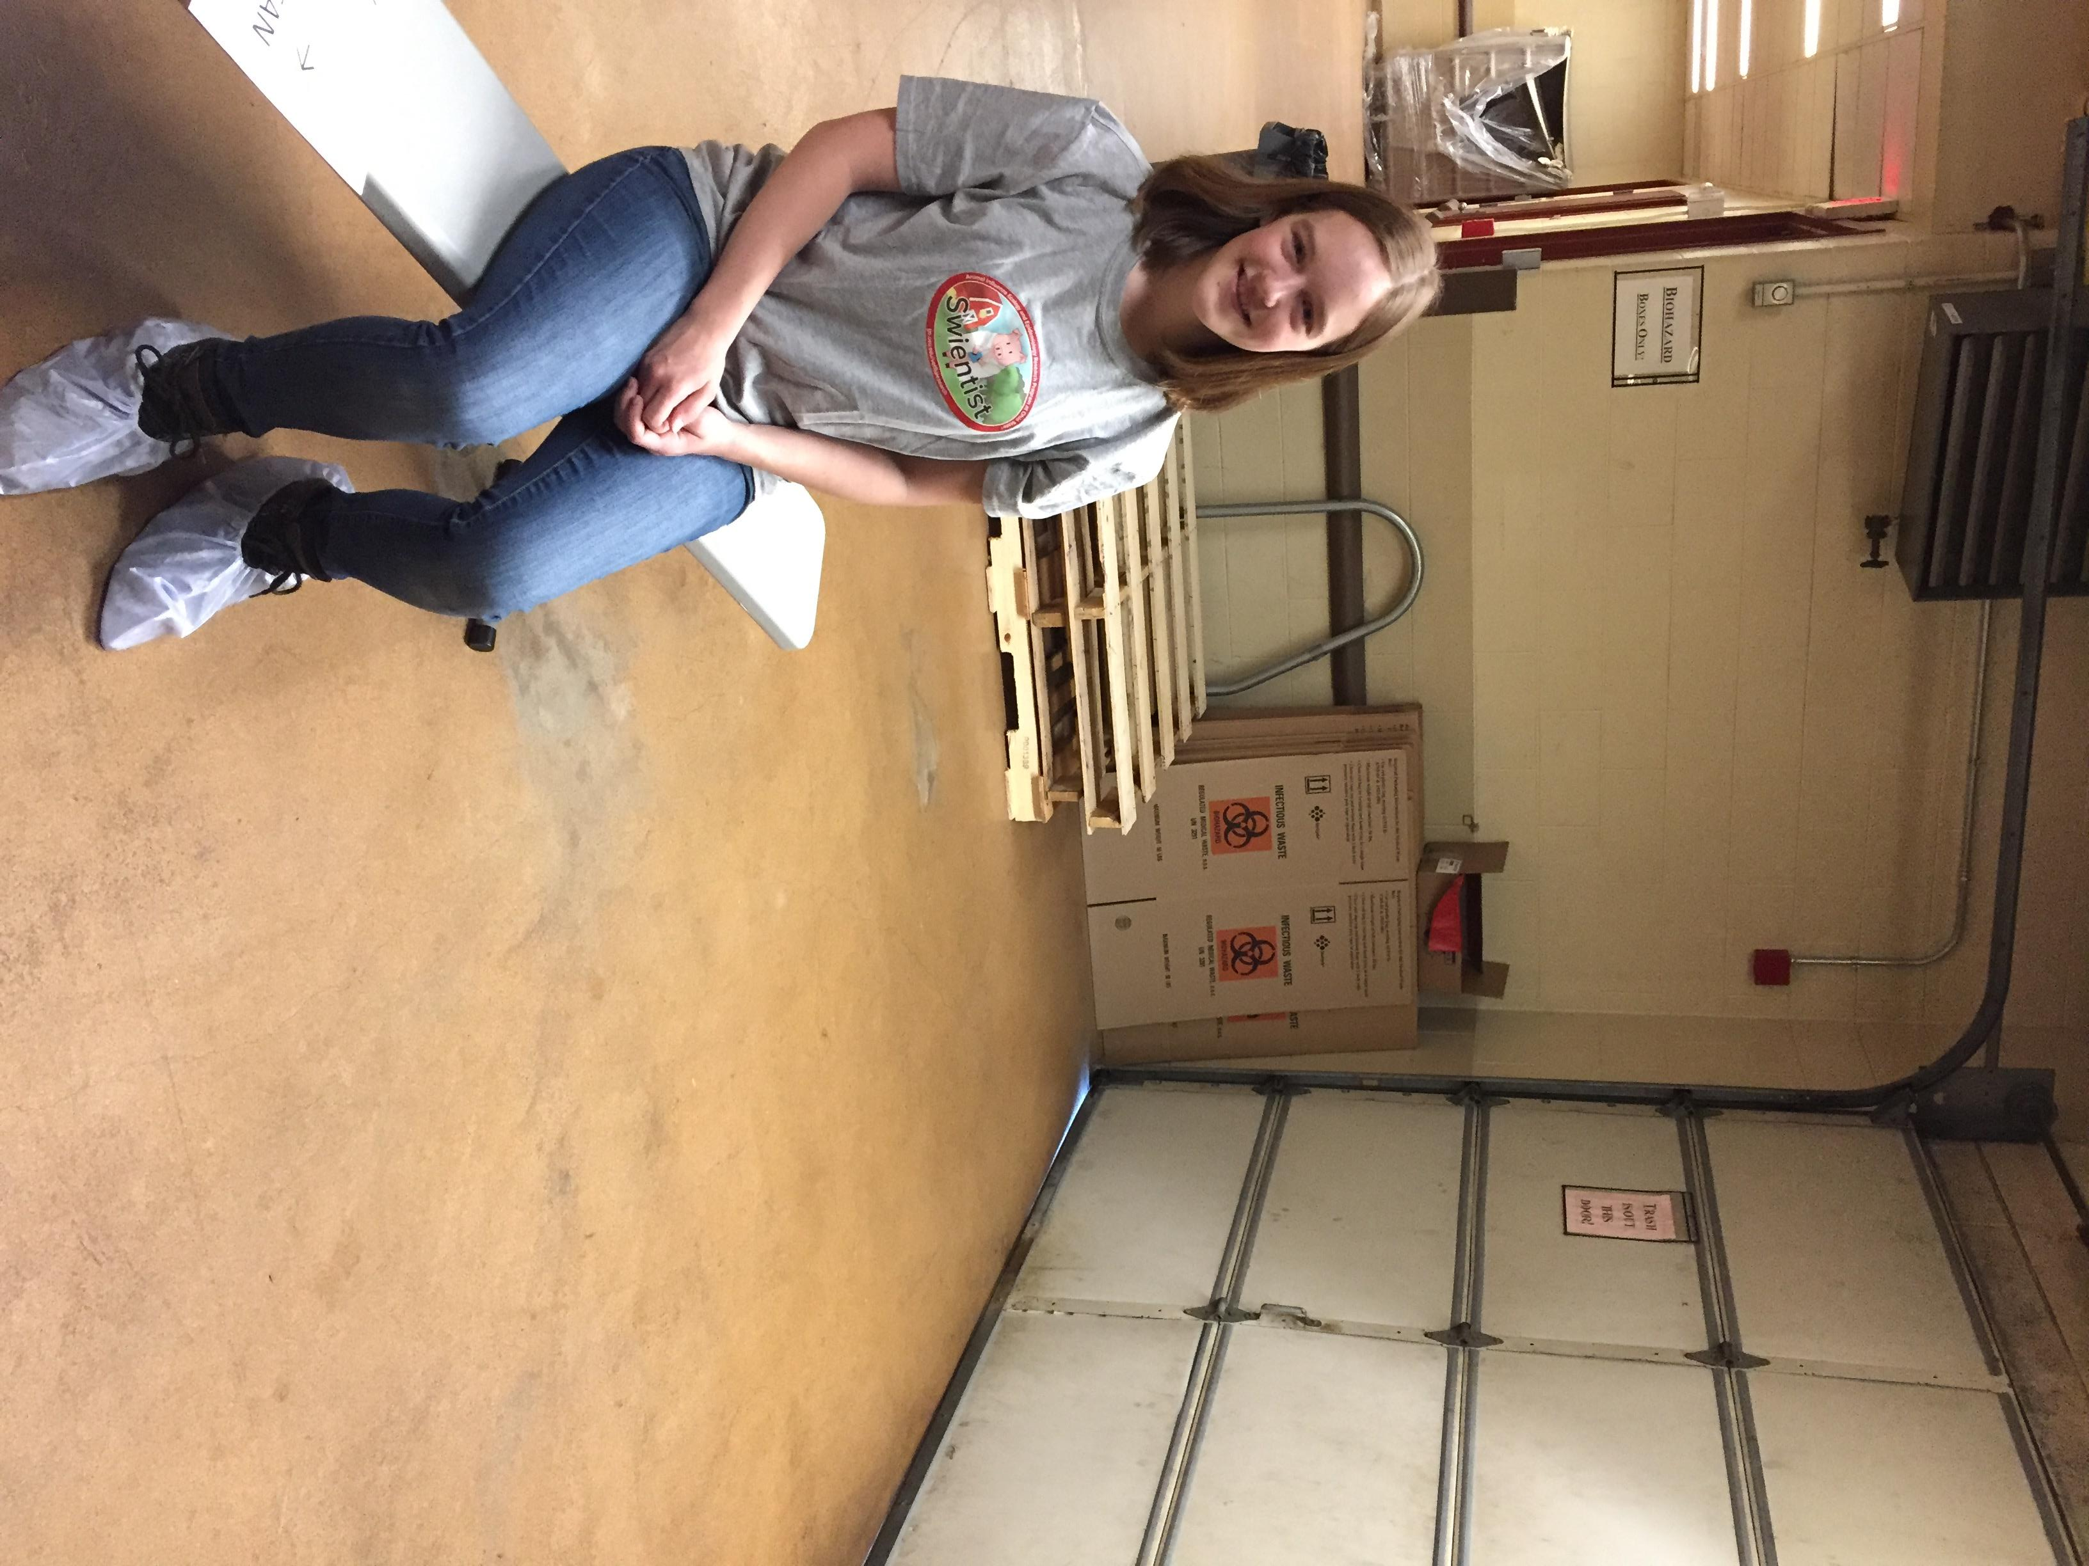
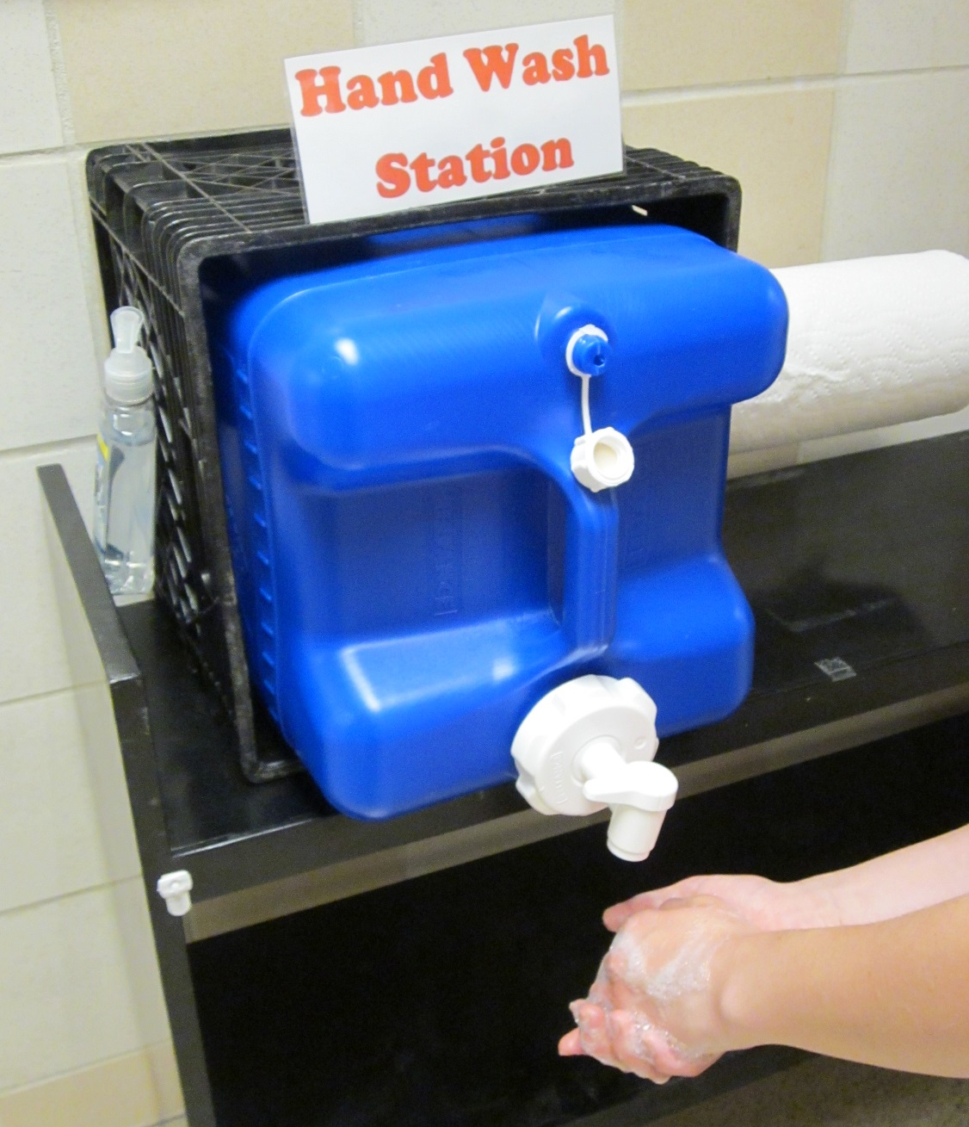
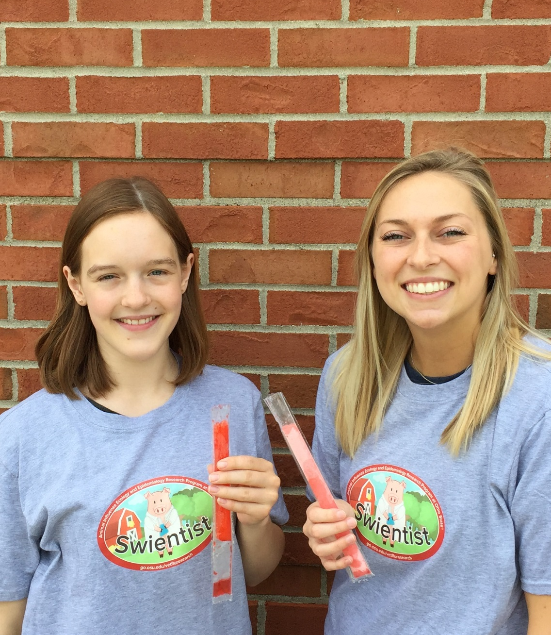
COME TO THE CLEAN SIDE FOR A FREEZE POP
1. Start on the “dirty” side.
2. Grab a boot cover, lift one leg at a time, and pull on boot cover before placing leg on the clean side. Don’t touch anything on the dirty side with clean boot cover.
3. Make sure not to cross back over to the dirty side with your clean boot covers on! Now head to the hand washing station.
4. Clean your hands by washing them with warm water and soap.
5. You’re officially on the clean side. Enjoy your freeze pop!
ONE STEP CLOSER TO BECOMING A SWIENTIST

