Slide 1
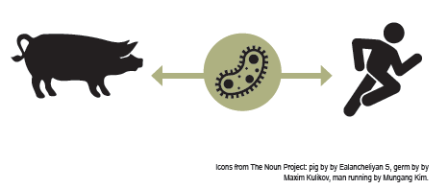
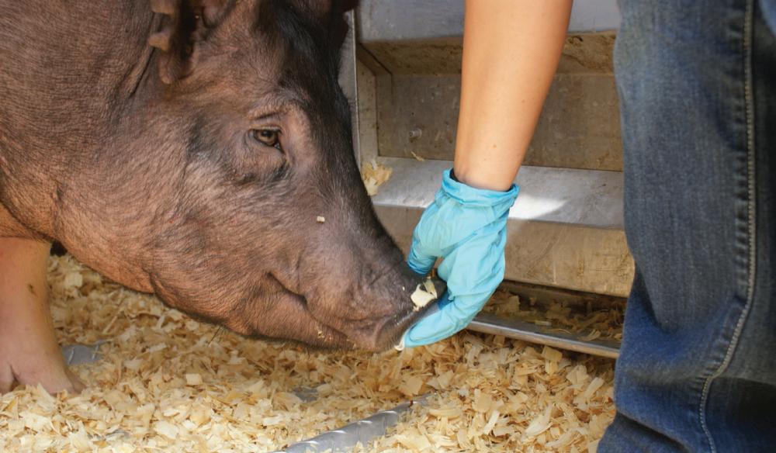

What is a zoonotic disease?
A zoonotic disease is one that can be spread between animals and people. Many diseases causing illness in humans come from animals. Viruses, bacteria, fungi, and parasites can cause
zoonotic diseases. Thus there are various levels of prevention measures and treatments.
How do diseases spread?
Infectious diseases spread in a variety of ways: 1) through the air; 2) from direct or indirect contact with another person or animal, soiled objects, skin or mucous membrane, saliva, urine, blood, and body secretions; and 3) through contaminated food and water. Direct contact occurs when there is physical interaction between an infected person or animal and a susceptible person or animal. Indirect contact occurs when there is no direct contact between a person and an animal. This contact occurs when a susceptible person or animal is exposed to contaminated air (aerosol transmission), objects (fomites),
fecal-oral matter, or insects (vector-borne).
Direct contact can be avoided with the use of personal protective equipment (PPE) like gloves.
Sneezing and coughing can result in indirect
airborne transmission.

