Slide 1
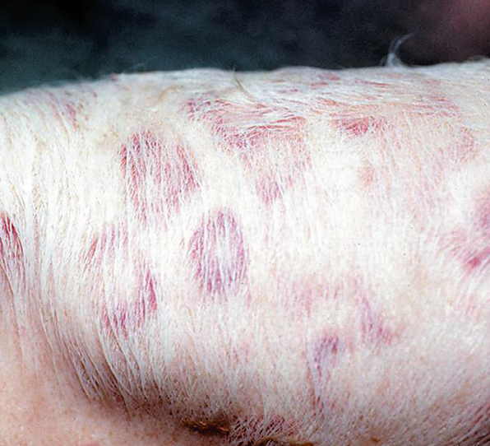
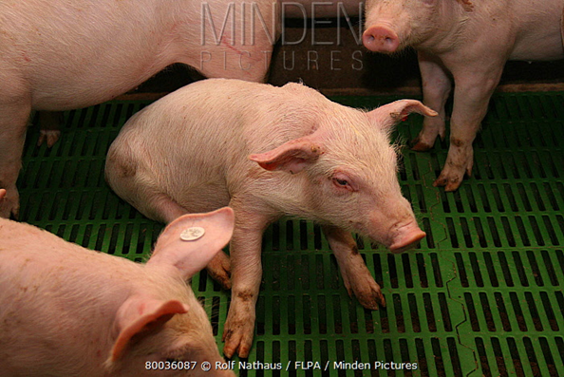
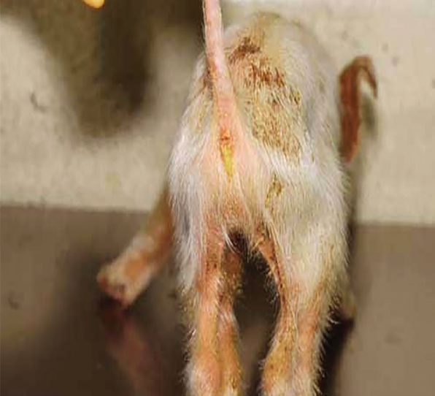
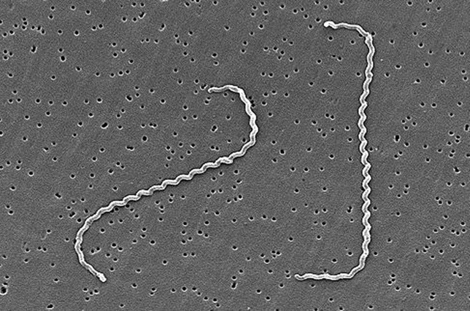
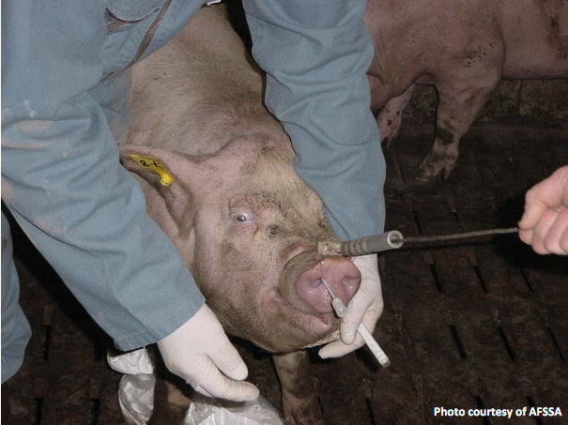
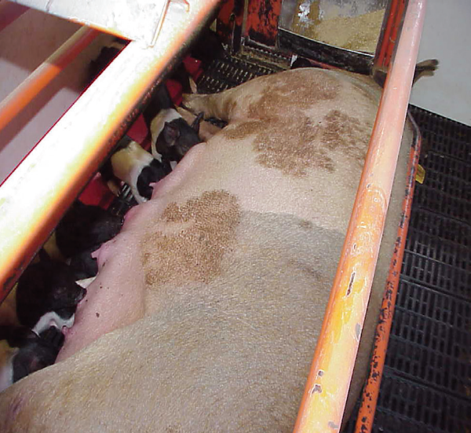
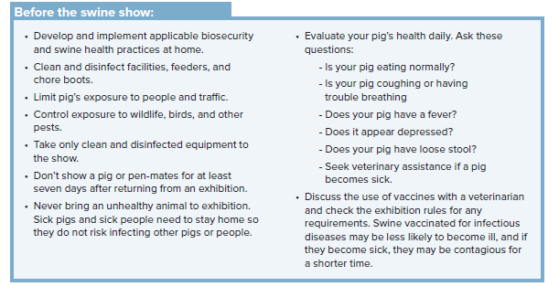
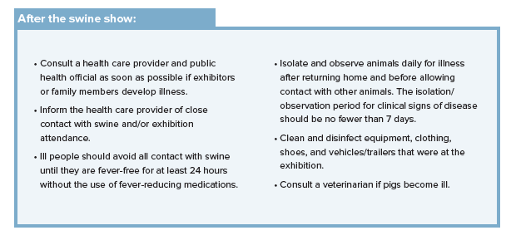
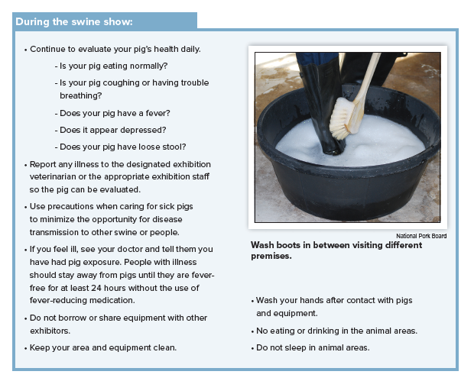
What swine diseases are zoonotic?
ERYSIPELAS
Cause of disease: Erysipelothrix rhusiopathiae
Clinical signs in swine: fever, anorexia, red
diamond shaped patches, lameness
Clinical signs in humans: Erysipeloid—painful, red/purple swelling on the hands. Lesions are usually confined to the hands and finger. Severe cases can progress to systemic infection with endocarditis.
Route of Transmission: Direct contact (usually
enters through cuts in the skin)
STREPTOCOCCUS SUIS
Cause of disease: Streptococcus suis
Clinical signs in swine: depression, tremors, incoordination, blindness, paralysis, and convulsions or paddling of the legs
Clinical signs in humans: meningitis, sepsis, endocarditis, arthritis, hearing loss, and skin lesions
Routes of Transmission: direct contact
GASTROINTESTINAL INFECTIONS
Cause of disease: Salmonella spp., Escherichia
coli, Campylobacter spp., Yersinia enterocolitica,
Cryptosporidium parvum, Giardia intestinalis,
Balantidium coli.
Clinical signs in swine: diarrhea
Clinical Signs in humans: nausea, vomiting,
abdominal pain, and diarrhea
Route of Transmission: Fecal-oral
LEPTOSPIROSIS
Cause of disease: Leptospira spp.
Clinical signs in swine: from unapparent to decreased weight gain, anorexia, abortion, still births, fever, diarrhea, and generalized neurological signs.
Clinical signs in humans: fever, chills,
headache, muscle ache, vomiting, liver and
kidney failure
Routes of Transmission: direct, Aerosol,
Fomites, Ingestion (spread in urine)
INFLUENZA
Cause of disease: Influenza A virus
Clinical signs in swine: fever, depression,
coughing (barking), discharge from nose or eyes, sneezing, difficulty breathing, anorexia
Clinical signs in humans: fever, lethargy, lack of appetite, coughing, nausea, vomiting, and diarrhea
Routes of transmission: Direct, Aerosol, Fomites
RINGWORM
Cause of disease: Dermatophytosis
Clinical signs in swine: crusty, dark, hairless patches; common on the skin around the head and neck; thorax, flank, behind the ears, on the legs
Clinical signs in humans: local itching, reddish skin, and hairless at the point of contact
Routes of Transmission: Direct and Fomites
How to prevent disease transmission when showing?
Exhibition swine are more frequently exposed to disease because they encounter other pigs and people at shows. The following measures should be considered to keep you and your pig healthy before, during, and after the show.
Diseases commonly spread between swine and some also spread between swine and humans. As a responsible livestock owner, you can take measures to reduce the spread of pig-to-pig and pig-to-human disease transmission.

