Slide 1
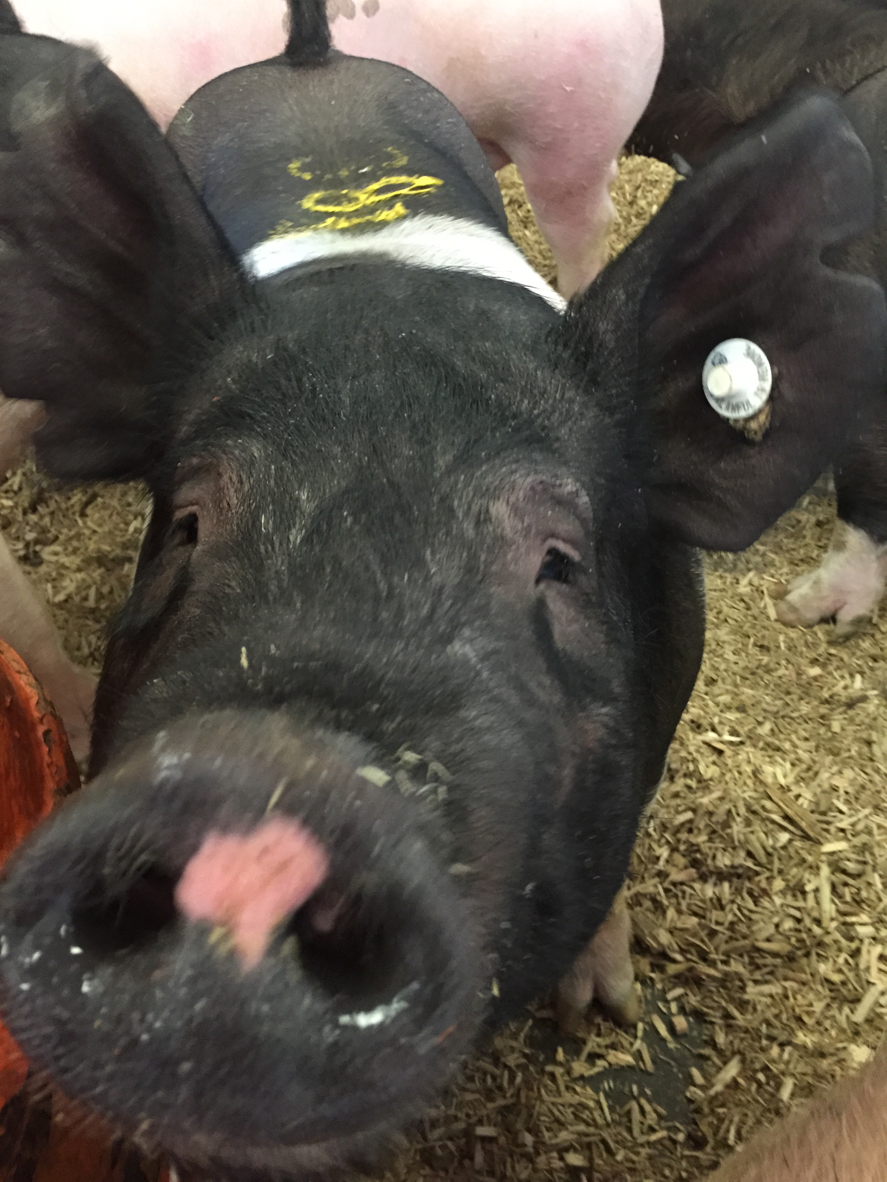

Staying Healthy with Your Hog
Andrew Bowman and Jacqueline Nolting

Slide 2
Agenda
What is a zoonotic disease?
What are common swine zoonotic diseases?
How do zoonotic diseases spread?
What is biosecurity?
What can I do to keep my pig and myself healthy?

Slide 3

What is a zoonotic disease?
One that can be spread between animals and people.
Many diseases causing illness in humans come from animals.
Viruses, bacteria, fungi, and parasites can cause zoonotic diseases.

Slide 4
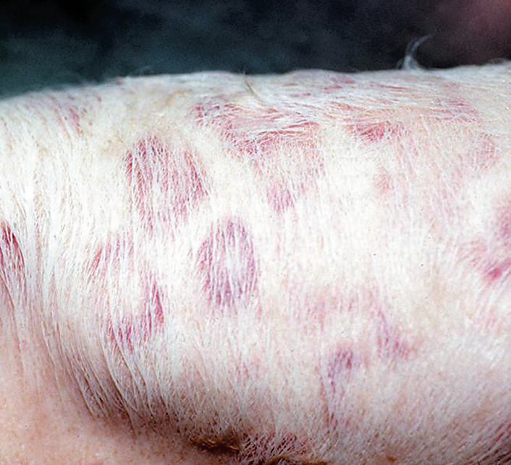

Common Swine Zoonotic Diseases
ERYSIPELAS
Cause of disease: Erysipelothrix rhusiopathiae
Clinical signs in swine: fever, anorexia, red
diamond shaped patches, lameness
Clinical signs in humans: Erysipeloid—painful, red/purple swelling on the hands. Lesions are usually confined to the hands and finger. Severe cases can progress to systemic infection with endocarditis.
Route of Transmission: Direct contact (usually
enters through cuts in the skin)
The Ohio State University

Slide 5
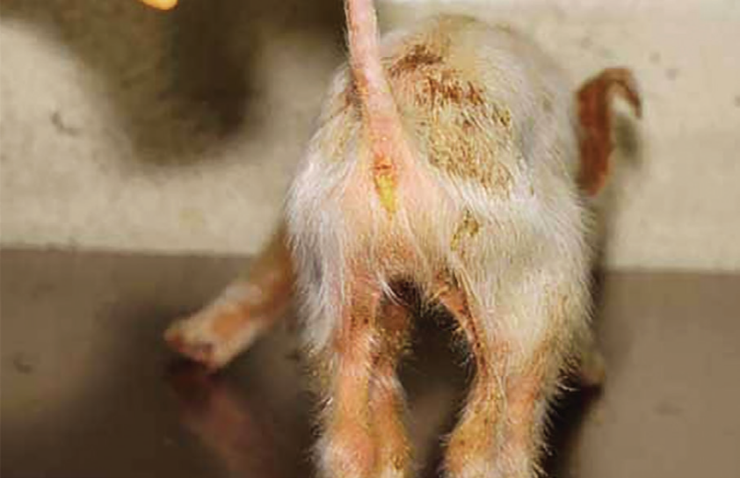
Common Swine Zoonotic Diseases
GASTROINTESTINAL INFECTIONS
Cause of disease: Salmonella spp., Escherichia
coli, Campylobacter spp., Yersinia enterocolitica,
Cryptosporidium parvum, Giardia intestinalis,
Balantidium coli.
Clinical signs in swine: diarrhea
Clinical Signs in humans: nausea, vomiting,
abdominal pain, and diarrhea
Route of Transmission: Fecal-oral
Dr. Pat Halbur, Iowa State University

Slide 6
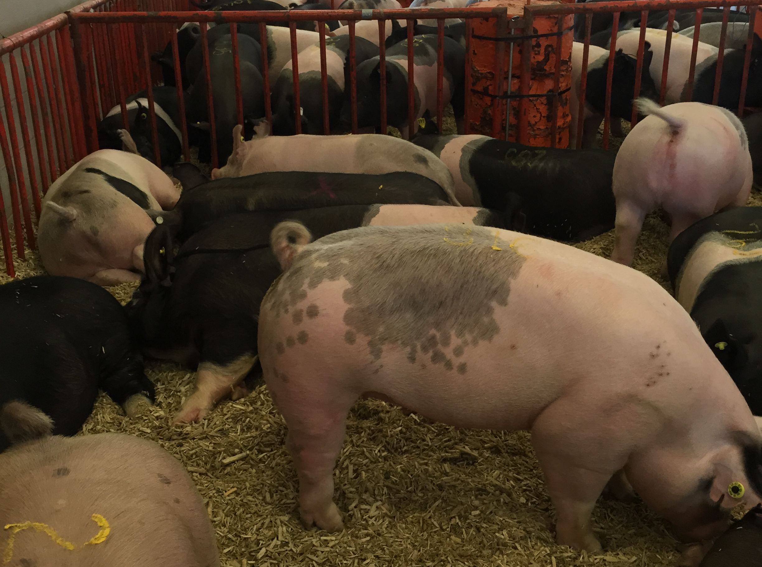
Common Swine Zoonotic Diseases
HEPATITIS E
Cause of disease: hepatitis E virus
Clinical signs in swine: none
Clinical signs in humans: mild fever, anorexia,
nausea and vomiting, lasting for a few days; some persons may also have abdominal pain, itching (without skin lesions), skin rash, or joint pain, jaundice, with dark urine and pale stools; and a slightly enlarged, tender liver
Route of Transmission: Fecal-oral

Slide 7
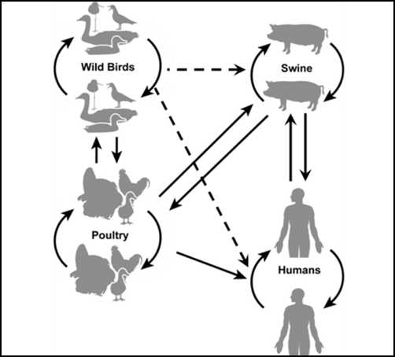

Common Swine Zoonotic Diseases
INFLUENZA
Cause of disease: Influenza A virus
Clinical signs in swine: fever, depression,
coughing (barking), discharge from nose or eyes, sneezing, difficulty breathing, anorexia
Clinical signs in humans: fever, lethargy, lack of appetite, coughing, nausea, vomiting, and diarrhea
Routes of transmission: Direct, Aerosol, Fomites

Slide 8
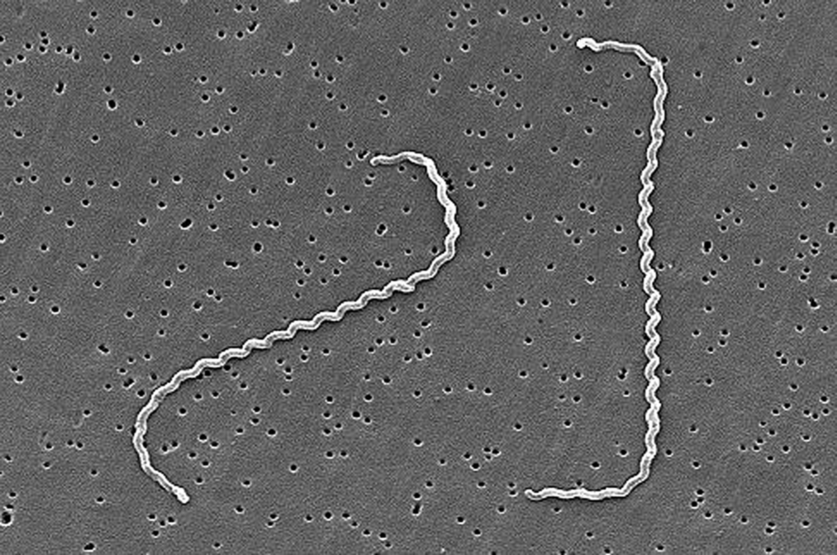
Common Swine Zoonotic Diseases
LEPTOSPIROSIS
Cause of disease: Leptospira spp.
Clinical signs in swine: from unapparent to decreased weight gain, anorexia, abortion, still births, fever, diarrhea, and generalized neurological signs.
Clinical signs in humans: fever, chills,
headache, muscle ache, vomiting, liver and
kidney failure
Routes of Transmission: direct, Aerosol,
Fomites, Ingestion (spread in urine)

Slide 9
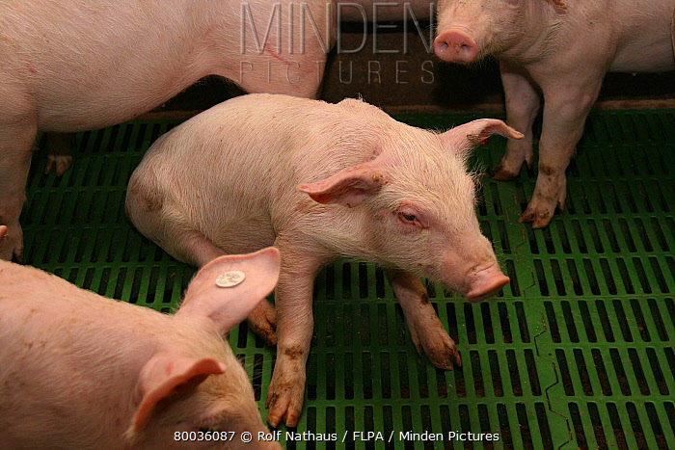
Common Swine Zoonotic Diseases
STREPTOCOCCUS SUIS
Cause of disease: Streptococcus suis
Clinical signs in swine: depression, tremors, incoordination, blindness, paralysis, and convulsions or paddling of the legs
Clinical signs in humans: meningitis, sepsis, endocarditis, arthritis, hearing loss, and skin lesions
Routes of Transmission: direct contact

Slide 10
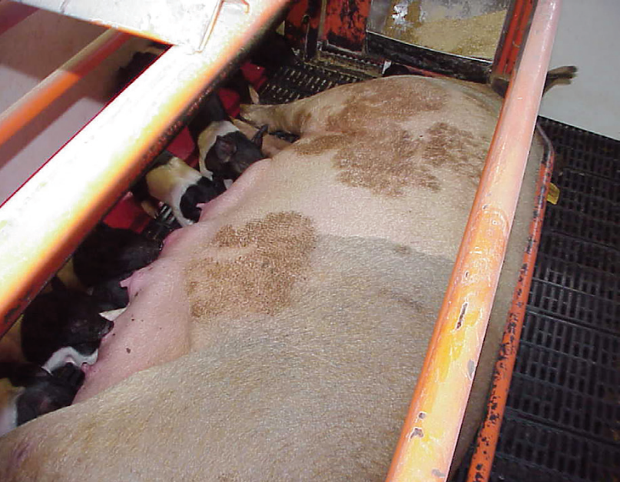
Common Swine Zoonotic Diseases
RINGWORM
Cause of disease: Dermatophytosis
Clinical signs in swine: crusty, dark, hairless patches; common on the skin around the head and neck; thorax, flank, behind the ears, on the legs
Clinical signs in humans: local itching, reddish skin, and hairless at the point of contact
Routes of Transmission: Direct and Fomites
nadis.org.uk

Slide 11
How do zoonotic diseases spread?
Fecal-oral transmission
Some infections are spread
when microscopic amounts of
feces from an infected person
or animal with or without signs
of disease (a carrier) are taken
in by another person or animal
by mouth. The feces may be
passed directly from soiled
hands to the mouth or indirectly
by way of objects, surfaces,
food, or water soiled with feces.

Slide 12
How do zoonotic diseases spread?
Contact with skin or
mucous membrane
(lining of nose and mouth)
Some infections are spread
directly when skin or mucous
membrane comes into contact
with other skin or mucous
membrane. Infections are
spread indirectly when skin
or mucous membrane comes
in contact with contaminated
objects or surfaces.

Slide 13

How do zoonotic diseases spread?
Airborne droplets from
the nose and throat
Some infections are spread
when an infected person/animal
sneezes or coughs out tiny
airborne droplets. The droplets
in the air may be breathed in
directly by another person or
animal, or enter another person
or animal indirectly through
contact with surfaces or objects
with the droplets on them.
Thinkstock.com

Slide 14

Tracking the spread of Infectious Diseases

