Slide 1
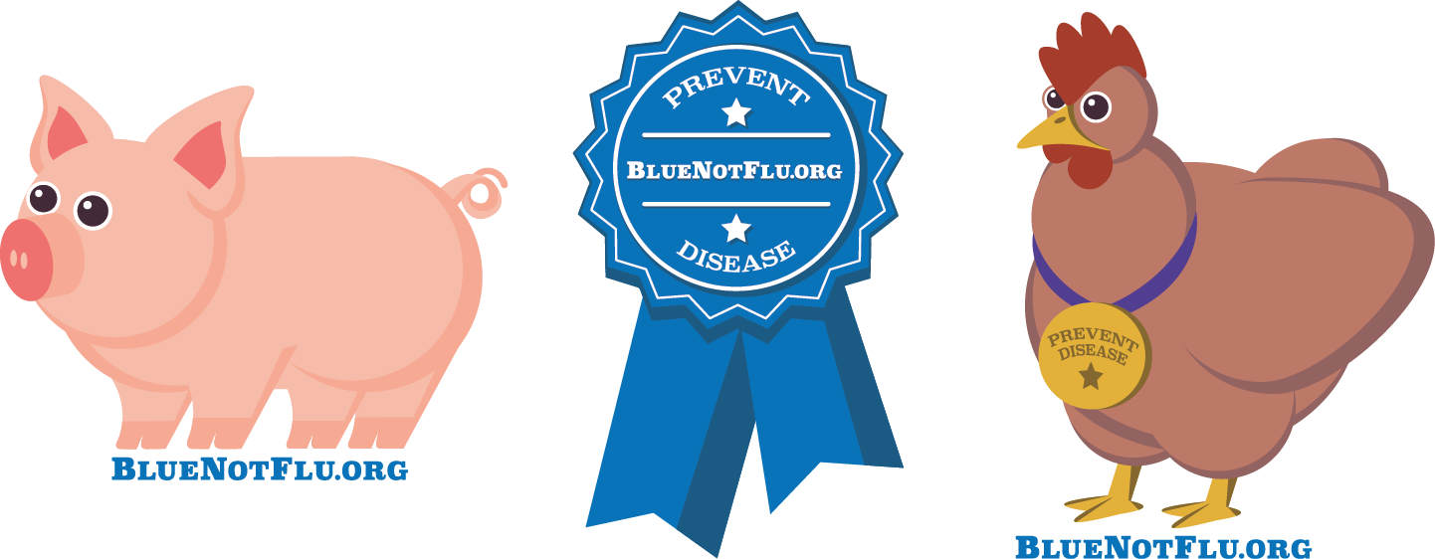

Bring Home the Blue,
Not the Flu!
Preventing Disease in Animals and People

Slide 2
Welcome
Amy Powell, PhD
Extension Youth Animal Science Program Specialist
Iowa State University Extension and Outreach
Andrew Hennenfent, DVM, MPH
Emergency Management Coordinator
Iowa Department of Agriculture and Land Stewardship

Slide 3


Andrew Hennenfent, DVM, MPH
May 29, 2020

Slide 4
Iowa & Agriculture

Slide 5

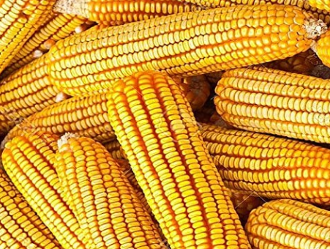
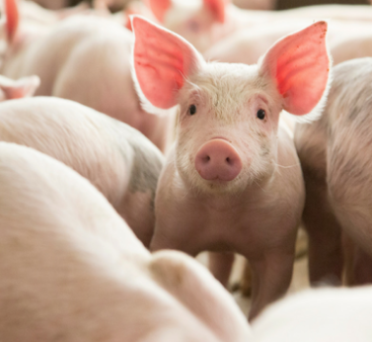
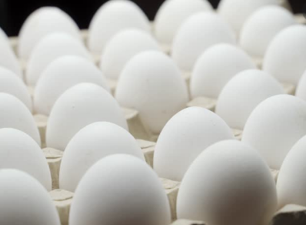
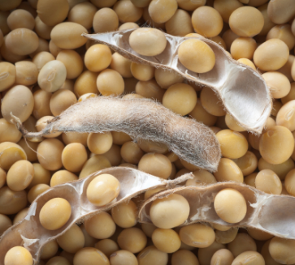
1st in the United States
Notes:
corn
soybeans
pigs
chicken eggs

Slide 6
2nd highest food producing state
34.8% U.S. pork
18.1% U.S. corn
13.3% U.S. soybeans
13.3% U.S. eggs
14.0% U.S. cattle

Slide 7
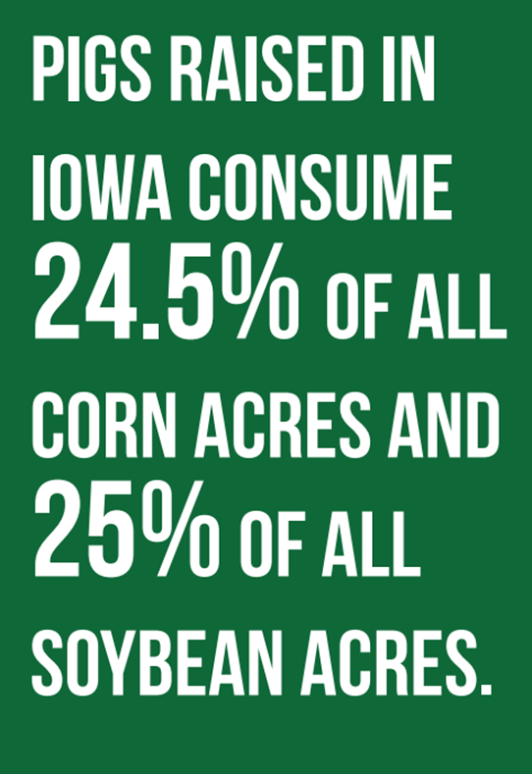
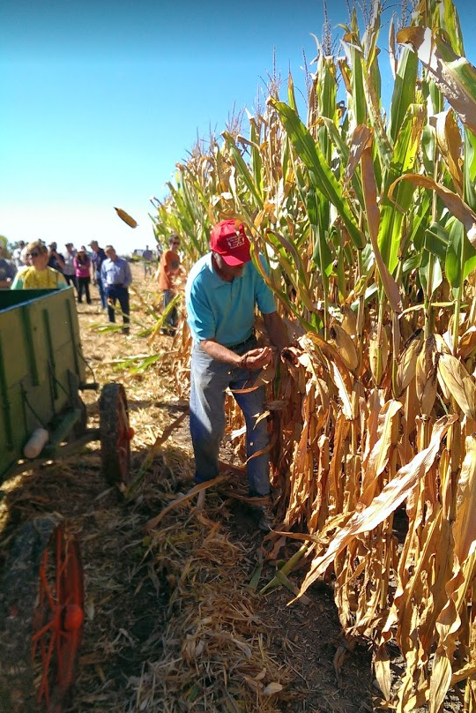
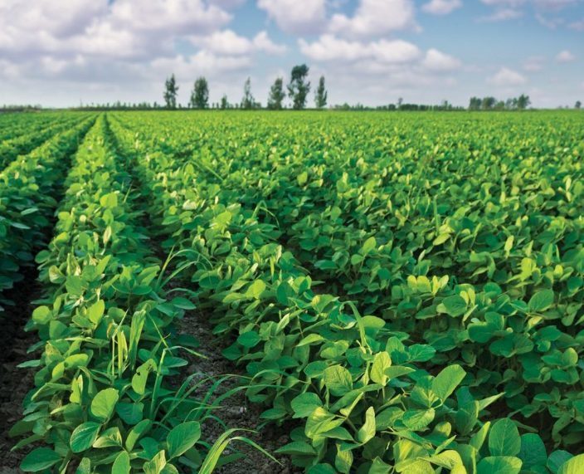
Source: Iowa Pork Facts

Slide 8

International Trade
U.S. Exports
  Beef: 12-15%
  Dairy: 15-20%
  Pork: 25-30%
  Poultry & Eggs: 18-20%

Slide 9
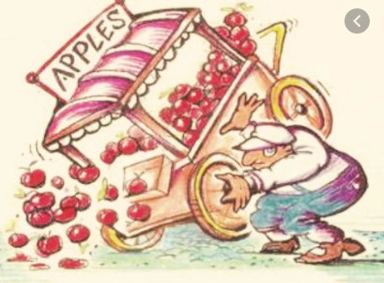

Poor On-Farm Biosecurity!

Slide 10
Bring Home the Blue,
Not the Flu!
Preventing Disease in Animals and People
Molly J. Lee, DVM, MPH, DACVPM
youthinag@iastate.edu

Slide 11
Goals for Today
Outline the learning goals and objectives associated with the online courses
Perform hands-on activities and relate these to content within the courses
Locate the different resources available on the course website
Design a program to hold a youth workshop in your area
Notes:
By the end of this webinar, you will be able to
-Outline the learning goals and objectives associated with the online courses, “Bring Home the Blue, not the Flu”, and show examples of content from the lessons
-Perform hands-on activities related to disease prevention and relate these to the corresponding content within the online courses
-Locate the different resources available on the course website
-Design a program using the available resources to hold a youth workshop in your area

Slide 12
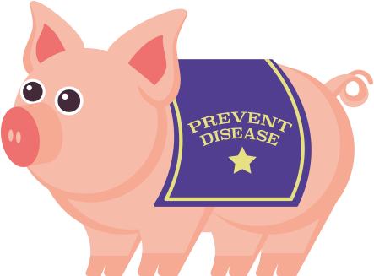
Background
H3N2v influenza outbreaks at fairs
Influenza prevention education among youth with swine and poultry exposure at agricultural fairs
CSTE/CDC pilot project
Other zoonotic diseases
Partnership
  Human health
  Animal health
  State and county youth
  agriculture organizations
Notes:
Briefly, I think it is important to describe how this project first started. As some of you may already know, H3N2 is a strain of influenza A that commonly circulates among swine and can infect humans. These viruses are called variant viruses when they infect people and the letter “v” is attached to the influenza strain name (e.g., H3N2v).
We saw sporadic cases of H3N2v influenza in humans during 2011, but during 2012, there were multiple outbreaks of H3N2v with 309 cases.
Because these H3N2v outbreaks “…occurred primarily in children with close contact and prolonged exposure to swine at agricultural fairs, many of whom were exhibitors”, the CDC and Council of State and Territorial Epidemiologists (CSTE) funded a pilot project to develop influenza prevention education, as well as awareness and education about other zoonotic diseases, among these youth. The project was also intended to foster collaboration and partnership between animal health, human health, and state and county youth agriculture organizations.

Slide 13
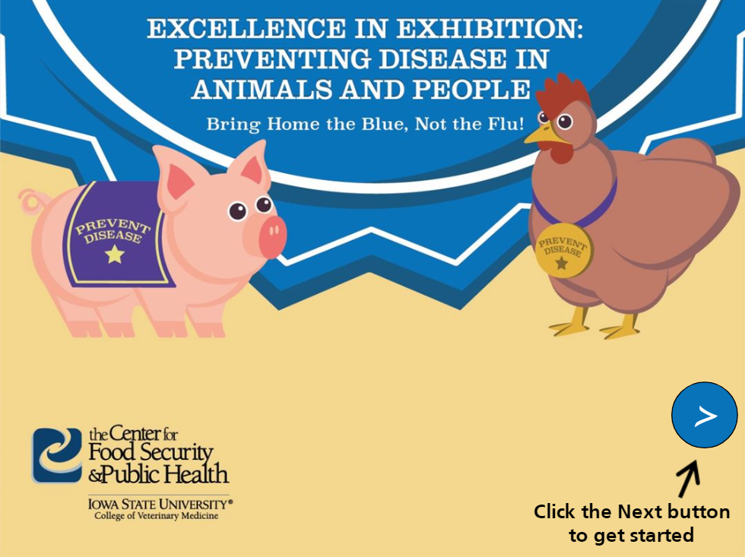
www.BlueNotFlu.org
Notes:
One of the early recipients of this grant, for the first time in 2016, was the Iowa Department of Public Health. They contracted with us, the CFSPH, as our expertise is education about biosecurity and disease prevention. In our original target audience, which was teens aged 13-18 years who are involved in animal agriculture, web-based education has been shown to offer engaging, available, and accessible results. Through the CDC/CSTE grant, we were able to offer the online course free of charge, further increasing its potential reach. A second course has since been added that is directed towards an elementary-aged audience. Both courses are free, interactive, accessible and responsive.

Slide 14
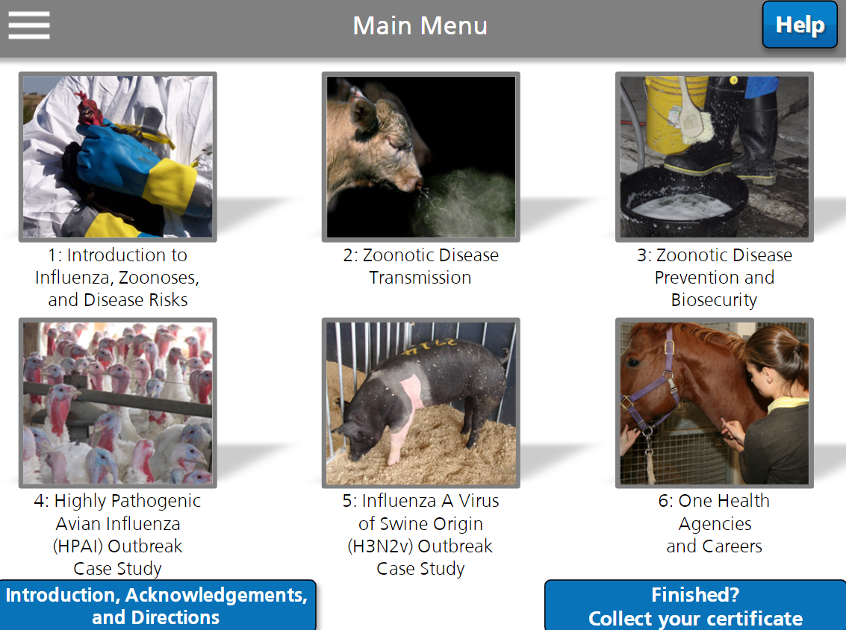
www.BlueNotFlu.org
Notes:
The first course offered is for 13-18 year olds. This course includes six lessons: Introduction to Influenza, Zoonoses, and Disease Risks; Zoonotic Disease Transmission; Zoonotic Disease Prevention and Biosecurity; Highly Pathogenic Avian Influenza (HPAI) Outbreak Case Study; Influenza A virus of Swine Origin (H3N2v) Outbreak Case Study; and One Health Agencies and Careers. Each lesson is designed to be completed in 20-30 minutes each. The course may be taken by anyone independently at any time, however, the course is targeted at middle-high school aged youth.

Slide 15
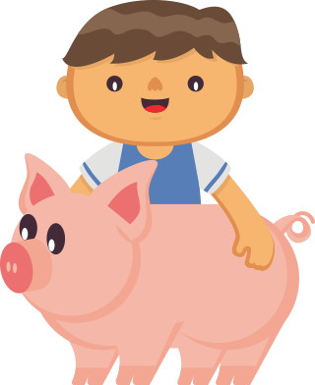
Lesson 1 Learning Objectives
Define zoonoses
Describe the importance of influenza and other zoonoses
Recognize common zoonoses that might affect people and animals at fairs or exhibitions
Identify risk factors for zoonotic disease infection
Notes:
In the first lesson, youth will learn about zoonotic diseases, endemic diseases, and emerging diseases. Youth will be able to learn about different zoonotic diseases by reading through interactive case files. Students will also be asked what zoonotic diseases affect specifically cattle, swine, and poultry.

Slide 16

Notes:
Next, I will show a video that navigates through some of the features of the online course, and includes some examples of the content in lesson 1.
[narrate what is happening in the video]
Note that the definitions appear in a glossary all together at the end of each lesson, with a comprehensive glossary at the end of all of the lessons which is also accessible any time by viewing the main menu.
Note that the ‘next button doesn’t appear until you’ve visited all of the material on the page. In pages without interaction, there is sometimes a small delay as words appear, before the next button pops up, to allow students time to read the content on the page before advancing.

Slide 17
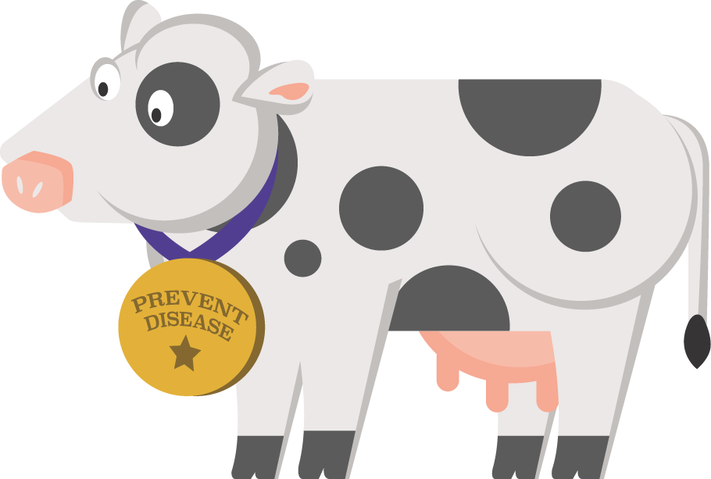
Lesson 2 Learning Objectives
Explain the five routes of disease transmission
Give an example of a zoonotic disease that can be transmitted by each route
Describe how influenza viruses are transmitted among among animals and to humans
Explain ways to prevent each route of transmission
Notes:
In Lesson 2, middle and high school students will learn about ways disease can be transmitted between animals and people. The lesson works through and describes the five routes of transmission. This lesson is structured by having an overview of the route of transmission, an example of diseases that spread this way, an example of disease spread in a relatable, story form, and measures to prevent that route of disease spread.

Slide 18
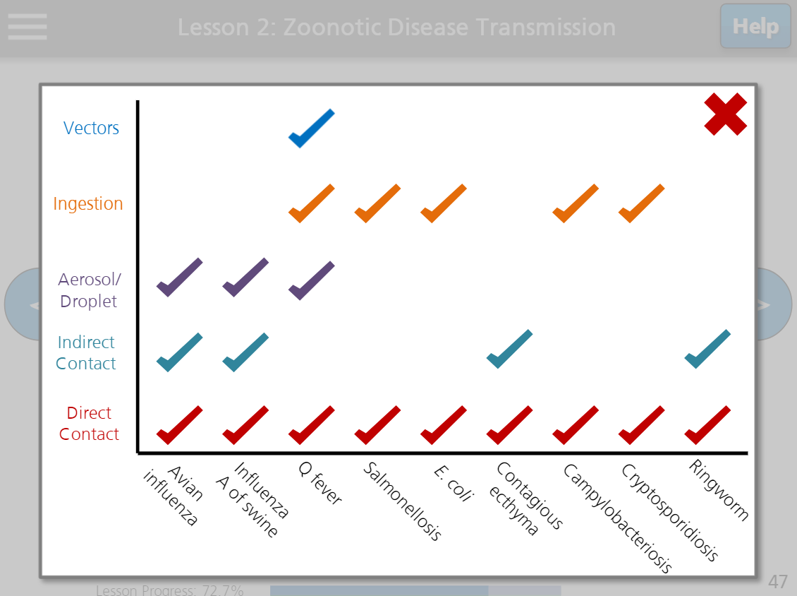
Notes:
As we go through these, we are also building a graph that at the end shows how different diseases spread in different ways, and how some diseases spread in multiple ways. I have shown an example of this here at the “end” of the graph after all 5 routes have been discussed. Interactive activities then allow the students to apply what they’ve learned, for example matching the route of transmission to their correct definition, and dragging and dropping the names of the five different transmission routes to pictures that depict that route of spread.

Slide 19
Lesson 3 Learning Objectives
Define biosecurity
Explain the importance of biosecurity in zoonotic disease control
Review ways zoonotic diseases might be spread to you, your family, and your animals on the farm and at exhibitions
Describe measures to prevent zoonotic diseases spread to you, your family, and your animals on the farm and at exhibitions
Notes:
Lesson 3 covers biosecurity and measures that students can take to prevent the spread of diseases. An interactive activity allows the students to put correct steps in order for cleaning and disinfecting their barn or pens. Students will also learn about the Hierarchy of Controls and steps to take to improve the biosecurity of their farms. Youth will also be able to explore PPE and what to use when working with infected animals.

Slide 20
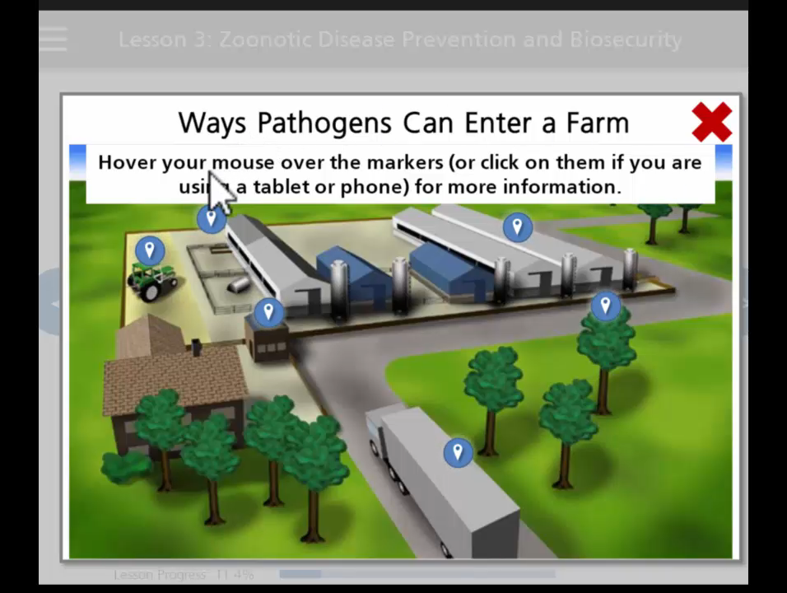
Notes:
First example here shows a bit different kind of interactive activity than what we’ve shown so far, where users can hover or tap instead of click and drag.
This video also shows the interactive activity that allows the students to put correct steps in order for cleaning and disinfecting their barn or pens.
At the end of the lesson, students will participate in an interactive biosecurity game, similar to Apples to Apples. A question is asked, then the student needs to pick the card with the best answer on it.

Slide 21
Lesson 4 Learning Objectives
Describe avian influenza and how it is transmitted among animals and between animals and people
Explain the impact that an HPAI outbreak has on animal agriculture
Identify potential public health impacts of a highly pathogenic avian influenza outbreak
Identify those persons most at risk for being infected with avian influenza A viruses and those with the highest risk of complications
Explain how and why animal exhibitions might be impacted by HPAI
Notes:
Lesson 4 is based around a case study on Avian Influenza. Students will read through the clues from the outbreak and answer questions over the clues presented about the disease case.

Slide 22
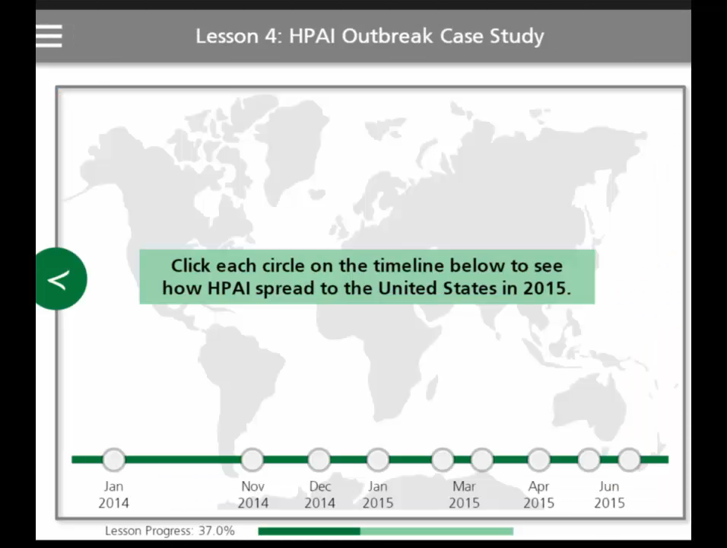
Notes:
There are many interactive, multiple choice questions for students to answer, as well as many facts about the Avian Influenza outbreak.

Slide 23
Lesson 5 Learning Objectives
Define influenza A viruses of swine and how they can be transmitted among animals and to humans
Explain measures to protect swine from infection with influenza viruses
Identify the public health impacts of the H3N2v virus outbreak
Identify those persons most at risk for being infected with swine influenza A viruses and those with highest risk of complications
Explain the measures humans can take to protect themselves from influenza A viruses of swine when on farms or attending animal exhibitions
Notes:
Lesson 5 is also based around a case study. This case study is analyzing Influenza A Virus of swine, or H3N2v. Similar to lesson 4, students will read through the clues from an outbreak and answer questions over the clues presented about the disease case.

Slide 24
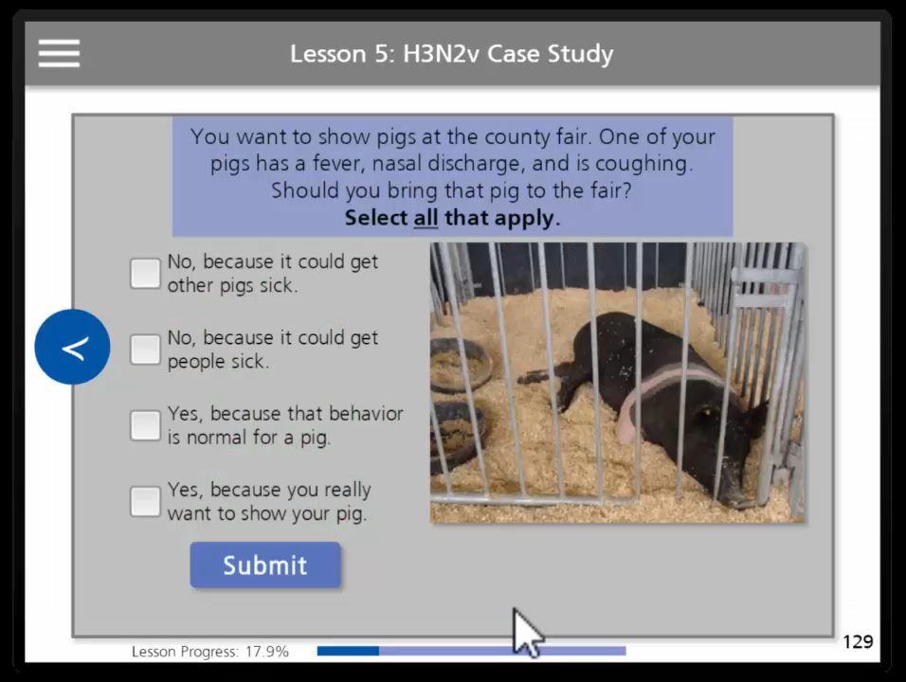
Notes:
There are many interactive, multiple choice questions for students to answer.

Slide 25

Lesson 6 Learning Objectives
Identify agencies that promote animal and public health
Recognize careers that are available in animal and public health
Describe the education and responsibilities that different animal and public health jobs require
Notes:
Lesson 6 focuses on the different careers in animal and public health. Middle-high school students will be able to learn about different agencies and hear from 6 different make-believe individuals about the specific aspects about their career.

Slide 26
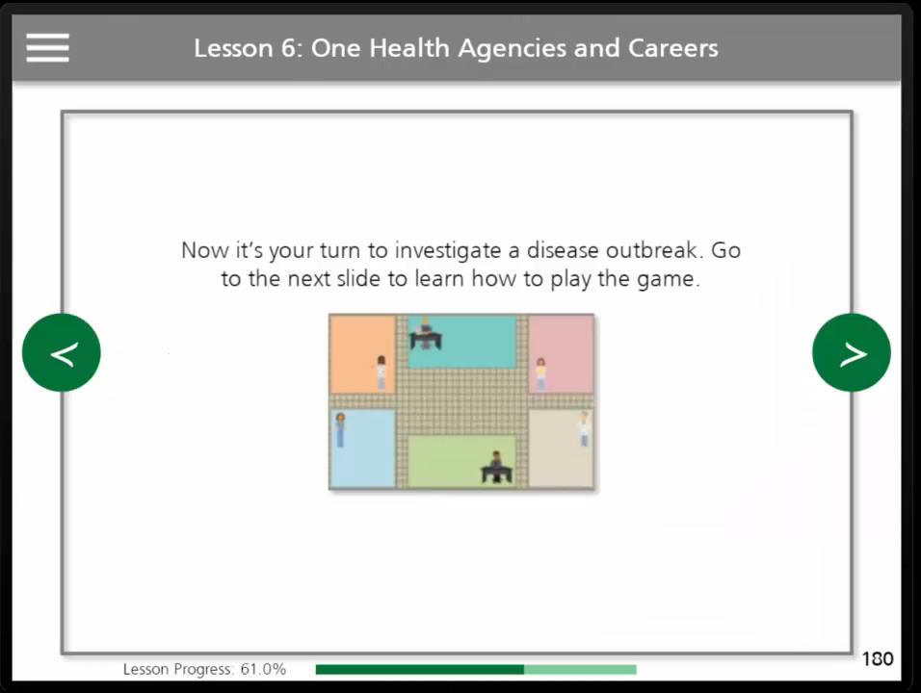
Notes:
This lesson culminates in a fun “Clue”-like game where students need to figure out what disease the people have, the animal that spread the disease, and the location where people were infected.

Slide 27
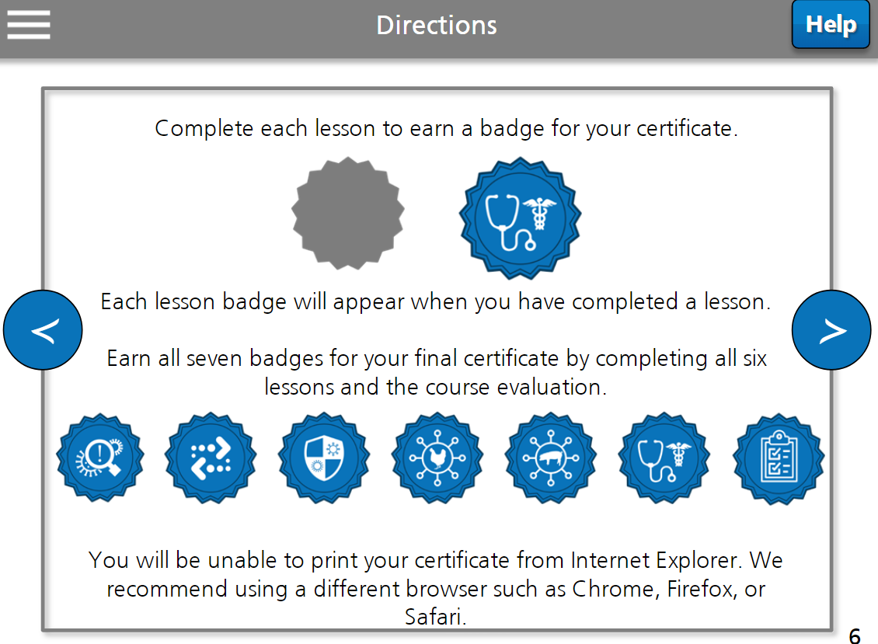
Certificates
Notes:
I also want to point out that the course includes certificates, which as we’ll discuss later in the presentation, can be very helpful in motivating and tracking students’ completion of the content. This slide is under ‘directions’ at the very beginning of the course and describes how students earn a badge on a certificate for each lesson completed. Also note that if students are using Internet Explorer, they will be unable to print their certificates.

Slide 28
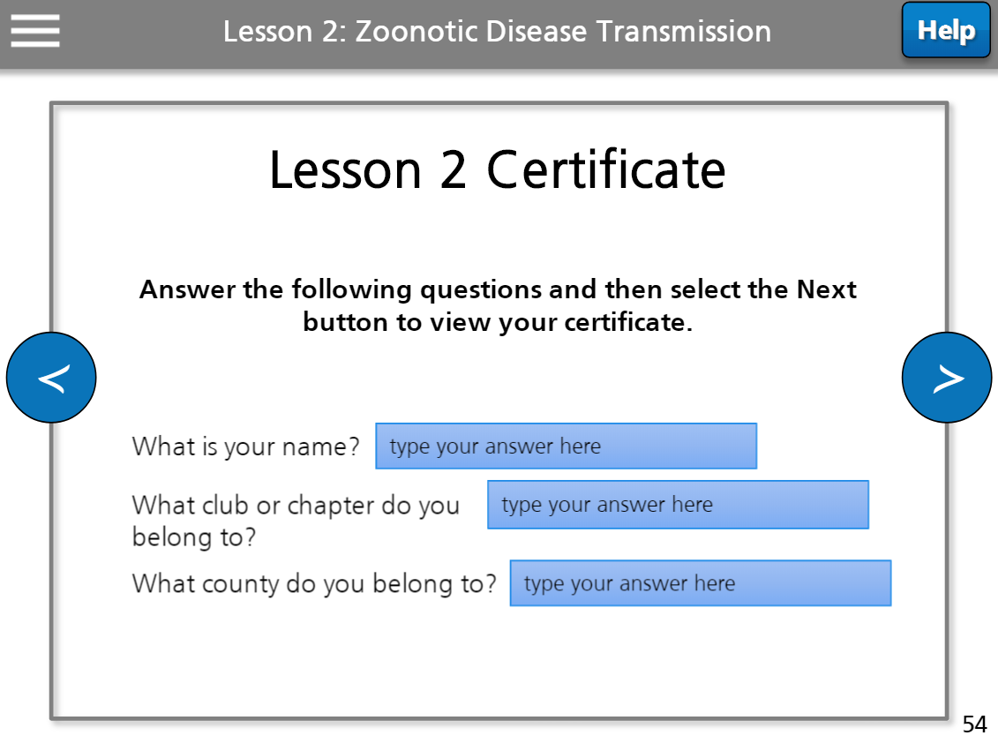
Notes:
A page similar to this appears after completion of each of the lessons. Students may type in their information (they do have to type it in each time)…

Slide 29
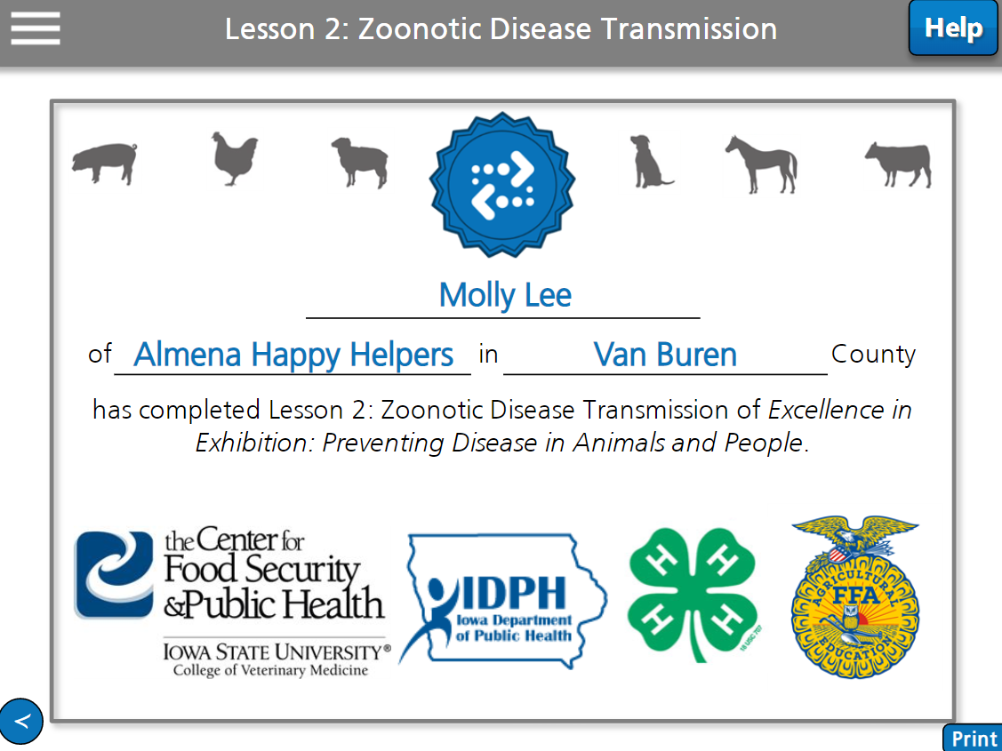
Notes:
… and then they receive the badge on the top of their customized certificate.
Note not Van Buren Co. Iowa :)

Slide 30
Notes:
After they have collected their certificate for Lesson 6, students are asked to complete a survey on Google forms– I’ll cover this later and why it’s important. Once done with that, they are able to collect their final certificate. If students take the courses out of order, they may also collect their final certificate by clicking in the bottom right corner of the main menu.

Slide 31
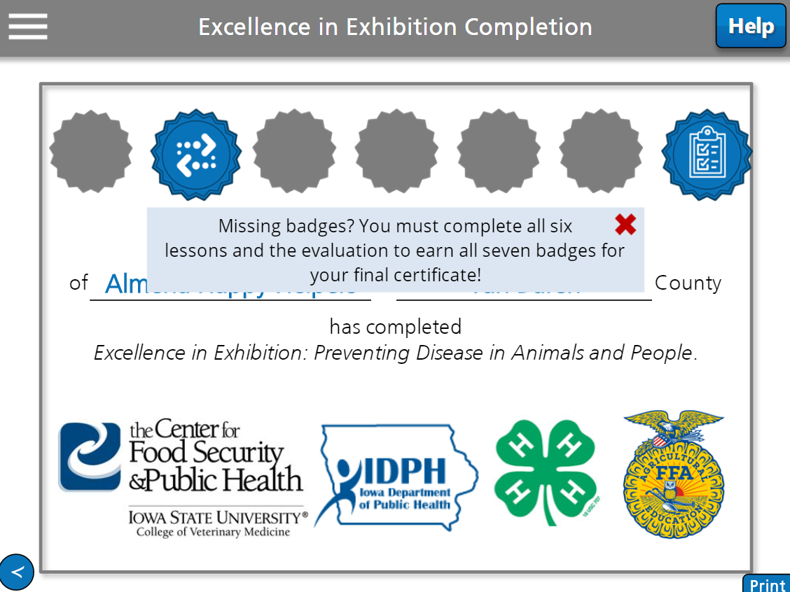
Notes:
The 7th and final badge appears when students complete the survey in Google forms. If the student only completes some of the lessons, they will only receive the badges for those lessons– and those remaining will be empty gray placeholders. In this example, I’ve only completed lesson 2. I also want to point out that if a student leaves the course and returns to it at a later time, the software we used to create the course will ‘save their spot’, and so even if they exit their browser, they can ‘resume where they left off, and the course will remember what lessons were already completed so that students still retain their badges from the last time they accessed the course. If you or students are concerned about this, you could also verify individual certificates instead of the final certificate.

Slide 32
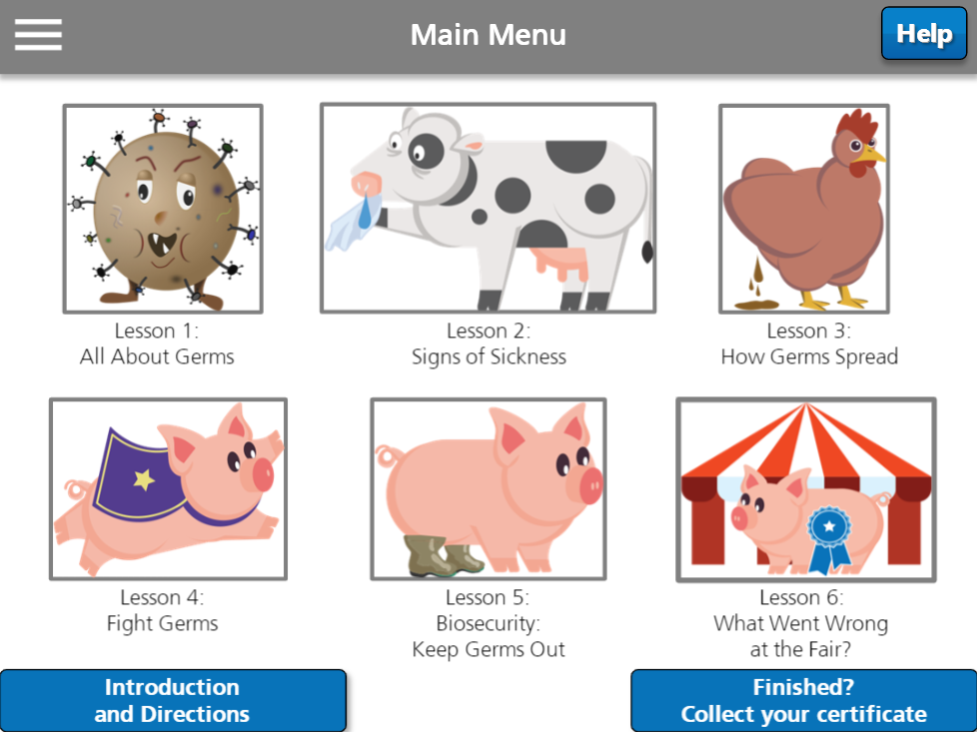
www.BlueNotFlu.org
Notes:
A newer course for elementary aged youth is also available, which follows similar content as the middle-high school level course. The course also follows six lessons: All About Germs; Signs of Sickness; How Germs Spread; Fight Germs; Biosecurity: Keep Germs Out; and What Went Wrong at the Fair? The content has been adjusted and simplified to target the younger audience (7-12 year olds). The content has been simplified and features more gamification, less text, a lower reading level, and shorter lessons.

Slide 33
Lesson 1 Learning Objectives
Tell me what a germ is
Tell me what germs can do
Tell me who can get sick from germs
Tell me what we call germs that are shared between people and animals
Notes:
The first lesson gives an overview of zoonoses and how they relate to humans and animals. As you can see, for the younger audience, words and concepts have been simplified and the lessons have been shortened.

Slide 34
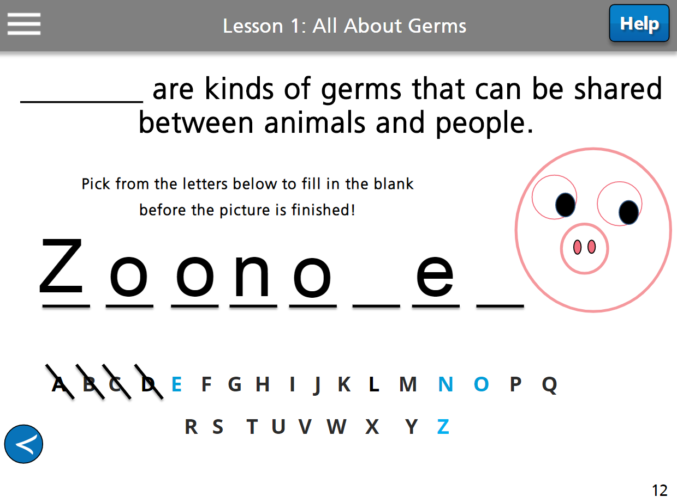
Notes:
Youth will learn about four different germs: bacteria, viruses, fungi, and parasites (the germs have names to help them remember– Freddy the Flu, Sam and Ella, Nash the Rash (a fungi– ringworm), and Irma the worm. Two animals tell a story about themselves describing their different clinical signs, students use the information about germs that they learned to decipher which germ caused the animal to get sick. There is a “hangman” type game that can also be played.

Slide 35
Lesson 2 Learning Objectives
Tell me how a person may act or feel when they are sick
Name who to tell if you find a sick animal
Tell me what you should do around a sick animal
Notes:
In Lesson 2, youth will learn about signs and symptoms in their animals and people when they are sick.

Slide 36
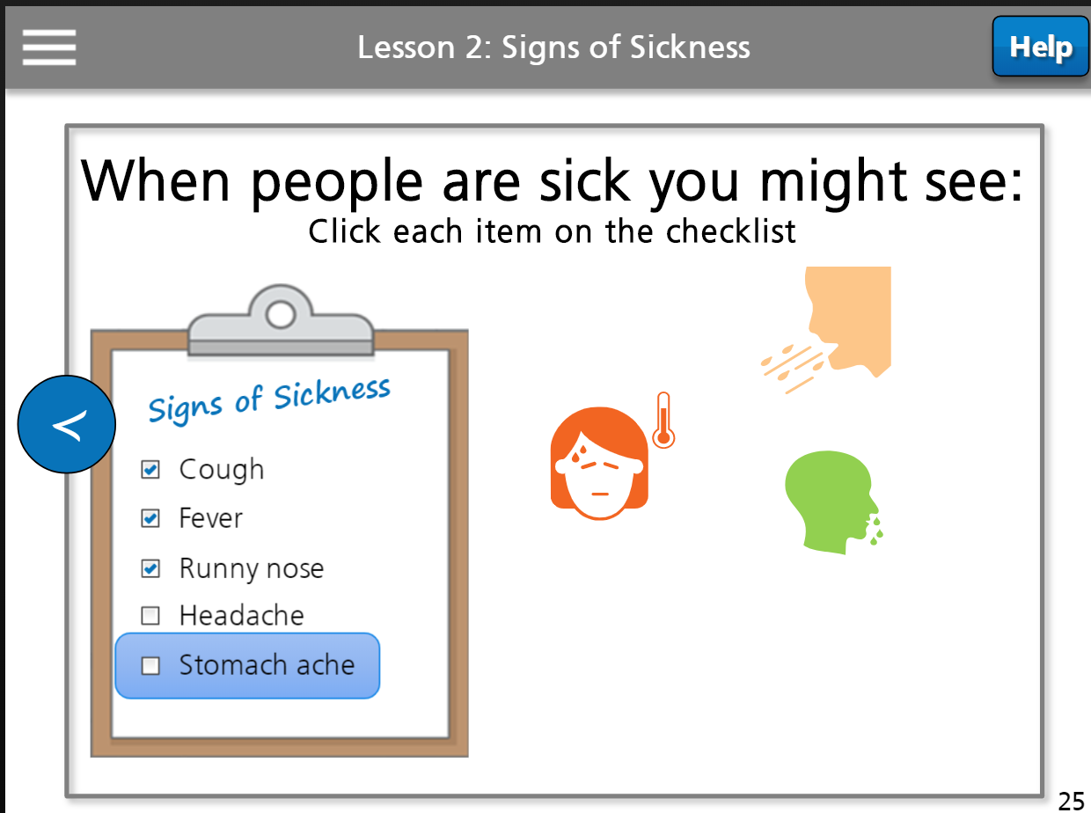
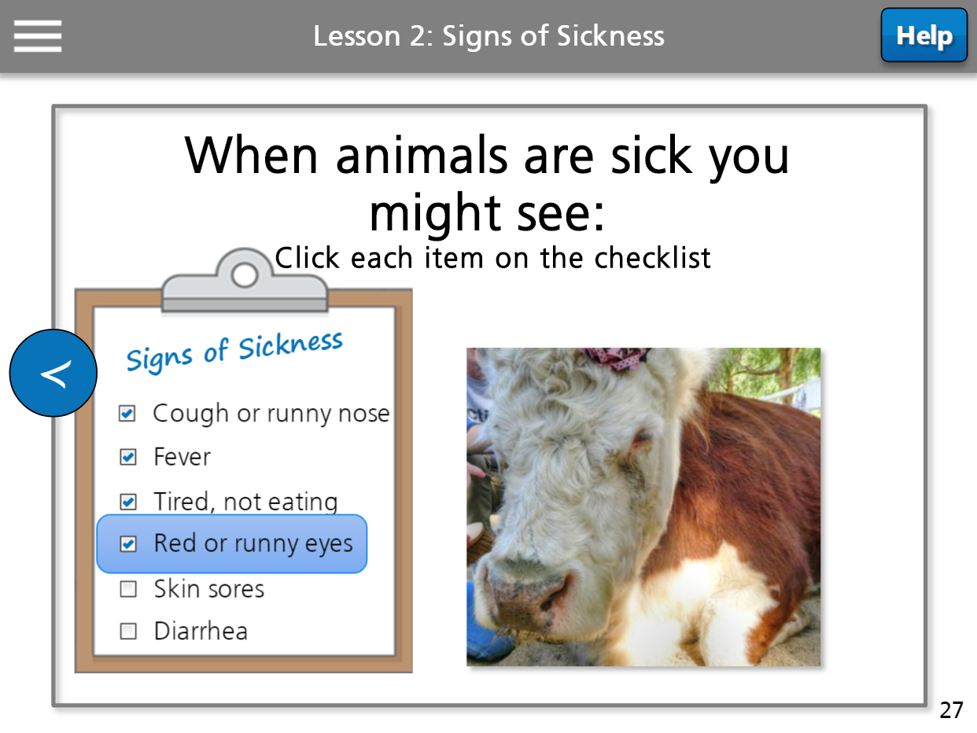
Notes:
This is an example of some of the course content, where students walk through signs and images that people, and animals, might exhibit when sick. In addition, two multiple choice activities are presented for students to test their knowledge about naming symptoms of a possibly infected animal, and then to select what precautions and steps to take when faced with an infected animal.

Slide 37
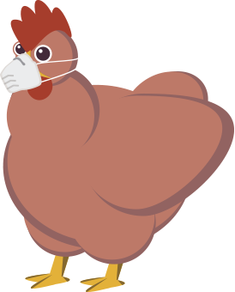
Lesson 3 Learning Objectives
Tell me four ways that germs can spread
Tell me ways to stop germs from spreading
Notes:
The topics in Lesson 3 educate youth on the different modes of transmission of germs.

Slide 38
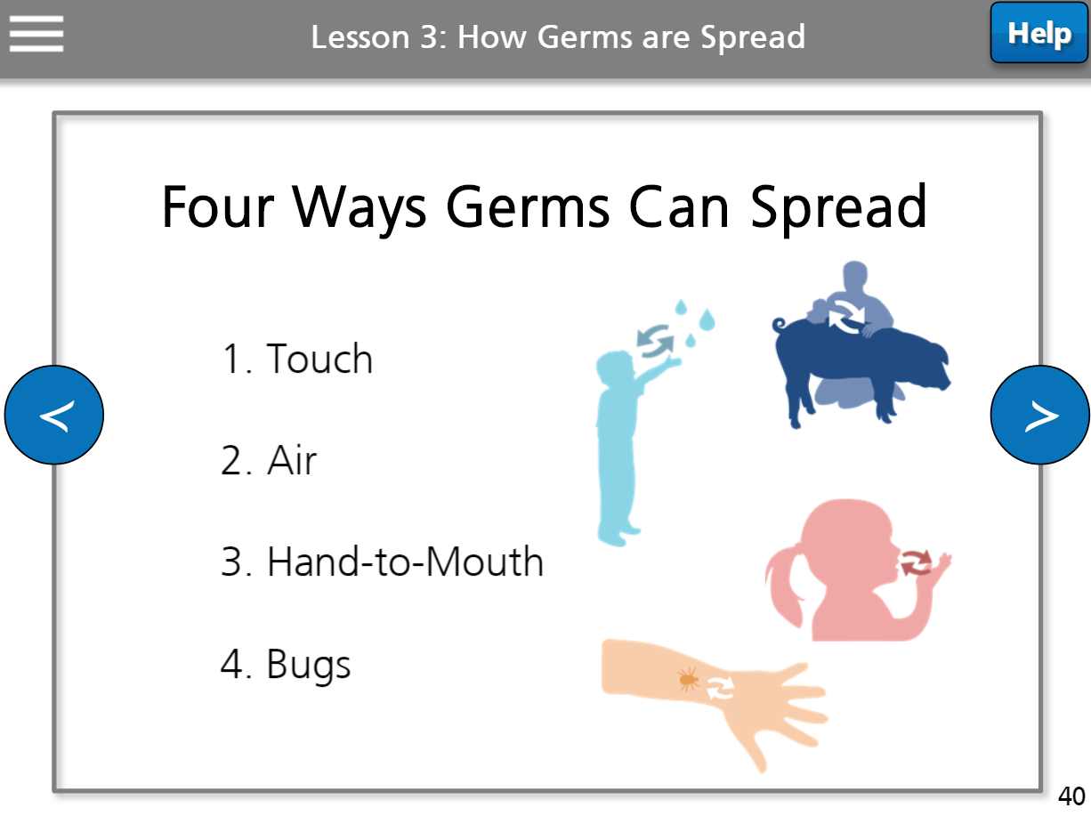
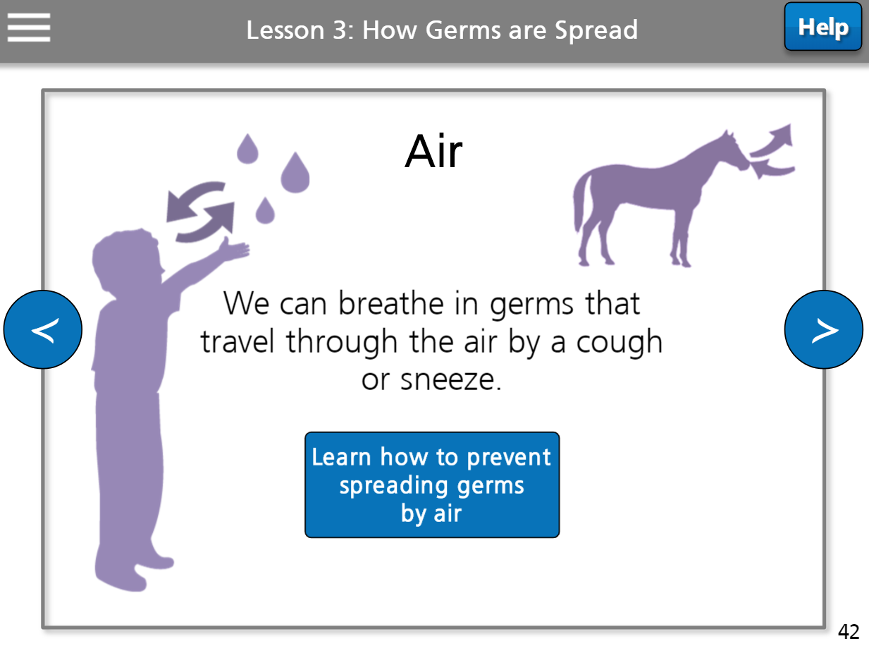
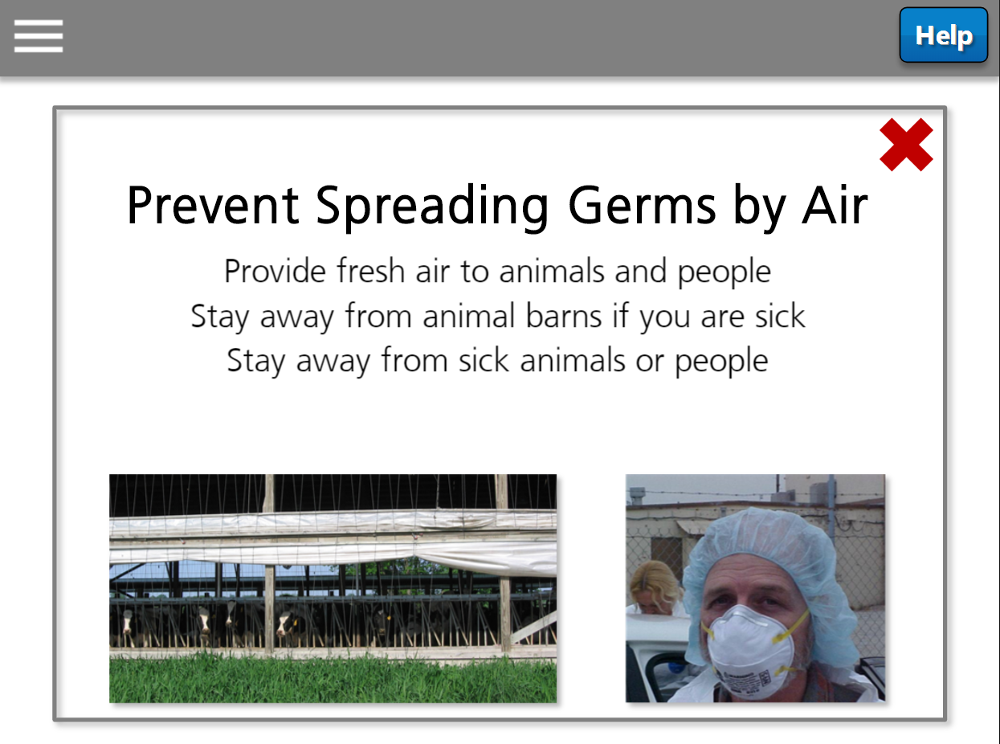
Notes:
There are five different routes of transmission are through air, hand-mouth, touching animals, touching objects, and bugs. The lesson activity asks students to drag and drop the correct mode of transmission to its matching picture.

Slide 39
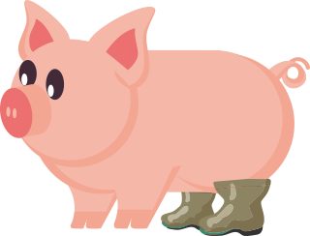
Lesson 4 Learning Objectives
Tell me one way to boost your health power to fight off germs
Show me how to wash your hands
Notes:
In this lesson, the acronym WASH is used for youth to remember the different ways to prevent disease (Wash, Avoid, Safety, Health). A handwashing video is presented for students to learn how to properly wash their hands, “sing along” with Hammy the pig to learn another fun handwashing song, and learn some other helpful tips about staying sanitary when handling animals. They are also tested with an activity to put the steps of proper handwashing in order– like the stall cleaning activity from the course for older students (the activity plays the handwashing song while the students work on this so they again get a sense of how long they should be handwashing).

Slide 40
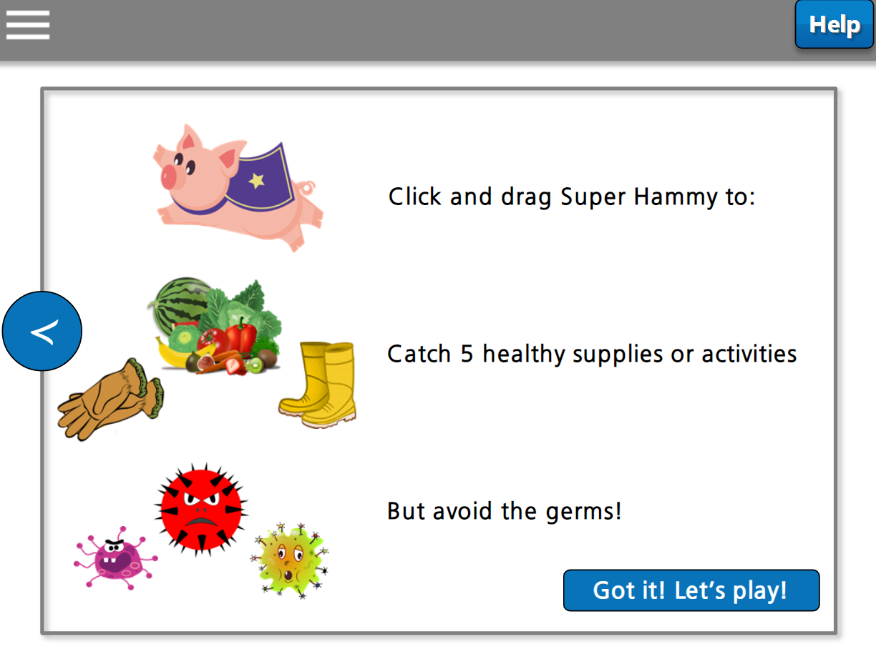
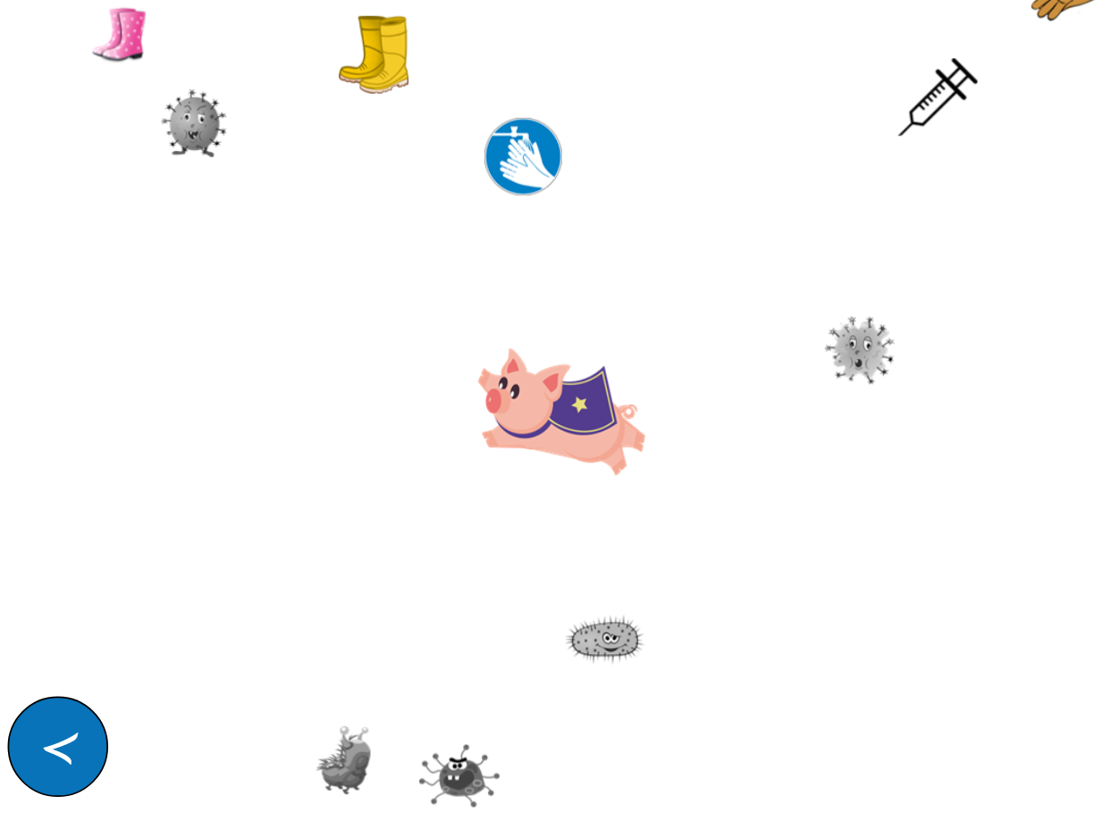
Notes:
At the end of the lesson, students will participate in an interactive game. In the game, they need to navigate Super Hammy to catch healthy foods or supplies while trying to avoid the germs. They win the game after gathering 5 healthy foods or supplies. With each healthy activity they catch, there is a quick reminder about why that activity is helpful for disease prevention, and if they get caught by a germ, they have to start over.

Slide 41

Lesson 5 Learning Objectives
Tell me what “biosecurity” means
Tell me how germs can get onto farms or fairs
Tell me how you can W.A.C.K. away germs
Practice good biosecurity at the farm and the fair
Notes:
Lesson 5 is all about biosecurity.

Slide 42
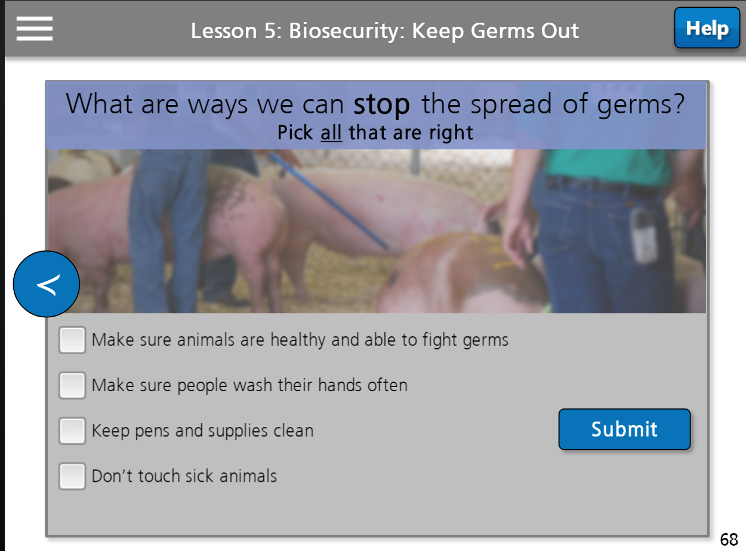
Notes:
Another acronym, W.A.C.K., is used to help students remember the four ways to keep germs and diseases out of their animals or farm (Watch (for sickness in your animals), Away (stay away from sick animals), be Clean, and Know (about your animal’s health)). Youth will also be able to explore PPE by “dressing up” a person and what to use when working with infected animals.
At the end of the lesson, students will participate in an interactive biosecurity game, similar to Apples to Apples– similar to the one from the middle-high school course, but simplified. A question is asked, then the student needs to pick the card with the best answer on it.

Slide 43
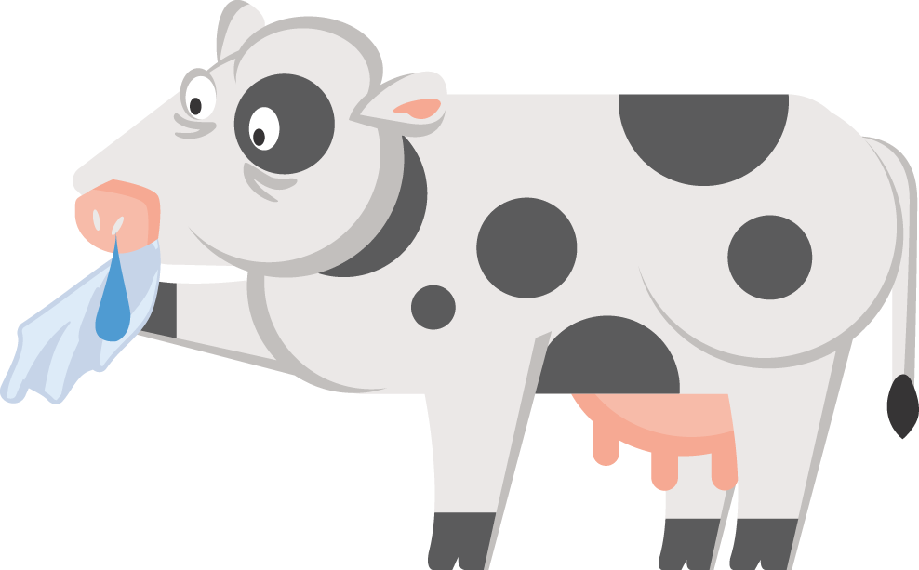
Lesson 6 Learning Objectives
Tell me how you and your animals can get germs
Tell me ways you and your animals can stay healthy at home and at the fair
Tell me some people that can help you and your animals stay healthy and stop germs
Notes:
Lesson 6 is a case study focused on application of the content learned, and includes some information about different jobs important in solving the case.

Slide 44
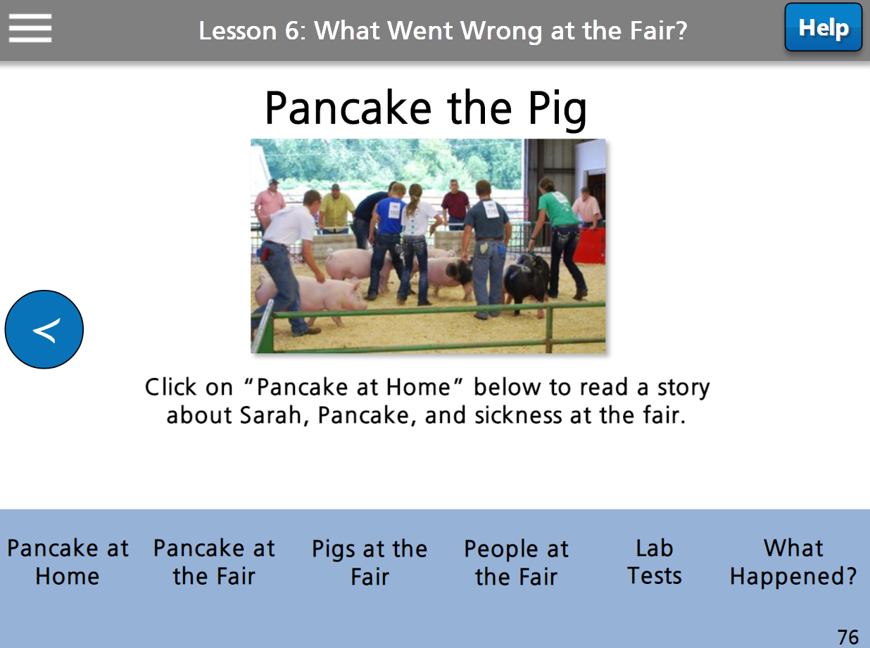
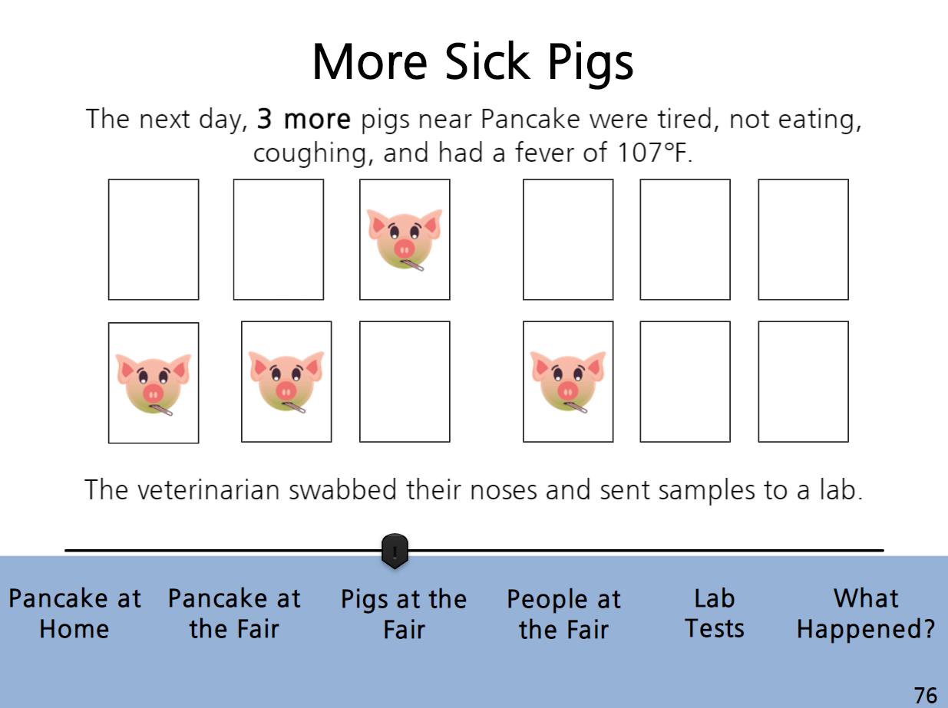
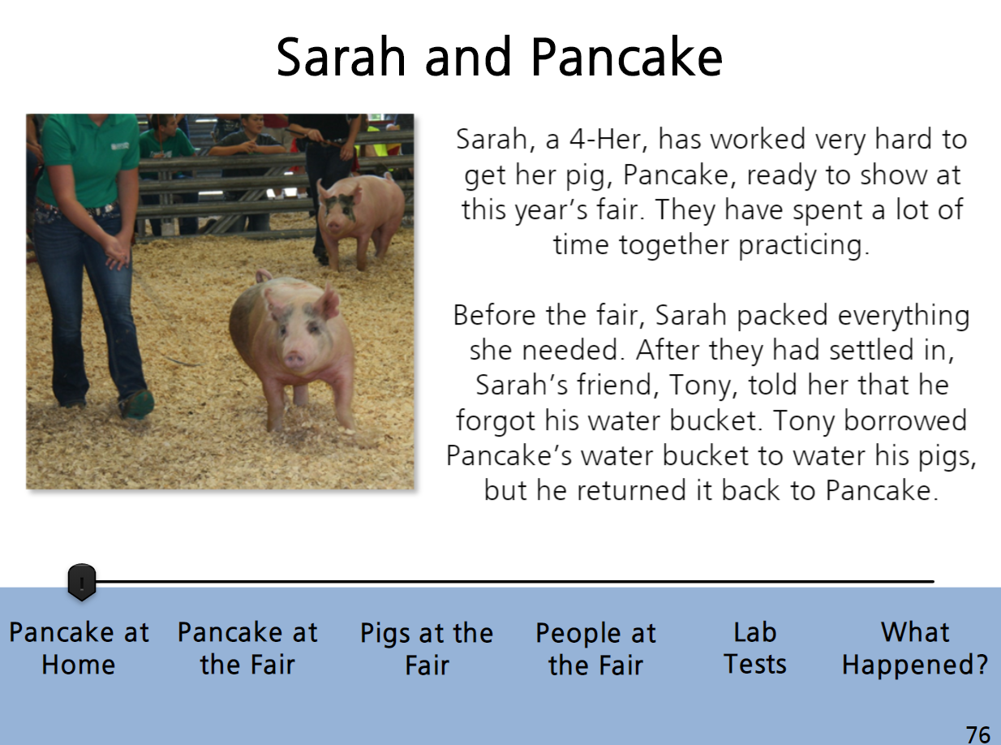
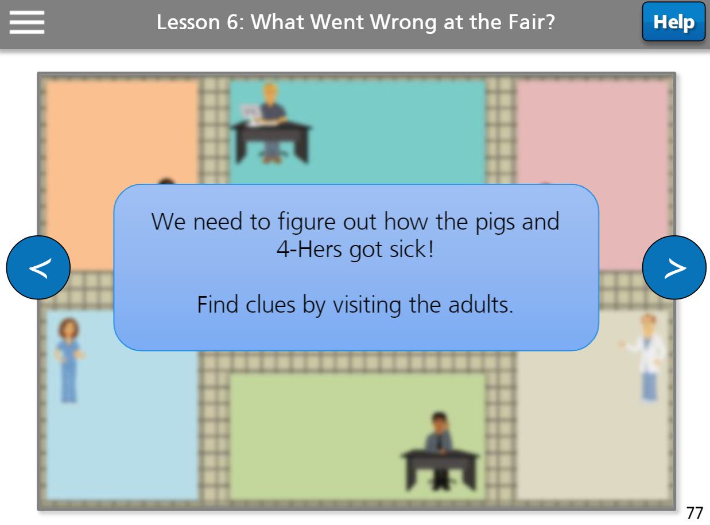
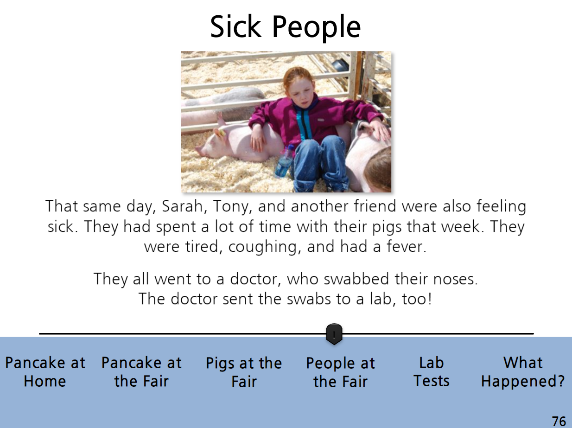
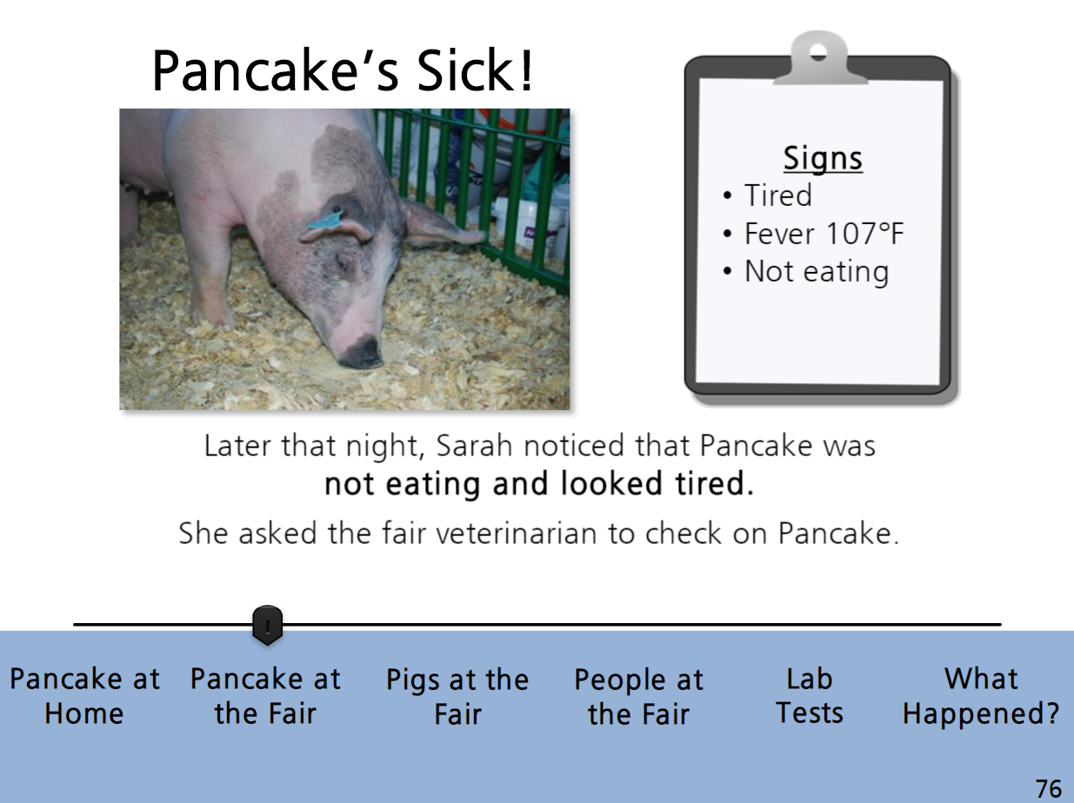
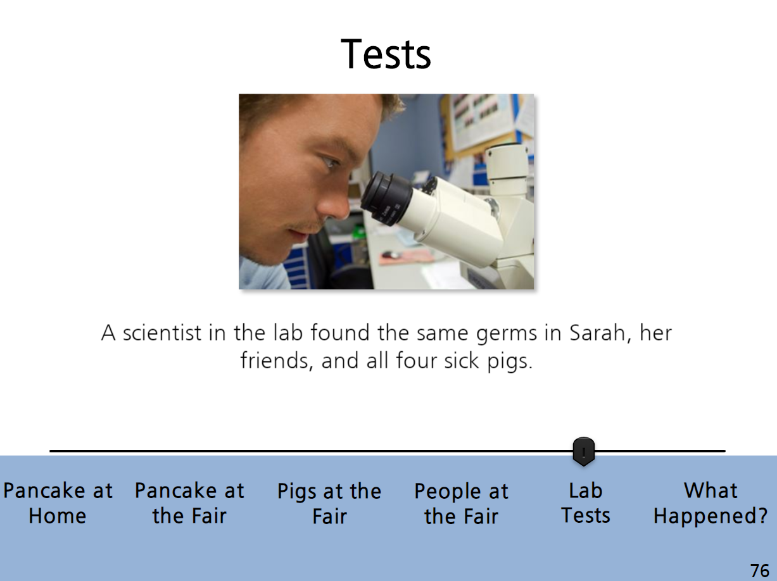
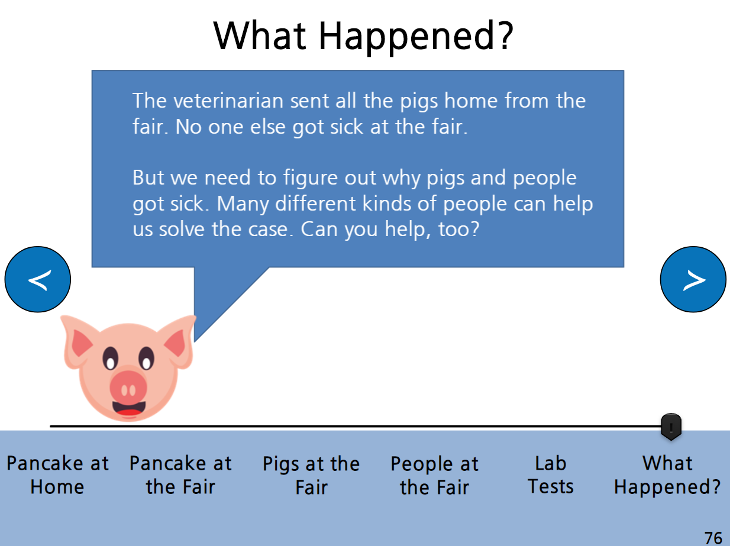
Notes:
The case is about an exhibitor (Sarah) and her pig, Pancake. The students will read through all the evidence and symptoms that Pancake had while at home and at the fair, while also reading about other animals and people at the fair. At the end of the lesson, like in the middle-high school course– but with a different case, the students will collect clues from six different adults that worked with the case study. The students will then put together the clues to decide how the disease started and was spread through the fair.
To solve the case, students will need to identify what spread the germ, how the germ spread, and who was the germ that made everyone sick.

Slide 45
Student Takeaway
Encourage youth involvement with livestock and exhibitions in a safe and healthy matter
Prevent zoonotic disease
Follow biosecurity recommendations
Promote public and animal health
Notes:
One of the things that we believe has been the most critical to our success is that throughout our educational material, we maintain the message that showing and interacting with animals is a good thing. We encourage this interaction to occur in a safe and healthy manner, but do not want to discourage or scare anyone away from working with animals.

Slide 46
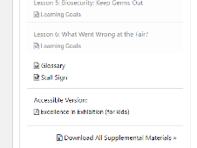
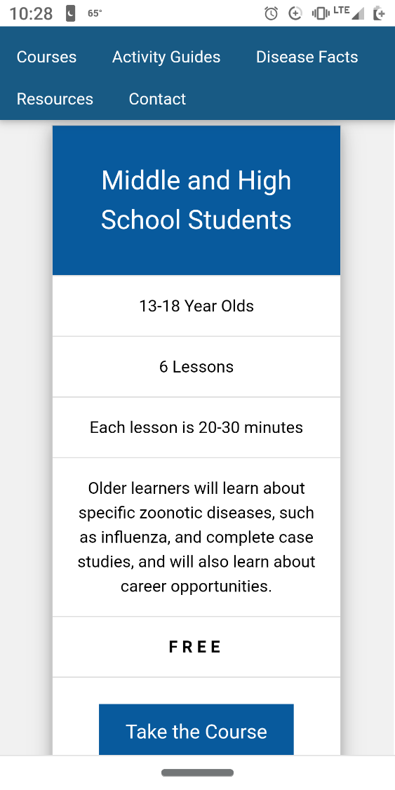
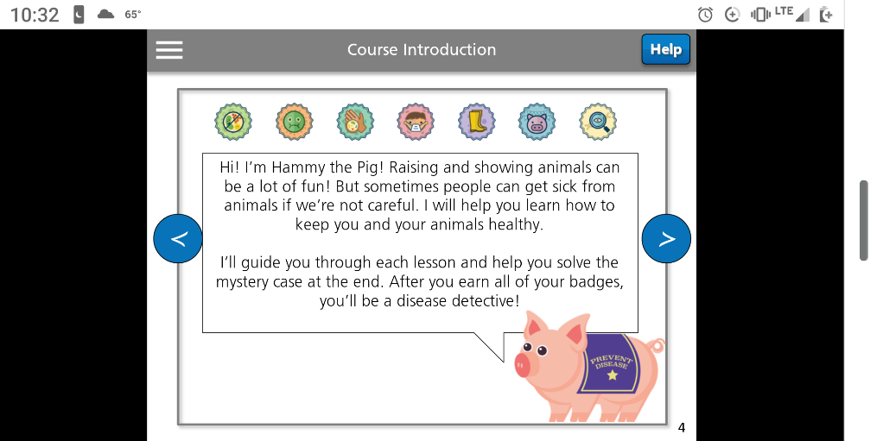
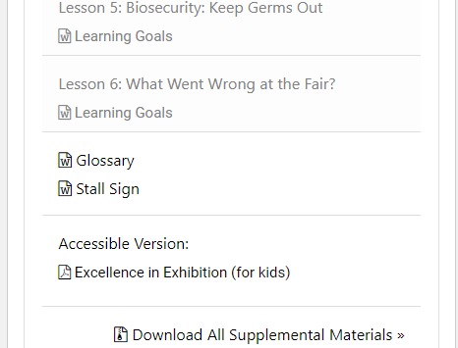
Accessible and Responsive
Notes:
Both courses are fully accessible. Accessibility of online courses is important because some individuals have disabilities that can make it difficult for them to take an online course. Additionally, many students with disabilities prefer online courses to face-to-face courses. As you can see, both the course website and the courses themselves are responsive.

Slide 47
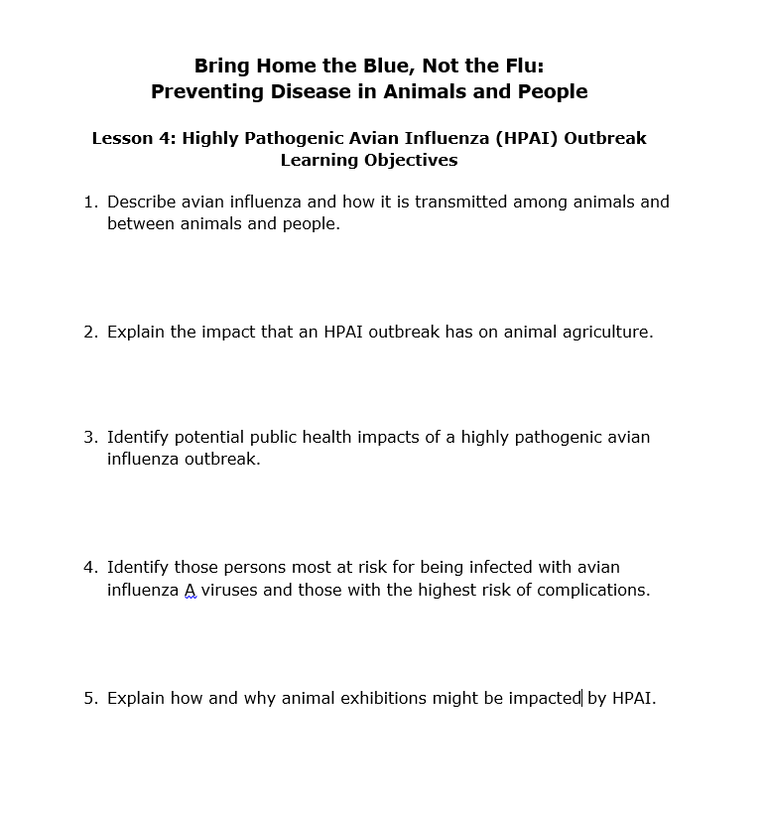
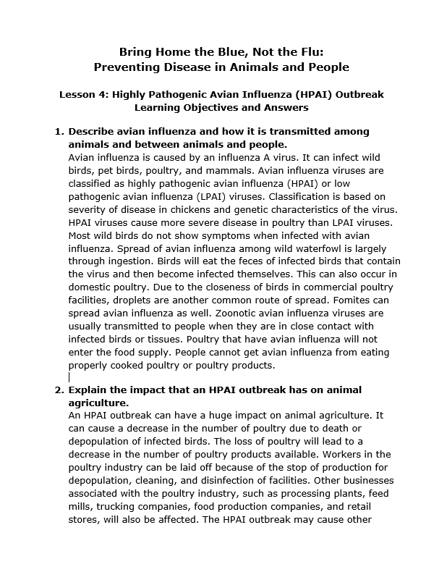

Supplemental Materials
Learning objective worksheets
  Worksheet keys
  available
PowerPoint
course material
Notes:
When visiting the course website, you will find a variety of materials designed to fit the two courses and learning objectives. Learning objective worksheets are available for both courses, and keys are available on a password-protected portion of the website for teachers. There are numerous materials available designed to fit the middle-high school course. PowerPoints are available to cover course lessons in a classroom setting.

Slide 48



Supplemental Materials
Lesson Worksheets
  Worksheet keys available
Customizable signage
Related resources
Notes:
Additional lesson worksheets, which also have keys available, have been created to emphasize the learning objectives for the middle-high school course—one of these is shown on the slide. Also available is signage, such as this customizable stall sign which students can download and populate with their information and a photo. We also include a ‘Related Resources’ section, which contains additional disease education resources, biosecurity tips, and other agriculture-related learning activities from various reputable sources.

Slide 49
Website – Hands-On Activities
Each activity includes
  Instructor guide
  Demonstration Video
Disease Transmission and Outbreak Investigation: Mucous Swap
  Also includes a participant guide
Disease Transmission and Biosecurity Activity
Personal Protective Equipment Activity
Notes:
Another great resource to utilize from the ‘Bring Home the Blue, Not the Flu’ program is the hands-on activities provided on the webpage. The three different activities are listed above, and they can be found under the Activity Guides section on the webpage. Each activity was created to be used in a classroom or large group setting. However, we have brainstormed some ideas in which you can implement these activities through virtual workshops/trainings or at-home student use in later slides.

Slide 50


Disease Transmission and Outbreak Investigation: Mucous Swap
Distilled water, baking soda, and phenol red are used to model how disease spreads at exhibitions
Some cups are “infected” with baking soda and water while others are not
Students each receive a behavior card that correlates with their cup
Notes:
The first activity is the Mucous Swap Investigation activity. This is a great model to show the transmission of disease between animals at an exhibition. 10% of the cups are filled with distilled water mixed with baking soda to act as the mucous of an “infected” animal. The rest of the cups are only filled with distilled water. Each student will receive a behavior card that correlates with the cup they were given. Two examples of behavior cards are shown here. Each student will also receive a number with the number of times they need to mix the liquid in their cup with another student.

Slide 51


Disease Transmission and Outbreak Investigation: Mucous Swap
Students will go through the group and mix their liquid together with others
Phenol red is used to determine which students are
“infected” or
”not infected”
Notes:
At the end of the activity, phenol red will be dropped into each student’s cup. After mixing the phenol red into the liquid, a color change may occur. A bright or faint pink indicates an “infection.” ”No infection” is indicated by no color change.
After determining which students were “infected,” you should work through the activity to then decide who was the original carrier of the disease. All the instructions are listed in the Mucous Swap instructor guide, which is available on the website and is also included in your Trainer packet.

Slide 52

Mucous Swap Investigation At Home
Food coloring may be substituted if phenol red is not available
Small kits may be created with the necessary materials for families to check-out to use during online training
Students could complete the activity with family members after the training
Notes:
We have brainstormed some ideas about how you could implement these activities with youth via online trainings or meetings. The most difficult obstacle youth may face is lack of materials.
Phenol red is not a common household material. However, we encourage you to teach students how to complete the activity while substituting food coloring for phenol red. The picture above is of students participating in the Mucous Swap activity using green food coloring. Because phenol red is not a common material, food coloring may be substituted. If using food coloring instead of phenol red, use only distilled water without baking powder. Instead, fill 10% of cups with distilled water and add blue food coloring. Fill the remaining cups with distilled water and yellow food coloring. Then, work through the mixing steps of the activity. At the end, those infected will have green liquid. Darker green liquid signals a more severe infection while a lighter green signals a less severe infection.
You could also create activity kits available for check-out that include the materials needed for this activity. This would allow youth to participate in the activity during your online meeting/training or on their own time with their family.

Slide 53
Disease Transmission and Biosecurity Activity
Demonstrates how zoonotic diseases may be spread to you or your animals on the farm or at exhibitions
Glo Germ revealed by a black light is used to model the easy spread of germs throughout animals, feed, supplies, and people
The importance of handwashing is also covered in the activity after observing the spread of the Glo Germ
Notes:
Another hands-on activity provided is the Disease Transmission and Biosecurity Activity. This demonstrates how zoonotic diseases may be spread to you or your animals on the farm or at exhibitions. Glo Germ is the main material used to model the spread of germs.
Before participants arrive, you should sprinkle Glo Germ on the floor by the door, a stuffed animal, brushes or other tack items, feed bags or buckets, and on a bag of popped popcorn. Allow the students to “inspect” the stuffed animal, mix feed, and “prepare” tack for the show. After they are finished handling all of the materials, shine a black light on the materials and their hands to show how easily the germs spread from the materials to their hands. Shine the black light on their shoes and the floor to observe how easily the Glo Germ was carried from their shoes all around the classroom. Then, observe the bag of popcorn with the black light and explain how germs can easily transfer to food.
Next, you should have everyone wash their hands and then observe everyone’s hands with the black light again. At this time, you should stress the importance of proper handwashing to fully clean the germs from their hands after working with animals.
Repeat the activity again, but have the students wear proper personal protective equipment (PPE). After handling the materials, have them observe the surfaces of their PPE and then have the students properly remove the PPE and observe their hands. You should encourage discussion over the importance of wearing proper PPE when working with infected animals.
A demonstration video for this activity can be found on the blunotflu.org webpage.

Slide 54
Disease Transmission and Biosecurity Activity at Home
Small kits may be created with the necessary materials for families to check-out to use during online training
Students could complete the activity with family members after the training
Another option for youth when Glo Germ is not available is to use glitter glue
Notes:
We encourage you to perform the activity for youth through your online training/meeting. Glo Germ is not a common household item, so students may wish to instead use glitter glue. Similar to the Mucous Swap Investigation activity, we encourage you to create activity kits for families to check-out. This would allow youth to participate in the activity during online trainings and at home with their family.

Slide 55
Personal Protective Equipment (PPE) Activity
Activity demonstrates the importance of PPE and handwashing
One volunteer will dress in full PPE with their hands filled with shaving cream
The volunteer will remove PPE while trying not to spread the shaving cream onto other parts of their clothes or body
Shaving cream is used to portray the difficulty with staying clean
Notes:
The final activity demonstrates the importance of PPE and handwashing. DON’T EXPLAIN
Next, we will show the demonstration video for this activity that can be found on the bluenotflu.org website.

Slide 56

Personal Protective Equipment (PPE) Activity

Slide 57
Personal Protective Equipment (PPE) Activity at Home
Encourage students to complete this activity at home with any PPE they have available
  Rubber boots, aprons, chore gloves
Demonstrate the activity to youth via online training/meeting or sharing the demonstration video
Notes:
This is a great activity for students to complete while at home because the materials are common household items. Students can use any PPE they would have available at home; this might include rubber boots, aprons, or chore gloves. The activity works with any type of PPE; Tyvek suits, plastic boot covers, and other “official” PPE does not have to be used. We encourage you to demonstrate the activity if you hold an online training/meeting or share the demonstration video from the bluenotflu website. It is important to facilitate discussion so youth can understand the goal of the activity. It is also important to facilitate discussion about the importance of handwashing after working with animals.

Slide 58



Integrating the Curriculum and Activities into a Class or Workshop
Trainer’s Guide
Notes:
The hands-on activities described have been used in combination with the online courses and in-person PowerPoint presentations and seminars.
The courses can be taken by anyone at their own time, while the content can be delivered in the classroom via the PowerPoint presentations. However, we have found the most success with integrating the biosecurity activities to reinforce content covered by the courses.
For example, we have held workshops at state 4-H events where we required participants to complete the online course before participation in the workshop and then provide proof of completion with the certificate.
The activities are used, and essential, to reinforce lessons learned about biosecurity, disease transmission, and prevention. Knowing that students have a base knowledge of zoonoses prevention lets us be more interactive and role play in disease investigation scenarios during the workshops.
The ‘Trainer’s Guide’ document available on the website and at the beginning of your digital packet, describes three different options for how to integrate the curriculum into a classroom or workshop with hands-on activities.

Slide 59
Curriculum Standards
Passed Iowa and National 4-H peer review
Align with
  Iowa and National 4-H Program Priorities
    Healthy Living
    STEM
  Iowa Core and National Education Standards
Teach life skills
  Health-Living
  Head-Thinking
  Head-Managing
  Heart-Relating
Notes:
Health—Living
o Healthy lifestyle choices
o Disease prevention
o Personal safety
- Head—Thinking
o Critical thinking
o Problem Solving
- Head—Managing
o Planning/organizing
- Heart—Relating
o Communication

Slide 60

4-H “At Home To-Go”
store.extension.iastate.edu
“4-H Youth Development”
“County Program Resources”
Available on Friday, June 5!
Notes:
Will be uploaded

Slide 61

Making it Relevant
Lessons in biosecurity→ Foreign Animal Disease (e.g., African swine fever)
Disease Transmission and Outbreak Investigation Mucous Swap → COVID-19
  “Flatten the curve”
“Super Hammy” game in Lesson 4 of
Elementary Course → Personal
well-being
  Preventive measures
Importance of, practicing
handwashing
Etc.
Notes:
We also encourage you to be flexible when integrating these resources into the youth education that you lead. Although zoonotic diseases are emphasized in the course, the biosecurity principles are applicable to control of Foreign Animal Diseases such as African swine fever, which youth may be curious about. And although the “Bring Home the Blue, Not the Flu” course material mainly focuses on preventing the spread of diseases among animals and between humans and animals, students can learn the importance of taking preventative measures to stop the spread of diseases among humans. This is VERY applicable to COVID-19, as the preventative measures that we are all using now is important and relatable to the course information. For instance, the disease transmission and outbreak investigation- mucous swap activity has participants draw an epi curve. When students understand, from beginning to end, what is represented by this curve, and have the opportunity to model it, phrases like “flatten the curve” become more meaningful and actionable. And of course, disease prevention measures such as the protective items “caught” by Super Hammy in the game in lesson 4 of the elementary course, can emphasize lessons on well-being. Finally, everyday life skills such as proper handwashing, have a place in almost any health or science based curriculum or outreach event.

Slide 62

Suggestions for Use
Education in classrooms
or clubs
Preparation for contests
Requirement to exhibit at fair
Competition between clubs or chapters for most
member certificates
Awards requirements
Notes:
The free online courses can be used in a variety of ways by anyone, anywhere. Local or state animal health associations, county fair boards, or other exhibition organizers can require exhibitors to complete the course before showing. Agriculture or science teachers can easily incorporate lessons and learning objectives into their classrooms. Youth can use the courses in preparation for animal science skillathons, exhibitions, or other contests. 4-H clubs could have local competitions for most certificates achieved by members, or counties or states could use these courses as part of animal or veterinary science award requirements.
While youth are not attending regular 4-H meetings, trainings, or activities, the “Bring Home the Blue, not the Flu!” course may be a great way for students to continue preparing for fairs or exhibitions, or simply to build knowledge about the health of their animals and themselves. We ask you to consider different ways of incentivizing the completion of the course material.

Slide 63
Evaluation Process
Online Google survey is anonymous and non-identifiable
Questions assess both knowledge and behavior
Grade level, specific animal experience, and future career plans are also recorded
Classes or workshops not utilizing the online course can use hard-copy versions provided on password-protected area of site
Notes:
To measure the effectiveness of the online courses and hands-on activities, we use a simple evaluation. In the online course, only one evaluation is given after the student finishes the course– this was done because by eliminating the need to match pre- and post- course responses, the surveys could remain anonymous and non-identifiable, thus also decreasing the maintenance needed for the evaluations and helping to keep these courses available free of charge. The online evaluation asks students to report their knowledge and behavior before completing the course vs. after. Grade level, specific animal experience, and future career plans are also recorded. Classes or workshops not utilizing the online course can use hard-copy versions provided on password-protected area of the site.

Slide 64
Evaluation Results
Motivation of youth
  Youth are more motivated to change behavior when they know it will make their animal healthier, as opposed to themselves
Efficacy of course
  Found an increase in reporting of “always” completing desirable behaviors
  Found a decrease in students reporting of “never” of completing desirable behaviors
Areas for improvement or continued education
  Reasons for not handwashing
  Favorite/least favorite parts of the course

Slide 65



How to Use these Resources
Website:
www.BlueNotFlu.org
  Teacher materials
    Password: “yiagpass”
Digital ‘packet’
for Iowa CYCs
Notes:
Bring up the website and navigate through it
CYC packet includes
-Workshop Flyer
-Trainer's Guide
-Resource Guide- Elementary
-Learning Goals Worksheet for EACH lesson (Elementary)
-Learning Goals Keys for EACH lesson (Elementary)
-Resource Guide- Middle-High School
-Learning Objectives Worksheet for EACH lesson (Middle-High School)
-Learning Objectives Keys for EACH lesson (Middle-High School)
-Hands-on activity guides for EACH activity (instructor versions AND participant version)
-Pre- and Post-Course Evaluation Forms
-4-H "At Home to Go" Lesson Template
Except for the 4H at Home to Go, all of these are available on the website, but not packaged like this

Slide 66
Discussion Questions
Visit www.Slido.com
Enter event code #YIA

Slide 67
Discussion Question 1
How do you forsee using the “Bring Home the Blue, Not the Flu!” course and course materials?

Slide 68
Discussion Question 2
How could you implement this material into your county’s preparation for fairs or exhibitions?

Slide 69
Discussion Question 3
How could you present this material during fairs/exhibitions?

Slide 70
Discussion Question 4
What ideas do you have for social distance implementation of the "Bring Home the Blue, Not the Flu!" course material?

Slide 71
Discussion Question 5
How can you involve senior level 4-Hers, county council, or State 4-H Council members to help deliver material and training?

Slide 72
Discussion Question 6
Select which of the following best describes how you feel after this training
  I am interested in and would feel comfortable holding my own training or workshop right now
  I am interested in holding my own training or workshop but would need to spend time on the website/reviewing documents to feel comfortable doing so
  I do not feel that this train-the-trainer has prepared me to hold my own training or workshop
  I do not plan to hold any trainings or workshops

Slide 73
Summary
Foster partnerships in and promote animal and public health
Promote youth involvement in
animal agriculture
Increase disease prevention practices
Reduce zoonotic disease risks
Notes:
The partnership of animal and public health with youth organizations is essential to reach youth, their parents, and other adult volunteers or youth specialists. Regarding considerations about zoonotic disease and biosecurity, the partnership through this project has significantly impacted and changed the direction of youth animal science programs in Iowa and across the nation.
Supported by these partnerships, web-based education, especially when supplemented with hands-on activities, presents an opportunity to promote youth involvement in animal agriculture, increase disease prevention practices, and reduce zoonotic disease risks. Requiring completion of these courses prior to showing animals may increase disease prevention behaviors and further reduce zoonotic disease risks.

Slide 74

Acknowledgements
These courses were created by veterinarians at the Center for Food Security and Public Health at Iowa State University in collaboration with the Iowa Department of Public Health and with support from the Centers for Disease Control and Prevention and the Council of State and Territorial Epidemiologists.
Notes:
Read slide 1st
Thank Dr. Andrew Hennenfent, Dr. Amy Powell, Dr. Danelle Bickett-Weddle, Hope Dohlman, and other CFSPH veterinarians and student employees…

Slide 75

Questions?
youthinag@iastate.edu
www.BlueNotFlu.org

