Slide 1
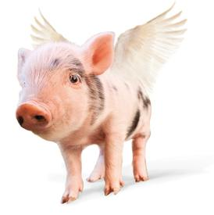
Can Pigs Fly
& Other Zoonotic Questions
Dr Kelly H. Giesbrecht, DVM, MPH
State Public Health Veterinarian
Laurel Culp
University of Kentucky

Slide 2
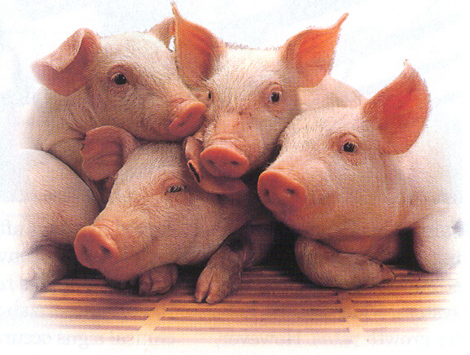
Agenda
Handwashing
Background
Zoonoses
Disease Transmission
  Aeroslization Demo
  Mucus Swap Demo
Disease Prevention
  So You’re Going to the Fair
Post Test
Review
Notes:
Use Glo Germ for Handwashing activity
Don’t alert attendees to glo germ on hands

Slide 3
So….Can pigs fly?
?

Slide 4
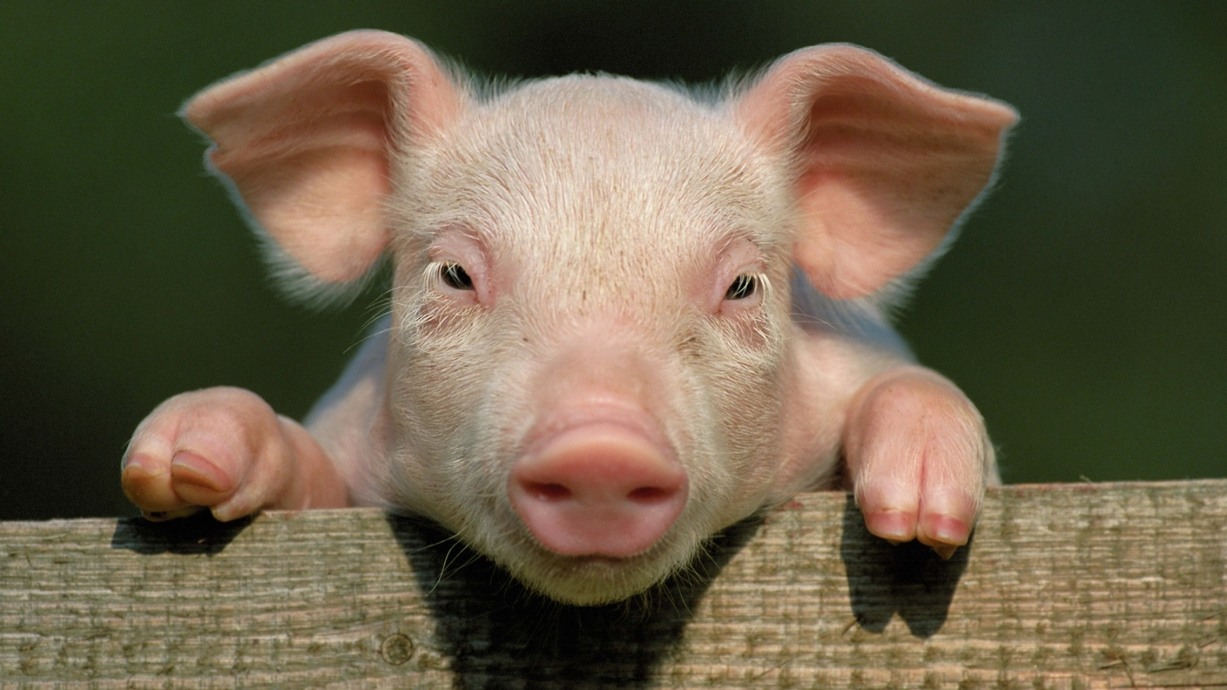
No, but they can get Swine Flu!
That is what we are here to discuss today

Slide 5
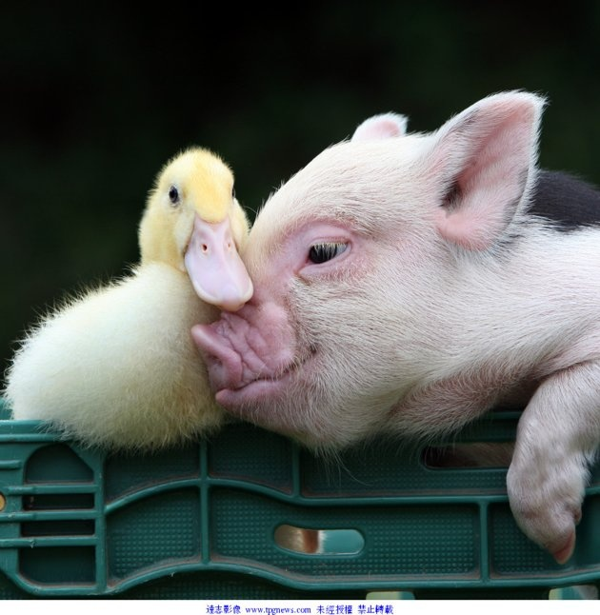
Background
Influenza: A virus that causes respiratory illness in humans, animals , pigs, dogs, poultry, horses and other mammals
Swine flu viruses can change over time and they can also be infected with other flu viruses such as avian and human causing a re-assortment of the virus
Scientists believe pandemic flu’s will come from swine this way & the 1918 pandemic flu started with pigs (Kansas) (CDC)

Slide 6
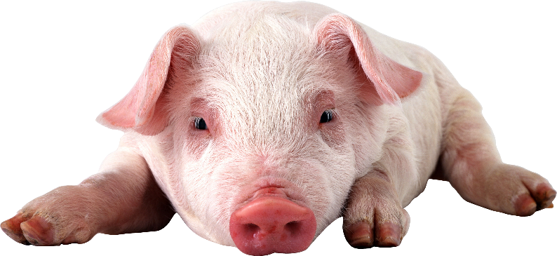
Swine Flu
Symptoms: Fever, depression, coughing, discharge from the eyes, nose, poor eating
  (Similar to people!)
Not all pigs show illness
H1N1 & H3N2 are common in swine
Is a vaccine available for pigs (Like people?)

Slide 7
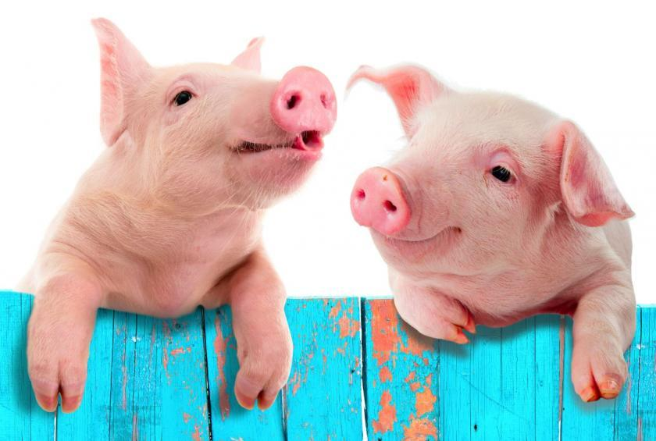
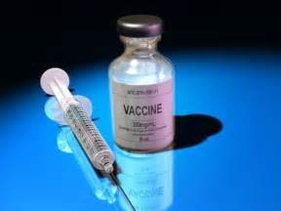
Yes! You can vaccinate pigs against Swine Flu!
Good news Wilbur…
We can get vaccinated
Against the Flu Virus!
You need a shot every year!

Slide 8

Why Do We Care?
People, especially kids, have gotten ill at Fairs (and other places where animals are…)
2016: 18 Human outbreaks associated with people from influenza-infected swine at 7 agricultural fairs in Ohio & Michigan
2017: Maryland (20) & Ohio (11)
Those are known cases
Many benefits to have pigs at fairs
Notes:
Benefits include: education, bonding, responsibility

Slide 9
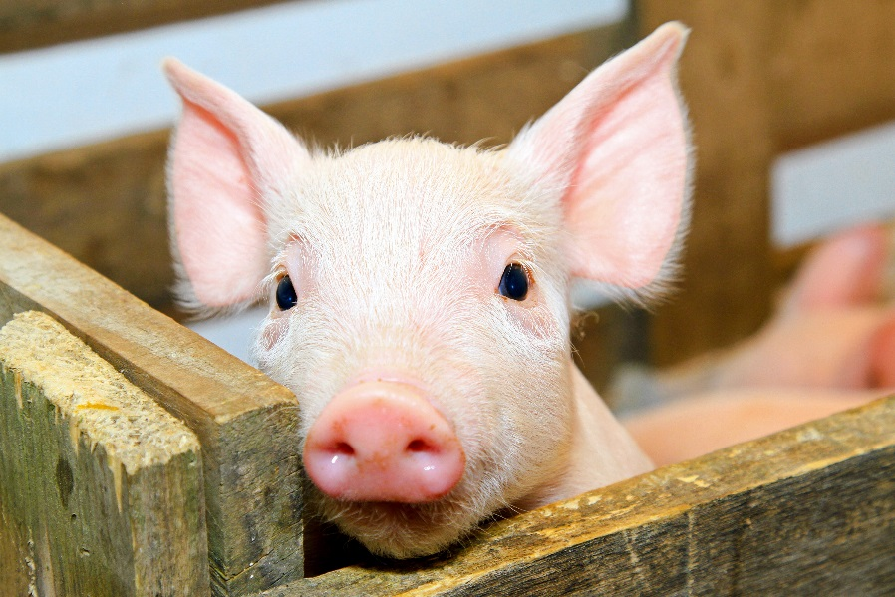
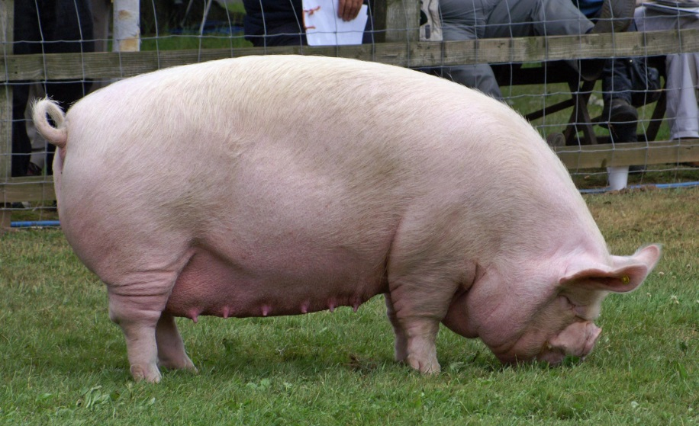
Benefits of Pigs at Fairs
Responsibilities to kids
Animal human bonds
Introduce swine to others
Teach about swine
Animal husbandry

Slide 10
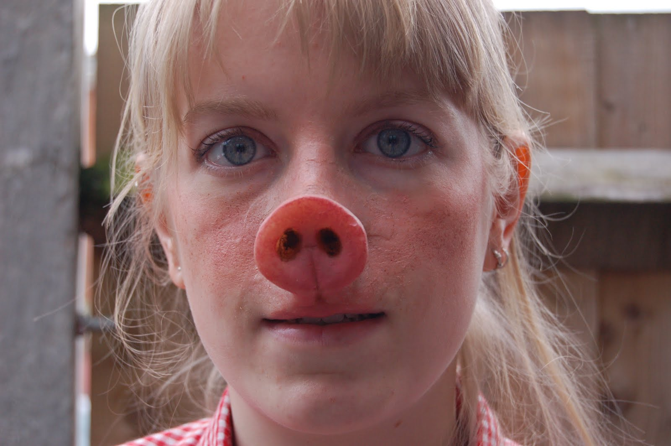
Zoonoses
Zoonosis:
It’s not an actual
Animal nose!
Diseases that are transmissible from animals to people
Examples: Swine Flu, Enteric Diseases (Salmonella, Campylobacter), Rabies,
Toxoplasmosis, Brucellosis, Parasites

Slide 11
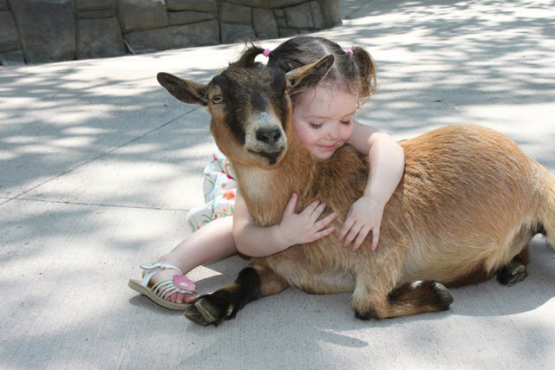
Zoonosis
Kids are disproportionately affected by zoonotic diseases
  Immature immunity
  More likely to touch animals & surroundings
  Less likely to have good handwashing
  More likely to put hands, objects in mouths
Includes Petting zoo’s, fairs & farms

Slide 12
Disease Transmission
Animals do not always appear ill
Germs enter the body: mouth, breathing, open sores
Touch animals or surroundings:
  Touch your mouth, rub your eyes
  Eat Food
  Use a pacifier
  Thumb sucking
Breath in aerosolized germs: sneezing, coughing

Slide 13
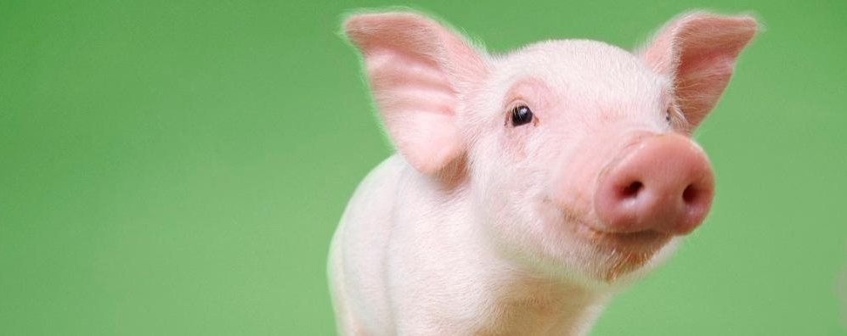
Disease Transmission Games
1. Mucus Swap
2. Aerosolization
Notes:
Demonstrate transmission of mucus swap and aerosolization

Slide 14
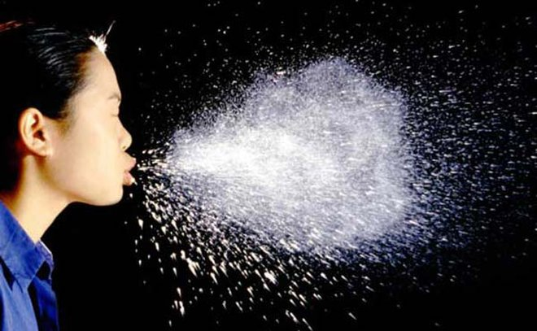
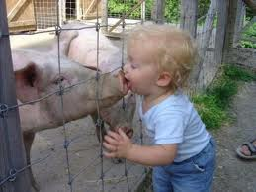
Swine Flu Spread
Snout to Snout
Snout to Nose
Aerosolize
A sneeze can travel over 6 feet!!!

Slide 15
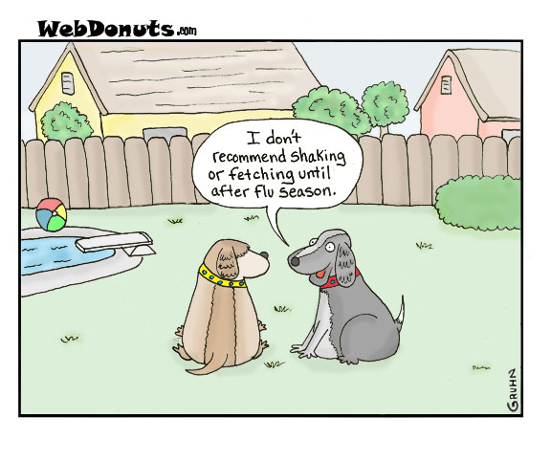
Disease Prevention

Slide 16
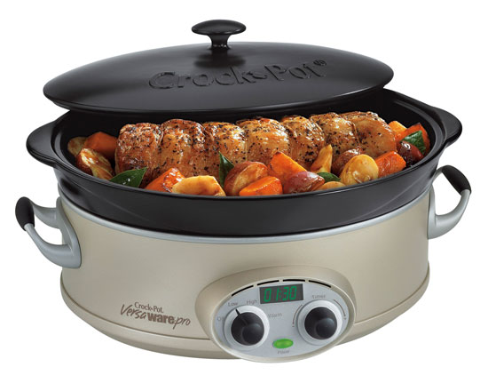
Prevention
No Eating in animals areas
Wash hands after petting or being around animals
Wash hands before you eat or drink
No strollers in animal areas
Supervise young children
Clean equipment
Do not sleep in animal areas

Slide 17
Fomites
Germs & Disease
Germs along with their diseases can pass from animal to equipment
Equipment to other animals
Equipment to people
Equipment, Barn
Animals
People
Notes:
Equipment includes brushes, halters, etc

Slide 18
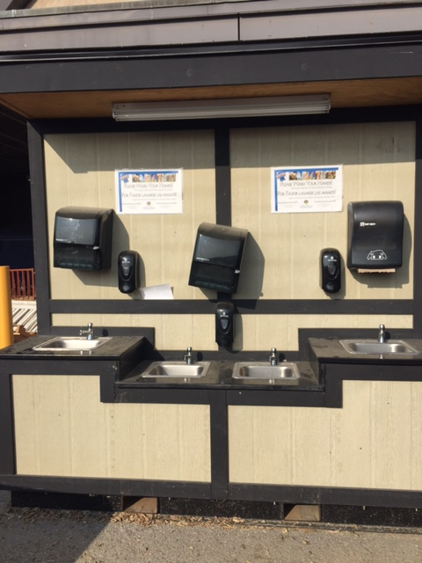
Hand Washing
One of the single most
Important things you
Can do & teach to prevent
illness

Slide 19
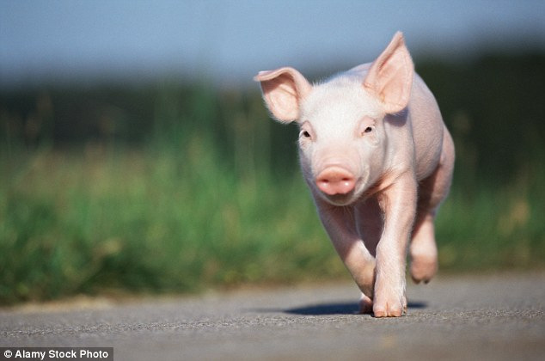
So You’re Going to the Fair…
Take only healthy animals to the fair
  Fever, normal behavior, normal stools
Report any illness during the fair
Clean & disinfect equipment:
  Home & after the fair
  Do not share equipment
Isolate animals after the fair: 7 days, watch for signs of illness (Quarantine)

Slide 20
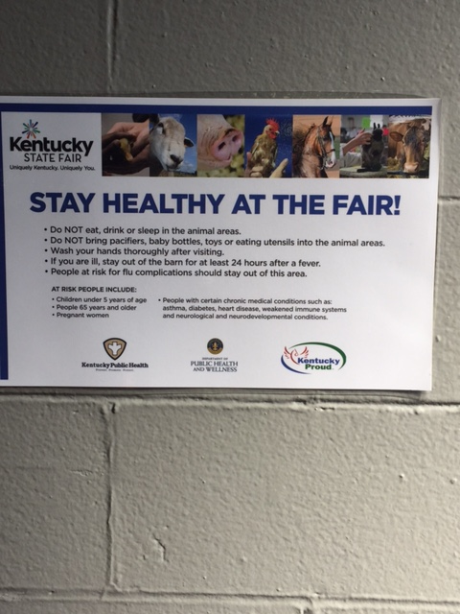
Teach your 4-H students how to stay healthy at the
Fair!
Have fun & enjoy your animals without getting ill!

Slide 21
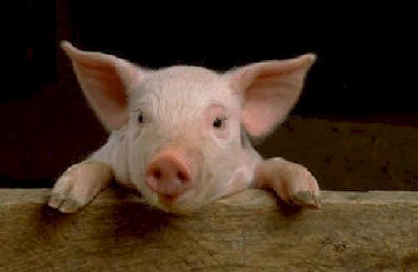
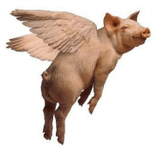
Questions?
Kelly Giesbrecht, DVM, MPH
kelly.giesbrecht@ky.gov
502-564-3418 ext 4313

