Slide 1
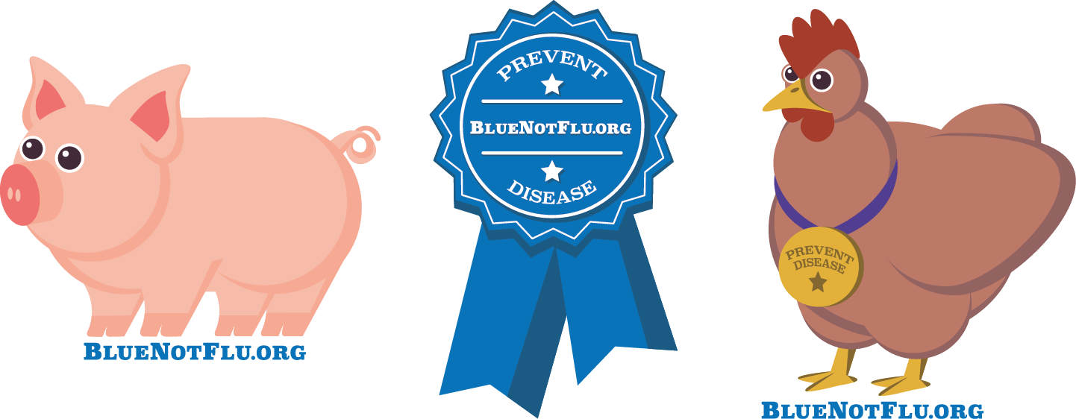
Excellence in Exhibition: Preventing Disease in Animals and People
Bring Home the Blue, Not the Flu!
Molly Lee, DVM, MPH
American Association of Extension Veterinarians
October 14, 2017
Notes:
Good afternoon, thank you all for being here! Today I’m going to give you a brief introduction to an online course we’ve developed at the Center for Food Security and Public Health at ISU, in conjunction with the Iowa Department of Public Health. The course is called Excellence in Exhibition: Preventing Disease in Animals and People, and is all about bringing home the blue, not the flu.
As I’m talking, I’m going to circulate around a handout and a letter to educators– please take a copy of each, this course is free and available to anyone so I encourage you to use it and spread the word. I also have a fun “favor” up here, stickers with the course website, bluenotflu.org, that we’re using to promote the course and which I’d love for you to take home and stick somewhere where you’ll get asked about it. We have pigs, chickens, and blue ribbons.

Slide 2
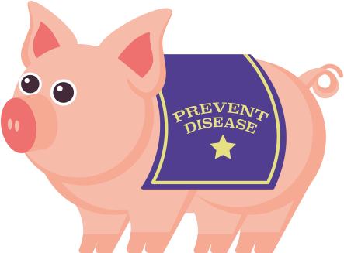
Background
H3N2v outbreaks at fairs
Influenza prevention education among youth with swine and poultry exposure at agricultural fairs
CSTE/CDC pilot project
Other zoonotic diseases
Partnership
  Human health
  Animal health
  State and county youth
  agriculture organizations
Notes:
So for a little background on why this course was developed, action was needed based on the H3N2v outbreaks that have occurred in recent years at fairs. Because these outbreaks “…occurred primarily in children with close contact with swine and poultry at agricultural fairs, many of whom were exhibitors participating in 4-H”, the CDC and Council for State and Territorial Epidemiologists funded a pilot project to develop influenza prevention education, as well as awareness and education about other zoonotic diseases, among these youth. The project was also intended to foster collaboration and partnership between animal health, human health, and state and county youth agriculture organizations.

Slide 3
Meeting a Need
Importance of agriculture
  In Iowa, 90,000 4-H; 23,000 FFA
Gaps
  Biosecurity for commercial, large-scale production vs. youth agriculture projects
  Education linking biosecurity, animal health,
  zoonotic disease
Web-based education offers engaging, available, accessible results
Free
Notes:
As in many of our states, agriculture is a key part of life in Iowa. In our state, we have approximately 90,000 youth involved in 4-H, and about 23,000 youth in FFA. In looking at where our gaps were for disease control and prevention, biosecurity was being addressed much more in our commercial, large-scale production facilities, but not so much on a smaller scale, particularly for youth agriculture projects. In addition, education linking biosecurity, animal health, and zoonotic disease was lacking. In our target audience, which was teens aged 13-18 years who are involved in animal agriculture, web-based education has been shown to offer engaging, available, and accessible results. Through the CDC/CSTE grant that was awarded to the Iowa Department of Public Health, who contracted us to work on the course, we were able to offer the online course free of charge, further increasing its potential reach.

Slide 4
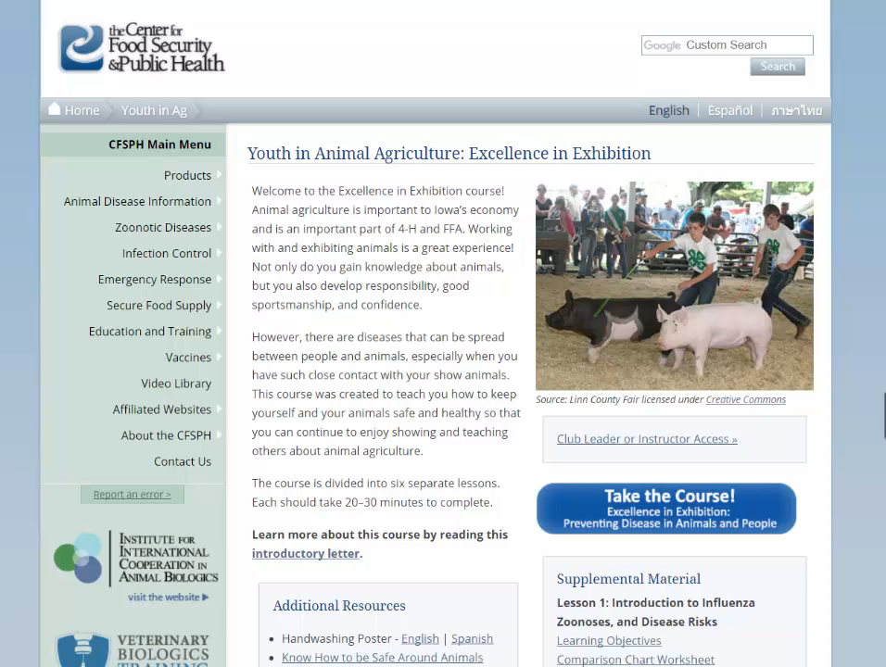
www.bluenotflu.org
Notes:
The course is designed to encourage youth involvement with livestock and animal exhibitions in a safe and healthy manner while preventing zoonotic disease, following biosecurity recommendations, and promoting public health and animal health. One of the main reasons why this course in particular is so exciting, is because we were able to use numerous interactive elements and gamification. The course is also responsive so can be used on tablets or phones. Next I’ll take you through a tour of parts of the course to showcase some of these.

Slide 5
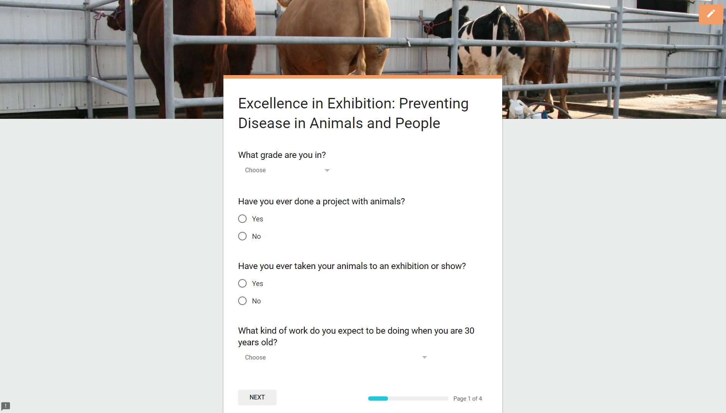
Evaluation
Notes:
Following completion of the course, we have an optional online evaluation. For ease of support of the course long-term and offering to anyone at any time, we chose not to have usernames and passwords be a part of the course. One drawback is that we’ve not had great response numbers on the survey, so we are looking to improve on that over the next year.

Slide 6
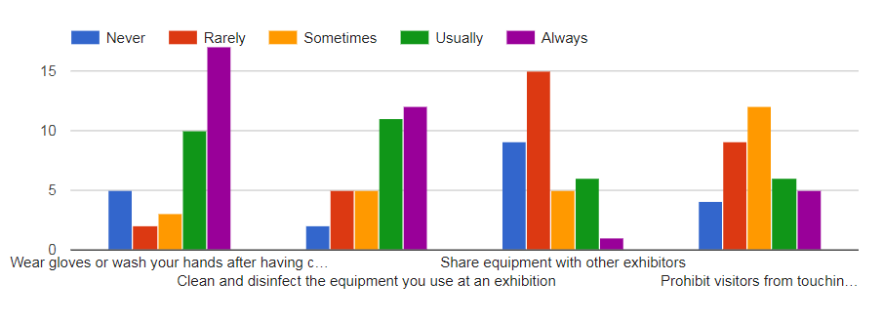
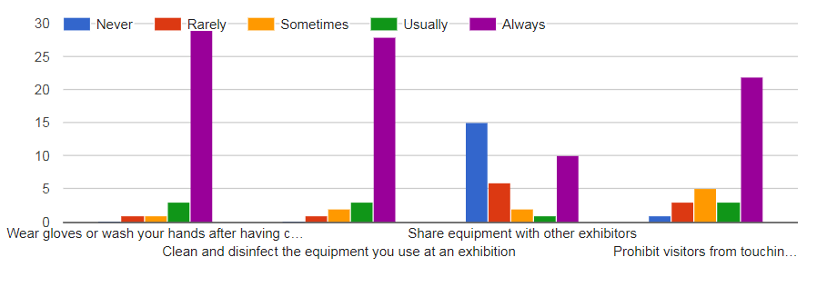
Before taking this course
How often do you…
After taking this course
Notes:
Despite not having high response numbers, the data that is in has shown the course to be effective. As you can see here, when comparing answers before taking the course with after taking the course on how often respondents…
Wear gloves or wash hands after having contact with manure or soiled bedding?
Clean and disinfect the equipment you use at an exhibition
Share equipment with other exhibitors
Prohibit visitors from touching your animals
… each measure shows improvement.

Slide 7
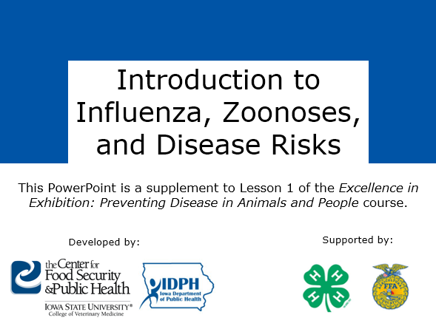
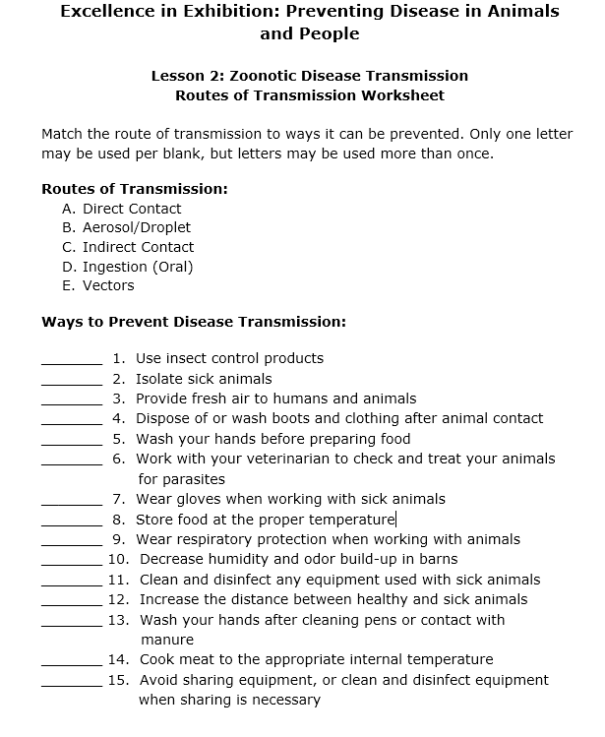
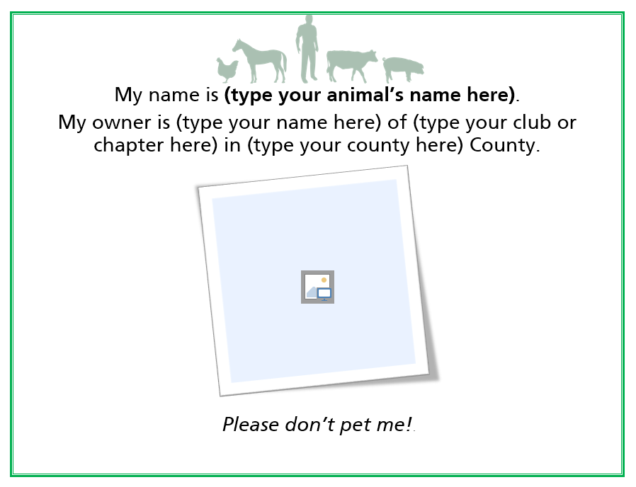
Supplemental Resources
Learning objectives
  With answers for instructors
Disease Factsheets
Lesson worksheets
  With answers for instructors
PowerPoint versions of lessons
Biosecurity and disease
prevention hands-on
activity guides
Notes:
On the website, we also have supplemental resources, including … [read]

Slide 8
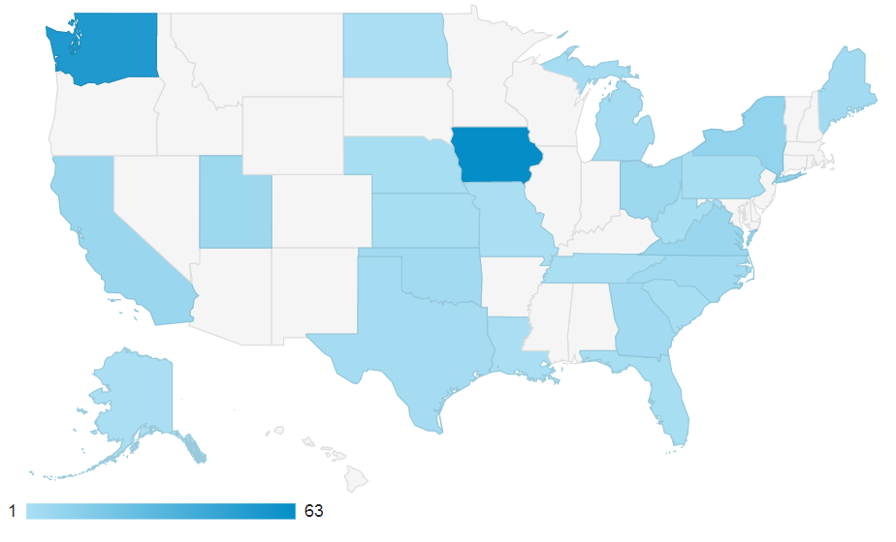
Google Analytics
(since course release)
Pageviews
  3,309
  2,783 unique
  39 logins to the
  instructors page
“Take the Course”
  198 events
Events by Region (State)
Notes:
We also track aspects of the course on Google Analytics, and seem to have had pretty good awareness of the course, from across the nation. We’re able to track visits to the website, and the numbers here show how many people have visited the bluenotflu.org website. We haven’t had as much response as we’d like from instructors looking for further information and logging into the password protected part of the website for additional resources. We’ve had about 200 people actually click the button to take the course, although we don’t have a way to track how many completed it, except for looking at the numbers of those who chose to complete the survey.
Another complication to tracking this is that at some of our outreach events where we wanted to avoid needing to access the internet, we downloaded a copy locally to the device, so these events did not contribute to web stats.

Slide 9
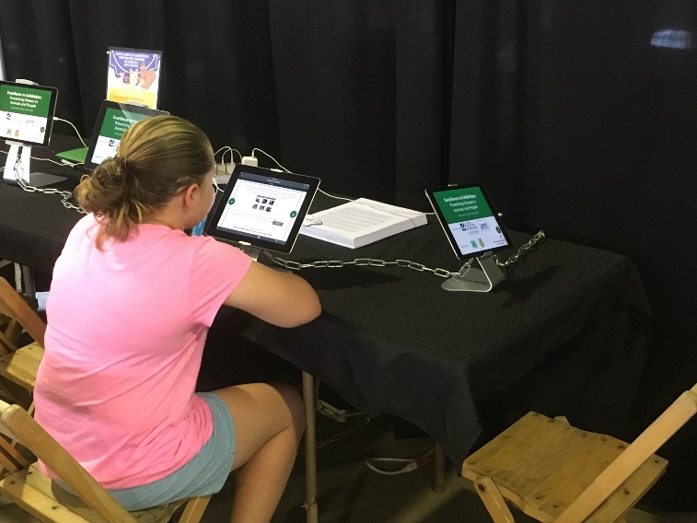
Events
Iowa FFA Convention
Iowa Agricultural Educator’s Conference
World Pork Expo
National FFA Convention
International Association of Fairs and Expositions
Annual Convention
National Association of Agricultural Educators
Annual Convention
Association of Iowa Fairs
Annual Meeting
Notes:
We’ve been lucky to have been funded for another year to continue work on this project, and one of our main goals is to increase outreach of the course. We have been or will be at the events listed here, some of which target youth and others which target ag instructors, to try to increase awareness. If any of you would like to include this in any outreach event in your state, just let us know and we can help get you resources.

Slide 10
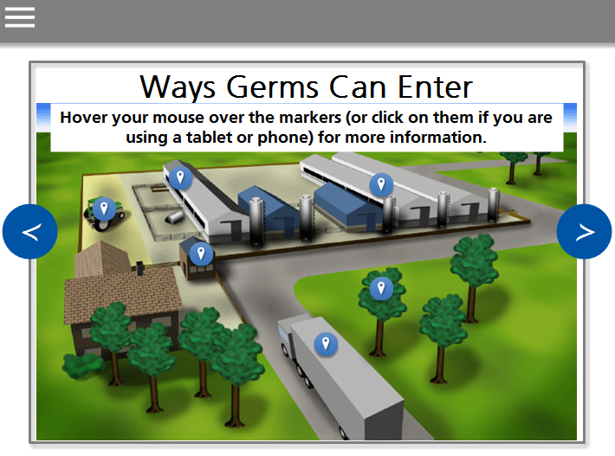
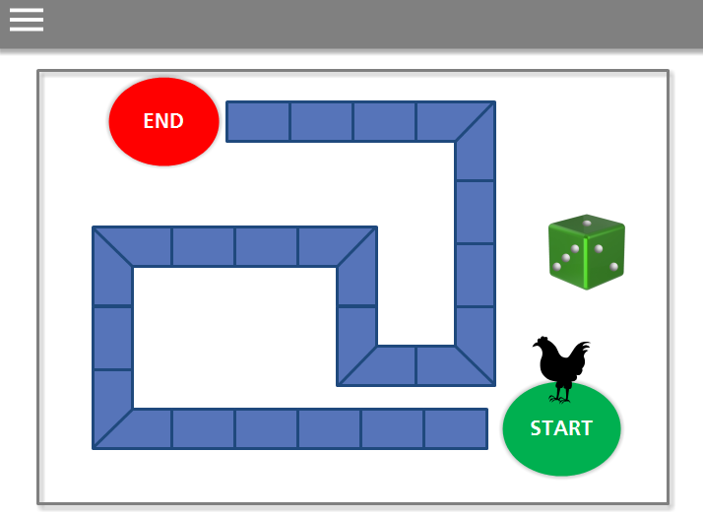
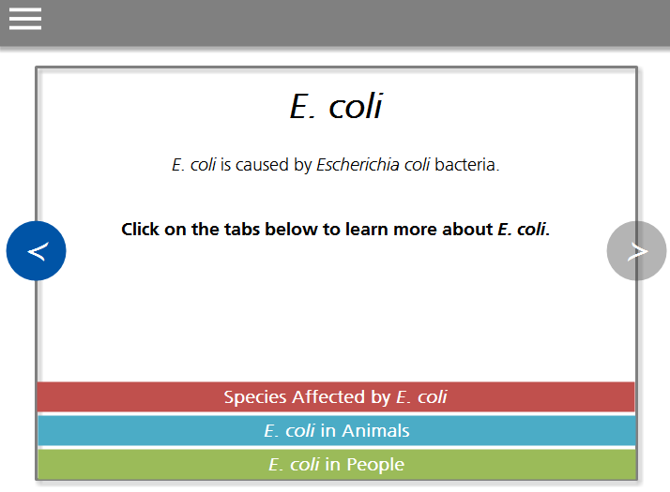
Next Steps
Ensure 508 compliance
Incorporation into National 4-H curriculum
Enhance evaluation component
New course for youth aged 7-12 years
Web-based, interactive
More gamification, less text, lower reading level, shorter lessons
Notes:
We are also working to enhance components of the existing course, to ensure section 508 compliance which has to do with accessibility for all users, regardless of disability status. We are also hoping to possibly incorporate this into the national 4-H curriculum, and to enhance the evaluation component as I’d mentioned. Additionally, we are reworking the content to create a new course for younger youth, with more gamification, less text, a lower reading level, and shorter lessons.

Slide 11
Thank you!
Authors- Center for Food Security and Public Health at Iowa State University
  Brittney Nelson, BS
  Abbey Canon, DVM, MPH, DACVPM
  Kristen Obbink, DVM, MPH, DACVPM
  Molly Lee, DVM, MPH
Iowa Department of Public Health
Support from- Iowa 4-H and FFA
Reviewed by-
Iowa Department of Agriculture and Land Stewardship, ISU Extension, National Pork Board
Notes:
I’d like to acknowledge the team that I’ve worked with on this… we hired a vet student, Brittney Nelson, who did an incredible amount of work in developing the course and learning the software that we used to develop it. Brittney, Drs. Abbey Canon, Kristen Obbink, and myself were authors; and we worked closely with the IDPH, who received the grant from CDC/CSTE, when developing the content. We also received support on the content from Iowa 4-H and FFA, and partnered with IDALS, ISU Extension, and the National Pork Board to review the course prior to release.

Slide 12
Questions?
youthinag@iastate.edu
Notes:
I appreciate you taking the time to listen today and would be happy to answer any questions.

