Slide 1
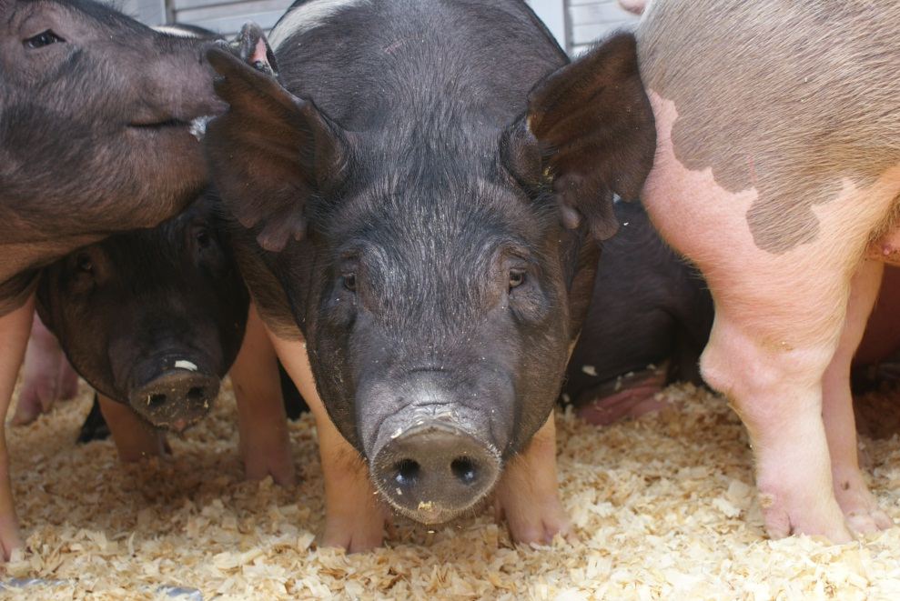

Influenza A Viruses in Exhibition Swine
Andrew Bowman, MS, DVM, PhD, DACVPM
Jacqueline Nolting, MS

Slide 2
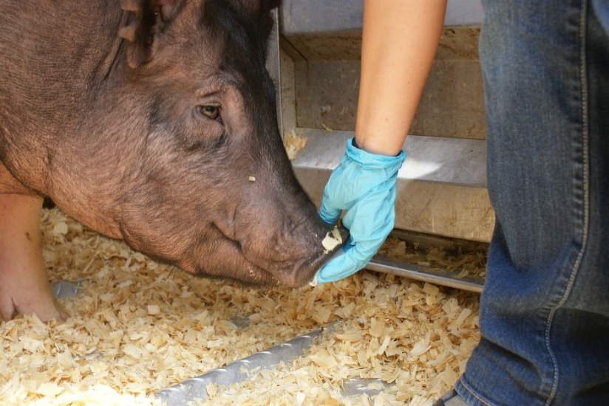
Agenda
  What is influenza?
  Why do we care about influenza A virus in pigs?
  History of IAV in swine at agricultural fairs
  Group Activity
  What to do before, during, and after the fair to keep you and your pigs healthy

Slide 3
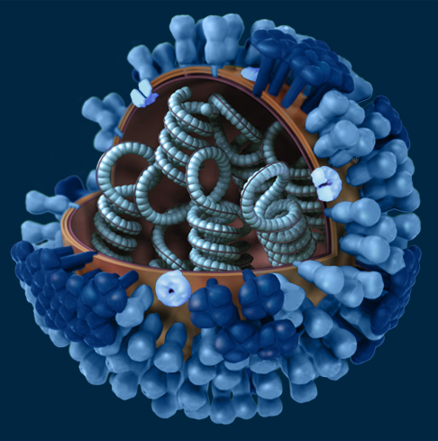
Influenza Background
Influenza A is a virus that causes respiratory illness in humans, pigs, horses, dogs, poultry, and other mammals.
IAVs have RNA (not DNA like people) that is unstable and changes often making it difficult to control disease in people and animals.
Influenza A viruses are named for the Hemagglutinin (HA) protein and Neuriminidase (NA) protein

Slide 4
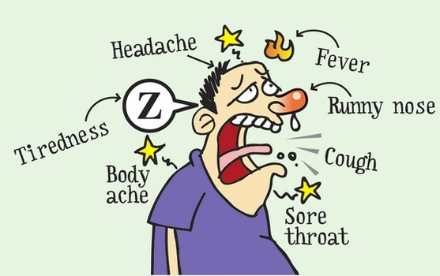
What does influenza A virus look like in People?

Slide 5
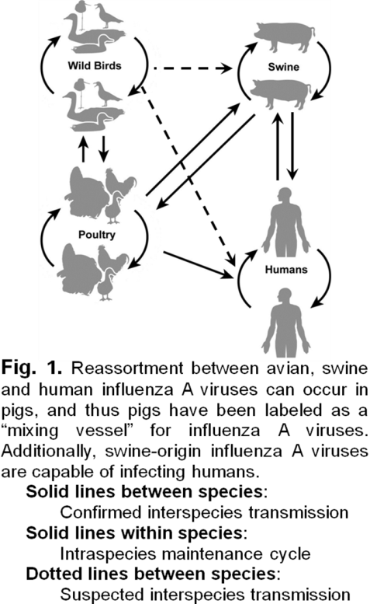
Influenza A Virus in Swine
Swine are commonly infected with IAVs
Swine influenza costs pork producers about $3.23-$10.31 per pig produced
Pigs have receptors in their respiratory tract for swine-, human-, and avian-origin influenza A viruses and thus, as depicted in the Figure, have been called ‘mixing vessels’ for influenza A viruses

Slide 6
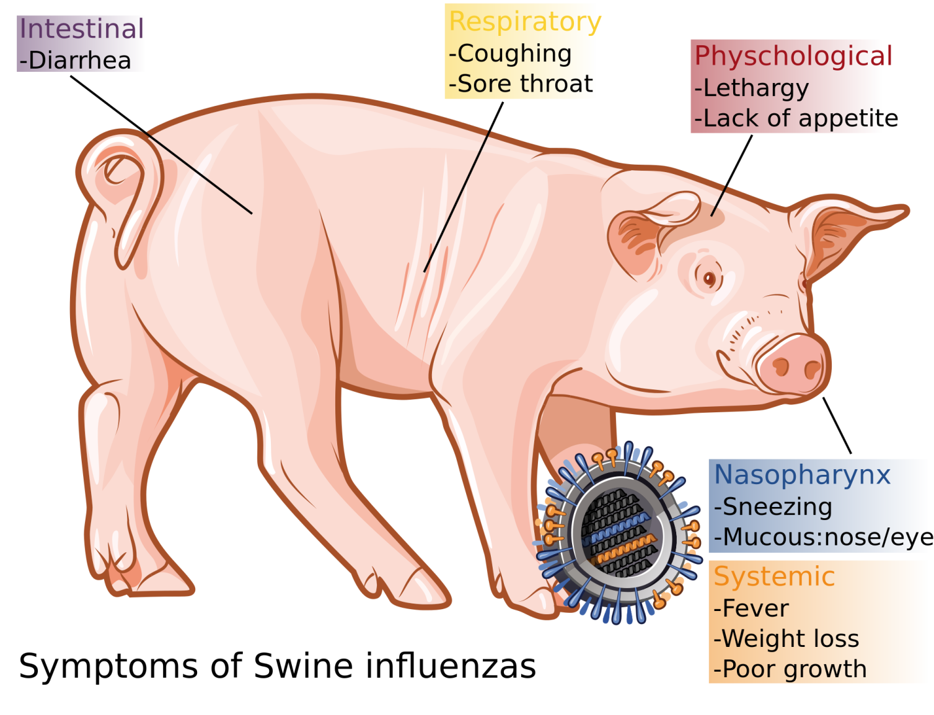
What does influenza A virus look like in Swine?

Slide 7
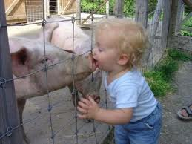
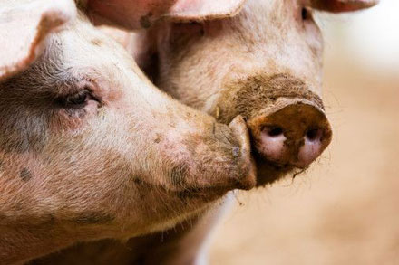
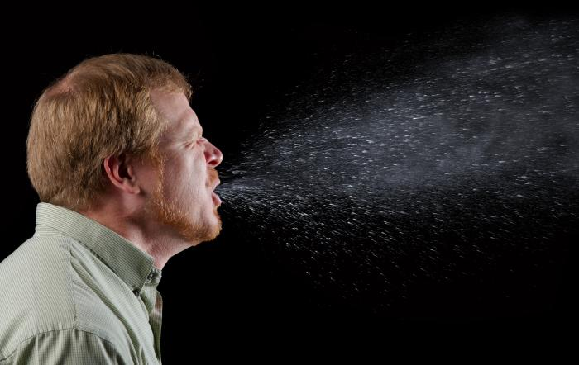
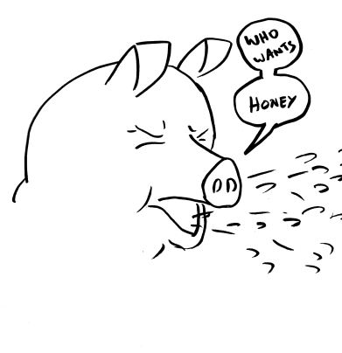
How does influenza A virus spread?
Contact transmission
Nose – Nose contact
Aerosol Transmission
Viral particles in the air (sneezing, coughing, dust)

Slide 8
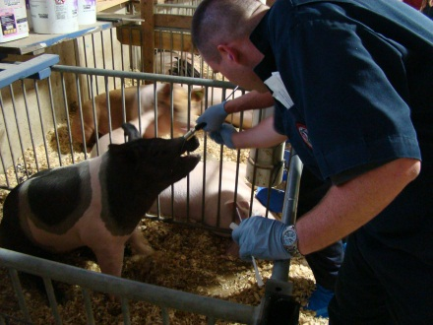
IAV at County Fairs
Since 2009, OSU AIEERP has been collecting nasal swabs from pigs at agricultural fairs in Ohio.
Approximately 25% of fairs we visit have pigs that are shedding IAVs
Most infectious pigs are NOT displaying clinical signs
If a fair has 1 positive pig, it probably has lots of positive pigs
In the United States, approximately 150 million people attend agricultural fairs each year.

Slide 9

Snout Wipe Video

Slide 10
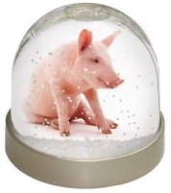
Swine – Human Interface
There was a dramatic increase in the number of documented variant influenza A cases in people during 2011-2014.
306 reported human cases of variant H3N2 influenza A (H3N2v) that occurred in 2012 linked the majority of them to human-swine exposure occurring at fairs.
Data from the H3N2v outbreaks show children have the highest risk of infection with H3N2v

Slide 11
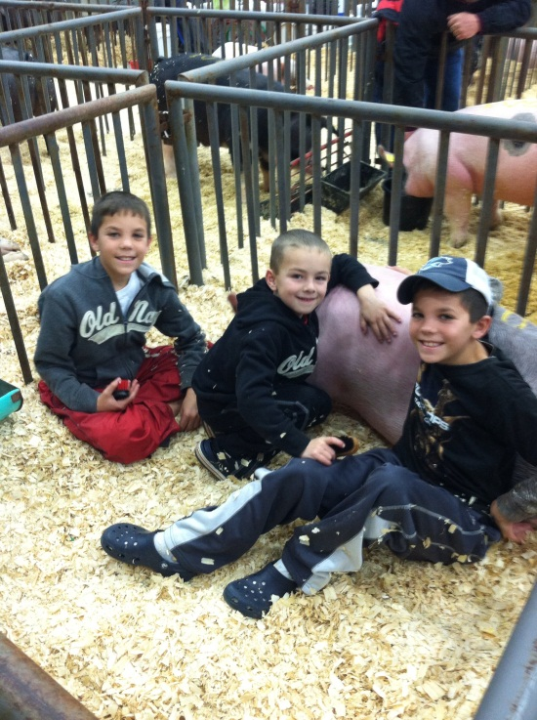
Group Activity
Divide into groups of 3 and complete the worksheet within 10 minutes.
Each group will have a chance to share their ideas at the end.
http://www.youtube.com/watch?v=0wK1127fHQ4&index=2&list=PLL3dzS7hzbKoKslaQTBVDsA5bb7j8pEke

Slide 12

What is Bio-Security?
The protection of agricultural animals from any type of infectious agent -- viral, bacterial, fungal, or parasitic.
Started when you brought your pig home and is a continuous process for your entire pig project.
What types of things can you do to protect your pigs health?

Slide 13
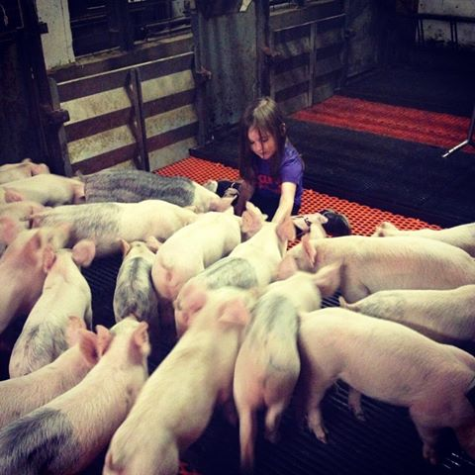
Things to consider before the fair…
Develop and implement applicable biosecurity and swine health practices at home.
  Cleaning and disinfection of facilities, feeders, chore boots
  Limiting pigs exposure to people and traffic
  Control exposure to wildlife, birds, and other pests
Evaluate your pig’s health daily
  Is your pig eating normally?
  Is your pig coughing or having trouble breathing
  Does your pig have a fever?
  Does it appear depressed?
  Does your pig have loose stool?
Seek veterinary assistance if a pig becomes sick.
Taken from “Measures to Minimize Influenza Transmission at Swine Exhibitions, 2014” National Assembly State Animal Health Officials (NASAHO) National Association of State Public Health Veterinarians (NASPHV) and “A Champions Guide to Youth Swine Exhibition: Biosecurity & Your Pig Project” National Pork Board

Slide 14
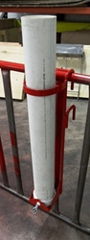
Things to consider before the fair…
Take only clean and disinfected equipment to the show
Don’t show a pig or pen-mates for at least seven days after returning from an exhibition
Discuss the use of swine influenza vaccines with a veterinarian and check the exhibition rules for any requirements. Swine vaccinated for influenza may be less likely to become ill, and if they become sick, they may be contagious for a shorter time.
Never bring an unhealthy animal to exhibition. Sick pigs and sick people need to stay home so they do not risk infecting other pigs or people.
Taken from “Measures to Minimize Influenza Transmission at Swine Exhibitions, 2014” National Assembly State Animal Health Officials (NASAHO) National Association of State Public Health Veterinarians (NASPHV) and “A Champions Guide to Youth Swine Exhibition: Biosecurity & Your Pig Project” National Pork Board

Slide 15

Things to consider during the fair…
Evaluate your pig’s health daily
  Is your pig eating normally?
  Is your pig coughing or having trouble breathing
  Does your pig have a fever?
  Does it appear depressed?
  Does your pig have loose stool?
Report any influenza-like illness to the designated exhibition veterinarian or the appropriate exhibition staff so the pig can be evaluated.
If you feel ill, see your doctor and tell them you have had pig exposure. People with influenza-like illness should stay away from pigs until they are fever-free for at least 24 hours without the use of fever-reducing medication
Taken from “Measures to Minimize Influenza Transmission at Swine Exhibitions, 2014” National Assembly State Animal Health Officials (NASAHO) National Association of State Public Health Veterinarians (NASPHV) and “A Champions Guide to Youth Swine Exhibition: Biosecurity & Your Pig Project” National Pork Board

Slide 16
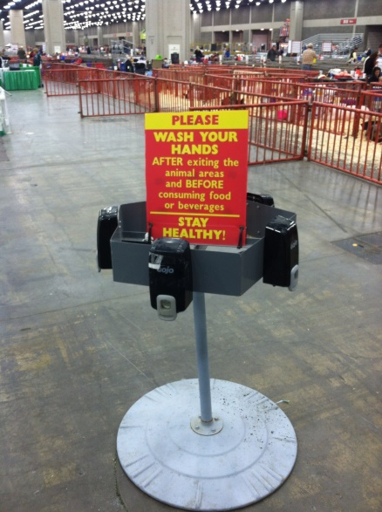
Things to consider during the fair…
Do not borrow or share equipment with other exhibitors
Keep your area and equipment clean
Use precautions when caring for sick pigs to minimize the opportunity for disease transmission to other swine or people.
Wash your hands after contact with pigs and equipment
No eating or drinking in the animal areas
Do not sleep in animal areas
Taken from “Measures to Minimize Influenza Transmission at Swine Exhibitions, 2014” National Assembly State Animal Health Officials (NASAHO) National Association of State Public Health Veterinarians (NASPHV) and “A Champions Guide to Youth Swine Exhibition: Biosecurity & Your Pig Project” National Pork Board

Slide 17
Things to consider after the fair…
Consult a health care provider and public health official as soon as possible if exhibitors or family members develop influenza-like illness
  Inform the health care provider of close contact with swine and/or exhibition attendance.
  Ill people should avoid all contact with swine until they are fever-free for at least 24 hours without the use of fever-reducing medications
Isolate and observe animals daily for illness after returning home and before allowing contact with other animals
  The isolation/observation period for clinical signs of influenza should be no fewer than 7 days.
  Clean and disinfect equipment, clothing, shoes, and vehicles/trailers that were at the exhibition.
  Consult a veterinarian if pigs become ill.
Taken from “Measures to Minimize Influenza Transmission at Swine Exhibitions, 2014” National Assembly State Animal Health Officials (NASAHO) National Association of State Public Health Veterinarians (NASPHV) and “A Champions Guide to Youth Swine Exhibition: Biosecurity & Your Pig Project” National Pork Board

Slide 18
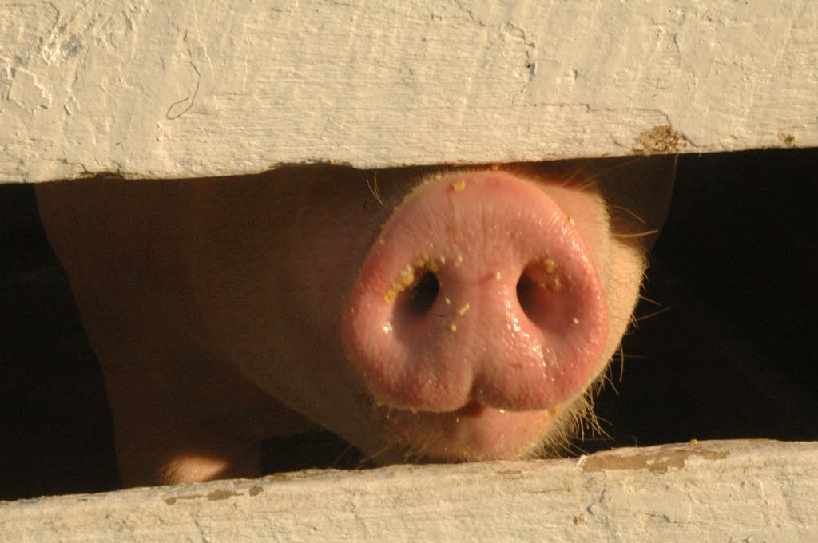
Questions???
Laboratory Phone: 614-292-6616 Email: nolting.4@osu.edu
Web address: http://vet.osu.edu/preventive-medicine/AIEERP

