Slide 1
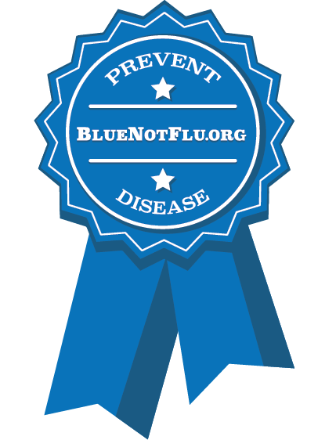

Excellence in Exhibition: Preventing Disease in Animals and People
Bring Home the Blue, Not the Flu!
Abbey Canon, DVM, MPH, DACVPM
youthinag@iastate.edu

Slide 2
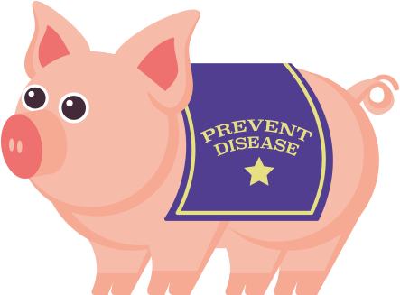
Background
H3N2v influenza outbreaks at fairs
Influenza prevention education among youth with swine and poultry exposure at agricultural fairs
CSTE/CDC pilot project
Other zoonotic diseases
Partnership
  Human health
  Animal health
  State and county youth
  agriculture organizations
Notes:
H3N2 is a strain of influenza A that commonly circulates in swine and can infect humans. These viruses are called variant viruses when they infect people and the letter “v” is attached to the influenza strain name (e.g., H3N2v). Because these H3N2v outbreaks “…occurred primarily in children with close contact with swine at agricultural fairs, many of whom were exhibitors”, the CDC and Council for State and Territorial Epidemiologists funded a pilot project to develop influenza prevention education, as well as awareness and education about other zoonotic diseases, among these youth. The project was also intended to foster collaboration and partnership between animal health, human health, and state and county youth agriculture organizations.

Slide 3
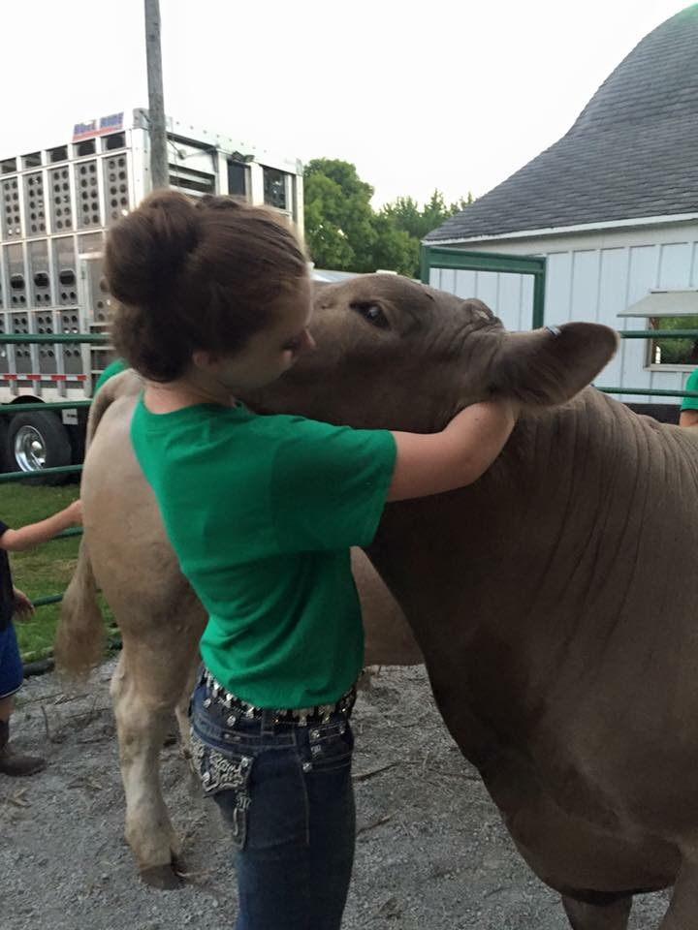
Meeting A Need
Youth ag programs are key
element in future of animal
husbandry and food production
Gaps in knowledge
  Disease transmission risks for
  youth animal agriculture projects
  Biosecurity for youth projects
  Education linking biosecurity,
  animal health, zoonotic disease
Notes:
Youth ag programs are a key element in future of animal husbandry and food production. Animal agriculture projects teach youth responsibility and sportsmanship, build confidence, and offer an opportunity for youth to educate the public about agriculture.
Youth animal agriculture projects are generally reared on a smaller scale and involve closer contact with animals. As a result, disease transmission risks exist. In looking at where our gaps were for disease control and prevention, biosecurity was being addressed much more in our commercial, large-scale production facilities, but not so much on a smaller scale, particularly for youth agriculture projects.
While programs addressing food safety are currently available for youth in agriculture, programs addressing biosecurity, animal health, and zoonotic disease risks are limited. Education linking biosecurity, animal health, and zoonotic disease was lacking.

Slide 4
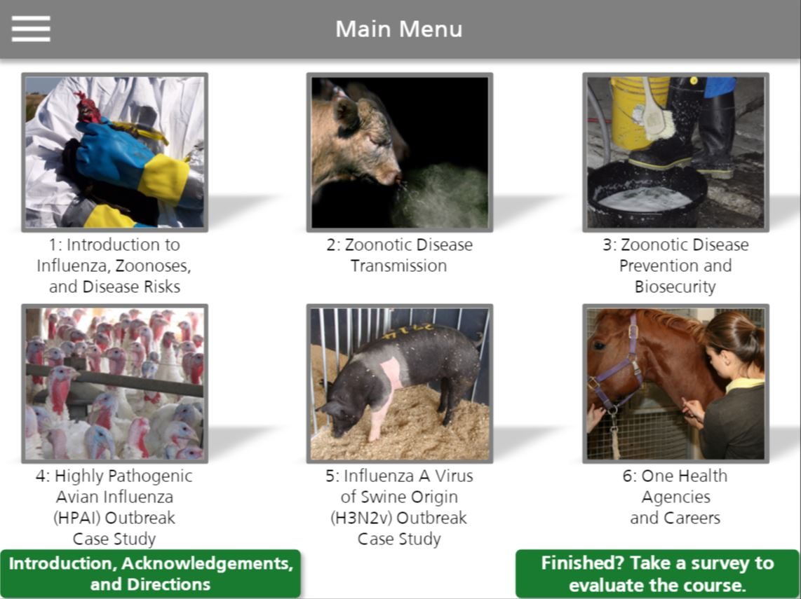
www.BlueNotFlu.org
Notes:
From those considerations, we developed an online course that is free, accessible, responsive (on tablets and phones), and available to anyone with an internet connection.
The course, which includes 6 lessons designed to be completed in 20–30 minutes each, may be taken independently by anyone at any time, but is targeted at youth aged 13–18 years. The first 3 lessons cover specific zoonotic diseases, such as influenza, and ways to prevent transmission to humans and animals. The remaining lessons review case studies, agencies, and career opportunities in One Health.
A new course for elementary aged youth will be available later this fall.

Slide 5
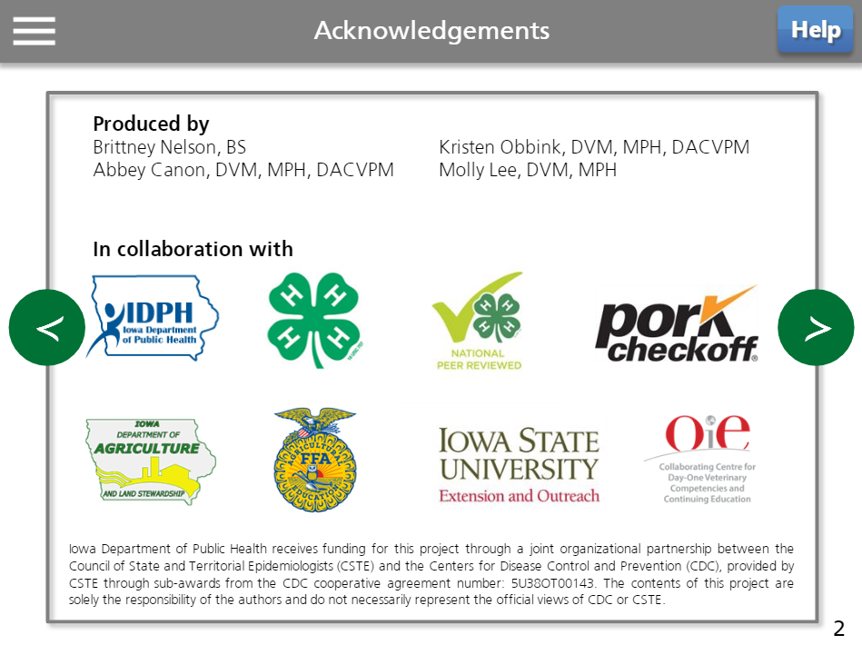
Showing Animals Is A Good Thing!
Notes:
The course was developed with many partners to ensure positive messaging. It has received National 4-H Peer Review status.

Slide 6
Showing Animals Is A Good Thing!
Encourage youth involvement with livestock and exhibitions in a safe and healthy manner
Prevent zoonotic disease
Follow biosecurity recommendations
Promote public and animal health
Notes:
The course is designed to encourage youth involvement with livestock and animal exhibitions in a safe and healthy manner while preventing zoonotic disease, following biosecurity recommendations, and promoting public health and animal health.

Slide 7
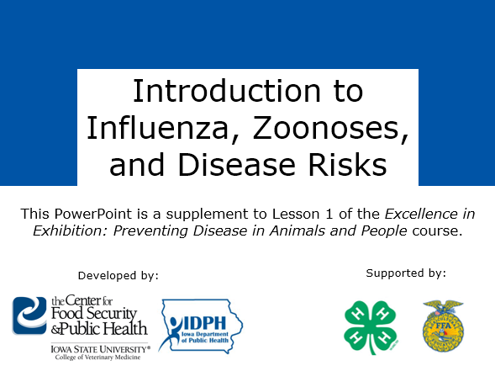
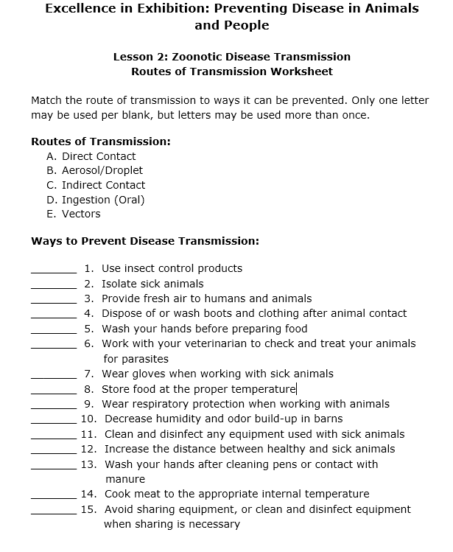
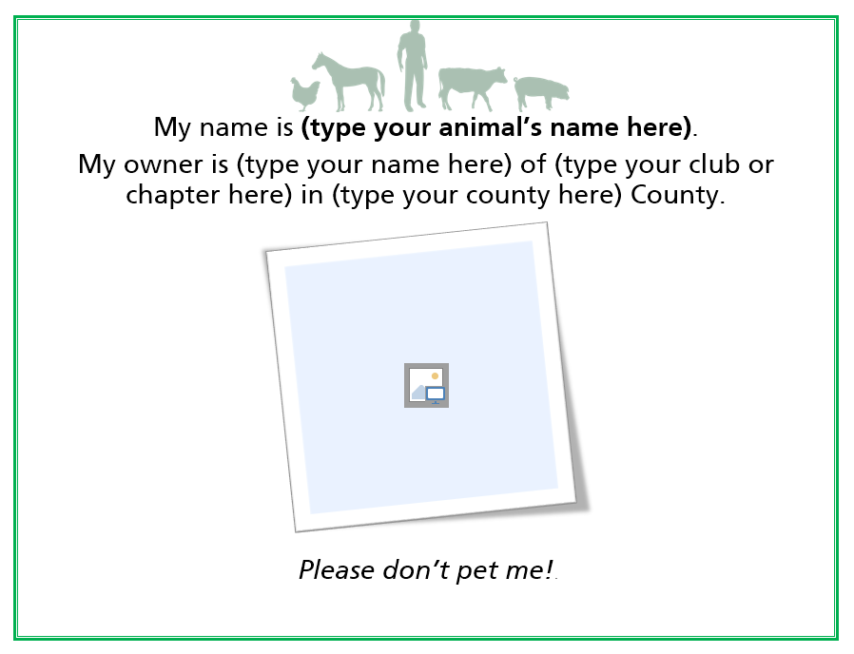
Supplemental Resources
Learning objectives
  With answers for instructors
PowerPoint versions
Disease factsheets
Lesson worksheets
  With answers for instructors
Biosecurity and disease
prevention hands-on
activity guides
Biosecurity signage
Notes:
On the website, we also have supplemental resources, including … [read]

Slide 8

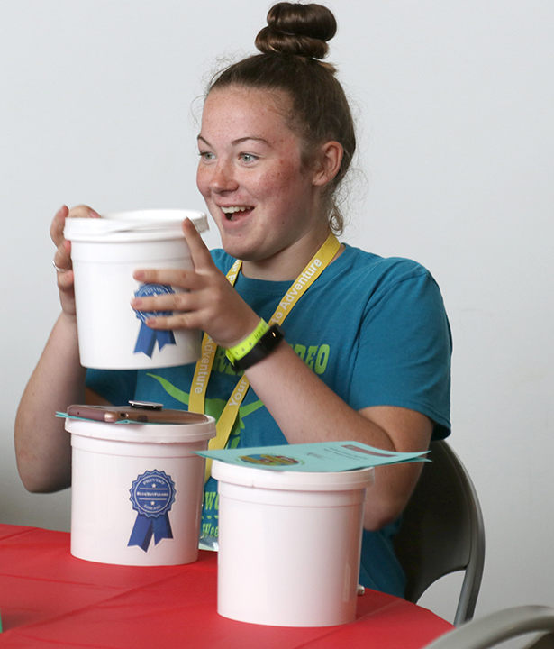
Volunteers Needed
Train-The-Trainer Opportunity
Volunteers needed
  Deliver live PPT curriculum to youth
  Deliver pre and posttest course evaluation
Volunteer incentive
  Travel reimbursement and meal
  Selected hands-on activity supplies
Youth incentive
  Biosecurity bucket
  Chance to win gift card
Contact YouthInAg@iastate.edu
by July 16
Notes:
We are offering free train-the-trainer workshops to 4-H youth specialists and volunteers interested in delivering zoonotic disease prevention and biosecurity education to middle and high school aged 4-H youth.
During these regional workshops, CFSPH veterinarians will train attendees to deliver ready-made PowerPoints, demonstrate hands-on activities, and provide additional information about zoonotic disease prevention. We then ask that you provide zoonotic disease prevention education to local middle and high school aged 4-H youth by September 30, 2018, by using the CFSPH-developed PowerPoint presentations and hands-on activities discussed at the workshop.
Volunteers will receive a travel stipend, meal during the workshop, and a chance to win selected hands-on activity supplies. Youth who attend local educational sessions offered by trained volunteers and complete a pre/post evaluation will receive a “biosecurity bucket” with goodies and a chance to win a gift card.
Volunteers interested in attending the workshops should contact youthinag@iastate.edu. We will then determine a time and location that is most convenient for all. Space is limited! Please respond with your interest by July 16.

Slide 9
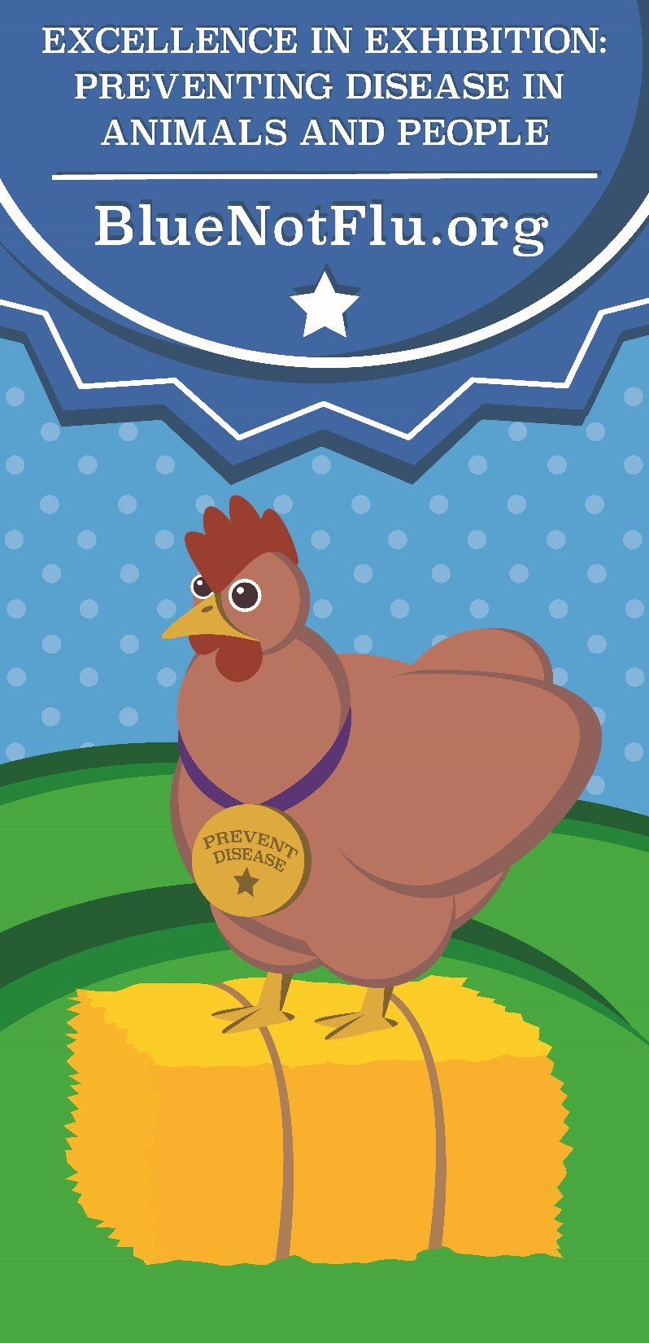
Suggestions for Use
Requirement to exhibit at fair
Education in classroom or clubs
Use in preparation for CDE, skillathon, or other contests
Competition between clubs or chapters for most
member certificates
Use as part of
awards requirements

Slide 10
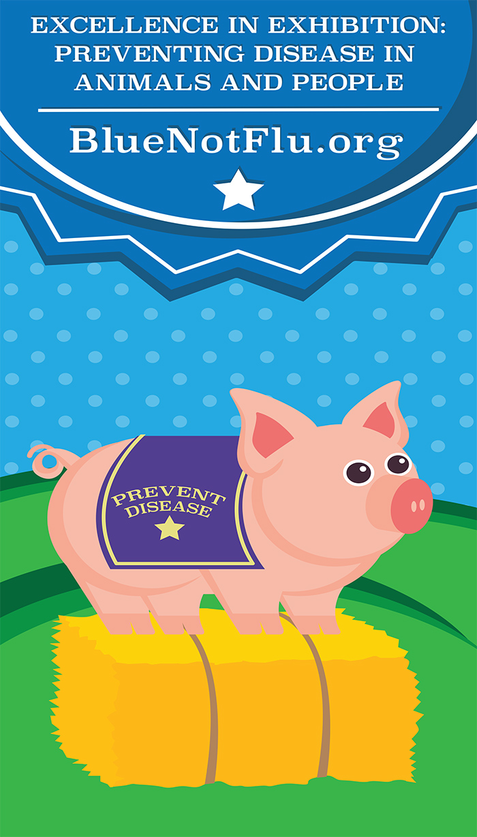
Questions?
youthinag@iastate.edu
www.BlueNotFlu.org

