Slide 1
CSTE/CDC Influenza and Zoonoses Among Youth in Agriculture Kick-Off Call
January 24, 2019
1:00 – 2:00 PM ET

Slide 2
Agenda
Welcome and Introductions/Roll Call
  CDC
  CSTE
  2019 Project Sites
Project Background and Introduction
Project Logistics
  Overview of timeline
  Reporting requirements
  Basecamp
  Resource Repository
Returning Site Presentations
  Iowa
  Maine
  Michigan
  Minnesota
  Ohio
New Site Introductions
  Indiana
  Nebraska
  Maryland
Next call: Feb 28, 2019 @ 1:00 PM ET

Slide 3
Iowa
CSTE CDC Influenza and Zoonoses Education Among Youth in Agriculture Program – 2019

Slide 4
Overview
Previous participation in FY16 and FY17 cycles
Project team
  Iowa Department of Public Health
  Center for Food Security and Public Health at Iowa State University College of Veterinary Medicine
Core partners
  Iowa 4-H, Iowa FFA
  Iowa Department of Agriculture and Land Stewardship, National 4-H, National Pork Board, ISU Extension and Outreach, Ohio… and more
  CDC, CSTE
    Evaluation component

Slide 5
Project Reach & Deliverables
Project deliverables- project years 2016-17 and 2017-18
  Developed two free, interactive, online courses (elementary and middle/high school versions) covering diseases, spread of diseases, biosecurity, case studies, and careers as well as downloadable supplemental material for students and instructors (learning objectives, lesson worksheets, activity guides, etc.)
  Promoted and increased course distribution through presentations at state and national conferences, youth workshops, and train-the-trainer events
Project deliverables- 2019 project year
  Maintain and promote existing courses and supplemental material
  Youth outreach
    Interactive workshops at state 4-H, FFA events, World Food Prize- Iowa Youth
    Biosecurity day camps to train youth “Biosecurity Ambassadors”*
  Adult training, outreach, and support
    Interactive workshops
    Videos demonstrating implementation of hands-on disease prevention activities
*If additional funding can be secured

Slide 6
Successes & Challenges
Successes
  Leveraged existing relationships for early engagement of partners
  Immediate implementation of a top-down approach for national reach
Challenges
  Participation in voluntary course evaluation following course completion
    Requirement for participation in activities
  Identification of adult volunteers to participate in in-person train-the-trainer workshops for enhanced evaluation
    Scheduling
    Data collection and analysis delays

Slide 7

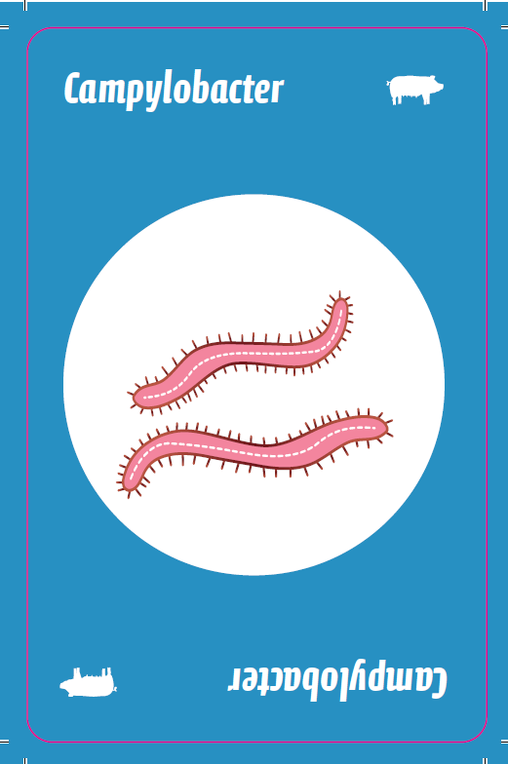
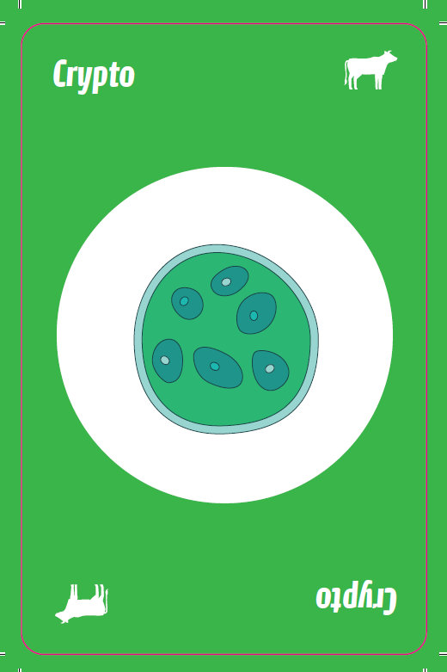
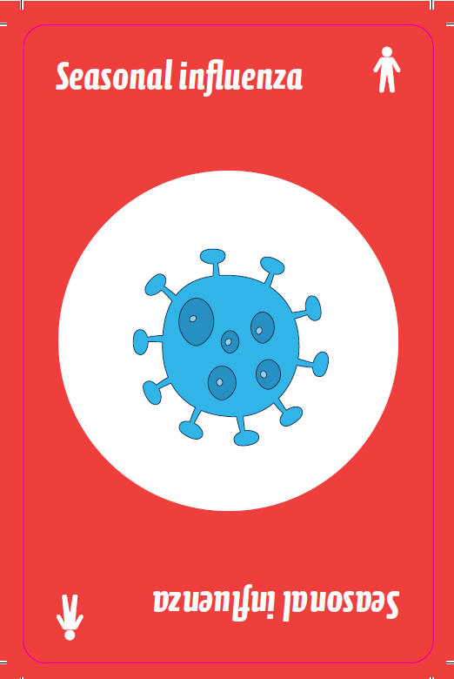
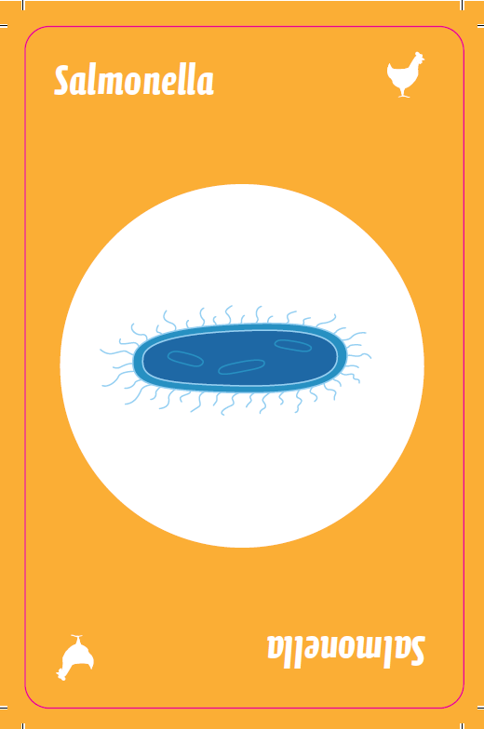
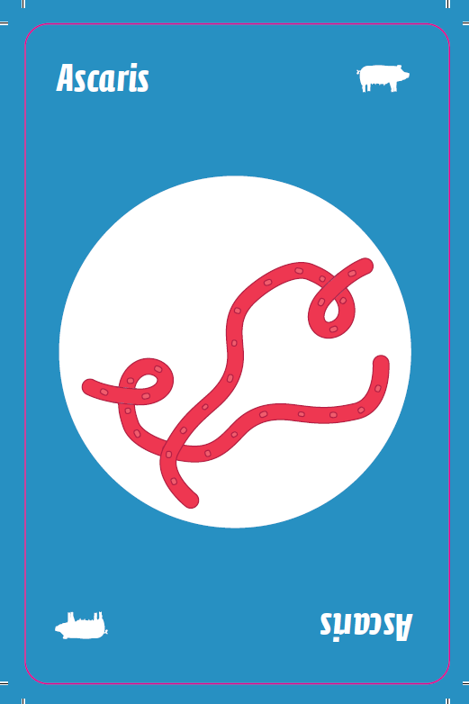
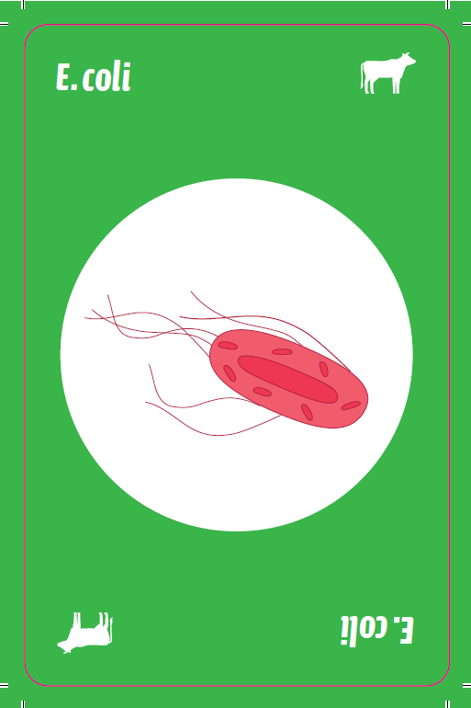
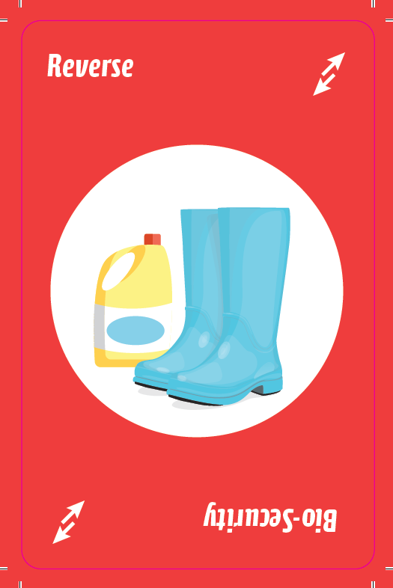
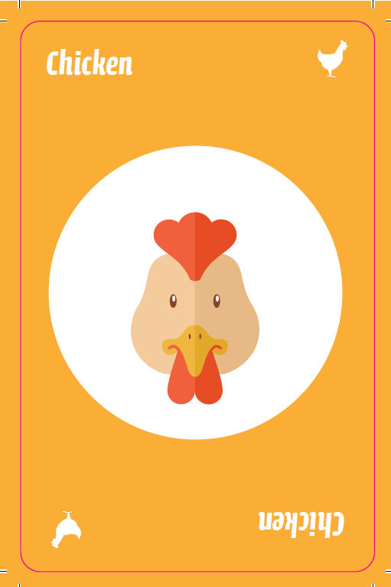


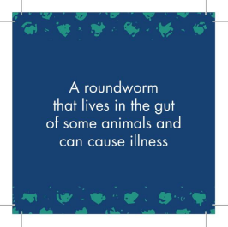
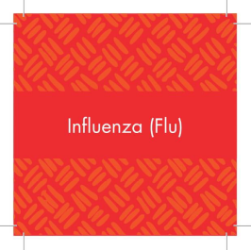
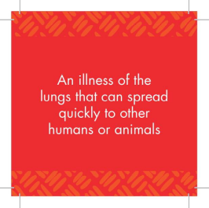

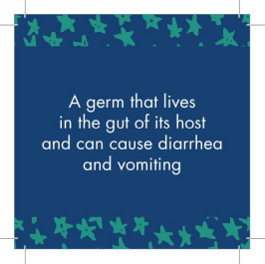

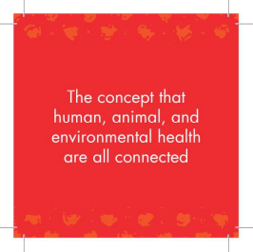
MAINE
CSTE CDC Influenza and Zoonoses Education Among Youth in Agriculture Program – 2019

Slide 8


Overview
3rd year of project participation
Project team
  Public Health (Maine CDC): Program Manager, Influenza Epidemiologist, Health Educator, Enteric Disease Coordinator, student interns
  Animal Health (Maine DACF): State Veterinarian, Assistant Veterinarians, Livestock Specialist, Youth in Agriculture & Northeast Livestock Expo (NELE) Liaison, Poultry Health Technician & 4H Liaison
Core Partners
  Current: Maine Association of Agricultural Fairs and Maine Agricultural Fairs, NELE, individual 4H groups
  New: Massachusetts and New Hampshire state and public health

Slide 9


Project Reach & Deliverables
Year 1: Develop content material and pilot
  Educational materials: pig postcard, pig poster, Germ-O
Year 2: Hold Train the Trainer event
  Educational materials: wash your hands stickers, matching game, share your love not your germs posters, handprint poster, One Health logo
2019
  Modify and create new posters
  Interstate Collaboration with New Hampshire & Hold a Train the Trainer Event
  Interstate Collaboration with Massachusetts

Slide 10


Successes & Challenges
Successes
  2018 Train the Trainer Event
    95% of attendees held their own trainings: 33 events held, total number of attendees estimated to be over 700, all 16 Maine counties represented
  Development of Educational Materials/GERM-O
    Modeled after UNO
    Color coded by species source (Pig, Cow, Chicken, Human)
    Preventative measures cards (Handwashing, Biosecurity)
    Sent across the country – recently to Iowa & North Carolina
    Featured in the Smithsonian’s infectious disease exhibit
Challenges
  Maine has a small population, but is large geographically. This makes it difficult to reach our target audience.
  Dedicated staff to this project

Slide 11
Michigan
CSTE CDC Influenza and Zoonoses Education Among Youth in Agriculture Program – 2019

Slide 12
Overview
Participation since 2014
Team includes MDHHS, MSU Extension
  Other partners: MDARD, MAFE, IAFE

Slide 13
Project Reach & Deliverables
2014-20818
Develop 4-H Animal Science Anywhere curriculum units (6 completed, 2 in process)
Design print/reprint/distribute durable “Be Healthy Around Animals” signage >2,000
Design “Biosecurity 1-2-3” posters for 4-H youth
“One Health” pull up banners for MSU Extension regional offices throughout state
Provide “Be a Disease Detective” session (6 hours of instruction) for MSUE 4-H Exploration Days for 3 years+
Print 500 copies of CDC graphic novel – “Operation: Outbreak”
2019
Hosted a Workshop session at the 2019 MAFE convention on working with your local health department
Develop regional meeting with MSUE partners to share the resources developed as a result of this funding, both in Michigan and other partners
Create MSUE webpage to host materials developed as a result of this project
Create and distribute Diseases Prevention Kits for younger 4-H participants
Develop Zoonotic Disease/Swine Influenza Educational Session using Epi lesson plan and CDC graphic novel-target high school 4-H and FFA/include KAP evaluation component
Consult with MSUE expert to develop evaluation components for educational content developed as a result of this project

Slide 14
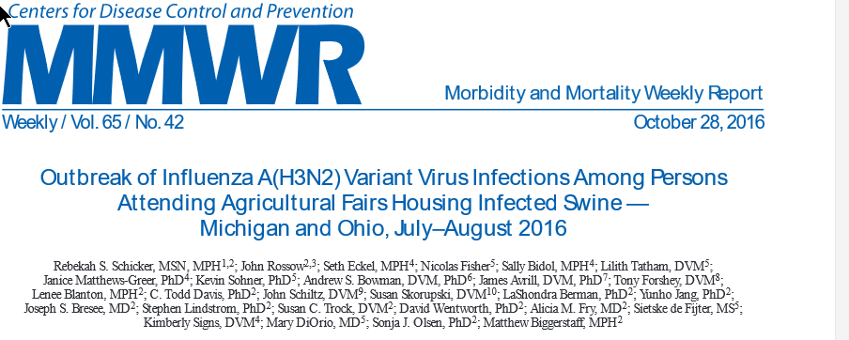
Successes & Challenges
Successes:
Fostering of collaborative relationships between MSUE staff, fair staff, and local health depts. that led to improving responses to swine influenza detection at fairs in Michigan in 2016, 2018
Scientific publications
Challenges:
Engaging local health departments – outside 9-5 business hours!
Learned we have more work to do to engage local MSUE staff

Slide 15

Minnesota
CSTE CDC Influenza and Zoonoses Education Among Youth in Agriculture Program – 2019
Notes:
Thank you and good evening

Slide 16
Overview
Third funding cycle; first funded in 2016
Partners: Minnesota Department of Health (MDH), 4-H, Minnesota Board of Animal Health (MNBAH)
Core Project Team: Carrie Klumb (MDH) & Joseph Rand (4-H)
Leveraged Upper Midwest Agricultural Safety and Health Center (UMASH) funding
Expanding partners in 2019: Wisconsin FFA and National Farm Medicine Center (Marshfield, WI)

Slide 17
Project Reach & Deliverables
Previous Deliverables:
Board game – Adventures in Agritourism: Farmstead Enterprise
Emerging Issues Breakfast – intersection of animal health and human health
Biosecurity & Food Safety videos using 4-H participants
Zoonotic Disease Prevention category for 4-H fair projects
2019 Deliverables:
Matching Game
Zoonotic Disease Intern: hands-on activities at fairs
Notes:
- Targeted clover buds (k-2nd grade) and based off of Germ-O game. So, same hygiene and disease transmission concepts but for younger kids. Will buy enough for every club in the state 1,300
- Intern’s main job duty will be attending county fairs throughout the central region of Minnesota and the 5 days of the Minnesota Livestock Delegation at the Minnesota State Fair at the end of August. The intern will be offering a hands-on learning experience to fair visitors and 4-H exhibitors related to zoonotic disease prevention, which will potentially engage thousands of fairgoers. There will be two hands-on experiences utilizing Glo Germ; one will be a “Germ City” that demonstrates how important proper handwashing is and the other will focus on proper cleaning and disinfection of exhibition surfaces
- Continue Emerging Issues Breakfast and zoonoses disease prevention category for 4-H projects

Slide 18
Successes and Challenges
Successes
Building and strengthening relationships (e.g., 4-H, Emerging Issues Breakfast, Agritourism Workshops)
Unique, student-focused products (e.g., Board game, educational videos, match game)
Challenges
Identifying a champion in 4-H
Timeline to get work accomplished

Slide 19

OH – IO and beyond
CSTE CDC Influenza and Zoonoses Education Among Youth in Agriculture Program – 2019

Slide 20
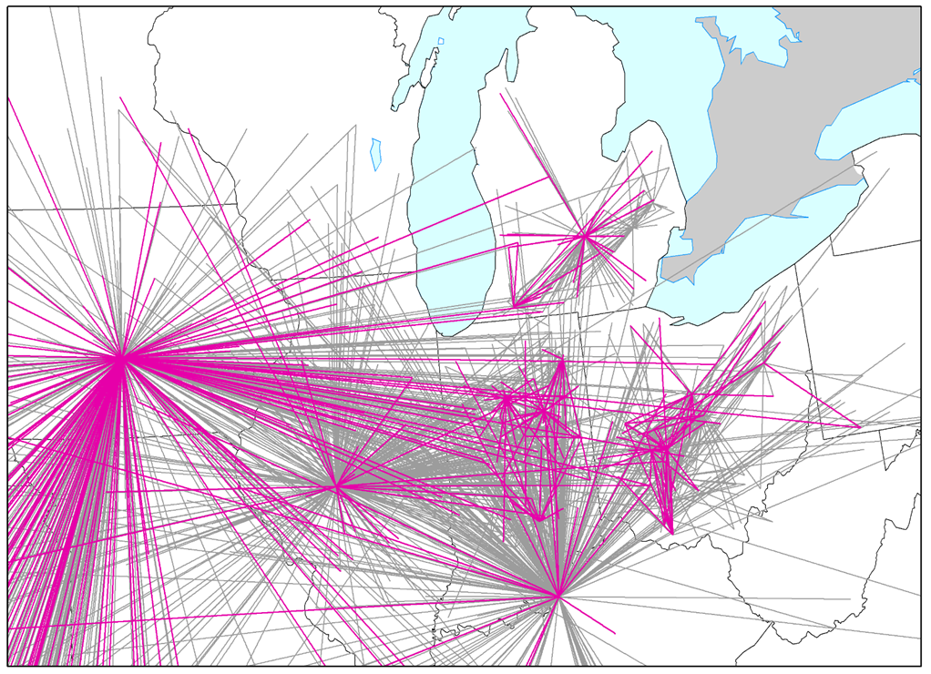
Overview
Started in 2015 with a pilot scenario-based training
Project partners include:
  The Ohio State University (multiple departments)
  Ohio Department of Health
  Ohio Department of Agriculture
  Ohio State Extension
  Ohio 4-H
  Ohio Pork Council
  Indiana Board of Animal Health
  Indiana State Department of Health
  Indiana 4-H
  National Junior Swine Association
                IAV surveillance efforts in exhibition swine funded by
                NIH Centers of Excellence for Influenza Research and
                Surveillance (CEIRS), CDC, and National Pork Board have
                all been leveraged to enhance activities
Bliss N, et al. J Am Vet Med Assoc. 2017 Sep 15;251(6):706-713.

Slide 21
Project Reach & Deliverables
Significant deliverables for previous years
  Zoonotic Disease Chapter
  Zoonotic Disease Skill-a-thon station
  ‘Becoming a Swientist’ program – Using experiential learning to engage youth in zoonotic risk and prevention across local, state, and national level exhibitors in places where influenza A virus surveillance among swine is being conducted.
  Qualitative assessment of attitudes, perceptions, and drivers of behavior change.
  Economic assessment of exhibition swine and the impact of influenza.
Project deliverables for 2019
  Disseminating zoonotic disease skill-a-thon kits to every county in Ohio and Indiana.
  Continuing becoming a ‘Becoming a Swientist’ program at Ohio spring jackpot circuit, World Pork Expo (IA), Ohio 4-H Conference, Ohio Junior Swine Day.
  Develop zoonotic disease programing for National Junior Swine Association
    Disseminate zoonotic disease information through show registration materials.
    Teach a zoonotic disease session at both the National Leadership, Education, Action, Development (LEAD) and National Youth Leadership Conference.

Slide 22
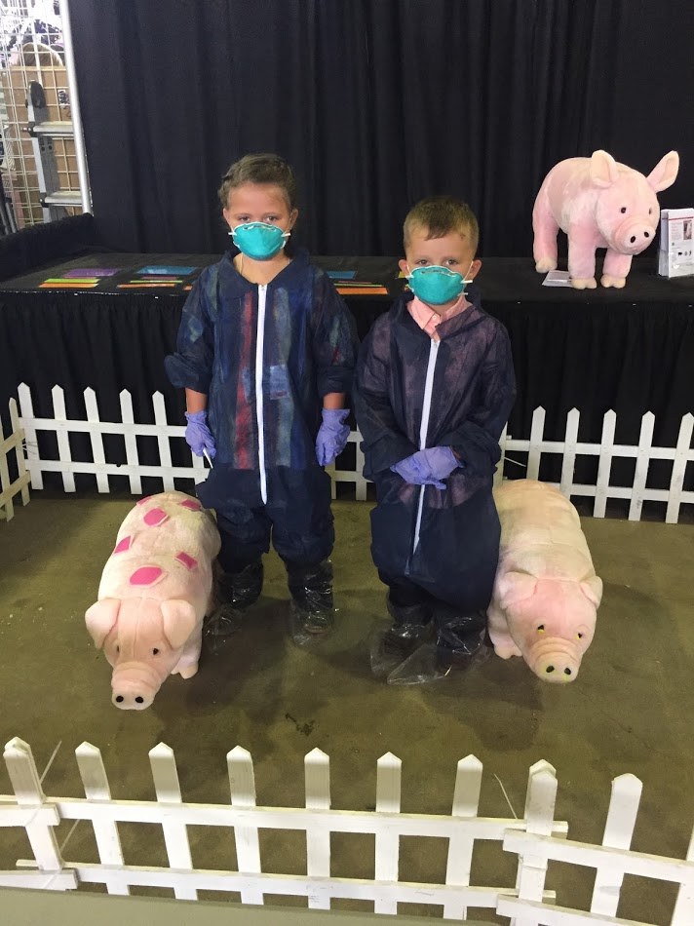
Successes & Challenges
Top 2 successes
  Development and use of experiential learning activities.
  Linking surveillance, education, and policy change.
Top 2 challenges
  Engaging older youth
    Trying to overcome by partnering with NJSA.
  Social Media
    #notcool
    #tooold
    #toobusy
    #putdownthephone

Slide 23

Indiana
CSTE CDC Influenza and Zoonoses Education Among Youth in Agriculture Program – 2019

Slide 24
Overview
Collaboration with Indiana 4-H Youth Development, Indiana Association of Fairs and Festivals (INAF), Indiana State Board of Animal Health (BOAH), and The Ohio State University (OSU)
“Teens as Teachers- Biosecurity” 2014
  Expansion of educational content
  Evaluation of knowledge and intent to change pre-test/post-test
  Collaboration with OSU
  Promote careers in public health
INAF Annual Convention
  Presentation to Fair and Festival Planners
  Compendium Self-Assessment Survey + Rubric
  Provide INAF with funding for additional trainings

Slide 25
Nebraska
CSTE CDC Influenza and Zoonoses Education Among Youth in Agriculture Program – 2019
Notes:
Add the title of your presentation, your division, name, etc.

Slide 26
Overview
Nebraska One Health Team
  Nebr. Departments of Health & Human Services and Agriculture, University of Nebraska-Lincoln Extension Services (4-H), & University of Nebraska Medical Center-College of Public Health
Opportunity
  Promote One Health principles and careers, zoonoses prevention, & protect health
  of ~140,000 youth and 12,000 volunteers involved in 4-H activities
Strategies/Key Deliverables
  Adapt existing online & print materials from interstate partners to provide zoonotic disease education targeting two age groups: youth in grades 3–6 (prime at-risk group) & youth in grades 7–12
  Train Extension Specialists at regional meetings to in-turn host local trainings
  with 4-H leaders and community volunteers & promote club-based exercises
  Deliver zoonotic disease risk messages at high-risk events such as fairs and animal exhibitions
  Strengthen relationships between State One Heath Team members, foster
  collaborative activities with routine meetings, add ad hoc members, & engage
  in new surveillance activities and data sharing
  Bonus: Encourage laboratory testing of severe ILI among youth in agriculture
Notes:
This slide includes the vision, mission, priorities and values outlined by Governor Ricketts for state government.

Slide 27




Maryland & West Virginia
CSTE CDC Influenza and Zoonoses Education Among Youth in Agriculture Program – 2019

Slide 28
Overview
Project Team and Partners
  Maryland Department of Health
    David A. Crum, DVM, MPH, State Public Health Veterinarian, Maryland Department of Health
  Maryland 4-H Program
    Christopher Anderson, Maryland 4-H Youth Development Specialist, Animal Science, University of Maryland Extension
  West Virginia 4-H Program:
    Kevin Shaffer, Livestock Production Specialist, West Virginia University Extension Service
  Maryland Department of Agriculture
    Michael Radebaugh, DVM, State Veterinarian, Maryland Department of Agriculture
Project Plan, Activities, and Deliverables
  Online training for 4-H students on novel influenza and other zoonotic diseases using a One Health approach
    Expand online Maryland 4-H Animal Husbandry and Quality Assurance (AHQA) Program (e.g. video vignettes)
    Add pre-test/post-test questions
  Signage to encourage zoonotic disease prevention at agricultural fairs
    Produce and distribute electronic and print versions of signage
  Supplementary zoonotic disease lesson plans and other educational materials
    Create electronic package of supplementary zoonotic disease prevention lesson plans and deliver to 4-H Club leaders

Slide 29
Agenda
Welcome and Introductions/Roll Call
  CDC
  CSTE
  2019 Project Sites
Project Background and Introduction
Project Logistics
  Overview of timeline
  Reporting requirements
  Basecamp
  Resource Repository
Returning Site Presentations
  Iowa
  Maine
  Michigan
  Minnesota
  Ohio
New Site Introductions
  Indiana
  Nebraska
  Maryland
Next call: Feb 28, 2019 @ 1:00 PM ET

