Slide 1


Slide 2
Agritourism Workshop Presented by:
Minnesota Department of Health - Food, Pools, and Lodging Unit
Minnesota Department of Health - Zoonotic Diseases Unit
Minnesota Department of Agriculture
Paid for by the Upper Midwest Agricultural Safety and Health (UMASH) Center, the Council for State and Territorial Epidemiologists (CSTE), and the Centers for Disease Control and Prevention (CDC)

Slide 3
Thank you to the University of Minnesota Extension and 4-H for providing the meeting space and for their help promoting the workshop

Slide 4
Housekeeping Items
Your workshop packet includes
  Tonight’s agenda
  Key points for each presentation
  Space for notes
  Helpful handouts
Resource table in the room
Bathrooms are down the hall to the left, on the left

Slide 5
What is Agritourism?
The intersection of tourism and agriculture
A commercial enterprise that links agricultural production and/or processing with tourism to attract visitors to a farm or ranch for the purpose of entertainment and/or education while generating income for the operation
Source: nationalaglawcenter.org

Slide 6
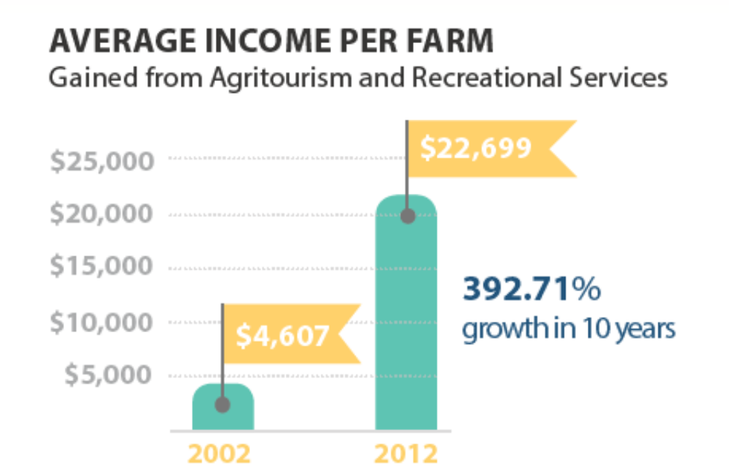
Agritourism as the Next Frontier in Agriculture
Source: www.nass.usda.gov

Slide 7
Agritourism Comes with Additional
Responsibilities
Keeping your visitors safe from injury
Reducing the risk of foodborne and animal contact illnesses
Providing visitors with a great experience
Protecting your assets
  Liability insurance

Slide 8
Introductions
Please introduce yourself by:
Saying your name
Your business or affiliation
Why you were interested in coming tonight
Notes:
We’d like to take a few minutes and go around the room to do introductions. Please ....

