Slide 1
Minnesota Food Licensing
Minnesota Department of Agriculture
651-201-6000
Notes:
The materials were developed by staff from the Minnesota Department of Health (MDH) and Minnesota Department of Agriculture (MDA).

Slide 2
What Will You Learn?
Understand the benefits of being licensed and how to begin the licensing process.
Learn about different types of food licenses and license exclusions
Learn about MDA and MDH resources
Notes:
Today’s presentation will be centered around three topics:
The benefits that go along with holding a food license; the different types of food licenses as well as licensing exclusions that exist in state statutes; and the website resources provided by MDH and MDA that are available to the public.

Slide 3
MN Statute 28A.04
License Required
  No person shall engage in the business of manufacturing, processing, selling, handling, or storing food without having first obtained from the commissioner a license for doing such business
Notes:
The Minnesota Department of Agriculture obtains its licensing authority from the state statutes; in particular MN Statute 28A.04. This statute states that no person shall engage in the business of manufacturing, processing, selling, handling, or storing food without having first obtained from the commissioner a license for doing such business. There are a few licensing exclusions which will be covered later in this presentation.

Slide 4
34A.01 Subd. 12: "Sell" and "sale"
Definition: keeping, offering, or exposing for sale, use, transporting, transferring, negotiating, soliciting, or exchanging food; having in possession with intent to sell, use, transport, negotiate, solicit, or exchange food; storing, manufacturing, producing, processing, packing, and holding of food for sale; dispensing or giving food; or supplying or applying food in the conduct of any food operation or carrying food in aid of traffic in food whether done or permitted in person or through others.
Notes:
To sum this definition up. The term sell or sale deals with the storage, transportation or exchange of food in any manner.

Slide 5
Why Get a License?
Licensing provides:
Resources and education.
Routine inspections.
Follow-up.
Consumer confidence.
Level playing field.
Notes:
There are many benefits to licensure.
-When you apply for a license as part of the process of setting up your business, you begin building the relationship with your inspector. Your inspector is your direct source for food safety guidance and information about food code requirements. The license fee pays for public health professionals who help to educate business owners and employees. Inspectors explain how food code regulations apply to your establishment. They also have access to resources that might not be readily available to the publich, and health department staff maintain current Web pages and print materials that are available for the public to use.
-Getting a license ensures – for most establishments – at least a yearly inspection. During the visit, your inspector will observe your food handling procedures. He or she can document what you and your employees are doing right, as well as areas where you need to make changes to better control hazards in your operation. The inspector provides a third party view and can observe hazards that are not always obvious during the daily routine in your food establishment. You’ll get a written report with details, resources and contact information.
-When food safety violations are found, your inspector will help you identify changes that can be made so you are doing things safely. And the inspector might come back for a follow-up inspection to make sure that violations have been corrected.
-Consumers expect – and have a right to expect – safe food when they eat out or purchase food for later consumption.
-Licensing also helps to create a level playing field for all businesses in that all business must follow relevant food safety regulations.

Slide 6
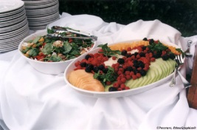
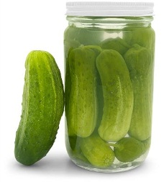
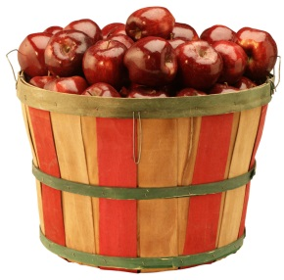
Who is Exempt From Licensure?
Church Lady Bill.
Potluck.
Chili or Soup Cook-off Fundraisers.
Charitable organizations.
Cottage Foods.
Product of the farm.
Sampling & demonstration only.
Notes:
Not every food establishment is required to have a license. Over the years, several exemptions have been written into Minnesota Statutes to allow businesses to sell food without obtaining a license. We will not go into any detail on most of these exemptions, as many of them would not be applicable to your operations. If you think you could fall into an exemption it is important to contact your local inspector to better understand the specific requirements to meet the exemption.
Common terms for the exemptions are:
We will focus on the last 3 for our discussion as the are the most widely used.

Slide 7
Do you fall into an Exclusion?
Assume a license is required.
Talk with a Food Inspector.
Restrictive & Specific
  Many businesses cannot fit into the restrictions set forth in the statutes.
Notes:
Never start a food business under the assumption that you meet a licensing exclusion. Always talk to the regulatory agency first. Some of the exclusions have specific criteria that has to be met by the food establishment. Just because a food establishment meet a licensing exclusion does not mean that they are exempt from applicable food safety requirements.

Slide 8
Cottage Foods
MN Statute 28A.152
Register with the Minnesota Department of Agriculture (MDA) before selling food regardless of the amount of food sold
  Registration is not the same as a retail food handler license. Cottage food producers are not approved sources of food for other licensed food establishments
Take an approved food safety course once every 3 years
  For $0-5,000 in sales an online training course is provided
  For $5,001-18,000 individuals must take an advanced training course in person offered by the University of Minnesota Extension Food Safety Program
Notes:
There are gross annual sale restrictions that apply to cottage foods producers and the type of training required also depends on the sales amount.

Slide 9
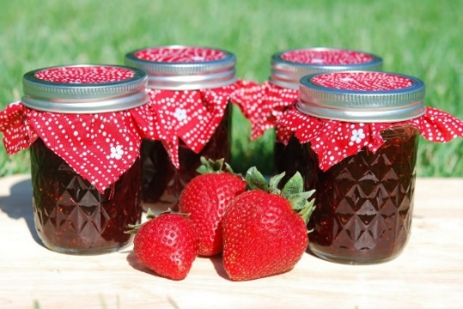
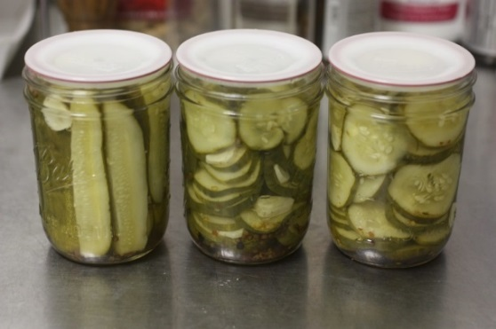
Cottage Foods
MN Statute 28A.152
Only non-potentially hazardous foods can be prepared or sold
Products with a low water activity or a pH of 4.6 or lower
  No meat products of any kind are allowed
  Baked goods that do not require refrigeration
  Home canned jams/jellies or canned pickles, vegetables or fruit that meet the pH requirements
Notes:
Cottage foods has restrictions on the types of foods that can be produced. In general, the food must be non potentially hazardous.

Slide 10
Question 1
Why is a low water activity or pH of 4.6 or less critical for the canning process of foods?

Slide 11
Cottage Foods
MN Statute 28A.152
Labels must include
  Name and Address
  Ingredients including declared allergens
  Date Produced
A sign at the point of sale that states “these products are homemade and not subject to state inspection”. If the products are sold over the internet this statement should be posted on the website
Notes:
There are specific labeling requirements for cottage food producers.

Slide 12
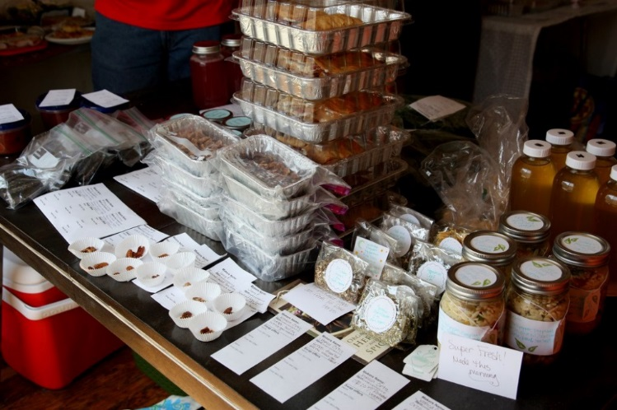
Cottage Foods
MN Statute 28A.152
Products can be sold from the individual’s home, at community events, at farmer’s markets or over the internet
The person that made the product must be the one that sells and delivers the product.
Products can only be sold to the ultimate consumer.
Notes:
Food that is produced under the cottage foods exclusion can only be sold by the cottage food producer. These food items must be sold directly to the end consumer and cannot be wholesaled.

Slide 13
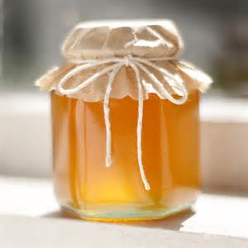
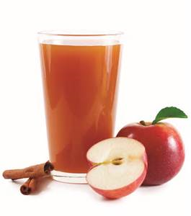
Product of the Farm
Minnesota Statutes, part 28A.15
Fruits & vegetables directly from the farmer/ producer.
Other items can include:
  Dried Herbs, Honey, Maple syrup, Cider
Products CAN be processed and/or stored in a licensed facility (i.e.. commercial kitchen, warehouse) NOT a private home
Notes:
In Minnesota, the farmer’s right to sell his or her own products is protected. But there are restrictions regarding the amount and type of processing that can be done.
-Other examples could be Juice or cider which can be considered a product of the farm but they are still subject to Juice HACCP regulation. it just means a license is not required

Slide 14
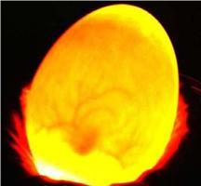
Product of the Farm (Shell Eggs)
Minnesota Statutes, part 28A.15
Shell eggs sold directly by the farmer or producer.
Packaging must include:
  Grade and size.
  Name, address and zip code of the farmer.
  Julian package date
  Freshness date not exceeding 30 days from packaging
  Safe handling instructions
  http://www.mda.state.mn.us/home.aspx
Notes:
Shell eggs: Maximum 30 day shelf-life. After 30 days, eggs are required to be re-graded or candled for proper labeling. Eggs sold after the 30 days are potentially a misbranded product, since the grade of the egg on the label may be false information.
Useful resources include: Approved Sources of Meat and Poultry for Food Facilities; Sale of Locally Home or Farm Raised Poultry; and the Sale of Locally Raised Eggs to Food Facilities. (Source: http://www.mda.state.mn.us/home.aspx)

Slide 15
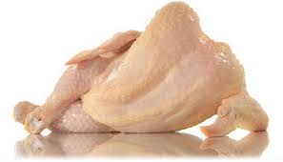
Product of the Farm: Meat & Poultry
Minnesota Statutes, part 28A.15
Poultry, waterfowl and game birds processed on the farm and sold directly to the individual consumers or households.
  Additional requirements apply for on-the-farm slaughter.
USDA inspected or Equal to plant
Talk with Inspector
Notes:
When selling poultry or any meat item off the farm, individuals should speak with their area food inspector to ensure all the proper steps have been taken to be in compliance. Examples of restrictions for on-farm slaughter include: number of birds, beef and lamb being processed under USDA inspection or in a state of Minnesota equal-to facility.

Slide 16
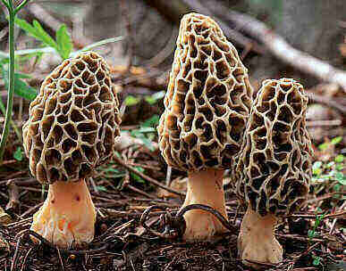
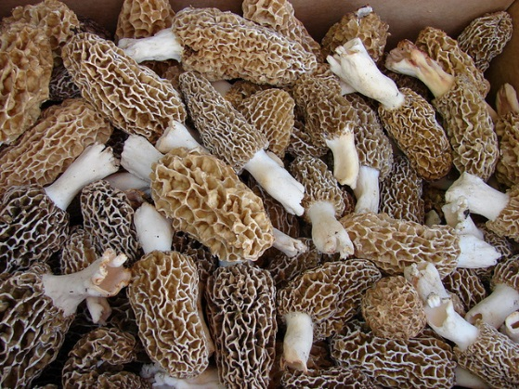
MN Food Code: Wild Mushrooms
Mushrooms harvested from an individual’s own land or rented land might be exempt from licensing
Mushroom Identification Expert – must have a letter from a college, university or mycological society stating the individual completed a mushroom identification course
Notes:
When harvesting wild mushrooms; an individual has to take an identification course that is specific to the mushrooms they are harvesting. Even if the mushrooms are coming from their own land or land they rent.

Slide 17
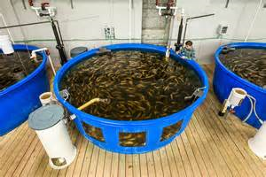
MN Statutes: Fish
Applies to farmed (aquaculture) fish only, not wild caught.
Aquaculture is the breeding, rearing, and harvesting of fish, shellfish, plants, algae and other organisms in all types of water environments.
Must also meet MN DNR requirements.
Notes:
Generally aquaculture is referred to as the raising of fish and aquatic life as agriculture. For information on aquaculture please visit MDA’s website. It is important to note that the Minnesota Department of Natural Resources also regulates aquaculture and an aquatic farm license may be required. Contact the Minnesota Department of Natural Resources for more information.

Slide 18
Food Product Sampling & Demonstration
Minnesota Statutes, part 28A.151
Only applicable at a farmer’s market or community events.
Food Sampling: a 3 ounce portion or less of a food or beverage provided at no cost to promote or educate the public about the product being sold by the vendor.
Food Product Demonstration: cooking or preparing foods to distribute to the public to promote or educate about the product.

Slide 19
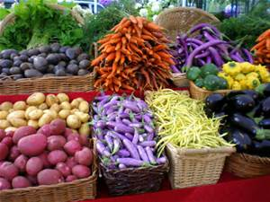
28A.151: Farmers Market
Farmers' market" means an association of three or more persons who assemble at a defined location that is open to the public for the purpose of selling directly to the consumer the products of a farm or garden occupied and cultivated by the person selling the product.

Slide 20

Community Event or Social Event
A public gathering sponsored or hosted by a town, county, city, or municipality or religious, charitable, or educational organization where food is sold.
  Charitable organization
  Open to the public
  The event is not intended for profit
Ex: County Fair
NOT a private party/event
Notes:
Charitable organization (fireman, police or public school)
Not for profit- it is to promote the community as a whole. For profit events such as those hosted by groups like chamber of commerce, boosters clubs, sportsmans clubs or other private clubs do not qualify

Slide 21
Food Product Sampling & Demonstration
Minnesota Statutes, part 28A.151
Upon request from the inspector, plan review officer, or supervisor; the person conducting the sampling or demonstration must provide information about the following:
  Source of the food, type and volume of food to be served, equipment to be used to serve the food, location and time of the event, availability of handwashing and dishwashing facilities at the event, water source at the event, and means of garbage disposal.
Vendors are required to meet the food safety standards that are required of a Special Event Food Stand as outlined in the Minnesota food code 4626.1855 items B to O, Q, R and 4626.0330 (consumer self-service requirements)

Slide 22

Shared Responsibility
Licensing Agencies
Minnesota Department of Health (MDH).
Minnesota Department of Agriculture (MDA).
Local public health agencies with delegated authority from MDH and/or MDA.
    County.
    City.
Notes:
There are many regulatory agencies throughout Minnesota that share the responsibility for licensing and inspection of food establishments. The two state agencies are:
MDH
MDA
Then there are local agencies—counties or groups of counties and some cities—

Slide 23

Delegated Agency
What is it?
City or County that conducts inspectional and licensing work on behalf of the State agency
MDA – Delegated agencies – Only Retail
  Hennepin County
  Ramsey County – except St. Paul
  City of Bloomington
  City of Minneapolis
  City of Minnetonka
  City of Brooklyn Park
  City of St. Cloud

Slide 24
Shared Responsibility
Licensing Agencies
MDH – Food Service - restaurants, fast food establishments, bars, caterers, schools, hospitals, nursing homes, etc.
MDA – Retail food such as packaged food products, bakery items, grocery stores etc., & wholesale food manufacturing and distribution.
Memorandum of understanding and statute prevents duplication of licensing.
Notes:
The departments of agriculture and health share responsibility for regulation of food businesses in Minnesota. Responsibilities are divided based on what kinds of food activities take place in the business.
-MDH is what we would generally consider food service:
-MDA is what we consider retail, such as grocery stores:
-Even though it can sometimes seem confusing, there are systems in place to make sure a business isn’t licensed by more than one agency for the same activities.

Slide 25

Shared Responsibility
Predominant Mode of Business
Licensed by MDH if >50% of sales consists of food served for immediate consumption such as:
  Served cooked hot dogs or hamburgers.
  Pizzas made to order.
  Fountain beverages.
  Deli counter that serves meatloaf or chicken dinners.
  Salad bar.
  Breakfast or pizza on the farm.
Notes:
Here’s how you can figure out if your business falls under MDH or MDA.

Slide 26

Shared Responsibility
Predominant Mode of Business
Licensed by MDA if >50% of sales consists of packaged food OR wholesaling such as:
  Packaged hot dogs.
  Frozen pizzas and dinners.
  Bottled beverages.
  Any boxed, bagged, or pre-packaged items.
  Wholesale Operations – not selling directly to the ultimate consumers

Slide 27
Plan Review
Both MDH and MDA conduct plan review
Review of facility layout and equipment and verifies building, plumbing, electrical, mechanical safety/code.
Most commonly required for new buildings, facilities that have never sold food or major food process changes, remodels/construction projects/vast amounts of new equipment.
Occurs prior to licensing.

Slide 28
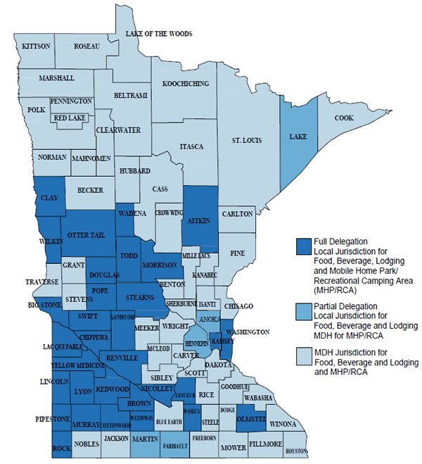

Shared Responsibility
MDH Delegation Map
www.health.state.mn.us/divs/eh/food/license/contactmap.html
Useful tool to determine which counties have one or more delegation agreements.
Notes:
Helpful tool – this delegation map is available on the Minnesota Department of Health website.

Slide 29

Shared Responsibility
Find Your MDA Inspector
MDA Contact Information
  651-201-6000
  800-967-2474
Notes:
The best way to figure out who is your retail food inspector is to contact the Minnesota Department of Agriculture. You will be given the appropriate contact information for the retail food inspector in your area.

Slide 30
Licensing Process
Identify the menu/foods you want to sell.
Identify who you will be selling the product to.
Identify predominant mode of business.
Identify ALL locations where the food will be prepared, served and stored.
Contact Inspector or licensing agency.
Notes:
Here is a summary of the licensing process. You always need to know:
What?
Where?
How?
There may be other information needed as well such as if its a
New business or new location.
Change of ownership or change in official company name.
Remodel of existing food establishment.

Slide 31
Types of Licenses
Retail License – MDH, MDA or delegated agency
Wholesale/Manufacturer – MDA
Mobile Food License – MDH, MDA or delegated agency
  Seasonal Permanent Food Stand
  Seasonal Temporary Food Stand
  Mobile Food Unit / Food Truck
  Food Vehicle/ Portable Structure or cart
  Special Event License
Notes:
Considering all the different types of operations and inventive concepts where food can be sold there are only a few types of licenses. It can be difficult to fit your operation into one of these categories, but this is what we have to work with.

Slide 32
License Fees
The license fees are different depending on the licensing agency.
Within the agency license fees vary by the type of license required, assigned risk or gross sales.
Talk with your area inspector for specific details.

Slide 33
What Have You Learned?
Not everyone needs a license, but everyone is required to offer safe food to the public.
MDH, MDA and some delegated agencies license food establishments in Minnesota, based on menu items and method of preparation.
A variety of licenses for selling food exist.
Inspectors are a resource to ensure your success.

Slide 34
Question 2
Say you want to build a brand new food establishment from the ground up, what might you do?
Begin the project as soon as possible
Contact a MDH or MDA inspector
Contact a plan review officer
B & C

Slide 35
Question 2
Say you want to build a brand new food establishment from the ground up, what might you do?
B & C

Slide 36
Question 3
What should you do if you desire to sell food to the general public?
A) Get to cooking
B) Assume a license is required and contact a food agency MDH/MDA
C) Buy all new equipment for your new business
D) Tell all of your friends and social media

Slide 37
Question 3
What should you do if you desire to sell food to the general public?
B) Assume a license is required and contact a food agency MDH/MDA

Slide 38
Question 4
What type of products can be sold/served to the public and are exempt from licensing?
Hamburger and hot dog grill out!!!
Products of the farm or garden
Pre-packaged foods- chips, ice cream, frozen dinners
Sushi

Slide 39
Question 4
What type of products can be sold/served to the public and are exempt from licensing?
Products of the farm or garden

Slide 40
Question 5
Which method of sale is NOT allowed under the cottage food registration?
Cottage food products may be sold to grocery stores
Cottage food products may be sold at farmers markets
Cottage food products may be sold over the internet
Cottage food products may be sold from the home

Slide 41
Question 5
Which method of sale is NOT allowed under the cottage food registration?
Cottage food products may be sold to grocery stores

Slide 42

Questions
Notes:
Take questions

