Slide 1
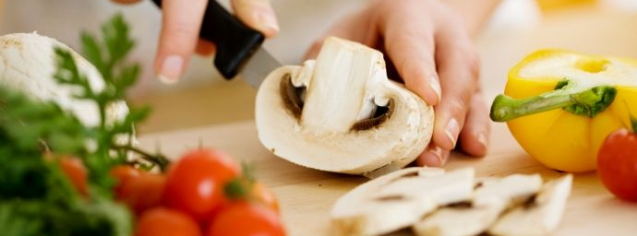
Preparing Food Safely
Nicole| Epidemiologist
Minnesota Department of Health

Slide 2
Foodborne Illness Risk Factors
Poor personal hygiene (ex. working while ill or recovering from illness, also unapproved hand washing or glove use practices)
Improper hot holding/cold holding/cooling
Inadequate cooking temperatures
Food from unsafe sources
Contaminated food and/or equipment

Slide 3
Question 1
What symptom(s) are most likely to indicate an employee has a disease that may be passed through food?
Pink eye
Runny nose and sneezing
Vomiting and diarrhea
All of the above

Slide 4
Question 1
What symptom(s) are most likely to indicate an employee has a disease that may be passed through food?
Vomiting and diarrhea

Slide 5
Healthy Employees
Employees who have had vomiting and/or diarrhea must not work for at least 24 hours after their symptoms end.
Supervision is required whenever food is served or prepared, and employees must report to the person in charge if they have been ill.
Employees must dress in clean clothing and wear an effective hair restraint (ex. hairnet, hat, or scarf).
Painted or false fingernails and jewelry on the arms and hands are not allowed (exception: wedding band or plain ring).

Slide 6
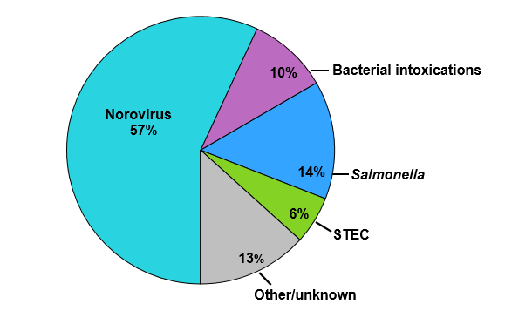
Norovirus Basics
Very contagious virus!
Most common cause of acute gastroenteritis (and foodborne disease outbreaks) in the United States.
This virus is highly infectious and it only takes a small number of viral particles to cause infection.
Sources: person-to-person, contaminated food or water, and contaminated surfaces.
  Infected employees are frequently the source of foodborne norovirus outbreaks.
Confirmed Foodborne Outbreaks by Etiology, Minnesota,1999-2016 (n=916)
Notes:
CDC Vital Signs report on Norovirus found that….

Slide 7

Clinical Features
Clinical disease (norovirus infection) is characterized by:
Incubation period of 12 – 48 hours.
Acute onset of symptoms.
  Diarrhea (non-bloody)
  Vomiting
  Abdominal pain
  Low-grade fever, or no fever
Duration of 12 – 72 hours.
No long-lasting immunity: all ages affected
Notes:
Incubation time for noro is usually between ½ a day and 2 days.
Symptoms set in suddenly, and people who are ill with noro are usually pretty sick for at least ½ a day, and up to three days.
We don’t develop an immunity to norovirus, so the bad news is that, even if you’ve had it once, you could get another round.
Vomiting:
More likely in children
Can be primary complaint
Mud run in France, over 1000 infected after a group of runners ran while experiencing symptoms or shortly after symptoms…mud is a good disguise for diarrhea….

Slide 8
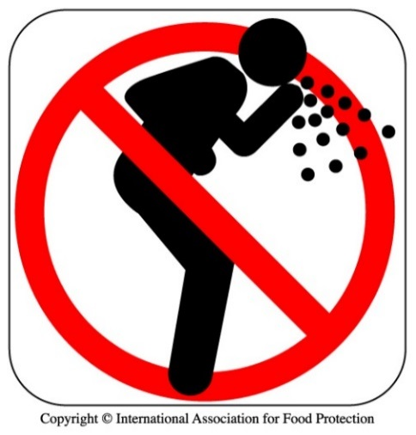
Norovirus Prevention
Do not prepare food for others if you have vomiting or diarrhea.
Do not prepare food for others for at least 24 hours after your last symptom.
Wash your hands
Don’t handle ready-to-eat foods with your bare hands

Slide 9
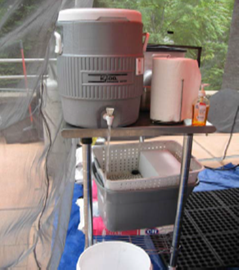
Handwashing
Handwashing is the single most effective means of preventing the spread of disease causing microbes and pathogens.
Handwashing sink(s) MUST be:
- set-up and operational prior to the start of an event
- easily accessible to all employees
- used only for handwashing (not food or dishes)
- supplied w/running water, soap, and paper towels.
Gloves, wet-wipes, or hand sanitizers are NOT approved substitutes for handwashing.

Slide 10
Question 2
Food handlers must wash their hands before they start work and after:
Using the restroom.
Sneezing, coughing, or using a tissue
Handling raw meat, poultry, or seafood.
All of the above.

Slide 11
Question 2
Food handlers must wash their hands before they start work and after:
All of the above.

Slide 12
When To Wash
1. before beginning or returning to work
2. after touching body parts other than clean hands and clean, exposed portions of arms, after contacting body fluids and discharges, after handling waste containing fecal mater, body fluids, or body discharges
3. after using the toilet
4. after caring for, or handling animals
5. after coughing, sneezing, or using a handkerchief or disposable tissues
6. after using tobacco, eating, or drinking
7. after handling soiled equipment or utensils
8. immediately before engaging in food preparation in the food preparation area
9. during food preparation, as often as necessary to remove soil and contamination and to prevent cross contamination when changing tasks
10. when switching between working with raw foods and working with ready-to-eat foods
11. after engaging in other activities that contaminate the hands.

Slide 13
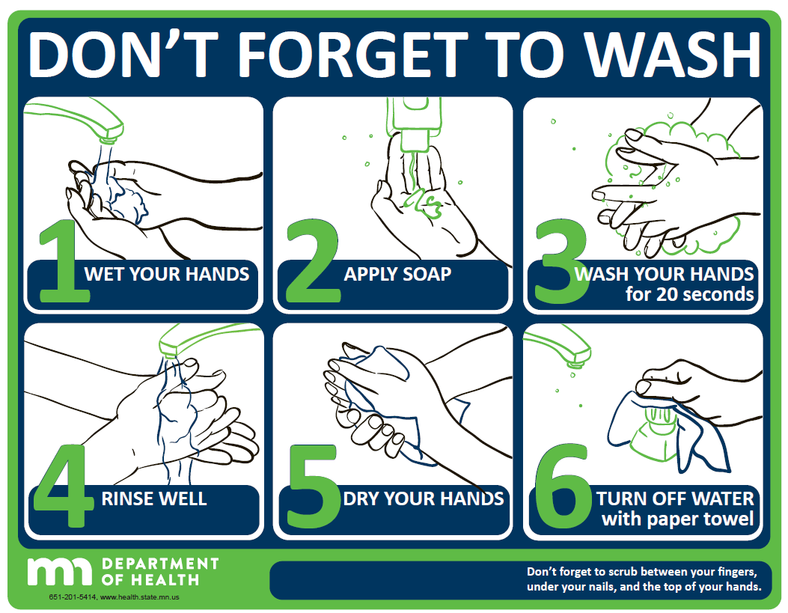
How To Wash

Slide 14
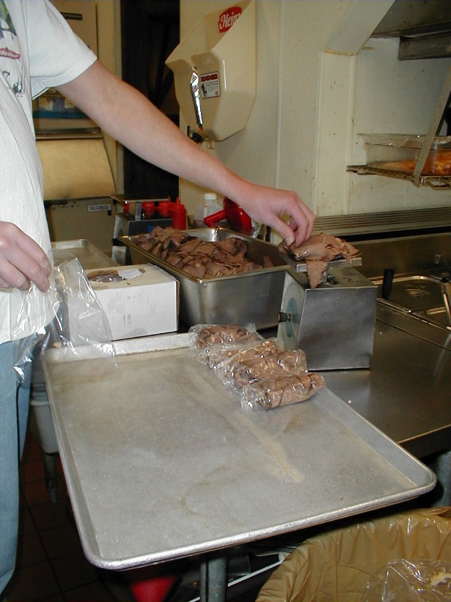
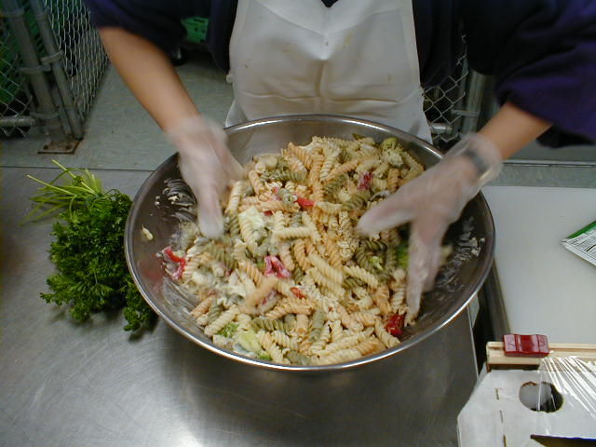
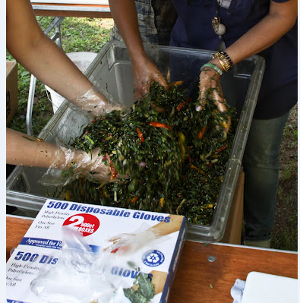
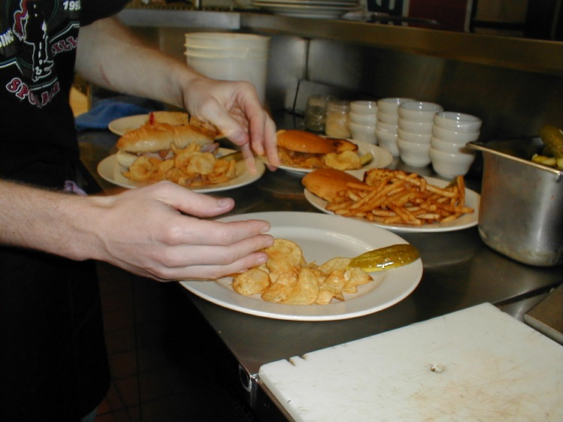
Question 3
Which image shows a foodworker(s) properly handling ready-to-eat food?
B.
C.
A.
D.

Slide 15
Question 3
Which image shows a foodworker(s) properly handling ready-to-eat food?
C.

Slide 16
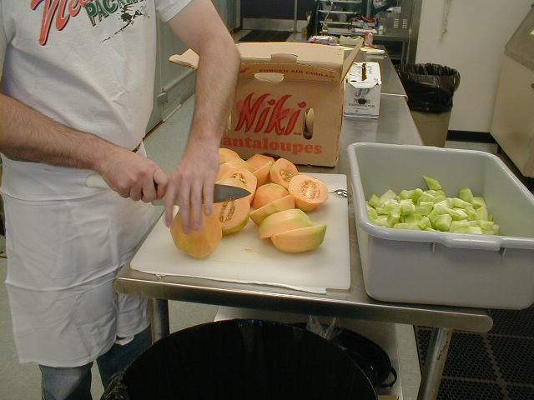
No Bare-hand Contact
Use spatulas, tongs, deli tissue, gloves or other dispensing equipment to limit direct hand contact with ready to eat food or ice.
What are “ready-to-eat” foods?

Slide 17
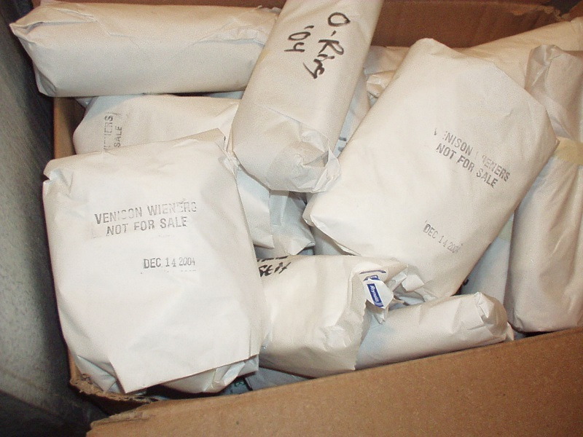
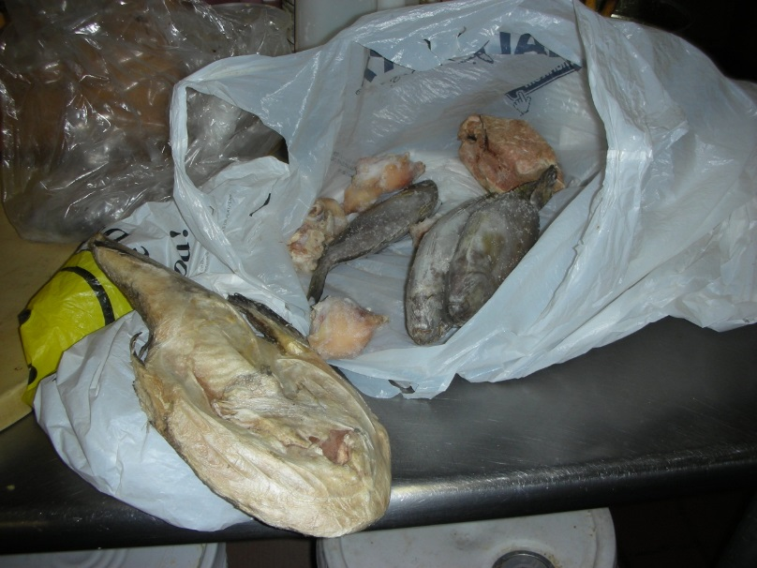
Food Sources and Preparation
All food, beverages, and ice must be obtained from approved sources.
Approved sources might include: restaurant suppliers, grocery stores, and buyer’s clubs.
Food cannot be prepared or stored in a residential home.
Off-site preparation or storage must be done at a licensed food establishment.

Slide 18
Potentially Hazardous Foods
What foods need time and temperature control for safety (TCS)?
Food from an animal origin that is RAW or COOKED
(ex. eggs, milk, fish, meat, and poultry)
Food from a plant origin that is COOKED
(ex. cooked rice, potatoes, and noodles)
Cut tomatoes and leafy greens – herbs not included
(ex. lettuce and spinach)
Cut melon (ex. watermelon, cantaloupe, and honeydew)
Also garlic and oil mixtures, raw seed sprouts, and baked goods made with cream, custard, or pudding.

Slide 19
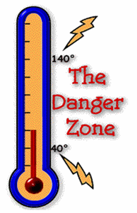
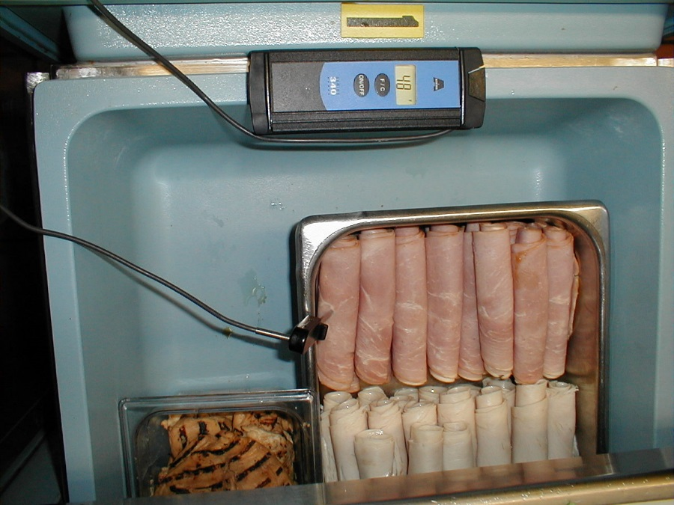
Safe Food Temperatures
Hold hot food at or above 140°F
Cold food at or below 41°F.
Serve or discard food held at room temperature within FOUR hours.
Thaw food in refrigerators; NEVER thaw at room temperature.

Slide 20
Question 4
What is the best way to determine raw animal food (such as hamburgers or eggs) is fully cooked and ready to be served?
A. By using a timer
B. By using a thermometer
C. By looking at the appearance and color
D. By touching or probing with a fork or utensil

Slide 21
Question 4
What is the best way to determine raw animal food (such as hamburgers or eggs) is fully cooked and ready to be served?
B. By using a thermometer

Slide 22
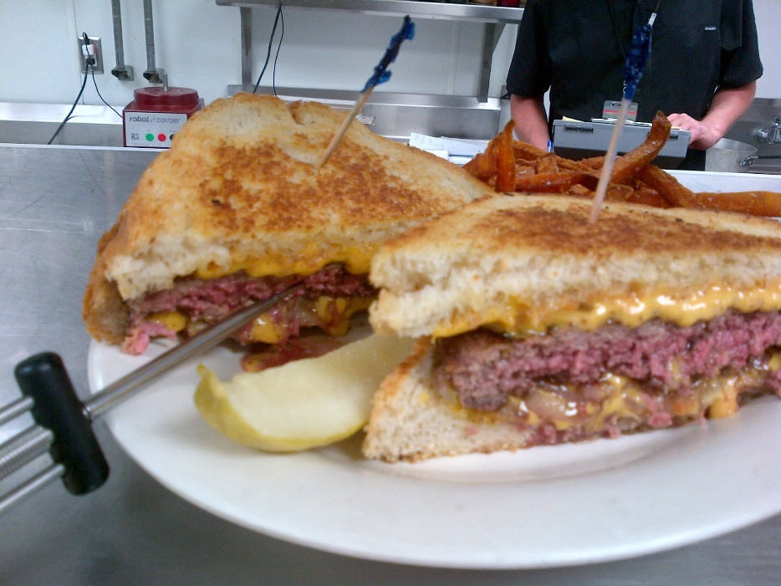
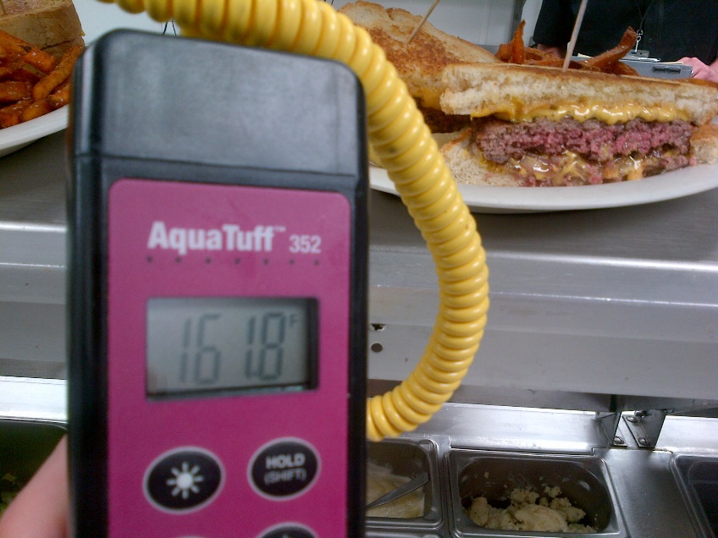
Cook Temperatures
Cook food to these temperatures:
Poultry : 165°F
Ground beef, gyro or pork: 155°F
Beef steak or shell eggs: 145°F

Slide 23
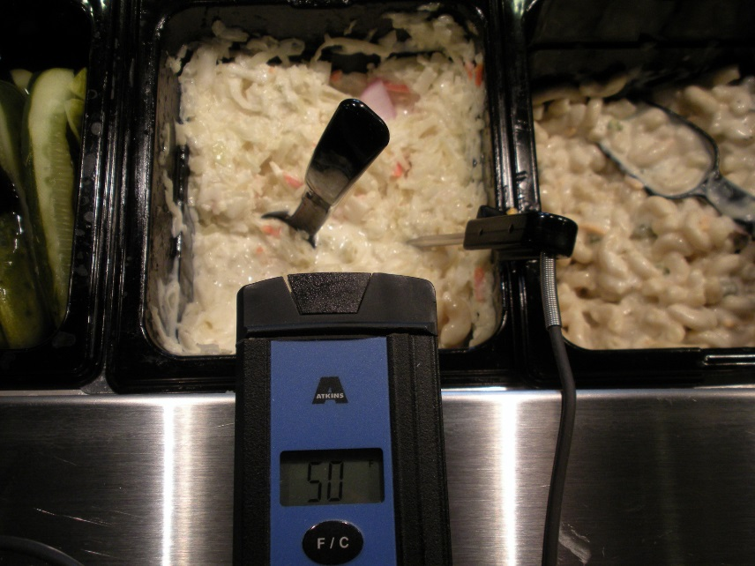
How to Take a Temperature
Cold Item- Take Temperature where it would be the warmest.
Hot Item- Take Temperature where it would be the coolest
Cooling- Take temperature in the middle
Cooking- Take Temperature in the middle

Slide 24
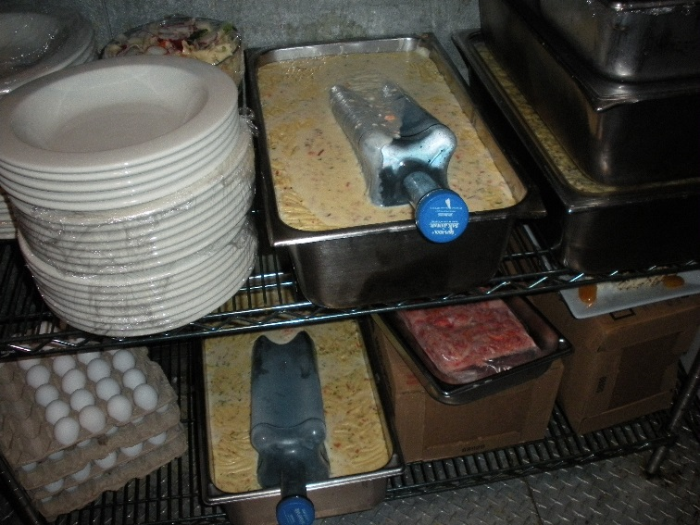
Cooling and Reheating
Cool hot food from 140°F to 70°F within two hours and from 70°F to 41°F within a total of six hours.
Use ice or shallow containers for rapid cooling; refrigerate food uncovered until fully cooled.
Re-heat prepared food to at least 165°F.
Re-heat food rapidly, within two hours or less.

Slide 25
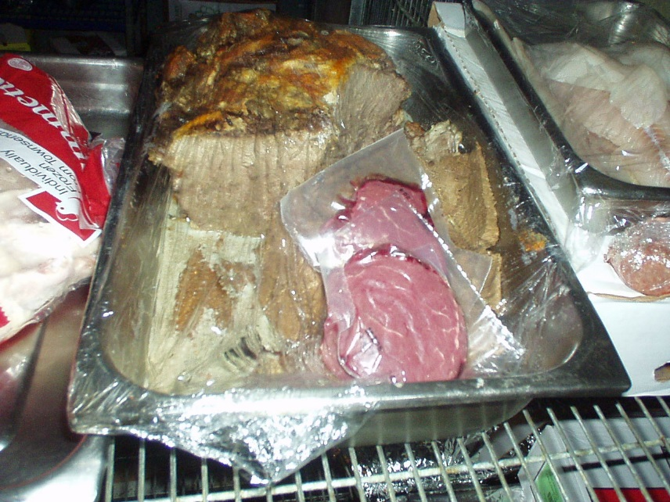
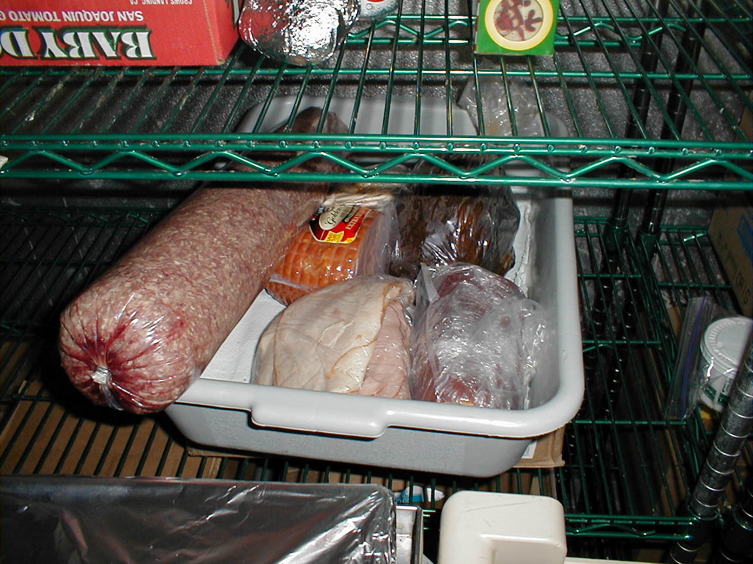
Avoid Cross-Contamination
Separate raw animal foods during storage, preparation, holding, and display from raw ready-to-eat foods or raw animal food and vegetables to prevent cross-contamination.

Slide 26
Cleaning and Sanitizing of Equipment
Use disposable utensils (ex. plates, forks, spoons, and cups) for service to customers.
Wash, rinse, sanitize, and air dry all equipment and utensils at least every FOUR hours, or replace with clean sets.
Approved sanitizers include chlorine bleach, quaternary ammonium or iodine.
Always follow label instructions when diluting, and provide an appropriate sanitizer test kit to check the concentration.

Slide 27
Question 5
Which practice is likely to cause cross-contamination?
A. Storing raw steaks above shredded lettuce in a cooler
B. Storing deli meat above raw chicken in a cooler
C. Using separate cutting boards for preparing raw meat and vegetables
D. Changing gloves and washing hands after cracking eggs and before buttering toast

Slide 28
Question 5
Which practice is likely to cause cross-contamination?
A. Storing raw steaks above shredded lettuce in a cooler

Slide 29
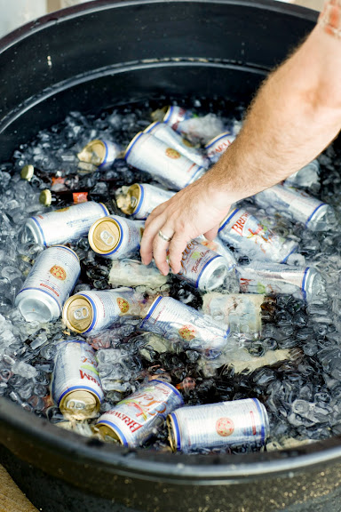
Equipment Requirements
Mechanical refrigeration is required; drained ice may only be used to cool beverages.
Domestic slow cookers (ex. crock pots) are not allowed.
Food thermometers are required for checking food temperatures and in all refrigerated units.
Dishwashing equipment and approved chemical sanitizers are required for multi-use utensils.

Slide 30
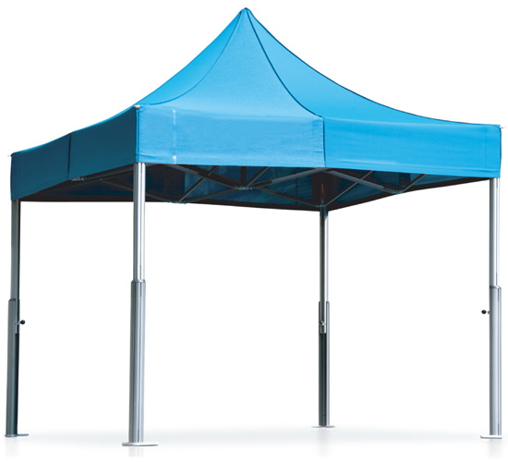
Location and Construction
Locate stands away from sources of contamination.
Provide overhead protection for exposed food.
Provide a ground covering for mud or dust control if needed.
Install approved gas hook-ups and provide appropriate fire protection.

Slide 31
Special Event vs. Seasonal Temporary Food Stands
Special Event Food Stand:
Intended for small businesses with simple menus.
Operates for no more than 10 days total per year.
Submit application at least 2 weeks prior to event
Seasonal Temporary Food Stand:
Requires the use of NSF-approved equipment.
Operates no more than 21 days annually at any one location unless approved by the by the licensing agency.

Slide 32
Online Resources
Find your Inspector/Regulatory Agency:
http://www.health.state.mn.us/divs/eh/food/license/delegation.html
Special Event License:
http://www.health.state.mn.us/divs/eh/food/license/specevent.pdf
Licensing Page:
http://www.health.state.mn.us/divs/eh/food/license/index.html
MDH Plan Review Page:
http://www.health.state.mn.us/divs/eh/food/license/planreview.html
MDA Plan Review Page:
https://www.mda.state.mn.us/food/business/plan-review.aspx

Slide 33
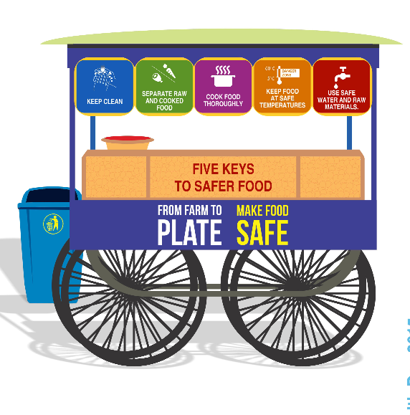

Questions
Notes:
Take questions and administer the Licensing Module multiple-choice quiz.

