Slide 1

Carrie Klumb, MPH
Stephanie Sikavitsas Johnson, MPH
April 18, 2018
Human Health Issues Related
to Agritourism Operations:
How to Manage the Inherent Risks

Slide 2
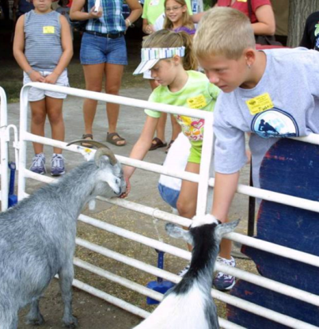
Why Are We Here Tonight?
Corn maze, hayride, corn pit safety
Working farm safety issues
Human-animal interactions best practices
  Discuss inherent risks
  Managing those risks
  Specific recommendations
Provide resources
Answer questions
Notes:
Why are we here tonight? We’re here to hear about safety for you Agritourism venue, both in animal and non-animal areas. I’ll cover non-animal areas like corn mazes, hayrides, and corn pit safety. As well as working farm safety issues. Carrie will cover the human-animal interaction areas. She’ll talk about the risks, and how to manage them to minimize them as much as possible. We’ll all provide resources and answer questions at the end of the presentation. So off we go!

Slide 3
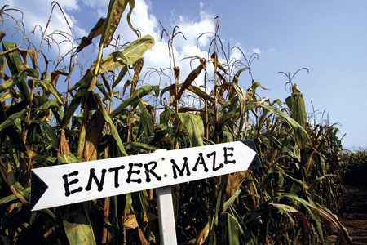
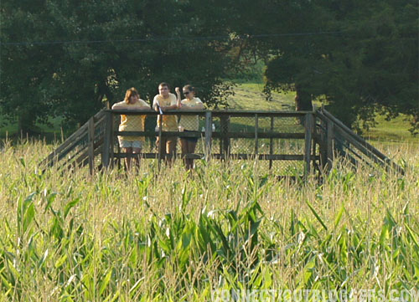
Corn Maze Safety
Signs posted indicating entrance & maze rules-- including no smoking!!
Method for guests to communicate with employees (i.e. flags/cell phones)
Kids <12 with an adult
Elevated platform for employees to monitor maze
Local fire department knows size & location of maze
Parking lots & roads ≥ 75 feet away
www.safeagritourism.com
Notes:
So we’ll start with corn mazes. They’re really popular, but before they open to the public, make sure you’re being as safe as possible. Make sure you have signs around showing which way the exit and entrance are. At the entrance make sure you have a sign, that is big and easy to read that has the rules of the maze on it. Especially the no smoking part! We don’t want a fire to happen. On that list of rules, make sure you have a number or way that people in the maze can contact employees in case of an emergency or they get lost. The employee with the cell phone should be on an elevated platform monitoring the maze, keeping an eye out for a flag or whatever you choose to use to let those without phone communicate. And unless specifically designed for young children, make sure they are accompanied by an adult
Make sure that your maze is at least 75 feet away from anywhere a car might normally drive, and let your local fire department know exactly how big and where your maze is. That way, if a fire or other emergency happens, they can go straight there without having to wait for directions. Especially if it’s a big maze and a ways away from buildings.

Slide 4
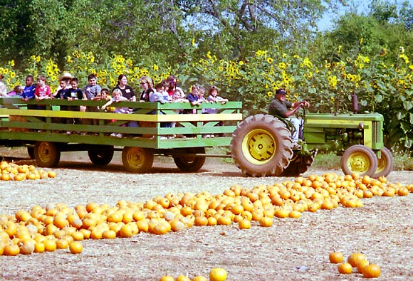
Hayride Safety
Before each ride inspect:
    Wagon for loose boards, sharp edges, exposed nails/screws
    Harnesses, hitches, & chains
Pull only one wagon at a time
Routes should not cross public roads or highways
Guests board only after wagon hitched
No children riding up front with driver, or without an adult
www.safeagritourism.com
Notes:
Before you start offering hayrides, make sure your routes are fairly level, and don’t cross roads, snowmobile trails, or other places that can affect wagon stability or throw people off the ride unexpectedly. Make sure your wagon has sturdy steps and railings to keep people within the ride at all times, especially up front. Check before each ride that the wagon and other tack are in good condition and won’t cause any injures to people/horses/etc. Don’t let children ride up front with the driver, to reduce distractions to the driver, and keep children safe. Make sure your driver has a valid drivers license, drives slowly and is prepared to stop when asked by the passengers. Before you let anyone on the wagon for a ride, make sure everything is hitched up, all children have an adult with them, and that everyone knows the rules as they board the wagon. You can consider putting a sign with the rules both at the waiting area and the wagon itself so people can easily see them.

Slide 5
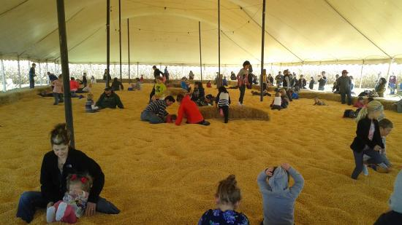
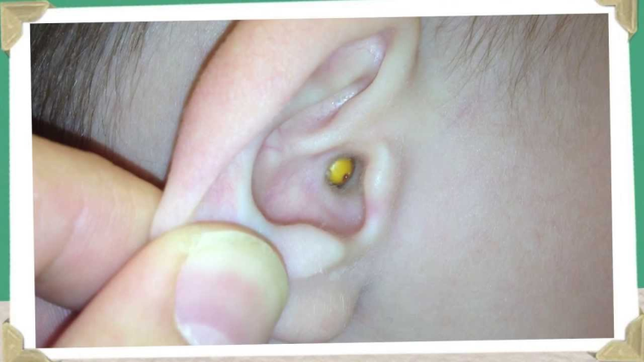
Corn Pits
Are not recommended because...
  Corn and other small grains are a choking hazard for young children
  Potential allergy/asthma hazard
  Perfect size to stick up nose and in ears
  Provides habitat for rodents, snakes, and other animals
Better alternative: Sand Pit
www.safeagritourism.com
Notes:
We don’t recommend corn pits. They can be a choking and health hazard for young children. Especially if they haven’t been exposed to corn before and have a bad allergy or asthma reaction. They are also the perfect size to get in all sorts of nooks and crannies of your body, like noses and ears. As well as wonderful places for other animals such as rodents and snakes to live in. If you are going to have a pit make sure they aren’t deep, i.e. drowning hazard, and try to cover it somehow so it doesn’t get wet and moldy. You should also have an employee there watching people in the pit. An alternative to a corn pit is a sand pit.

Slide 6
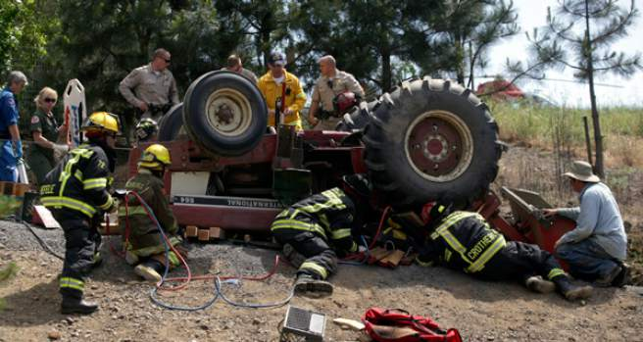
Farming is a High Risk Occupation
  Agriculture is one of the most dangerous U.S. industries
  Leading cause of death is tractor rollovers
  Agricultural injuries more severe than non-agricultural injuries
www.pressdemocrat.com
Notes:
Working on a farm is a tough job, and we respect those that do it. You deal with a lot of heavy machinery that the public doesn’t understand, and there can be accidents. And we know that when accidents happen, they usually aren’t pretty.

Slide 7
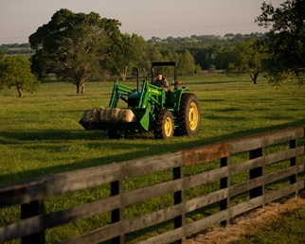
Working Farm Safety Issues: Prevention
Do not allow visitors to explore the farm unattended
Do not operate farm machinery near visitors
Buckets down & keys removed when machines not in use
Unsafe equipment stored in locked area
www.safeagritourism.com
Notes:
So some of the best ways to stop accidents from happening, is to not allow visitors to wander your farm alone. It’s also good if the guests don’t see you actually operating the machinery near them. If your machinery is in a visitor area, make sure equipment is on a level surface and it’s secured with buckets down, keys removed, and parking brakes on when not in use. Don’t let unsafe equipment (such as ones carrying chemicals, or without guardrails) sit within sight of guests. This does include unattended ladders! Make sure that children do not play on the equipment, even when not in use! If you have children that use the machinery, make sure they don’t do it while visitors are present. It gives children who haven’t grown up on the farm ideas.

Slide 8
Working Farm Safety Issues: Farm Machinery & Environment
Farm Machinery
  Tractors, combines, front loaders, wagons, grain carts, trucks, ATVs, etc.
    Falls
    Pinch/crush injuries from moving parts
    Entanglement in power take offs or drive belts
Farm Environment
  Electric fences
  Grain bins
  Silos
  Manure pits
  Haymows
www.safeagritourism.com
Notes:
So these are the machines and environments that we are most concerned about safety in. You can see the machinery we are most concerned about and potential injures that can happen to both visitors and workers. We also have these farm environments that we recommend you keeping visitors away from.

Slide 9
Question
Children <12 should be accompanied in a maze or hayride by an adult.
  True
  False

Slide 10
Question
Children <12 should be accompanied in a maze or hayride by an adult.
  True

Slide 11
Question
What is a safer alternative to a corn pit?
  Gravel Pit
  Ball Pit
  Sand Pit
  Mud Pit

Slide 12
Question
What is a safer alternative to a corn pit?
  Sand Pit

Slide 13
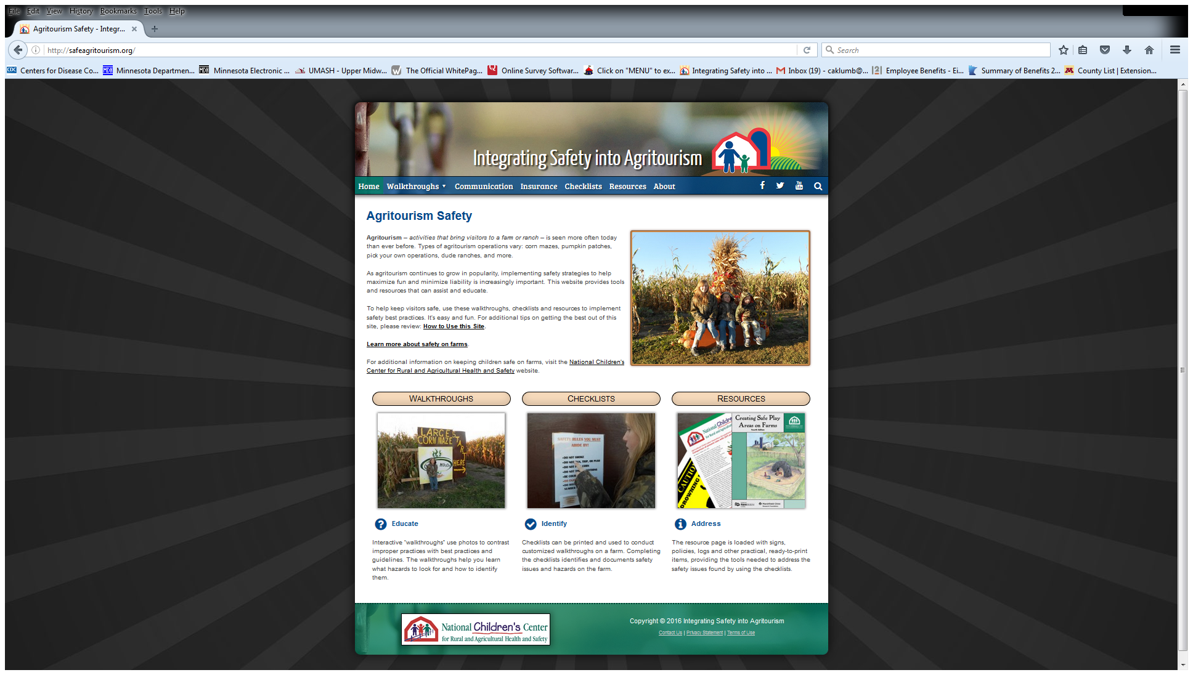
For More Information and Resources Please Visit the Integrating Safety into Agritourism Website
www.safeagritourism.com
Notes:
I hope I was able to give you a brief overview of safety for farm visitors, and helped find a place to start. I highly encourage everyone to check out the website on the slide. They do great walkthroughs and provide checklists for a wide variety of topics from general farm info, to water safety, to play area safety, with lots of others. I’m going to hand the presentation over to Carrie to cover our animal portion.

Slide 14
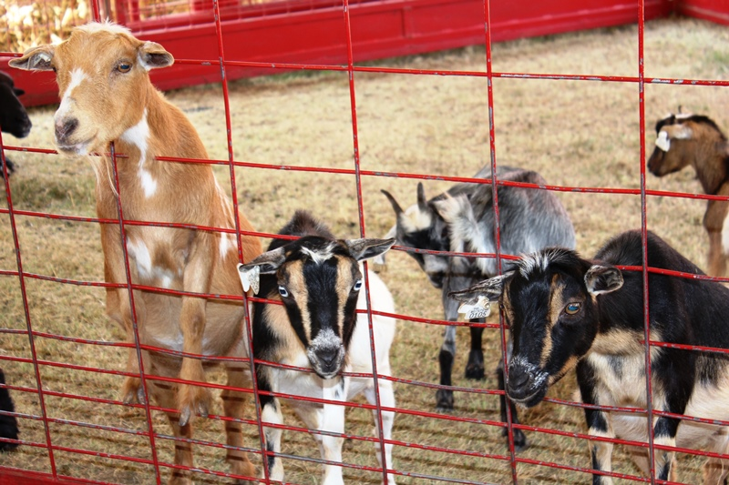
Does Your Operation Have Animals?

Slide 15
Do You Need an Exhibitor’s License for Your Animals?
You need a license if:
You don’t need a license if:
Animals are part of the agritourism attraction
Contact with animals is purposeful
Petting or feeding of animals occurs
  Animals are working or food animals
Contact with animals is incidental and agriculture based, or
Agricultural or veterinary skills taught

Slide 16
Obtaining a License
Visit the USDA Animal Care website: www.aphis.usda.gov
  Click on Animal Welfare
  OR
Contact the Regional Office at: 919-855-7100
Exhibitors license is required for domestic and exotic animals
Pre-license process can take several months- don’t wait until the last minute!

Slide 17
Situation #1
You own a dairy farm and occasionally give tours to school groups. When the students are in the calf rearing area learning about calf care, they sometimes reach out and pet a calf.
Do you need a USDA exhibitor’s license?
  A) Yes
  B) No

Slide 18
Situation #1
You own a dairy farm and occasionally give tours to school groups. When the students are in the calf rearing area learning about calf care, they sometimes reach out and pet a calf.
Do you need a USDA exhibitor’s license?
  B) No

Slide 19
Situation #2
?
You run a crop farm and have a pumpkin patch open in the fall with a corn maze, hot dog stand, 50 head of feeder cattle in a dry lot, and 10 goats. The goats are brought in from a friend’s farm just for pumpkin season for the kids to play with.
Do you need a USDA exhibitor’s license?
  A) Yes
  B) No

Slide 20
Situation #2
?
You run a crop farm and have a pumpkin patch open in the fall with a corn maze, hot dog stand, 50 head of feeder cattle in a dry lot, and 10 goats. The goats are brought in from a friend’s farm just for pumpkin season for the kids to play with.
Do you need a USDA exhibitor’s license?
  A) Yes

Slide 21
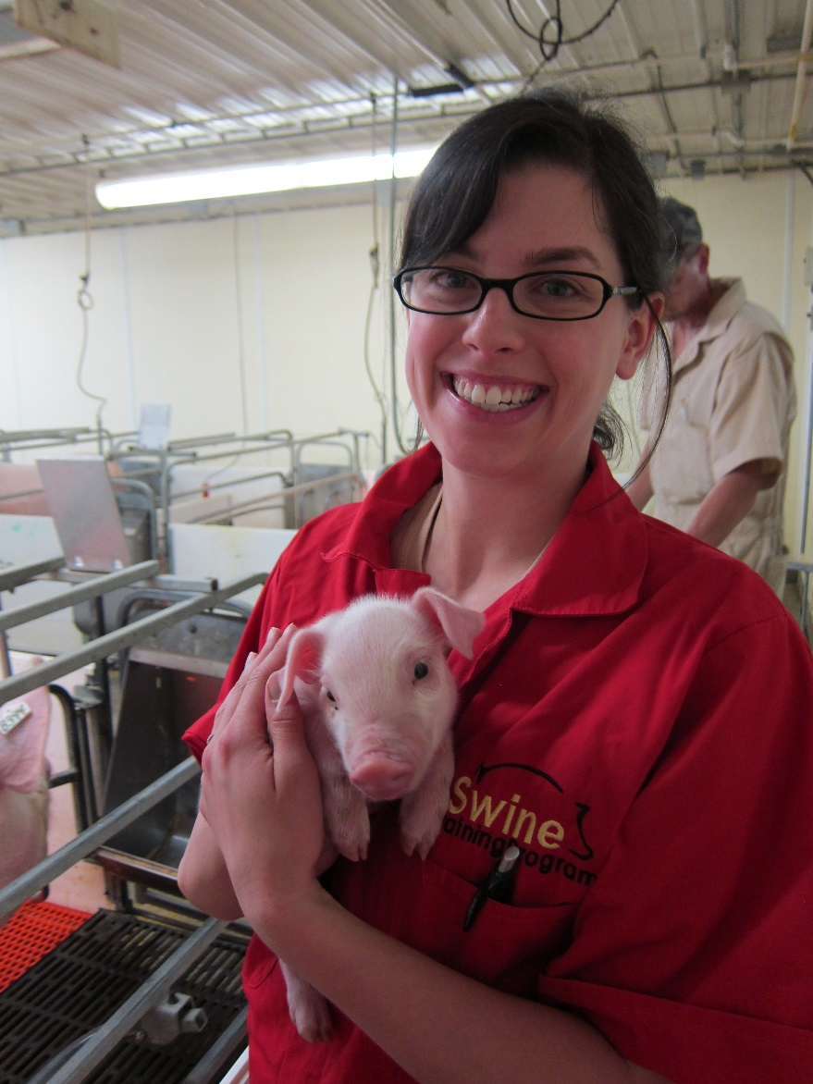
Benefits of Animal Contact
Most people have lost their connection to the land and animals. Agritourism can give people that connection
Visitors can learn about:
  Living or working on a farm
  Where their food comes from
  Animal behavior
  The human-animal bond

Slide 22
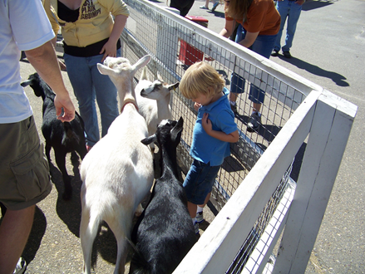
Risks of Animal Contact
Injury risk
  Animals can be unpredictable. Injuries are more common in children because of their size and behavior. Injuries include being stepped on, pushed over, pinned, kicked, scratched, or bitten
Disease risk
  Zoonotic diseases are caused by germs that animals and people can share. Common examples are influenza and E. coli

Slide 23

How Do People Get Sick From Animals?
Healthy animals may carry germs
These germs are normal for the animal & don’t cause illness
You can’t tell which animals have these germs by looking at them
I’m shedding germs.
But I’m not!
Who can tell??

Slide 24
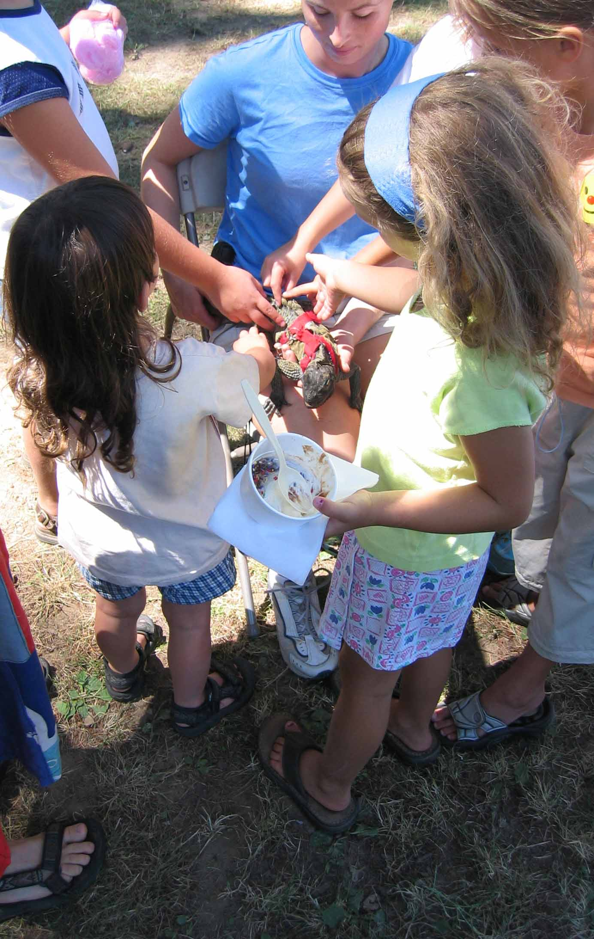
How Do People Get Sick From Animals?
Germs are present in animal feces
The feces help spread germs into the animal’s environment and onto the animal's fur and skin
People touch the animals or the environment & then accidently get germs in their mouths
  This is called a fecal-oral transmission route

Slide 25
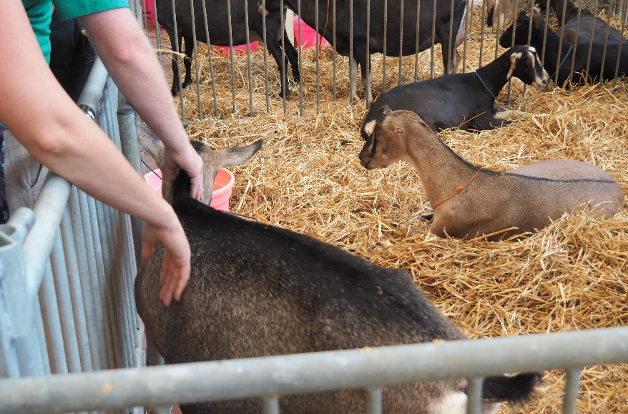
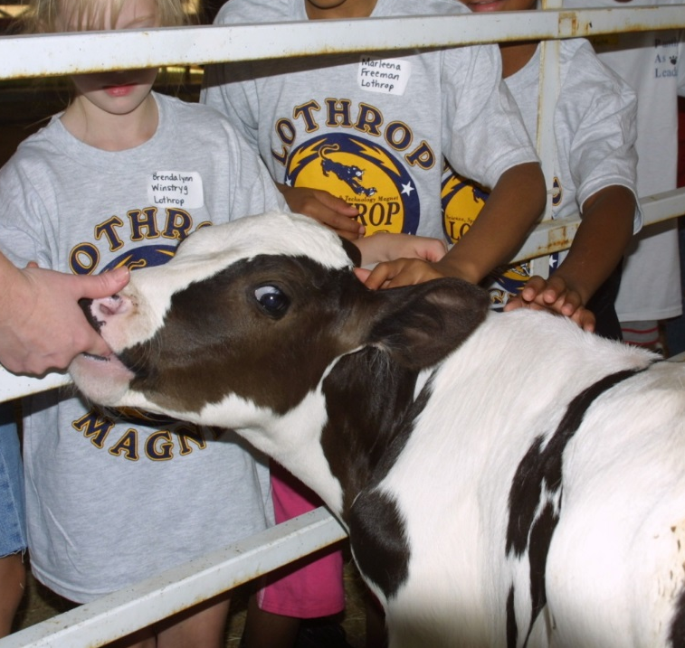
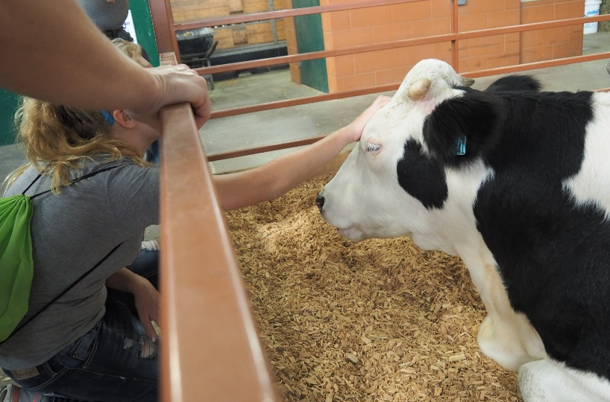
Transmission Through Direct Animal Contact
Direct contact is exactly what it sounds like: People touch animals directly with their hands
People then accidently transfer the germs to their mouths

Slide 26
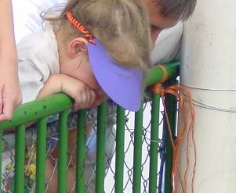
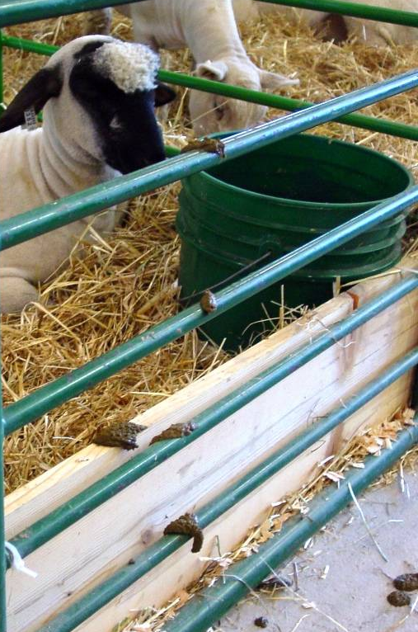
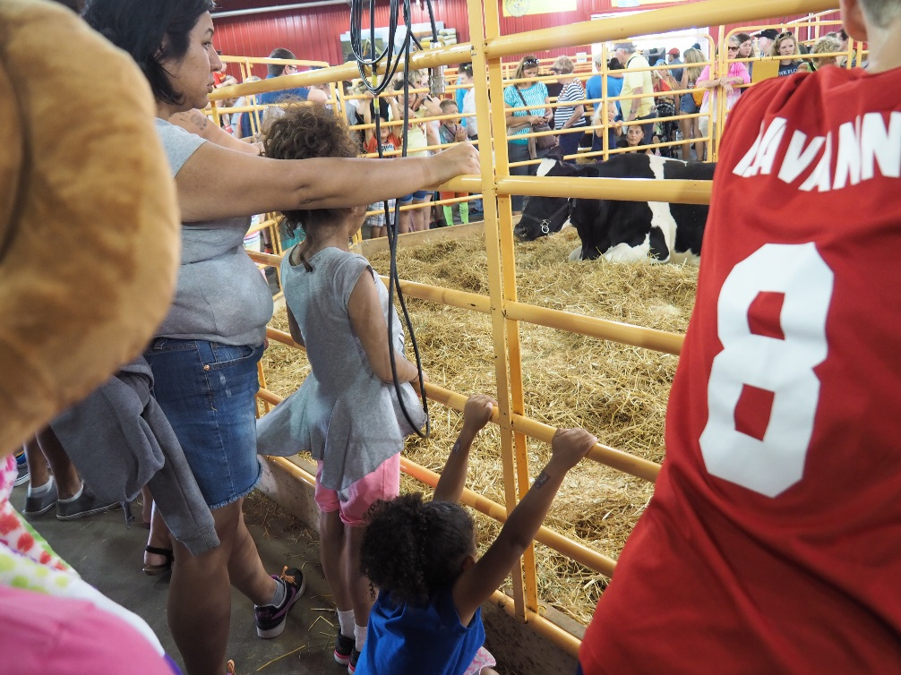
Transmission Through Indirect Animal Contact
Indirect contact occurs when hands or mouths come into contact with contaminated surfaces, such as railings or animal bedding
People then accidently transfer the germs to their mouths

Slide 27
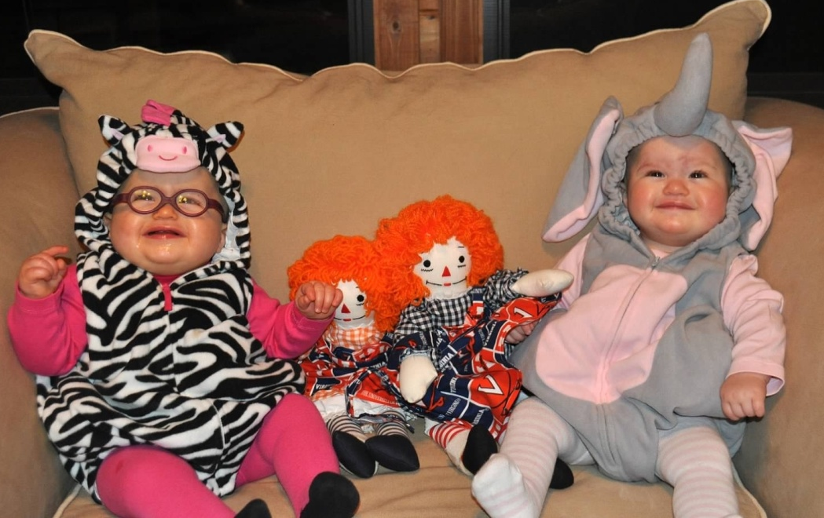
Are Certain People More Likely to Get Sick Than Others?
Yes! These are known as “high risk” groups
High Risk Groups
  Children <5 years old
  Adults >65 years old
  Pregnant women
  People with compromised immune systems
Urban and suburban people who are naïve to germs farm animals may have
Notes:
People don’t know there is a risk!
Most visitors have little understanding of agriculture. What is common sense to you is not common sense to them.
Because you know the risks you use different clothes and shoes for working with animals. When you are done with work, you change them.
But your visitors don’t know this. They don’t change clothes or shoes when they get home from visiting animals. They eat and drink in the animal areas. They don’t necessarily know how important it is to wash their hands immediately.
It is very important that visitors understand the possible hazards of animal contact. It is your responsibility to help educate them.

Slide 28
What Germs Are Most Concerning?
Germ | Animals that carry germ | Symptoms in people
E. coli O157:H7 and other Shiga toxin-producing E. coli (STEC) | Cattle, sheep, goats | Diarrhea, bloody stool, stomach cramps
Salmonella | Poultry, cattle, sheep, pigs, reptiles | Diarrhea, stomach cramps, fever, vomiting
Campylobacter | Poultry, cattle, sheep, goats, pigs | Diarrhea, stomach cramps, fever
Cryptosporidium | Cattle, sheep, goats, deer | Watery diarrhea, stomach cramps, vomiting, weight loss, loss of appetite

Slide 29
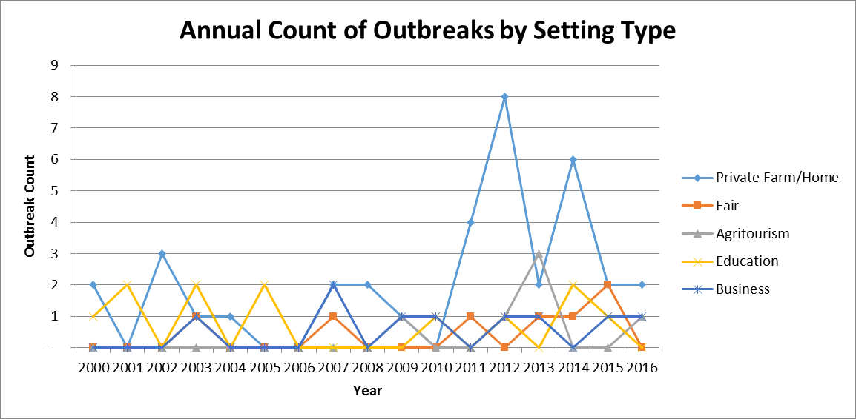
Is This A Big Problem?
MDH investigates animal contact outbreaks every year
Little to no regulation or guidance for operators
Outbreaks causing severe illness often result in lawsuits
Notes:
This boy, who lives on a Minnesota dairy farm, was hospitalized for 9 days.

Slide 30
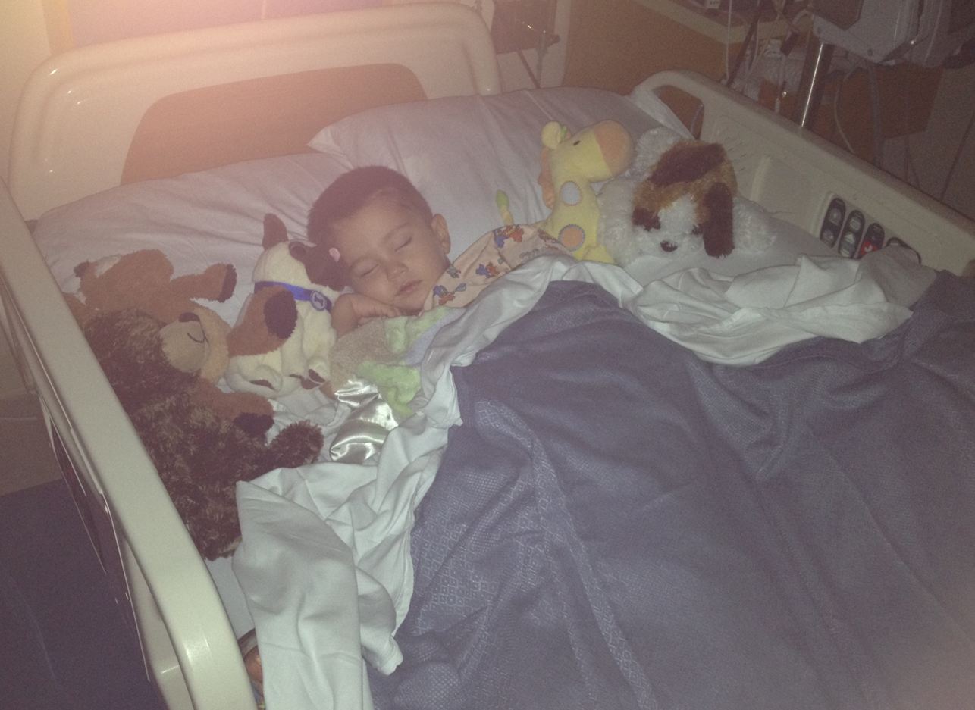
Why Should We Be Concerned?
E.coli O157:H7 infections can cause Hemolytic Uremic Syndrome (HUS); a severe illness requiring hospitalization. 5% of HUS cases are fatal.
Children <5 at higher risk of severe illness
The average hospitalization cost of an HUS case is $200,000 but can be over $1 million
Notes:
This boy, who lives on a Minnesota dairy farm, was hospitalized for 9 days.

Slide 31
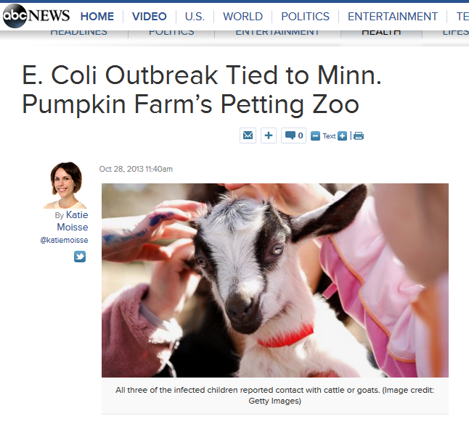
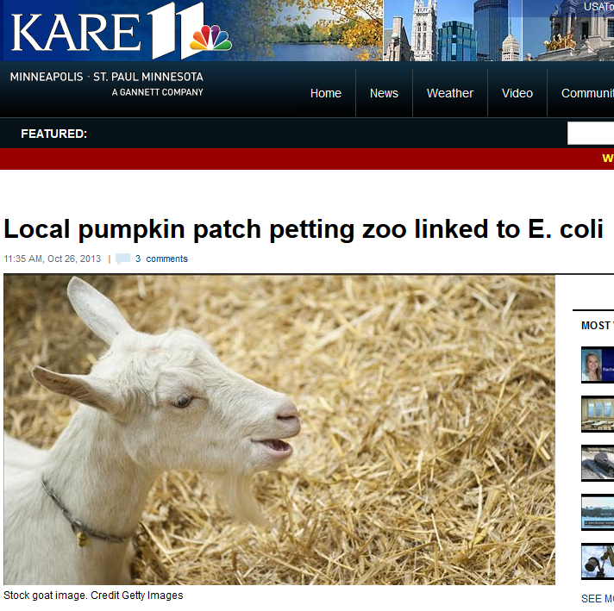
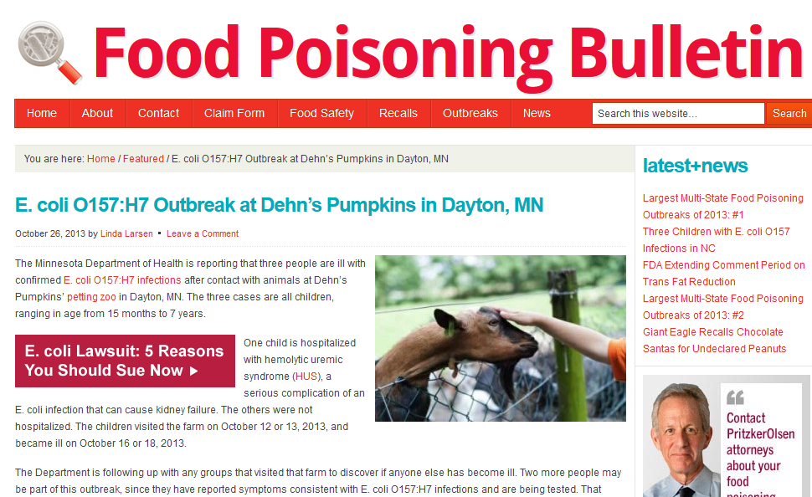
What Do These Outbreaks Mean For You?
For an owner, an outbreak can have a significant impact on both finances & reputation
In Minnesota, a recent jury trial awarded $7.5 million to the family of a girl who became ill with E. coli and HUS after visiting an agritourism farm

Slide 32
Question
Can healthy, well cared for animals carry germs that can make people sick?
      Yes
No

Slide 33
Question
Can healthy, well cared for animals carry germs that can make people sick?
      Yes

Slide 34
Question
How do people get sick from animal germs?
Just by looking at the animals
By ingesting the germs
Through the air
By sneezing on an animal

Slide 35
Question
How do people get sick from animal germs?
By ingesting the germs

Slide 36
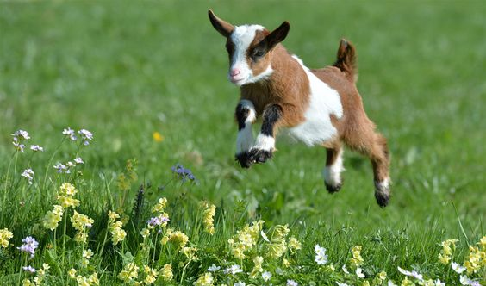
Animal Contact Venue Best Practices
Let’s get started!

Slide 37
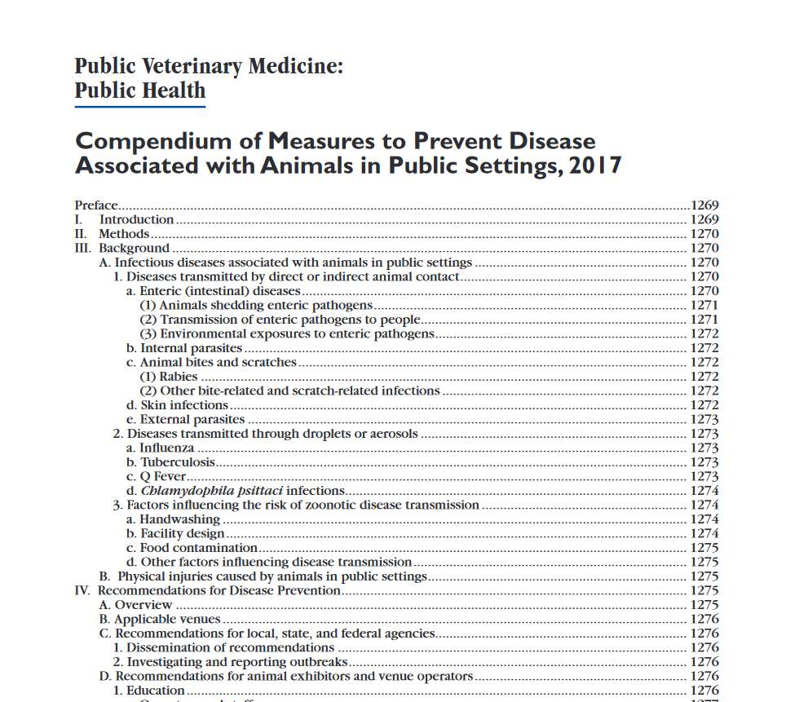
Where Does This Information Come From?
National best practices set by a group of experts
Updated regularly
Used in lawsuits to determine if operation was following best practices
  Used due to lack of regulation
Notes:
Beginning in 2009, members from the National Association of State Public Health Veterinarians met in order to develop best practices for preventing human disease associated with animals in pubic settings. These best practices were updated in 2011. This entire compendium has been included in your binder. These best practices are similar to what the Ag industry’s best practices for animal health.

Slide 38
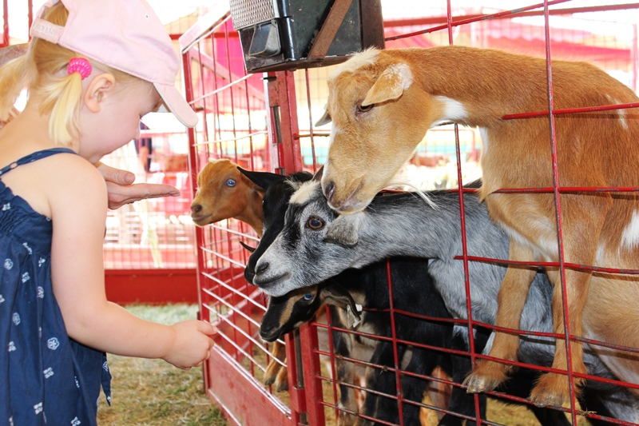
Main Problem
Most visitors don’t understand that healthy animals can carry germs that may make them sick
Lack of understanding of inherent risks prevents visitors from taking action to reduce their risk
Goal is to minimize risk using best practices
  Risk will never be zero

Slide 39
Animal Exhibit Facility Design

Slide 40
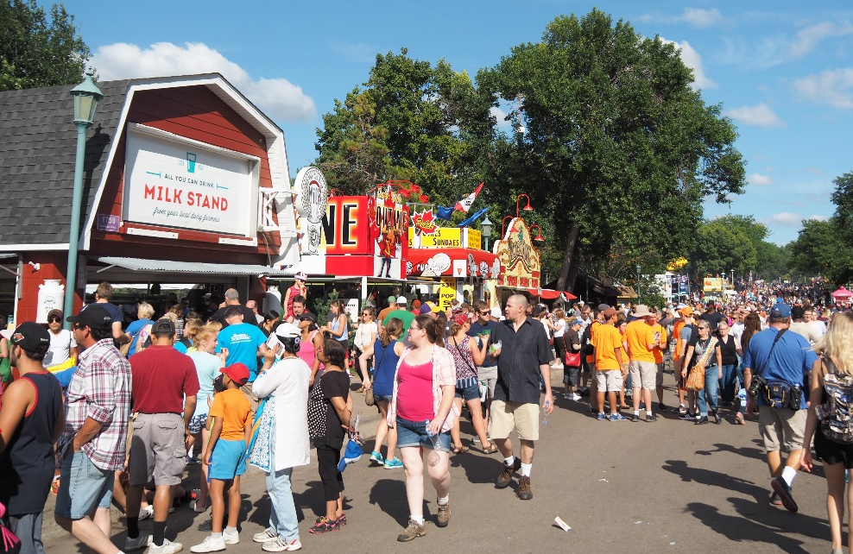
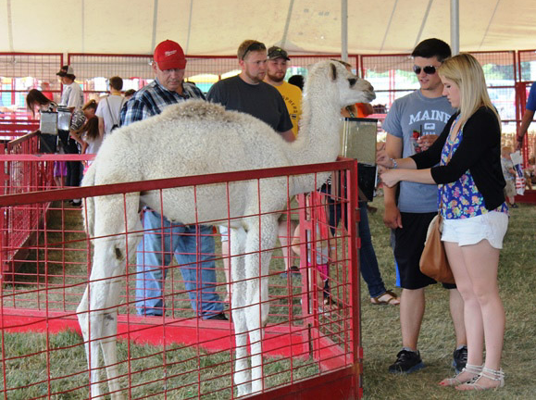
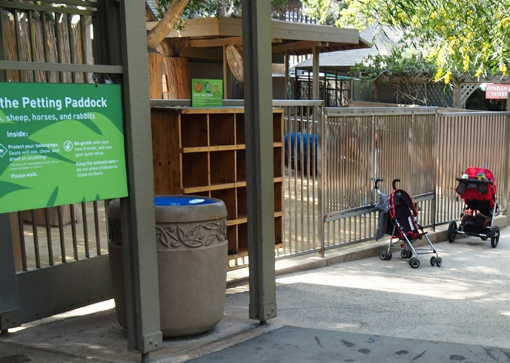
Every Venue Should Have Three Areas
  Non-animal areas No animals are on display here
  2. Transition areas Located at the entrances and exits to animal areas
  3. Animal areas
  Animal contact is possible or encouraged

Slide 41
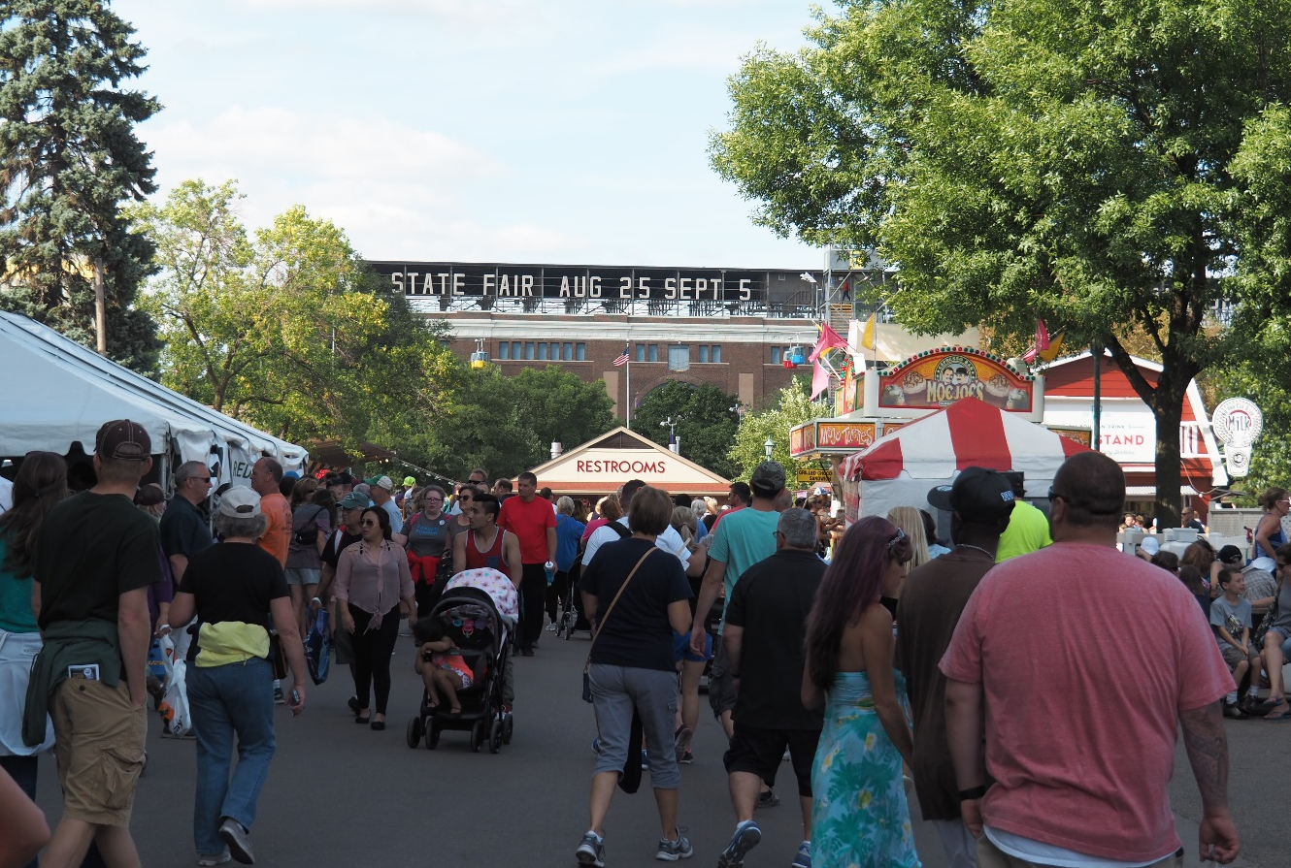
1. Non-animal Area
No animals displayed
All food preparation and consumption in this area
Handwashing facilities & signs

Slide 42
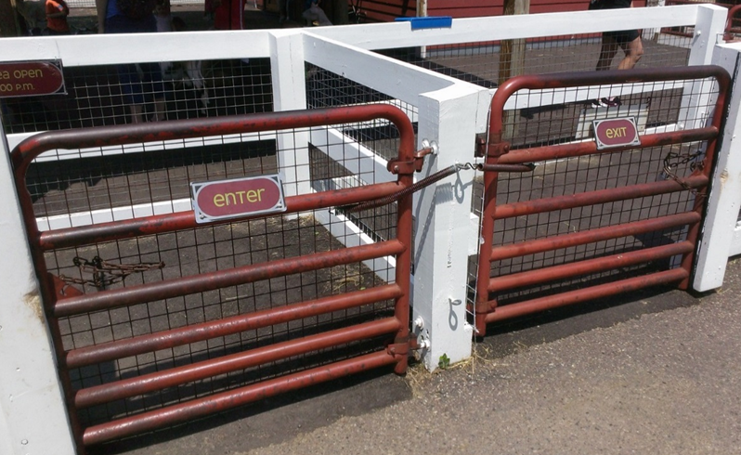
2. Transition Areas
  Zones at entrance & exit of the animal contact area
  May seem unnecessary, but are critical in minimizing risk
  Transition zones help establish a 1-way flow of traffic; separate entrance and exit points

Slide 43
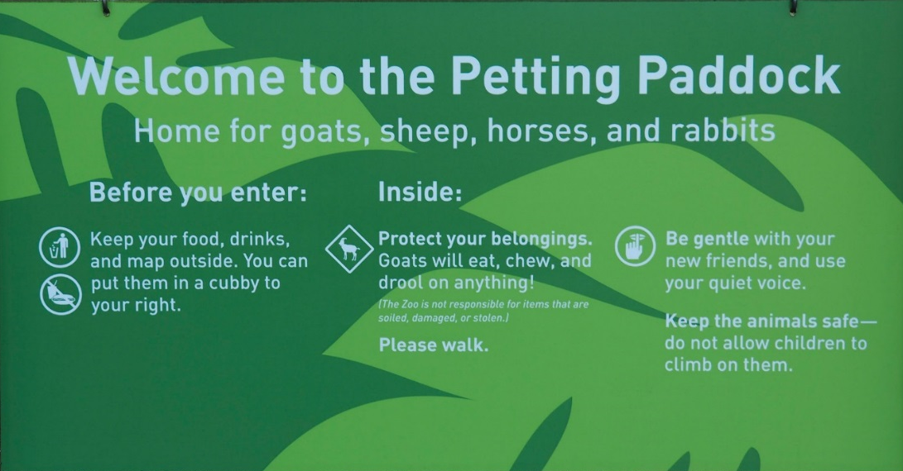
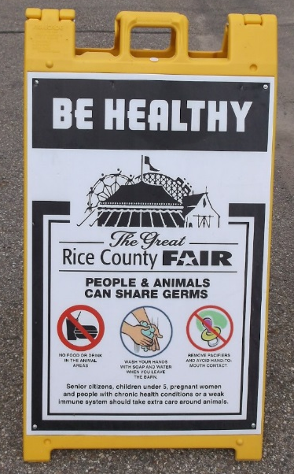
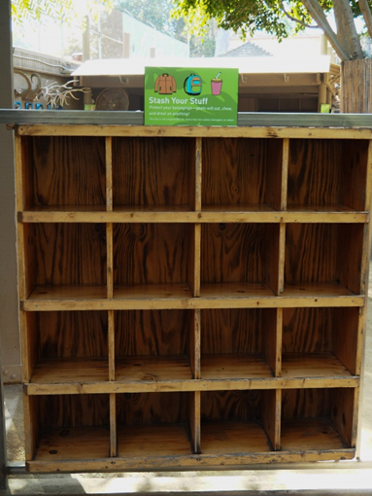
Entrance Transition
Main focus should be education
  Signs
  Staff members to educate, monitor for prohibited items, answer questions, and regulate traffic flow
  Storage for strollers, wagons, diaper bags, food and drink

Slide 44
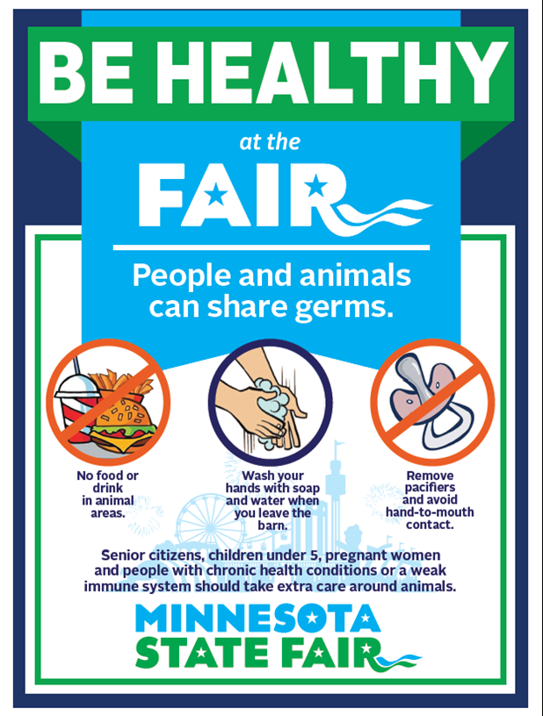
Key Messages For Entrance Transition Signs
  Animals carry germs that may make people sick
  No hand-to-mouth activities
  No food or drink
  No sippy cups, bottles, or pacifiers
  No strollers or wagons
  Children less than 5 years old, adults over 65, pregnant women, and those with immunocompromised are at increased risk of illness
  Ask staff if you have questions

Slide 45
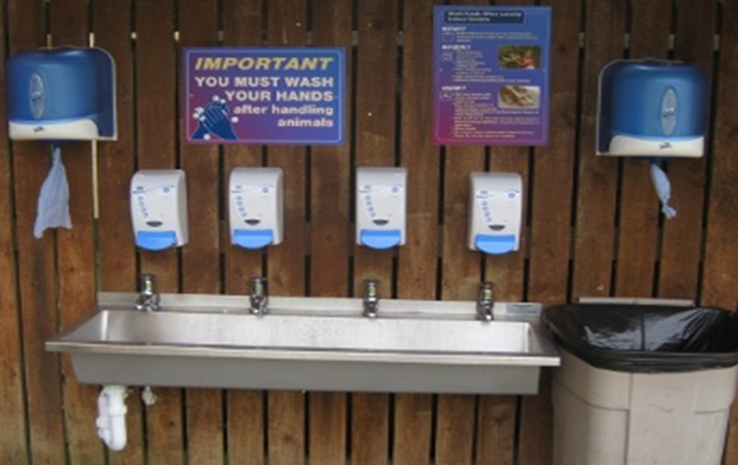
Exit Transition
Handwashing facilities
  Signage should instruct visitors to wash hands
  Staff members should be present to encourage proper handwashing

Slide 46
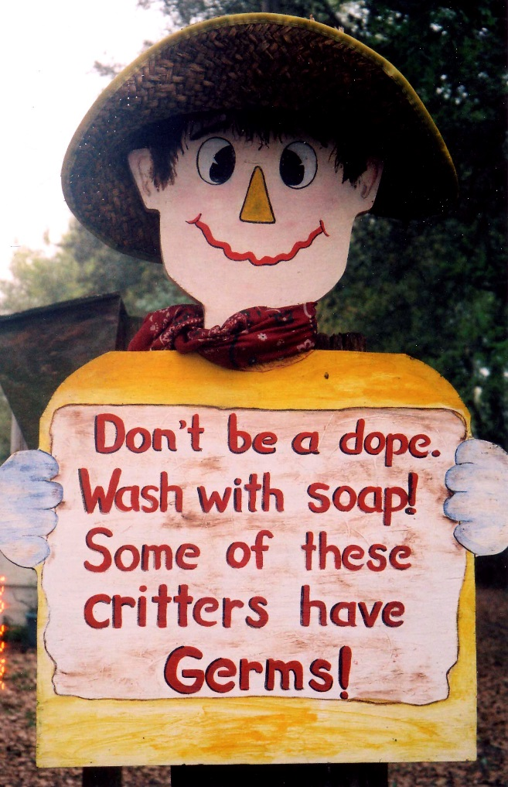
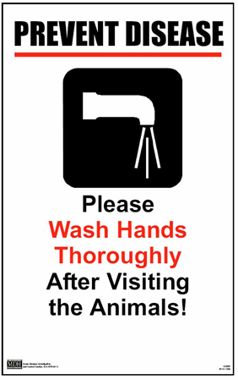
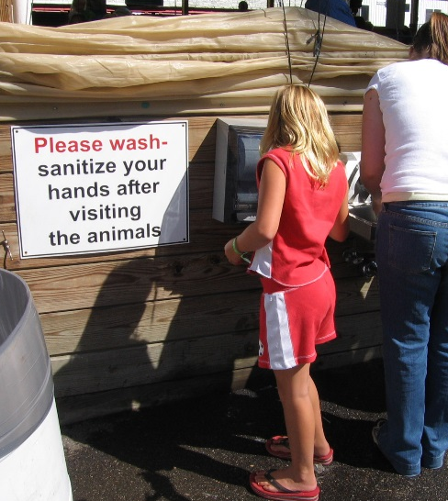
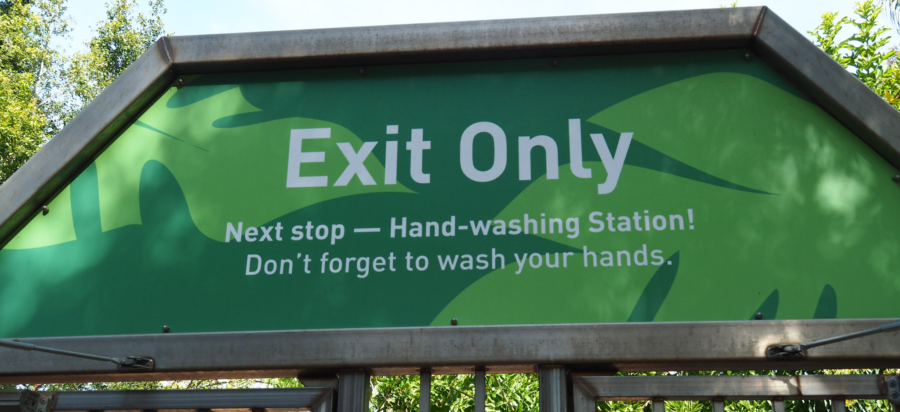
Key Messages For Exit Transition Signs
  Handwashing is the best way to protect yourself
  Location of handwashing stations
  Instructions for handwashing

Slide 47
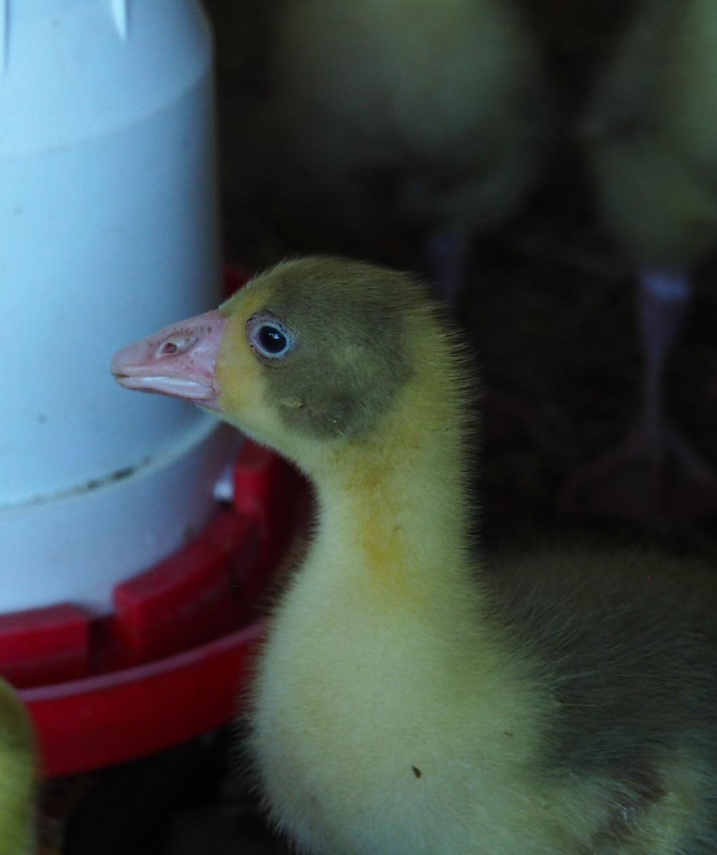
3. Animal Areas
Contact with animals through a fence; no visitors in pens
Keep food and beverages out
Waste management considerations
Notes:
Waste management
Remove manure and soiled animal bedding promptly
Store animal manure and tools for removal (shovels, pitchforks) in designated areas not accessible to public
Avoid transporting manure and soiled bedding through public areas

Slide 48

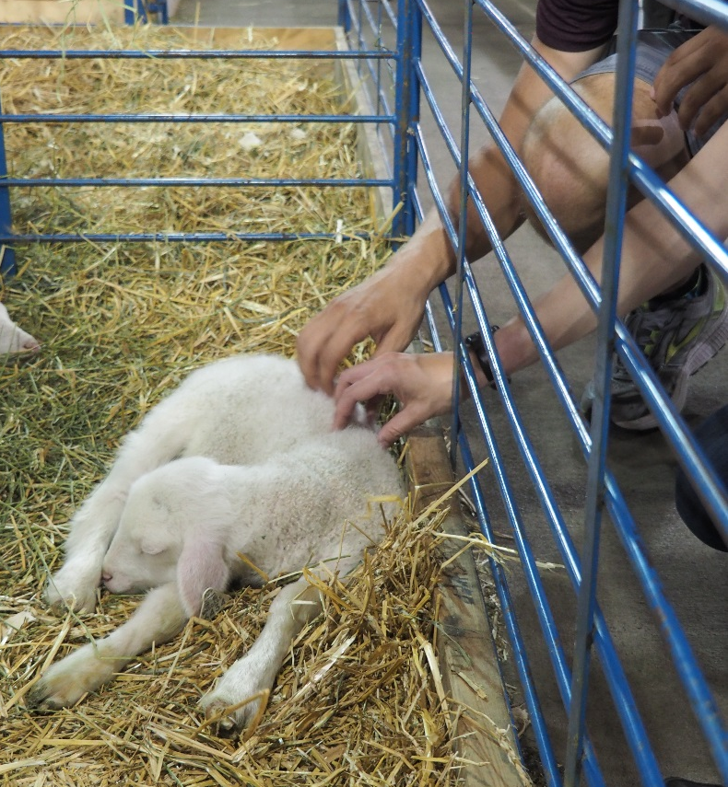
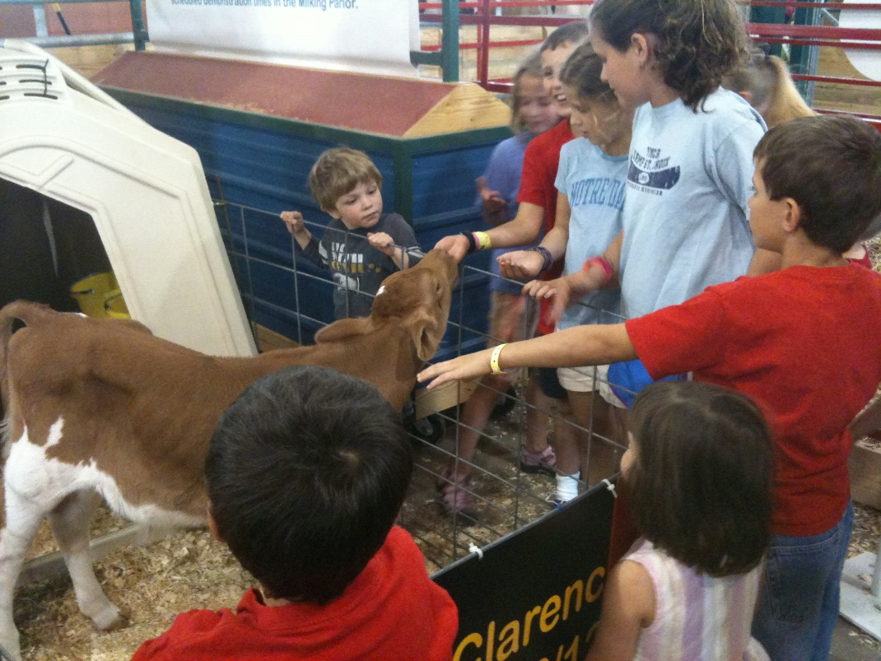
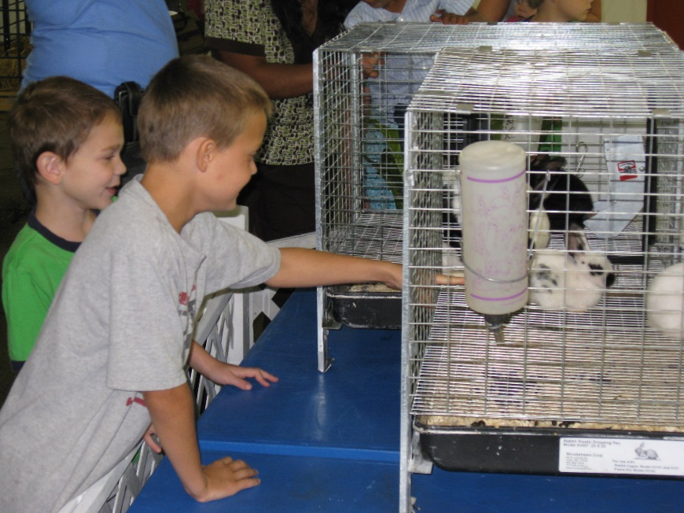
Animal - Visitor Interactions
Visitors should pet animals only through or over barriers
This reduces the potential for contamination & injury

Slide 49
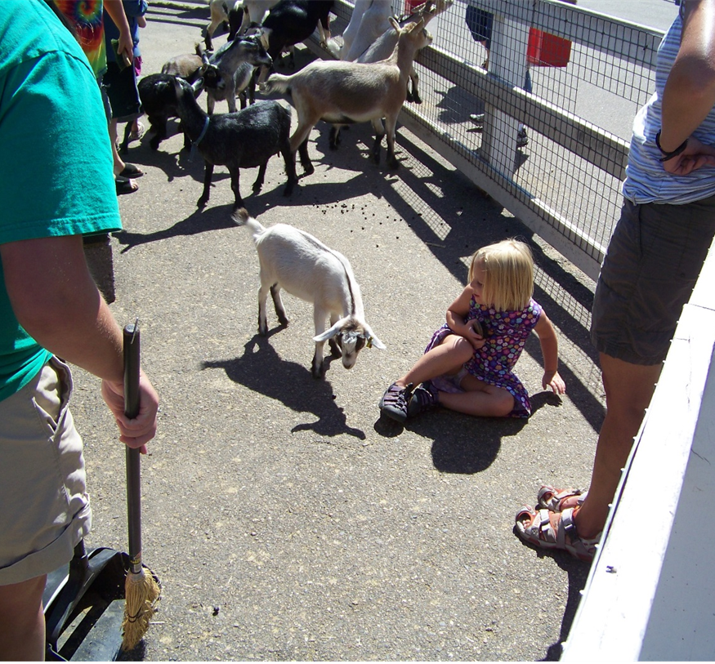
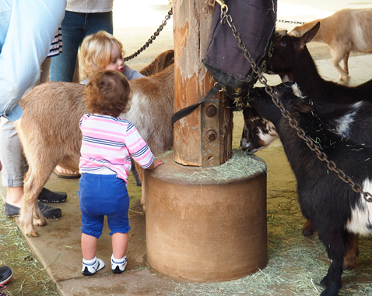
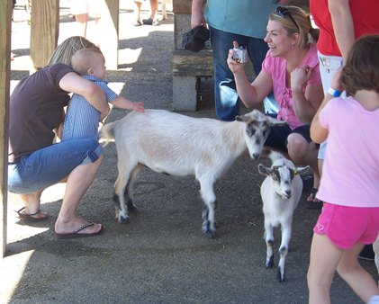

Animal - Visitor Interactions
People love to be inside the pen with animals, but it greatly increases the chance of getting manure on clothes, shoes, or hands. The risk of injury increases as well

Slide 50
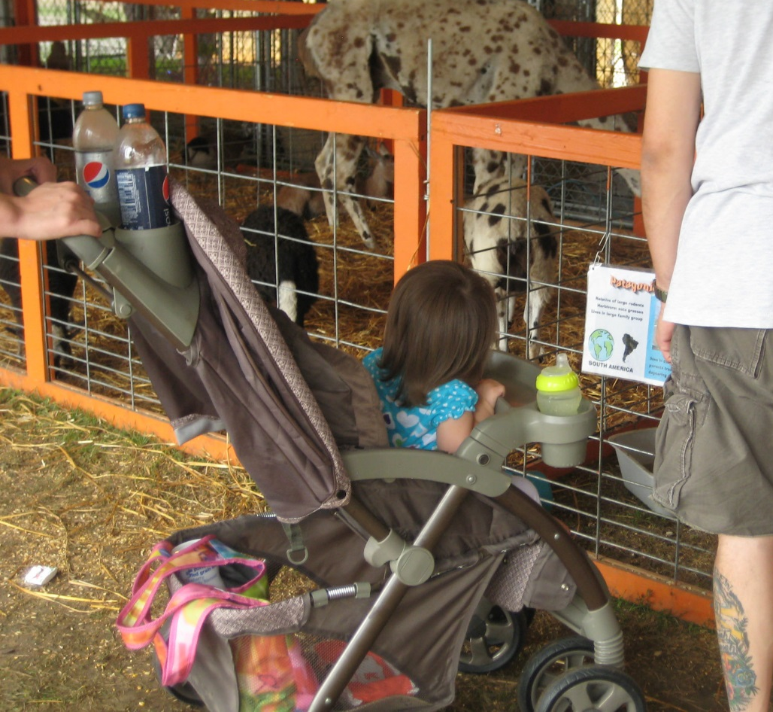





Prohibited Items In The Animal Area
No food or beverages
No pacifiers, sippy cups, baby bottles, toys (i.e., no hand-to-mouth items)
No smoking, tobacco, or e-cigarettes
Removing these items reduces risk of ingesting germs that got onto food or drink and reduces hand-to-mouth contact

Slide 51

Animal Feeding
    If allowing feeding, be creative to minimize human-animal contact!
    One Minnesota exhibitor created PVC pipes that extend from visitor side to animal side

Slide 52
Question
What’s the main point of the exit transition area?
    Place to keep bags and strollers
    Handwashing
    Education about the risks
    Taking pictures of the animals

Slide 53
Question
What’s the main point of the exit transition area?
    Handwashing

Slide 54
Animal Care and Management

Slide 55






Animal Care And Management
Carefully choosing the types of animals at your venue can reduce the possibility of disease and injury
Some species or ages of animals are more likely to carry germs. This means they are riskier for our high risk groups
vs
vs
vs
HIGHER RISK
LOWER RISK

Slide 56


Slide 57

Animal Care
Don’t include animals from herds with a recent history of abortion, diarrhea, respiratory or skin disease
Monitor animals daily for signs of illness or injury
Remove sick or injured animals promptly, especially those with diarrhea/scours. These animals shed more germs
Minimize stress and overcrowding. This will also cause animals to shed more germs

Slide 58

Cleaning and Disinfection
  Cleaning & disinfection are two separate processes. Both must be done to remove germs
  What to clean & disinfect?
    Surfaces in the animal area that visitors can touch, such as railings & barriers
When to clean & disinfect?
  Daily
  When manure or visible debris is noticed

Slide 59


1. Cleaning
How to clean?
  For cleaning, use water and a good detergent
  Surfaces should be cleaned to remove visible debris/feces
Notes:
Link: http://www.cfsph.iastate.edu/Disinfection/index.php
Make “Iowa State University Center for Food Security and Public Health” the link text.
Many disinfectants require 10 minutes contact time to work, so it’s best to apply and let dry

Slide 60

2. Disinfection
How to disinfect?
  For disinfection after cleaning:
    Bleach, in a 1:32 dilution, is very good (Use 1/2 cup bleach to 1 gallon of water)
    or
    Disinfection products, such as quaternary ammonium
  Apply and let dry! Don’t wipe off- contact time is important
  Consider your animals! You don’t want them to inhale strong fumes
Notes:
Link: http://www.cfsph.iastate.edu/Disinfection/index.php
Make “Iowa State University Center for Food Security and Public Health” the link text.
Many disinfectants require 10 minutes contact time to work, so it’s best to apply and let dry

Slide 61

Waste Management
Remove feces and soiled bedding promptly, as soon as it is noticed
Store animal waste away from the public. Consider rainfall, and prevent run-off from seeping into foot traffic areas
Store pitchforks, shovels, front-loaders in areas not accessible to the public
Avoid moving waste and soiled bedding through the non-animal area and transition areas if possible

Slide 62



Walkways and Floors
  Walkways and floors should be kept free of feces and bedding
Use solid bottom barriers to keep feces and bedding from spreading into the walkways
When no barriers are present, bedding & feces can easily contaminate shoes & clothing & be tracked home or grabbed by children

Slide 63
Question
What animals are NOT recommended for children <5 years of age?
Calves
Chicks and ducklings
Reptiles and amphibians
None of them are recommended

Slide 64
Question
What animals are NOT recommended for children <5 years of age?
None of them are recommended

Slide 65
Staff Education

Slide 66
Main Messages You Should Understand
  Healthy animals carry germs that may make people sick, and these illnesses are sometimes very serious
    Visitors can get germs on their hands, clothes, bags, or strollers through direct or indirect contact with animals or their environment
    People accidently put these germs in their mouth, via eating, drinking or hand-to-mouth contact
  Handwashing is the best prevention step visitors can take
    Visitors can remove most germs by washing their hands immediately after leaving the animal area
    Visitors should wash and dry their hands even if they didn’t touch animals

Slide 67

Additional Owner/Operator Responsibilities
  Understand and apply the recommendations from the national best practices (NASPHV Animal Contact Compendium)
  Train staff on risks and prevention at least once per year
  Ensure that you and your staff are comfortable explaining risk and prevention concepts to visitors

Slide 68
Visitor Education

Slide 69


Visitor Education and Signage
The two best ways to educate people
Verbal education from staff
Well placed and effective signs

Slide 70

Verbal Education From Staff to Visitors
Staff should be actively engaged with visitors
Education becomes a natural conversation and is much more effective than signs alone
Notes:
Use the topics 2 slides ago to verbally educate people;
Healthy animals can carry germs that make people sick, and these illnesses are sometimes very serious.
Visitors can pick up these germs when they touch animals or enter the animal’s environment.
People should not eat or drink and should avoid hand-to-mouth activities while visiting the animals.
Handwashing is the BEST prevention step visitors can take to reduce their risk of illness.
Visitors should wash and dry their hands even if they didn’t touch animals.

Slide 71

Verbal Messages To Use With Visitors
  Healthy animals can carry germs that may make people sick so it’s important to wash your hands after visiting the animals
  These germs come out in the animal’s feces and can end up on the animal’s fur, in its mouth, or in it’s living environment
  That’s why we want people to keep food and drink out of the animal areas and avoid hand-to-mouth activities while visiting the animals
  Even if you don’t touch the animals it’s still important to wash your hands

Slide 72

Remember, Visitors Don’t Understand the Risks
Your responsibility is to educate as much as possible

Slide 73
The Importance of Handwashing

Slide 74

Handwashing
Handwashing is the best prevention step visitors can take to reduce their risk of getting sick!
Key points to improve hand hygiene:
Verbal reminders from staff
Large signs with prominent messages
Staff at the exit area
Convenient, clean & close facilities
Adequate running water with soap & paper towels

Slide 75

Location of Handwashing Stations
Position handwashing stations at exit within traffic flow to maximize usage
Also have stations located near food concession areas
Independent handwashing stations that are located away from bathrooms can help families supervise children washing

Slide 76




Type and Design
Stations should be accessible to children, adults & those with disabilities
They should be low enough to reach or equipped with a stool

Slide 77


Type and Design
Easy to use sinks or stations are best. Complex stations will cause people to quickly give up without washing
Stations should allow both hands to be free to wash. Don’t use stations that require one hand holding a pump to get water
Hand pump!
Needs instructions!

Slide 78

Notes About Hand Sanitizer
Sanitizer has a place & can quickly eliminate some germs, but it is not effective against all germs
  Doesn’t work against Cryptosporidium
Doesn’t work if hands are visibly dirty
Needs to contain 60% (or more) alcohol
May be used until soap & water are available but doesn’t replace soap & water!

Slide 79

Help With Handwashing Stations
AGRI Minnesota Value Added Grant Program from MDA
  Offers grants to individual farmers or businesses for improvements to their agritourism operation. Handwashing stations, construction costs for expansion, or season-extending facilities
  Also available for other items that will add value to an agricultural operation
  There are two application periods per year
  Grant program
Notes:
http://www.mda.state.mn.us/en/grants/grants/valueaddedgrant.aspx

Slide 80
Question
Hand sanitizer is just as effective as soap and water at killing all types of germs.
    True
    False

Slide 81
Question
Hand sanitizer is just as effective as soap and water at killing all types of germs.
    False

Slide 82
Resources

Slide 83

Safer Farm Animal Contact Exhibits (Safer FACEs)
New, free online program offered by MDH
Voluntary; certificate mailed upon completion
To register:
  Email SaferFaces@state.mn.us with the following information: your name, your animal contact venue, and the best way to contact you
  Call: 651-201-5414 and ask about Safer FACEs

Slide 84
Safer FACEs Testimonials
Small petting farm: "The training is great. What I really like about this training is that it is something I can have all my volunteers do.”
Nature center/small farm: "One of the reasons for taking the course was to help us not only know we should be doing but to help us see what we are already doing that is part of best practices. Part of my job is training and mentoring new staff. I will definitely be having them take this course to help them understand why we do things the way we do at the farm.”
Fairgrounds manager: "The topics were informative and I feel we will be better prepared for our county fair."

Slide 85



MDH Resources
MDH
Notes:
Use us as a resource; we’re the cheapest consultants you’ll ever get- free!
In person
Over the phone
By email

Slide 86


Upper Midwest Agricultural Safety and Health Center (UMASH) Resources
UMASH
Notes:
Use us as a resource; we’re the cheapest consultants you’ll ever get- free!
In person
Over the phone
By email

Slide 87




Questions?

