Slide 1
Evaluating “Swineage” in Maryland:
Lessons Learned
MARYLAND DEPARTMENT OF HEALTH
Monique Duwell, MD, MPH
David Crum, DVM, MPH
February 28, 2019

Slide 2
Background and Methods

Slide 3
Background
Fall 2017: Variant influenza outbreak in Maryland
Letter from parent
Developed signs and met with stakeholders
Distributed signs for 2018 fair season

Slide 4
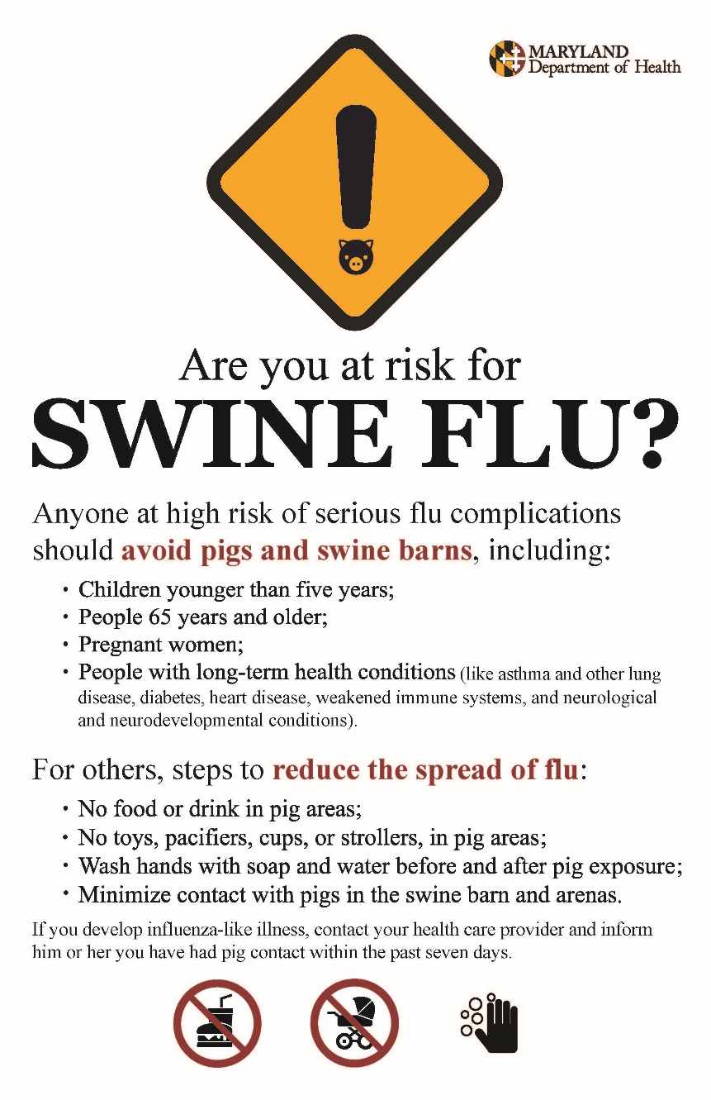

Slide 5
Sign Evaluation Planning
Drafted 10-question survey to learn about K, A, B of fair visitors to signs
Input from CDC staff

Slide 6
Survey
Did you enter a swine exhibit today? If not, why not?
What do you think your risk of getting swine flu is?
Do you remember seeing a sign about swine flu?
If so, what do you remember?
Did you do anything different as a result of the signs?
If yes, what?
How could we make the signs more effective?
Other recs to prevent swine flu?

Slide 7
Methods
Convenience sample of fair visitors near swine barn
Voluntary participation
2 staff conducted verbal surveys, recorded responses on paper
Offer give-away

Slide 8
Fair 1

Slide 9
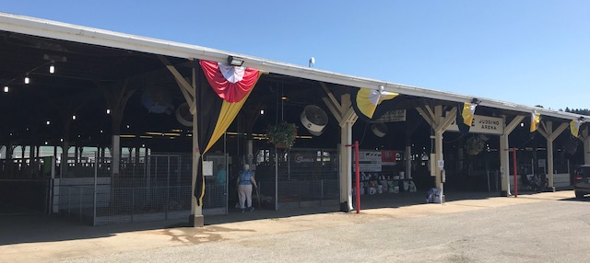
Fair 2

Slide 10
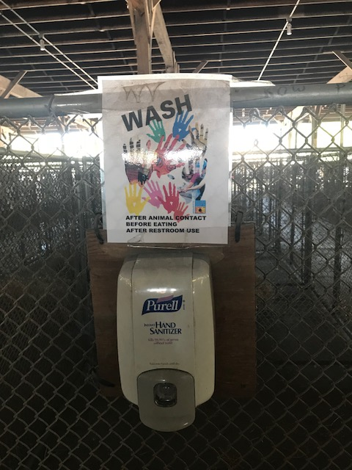
Fair 2

Slide 11
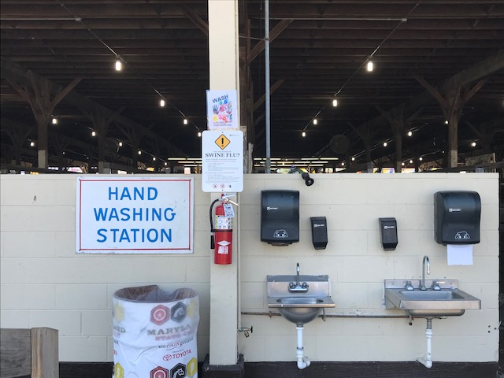
Fair 2

Slide 12
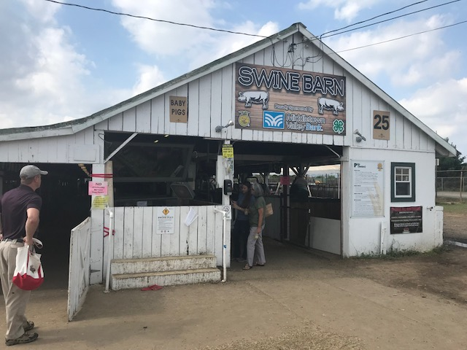
Fair 3

Slide 13
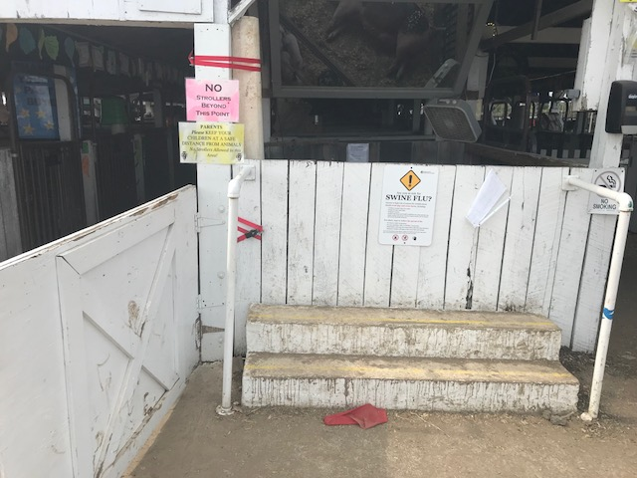
Fair 3

Slide 14
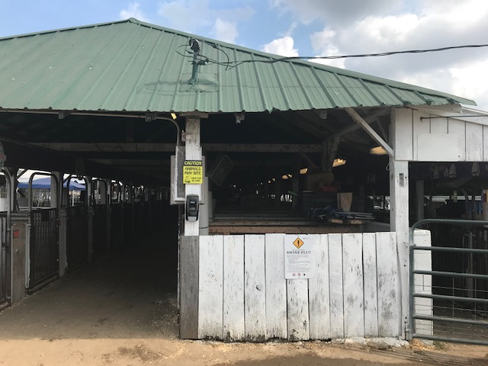
Fair 3

Slide 15
Evaluation Results

Slide 16


11 of 12 visitors agreed to survey.

Slide 17
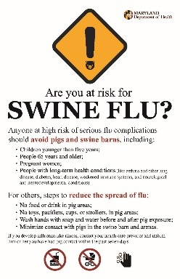
Fewer than half of visitors saw sign.

Slide 18
Most recalled high-risk group rec.
High risk group (4)
No toys, pacifiers (1)
Wash hands (1)

Slide 19



Most visitors perceived variant flu risk as “low” or “very low”.
Very low
Low
Somewhat high
Very high

Slide 20


7 visitors entered the barn.

Slide 21
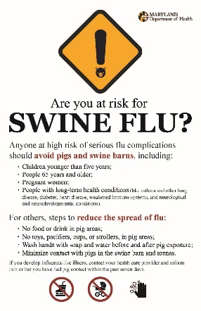
2 visitors didn’t enter barn because of signs.

Slide 22

Swineage Recs
Make signs bigger (2)
Post more signs (3)
Avoid negative portrayal of pigs (2)

Slide 23
Other Recs
Post signs to direct people to handwashing stations (6)
Move handwashing stations closer to the swine barn (1)

Slide 24
Lessons Learned

Slide 25
“Swineage” Placement
Provide specific instructions
Offer on-site assistance

Slide 26

Survey Logistics
Advance notification
Schedule more fairs than needed
Source: CDC

Slide 27


Conducting Surveys
Offer give-aways first
No clipboards
Questions as a guide only
Source: CDC

Slide 28
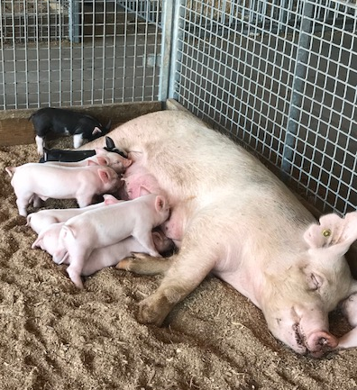
Thank you!

