Slide 1


Excellence in Exhibition: Preventing Disease in Animals and People
Bring Home the Blue, Not the Flu!
Molly Lee, DVM, MPH, DACVPM
youthinag@iastate.edu

Slide 2
Overview
Messaging
Build a flexible and engaging tool
Build on existing relationships
Awareness-level outreach
Project outreach
Finding the “right” individual
Train-the-trainer approach
Funding comments

Slide 3

Messaging
Showing animals is a good thing!
Encourage youth involvement with livestock and exhibitions in a safe and healthy manner
Prevent zoonotic disease
Follow biosecurity
recommendations
Promote public and animal health
Notes:
The course is designed to encourage youth involvement with livestock and animal exhibitions in a safe and healthy manner while preventing zoonotic disease, following biosecurity recommendations, and promoting public health and animal health.

Slide 4

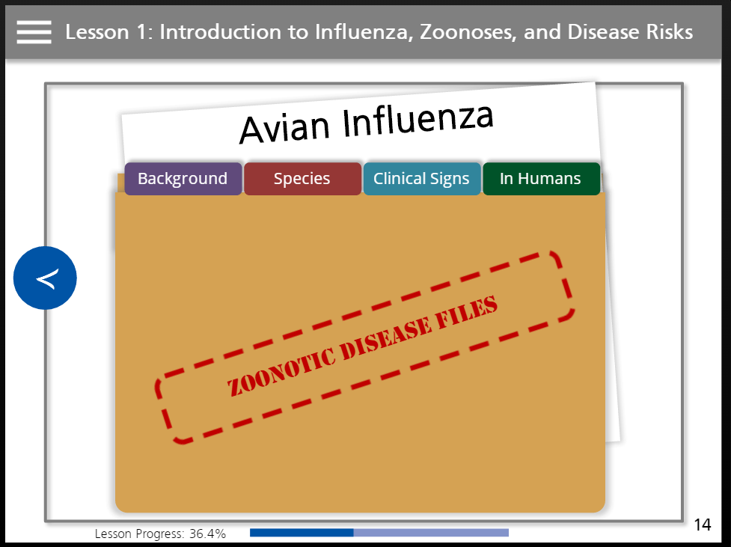
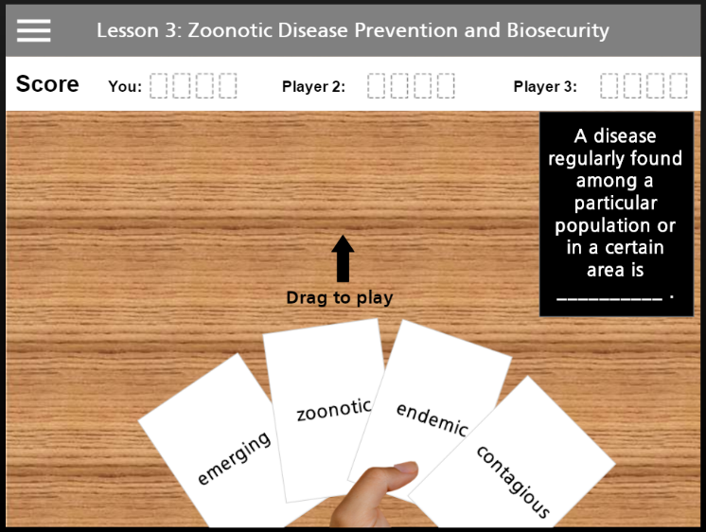
Build a Flexible and Engaging Tool
Interactive online courses
6 lessons per course
  Zoonotic diseases, ways to prevent disease spread, case studies, One Health agencies and careers
Supplemental resources for teachers

Slide 5

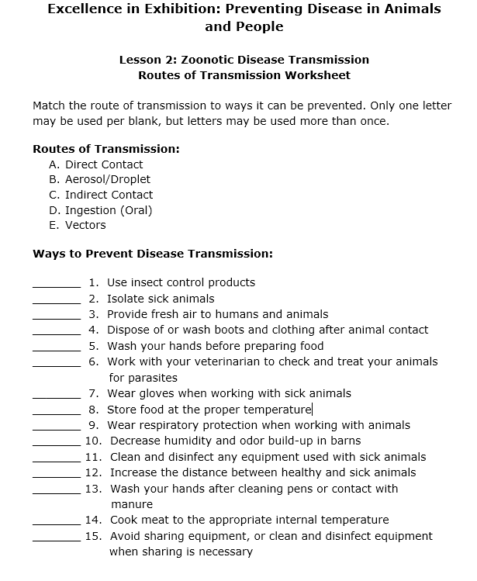
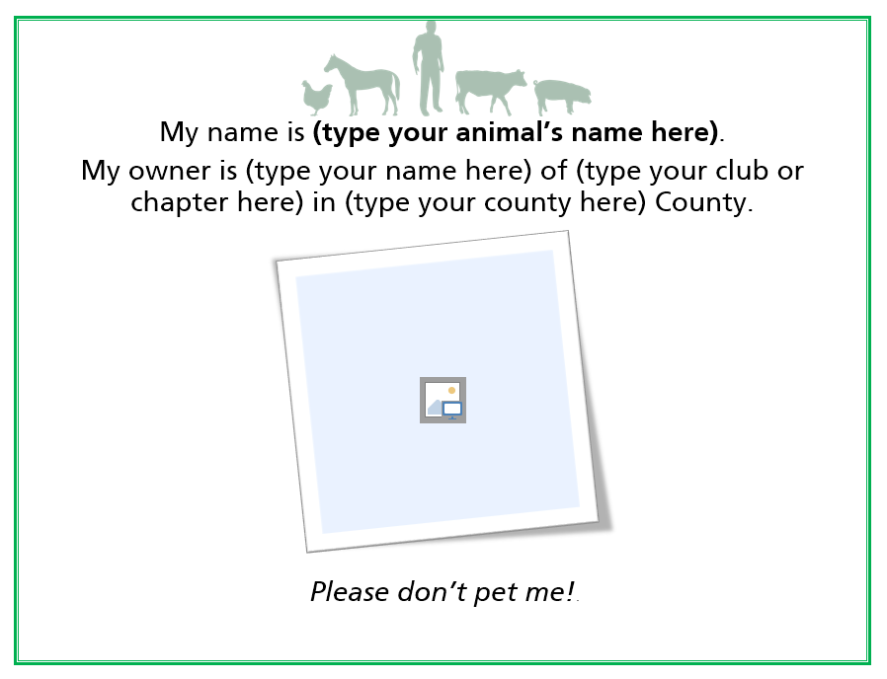
Supplemental Resources
Learning objectives
  With answers for instructors
PowerPoint versions
Disease factsheets
Lesson worksheets
  With answers for instructors
Biosecurity and disease
prevention hands-on
activity guides
Biosecurity signage
Notes:
On the website, we also have supplemental resources, including … [read]

Slide 6
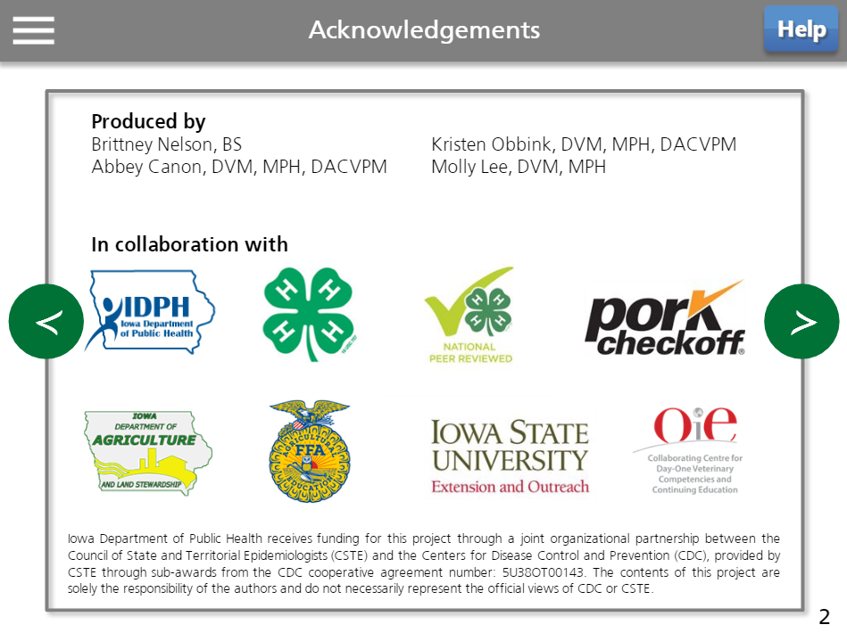
Build on Existing Relationships
Human health
Animal health
State and county youth agriculture organizations
Notes:
The project was also intended to foster collaboration and partnership between animal health, human health, and state and county youth agriculture organizations.
Built on existing relationships

Slide 7
Awareness-Level Outreach
American Association of Extension Veterinarians
United States Animal Health Association
Midwest Veterinary Conference
Multi-State Partnership for Security in Agriculture
CDC ZOHU Call
Email announcements and web postings to partner organizations, industry, etc.
Notes:
Email announcements: AABP, AASV, NASPHV, Iowa FFA and Extension, AAFSPHV, National Pork Board website…

Slide 8
Project Outreach
“Plug in” to existing mechanisms
  Iowa 4-H Youth Staff Conference (YouthFest)
  Iowa 4-H Conference
  Iowa 4-H Animal Science Roundup
  Iowa 4-H Extension Webinar
  Iowa Extension and Outreach Annual Conference Learning Fair
  Iowa FFA State Convention
  Iowa Regional FFA FSQA Trip
  Iowa Association of Agricultural Educators Conference
  Iowa Association of Fairs Annual Meeting
  World Food Prize Iowa Youth Institute
  World Pork Expo
  North Dakota Healthy Fairs
  International Association of Fairs and Expositions
  CSTE Conference
  World Food Prize Iowa Youth Institute
Notes:
Used project funding for time specifically related to the course: travel for project team (sometimes), but not attendees– no expenses related to room reservations, food for attendees, administrative time and expenses related to registration, etc.
Already interested in AnSci, Food Security, Vet Sci, etc.
We were able to use our funding for supplies, setting up evaluations for our course, development of agendas and in-person activities, some of them at the same time (if our staffing allows), etc. for these meetings
Some of these are table exhibits, some are demonstrations/seminars
Table exhibit
*Iowa FFA Convention (5,000 youth, educators, guests)
*Iowa Association of Agricultural Educator’s Conference (200)
National FFA Convention (64,000 youth, educators, guests)
National Association of Agricultural Educators Annual
Convention (600)
Demonstration/seminar
Iowa 4-H Conference
Eastern Iowa FSQA training (112)
*World Pork Expo (20,000 producers)
International Association of Fairs and
Expositions Annual Convention (4,000)
*Association of Iowa Fairs Annual
Meeting (100)

Slide 9
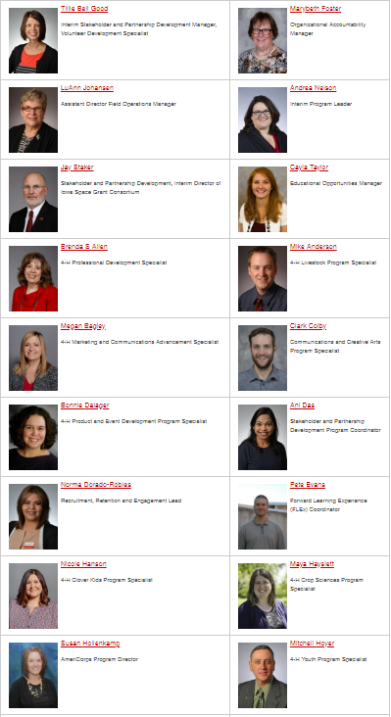
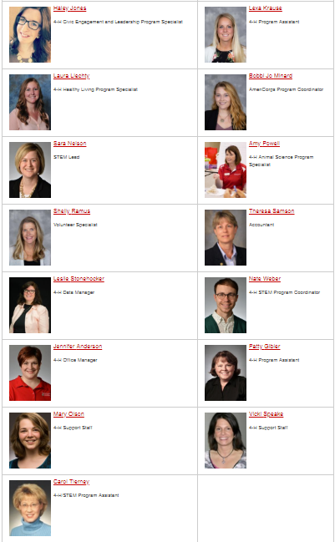
Finding the “Right” Individual
Notes:
Extension youth STEM specialist
“dramatic change in animal science programs in Iowa” (paraphrase)

Slide 10

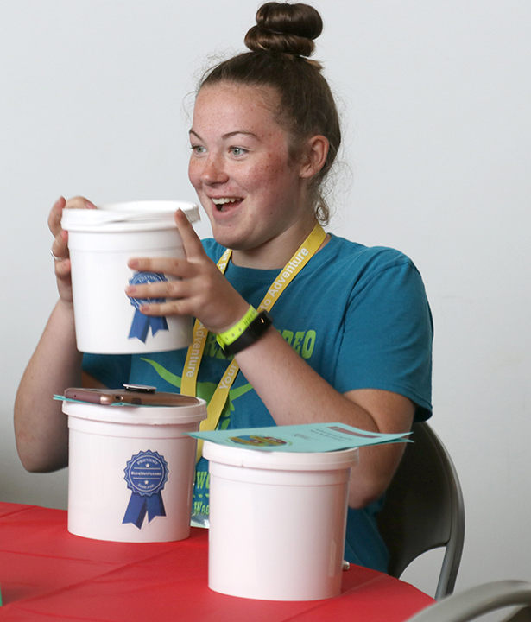
Train-The-Trainer
Volunteers needed
  Deliver live PPT curriculum to youth
  Deliver pre and posttest course evaluation
Volunteer incentive
  Travel reimbursement and meal
  Selected hands-on activity supplies
Youth incentive
  Biosecurity bucket
  Chance to win gift card
Contact YouthInAg@iastate.edu
by July 16
Notes:
Trickle-down approach to reach more youth; interest was great, success was marginal
We are offering free train-the-trainer workshops to 4-H youth specialists and volunteers interested in delivering zoonotic disease prevention and biosecurity education to middle and high school aged 4-H youth.
During these regional workshops, CFSPH veterinarians will train attendees to deliver ready-made PowerPoints, demonstrate hands-on activities, and provide additional information about zoonotic disease prevention. We then ask that you provide zoonotic disease prevention education to local middle and high school aged 4-H youth by September 30, 2018, by using the CFSPH-developed PowerPoint presentations and hands-on activities discussed at the workshop.
Volunteers will receive a travel stipend, meal during the workshop, and a chance to win selected hands-on activity supplies. Youth who attend local educational sessions offered by trained volunteers and complete a pre/post evaluation will receive a “biosecurity bucket” with goodies and a chance to win a gift card.
Volunteers interested in attending the workshops should contact youthinag@iastate.edu. We will then determine a time and location that is most convenient for all. Space is limited! Please respond with your interest by July 16.

Slide 11

Suggestions for Use
Requirement to exhibit at fair
Education in classroom
or clubs
Use in preparation for CDE, skillathon, or other contests
Competition between clubs or chapters for most
member certificates
Use as part of
awards requirements
Notes:
Didn’t want this to be a program run by us, wanted it to be sustainable and able to be used by others with similar goals.

Slide 12
Funding Comments
Easy to reach people that are already engaged
Connect with people who are engagING
Train-the-trainer approach has benefits and limitations
Challenge: to ensure reach to youth at the
county level
Notes:
Still a place for “own” events– have reached past the awareness-level and that “upper level” that attends the ‘existing’ events and want to get down to the youth in the county who may not be attending the leadership events, etc. but are still showing and interacting with youth. Unfortunately, this is more difficult to secure funding for (Biosecurity Camp)

Slide 13

Questions?
youthinag@iastate.edu
www.BlueNotFlu.org

