Slide 1
Youth in Agriculture: Improving the Health of People and their Animals through Education
Joe Gregg, Lauren Roper, Grace Goryoka
2019 NACCHO Prep Summit
Notes:
Mention that we will be using poll everywhere and to have their cell phones or laptops out

Slide 2
PollEverywhere
This session will be utilizing PollEverywhere, a fun and interactive tool. Please log in now with a cell phone or laptop using the information below:
PollEv.com/prepsummit4
Or
Text PREPSUMMIT4 to 22333

Slide 3
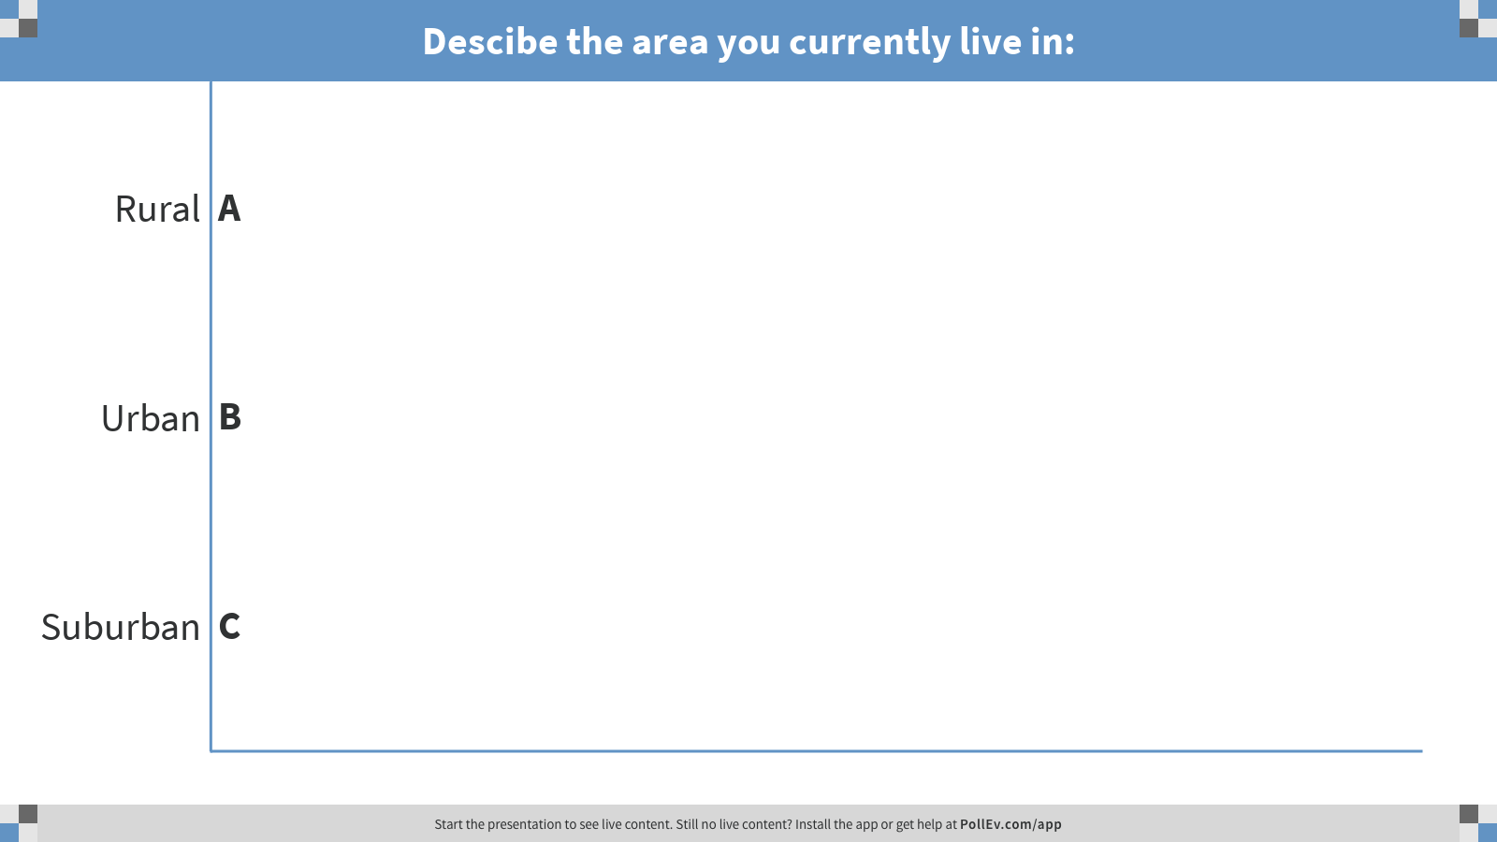
Notes:
Poll Title: Descibe the area you currently live in:
https://www.polleverywhere.com/multiple_choice_polls/tNyHwRBEdgw0AeuaDJmma

Slide 4
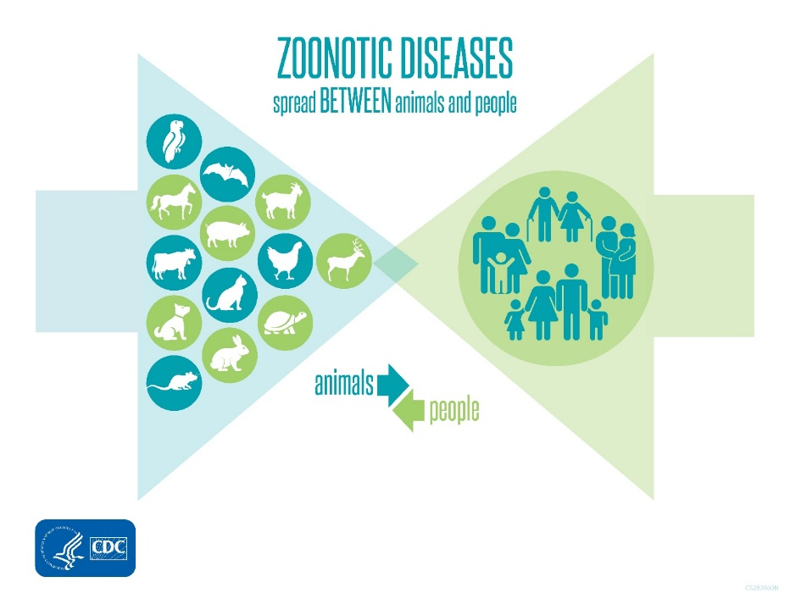
Endemic and Emerging Zoonotic Diseases are spread between animals and people
80% of agents with potential bioterrorist use are zoonotic pathogens
60% of existing human infectious diseases are zoonotic
At least 70% of emerging infectious diseases of humans (including Ebola, HIV, and influenza) have an animal origin
5 new human diseases appear every year. Three are of animal origin.
www.oie.int/onehealth

Slide 5
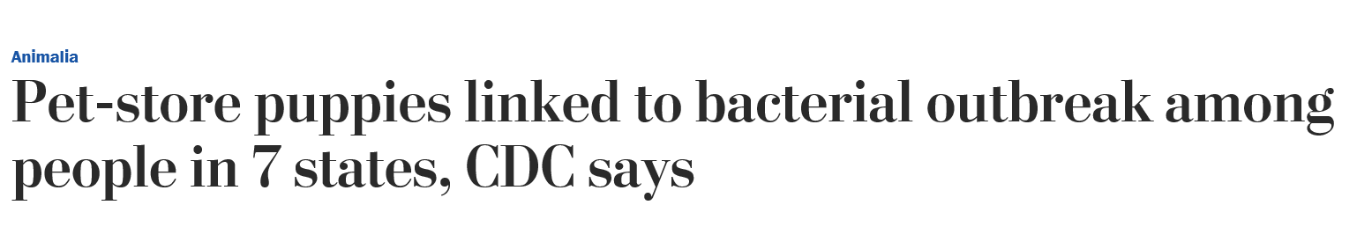
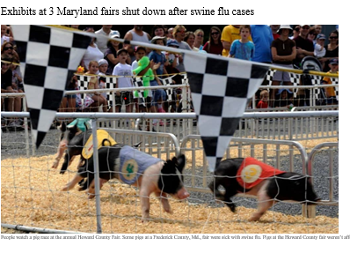
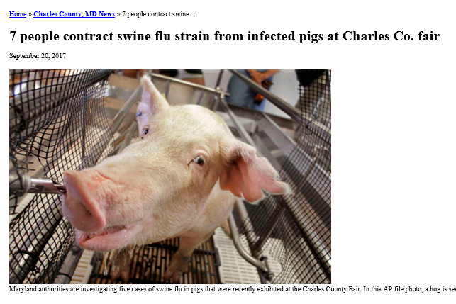
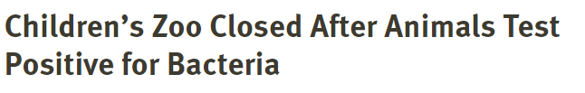
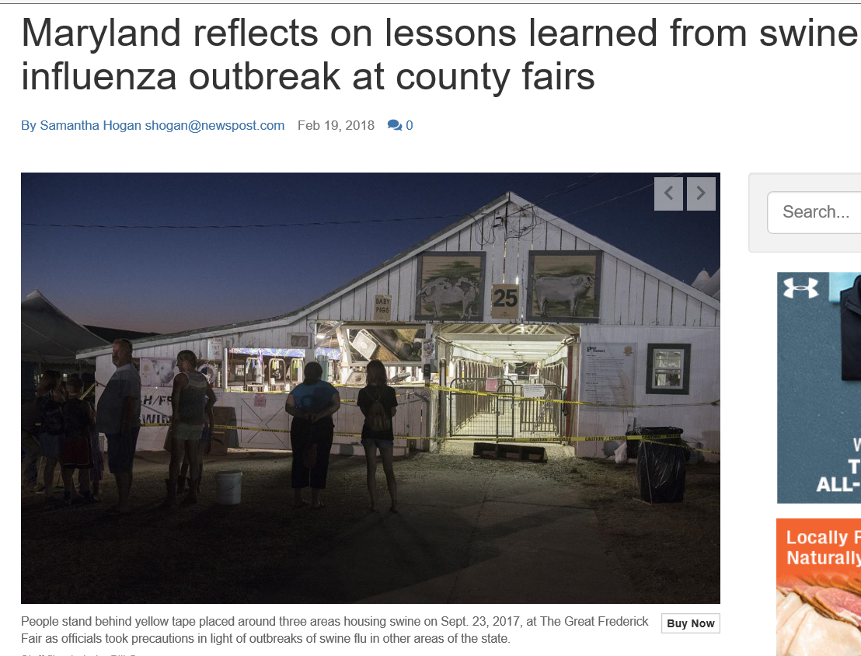
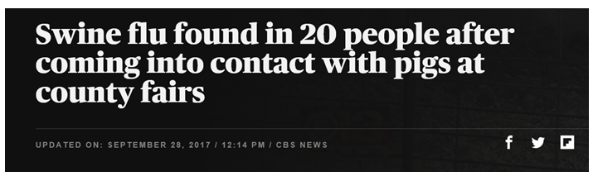
Notes:
Given the widespread impacts zoonotic diseases can have on humans, animals, and the environment, a One Health approach to public health is necesssary. One Health is the collaborative effort of multiple disciplines and sectors – working locally, nationally, regionally, and globally– with the goal of achieving optimal health outcomes recognizing the interconnection between people, animals, plants, and our shared environment.
Impacts
Public health problem
Reduced animal production capacity
Impact wildlife health
Bioterrorism potential
Economic losses
Cause outbreaks of illness in people and animals
Food safety concerns
Obstacle to international trade
Affect environmental health and ecosystems
Impact mental health
Many more……

Slide 6
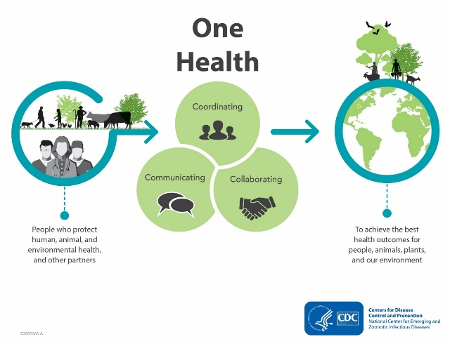
One Health Partnership for Prioritization
POLL: Which zoonotic diseases do you think the U.S. prioritized for One Health collaboration?
Notes:
The One Health approach has been accepted by federal agencies as a way of addressing zoonotic disease threats in the US. In 2017, the 3 federal leads for zoonotic diseases collaborated to use a One Health approach to prioritize zoonotic diseases of greatest national concern that should be jointly addressed by human, animal, and environmental health agencies in 2017.

Slide 7
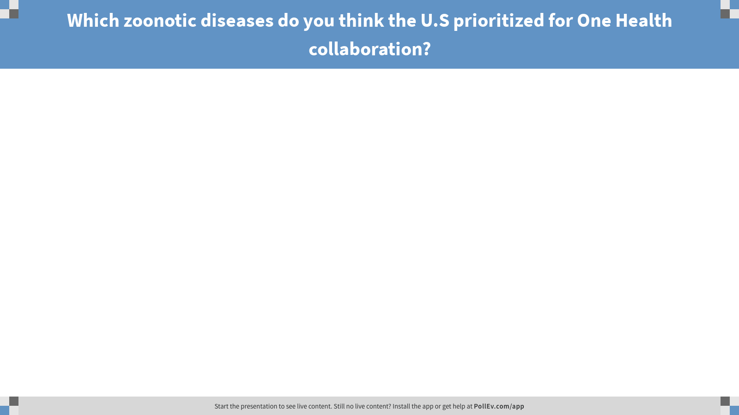
Notes:
Poll Title: Which zoonotic diseases do you think the U.S prioritized for One Health collaboration?
https://www.polleverywhere.com/free_text_polls/8mZ0AYwjL4wTOYBauWSsF

Slide 8
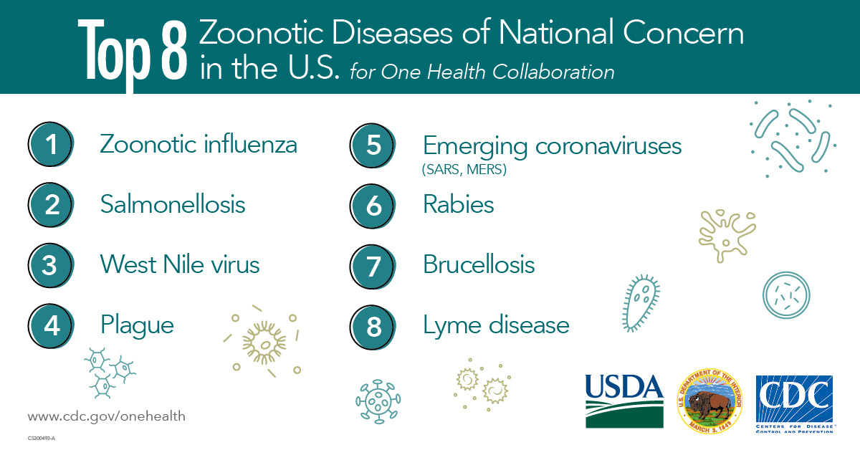
Notes:
Compare answers from poll everywhere to the top 8 diseases
The top 8 zoonotic diseases of national concern in the United States for One Health collaboration are: zoonotic influenza, salmonellosis, west nile virus, plague, emerging coronaviruses, rabies, brucellosis, and lyme disease. You may notice that several of these diseases, like flu, salmonella, and brucellosis, are relevant to agriculture and rural health

Slide 9
Program Background

Slide 10
Outbreaks and Animal Exhibits
200 outbreaks reported to CDC (1996-2012)
  78% of illnesses caused by E. coli, Salmonella, and cryptosporidium
  49% of illnesses associated with fairs, farm visits, and petting zoos
  13% of settings involved daycares, schools and universities
http://www.nasphv.org/Documents/AnimalContactCompendium2017.pdf
Notes:
Other illnesses include Q fever,

Slide 11
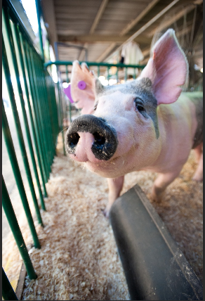
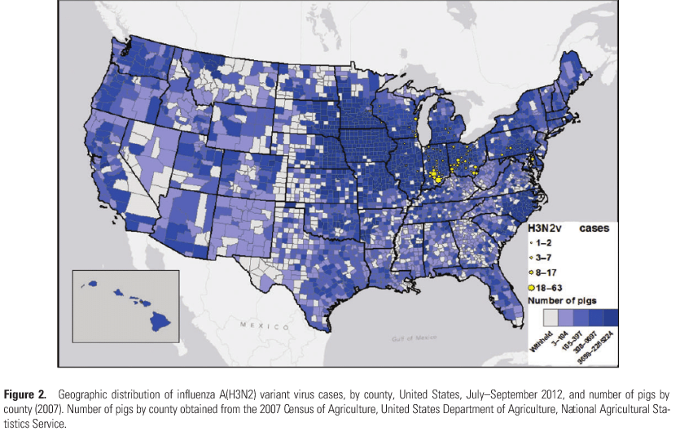
Variant Influenza Outbreak of 2012
H3N2v outbreak
  95% of cases reported direct or indirect contact with swine
  93% of cases recalled attendance at an agricultural fair within four days of illness onset
  Majority of cases were youth exhibitors and others in close contact with pigs at the fairs
Spurred the need for increased awareness of risk associated with agricultural fair interaction
Jhung MA et al. 2013. Outbreak of variant influenza A(H3N2) virus in the United States. Clin Infect Dis 57:1703-12.

Slide 12



CDC initiated the Youth in Agriculture program
Partners:
  U.S. Department of Agriculture (USDA)
  Council of State and Territorial Epidemiologists (CSTE)
Goal:
  Educate youth about zoonotic diseases shared between animals and people
  Deliver disease prevention messages
  Strengthen One Health networks among state human and animal health departments and agricultural communities across rural America.

Slide 13
Youth in Ag Program
Youth Engagement
Improvement in participant awareness and knowledge
Development of positive actions among participants
Partnership Development
Increased member/organization communication and collaboration
Increased understanding of membership structure and goals at local, state, and federal level
Long-Term Desired Outcome: Improved prevention, detection, and monitoring of zoonotic diseases, especially emerging diseases with epidemic potential

Slide 14
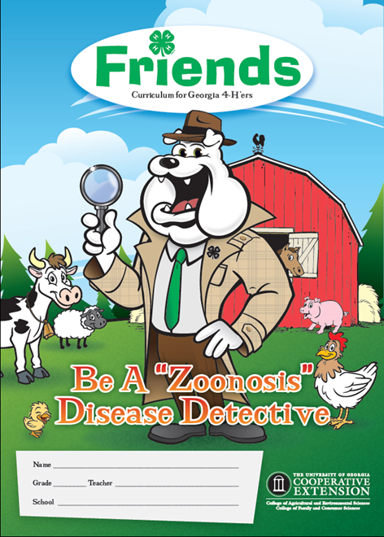
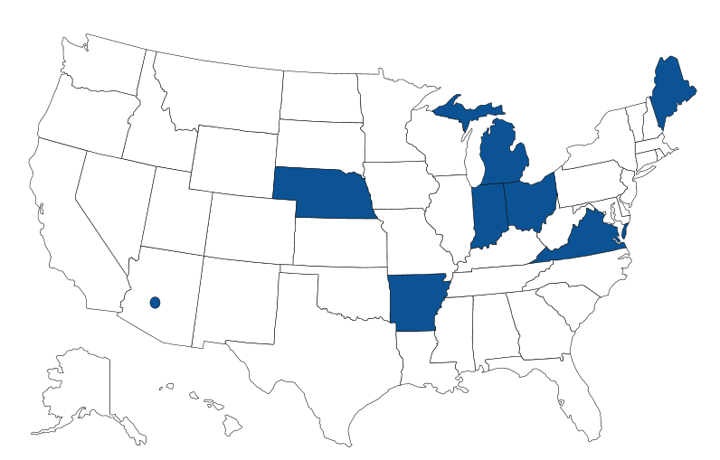
2012: CDC and USDA developed a pilot program with Georgia 4-H to develop and implement educational tools about public health, zoonotic diseases, and youth safety around animals
2014: the Influenza Education Among Youth in Agriculture Pilot project (Youth in Ag) was launched
  One Health approach to educate youth at high risk of novel influenza transmission by showing animals at agricultural events
  1 county and 7 state health departments were funded to launch state-owned collaborations with 4-H and FFA

Slide 15
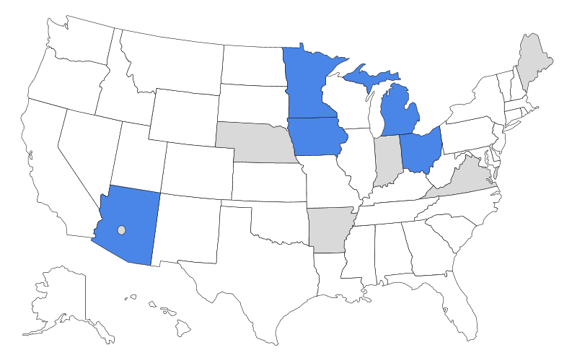
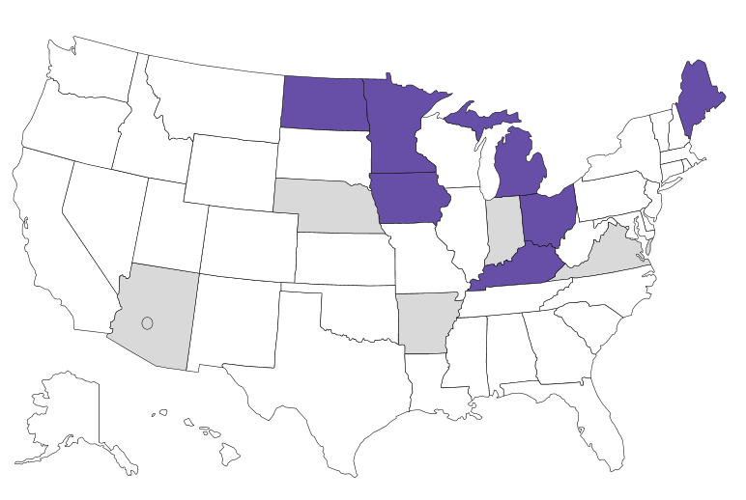
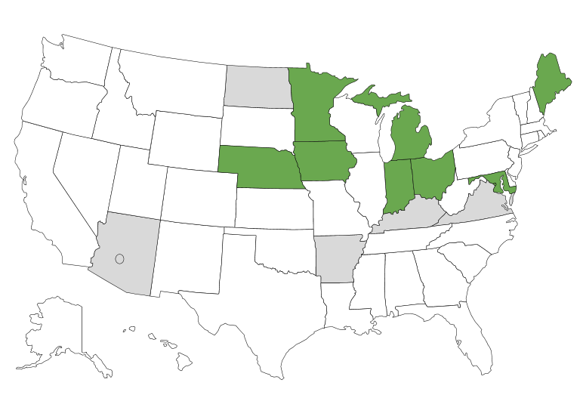
2016: 5 states were funded to build upon successes and expand the program’s reach to new jurisdictions
2017: 7 states received funding
  Efforts focused on strengthening evaluation efforts and identifying platforms to share tools and resources
2018: 8 states received funding
  Encouraging interstate collaborations and incorporating evaluation to build an evidence base

Slide 16

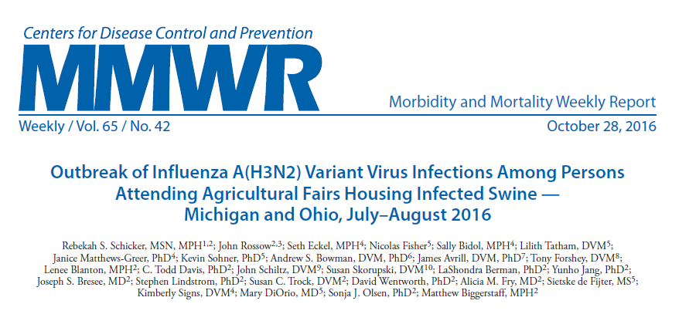
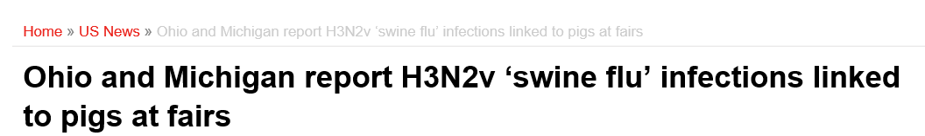
Partnership Engagement
Partnerships developed and strengthened through this program facilitated rapid response activities after identification of fair-associated H3N2v illnesses in the summer of 2016
https://www.cdc.gov/mmwr/volumes/65/wr/mm6542a1.htm
Notes:
Partnerships developed and strengthened through this program were leveraged to facilitate rapid response activities after identification of fair-associated H3N2v illnesses in the summer of 2016.

Slide 17

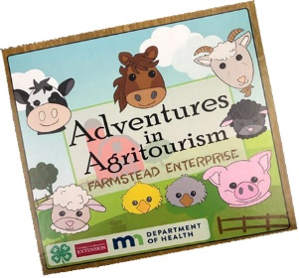
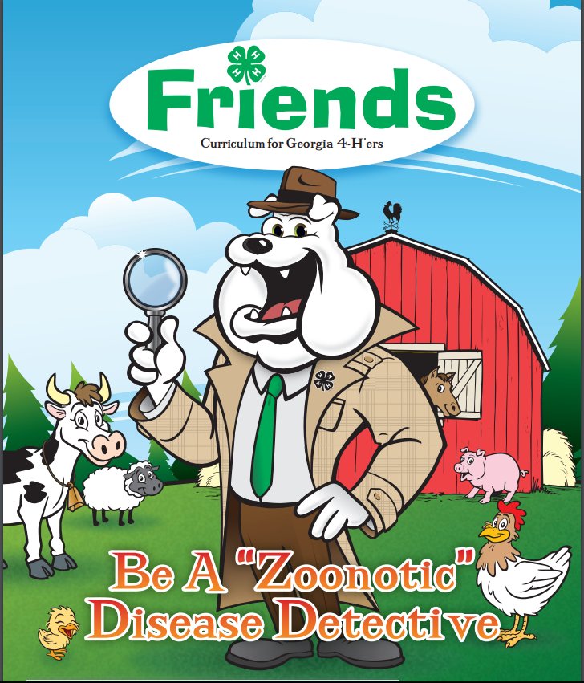


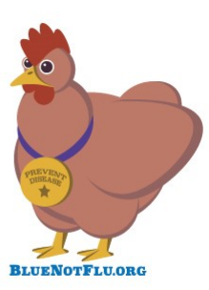
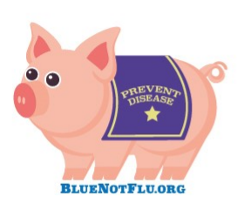
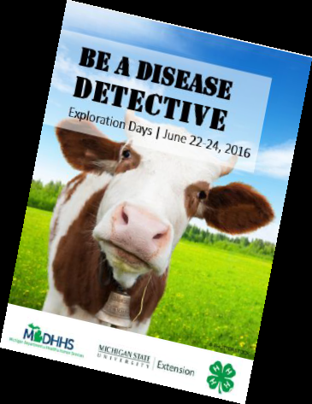
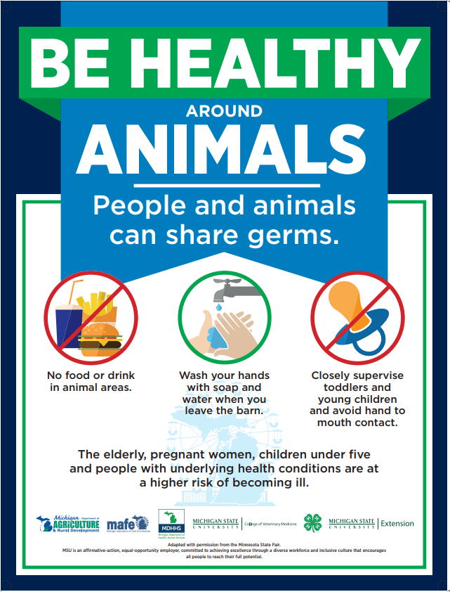
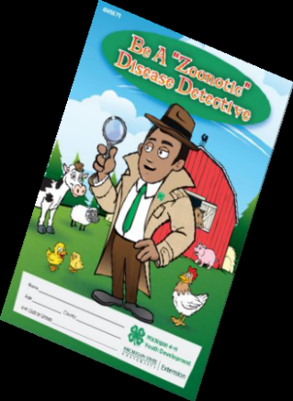
Funding in Action
Free, web-based, interactive education curricula on zoonotic diseases
Workshops on biosecurity and zoonotic diseases
Biosecurity and health signs for use at fairs, extension offices, and local health departments
One Health chapter in a 4-H training manual
Educational board game and a card game for youth
Magazines and pamphlets on how to be a zoonotic disease detective
Notes:
Materials that have been developed through this grant are meant to be shared and used by others . We’re going to be demo-ing some of these products later in the presentation

Slide 18
Online Resource Repository

Slide 19
Why develop an online resource repository?
Need identified at a 2017 meeting for all grantee states
Allowed for widespread resource sharing outside of grantee states
No need to reinvent the wheel when there are products already developed
Rapid gathering of resources in the event of an outbreak
Notes:
Our states have done amazing work and we wanted to lessen the burden on them for having to distribute resources on their own, so CDC and CSTE collaborated to build a platform for them to do so. We update this repository about once a month with new content developed or updates to existing content.

Slide 20
What is in the repository?
Factsheets, fair signage, abstracts and publications, online courses, and materials for in-person courses
  Short description for each product including intended audience
  Course materials are grouped together
Filter by:
  State
  Type of material (traditional media, courses, interactive activities, etc.)
Search by any term

Slide 21
How to access the repository
https://www.cste.org/page/yia
http://resources.cste.org/yia
Notes:
You can get to the online resource repository one of 2 ways.. You can go to our Youth in Ag Landing Page (link 1) or directly using the second link

Slide 22
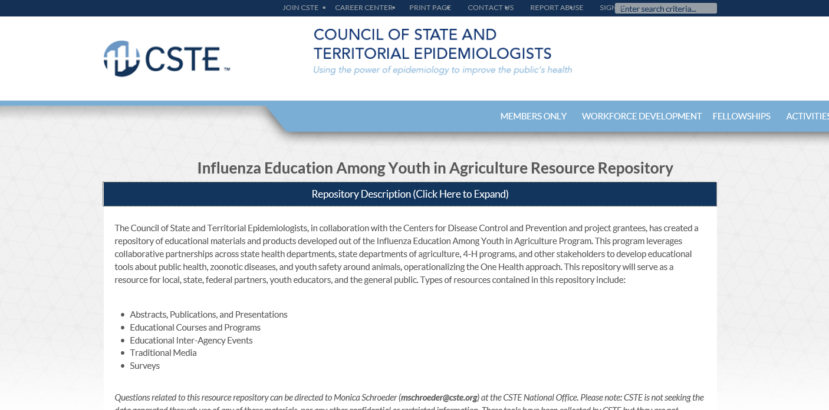
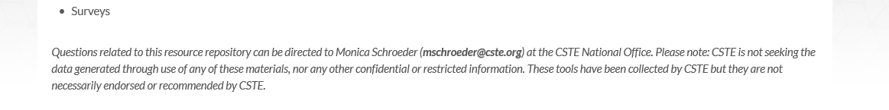

Slide 23
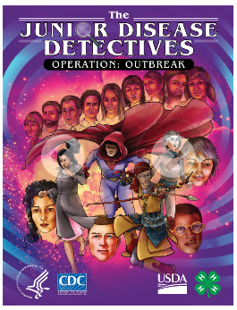
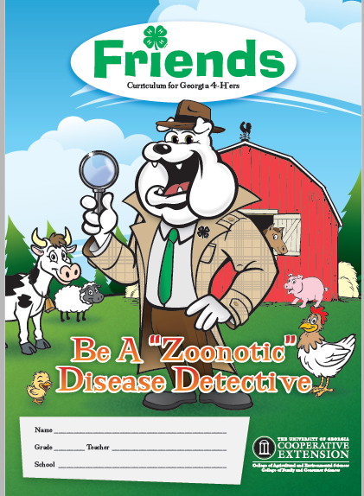
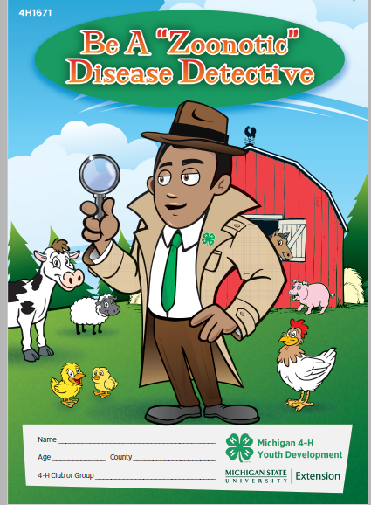

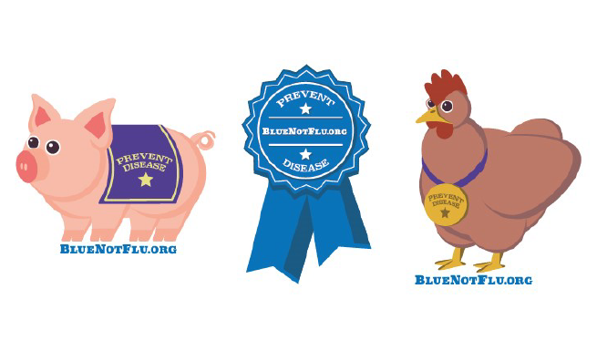
Walk through of materials
Excellence in Exhibition-Iowa
Becoming a Swientist-Ohio
Friends magazine (UGA vs Michigan)
Germ-O game- Maine
CDC Graphic Novel
Notes:
We have a ton of great resources on here, but just to highlight a few..
Iowa put out a great program (Excellence in Exhibition). There are 2 versions: one for elementary students (age 7‐12) and one for middle and high school students (age 13‐18). If a 4-H leader wanted to do the lessons in person, all the resources are in one place with instructions, or kids can do these lessons online at their own pace.
Friends Magazine no need to reinvent the wheel.. Michigan produced this version of a friends magazine for distribution borrowing from the UGA’s friends magazine
Minnesota had the need to create various factsheet for when field trips would go to farms (show handout) then in years after that, the farm would visit the school so they switched it up and made the (show when the farm comes to you)
CDC Graphic Novel for download. CDC has released a graphic novel to help young people understand the potential health risks of influenza viruses that normally circulate in swine and can cause disease in people (known as variant flu infections).

Slide 24
Improved Evaluation
Notes:
For the Youth in Ag project, we wanted to have actionable evaluation metrics. We can evaluate knowledge relatively easy. Did they learn/retain this information or no? In 2017, we had an anthropologist join the team to look at evaluating why people will or won’t change their behavior, which is more challenging.
-Is it a hassle to wash your hands? That’s the way I’ve always done things, so why change now? Etc.

Slide 25

Survey Bank
Categorized by:
  Personal Experience/Background
  Knowledge/Awareness
  Attitude/Motivation/Values
  Intention to Change Behavior
  Each of those is broken into:
    Zoonotic Disease
    Agritourism
    Epidemiology/Disease Detectives
    General Flu Prevention
    Swine Exhibit Specific
Notes:
To help with these evaluation efforts, we created an evaluation workgroup which designed a survey bank of questions. We also awarded a supplemental award for enhancing evaluation efforts in 2018 in which one of our state grantees, Maryland evaluated their signage’s or “swinage” effectiveness.
The questions in this survey bank are grounded in peer reviewed research methodologies. To demonstrate some different evaluation methods, we are going to poll you on some of these. There is a copy of this around you..

Slide 26
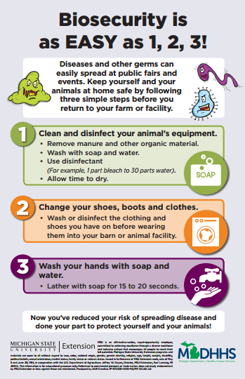
Notes:
http://resources.cste.org/yia/resourcefiles/Michigan/Michigan_Biosecurity_is_Easy_as_1_2_3.pdf
Poll everywhere questions: What do you notice about this handout?
Did you learn new information from this handout?

Slide 27
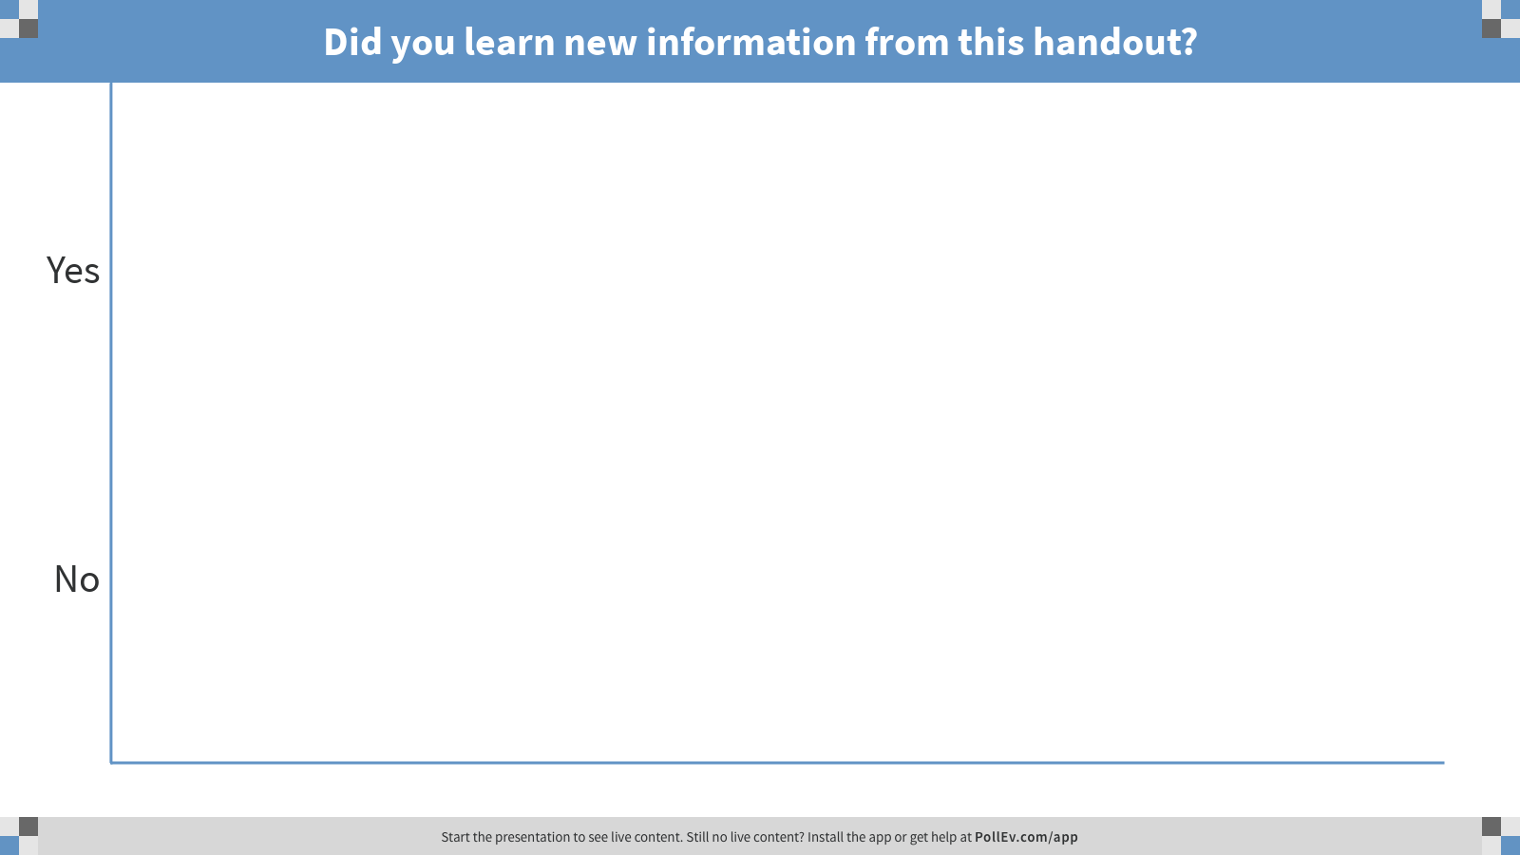
Notes:
Poll Title: Did you learn new information from this handout?
https://www.polleverywhere.com/multiple_choice_polls/HHrCVMUNNvN767pLgObm4

Slide 28

Notes:
Poll everywhere questions: What do you remember about the video?
Did you learn new information from this video?
Will you wash your hands for 20 seconds after watching this video?
Would you change your behavior at a farm to keep yourself healthier?
Would you change your behavior at a farm to keep the animals healthier?
Highlight anthropologic questions
If people answer no/maybe to would they wash their hands fro 20 seconds, ask what information would have help them to change their behavior
Highlight that kids especially are more likely to change their behaviors to protect their animals than themselves. Keep this in mind when making videos or signage directed towards kids’ behavior changes
We are working on improving and broadening our evaluation efforts in order to build an evidence based approach to what public health interventions are most effective. This knowledge will help us focus our efforts on the most effective interventions as the program expands beyond novel influenza into other zoonotic diseases and beyond

Slide 29
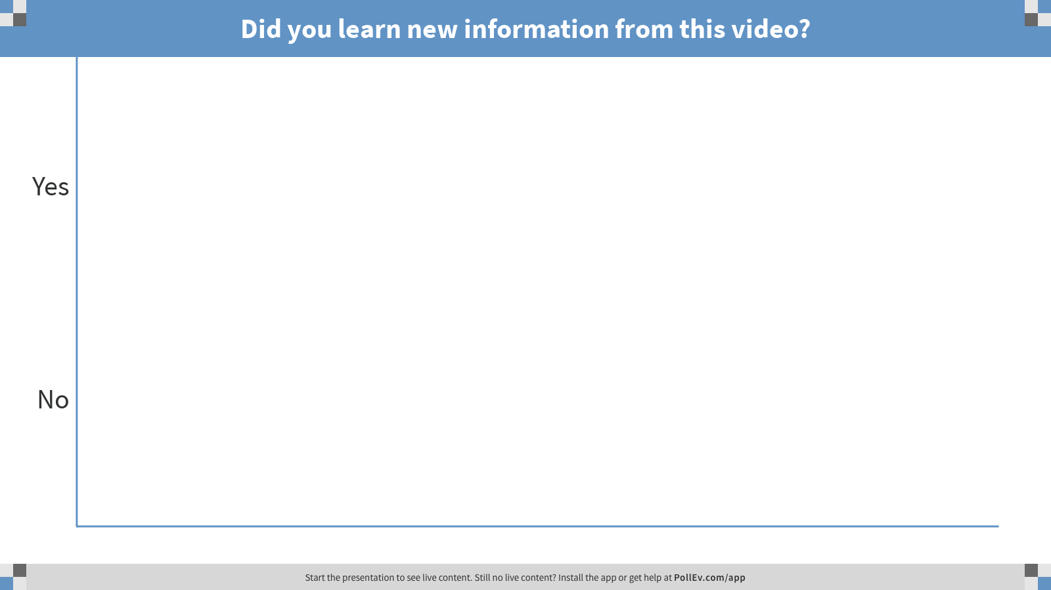
Notes:
Poll Title: Did you learn new information from this video?
https://www.polleverywhere.com/multiple_choice_polls/kWkRpQaAqzTyNBlNef1Hp

Slide 30
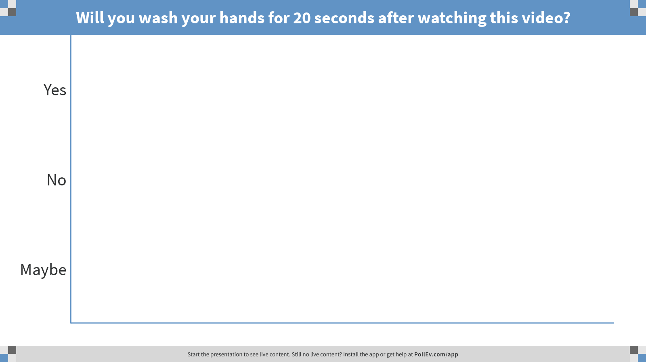
Notes:
Poll Title: Will you wash your hands for 20 seconds after watching this video?
https://www.polleverywhere.com/multiple_choice_polls/SRreJRXEbuIAxBpquFn5n

Slide 31
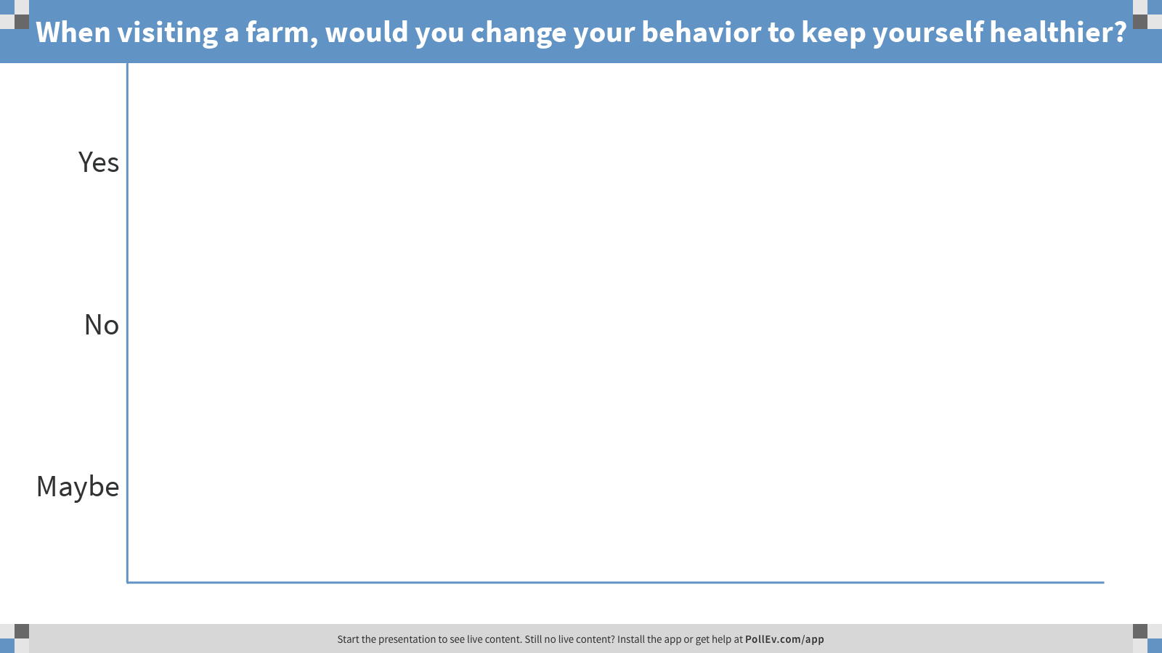
Notes:
Poll Title: When visiting a farm, would you change your behavior to keep yourself healthier?
https://www.polleverywhere.com/multiple_choice_polls/QswfW4d1L1cI6ZFyZCdS8

Slide 32
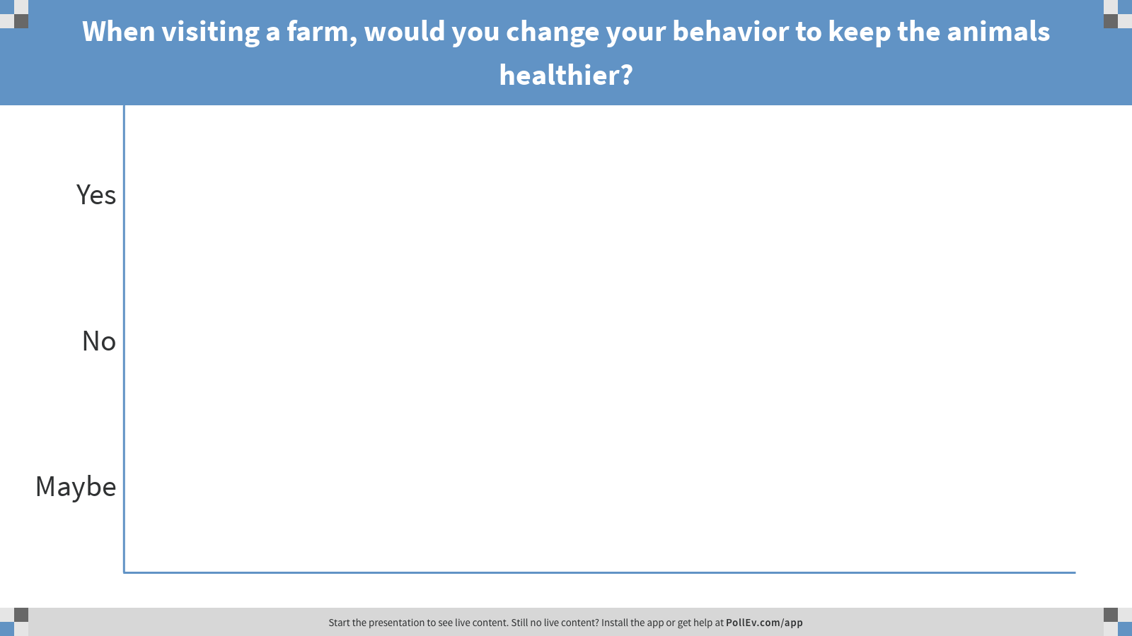
Notes:
Poll Title: When visiting a farm, would you change your behavior to keep the animals healthier?
https://www.polleverywhere.com/multiple_choice_polls/ahk81ARYTTPJ5eSIIgLE1

Slide 33
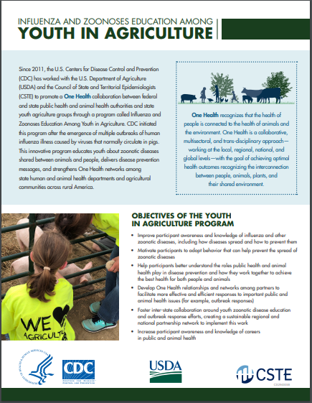
Future Directions

Slide 34
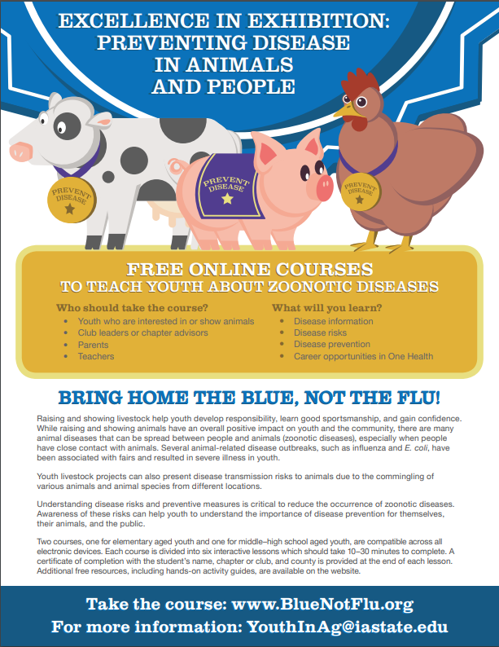
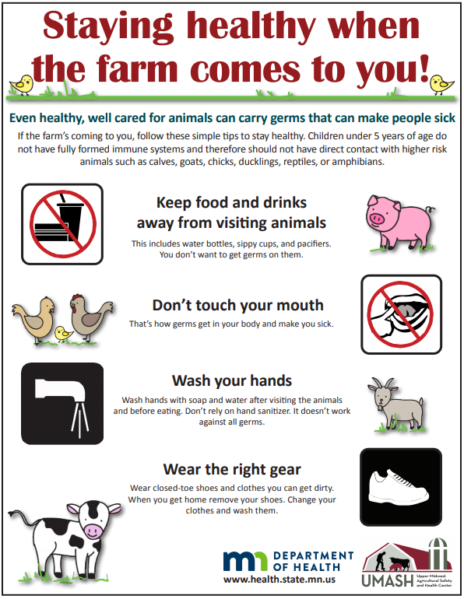

Program Expanded to Zoonoses Prevention and Education
Notes:
As zoonotic disease outbreaks are recognized more frequently with animals in public settings, state grantees identified a need to expand the educational outreach of the YIA program to encompass additional zoonotic diseases. Materials, like the pictures on this slide, were developed to educate youth about zoonotic diseases and deliver disease prevention messages.

Slide 35
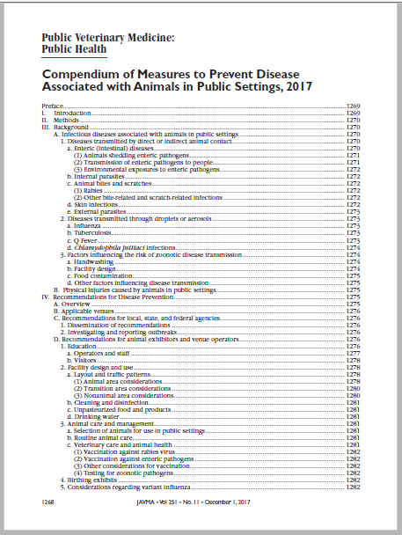
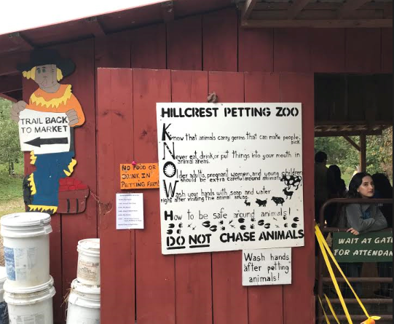
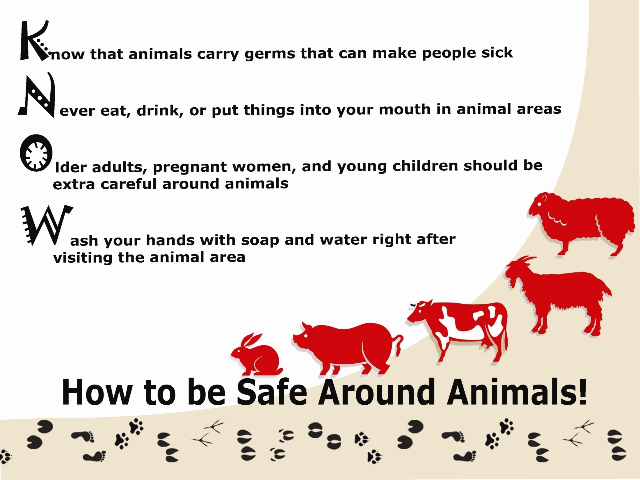
Collaborating to Prevent Zoonoses
Compendium of Measures to Prevent Diseases Associated with Animals in Public Settings, 2017
http://nasphv.org/Documents/AnimalContactCompendium2017.pdf
Notes:
With the number of zoonotic disease outbreaks being more frequently recognized in these public settings, the National Association of State Public Health Veterinarians developed a Compendium of Measures to Prevent Disease Associated with Animals in Public Settings. This compendium provides standardized recommendations for public health officials, veterinarians, animal venue operators, animal exhibitors, visitors to animal venues and exhibits, teachers, camp operators, and others concerned with control of disease and with minimizing health risks associated with animal contact in public settings.

Slide 36
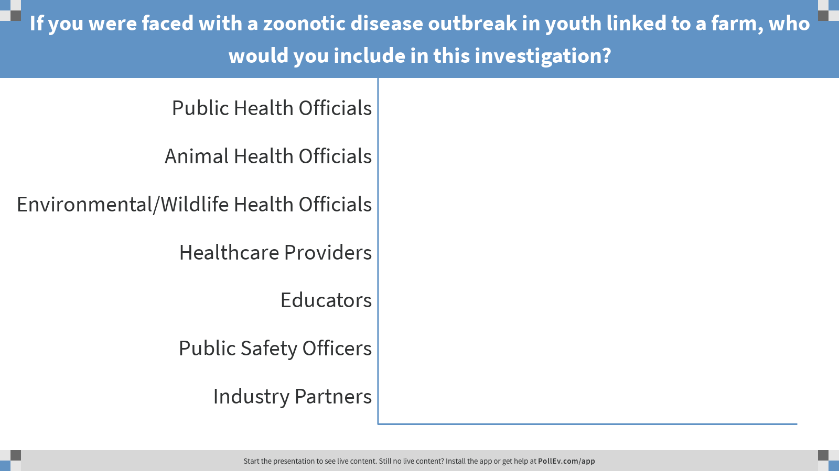
Notes:
Poll Title: If you were faced with a zoonotic disease outbreak in youth linked to a farm, who would you include in this investigation?
https://www.polleverywhere.com/multiple_choice_polls/zDSixYfzbNBnB3gI66Fq1

Slide 37









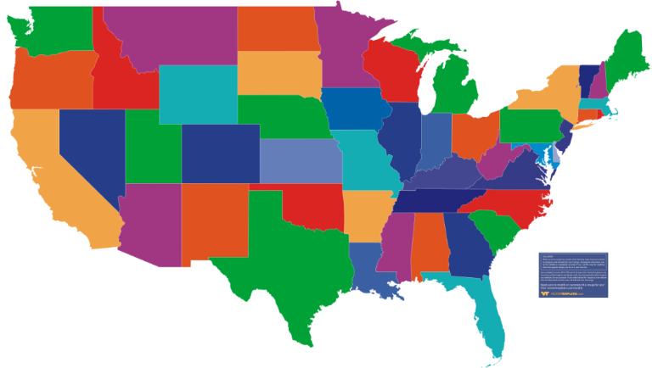


One Health is a Team Sport – Partners are Key
Government, NGOs, industry, academia, communities, and many other partners
State and local health departments
State Departments of Agriculture
State Wildlife Agencies
Notes:
One Health approach is crucial to address zoonotic disease threats, and partners are extremely important. One Health partners represent sectors like: human health, animal health for pets, livestock, and wildlife, and environmental health. These partners can be from government, NGOs, industry, academia, communities, and many more. One Health is a team sport and by working together, One Health partners can more effectively address zoonotic disease threats utilizing these shared and trusted networks.

Slide 38
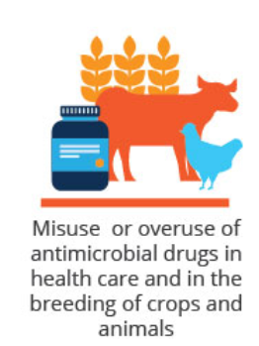
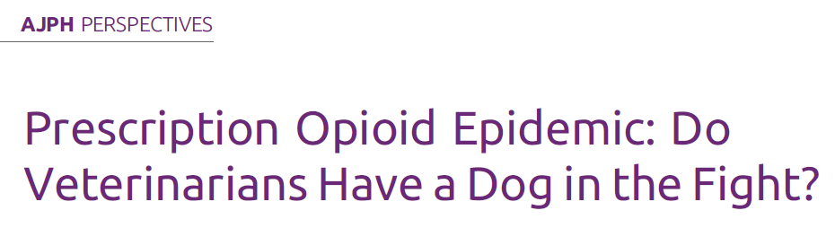
Other One Health Topics to Engage Partners Using the Youth in Ag Model
Antimicrobial Resistance
Opioid Response
POLL: What other public health challenges could utilize these already established partnerships?
Notes:
A growing One Health issue is antibiotic resistance. Antibiotics are valuable tools for treating infections in people and animals, but improper use or overuse of these medications in people or animals, as well as other factors like poor sanitary conditions, inappropriate food handling or poor infection control in hospitals, can create drug resistance. Resistance happens when germs like bacteria and fungi develop the ability to defeat the drugs designed to kill them. As the germs are exposed to drugs, they develop characteristics that makes the drugs less effective or ineffective. Each year in the U.S. at least 2 million people are infected with antibiotic resistant bacteria, and at least 23,000 people die as a result.
Antibiotic resistance is not just a human health problem it affects the ability to treat infections in animals as well, making it a One Health issue. Antibiotics must be used responsibly in order to prevent resistance from developing and to ensure that these important medications work to treat infections in people and animals. In order to address antibiotic resistance, One Health sectors need to work together nationally and globally to align policies, strategies and activities, in collaboration with other stakeholders to promote antibiotic stewardship and responsible use of these drugs.
Opioid Response - The use of opioids and other controlled substances isn’t limited to human medicine, veterinarians are also able to prescribe these medications to animals. Veterinarians are urged to join in the fight against human opioid abuse. This includes developed guidance on how to tell if a prescription is being abused by a pet owner, and more. According to a recent study in the American Journal of Public Health, 13 percent of veterinarians polled were aware of cases where pets were made to appear ill or injured so that a staff member or pet owner could obtain an opioid prescription, and 12 percent had uncovered opioid use or diversion by veterinary staff—yet only 62 percent of veterinarian believed they play a role in preventing opioid abuse.

Slide 39
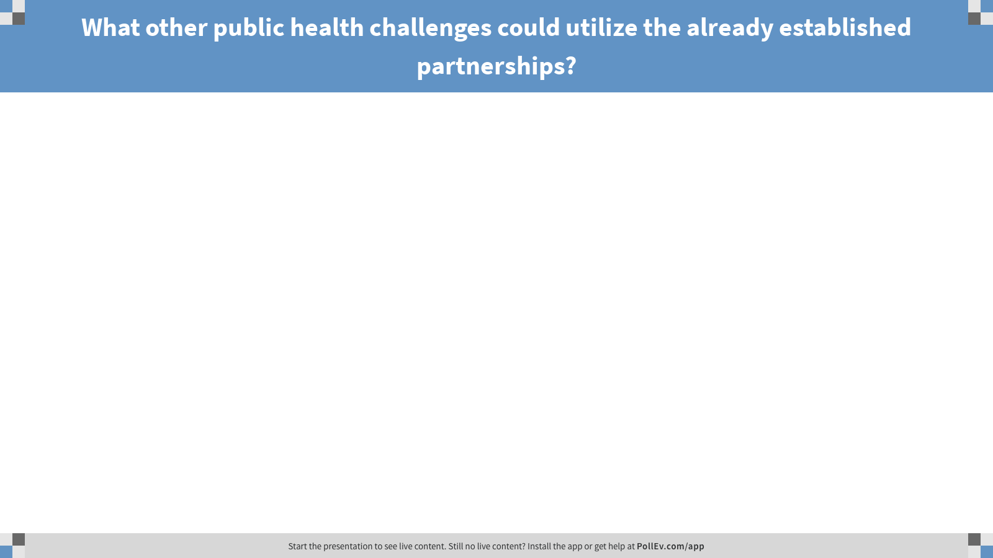
Notes:
Poll Title: What other public health challenges could utilize the already established partnerships?
https://www.polleverywhere.com/free_text_polls/Shn4UBO4nWZyQgCGr5d1L

Slide 40
Wrap Up

Slide 41
Today we’ve discussed:
Why preventing zoonotic diseases is important
Background of how Youth in Ag Project came to be
Resources developed through this project
Enhancing evaluation efforts
Expanding the project beyond influenza into other zoonotic diseases
Future directions of the project

Slide 42
Questions?
Notes:
Add pictures of our animals

Slide 43

Joe Gregg, Influenza Coordination Unit
Wgregg@cdc.gov
Lauren Roper, Influenza Coordination Unit
Lroper@cdc.gov
Grace Goryoka, CDC One Health Office
GGoryoka@cdc.gov or OneHealth@cdc.gov

Slide 44
Backup Slides

Slide 45



Healthy Pets, Healthy People
Preventing zoonoses spread between people and pets, livestock, and wildlife
www.cdc.gov/healthypets
Notes:
There are many benefits of human-animal contact and millions of human-animal interactions occur each year, both at home and away. Animals provide opportunities for entertainment, education, companionship and are also an important part of our food supply and ecosystem.
CDC’s Healthy Pets, Health People website provides many resources on preventing the spread of zoonoses between people and pets, livestock, and wildlife, including information on staying healthy at animal exhibits. There are also resources on this website for pet safety in emergencies like pets in evacuation centers and a pet disaster preparedness kit. Resources are also available for pets in emergencies in Spanish as well.

Slide 46





Zoonoses and One Health Updates (ZOHU)
Website: cdc.gov/onehealth/zohu
Contact us: zohucall@cdc.gov
Notes:
CDC’s One Health Office also hosts the Zoonoses & One Health Updates (ZOHU) call. These ZOHU calls are one-hour monthly webinars that provide timely education on zoonotic and infectious diseases, One Health, antimicrobial resistance, food safety, vector-borne diseases, recent outbreaks, and related health threats at the animal-human-environment interface. The ZOHU call has over 12,000 subscribers and the calls are now recorded so anyone can listen at anytime they would like and earn free Continuing Education. If you would like to learn more, there are handouts on your tables, or if you would like to highlight your work on one of these calls, please contact us at ZOHUcall@cdc.gov

