Slide 1
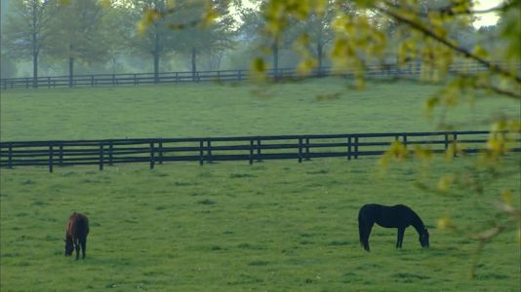
Influenza and Zoonosis Education Among Youth in Agriculture
Kelly Giesbrecht, DVM, MPH
State Public Health Veterinarian
Department for Public Health

Slide 2
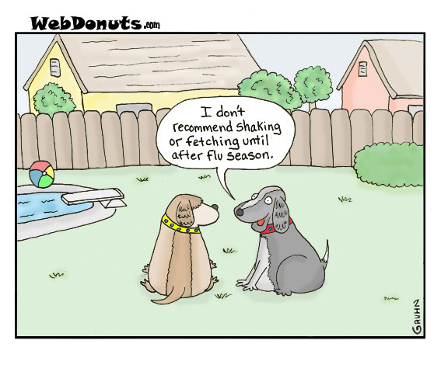

Slide 3
Partners
KY Department for Public Health
  State Epidemiologist
  CFO, Epidemiology and Health Planning
  Public Health Veterinarian
University of Kentucky
  4-H Extension Service
  Student Assist

Slide 4
Train the Trainer
Grant was written as a “Train the Trainer” method of education
Plan: Train 4-H Leaders
  Pre and Post Test
Leaders train their 4-H students
Students are tested (Skillathon)

Slide 5
Certification Workshops
November 18, 2017: Cumberland Lake Resort (South Central KY)
December 2, 2017 : General Butler State Park (North & Central KY)
February 11-12, 2018: Lexington (Central KY)
Workshops for Livestock Leaders
UK 4-H distributed materials for ages 9-18 years

Slide 6
4-H Volunteer Forum
Feb 11-12, 2018: Lexington, KY
Workshops
Awards Banquet
Trainings
1 Hour Workshop on Swine Flu & Zoonotic Disease Prevention & Understanding

Slide 7
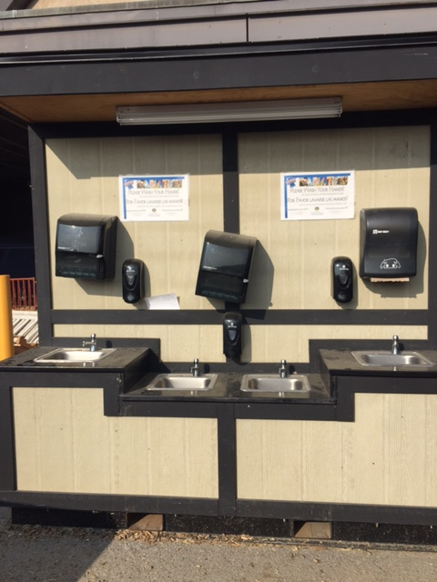
Training
Pre and Post Test
Discuss Zoonosis
Incubation Period
Methods of Transmission
Biosecurity Home vs Fair
Prevention
At the Fair

Slide 8
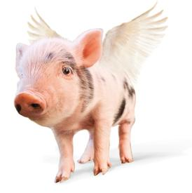
Can Pigs Fly
& Other Zoonotic Questions
Dr Kelly H. Giesbrecht, DVM, MPH
State Public Health Veterinarian
Laurel Culp
University of Kentucky

Slide 9
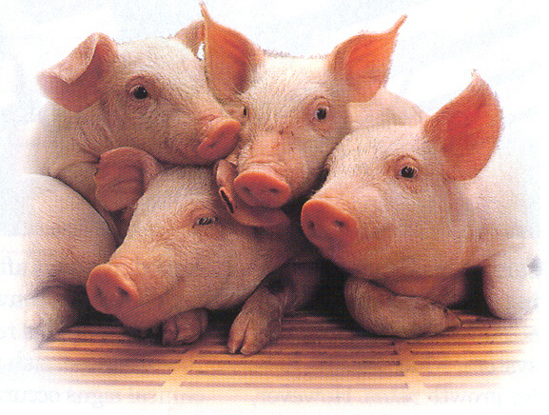
Agenda
Handwashing
Background
Zoonosis
Disease Transmission
  Aeroslization Demo
  Mucus Swap Demo
Disease Prevention
  So You’re Going to the Fair
Post Test
Review
Notes:
Use Glo Germ for Handwashing activity
Don’t alert attendees to glo germ on hands

Slide 10
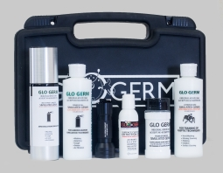
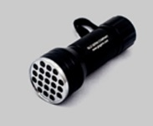
Glo Germ for Training
Glo Germ lotion and gel for hand hygiene and germ transfer training
Spray mist for Aerosolization simulation
Glow under black lights
2 Flashlights for 2 trainers

Slide 11
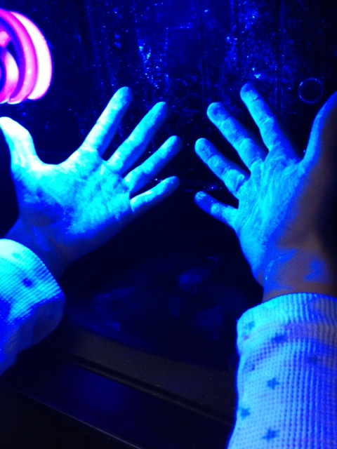
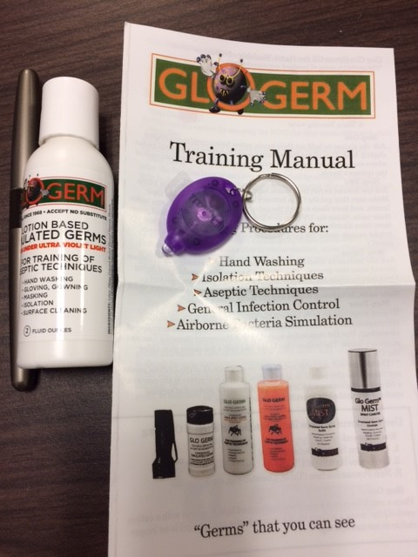
Glo Germ Kit
Give out to trainers
After complete training and Post-Test

Slide 12
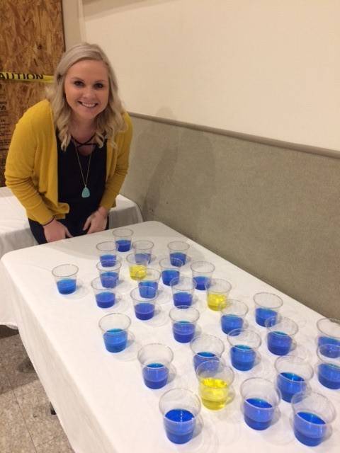
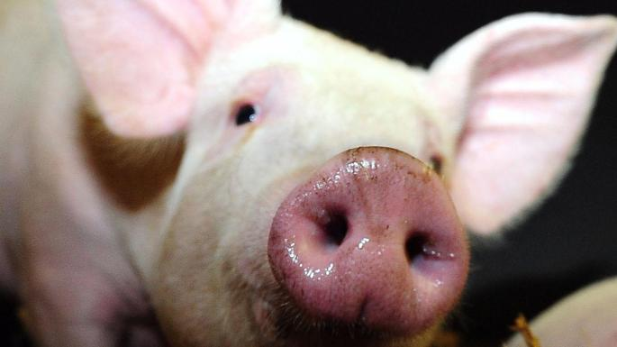
Mucus Game
Ph indicator to show “mucus swapping” between animals

Slide 13
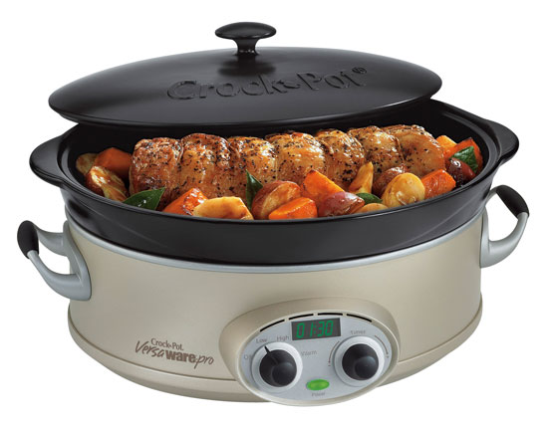
Biosecurity Buckets
  Gloves
  Cleaning Solutions
  Disinfectant
  Wipes
  Hand Sanitizer
Food Safety at the Fair
  Individual Packets
  Away from animal areas
  Handwashing

Slide 14
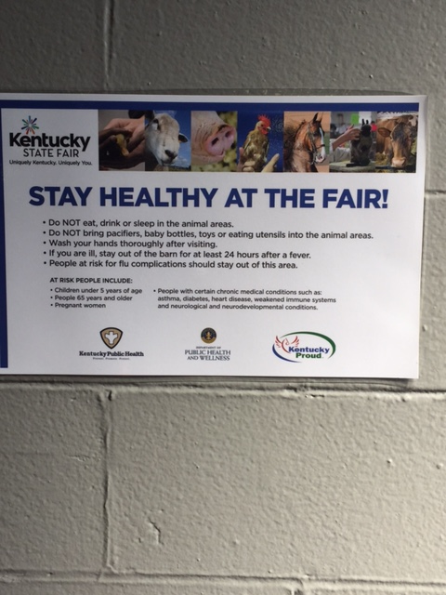
Skillathon
Feb 17, 2018: Skillathon Competition
4-H Youth with Livestock answer questions
Influenza questions to Skillathon
  Multiple Choice
  3 Different levels
  Test their knowledge

Slide 15
Results
November Training
  Pre-test ave: 84.5%
  Post-test ave: 95.4%
December Training
  No Pre-test given
  Post-Test ave: 90% (mean, median, mode)
February Training:
  Pre-test ave: 75%
  Post-test aver: 95%
Skillathon: Results pending

Slide 16
Expenditures
Travel
  Atlanta Training
  Workshops
Mailings
Glo Germ Training Supplies
Glo Germ kits to distribute
Mucus swap chemicals

Slide 17
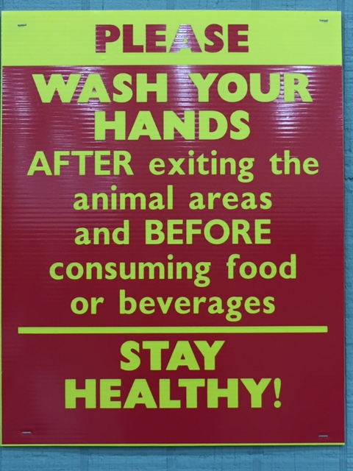
Mailings
Education about Swine Flu
Zoonotic Disease Spread
Handwashing
Recognition of Ill animals
Stopping Transmission of Illnesses
Cleaning Equipment

Slide 18
What’s Ahead
State Fair: Signs posted
  Handwashing
  Animal Health
Mailing:
  Zoonotic Diseases
  Posters

Slide 19
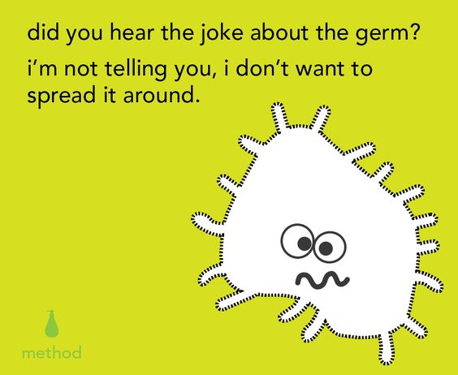
KellyGiesbrecht, DVM, MPH
State Public Health Veterinarian
502-564-3418x4313
Kelly.Giesbrecht@ky.gov

