Slide 1

CDC/USDA/CSTE Project Development Grant
Site Visit
Thursday, April 11, 2019

Slide 2
Welcome and Introductions
ISDH Epidemiology Resource Center:
  Madhura Sundararajan, Enteric Epidemiologist
  Taryn Stevens, Zoonotic and Vectorborne Epidemiologist
  Dr. Jennifer Brown, Indiana State Public Health Veterinarian
  Shawn Richards, Outbreak Supervisor
  Sara Hallyburton, Respiratory Epidemiologist
  Hailey Vest, Enteric Public Health Investigator
  Dr. Kathryn Gaub, Epidemic Intelligence Service Officer
  Nicole Stone, Enteric/Waterborne Epidemiologist
4-H
  Courtney Stierwalt, 4-H Animal Science Specialist
  Dr. Renee McKee, 4-H Youth Development Program Leader and CES Assistant Director
Indiana Association of Fairs and Festivals
  Steve Patterson, INAF Director of Administration

Slide 3





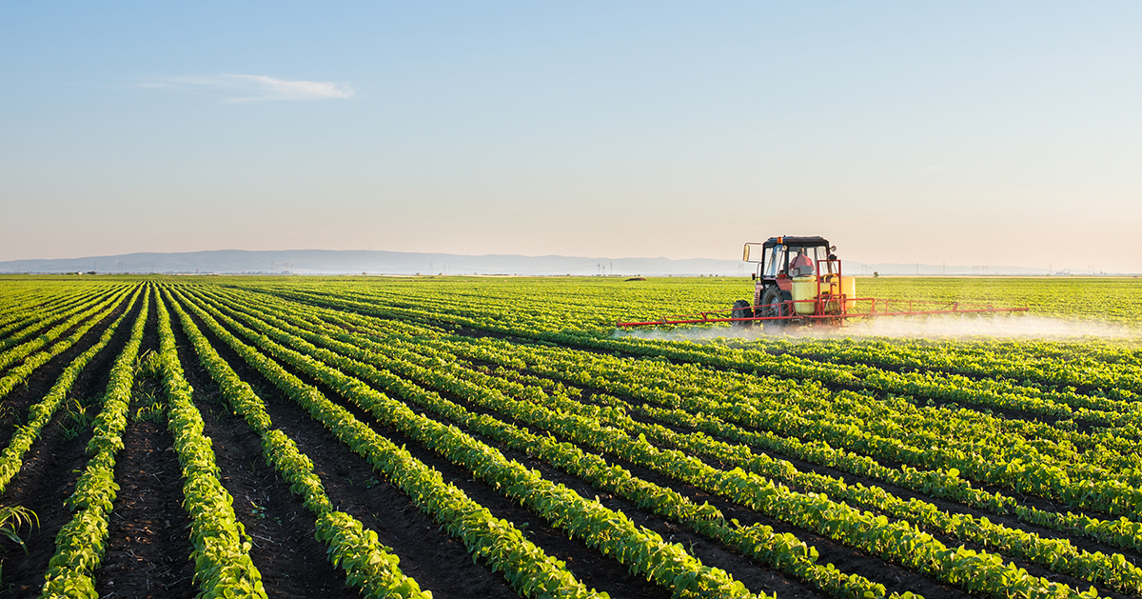
Indiana Agriculture
97 agricultural fairs in 2018
65,000 active farm operations in 2018
14,000 registered swine in 2018
1,455,000 ruminant animals in 2017
4,000,000 hogs in 2017
97% of farms are family owned
Notes:
Agricultural organizations are central to lifestyle for many Indiana families.

Slide 4
Variant Influenza
Notes:
Indiana has the most cases of variant influenza

Slide 5
Enteric Disease
Shiga Toxin-producing E. coli Rates by Year – Indiana, 2013-2017
Salmonellosis Rates by Year – Indiana, 2013-2017

Slide 6
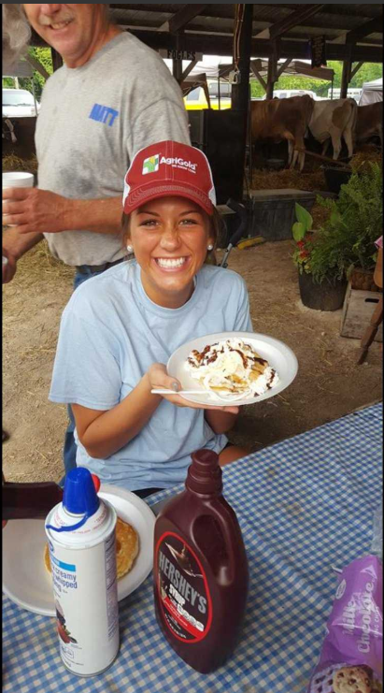
Need for Education
IN: Significant focus on farming and demonstrated risk for fair-associated zoonotic disease
Apply information gathered from epidemiologic trends to inform public education
Teaching exhibitors:
  How to recognize zoonotic disease risk factors
  Understand transmission routes
  Implement prevention strategies
Make changes to fair planning and infrastructure so we can enable public health practices

Slide 7
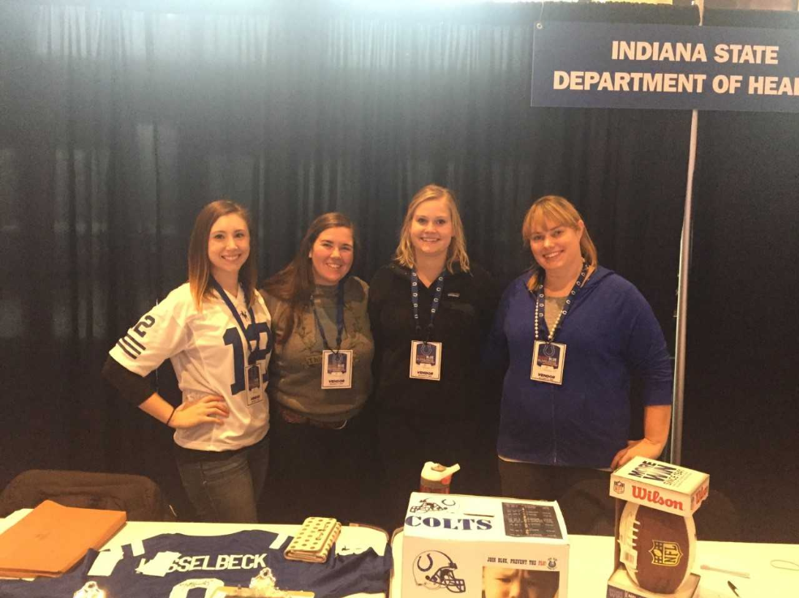
Existing Programs
Influenza Surveillance:
  Flu Near You (FNY)
    Self-swabbing pilot surveillance project
  Join Blue, Prevent the Flu (JBPF)- partnership with Indianapolis Colts
    Public messaging and surveying
Enteric Disease Surveillance:
  CDC OutbreakNet Enhanced
    Increased team capacity
  FDA Rapid Response Team
    Coordination between epidemiology, laboratory, and environmental health

Slide 8
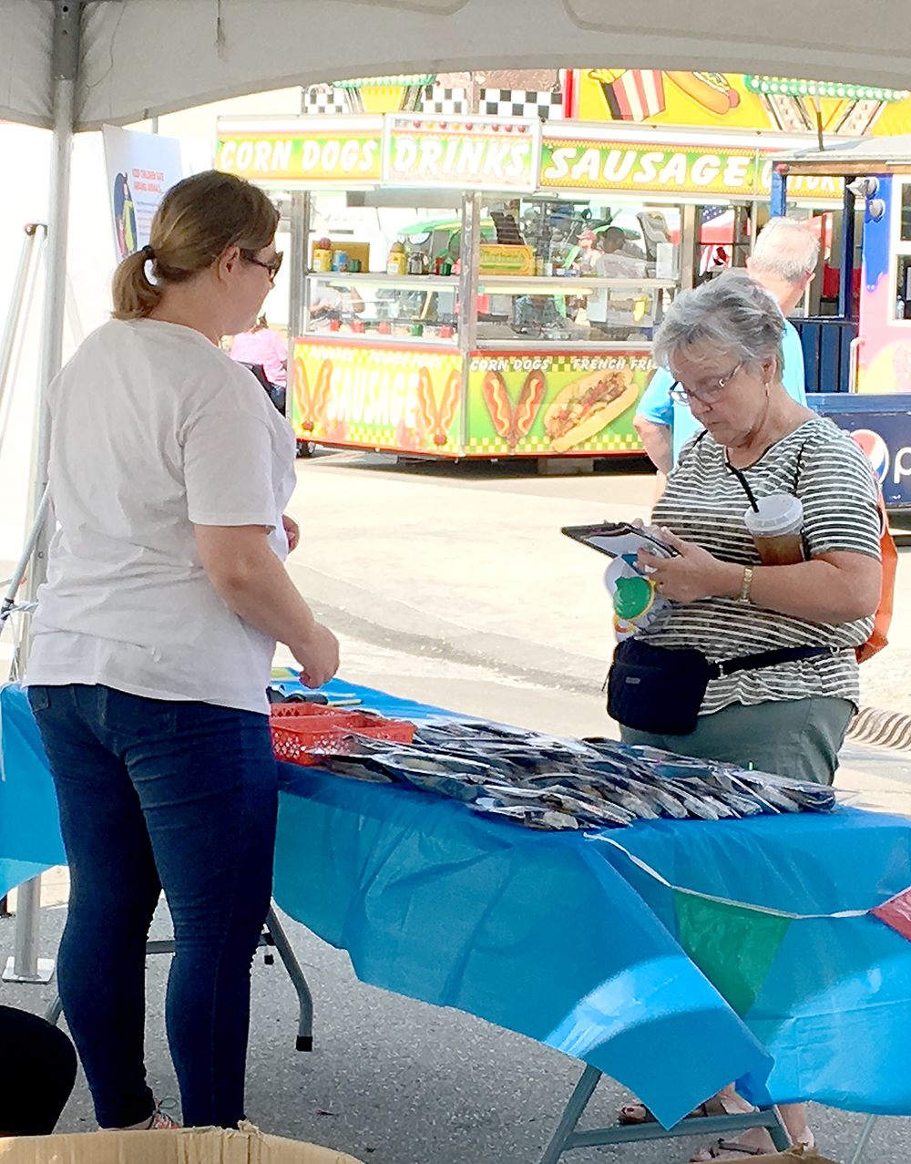
Past Outreach
Indiana State Fair
  August 2018
  1,000 zoonotic disease prevention kits
    Informational flyer (see packet)
    Soap
    Digital food thermometer and food safety magnet
    Bug repellent wipes
    Bleach wipes
    Animal stickers
  Bag toss game about handwashing
  Survey

Slide 9
Project Plan
Expanded curriculum for annual 4-H “Teens as Teachers – Biosecurity” workshop via a partnership with Dr. Bowman and OSU. Ongoing
Pre-test/post-test for workshop participants to evaluate expanded 4-H curriculum. Ongoing
Materials for INAF workshop. Complete
State and county fair self-assessment and scoring rubric based on the Compendium of Measures to Prevent Disease Associated with Animals in Public Settings. Complete
Installation of 6 handwashing stations and educational signage at local agricultural events in greatest need of assistance. Ongoing
Attendance of INAF staff at the IAFE training on zoonotic disease prevention. Ongoing

Slide 10
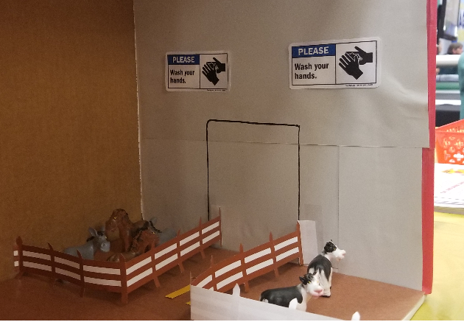
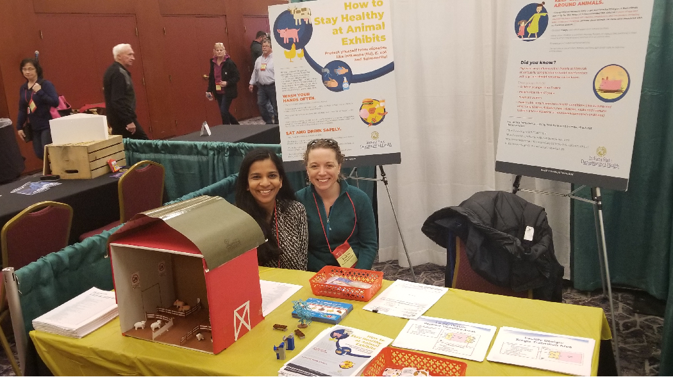
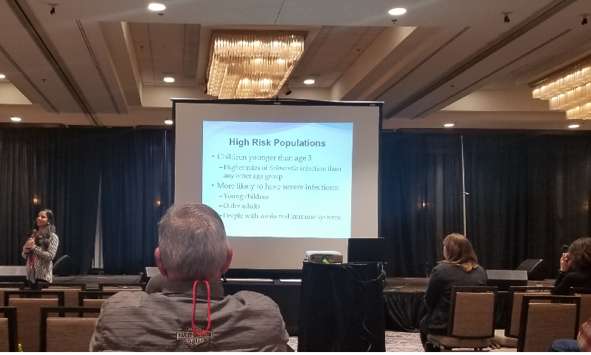
INAF Convention
Presentation is in Packet
Webinar created and disseminated to all local public health nurses and environmental health staff
            Handouts: Compendium, Infographic for public, animal barn set-up recommendations

Slide 11
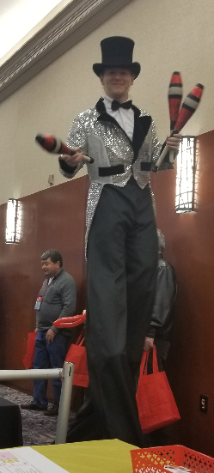
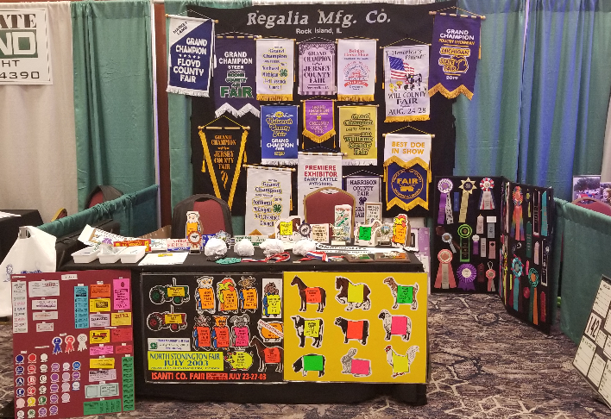
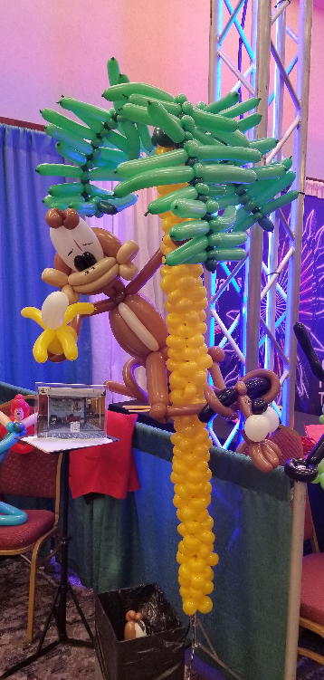
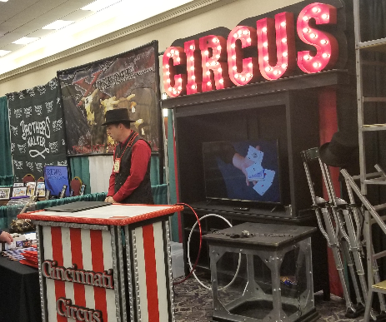

Slide 12
Teens as teachers and biosecurity track kits demonstration
Courtney Stierwalt

Slide 13
Lunch
Break

Slide 14
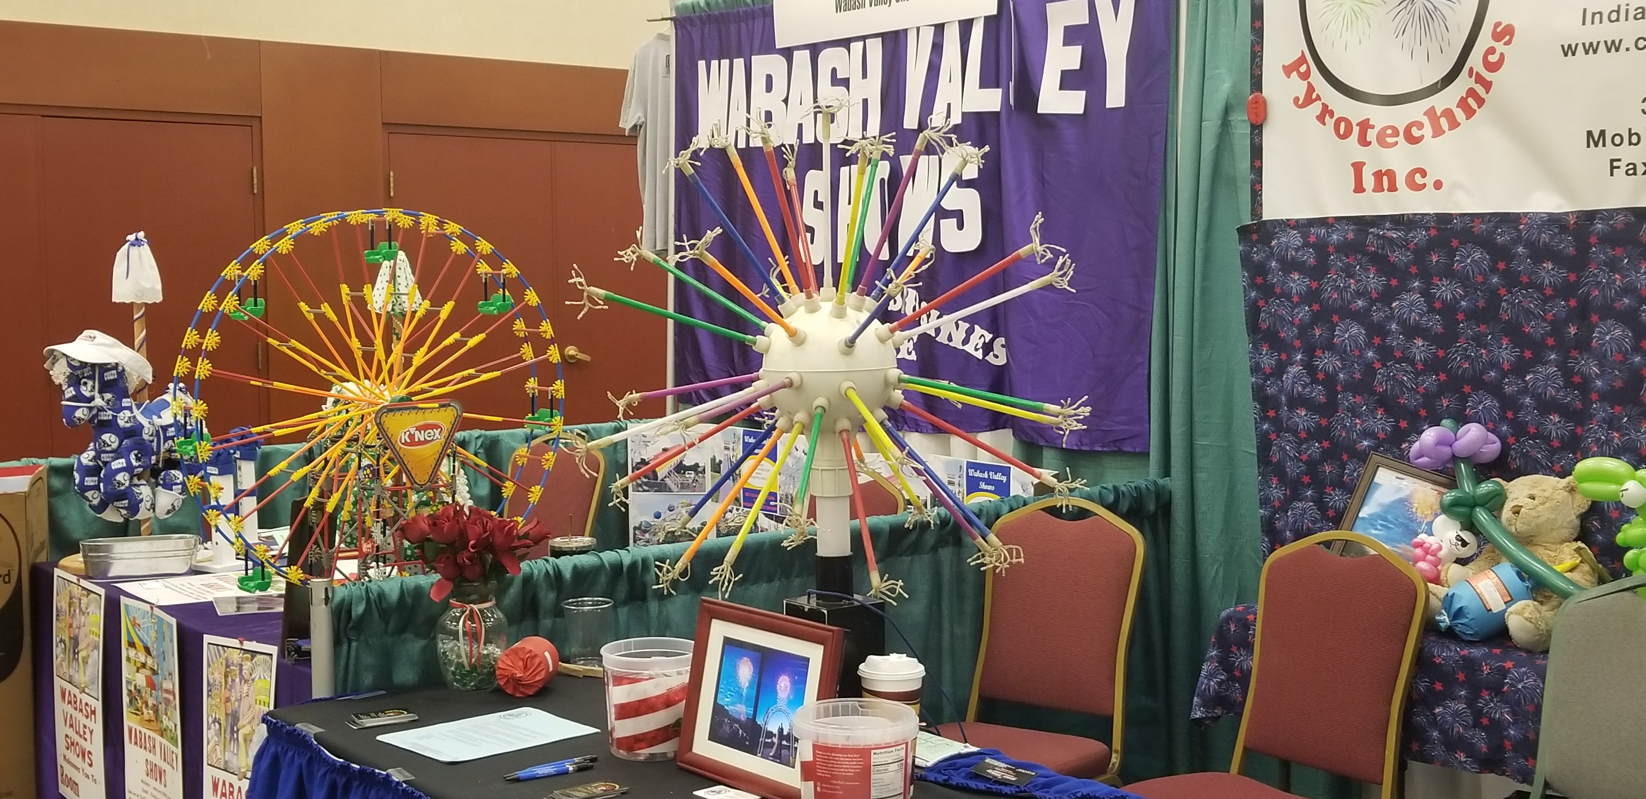
INAF Annual convention and iafe training opportunity
Steve Patterson

Slide 15
Afternoon agenda
BOAH Offices

Slide 16
BOAH Introductions
Dr. Maria Cooper, Biodefense, Food Protection, High Consequence Disease Preparedness
Denise Derrer, Public Information & Communication Director
Dr. Kyle Shipman, Avian Health & Field Operations
Dr. Kelli Werling, Swine Health/District 4

Slide 17
ISDH:
Inaf self-assessment
State fair survey
Madhura Sundararajan

Slide 18
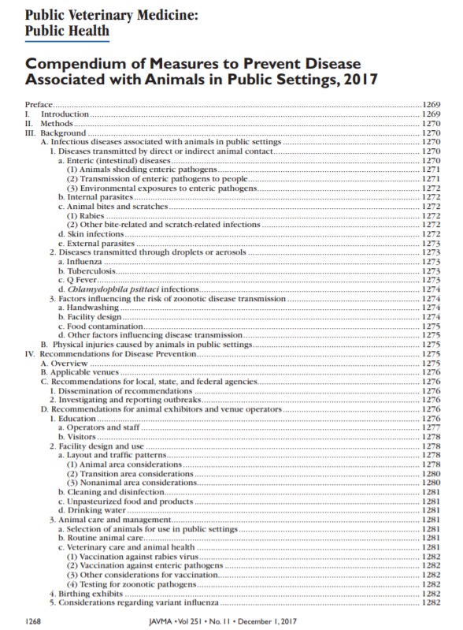
Compendium Self-Assessment: Methods
Question Development: Compendium of Measures to Prevent Disease Associated with Animals in Public Settings
Distributed to INAF listserv
Handwashing stations used as an incentive for participation

Slide 19
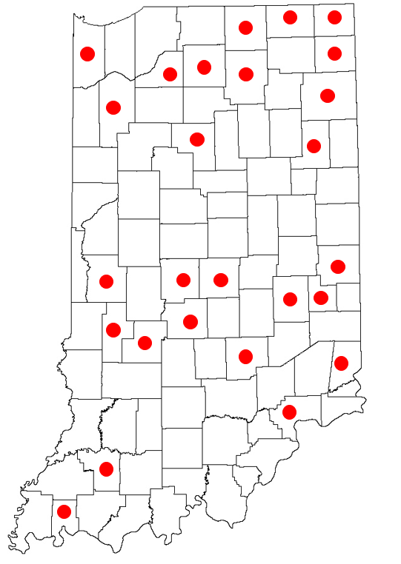
Results
30 fairs and festivals responded to the survey
Number of reported event attendees ranged from 6,000-800,000+

Slide 20







Results: Animals Exhibited
Other reported animals: Dogs, cats, llamas, pigeons

Slide 21
Visitor Education and Set-Up
Strongly Agree Agree Neutral Disagree Strongly Disagree N/A
5 4 3 2 1 --
Before entering an animal exhibit, visitors are informed that animals carry germs that can cause serious illness.
Staff encourage visitors to wash their hands after leaving animal areas and before eating.
Visitors are not allowed to eat or drink in animal areas.
Strollers, toys, pacifiers, cups, baby bottles, and other similar items are not allowed in animal areas.
Smoking and use of other tobacco products is not allowed in animal areas.
Parents of children < 5 are asked to supervise their children to discourage hand-to-mouth activities (ex: nail biting, thumb sucking), contact with manure, or sitting/playing on the ground.
Soap and paper towels are provided at hand washing areas.
Children <5, people ≥ 65, pregnant women, and those with weakened immune systems are educated about the risk of coming in contact with animals.
Visitors with high risk of complications from influenza (flu) are advised not to enter swine exhibition areas.
Visitors receive public health information in multiple formats (signs, stickers, handouts, verbally)

Slide 22
Results: Visitor Education and Set-Up
Average Score (Total): Visitor Education
3.5
Lowest Average Score:
Parents of children < 5 are asked to supervise their children to discourage hand-to-mouth activities (ex: nail biting, thumb sucking), contact with manure, or sitting/playing on the ground.
2.7
2.7
Soap and paper towels are provided at hand washing areas.
Highest Average Score:
Children <5, people ≥ 65, pregnant women, and those with weakened immune systems are educated about the risk of coming in contact with animals.
4.3
Visitors with high risk of complications from influenza (flu) are advised not to enter swine exhibition areas.
4.3

Slide 23
Results: Visitor Education and Set-Up

Slide 24
Results: Visitor Education and Set-Up

Slide 25
Results: Visitor Education and Set-Up

Slide 26
Event Set-Up and Protocol
Strongly Agree Agree Neutral Disagree Strongly Disagree N/A
5 4 3 2 1 --
Public contact with SICK animals is not allowed.
SICK animals are removed from exhibitions.
Exhibitors do not give live reptiles, amphibians, and poultry away as prizes.
Staff are trained about the risks associated with animal contact.
Staff are able to explain disease risks to visitors.
Food areas are separate from animal areas.
The public is only allowed to feed animals when contact is controlled (ex: with barriers).
Staff control visitor traffic to prevent overcrowding.
Manure and soiled bedding is removed immediately from exhibit areas.
Staff are positioned in animal areas to monitor human-animal interactions and discourage activities that could result in disease transmission or injuries.
Animal areas are cleaned and disinfected at least once daily.
Animals are removed during disinfection and do not reenter the area until disinfected areas have been thoroughly rinsed.
Animal areas are not used for public activities (e.g., weddings, dances) at other times of the year.
When visitors enter animal areas, there are signs that tell them not to eat, drink, or bring strollers or other objects.
When visitors exit animal areas, there are signs that tell them to wash their hands.
There are handwashing signs in the areas where food is prepared, served, and consumed.
Consumption and sale of raw or unpasteurized milk and dairy is not allowed.
Animals are housed in a manner to minimize stress and overcrowding.

Slide 27
Results: Visitor Education and Set-Up
Average Score (Total): Visitor Education
3.7
Lowest Average Score:
Animals are removed during disinfection and do not reenter the area until disinfected areas have been thoroughly rinsed.
2.4
2.6
Animal areas are cleaned and disinfected at least once daily.
Highest Average Score:
SICK animals are removed from exhibitions.
4.3
Exhibitors do not give live reptiles, amphibians, and poultry away as prizes.
4.3
Animals are housed in a manner to minimize stress and overcrowding.
4.3

Slide 28
State Fair Survey

Slide 29
State Fair Survey: Purpose
To assess public understanding of infectious diseases that result from farm animal contact

Slide 30
Materials & Methods
Epidemiology Resource Center (ERC) staff members administered a survey to attendees of the Indiana State Fair
  Monday, August 13, 2018 from 8:00 a.m. to 9:00 p.m.
  Staff members were stationed at a booth in teams of 3-4 throughout the day
  All participants were >18 years

Slide 31
Materials & Methods
Survey comprised of 14 questions
  Q1-5: Objective knowledge-based questions related to infectious disease
    True/False
    Multiple Choice
  Q6-10: Subjective questions related to animal contact
  Q11-14: Demographic questions

Slide 32
Results
Survey was administered on an iPad through SurveyMonkey
Voluntarily completed by 104 attendees
  Age Range: 18-82
    Participants were required to be at least 18 years old to complete the survey

Slide 33
Knowledge of Zoonotic Diseases

Slide 34
Knowledge of Zoonotic Diseases
Notes:
Both Chicken and Pigs: 38 (36.5%)
Chicken or Pigs (1 only): 37 (35.6%)
Neither Chicken nor Pigs: 29 (27.9%)
**This question was impacted by survey logic and was skipped by a significant portion of people.

Slide 35
Knowledge of Zoonotic Diseases

Slide 36
Knowledge of Zoonotic Diseases

Slide 37
Knowledge of Zoonotic Diseases

Slide 38
Farm Animal Ownership
16% reported owning farm animals
18% reported living or working in a location that has interaction with farm animals frequently
Notes:
The small number of individuals reporting farm animal ownership in this study is likely the result of location. Since the Indiana State Fair is located in Indianapolis, an urban area, individuals in rural areas who are more likely to own farm animals would have to travel a larger distance to get to the fair.
Rural individuals may also have been less inclined to take the survey because the incentive—an Indianapolis-based event—may not have been as appealing.

Slide 39
Farm Animal Ownership
Notes:
Other reported animals: “donkeys”, “duck, peahens, gunnies”, “guinnies”, “turkeys, ducks”, “ducks”, “donkeys”
Excluded responses: cows” (moved to cattle), “dog”, “none”

Slide 40
Intent to Change
Notes:
75% were somewhat open or very open

Slide 41
Weaknesses
Response bias due to non-random sampling
May not be representative of general population
  Sample population skewed towards females
  Administered on “First Responders Day”
Notes:
Because fair attendees were asked to complete the survey only after they had approached the ISDH booth, random sampling was not possible. Response bias may be present in this study with participants more open and willing to learn about animal safety.
The sample population may not be representative of the general population. The differences seen are likely less significant than they would be in a sample population with a greater proportion of males because of a sample population with 79% females. Furthermore, the survey was administered on a Monday that first responders received free admission to the Indiana State Fair. Therefore, participants were more likely to be employed in one of those positions, unemployed, or retired.

Slide 42
CHallenges
Taryn Stevens and Madhura Sundararajan

Slide 43
Discussion and closing remarks

