Slide 1
NMI Evaluation Workgroup Meeting
April 23, 2019

Slide 2
Agenda
Welcome & Introductions
Overview of past NMI evaluation activities
Overview of structure, charge, and scope of NMI Evaluation workgroup
Feedback on development of evaluation questions
Open discussion: NMI Evaluation Assessment topics
Wrap up & action items
Preferred repositories: Basecamp/ Smartsheet

Slide 3
Past NMI Evaluation Activities

Slide 4
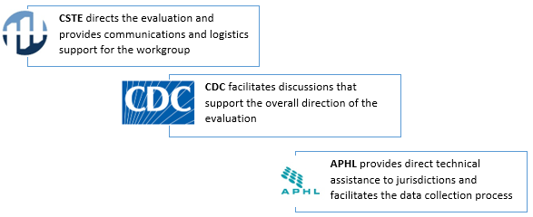
Past NMI Evaluation Activities
CSTE supported NMI evaluation efforts from 2015-2018 by collecting data from jurisdictions to:
  Provide input to refine and improve the Message Mapping Guide (MMG) implementation process
  Evaluate the resources required to complete MMG implementation
  Provide feedback on tools and resources used to achieve successful onboarding of MMG
  Provide CDC, APHL, CSTE leadership with information and data to support jurisdictions
  The evaluation activities were a collaborative effort directed by the previous NMI Evaluation Workgroup consisting of CDC, CSTE and APHL partners

Slide 5
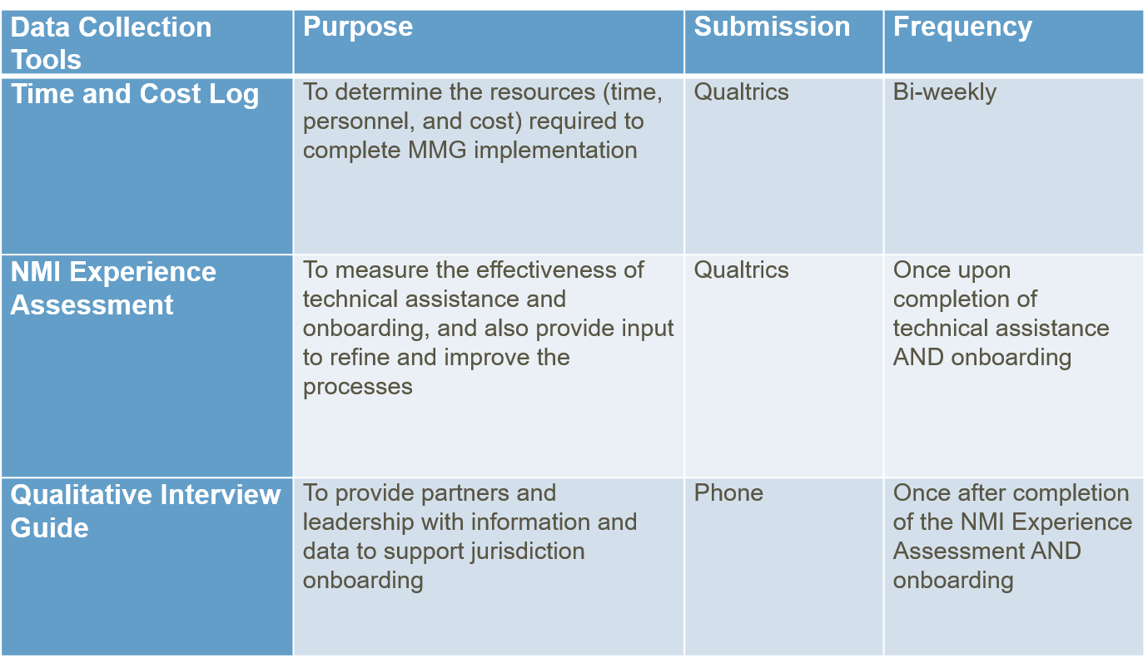
Past NMI Evaluation Activities:
NMI Evaluation Data Collection Tools

Slide 6
Change in NMI Evaluation Activities
CDC informed CSTE that all ongoing assessments for NMI evaluation would need to go through the normal OMB clearance process (takes up to one year or more)
CSTE stopped all data collection in January 2019 due to OMB clearance requirements
The changes in NMI evaluation activities for this project period will address:
  The formation of a new CSTE-member driven NMI evaluation workgroup
  Development of an assessment tool with member feedback to evaluate jurisdictions’ experiences with MMG implementation, onboarding, maintenance, and technical assistance
  Submission of OMB package related to this assessment
  Development of an updated evaluation plan

Slide 7
NMI Evaluation Workgroup:
Activities and Timeline

Slide 8
NMI Evaluation Workgroup:
Charge and outputs
Charge: To convene epidemiologists, informaticians, and surveillance experts from state, local and territorial jurisdictions participating in the NNDSS Modernization Initiative (NMI) Message Mapping Guide (MMG) implementation activities, and other key stakeholders to evaluate and identify improvements in processes related to MMG implementation, MMG onboarding, MMG maintenance, and Technical Assistance (TA)
Key outputs resulting from workgroup activities:
OMB approved NMI Evaluation Assessment to conduct the evaluation of jurisdictions’ experiences with NMI Message Mapping Guide (MMG) implementation, onboarding, maintenance, and TA processes, and to identify related process improvements
CSTE publication of NMI Evaluation Assessment reports

Slide 9
NMI Evaluation Workgroup:
Activities
Examine current jurisdictional experiences and resource needs related to MMG implementation processes, and related differences based on jurisdiction surveillance systems
Examine current jurisdictional experiences and resource needs related to MMG onboarding processes, and related differences based on jurisdiction surveillance systems
Examine current jurisdictional experiences and resource needs related to ongoing MMG maintenance, and related differences based on jurisdiction surveillance systems
Examine current jurisdictional experiences related to Technical Assistance (TA) for MMG implementation and onboarding
Identify issues and challenges related to MMG implementation, onboarding, maintenance, and TA
Identify methods to make improvements in MMG implementation, onboarding, maintenance, and TA processes (from a jurisdictional perspective)
Provide a forum to address issues with CDC programs
Identify topics for elevation and discussion in the Surveillance Practice and Implementation Subcommittee

Slide 10
NMI Evaluation Workgroup: Structure
CSTE staff will assist in facilitating structured workgroup discussions and provide logistical support to develop the NMI Evaluation Assessment, which will be sent to jurisdictions to conduct a periodic evaluation of NMI MMG implementation
  Shaily Krishan (Program Analyst, CSTE staff lead for NMI)
  Elandis Miller (Senior Evaluation Analyst)
Workgroup members are the key drivers of discussions to develop the NMI Evaluation Assessment
Does this workgroup need a co-chair?

Slide 11
NMI Evaluation Workgroup:
2019 Activity Schedule and Timeline
April 2019 – June 2019:
  Develop and finalize NMI Evaluation assessment
  Bi-weekly call at 3pm EST on the 2nd and 4th Tuesdays of the month.
July 2019:
  Submit OMB package for NMI Evaluation Assessment
  Continue Bi-weekly call schedule to provide updates on OMB package and the next project periods
August 2019 - July 2020:
  Monthly conference calls will continue through the next project period
  Workgroup can identify next output or use case related to NMI
  Ongoing discussions on CSTE Surveillance Practice & Implementation Subcommittee (SPIS) calls
  Projected OMB clearance received during this period to begin administration of NMI Evaluation Assessment
Overall workgroup activities are supported by CSTE staff and are projected to continue through the next project period (s)

Slide 12
NMI Evaluation Workgroup:
April 2019-May 2019 Activities & Schedule
Date | Task
April 23 | Workgroup meeting to provide an overview and discuss evaluation questions
April 26 | Finalize evaluation questions, purpose, and goals for evaluation plan (CSTE)
April 30 | Provide feedback on assessment topics
April 30 | Develop draft logic model (CSTE)
April 30 | Sub-group assignments complete
May 6 | Provide feedback on logic model
May 8 | Finalize logic model (CSTE)
May 10 | Provide feedback on draft questions for assessment
May 14 | Workgroup meeting to discuss draft versions of the evaluation plan and assessment questions
May 28 | Workgroup meeting to discuss feedback on evaluation plan and discuss progress on assessment
May 30 | Finalize evaluation plan (CSTE)

Slide 13
NMI Evaluation Workgroup:
June 2019-July 2019 Activities & Schedule
Date | Task
June 11 | Workgroup meeting to discuss draft assessment tool
June 18 | Provide feedback on draft assessment
June 25 | Workgroup meeting to provide update on assessment tool and discuss OMB package
June 28 | Finalize assessment tool (CSTE)
July 9 | Workgroup meeting to discuss piloting the assessment and provide an update on OMB package
July 14 | Pilot assessment tool
July 23 | Workgroup meeting to discuss OMB package, data collection and reporting
July 29 | OMB package submitted to CDC (CSTE)

Slide 14
NMI Evaluation Workgroup: Evaluation Questions & Discussion

Slide 15
NMI Evaluation Workgroup: Feedback on Proposed Evaluation Questions
Have any unforeseen barriers been encountered during MMG implementation and how have they been addressed?
How useful was the technical assistance that was provided? How can this assistance be improved?
How was jurisdictional cost impacted by the implementation of MMGs?
Was the MMG implementation on target for allocated time?
Was the MMG implementation on target for allocated costs?
Was the MMG implementation on target for allocated resources (staff, system, equipment)?
Did workforce/ skillset gaps or challenges present barriers to the MMG implementation process?
How sustainable are the investments made for MMG implementation and onboarding? Will additional support be needed going forward?
What is the impact on the satisfaction of jurisdictions?

Slide 16
NMI Evaluation Assessment Development: Discussion
Discussion about workgroup ideas/ challenges about overall NMI MMG implementation, onboarding, TA
What data from jurisdictions would this workgroup consider as most important for feedback on MMG implementation, onboarding, TA?
Brainstorm topics/ constructs that we would measure using NMI Evaluation Assessment
Form sub-groups based on surveillance systems (e.g. NBS, non-NBS, others?)
Form sub-groups to work on various topics for the assessment?
How often would this assessment be administered to jurisdictions?

Slide 17
NMI Evaluation Workgroup: Wrap-up and Action Items

Slide 18
Wrap up/ Action Items
CSTE needs input on scope and topics for the NMI Evaluation Assessment, to inform our ‘final’ evaluation questions, logic model, and evaluation plan
Action items
  Provide input on Basecamp about:
    Core evaluation questions to inform the NMI Evaluation Assessment
    NMI Evaluation Assessment topics/ constructs
      Group assignments based on topics?
    Ideas for topic threads/ categories in Basecamp
    Structure of workgroup
  Next meeting overview (Tuesday, May 14, 3-4 ET)
    Draft evaluation plan discussion
    Draft assessment topics/ questions discussion

Slide 19

NMI Evaluation Workgroup Basecamp
We have created a Basecamp site to facilitate workgroup discussion forums and to collect feedback on documents developed by the workgroup
In “Assessment Topic Forums”, you can pick a category to provide ideas, or just start a general discussion thread without choosing a category
Meeting documents and resources will be posted on Basecamp
Everyone on the distribution list has been added to the Basecamp
Opt-in link: https://3.basecamp.com/3164497/join/QtCspxDstktL

Slide 20
CSTE National Office
2635 Century Parkway NE, Suite 700
Atlanta, Georgia 30345
770.458.3811
770.458.8516
skrishan@cste.org
emiller@cste.org

Slide 21
Appendix: Past NMI Evaluation Data Collection Status
MMG Time & Cost Log
  Data analyzed for Hepatitis, Gen v2, STD/ CS
  Data collection completed for Mumps, Pertussis, Varicella
  Data collection was ongoing for FDD, terminated in January 2019 due to OMB issue
NMI Experience Assessment
  Data collection was ongoing until December 2018, terminated in January 2019 due to OMB issue
Qualitative Interviews
  One round of interviews (17 jurisdictions) was completed through summer 2018

